Slide 1
Five new ideas for SCATS, tested honestly
SCATS · Level 3 · Mastery
Connected cars, a learning agent, max-pressure, broken detectors and signal prediction: what each one does, how to test it fairly, and what really happened in SUMO.
smrahmanbd.github.io/scats-learning-lab
Notes:
This is the research level, written for beginners. You should know what SCATS is (Foundation) and how its cycle, split and offset logic works (Advanced), but every idea is explained again in plain words. There are six ideas: one on how to test a new idea, then five research directions, each implemented in this lab's SUMO controller. Several did not beat standard SCATS. That is normal in research, and this guide shows you why.

Slide 2
6 ideas, each building on the last
1
How to evaluate a new SCATS idea
2
Degree of saturation from connected vehicles
3
Learning split selection inside the SCATS envelope
3 seeds minimum to see whether a difference is real
0.65 mean DS error with 5% connected vehicles
+4.2 s RL delay penalty against SCATS, 3 seeds
4
SCATS and max-pressure
5
Resilience to detector faults
6
Predicting signal timing for connected vehicles
57.4 s bus delay under pure max-pressure (SCATS 29.7 s)
+60% delay increase with 30% of loops faulty and no alarms
2.63 s mean error of the planned-green predictor
Notes:
Outcomes for today:
- Design a fair test of a new signal-control idea: one change, three baselines, several seeds, more than one measure.
- Estimate degree of saturation (DS) from connected-vehicle counts and explain why low penetration gives noisy estimates.
- Do one Q-learning update by hand and explain why the lab's agent picks only engineer-approved split plans.
- Compute max-pressure greens and blend them with SCATS greens using a weight β.
- Explain what stuck-on and stuck-off loops do to DS, and how alarms and imputation recover performance.
- Compare signal-timing predictors by mean absolute error and say why an adaptive controller is hard to predict.

Slide 3
Three surprises to start
Two of the five new ideas lost.
Three broken loops in ten raised delay by 60%.
A connected car can mislead you by being lucky.
A reinforcement-learning agent and a max-pressure hybrid both gave more delay than standard SCATS on this lab's corridor. Reporting that honestly is what makes the other results believable.
When 30% of the detectors failed, mean delay jumped from 36.9 to 59.2 seconds per vehicle. Two simple alarm rules brought it back to 40.7 s.
If only 1 car in 20 reports its position, one green may contain zero reporting cars and the next may contain three. With 5% penetration the DS estimate was off by 0.65 on average: bigger than many real DS values.

Slide 4
Words you will meet
Degree of saturation (DS) | How fully a green was used: 1.0 means the green was busy from start to end. SCATS measures it at stop-line loops.
Split plan | A stored way of sharing the cycle between phases, for example 'main road 55%, side road 45%'.
Baseline | The method you compare against, for example fixed time, actuated, or standard SCATS.
Seed | A number that fixes the random traffic in a simulation. Different seeds give different, equally likely days.
Connected vehicle (CV) | A car that reports its position and speed by radio or mobile data.
Penetration rate p | The share of vehicles that are connected: p = 0.25 means one in four.
Reinforcement learning (RL) | A program that learns by trial and error, getting a reward after each choice.
Max-pressure | A control rule that gives green to the movement with the most waiting traffic and the most room to go to.
SPaT | Signal Phase and Timing: a message telling cars which light is on and when it will change.
Notes:
You do not need to memorise these now; each is explained again when it first matters.

Slide 5
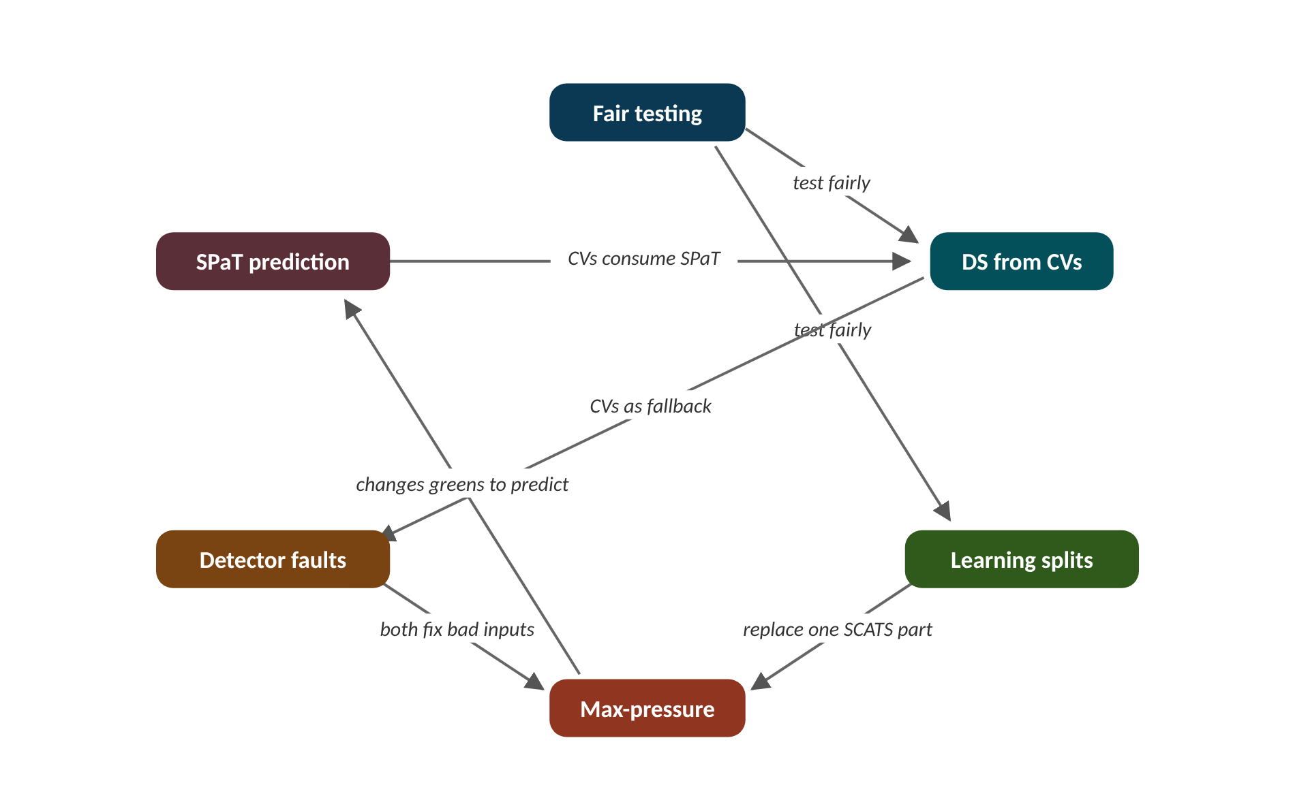
The map of today's ideas
Notes:
Each box is one idea; arrows say how one feeds the next. test fairly; test fairly; CVs as fallback; both fix bad inputs; replace one SCATS part; changes greens to predict; CVs consume SPaT.

Slide 6
1 How to evaluate a new SCATS idea
IN PLAIN WORDS
Testing a new running shoe? Change only the shoe, not the shoe and the track. Race on several days, not one lucky windy day. And time the sprint and the marathon, because a shoe can help one and hurt the other.
Change one thing through one hook
Three baselines on identical demand
Several seeds: mean and spread
Report delay, stops, bus delay, queue
Ask what would stop deployment
3 seeds
minimum to see whether a difference is real
Notes:
A new controller beats SCATS by 3 seconds in one simulation run. Is it better? You cannot tell yet. Here is why, and what to do instead.
Research on traffic control is full of big claimed gains that disappear in practice. Most of them break one of a few simple rules. The first rule is to change one thing. In this lab every new idea plugs into SCATS through one hook (a slot in the controller settings): ds_source, split_selector, green_allocator or sensor_filter. Everything else stays standard SCATS, so any change in delay is caused by the new idea.
The second rule is to compare against three baselines on identical demand: fixed time, actuated and standard SCATS. The third is to use several seeds. A seed fixes the random arrivals; a new seed is a new, equally likely day. Report the mean and the spread across seeds, never your best run.
The fourth rule is to report more than delay: stops, bus delay and queue tell different stories, and a method can win one by losing another. Finally, ask what would stop it being used on a real street: safety limits, whether an engineer can explain a decision, what data it needs, and how it behaves when sensors fail.
Presenter tip: Start with the running-shoe analogy. Work the RL example on the board: the point is that a single run can mislead in either direction.

Slide 7
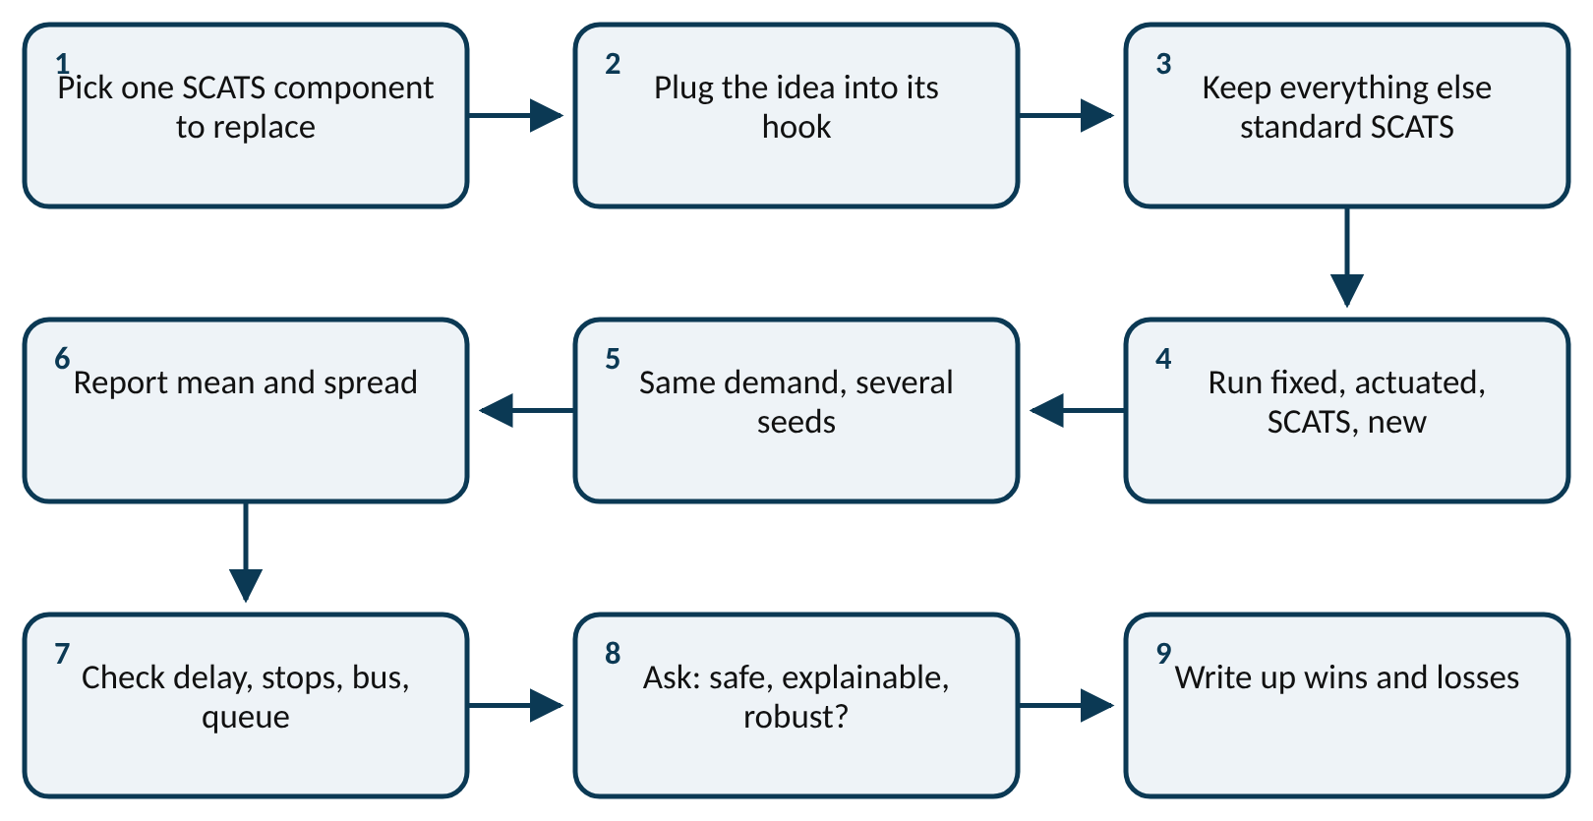
Worked example: Is the RL agent worse than SCATS?
difference per seed d_{s} = delay_{new} − delay_{SCATS}
report mean(d) and spread (standard deviation) of d
Mean delay (s/veh) on three unseen seeds. SCATS: 37.91, 35.57, 35.86. RL agent: 39.37, 42.27, 40.27.
1. Differences: 39.37 − 37.91 = 1.46, 42.27 − 35.57 = 6.70, 40.27 − 35.86 = 4.41.
2. Mean difference: (1.46 + 6.70 + 4.41) ÷ 3 = 12.57 ÷ 3 = 4.19 s.
3. Spread (sample standard deviation): about 2.63 s.
4. All three differences are positive, and the mean is larger than the spread.
The agent is worse by about 4.2 s per vehicle on every seed. One seed alone could have shown anything from 1.5 to 6.7 s.
Notes:
A fair test of a new idea. What to notice: the new idea enters through one hook, it is compared with three baselines on the same seeds, and it must pass a deployment check, not only a delay check.
Try it with the audience: A new method is tested on two seeds. Its delay differences from SCATS are −2.0 s and +1.0 s. What is the mean difference, and can you claim it is better?
Answer: Mean = (−2.0 + 1.0) ÷ 2 = −0.5 s. One seed is better and one worse, and the spread is far bigger than the mean, so you cannot claim it is better. Run more seeds.

Slide 8
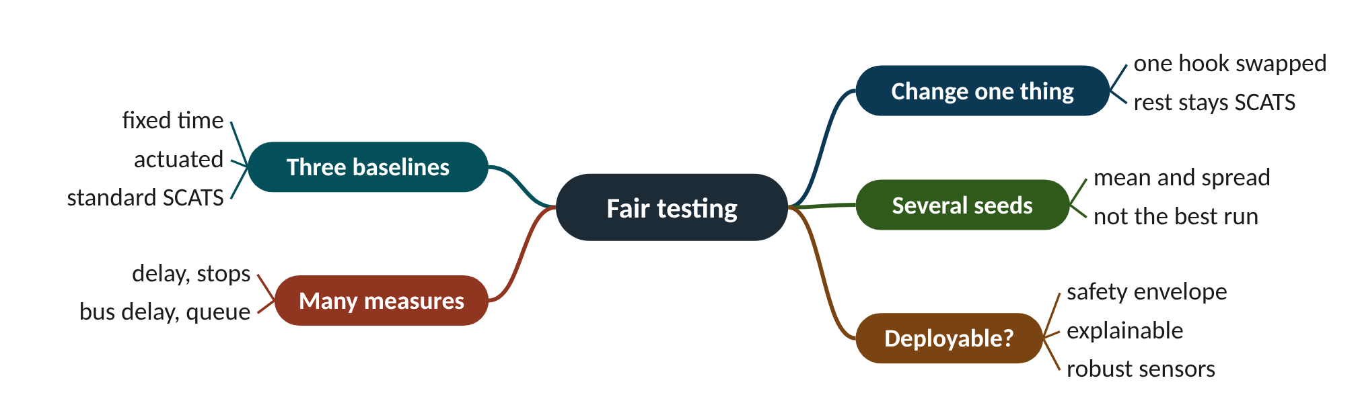
Remember it: Fair testing
PICTURE THIS · STOP 1: LIGHTHOUSE
TRAP
At the lighthouse the keeper races four identical toy ships in a bathtub. She changes only one sail on the new ship, then throws three dice to make three different storms, and writes every result on the wall, even the races the new ship lost.
Do not tune your new method on the same seeds you use to test it. The RL agent here was trained on other seeds and tested on unseen seeds 7, 8 and 9. Testing on training seeds flatters the method.
Notes:
What the scene encodes: One sail = change one thing; four ships = three baselines plus the new idea; three dice = several seeds; writing every result = report mean, spread and losses.
Recap: Fair testing: change one hook, compare with fixed, actuated and SCATS on the same seeds, report mean and spread of several measures, check deployability.

Slide 9
2 Degree of saturation from connected vehicles
IN PLAIN WORDS
It is like guessing how many people came to a party from the guests who posted photos. If one guest in four posts, you multiply by four. With only a few posters, one extra photo changes your guess a lot.
Count connected cars, scale up by 1/p
Convert to green needed, divide by green
Noise shrinks like one over root p
Error 0.65 at 5%, 0.08 at 100%
Closed loop: 8-21% more delay
0.65
mean DS error with 5% connected vehicles
Notes:
Loops cut into the road are expensive and break often. Cars already carry phones and GPS. Could SCATS measure traffic from the cars instead?
SCATS normally measures degree of saturation (DS) at stop-line loops: how much of the green was used by moving vehicles. A connected vehicle (CV) reports its own position, so the controller can count CVs that cross the stop line during a green. Only a share p (the penetration rate) of vehicles is connected.
The simplest estimator scales the count up by 1/p, then converts vehicles into the green time a saturated stream would need, using the lane's maximum flow MF (vehicles per hour of green). Dividing by the actual green gives an estimated DS.
The catch is sampling noise. Whether a car is connected is like a coin toss, so the count of CVs jumps around, and dividing by a small p magnifies the jump. In shadow mode (same traffic, estimate compared with loop DS over 2,122 lane-cycles) the mean error was 0.65 at p = 5% and 0.08 at p = 100%. Driving SCATS with the estimate gave 8% to 21% more delay than loops.
Presenter tip: Do the party-photo analogy, then the coin-toss arithmetic. Point out that even 100% penetration is not loop-quality, because counts miss how the green was used.

Slide 10
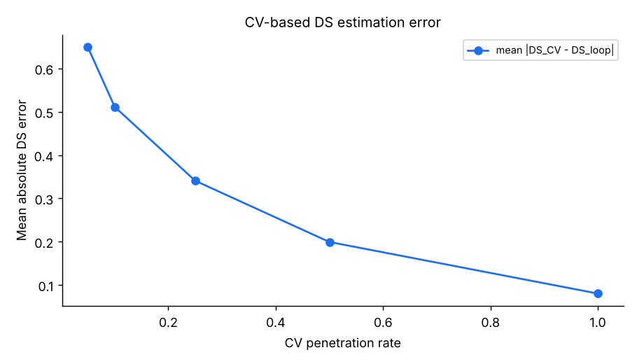
Worked example: One green at 25% penetration
n̂ = n_{CV} ÷ p g'̂ = n̂ × 3600 ÷ MF DŜ = g'̂ ÷ g
error ∝ 1 ÷ √p
Green g = 30 s. MF = 1,800 veh/h, so a saturated stream needs 3600 ÷ 1800 = 2 s per vehicle. In truth 14 vehicles crossed. 4 of them were connected. p = 0.25.
1. Scale up: n̂ = 4 ÷ 0.25 = 16 vehicles (truth: 14).
2. Green needed: g'̂ = 16 × 2 = 32 s. Estimated DS = 32 ÷ 30 = 1.07.
3. If counted perfectly: 14 × 2 = 28 s, DS = 28 ÷ 30 = 0.93.
4. Spread of the CV count: √(14 × 0.25 × 0.75) = 1.62 cars, so n̂ wobbles by 1.62 ÷ 0.25 = 6.5 cars, and DS by 6.5 × 2 ÷ 30 = 0.43.
5. Chance that none of the 14 is connected: 0.75¹⁴ = 0.018, about 1 green in 56.
One lucky extra CV moved DS from 0.93 to 1.07. Typical wobble is ±0.43, which is why SCATS on 25% CV data cannot match loops green by green.
Notes:
Mean DS error against CV penetration (shadow mode, 2,122 lane-cycles). What to notice: error falls fast at first, then slowly, roughly like 1/√p: about 0.65 at 5%, 0.34 at 25%, 0.20 at 50%, 0.08 at 100%. Even at 100% it is not zero, because counting cars cannot see gaps in how the green was used.
Try it with the audience: p = 0.5, green 30 s, MF 1,800 veh/h, and 9 CVs crossed. What is the estimated DS?
Answer: n̂ = 9 ÷ 0.5 = 18 vehicles; g'̂ = 18 × 3600 ÷ 1800 = 36 s; DŜ = 36 ÷ 30 = 1.20.

Slide 11
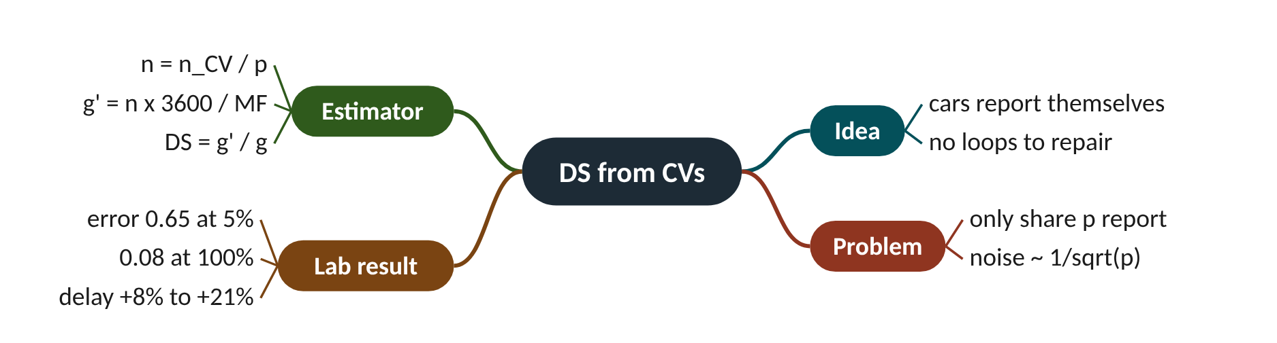
Remember it: DS from CVs
PICTURE THIS · STOP 2: FISHING FLEET RADIO
TRAP
On the quay, the harbourmaster counts returning fishing boats by radio. Only one boat in four has a radio, so every 'beep' he hears he multiplies by four on a huge chalkboard. A seagull steps on the radio, one extra beep sounds, and his total leaps by four boats.
Do not expect delay to improve smoothly as penetration rises. In closed loop, delay was +11% at 5%, +8% at 25% and +21% at 50%. SCATS's plan voting absorbs some noise, and noisy overestimates lengthen greens, which can help buses and stops by chance.
Notes:
What the scene encodes: Radio boats = connected vehicles; one in four = p = 0.25; multiply by four = n̂ = nCV/p; the seagull's extra beep = sampling noise magnified by 1/p.
Recap: DS from CVs: n̂ = nCV/p, g' = n̂·3600/MF, DS = g'/g; noise ∝ 1/√p; error 0.65 at 5%, 0.08 at 100%; closed-loop delay +8% to +21%.

Slide 12
3 Learning split selection inside the SCATS envelope
IN PLAIN WORDS
Think of a new waiter allowed to recommend only dishes from the chef's menu. He learns from tips which dish suits which table. He cannot invent a dangerous dish, but early on he still recommends worse than the experienced head waiter.
Agent picks only approved split plans
Safety limits stay with SCATS
Tabular Q-learning, reward = fewer halted cars
Lost by about 4 s per vehicle
Next: richer state, longer training
+4.2 s
RL delay penalty against SCATS, 3 seeds
Notes:
Papers often report that a learning agent cuts delay by 20% or more. Few such agents run on real streets. What if the agent could only choose among plans an engineer already approved?
Reinforcement learning (RL) learns by trial and error. In each situation (the state) it picks an action, receives a reward, and updates its estimate of how good that action is. Deep RL controllers can, in principle, do anything with the lights, which makes them hard to certify and explain.
This lab restricts the agent to the SCATS envelope: it only replaces the split selector, choosing among four engineer-approved split plans SP1 to SP4. Minimum greens, intergreens, cycle length and offsets stay standard SCATS, so the agent cannot make an unsafe timing.
The agent is tabular Q-learning: a table of values Q(state, action), shared by the four intersections. The state is each phase's DS put into bins (below 0.5, 0.5-0.8, 0.8-1.0, above 1.0) plus the plan in service. The reward is minus the mean number of halted vehicles. After 12 short training episodes it averaged 40.6 s delay on three unseen seeds against SCATS's 36.4 s: about 4 s worse.
Presenter tip: Emphasise the envelope idea: it is what makes RL deployable. Then be honest about the result and turn each cause into a project idea.

Slide 13
Worked example: One Q-learning update
Q(s, a) ← Q(s, a) + α [ r + γ · max Q(s', ·) − Q(s, a) ]
target = r + γ · max Q(s', ·)
Current Q(s, SP2) = −5. The agent picks SP2 and sees reward r = −4 (four halted cars). The best value in the next state is −3. Learning rate α = 0.1, discount γ = 0.9.
1. Target: −4 + 0.9 × (−3) = −4 − 2.7 = −6.7.
2. Surprise (error): −6.7 − (−5) = −1.7.
3. Step: 0.1 × (−1.7) = −0.17.
4. New Q(s, SP2) = −5 − 0.17 = −5.17.
SP2 now looks slightly worse in this state, so the agent will try it a little less. Thousands of such small updates are needed; 12 short episodes give only a few hundred per state.
Notes:
Mean delay on three unseen seeds: SCATS against the RL agent. What to notice: the agent (rust bars) is worse than SCATS (navy bars) on every seed, by 1.5 to 6.7 s. Means: SCATS 36.4 s, RL 40.6 s. From rl_vs_scats.csv.
Try it with the audience: Q(s, a) = −2, reward −3, best next value −2, α = 0.2, γ = 0.9. What is the new Q(s, a)?
Answer: Target = −3 + 0.9 × (−2) = −4.8. Error = −4.8 − (−2) = −2.8. New Q = −2 + 0.2 × (−2.8) = −2.56.

Slide 14
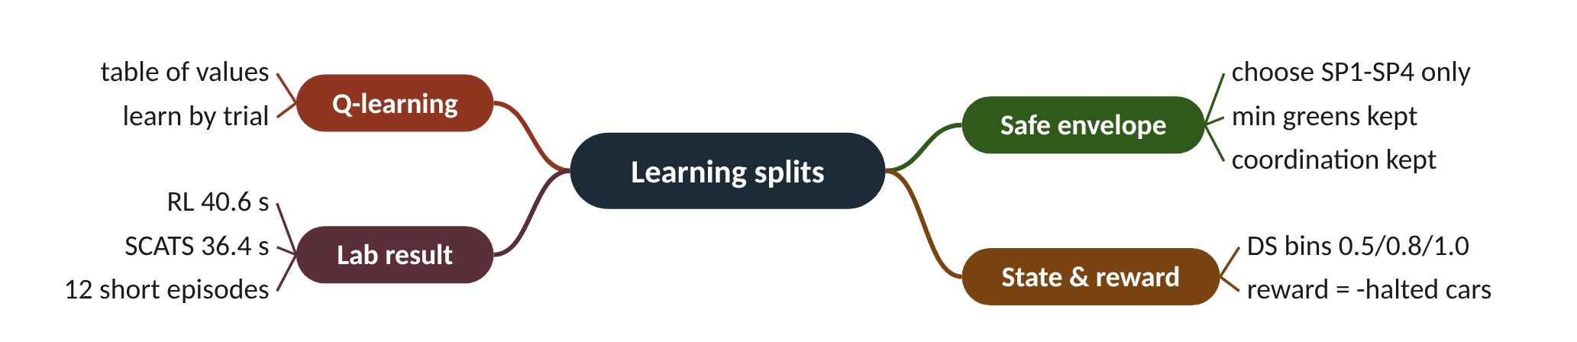
Remember it: Learning splits
PICTURE THIS · STOP 3: PARROT AT THE FISH MARKET
TRAP
In the fish market a parrot sits in a cage holding exactly four menu cards. It may only shout a dish from those cards. When the queue at the counter shrinks it gets a sardine. It still shouts the wrong card so often that its queue is four people longer than the old fishmonger's.
A losing result is not a useless result. The agent lost because its state is coarse, its reward is noisy, it trained for only 12 episodes, and SCATS's DS rule is a strong, well-tuned baseline. Each reason is a concrete next experiment.
Notes:
What the scene encodes: Four cards = SP1 to SP4, the safe envelope; sardine = reward (fewer halted cars); four people longer = about 4 s worse (40.6 vs 36.4 s).
Recap: Learning splits: a Q-learning agent picks only approved plans SP1-SP4 (safe envelope); Q ← Q + α[r + γ max Q' − Q]; after 12 episodes RL 40.6 s vs SCATS 36.4 s.

Slide 15
4 SCATS and max-pressure
IN PLAIN WORDS
Think of doors between crowded rooms. Open the door where many people wait on your side and few on the other side. Opening a door into an already packed room just moves the crush.
Pressure: waiting queue minus downstream load
Pure max-pressure breaks green waves
Hybrid keeps cycle and offsets, blends greens
Corridor: SCATS 36.9, hybrid 40.2 s
Next: test on a congested grid
57.4 s
bus delay under pure max-pressure (SCATS 29.7 s)
Notes:
SCATS's DS only looks at the stop line. If the road beyond the junction is already full, DS still asks for more green, for cars that have nowhere to go.
Max-pressure control (Varaiya, 2013) scores each phase by its pressure: the queue waiting to use it minus the load on the road it feeds. It serves the phase with the highest pressure. Under ideal assumptions it is proven to carry as much traffic as any controller can.
Pure max-pressure is acyclic: it does not keep a fixed cycle, so neighbouring junctions cannot keep a green wave (offsets). The lab's hybrid keeps SCATS's cycle length and offsets and only blends the greens: a share β comes from pressure, the rest from SCATS's DS-based split.
On this lab's short, uncongested corridor SCATS still won: 36.9 s mean delay, against 40.8 s for pure max-pressure and 40.2 s for the hybrid with β = 0.5. Pure max-pressure stopped vehicles more (1.75 stops per vehicle against 1.30) and nearly doubled bus delay (57.4 s against 29.7 s), because it ignores progression.
Presenter tip: Use the crowded-rooms analogy. Stress that a method can be provably good under ideal assumptions and still lose on a particular network.

Slide 16
Worked example: Blending 70 s of green between two phases
pressure_{p} = Σ ( queue_{upstream} − ½ · load_{downstream} )
g_{p} = (1 − β) · g_{SCATS,p} + β · avail · pressure_{p} ÷ Σ pressure
Phase A: 12 cars queued, 16 on its exit road. Phase B: 8 queued, 2 on its exit. 70 s of green to share. SCATS's own split gives A 40 s, B 30 s. β = 0.5.
1. Pressure A = 12 − ½ × 16 = 4. Pressure B = 8 − ½ × 2 = 7. Total 11.
2. Pressure greens: A = 70 × 4 ÷ 11 = 25.5 s; B = 70 × 7 ÷ 11 = 44.5 s.
3. Blend A: 0.5 × 40 + 0.5 × 25.5 = 32.7 s.
4. Blend B: 0.5 × 30 + 0.5 × 44.5 = 37.3 s. Check: 32.7 + 37.3 = 70 s.
Pressure pulls about 7 s away from A, whose exit is filling up. On a congested grid that prevents spill-back; on an uncongested corridor it just disturbs a good SCATS split.
Notes:
Mean delay on the corridor: SCATS, pure max-pressure and the hybrid. What to notice: both pressure-based methods lose on this short, uncongested corridor. Bus delay (not shown) was 29.7 s for SCATS, 57.4 s for pure max-pressure and 33.1 s for the hybrid. From maxpressure.csv.
Try it with the audience: 60 s of green. Phase A: queue 10, downstream 4. Phase B: queue 6, downstream 12. SCATS split 30 s / 30 s, β = 0.5. Find the blended greens.
Answer: Pressure A = 10 − 2 = 8; B = 6 − 6 = 0. Pressure greens: A 60 s, B 0 s. Blend: A = 0.5 × 30 + 0.5 × 60 = 45 s; B = 0.5 × 30 + 0.5 × 0 = 15 s. (A real controller would still enforce B's minimum green.)

Slide 17
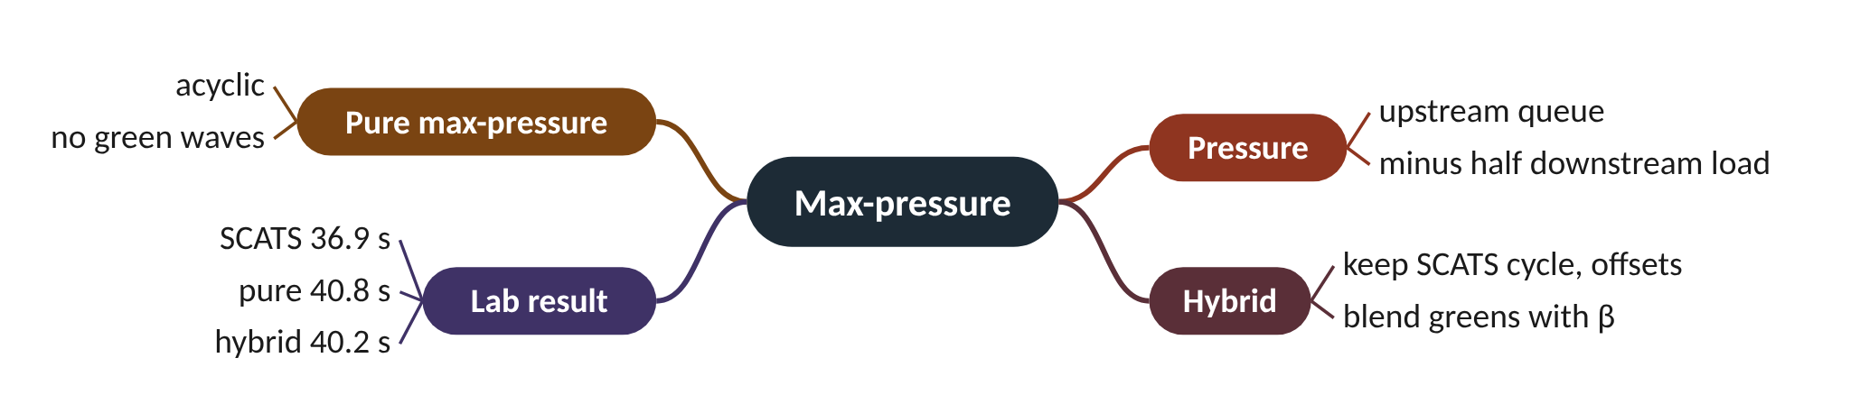
Remember it: Max-pressure
PICTURE THIS · STOP 4: HARBOUR LOCKS
TRAP
At the harbour locks two gates hold back boats. A pressure gauge on each gate shows boats waiting minus half the boats crammed in the basin beyond. The lock keeper turns a dial marked β halfway, mixing his old timetable with the gauges. Meanwhile the water bus, ignored, waits so long it sinks to its chimney.
Max-pressure being 'throughput-optimal' does not mean 'lowest delay everywhere'. The proof assumes idealised queues and no platoons. Test it where it should shine: a grid with spill-back and turning conflicts.
Notes:
What the scene encodes: Gauge = pressure (queue − ½ downstream load); half-turned dial = β = 0.5 blend; the sinking water bus = bus delay nearly doubling under pure max-pressure (57.4 vs 29.7 s).
Recap: Max-pressure: pressure = queue − ½ downstream load; hybrid keeps SCATS cycle and offsets, blends greens with β; corridor: SCATS 36.9, pure 40.8, hybrid 40.2 s.

Slide 18
5 Resilience to detector faults
IN PLAIN WORDS
Imagine a smoke alarm stuck silent and another that never stops beeping. The silent one says all is calm; the beeping one says the house is always on fire. A sensible person notices 'this alarm has beeped for two days' and ignores it until it is repaired.
Stuck-off: DS near zero, early gap-out
Stuck-on: DS near one, runs to max
30% faulty loops: delay up 60%
Simple alarms recover about 83%
Exclude or impute: both work here
+60%
delay increase with 30% of loops faulty and no alarms
Notes:
Every real city has broken loops. In the lab, when 3 loops in 10 failed, delay rose by 60%. Two simple 'this looks wrong' rules recovered most of it.
A stuck-off loop never sees a vehicle. The tactical controller sees endless gaps, ends the green early (gap-out at minimum green), and the loop's DS reads near zero. A stuck-on loop is permanently occupied. There are no gaps, so the phase runs to its maximum, and DS reads as fully saturated. Both mislead the strategic layer, which then sets wrong cycle lengths and splits for the whole subsystem.
The lab's experiment failed 30% of loops at minute 20, half stuck-off and half stuck-on. Using the raw data raised mean delay from 36.9 to 59.2 s per vehicle, a 60% increase.
Two plausibility alarms catch most faults: a loop with no counts for 6 greens in a row, or near-100% occupancy for 2 greens. An alarmed loop is then either excluded (the phase uses its other loops) or imputed (its DS is replaced by its own recent history). Both brought delay back to about 40.7 s, recovering about 83% of the loss.
Presenter tip: Use the two smoke alarms. Then show how one stuck-on loop raises phase DS through the max rule, before showing the lab figure.

Slide 19
Worked example: What two broken loops report on a 30 s green
DS = (g − (T − n · h)) ÷ g
recovered = (raw − fixed) ÷ (raw − healthy)
Green g = 30 s, h = 1.6 s. Healthy loop 1: 6 vehicles, unoccupied for 15.6 s. Phase DS = highest DS among its loops.
1. Healthy loop: g' = 30 − (15.6 − 6 × 1.6) = 30 − 6.0 = 24 s; DS = 24 ÷ 30 = 0.80.
2. Stuck-off loop: n = 0, T = 30, so DS = (30 − 30) ÷ 30 = 0. The highest is still 0.80, but if every loop of a phase is stuck off, DS = 0.
3. Stuck-on loop: T = 0, so DS = (30 − 0) ÷ 30 = 1.00. The phase reads 1.00, wrongly saturated.
4. Exclude the alarmed stuck-on loop: phase DS = 0.80 again.
5. Lab recovery: (59.17 − 40.70) ÷ (59.17 − 36.94) = 18.47 ÷ 22.23 = 0.83.
One stuck-on loop is enough to make a lightly used phase look full. Excluding it restores the right DS, and in the lab such handling recovered 83% of the lost performance.
Notes:
Mean delay with 30% of loops failed at minute 20. What to notice: raw faulty data raises mean delay from 36.9 to 59.2 s; excluding or imputing alarmed loops brings it back to 40.7 and 40.6 s. Stops barely change (1.30 to 1.40 per vehicle) and bus delay stays above healthy (29.7 vs 35-36 s). From faults.csv.
Try it with the audience: A phase has two loops on a 40 s green. Loop 1 is healthy with DS 0.60; loop 2 is stuck on. What DS does SCATS use with raw data, and after excluding loop 2?
Answer: Stuck on: T = 0, DS = (40 − 0) ÷ 40 = 1.00. Raw phase DS = max(0.60, 1.00) = 1.00. After excluding loop 2: 0.60.

Slide 20
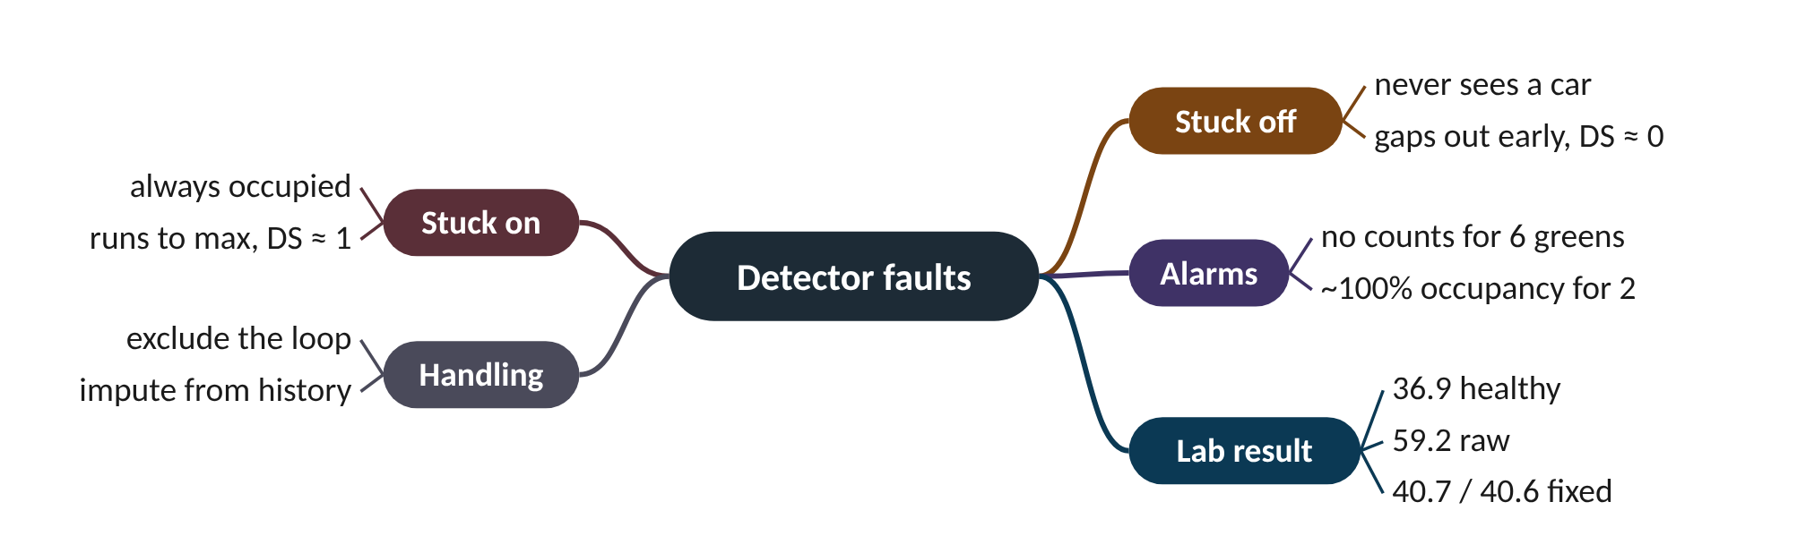
Remember it: Detector faults
PICTURE THIS · STOP 5: BROKEN BUOYS
TRAP
In the bay floats a row of bell buoys. One bell is silent, wrapped in seaweed. Another rings non-stop, driving the gulls mad. A diver swims up and ties a red alarm flag to each, and the ringing one is muted. A delay balloon tied to the pier swells from 37 to 59, then shrinks back to 41.
Do not assume a faulty loop always shows up as 'zero'. A stuck-on loop is worse for the strategic layer: it looks like heavy traffic, so it can push the whole subsystem's cycle length up.
Notes:
What the scene encodes: Silent bell = stuck-off; ringing bell = stuck-on; red flags = alarms (6 greens of nothing, 2 greens of non-stop); balloon = delay 36.9 → 59.2 → 40.7 s.
Recap: Detector faults: stuck-off reads DS ≈ 0, stuck-on reads DS ≈ 1; alarms (6 empty greens, 2 full greens) then exclude or impute; delay 36.9 → 59.2 → 40.7 s.

Slide 21
6 Predicting signal timing for connected vehicles
IN PLAIN WORDS
It is like a bus app predicting arrival. A timetable is easy to read but the driver may hurry or wait. The best guess is often the driver's own plan for today, not what the bus did yesterday.
SPaT tells cars when lights change
Adaptive control re-plans, so it's uncertain
Planned green best: 2.63 s error
History alone did worse
Next: live updates and confidence bands
2.63 s
mean error of the planned-green predictor
Notes:
A car told 'the light turns red in 8 seconds' can ease off and save fuel. A fixed-time signal knows that exactly. An adaptive one changes its mind every cycle. How well can we predict it?
SPaT (Signal Phase and Timing) messages tell vehicles which light is showing and when it will change. They make GLOSA (green light optimal speed advice), eco-driving and automated driving possible. Fixed-time signals can publish exact times. SCATS re-plans every cycle and can gap out (end a green early when traffic stops) or skip phases, so the time to change is uncertain.
The lab logged every green on the corridor and tested three predictions made at the moment each green starts: the controller's planned green, persistence (the same green as last cycle) and a linear regression trained on the first half of the run.
They were compared by mean absolute error (MAE): the average size of the miss, ignoring its sign. The plan won with 2.63 s; regression 3.24 s; persistence 3.94 s. The useful research lies in what a plan cannot know: live gap timers and priority calls.
Presenter tip: Use the bus-app analogy. Show that MAE is just an average of absolute misses, then stress the risk of rare large misses for drivers who trust the advice.

Slide 22
Worked example: Two predictors on four greens
MAE = ( |actual₁ − predicted₁| + … + |actual_{n} − predicted_{n}| ) ÷ n
Actual greens: 31, 26, 34, 29 s. Planned: 32, 30, 33, 30 s. Persistence (last cycle's green): 28, 31, 26, 34 s.
1. Planned errors: |31 − 32| = 1, |26 − 30| = 4, |34 − 33| = 1, |29 − 30| = 1.
2. Planned MAE = (1 + 4 + 1 + 1) ÷ 4 = 7 ÷ 4 = 1.75 s.
3. Persistence errors: |31 − 28| = 3, |26 − 31| = 5, |34 − 26| = 8, |29 − 34| = 5.
4. Persistence MAE = (3 + 5 + 8 + 5) ÷ 4 = 21 ÷ 4 = 5.25 s.
The plan wins because it already includes this cycle's decision. Persistence is always one cycle behind. The same ranking appeared in the lab (2.63 s against 3.94 s). Numbers here are illustrative.
Notes:
Green-duration prediction error on the SUMO corridor. What to notice: the controller's own plan is the best of the three; learning from history did not beat it. From spat_mae.csv.
Try it with the audience: Two greens last 40 s and 35 s. The plan predicted 38 s for both. What is the MAE?
Answer: Errors |40 − 38| = 2 and |35 − 38| = 3. MAE = (2 + 3) ÷ 2 = 2.5 s.

Slide 23
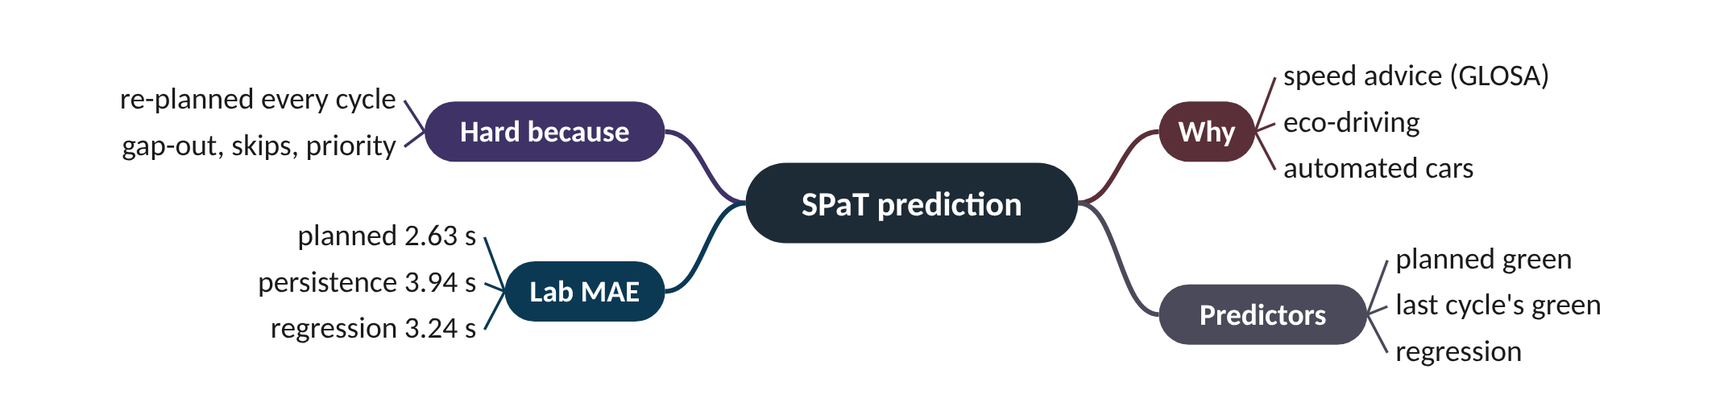
Remember it: SPaT prediction
PICTURE THIS · STOP 6: FERRY DEPARTURES BOARD
TRAP
At the ferry terminal a departures board shows the next sailing with a small error, about two and a half minutes. Beside it an old sailor shouts yesterday's times and is off by four. A third man with a calculator lands in between. A ferry suddenly leaves early because nobody is boarding.
A low average error can hide large misses. A green that gaps out 10 s early can catch a car that trusted the prediction. Publish a confidence band, not just one number, and update it every second.
Notes:
What the scene encodes: Board = planned green (2.63 s); old sailor = persistence (3.94 s); calculator = regression (3.24 s); early ferry = gap-out, which no plan can foresee.
Recap: SPaT prediction: SCATS re-plans and gaps out, so timing is uncertain; MAE compares predictors; planned 2.63 s beats regression 3.24 s and persistence 3.94 s.

Slide 24
Five research directions at a glance
Direction | SCATS part replaced | Lab result | Beat SCATS?
CV-based DS | ds_source | delay +8% to +21% | no
RL split selection | split_selector | 40.6 vs 36.4 s | no
Max-pressure hybrid | green_allocator | 40.2 vs 36.9 s | no (corridor)
Fault alarms | sensor_filter / fault_handling | 59.2 → 40.7 s | recovers 83% of fault loss
SPaT prediction | none (prediction only) | planned MAE 2.63 s | best of three predictors

Slide 25
Things beginners mix up
This… | …is not this | The fact that tells them apart
Throughput-optimal | Lowest delay | Max-pressure's proof is about carrying the most traffic under ideal queues, not delay with platoons.
Stuck-off loop | Stuck-on loop | Stuck-off reads DS 0 and gaps out early; stuck-on reads DS 1 and runs to maximum.
Shadow mode | Closed loop | Shadow mode only compares estimates on the same traffic; closed loop lets the estimate drive the lights.
Penetration p | Accuracy | Error falls like 1/√p: four times the penetration halves the error.
Training seeds | Test seeds | Evaluate on seeds the method never trained on (here 7, 8, 9).

Slide 26
Check yourself (1 of 2)
p = 0.2, green 30 s, MF 1,800 veh/h, 3 CVs crossed. Estimated DS?
Phase A: queue 9, downstream 10. Phase B: queue 5, downstream 0. Which has the higher pressure?
A. 0.20
B. 0.50
C. 1.00
D. 1.50
A. A (4)
B. B (5)
C. Equal
D. Cannot tell
Answers are in the speaker notes and in the study guide's answer key.
Notes:
Answer: C. n̂ = 3 ÷ 0.2 = 15; g' = 15 × 2 = 30 s; DS = 30 ÷ 30 = 1.00.
Answer: B. A = 9 − 5 = 4; B = 5 − 0 = 5. B wins despite its shorter queue because its exit is empty.

Slide 27
Check yourself (2 of 2)
Healthy 36.9 s, raw faults 59.2 s, with alarms 40.7 s. What share of the fault damage was recovered?
A GLOSA app uses the planned green (MAE 2.63 s). What is the main remaining risk?
A. about 40%
B. about 60%
C. about 83%
D. 100%
A. Average error too large
B. Rare large misses from gap-out or priority calls
C. Cars cannot receive SPaT
D. Planned greens are random
Answers are in the speaker notes and in the study guide's answer key.
Notes:
Answer: C. (59.2 − 40.7) ÷ (59.2 − 36.9) = 18.5 ÷ 22.3 ≈ 0.83.
Answer: B. MAE hides tail errors; a green ending 10 s early can catch a driver who trusted the advice.

Slide 28
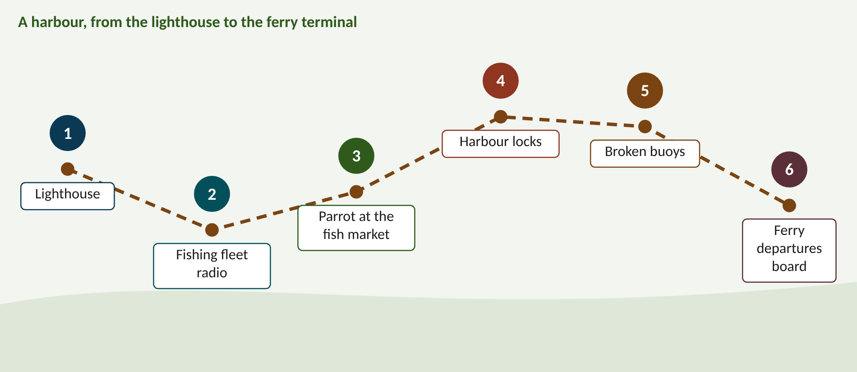
Walk the memory route
1 Lighthouse = Fair testing · 2 Fishing fleet radio = DS from CVs · 3 Parrot at the fish market = Learning splits · 4 Harbour locks = Max-pressure · 5 Broken buoys = Detector faults · 6 Ferry departures board = SPaT prediction
Notes:
Stop 1, Lighthouse: At the lighthouse the keeper races four identical toy ships in a bathtub. She changes only one sail on the new ship, then throws three dice to make three different storms, and writes every result on the wall, even the races the new ship lost. (One sail = change one thing; four ships = three baselines plus the new idea; three dice = several seeds; writing every result = report mean, spread and losses.)
Stop 2, Fishing fleet radio: On the quay, the harbourmaster counts returning fishing boats by radio. Only one boat in four has a radio, so every 'beep' he hears he multiplies by four on a huge chalkboard. A seagull steps on the radio, one extra beep sounds, and his total leaps by four boats. (Radio boats = connected vehicles; one in four = p = 0.25; multiply by four = n̂ = nCV/p; the seagull's extra beep = sampling noise magnified by 1/p.)
Stop 3, Parrot at the fish market: In the fish market a parrot sits in a cage holding exactly four menu cards. It may only shout a dish from those cards. When the queue at the counter shrinks it gets a sardine. It still shouts the wrong card so often that its queue is four people longer than the old fishmonger's. (Four cards = SP1 to SP4, the safe envelope; sardine = reward (fewer halted cars); four people longer = about 4 s worse (40.6 vs 36.4 s).)
Stop 4, Harbour locks: At the harbour locks two gates hold back boats. A pressure gauge on each gate shows boats waiting minus half the boats crammed in the basin beyond. The lock keeper turns a dial marked β halfway, mixing his old timetable with the gauges. Meanwhile the water bus, ignored, waits so long it sinks to its chimney. (Gauge = pressure (queue − ½ downstream load); half-turned dial = β = 0.5 blend; the sinking water bus = bus delay nearly doubling under pure max-pressure (57.4 vs 29.7 s).)
Stop 5, Broken buoys: In the bay floats a row of bell buoys. One bell is silent, wrapped in seaweed. Another rings non-stop, driving the gulls mad. A diver swims up and ties a red alarm flag to each, and the ringing one is muted. A delay balloon tied to the pier swells from 37 to 59, then shrinks back to 41. (Silent bell = stuck-off; ringing bell = stuck-on; red flags = alarms (6 greens of nothing, 2 greens of non-stop); balloon = delay 36.9 → 59.2 → 40.7 s.)
Stop 6, Ferry departures board: At the ferry terminal a departures board shows the next sailing with a small error, about two and a half minutes. Beside it an old sailor shouts yesterday's times and is off by four. A third man with a calculator lands in between. A ferry suddenly leaves early because nobody is boarding. (Board = planned green (2.63 s); old sailor = persistence (3.94 s); calculator = regression (3.24 s); early ferry = gap-out, which no plan can foresee.)

Slide 29
Numbers to remember
› RL vs SCATS on 3 seeds: 40.6 vs 36.4 s (+4.2 s)
› CV DS error: 0.65 (5%), 0.34 (25%), 0.08 (100%)
› CV closed loop: delay +8% to +21%
› Corridor: SCATS 36.9, pure MP 40.8, hybrid 40.2 s
› Bus delay: SCATS 29.7, pure MP 57.4 s
› Faults: 36.9 → 59.2 → 40.7 / 40.6 s
› SPaT MAE: planned 2.63, regression 3.24, persistence 3.94 s

Slide 30
Keep going
Study guide: SCATS_Mastery_Study_Guide.pdf · Interactive labs and SUMO code: smrahmanbd.github.io/scats-learning-lab
Notes:
Point learners to the study guide for the full worked examples, quiz and revision plan, and to the website for the simulators.

