Slide 1
Designing SCOOT for a town, step by step
SCOOT · Foundation · Design workshop
From 'is it worth it?' to switch-on day: seven steps an engineer follows to put adaptive signal control on a real urban network.
smrahmanbd.github.io/scoot-learning-lab
Notes:
This deck is for beginners who have met the SCOOT basics (detectors, LPUs, the link model). It follows one made-up town centre, Riverside, through the seven design steps. Every step has a picture, a small hand calculation, a mind map and a memory scene. Numbers for Riverside are invented and easy; rules of thumb come from the references at the end.

Slide 2




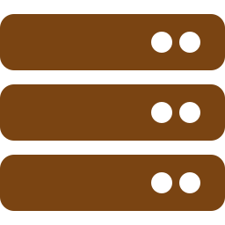


Seven design steps, each feeding the next
1
Decide whether SCOOT is worth it
2
Survey the network
3
Group the nodes into regions
~20% less delay than typical fixed-time plans (TAL 7/99)
1800 veh/h per lane: a typical saturation flow
60 | 90 seconds: Riverside's two region cycles
4
Define links and place the detectors
5
Wire it up and build the database
6
Validate every link on the street
8–15 s ideal warning time from loop to stop line
144/s loop readings for Riverside's 36 loops
0.59 LPU/s: N3A's validated SATO
7
Commission, fine-tune and evaluate
13–15% shorter peak journeys in Riverside (illustrative)
Notes:
Outcomes for today:
- List the seven design steps in order and say what each one hands to the next.
- Estimate the benefit and payback of a SCOOT scheme from a before survey.
- Measure a saturation flow with a stopwatch and turn it into a capacity.
- Group junctions into regions using the critical node's cycle, and spot when a crossing can double-cycle.
- Place a SCOOT loop by journey time (8–15 s upstream) and count the loops a network needs.
- Fill one link's database record and validate SATO from a stopwatch reading.
- Plan a before/after survey and read its result honestly.

Slide 3
Three surprises to start
The software is the easy part.
The loops go 13 seconds before the lights.
A good fixed plan goes stale.
SCOOT comes as a finished product. Most of an engineer's time goes on the street: counting traffic, choosing where loops go, and standing at stop lines with a stopwatch until the model matches reality.
An actuated signal puts loops at the stop line. A SCOOT loop sits near the upstream end of the road, about 8 to 15 seconds' drive away, so the model gets warning of every platoon.
Traffic patterns drift, so a fixed-time plan loses about 3% of its quality each year (TAL 7/99). SCOOT re-times the network every few minutes instead of every few years.

Slide 4
Words you will meet
Node | A junction or pedestrian crossing controlled by SCOOT.
Region | A group of nodes that share one cycle time.
Link | One approach into a node, from its detector to the stop line.
Critical node | The busiest node in a region; it sets the region's cycle.
Double cycling | A quiet node runs two cycles in the region's one.
Loop | A wire coil cut into the road that 'feels' a vehicle above it.
Outstation | The box in the signal cabinet that talks to the centre.
UTC | Urban Traffic Control: the central computer system SCOOT runs on.
Saturation flow | Vehicles per hour that cross the stop line from a queue on green.
Validation | Tuning each link's model until it matches the street.
Commissioning | Switching SCOOT on and checking it works as designed.
Before/after study | Journey-time surveys that show what the scheme gained.
Notes:
You do not need to memorise these now; each is explained again when it first matters.

Slide 5
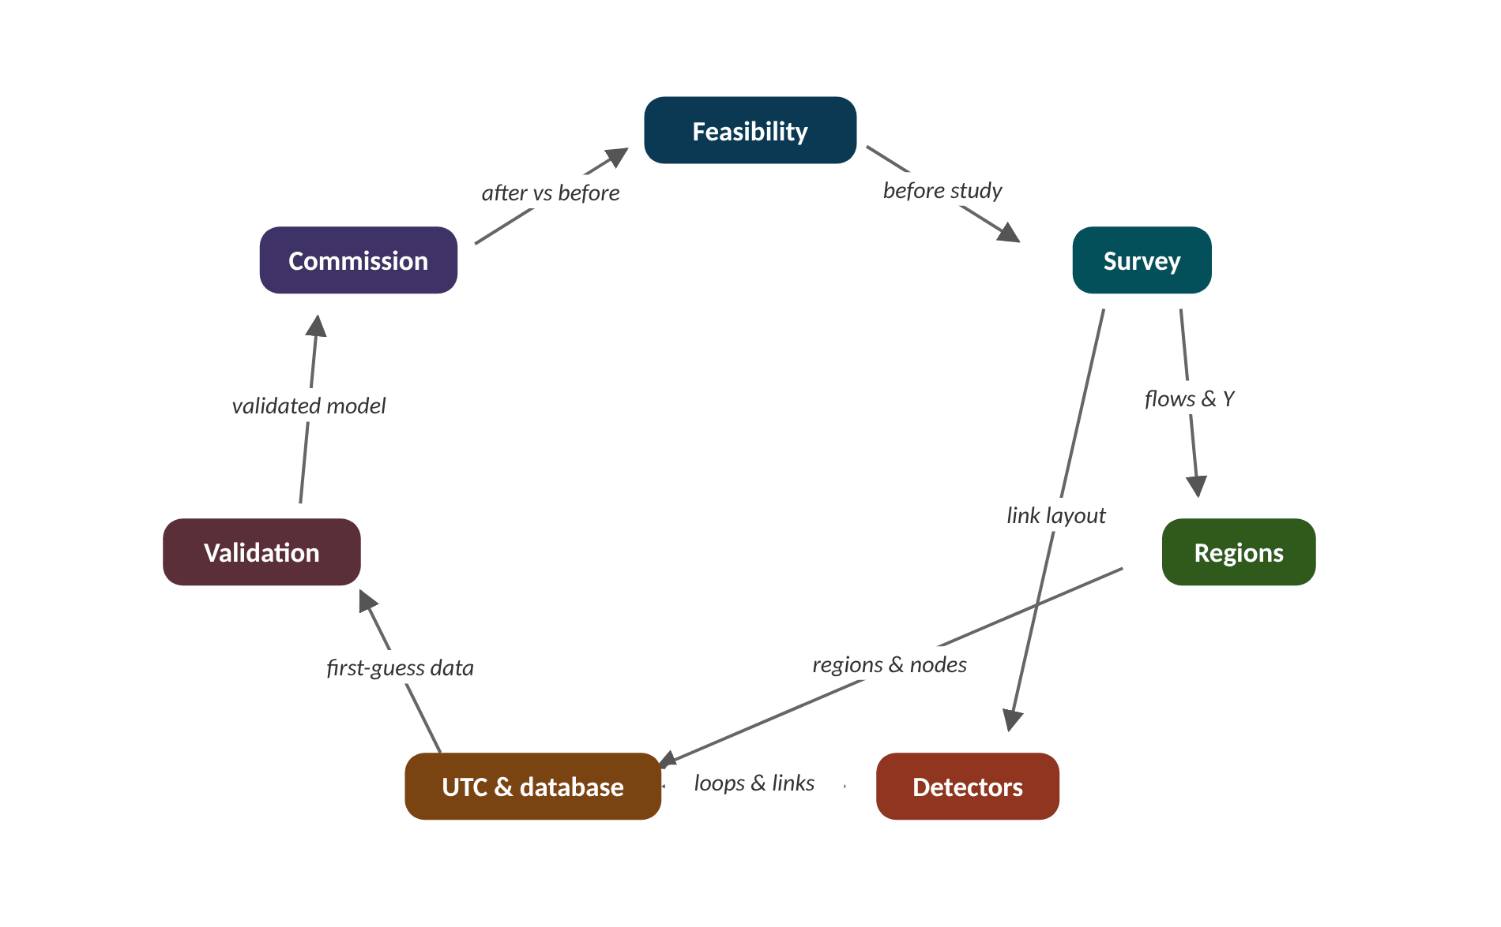
The map of today's ideas
Notes:
Each box is one idea; arrows say how one feeds the next. before study; flows & Y; link layout; regions & nodes; loops & links; first-guess data; validated model; after vs before.

Slide 6
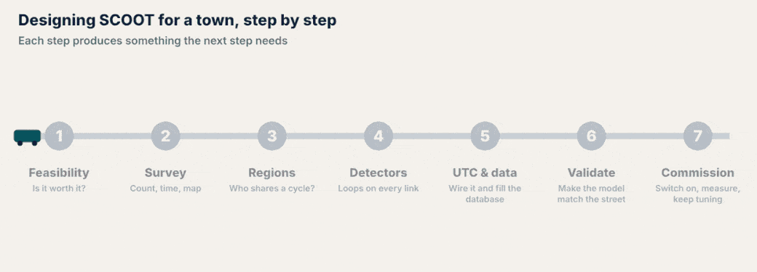
The whole journey in one picture
NOTICE 1 Every step produces something the next step needs: no step can be skipped.
NOTICE 2 Steps 2, 4 and 6 happen on the street; steps 3 and 5 happen at a desk.
NOTICE 3 Step 7 never really ends: loops fail and traffic changes, so the model is checked every year or two.
Notes:
Play the animation once without talking, then once while pointing out each notice.
1. Every step produces something the next step needs: no step can be skipped.
2. Steps 2, 4 and 6 happen on the street; steps 3 and 5 happen at a desk.
3. Step 7 never really ends: loops fail and traffic changes, so the model is checked every year or two.

Slide 7
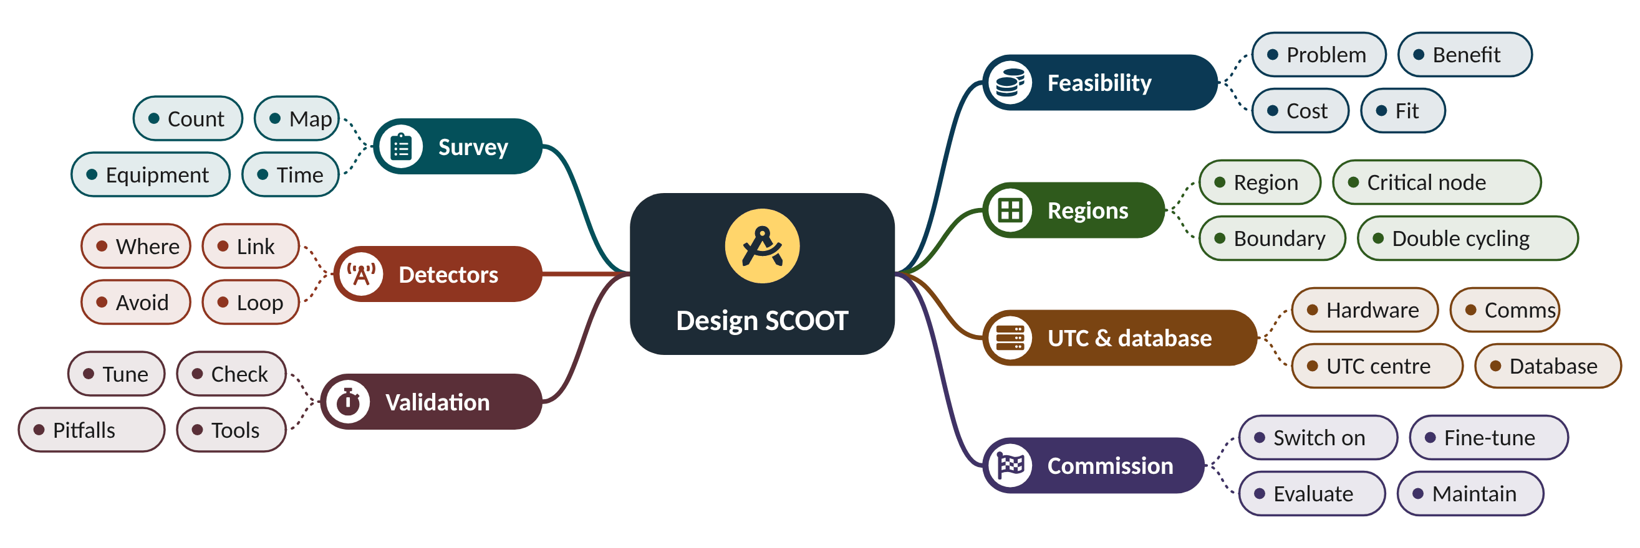
Mind map: the seven design steps
Notes:
Each branch is one design step; its four leaves are what the step covers. Come back to this slide at the end.

Slide 8
1 Decide whether SCOOT is worth it
IN PLAIN WORDS
Buying SCOOT is like fitting a smart thermostat to a big building. You first check how much energy you waste now, how much the gadget saves, and how long until the savings repay the price.
Measure today's delay: the before study
Expect about 12% (fresh plans) to 20% (typical plans) less delay
Plans age about 3% a year
Payback = cost ÷ yearly saving
~20%
less delay than typical fixed-time plans (TAL 7/99)
Source: Benefit figures and plan ageing: DfT Traffic Advisory Leaflet 7/99.
Notes:
SCOOT costs money: loops, cables, a central computer and many engineer-days. How does a town decide it will get its money back?
Start with the problem. A before study measures journey times and delay on the main routes at the busy times. It is also the baseline for the after study in step 7.
TAL 7/99 reports average delay savings of about 12% against up-to-date fixed-time plans and about 20% against typical (older) plans. Plans age by about 3% a year as traffic changes.
SCOOT suits networks where junctions are close enough for platoons to matter, traffic varies through the day, and reliable communications to a control centre are possible. An isolated junction far from others is often better served by MOVA (TAL 7/99).
Presenter tip: Ask the class what 'delay' costs a town. Emphasise that the before study is reused in step 7.

Slide 9
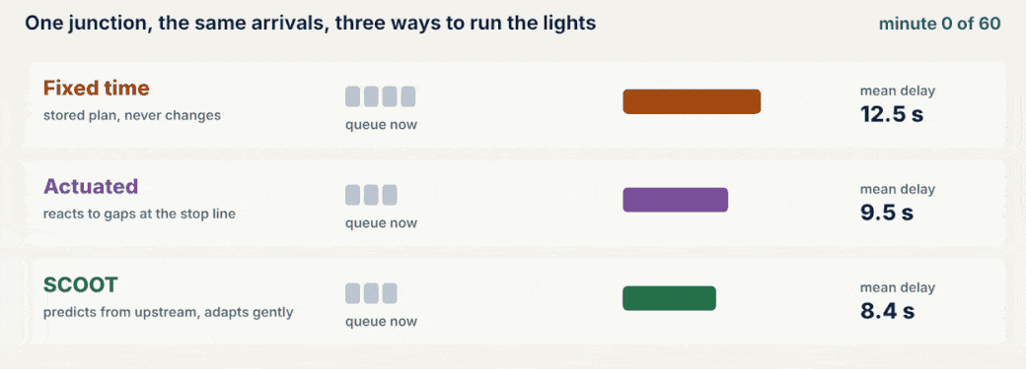
Watch: Fixed, actuated and SCOOT side by side
NOTICE 1 Fixed time cannot react: the plan was made for yesterday's traffic.
NOTICE 2 Actuated signals react, but each junction on its own.
NOTICE 3 SCOOT reacts and coordinates, which is where the delay saving comes from.
Notes:
Play the animation once without talking, then once while pointing out each notice.
1. Fixed time cannot react: the plan was made for yesterday's traffic.
2. Actuated signals react, but each junction on its own.
3. SCOOT reacts and coordinates, which is where the delay saving comes from.
Source: Benefit figures and plan ageing: DfT Traffic Advisory Leaflet 7/99.

Slide 10
Worked example: Is Riverside worth it?
Yearly saving = daily delay × saving % × working days × value of time
Payback (years) = scheme cost ÷ yearly saving
Before study: 400 vehicle-hours of delay each weekday on old plans. Value of time 10 money units per vehicle-hour (illustrative). Scheme cost 400,000.
1. Expected saving vs typical plans ≈ 20%, so 400 × 0.20 = 80 veh·h per day.
2. Over 250 working days: 80 × 250 = 20,000 veh·h per year.
3. In money: 20,000 × 10 = 200,000 per year.
4. Payback = 400,000 ÷ 200,000 = 2 years.
Riverside repays the scheme in about 2 years, if the 20% saving is achieved.
Notes:
Reported delay savings with SCOOT (TAL 7/99). What to notice: savings are bigger when the old plans are older or the comparison is vehicle actuation; about 12% is typical against fresh fixed-time plans.
Try it with the audience: Delay is 250 veh·h per day, the saving is 12%, value of time 10, 250 days. What is the yearly saving?
Answer: 250 × 0.12 = 30 veh·h/day; × 250 = 7,500 veh·h/yr; × 10 = 75,000 per year.

Slide 11
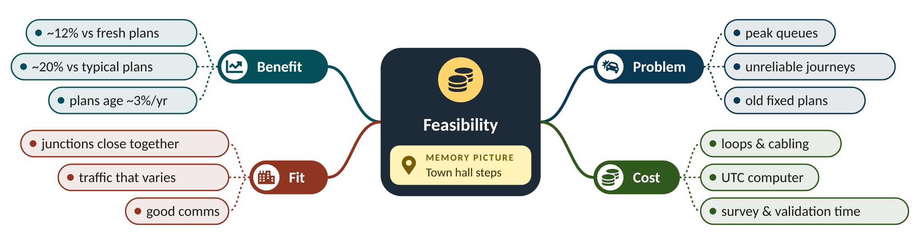
Remember it: Feasibility
PICTURE THIS · STOP 1: TOWN HALL STEPS
TRAP
On the town hall steps sits a giant piggy bank with a 20% slice cut out like a cake. Every year the mayor must feed it 3 coins or it goes stale and smelly.
The 12–20% are averages from past schemes, not a promise. A network with fresh, well-made plans may gain less; a badly timed one may gain more. Always measure with your own before study.
Notes:
What the scene encodes: Piggy bank = money case; 20% slice = saving vs typical plans; 3 coins a year = plans age about 3% a year.
Recap: Feasibility: measure today's delay, expect about 12–20% less, and check the payback.

Slide 12
2 Survey the network
IN PLAIN WORDS
Before a tailor cuts cloth, they measure you: chest, arms, legs. The survey is the town's measuring session; SCOOT is then cut to fit.
Map every node: lanes, stages, controller
Count turning flows, peak and off-peak
Time journey times along each link
Stopwatch the saturation flow
1800
veh/h per lane: a typical saturation flow
Source: Survey items: TRID 186642 (practical implementation of SCOOT); saturation flow method: standard practice (TSM Ch. 6).
Notes:
SCOOT's model is only as good as what you tell it about the roads. What must an engineer find out before drawing a single loop?
List and map every node: junctions and pedestrian crossings, their lanes, stages and intergreens, and the controller in each cabinet.
Count traffic: turning flows at the busy periods and off-peak, plus buses. Time free-flow journey times along each link.
Measure the saturation flow: the rate at which a standing queue crosses the stop line on green. It turns into each approach's capacity, and later into SCOOT's SATO.
Presenter tip: If you can, do the stopwatch count with students at a real junction. Start timing when the first vehicle crosses, so there are 15 gaps for 16 vehicles.

Slide 13
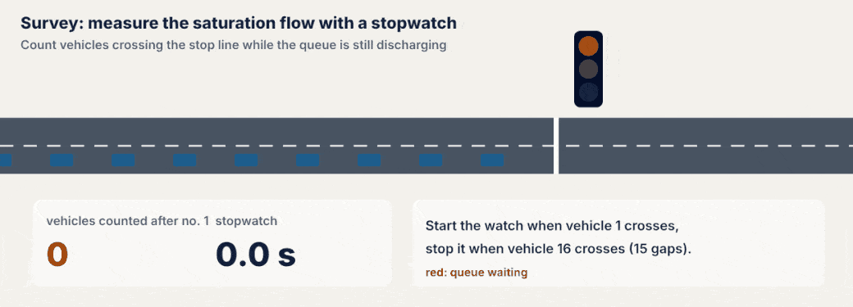
Watch: Measuring the saturation flow
NOTICE 1 The watch starts when vehicle 1 crosses the stop line.
NOTICE 2 Vehicles 2 to 16 cross at a steady 2 s spacing while the queue lasts.
NOTICE 3 15 vehicles in 30 s gives 0.5 veh/s, or 1800 veh/h per lane.
Notes:
Play the animation once without talking, then once while pointing out each notice.
1. The watch starts when vehicle 1 crosses the stop line.
2. Vehicles 2 to 16 cross at a steady 2 s spacing while the queue lasts.
3. 15 vehicles in 30 s gives 0.5 veh/s, or 1800 veh/h per lane.
Source: Survey items: TRID 186642 (practical implementation of SCOOT); saturation flow method: standard practice (TSM Ch. 6).

Slide 14
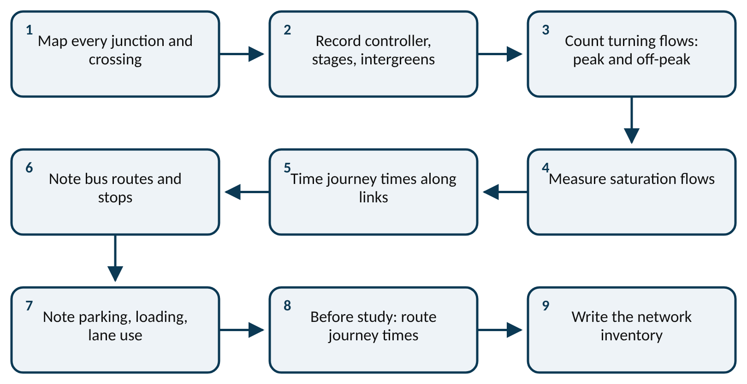
Worked example: Saturation flow and capacity at Riverside J3
s = vehicles counted ÷ time (start timing at vehicle 1)
capacity = s × green ÷ cycle; DoS x = flow ÷ capacity
Two-lane main approach. On green, 15 vehicles cross in 30 s after the first one (per lane). Green 27 s in a 60 s cycle. Flow 1300 veh/h.
1. s = 15 ÷ 30 = 0.5 veh/s per lane = 1800 veh/h per lane.
2. Two lanes: 2 × 1800 = 3600 veh/h.
3. Capacity = 3600 × 27 ÷ 60 = 1620 veh/h.
4. Degree of saturation x = 1300 ÷ 1620 = 0.80.
The approach runs at 80% of capacity: busy, but not yet at SCOOT's 90% target.
Notes:
The survey checklist. What to notice: the survey covers roads, traffic and equipment. Everything here goes into the database in step 5.
Try it with the audience: 12 vehicles cross in 26 s on a one-lane approach. What is s in veh/h?
Answer: 12 ÷ 26 = 0.46 veh/s; × 3600 = about 1660 veh/h.

Slide 15
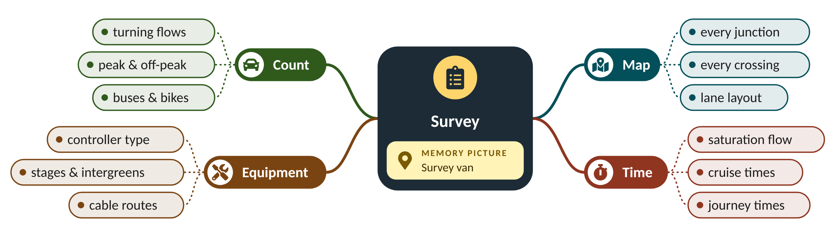
Remember it: Survey
PICTURE THIS · STOP 2: SURVEY VAN
TRAP
A survey van has a giant stopwatch for a headlight. When it clicks, 15 tiny cars hop out of its door in 30 ticks, and a clipboard on the roof writes '1800'.
Do not count only the morning peak. SCOOT runs all day, so the survey needs off-peak and evening counts too, and it should note events that cause surges (schools, football, car parks).
Notes:
What the scene encodes: Stopwatch = timing; 15 cars in 30 s = 0.5 veh/s; 1800 = veh/h per lane.
Recap: Survey: map nodes, count flows, time journeys and saturation flows; this fills the database.

Slide 16
3 Group the nodes into regions
IN PLAIN WORDS
A region is like a marching band: everyone keeps the same beat. The drummer is the critical node, the busiest junction, and the others march in step. A second band far down the road can keep its own beat.
A region shares one cycle time
The critical node sets it, at about 90% saturation
Split regions at long links
Crossings and quiet nodes can double-cycle
60 | 90
seconds: Riverside's two region cycles
Source: Regions, common cycle, double cycling and the 90% target: DfT Traffic Advisory Leaflet 7/99.
Notes:
All junctions in a SCOOT region share one cycle time. So which junctions should be grouped together, and which should be kept apart?
SCOOT divides the network into regions. All nodes in a region run one common cycle, which lets offsets form green waves between them (TAL 7/99).
The cycle optimiser aims to keep the busiest, critical node at about 90% saturation. A simple way to see the cycle each node needs: C = 0.9 L ÷ (0.9 − Y), where L is lost time and Y the sum of flow ratios.
Put region boundaries on long links, where platoons have spread out and coordination matters little. Pedestrian crossings and quiet nodes can double cycle: run two cycles in the region's one.
Presenter tip: Draw the town on the board and let students vote on the region boundary before showing the answer.

Slide 17
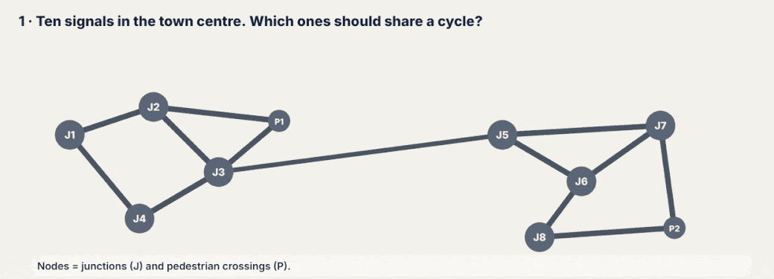
Watch: Dividing Riverside into regions
NOTICE 1 Each node's needed cycle comes from its own traffic.
NOTICE 2 The gold-ringed critical node sets the cycle for its whole region.
NOTICE 3 The 900 m link is the natural boundary; P1 and P2 run twice per region cycle.
Notes:
Play the animation once without talking, then once while pointing out each notice.
1. Each node's needed cycle comes from its own traffic.
2. The gold-ringed critical node sets the cycle for its whole region.
3. The 900 m link is the natural boundary; P1 and P2 run twice per region cycle.
Source: Regions, common cycle, double cycling and the 90% target: DfT Traffic Advisory Leaflet 7/99.

Slide 18
Worked example: Two regions for Riverside
node DoS = Y × C ÷ (C − L) → needed cycle for 90%: C = 0.9 L ÷ (0.9 − Y)
Lost time L = 12 s at every junction. J3 has Y = 0.72; J6 has Y = 0.78. The link J3–J5 is 900 m long; cruise speed 13.3 m/s.
1. J3: C = 0.9 × 12 ÷ (0.9 − 0.72) = 10.8 ÷ 0.18 = 60 s.
2. J6: C = 10.8 ÷ (0.9 − 0.78) = 10.8 ÷ 0.12 = 90 s.
3. J3–J5 takes 900 ÷ 13.3 ≈ 68 s to drive: a natural boundary.
4. Region A runs 60 s, region B 90 s. Crossing P1 needs only 30 s, so it double-cycles (2 × 30 = 60).
Two regions: A at 60 s set by J3, B at 90 s set by J6. One region at 90 s would make every red in A longer for no benefit.
Notes:
Cycle each Riverside node needs for 90% saturation (s). What to notice: J3 and J6 need the longest cycles, so each becomes the critical node of its region. P1 and P2 need far less, so they can double-cycle.
Try it with the audience: A node has L = 10 s and Y = 0.75. What cycle gives 90% saturation?
Answer: C = 0.9 × 10 ÷ (0.9 − 0.75) = 9 ÷ 0.15 = 60 s.

Slide 19
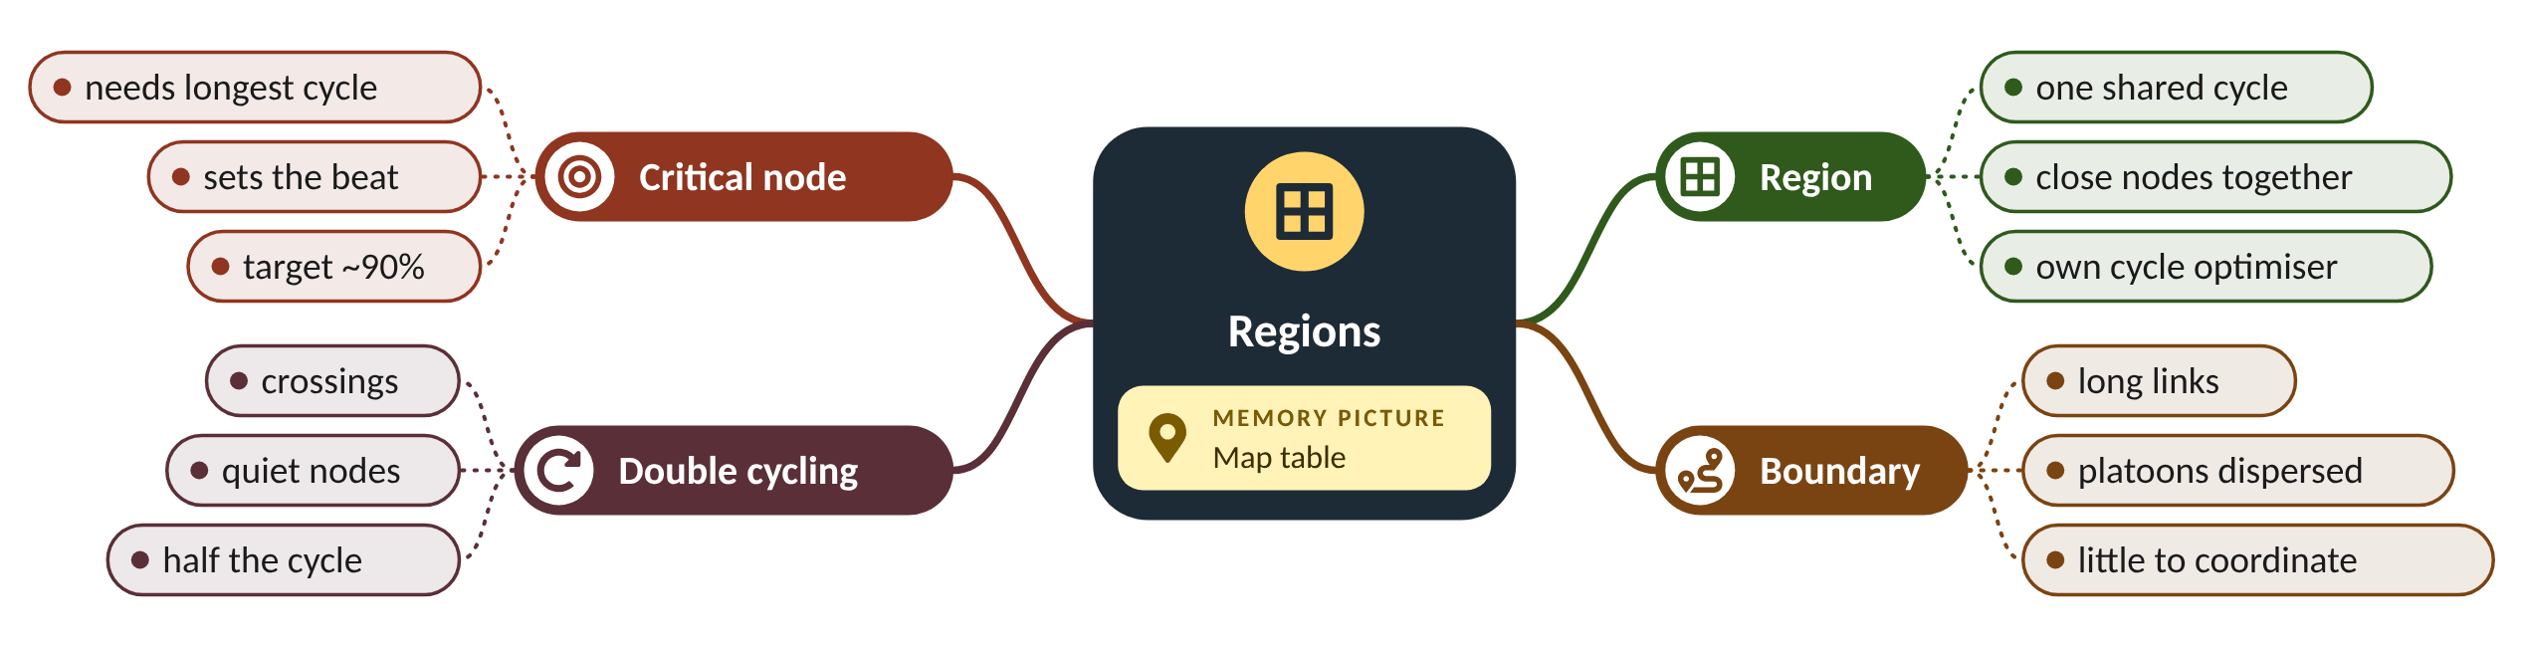
Remember it: Regions
PICTURE THIS · STOP 3: MAP TABLE
TRAP
On a huge map table sit two jelly moulds full of junctions. In each mould a junction wearing a gold crown beats a drum, one at 60, the other at 90. A 900 m strip of liquorice keeps the moulds apart, and two tiny crossings tap twice per beat.
The formula C = 0.9 L ÷ (0.9 − Y) is a classroom shortcut that shows the idea. SCOOT's cycle optimiser works on its own modelled degrees of saturation, in small steps every few minutes.
Notes:
What the scene encodes: Jelly moulds = regions; crowned drummer = critical node and its cycle; liquorice = long-link boundary; double taps = double cycling.
Recap: Regions: close nodes share one cycle set by the critical node; split at long links; crossings can double-cycle.

Slide 20
4 Define links and place the detectors
IN PLAIN WORDS
A loop is like a lookout posted down the road who shouts 'cars coming!'. Post them too close and the shout arrives with the cars; post them a little way up the road and the gatekeeper has time to get ready.
One link = one approach, detector to stop line
Loop at the upstream end: 8–15 s, at least 6 s
2 m loop, covering at most two lanes
Keep the journey time consistent
8–15 s
ideal warning time from loop to stop line
Source: Loop size, lanes per loop, 6 s minimum and 8–15 s optimum: Davies (SCOOT design principles); one loop per two lanes: FDOT (2016); detectors on every link, upstream end: DfT Traffic Advisory Leaflet 7/99.
Notes:
A loop at the stop line tells you about cars that have already arrived. Where should a loop go so SCOOT hears about them in time?
Each link is one approach to a node, from its detector to the stop line. Detectors are normally needed on every link, at its upstream end (TAL 7/99).
Place the loop by journey time, not metres: no less than about 6 s from the stop line, ideally 8–15 s, often just past the exit of the junction upstream (Davies).
A SCOOT loop is about 2 m long and covers no more than two lanes. Keep it away from bus stops, parking and places where drivers change lanes, so the time from loop to stop line is consistent.
Presenter tip: Ask: why is a loop 2 s from the stop line useless for SCOOT? (the model needs time to predict and the optimiser time to act).

Slide 21
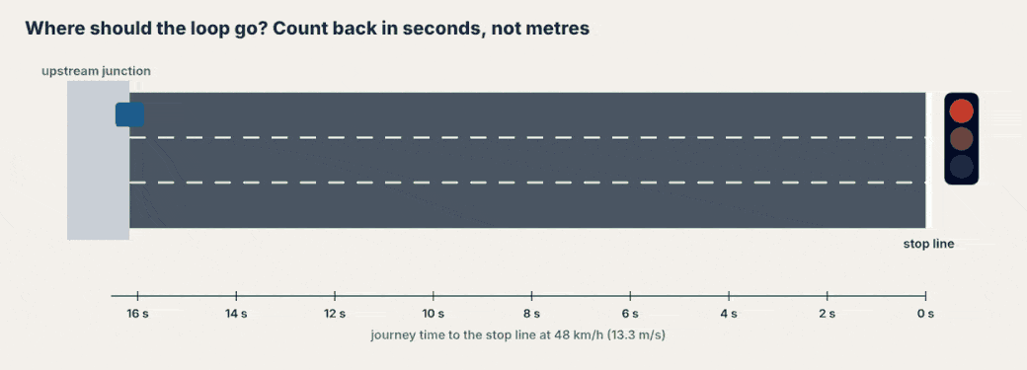
Watch: Counting back in seconds
NOTICE 1 The ruler under the road is in seconds of driving, not metres.
NOTICE 2 Red is too late (under 6 s); green is the ideal 8–15 s.
NOTICE 3 Each car flashes the loop as it passes: that count is SCOOT's input.
Notes:
Play the animation once without talking, then once while pointing out each notice.
1. The ruler under the road is in seconds of driving, not metres.
2. Red is too late (under 6 s); green is the ideal 8–15 s.
3. Each car flashes the loop as it passes: that count is SCOOT's input.
Source: Loop size, lanes per loop, 6 s minimum and 8–15 s optimum: Davies (SCOOT design principles); one loop per two lanes: FDOT (2016); detectors on every link, upstream end: DfT Traffic Advisory Leaflet 7/99.

Slide 22
Worked example: Placing the loop on link N3A
distance = speed × journey time; 48 km/h = 13.3 m/s
6 s → 80 m 8 s → 107 m 15 s → 200 m
The link is 200 m from the upstream junction to J3's stop line. Speed 48 km/h (13.3 m/s). Three lanes.
1. Ideal zone: 8 × 13.3 = 107 m to 15 × 13.3 = 200 m from the stop line.
2. Put the loop 20 m past the upstream exit: 200 − 20 = 180 m from the stop line.
3. Journey time = 180 ÷ 13.3 = 13.5 s: inside the 8–15 s zone.
4. Three lanes, at most two per loop: 2 loops (lanes 1–2, lane 3).
Link N3A gets two 2 m loops at 180 m (13.5 s). Over 30 links (6 of them three-lane) Riverside needs 24 + 12 = 36 loops.
Notes:
How far up the road is 8–15 s? What to notice: the same 8–15 s warning means a shorter distance on a slow street. Place loops in seconds, then convert to metres for the local speed.
Try it with the audience: A street has a 30 km/h speed (8.3 m/s). How far from the stop line is 10 s?
Answer: 8.3 × 10 = 83 m.

Slide 23
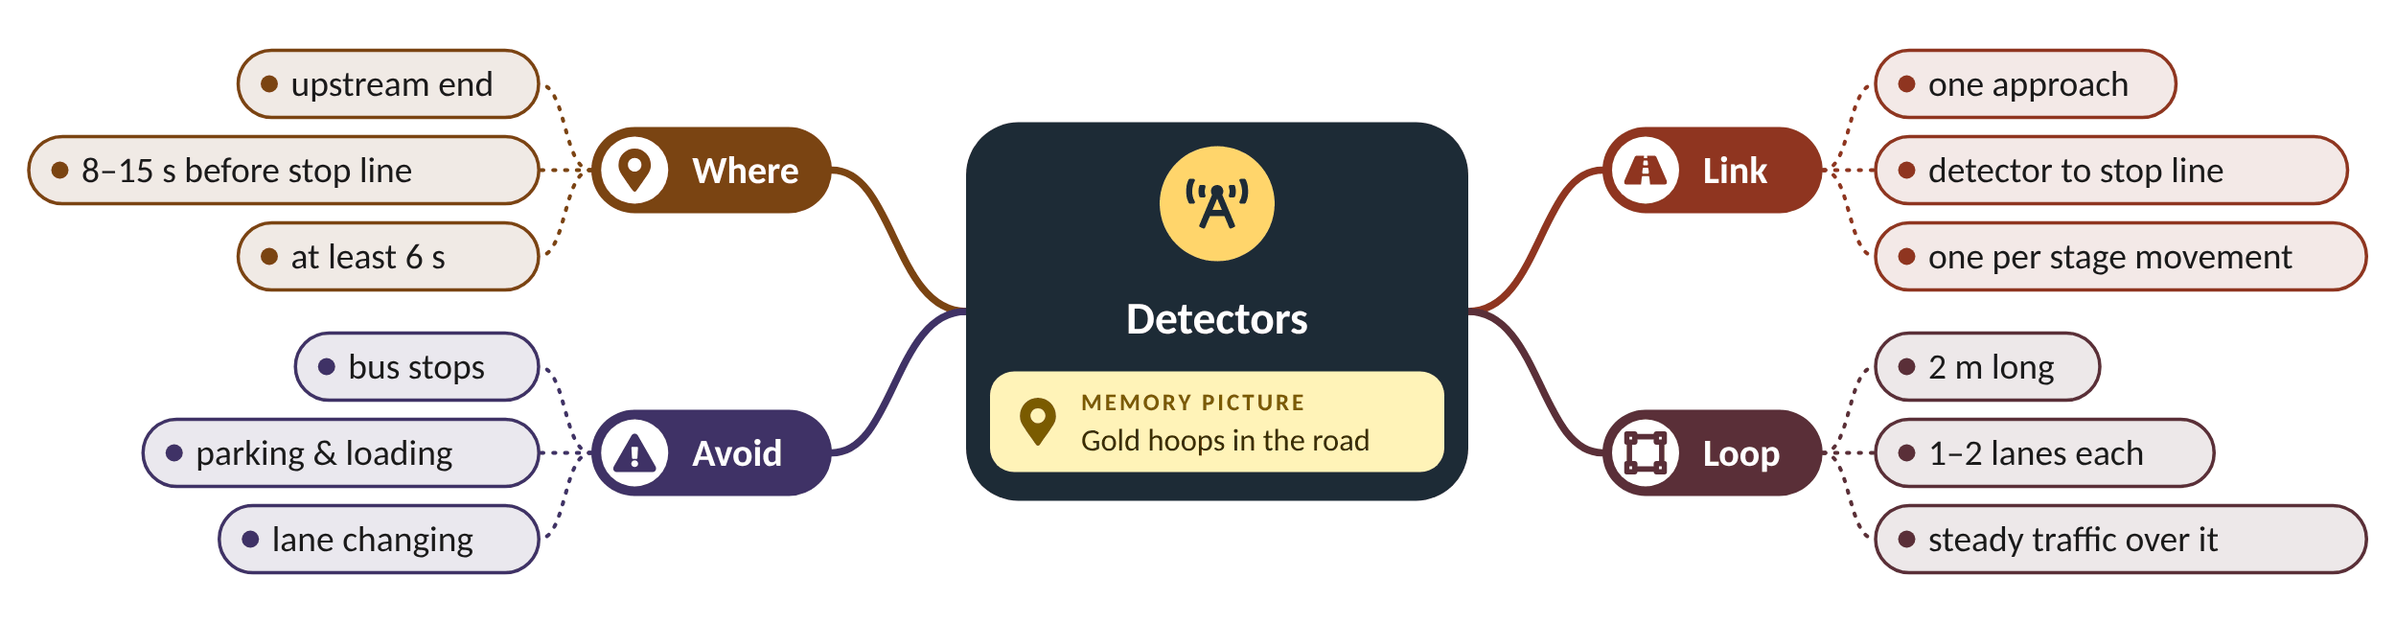
Remember it: Detectors
PICTURE THIS · STOP 4: GOLD HOOPS IN THE ROAD
TRAP
Gold hula hoops lie in the road 13 big strides before the traffic lights. Each hoop is just wide enough for two lanes, and a lookout sits in every hoop shouting 'coming!' at each car.
'Upstream' does not mean 'as far as possible'. The time from loop to stop line must be consistent: a loop before a bus stop or a car park entrance gives the model the wrong arrival times.
Notes:
What the scene encodes: Hoops = loops; 13 strides = about 13 s (8–15 s zone); two lanes per hoop; the lookout = early warning.
Recap: Detectors: one loop per link at its upstream end, 8–15 s (at least 6 s) before the stop line, 2 m long, at most two lanes.

Slide 24
5 Wire it up and build the database
IN PLAIN WORDS
Wiring SCOOT is like setting up a nervous system: the loops are nerve endings, the cables are nerves, and the UTC computer is the brain. The database is the brain's memory of what each road is like.
Loops → outstation → UTC computer → signals
Each loop read about 4 times a second
The database describes every link and stage
Fault monitoring watches loops and comms
144/s
loop readings for Riverside's 36 loops
Source: Central computer, communications and fault monitoring: DfT Traffic Advisory Leaflet 7/99; UTC and detection: DfT Traffic Signs Manual Ch. 6 (2019), sections 9.5 and 10.
Notes:
The loops are in the road and the computer is in the control centre. What has to travel between them, how often, and what does the computer need to know about each road?
Each loop is read about 4 times a second. An outstation in the signal cabinet sends these readings to the UTC computer and receives stage-change commands back (TAL 7/99).
The database describes the network: which links feed which stages, each link's journey time from loop to stop line, its maximum queue clear time, lanes and saturation values.
The system also watches itself: fault monitoring flags loops or communications that stop reporting, because a broken loop feeds the model wrong counts.
Presenter tip: Link back to step 2: every survey item becomes a database field. Then preview step 6: the database is a first guess until validated.

Slide 25
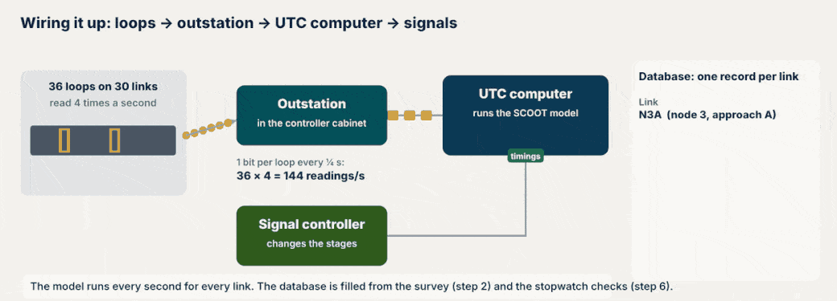
Watch: Loops to computer and back
NOTICE 1 Readings travel up from the street several times a second.
NOTICE 2 Timings travel back down to the signal controller.
NOTICE 3 The database card fills field by field; SATO is set later, in step 6.
Notes:
Play the animation once without talking, then once while pointing out each notice.
1. Readings travel up from the street several times a second.
2. Timings travel back down to the signal controller.
3. The database card fills field by field; SATO is set later, in step 6.
Source: Central computer, communications and fault monitoring: DfT Traffic Advisory Leaflet 7/99; UTC and detection: DfT Traffic Signs Manual Ch. 6 (2019), sections 9.5 and 10.

Slide 26
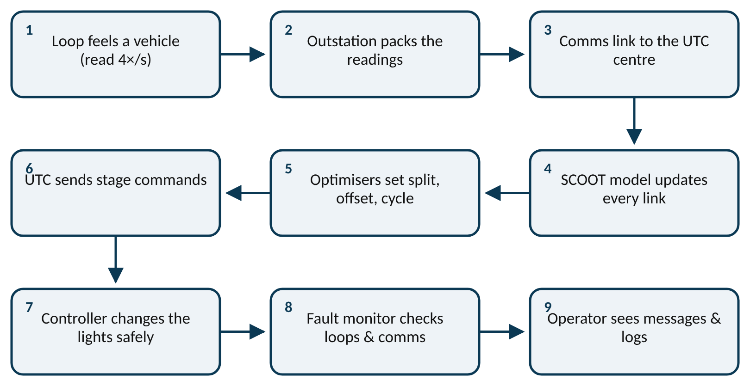
Worked example: Filling link N3A's record
readings per second = loops × 4
max queue clear time ≈ (queue length ÷ space per vehicle) ÷ s + start lag
36 loops in Riverside. Link N3A: loop 180 m from the stop line, 6 m of road per queued vehicle, s = 0.5 veh/s per lane, start lag 2 s. Three stopwatch runs from loop to stop line: 13.2, 13.8 and 13.5 s.
1. Data rate: 36 × 4 = 144 readings per second.
2. Journey time = (13.2 + 13.8 + 13.5) ÷ 3 = 13.5 s.
3. A full queue reaches the loop: 180 ÷ 6 = 30 vehicles per lane.
4. Max queue clear ≈ 30 ÷ 0.5 + 2 = 62 s.
N3A's record: journey time 13.5 s, max queue clear time 62 s. Step 6 checks both on street.
Notes:
What travels where, every second. What to notice: data flows up from the loops and decisions flow back down. Fault monitoring watches the whole chain.
Try it with the audience: A network has 50 loops. How many readings reach the centre each second?
Answer: 50 × 4 = 200 readings per second.

Slide 27
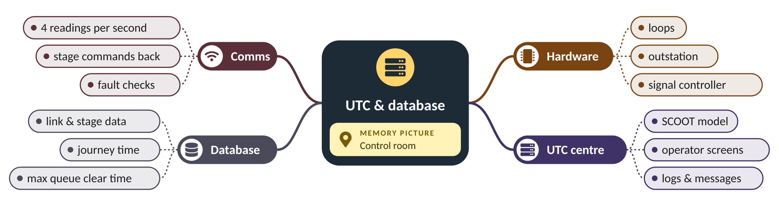
Remember it: UTC & database
PICTURE THIS · STOP 5: CONTROL ROOM
TRAP
In the control room a hungry computer gobbles 144 jelly beans a second through a long straw from the street. Beside it a librarian files a recipe card for every road: '13.5 s to the stop line, 62 s to clear the queue'.
The controller in the street still enforces safety: minimum greens and intergreens. SCOOT asks for stage changes; it can never order an unsafe one.
Notes:
What the scene encodes: 144 jelly beans = 36 loops × 4 readings/s; straw = comms; recipe cards = the link database.
Recap: UTC & database: loops → outstation → UTC → controller; each link's record holds journey time and max queue clear time.

Slide 28
6 Validate every link on the street
IN PLAIN WORDS
Validation is like tuning a guitar by ear. You pluck the string (watch a real queue clear), compare with the note you expect (the model's queue), and turn the peg (SATO) until they match.
Calibrate the model to the street, link by link
Check journey time, max queue clear time and lags
Tune SATO until model and street queues clear together
Use normal days and several cycles
0.59
LPU/s: N3A's validated SATO
Source: Validation = calibrating the model to the street: DfT Traffic Advisory Leaflet 7/99; journey time and max queue clear time as key parameters: Davies; procedures in the SCOOT Traffic Handbook (TRID 457437).
Notes:
The database is a careful guess. How does an engineer prove that SCOOT's imaginary queue matches the real one at the lights?
Validation is calibrating the model to the street (TAL 7/99). The engineer stands at the stop line and watches the model's queue on a handset or laptop while watching the real queue.
The key values are the link's journey time, maximum queue clear time, the start and end lags and the saturation occupancy (SATO), the rate at which the queue clears in LPU per second.
If the model's queue clears before the real one, SATO is set too high: turn it down. SATO = queue ÷ (observed clear time − start lag).
Presenter tip: This is the step beginners underestimate. Mention that an unvalidated SCOOT can perform worse than a good fixed plan.

Slide 29
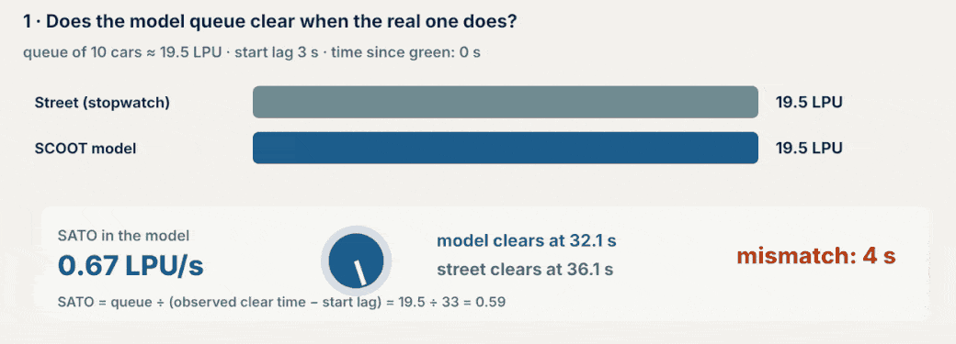
Watch: Validating SATO with a stopwatch
NOTICE 1 Grey bar = the real queue; blue bar = SCOOT's model queue.
NOTICE 2 With SATO 0.67 the model clears 4 s early.
NOTICE 3 Turning SATO down to 0.59 makes the two clear together.
Notes:
Play the animation once without talking, then once while pointing out each notice.
1. Grey bar = the real queue; blue bar = SCOOT's model queue.
2. With SATO 0.67 the model clears 4 s early.
3. Turning SATO down to 0.59 makes the two clear together.
Source: Validation = calibrating the model to the street: DfT Traffic Advisory Leaflet 7/99; journey time and max queue clear time as key parameters: Davies; procedures in the SCOOT Traffic Handbook (TRID 457437).

Slide 30
Worked example: Correcting SATO on link N3A
SATO = queue (LPU) ÷ (observed clear time − start lag)
Queue of 10 cars ≈ 19.5 LPU. Start lag 3 s. Default SATO 0.67 LPU/s. Stopwatch: the real queue clears 36 s after green starts.
1. Model clears at 3 + 19.5 ÷ 0.67 = 32.1 s.
2. Street clears at 36 s: the model is about 4 s early, so SATO is too high.
3. New SATO = 19.5 ÷ (36 − 3) = 19.5 ÷ 33 = 0.59 LPU/s.
4. Check: 3 + 19.5 ÷ 0.59 = 36.1 s, matching the street.
SATO for N3A is set to 0.59. Repeat over several cycles and at different times of day before accepting it.
Notes:
Queue clearing on N3A: street vs model before validation. What to notice: with the default SATO the model's queue (gold) empties 4 s before the real one. After setting SATO to 0.59 the two lines lie on top of each other.
Try it with the audience: A 15 LPU queue clears 28 s after green. Start lag 3 s. What is SATO?
Answer: 15 ÷ (28 − 3) = 15 ÷ 25 = 0.60 LPU/s.

Slide 31
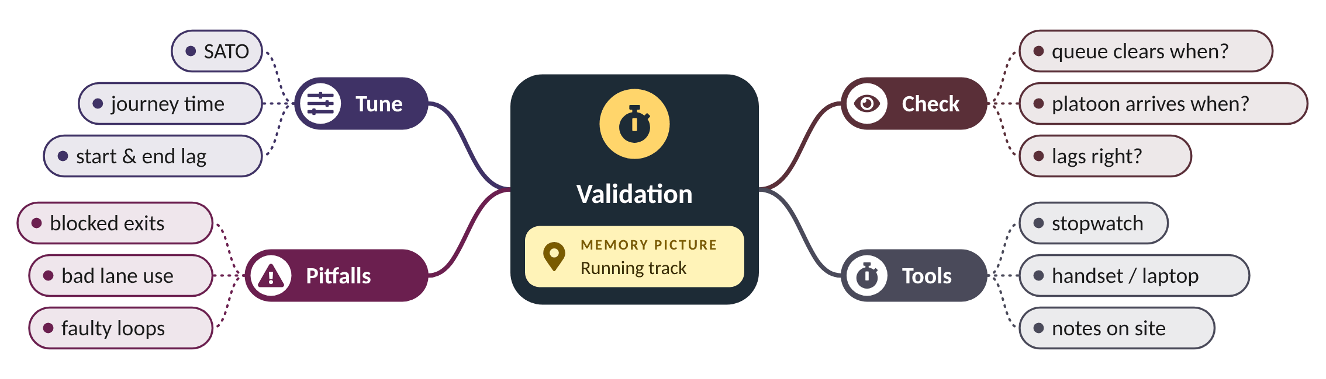
Remember it: Validation
PICTURE THIS · STOP 6: RUNNING TRACK
TRAP
On a running track, engineers with stopwatches race a robot queue. The robot always finishes 4 seconds early, until an engineer turns the dial on its back from 0.67 down to 0.59. Now they cross the line together.
Never validate on a day with road works, an incident or a blocked exit. You would tune the model to an unusual day and it would be wrong on every normal day.
Notes:
What the scene encodes: Race = model vs street; 4 s early = SATO too high; dial 0.67 → 0.59 = the validated SATO.
Recap: Validation: watch real and model queues together and tune SATO, journey time and lags until they match.

Slide 32
7 Commission, fine-tune and evaluate
IN PLAIN WORDS
Commissioning is like the first weeks in a new house. You move in (switch on), fix the doors that stick (fine-tune), and check the heating bill against the old house (after study).
Switch on region by region, fallback ready
Fine-tune: gating, bus priority, congestion links
After study on the same routes and times
Keep checking loops and re-validating
13–15%
shorter peak journeys in Riverside (illustrative)
Source: Gating: DfT TAL 7/00; bus priority: DfT TAL 8/00; congestion and importance factors, ASTRID/INGRID: DfT Traffic Advisory Leaflet 7/99.
Notes:
Switch-on day is not the finish line. What does an engineer do in the weeks after SCOOT goes live, and how do they prove it worked?
Switch SCOOT on region by region and watch it closely, with the old fixed plans ready as a fallback. Wait until traffic has settled before judging it.
Fine-tune with SCOOT's extra features where needed: gating holds traffic back to protect a sensitive area (TAL 7/00), bus priority extends or recalls green for detected buses (TAL 8/00), and congestion settings help links that block back.
Finally run the after study: the same routes, days and times as the before study, so the comparison is fair. Keep maintaining: faulty loops and changed roads mean re-validation.
Presenter tip: Close the loop with step 1: did the scheme deliver the payback we promised?

Slide 33
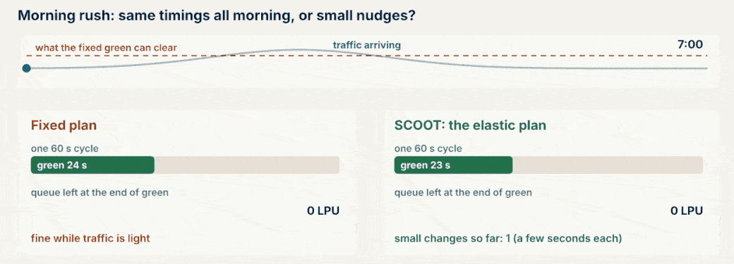
Watch: The elastic plan after switch-on
NOTICE 1 The timings now stretch with demand instead of staying fixed.
NOTICE 2 Changes are small and frequent, so the network never jumps.
NOTICE 3 This is what the after study measures.
Notes:
Play the animation once without talking, then once while pointing out each notice.
1. The timings now stretch with demand instead of staying fixed.
2. Changes are small and frequent, so the network never jumps.
3. This is what the after study measures.
Source: Gating: DfT TAL 7/00; bus priority: DfT TAL 8/00; congestion and importance factors, ASTRID/INGRID: DfT Traffic Advisory Leaflet 7/99.

Slide 34
Worked example: Riverside's after study
journey-time saving % = (before − after) ÷ before × 100
Same corridor, same weekdays, 12 runs each. Mean journey time AM peak: 6.0 min before, 5.2 min after. PM peak: 6.6 min before, 5.6 min after.
1. AM saving = (6.0 − 5.2) ÷ 6.0 = 0.8 ÷ 6.0 = 13.3%.
2. PM saving = (6.6 − 5.6) ÷ 6.6 = 1.0 ÷ 6.6 = 15.2%.
3. Both sit within the 12–20% range in TAL 7/99.
4. Report both, with the number of runs, not just the better one.
Riverside's journeys are about 13–15% shorter at the peaks: the feasibility estimate in step 1 was reasonable.
Notes:
Riverside before/after journey times (min, illustrative). What to notice: both peaks improve. Comparing the same routes and times is what makes the comparison fair.
Try it with the audience: Before 8.0 min, after 7.0 min. What is the saving?
Answer: (8.0 − 7.0) ÷ 8.0 = 12.5%.

Slide 35
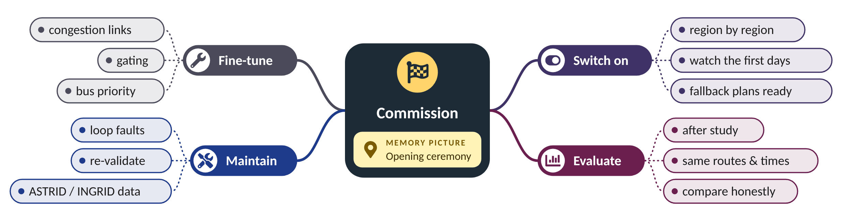
Remember it: Commission
PICTURE THIS · STOP 7: OPENING CEREMONY
TRAP
At the opening ceremony giant scissors cut a ribbon of traffic lights. A scoreboard flips from 6.0 to 5.2, and a mechanic in overalls keeps tightening bolts on the lights long after the crowd has gone home.
An after study on a quiet August day compared with a before study in busy November proves nothing. Match the season, weekday and time, and count enough runs.
Notes:
What the scene encodes: Ribbon = switch-on; scoreboard = before/after study; the mechanic = fine-tuning and maintenance that never stop.
Recap: Commission: switch on carefully, fine-tune (gating, bus priority, congestion), run a fair after study and keep maintaining.

Slide 36
Practical questions
Fourteen questions engineers ask: detectors, siting, scheme size, data, standards, sources, mistakes, stages, cycle limits, failures, congestion, alternatives, team, report.

Slide 37

Which kind of detector, and why?
SCOOT needs to know, several times a second, whether a vehicle is over one spot on each link. Any detector that can do that reliably will work; loops are the reference.
Detector | How it senses | Why use it for SCOOT | Watch out for
Inductive loop (cut into the road) | a vehicle's metal changes the loop's inductance | SCOOT was designed around loops: steady presence and occupancy at a fixed spot | lane closures to cut and repair; broken by road works
Magnetometer (core-drilled stud) | change in the Earth's magnetic field | wireless and quick to fit; adopted at over 1,000 TfL junctions, including SCOOT | battery life; must give loop-like occupancy
Radar / microwave (above ground) | reflected radio waves | no road cutting; TRL has tested radar for SCOOT | motion-only types miss stopped vehicles (TAL 16/99)
Video camera | image processing of drawn zones | many lanes from one pole; can also count turns | accuracy drops at night, in rain and low sun
Bus detection (AVL, transponder) | the bus reports where it is | needed for bus priority (TAL 8/00) | only equipped buses are seen
Sources: TRL PPR087; TAL 16/99; JCT Symposium 2019 (magnetometers); TTI report 0-5845-1; TAL 8/00.
Notes:
Which kind of detector, and why?
SCOOT needs to know, several times a second, whether a vehicle is over one spot on each link. Any detector that can do that reliably will work; loops are the reference.
- Inductive loop (cut into the road) | a vehicle's metal changes the loop's inductance | SCOOT was designed around loops: steady presence and occupancy at a fixed spot | lane closures to cut and repair; broken by road works
- Magnetometer (core-drilled stud) | change in the Earth's magnetic field | wireless and quick to fit; adopted at over 1,000 TfL junctions, including SCOOT | battery life; must give loop-like occupancy
- Radar / microwave (above ground) | reflected radio waves | no road cutting; TRL has tested radar for SCOOT | motion-only types miss stopped vehicles (TAL 16/99)
- Video camera | image processing of drawn zones | many lanes from one pole; can also count turns | accuracy drops at night, in rain and low sun
- Bus detection (AVL, transponder) | the bus reports where it is | needed for bus priority (TAL 8/00) | only equipped buses are seen
Sources: TRL PPR087; TAL 16/99; JCT Symposium 2019 (magnetometers); TTI report 0-5845-1; TAL 8/00.

Slide 38







Where exactly does each detector go?
The rule is the same everywhere: give the model warning, and keep the time from detector to stop line consistent. Special layouts need special answers.
Normal link
Short link
Stop-line detector
At the upstream end, 8–15 s before the stop line (never under about 6 s), often just past the upstream junction's exit.
If the junction upstream is close, put the loop on its exit: the warning is short but still useful.
Where upstream siting is impossible: 0–20 m from the stop line, with the link journey time set to zero.
Poor lane discipline
Bus detector
Avoid
With very poor lane use or a short flare, the loop can go downstream of the junction instead.
Far enough upstream that SCOOT can extend or recall the green before the bus arrives (TAL 8/00).
Bus stops, parking and loading bays, side-road entries and lane changes between loop and stop line; keep cable runs short.
Sources: Davies (SCOOT design principles); TAL 7/99; TAL 8/00; FDOT (2016).
Notes:
Where exactly does each detector go?
The rule is the same everywhere: give the model warning, and keep the time from detector to stop line consistent. Special layouts need special answers.
- Normal link: At the upstream end, 8–15 s before the stop line (never under about 6 s), often just past the upstream junction's exit.
- Short link: If the junction upstream is close, put the loop on its exit: the warning is short but still useful.
- Stop-line detector: Where upstream siting is impossible: 0–20 m from the stop line, with the link journey time set to zero.
- Poor lane discipline: With very poor lane use or a short flare, the loop can go downstream of the junction instead.
- Bus detector: Far enough upstream that SCOOT can extend or recall the green before the bus arrives (TAL 8/00).
- Avoid: Bus stops, parking and loading bays, side-road entries and lane changes between loop and stop line; keep cable runs short.
Sources: Davies (SCOOT design principles); TAL 7/99; TAL 8/00; FDOT (2016).

Slide 39






How many signals should the scheme include, and how do I choose?
Start from the problem, then follow the traffic: include every signal whose platoons reach the next one.
Start with the problem
Follow the platoons
Count the crossings
Use the before study: which routes and junctions have the worst delay and the most variable traffic?
Include neighbouring signals close enough for platoons to matter. Junctions about 1 km or more apart are often better on MOVA (TAL 7/99).
Pedestrian crossings on the routes become SCOOT nodes too; many can double-cycle.
Group into regions
Check the hardware
Riverside's answer
Clusters that should share a cycle form regions (step 3); long links make the boundaries.
Each signal needs a suitable controller and a communication link to the UTC centre.
8 junctions + 2 crossings = 10 nodes, 2 regions, 30 links, 36 loops.
Sources: TAL 7/99; FHWA-HOP-11-027 (define the scope in a concept of operations).
Notes:
How many signals should the scheme include, and how do I choose?
Start from the problem, then follow the traffic: include every signal whose platoons reach the next one.
- Start with the problem: Use the before study: which routes and junctions have the worst delay and the most variable traffic?
- Follow the platoons: Include neighbouring signals close enough for platoons to matter. Junctions about 1 km or more apart are often better on MOVA (TAL 7/99).
- Count the crossings: Pedestrian crossings on the routes become SCOOT nodes too; many can double-cycle.
- Group into regions: Clusters that should share a cycle form regions (step 3); long links make the boundaries.
- Check the hardware: Each signal needs a suitable controller and a communication link to the UTC centre.
- Riverside's answer: 8 junctions + 2 crossings = 10 nodes, 2 regions, 30 links, 36 loops.
Sources: TAL 7/99; FHWA-HOP-11-027 (define the scope in a concept of operations).

Slide 40

What traffic data should be collected?
Collect what the model needs (step 5), what validation checks (step 6) and what the before and after studies compare (steps 1 and 7).
Data | How | Used for | Step
Turning counts, 15-min, peak and off-peak | manual or video counts | flow ratios Y, regions, stages | 2–3
Saturation flows | stopwatch at the stop line | capacity; starting value for SATO | 2, 6
Link journey (cruise) times | stopwatch or GPS runs | journey time in the database; offsets | 2, 5
Queue lengths and clear times | watch the back of the queue | max queue clear time; validation | 5–6
Route journey times, before and after | floating-car runs, same days and times | the benefit of the scheme | 1, 7
Bus routes, stops and frequencies | operators' timetables, site visits | bus priority; loop siting | 4, 7
Pedestrian demand at crossings | counts, push-button use | double cycling; pedestrian stages | 3
Lane use, parking, loading | site visits, photos | where loops can and cannot go | 4
Sources: TRID 186642 (practical implementation of SCOOT); TAL 7/99; Traffic Signs Manual Ch. 6.
Notes:
What traffic data should be collected?
Collect what the model needs (step 5), what validation checks (step 6) and what the before and after studies compare (steps 1 and 7).
- Turning counts, 15-min, peak and off-peak | manual or video counts | flow ratios Y, regions, stages | 2–3
- Saturation flows | stopwatch at the stop line | capacity; starting value for SATO | 2, 6
- Link journey (cruise) times | stopwatch or GPS runs | journey time in the database; offsets | 2, 5
- Queue lengths and clear times | watch the back of the queue | max queue clear time; validation | 5–6
- Route journey times, before and after | floating-car runs, same days and times | the benefit of the scheme | 1, 7
- Bus routes, stops and frequencies | operators' timetables, site visits | bus priority; loop siting | 4, 7
- Pedestrian demand at crossings | counts, push-button use | double cycling; pedestrian stages | 3
- Lane use, parking, loading | site visits, photos | where loops can and cannot go | 4
Sources: TRID 186642 (practical implementation of SCOOT); TAL 7/99; Traffic Signs Manual Ch. 6.

Slide 41

Which references and standards, and why?
Use UK SCOOT guidance for how SCOOT works, a systems-engineering guide for planning the project, and your own national rules for what is legal and safe.
Document | Why use it
DfT TAL 7/99: The SCOOT UTC system | the official overview: regions, detectors, optimisers, validation, benefits
DfT TAL 7/00 and 8/00 | how to design gating and bus priority
DfT TAL 16/99 (and spec. TR 2123) | rules for above-ground detectors
Traffic Signs Manual Ch. 6 (2019) | UK practice for signal junctions, UTC and detection
SCOOT Traffic Handbook (TRL, with the licence) | the detailed database and validation procedures
FHWA-HOP-11-027 (2012) | templates: concept of operations, requirements, verification and validation plans
NCHRP Synthesis 403 (2010) | lessons from agencies that deployed adaptive control
Your national / city signal manual | local law and safety rules (intergreens, pedestrian times) come first
Full details in the reference list at the end of the deck.
Notes:
Which references and standards, and why?
Use UK SCOOT guidance for how SCOOT works, a systems-engineering guide for planning the project, and your own national rules for what is legal and safe.
- DfT TAL 7/99: The SCOOT UTC system | the official overview: regions, detectors, optimisers, validation, benefits
- DfT TAL 7/00 and 8/00 | how to design gating and bus priority
- DfT TAL 16/99 (and spec. TR 2123) | rules for above-ground detectors
- Traffic Signs Manual Ch. 6 (2019) | UK practice for signal junctions, UTC and detection
- SCOOT Traffic Handbook (TRL, with the licence) | the detailed database and validation procedures
- FHWA-HOP-11-027 (2012) | templates: concept of operations, requirements, verification and validation plans
- NCHRP Synthesis 403 (2010) | lessons from agencies that deployed adaptive control
- Your national / city signal manual | local law and safety rules (intergreens, pedestrian times) come first
Full details in the reference list at the end of the deck.

Slide 42






Simple sources to start implementing
You can learn and test most of the design before touching a real road.
Free UK leaflets
Traffic Signs Manual Ch. 6
FHWA ASCT model documents
DfT Traffic Advisory Leaflets (7/99, 7/00, 8/00, 16/99) are free on gov.uk.
Free from gov.uk; read sections 9.5 (UTC) and 10 (Detection).
Fill-in templates for scoping and specifying an adaptive signal project.
SUMO simulation
This lab's animations
Supplier training
Free, open-source traffic simulator; this lab's SUMO labs F1–F3 test fixed, actuated and SCOOT-style control.
The design GIFs and the junction simulation in this deck, on the course website.
Real SCOOT databases are built with TRL's licensed tools and handbook; plan training into the budget.
SUMO: eclipse.dev/sumo · Lab: smrahmanbd.github.io/scoot-learning-lab
Notes:
Simple sources to start implementing
You can learn and test most of the design before touching a real road.
- Free UK leaflets: DfT Traffic Advisory Leaflets (7/99, 7/00, 8/00, 16/99) are free on gov.uk.
- Traffic Signs Manual Ch. 6: Free from gov.uk; read sections 9.5 (UTC) and 10 (Detection).
- FHWA ASCT model documents: Fill-in templates for scoping and specifying an adaptive signal project.
- SUMO simulation: Free, open-source traffic simulator; this lab's SUMO labs F1–F3 test fixed, actuated and SCOOT-style control.
- This lab's animations: The design GIFs and the junction simulation in this deck, on the course website.
- Supplier training: Real SCOOT databases are built with TRL's licensed tools and handbook; plan training into the budget.
SUMO: eclipse.dev/sumo · Lab: smrahmanbd.github.io/scoot-learning-lab

Slide 43



Common design mistakes (and how to avoid them)
Most failed adaptive schemes did not fail because of the software.
Skipping validation
Loops in the wrong place
No maintenance plan
An unvalidated model times the lights for an imaginary town. Budget days on street for every link.
Too close, before a bus stop, or across three lanes. Site them by seconds and check on street.
Many adaptive systems were switched off early for lack of staff and money (FHWA-HOP-11-027).
Unfair before/after
Forgetting pedestrians
One giant region
Different season or weekday makes the result meaningless. Match days, times and routes.
Crossings are nodes too, and pedestrian times are safety rules, not options.
Forcing far-apart clusters onto one cycle makes the quiet ones wait. Split at long links.
Sources: FHWA-HOP-11-027; TAL 7/99; Stevanovic (2010) NCHRP Synthesis 403.
Notes:
Common design mistakes (and how to avoid them)
Most failed adaptive schemes did not fail because of the software.
- Skipping validation: An unvalidated model times the lights for an imaginary town. Budget days on street for every link.
- Loops in the wrong place: Too close, before a bus stop, or across three lanes. Site them by seconds and check on street.
- No maintenance plan: Many adaptive systems were switched off early for lack of staff and money (FHWA-HOP-11-027).
- Unfair before/after: Different season or weekday makes the result meaningless. Match days, times and routes.
- Forgetting pedestrians: Crossings are nodes too, and pedestrian times are safety rules, not options.
- One giant region: Forcing far-apart clusters onto one cycle makes the quiet ones wait. Split at long links.
Sources: FHWA-HOP-11-027; TAL 7/99; Stevanovic (2010) NCHRP Synthesis 403.

Slide 44





Stages, phases and the controller
SCOOT decides when to change stage; the street controller decides what is safe. Design both together.
Define the stages
Safety stays local
Pedestrian stages
List each node's stages and their order, and which links feed each stage. This goes into the database.
Minimum greens and intergreens are set in the controller; SCOOT cannot shorten them.
Size crossing times from your local manual's walking speed (TSM Ch. 6 in the UK); demand-dependent stages run only when called.
Min and max greens
Fallback plans
Check on site
Give every stage a minimum (safety, pedestrians) and a sensible maximum, so no movement waits forever.
Every controller keeps a local plan (fixed time or VA) to run if it loses contact with the centre.
Before switch-on, test that each stage request from the centre gives the expected lights.
Sources: TAL 7/99; DfT Traffic Signs Manual Ch. 6 (2019).
Notes:
Stages, phases and the controller
SCOOT decides when to change stage; the street controller decides what is safe. Design both together.
- Define the stages: List each node's stages and their order, and which links feed each stage. This goes into the database.
- Safety stays local: Minimum greens and intergreens are set in the controller; SCOOT cannot shorten them.
- Pedestrian stages: Size crossing times from your local manual's walking speed (TSM Ch. 6 in the UK); demand-dependent stages run only when called.
- Min and max greens: Give every stage a minimum (safety, pedestrians) and a sensible maximum, so no movement waits forever.
- Fallback plans: Every controller keeps a local plan (fixed time or VA) to run if it loses contact with the centre.
- Check on site: Before switch-on, test that each stage request from the centre gives the expected lights.
Sources: TAL 7/99; DfT Traffic Signs Manual Ch. 6 (2019).

Slide 45



Cycle limits, pedestrians and cyclists
The cycle optimiser works inside limits that you set. Those limits are where people on foot and on bikes are protected.
Minimum cycle
Maximum cycle
Double cycling
Long enough for every stage's minimum green, including the pedestrian stages.
Short enough that pedestrians and side roads do not wait too long, and queues fit in the road space.
Crossings and quiet nodes can run twice per region cycle, halving pedestrian waits (TAL 7/99).
Walking speed
Cycle detection
Newer SCOOT
Use the design walking speed from your own standard (UK: TSM Ch. 6) for crossing times.
Bicycles can be detected (for example by in-ground radar) where they need their own stage.
SCOOT 7 is aimed at multi-modal networks: cycling, walking, public transport (TRL Software).
Sources: TAL 7/99; Traffic Signs Manual Ch. 6; TRL Software, SCOOT version history; JCT Symposium 2019.
Notes:
Cycle limits, pedestrians and cyclists
The cycle optimiser works inside limits that you set. Those limits are where people on foot and on bikes are protected.
- Minimum cycle: Long enough for every stage's minimum green, including the pedestrian stages.
- Maximum cycle: Short enough that pedestrians and side roads do not wait too long, and queues fit in the road space.
- Double cycling: Crossings and quiet nodes can run twice per region cycle, halving pedestrian waits (TAL 7/99).
- Walking speed: Use the design walking speed from your own standard (UK: TSM Ch. 6) for crossing times.
- Cycle detection: Bicycles can be detected (for example by in-ground radar) where they need their own stage.
- Newer SCOOT: SCOOT 7 is aimed at multi-modal networks: cycling, walking, public transport (TRL Software).
Sources: TAL 7/99; Traffic Signs Manual Ch. 6; TRL Software, SCOOT version history; JCT Symposium 2019.

Slide 46

Communications, and what happens when things fail
SCOOT is centralised, so the design must say what happens when a loop, a cable or the computer fails.
Failure | What happens | Design for it
Loop stops working | fault monitoring flags the loop; that link's model loses its input | fault reports checked daily; repair contracts with fast response
Loop damaged by road works | wrong or missing counts until repaired | agree a process with street works teams; re-validate after
Comms link lost | the controller cannot hear the centre | each controller holds a local fallback plan
Central computer down | every node loses SCOOT control | standby computer or server; fallback plans everywhere
Road layout changed | the database no longer describes the street | update the database and re-validate the links
Sources: TAL 7/99 (fault monitoring, communications, central processor).
Notes:
Communications, and what happens when things fail
SCOOT is centralised, so the design must say what happens when a loop, a cable or the computer fails.
- Loop stops working | fault monitoring flags the loop; that link's model loses its input | fault reports checked daily; repair contracts with fast response
- Loop damaged by road works | wrong or missing counts until repaired | agree a process with street works teams; re-validate after
- Comms link lost | the controller cannot hear the centre | each controller holds a local fallback plan
- Central computer down | every node loses SCOOT control | standby computer or server; fallback plans everywhere
- Road layout changed | the database no longer describes the street | update the database and re-validate the links
Sources: TAL 7/99 (fault monitoring, communications, central processor).

Slide 47




Congestion, incidents and special features
SCOOT works best below saturation. For the busy edges of the day it has extra tools; design which ones you need.
Oversaturation
Gating
Bus priority
When demand exceeds capacity every adaptive system struggles (FDOT 2016). Decide where the queues should be.
Hold traffic back at chosen links to protect a sensitive area or a bus route (TAL 7/00).
Extend or recall green for detected buses (TAL 8/00).
Congestion settings
ASTRID and INGRID
Emissions
Congestion offsets and importance factors favour links that block back (TAL 7/99).
ASTRID stores SCOOT's data for reports; INGRID helps detect incidents (TAL 7/99).
SCOOT can estimate vehicle emissions from its model (TAL 9/00).
Sources: TAL 7/99, 7/00, 8/00, 9/00; FDOT (2016).
Notes:
Congestion, incidents and special features
SCOOT works best below saturation. For the busy edges of the day it has extra tools; design which ones you need.
- Oversaturation: When demand exceeds capacity every adaptive system struggles (FDOT 2016). Decide where the queues should be.
- Gating: Hold traffic back at chosen links to protect a sensitive area or a bus route (TAL 7/00).
- Bus priority: Extend or recall green for detected buses (TAL 8/00).
- Congestion settings: Congestion offsets and importance factors favour links that block back (TAL 7/99).
- ASTRID and INGRID: ASTRID stores SCOOT's data for reports; INGRID helps detect incidents (TAL 7/99).
- Emissions: SCOOT can estimate vehicle emissions from its model (TAL 9/00).
Sources: TAL 7/99, 7/00, 8/00, 9/00; FDOT (2016).

Slide 48
SCOOT or something else?
SCOOT is one option. A good design report says why it beats the alternatives for this network.
Option | Best when | Less good when
Fixed-time plans (UTC) | traffic is regular and plans are kept up to date | traffic varies; plans age about 3% a year
VA or MOVA | isolated junctions, about 1 km or more apart (TAL 7/99) | closely spaced junctions that need coordinating
SCATS | stop-line detection is preferred; distributed control | you want the link model and upstream warning
SCOOT | close junctions, variable traffic, reliable comms | heavy oversaturation; no budget for upkeep
Sources: TAL 7/99; FDOT (2016); this lab's SCATS course.
Notes:
SCOOT or something else?
SCOOT is one option. A good design report says why it beats the alternatives for this network.
- Fixed-time plans (UTC) | traffic is regular and plans are kept up to date | traffic varies; plans age about 3% a year
- VA or MOVA | isolated junctions, about 1 km or more apart (TAL 7/99) | closely spaced junctions that need coordinating
- SCATS | stop-line detection is preferred; distributed control | you want the link model and upstream warning
- SCOOT | close junctions, variable traffic, reliable comms | heavy oversaturation; no budget for upkeep
Sources: TAL 7/99; FDOT (2016); this lab's SCATS course.

Slide 49

Who does what, and in what order?
A SCOOT scheme is a team project. FHWA advises writing a concept of operations first, so everyone agrees what the system is for.
Phase | Main tasks | People
Plan (step 1) | before study, business case, concept of operations | client, traffic planner
Design (steps 2–5) | survey, regions, loop drawings, database | traffic signal engineer
Build | cut loops, cables, outstations, comms | contractor, signal technicians
Validate (step 6) | stopwatch checks link by link | engineer + technician on site
Operate (step 7) | switch-on, after study, faults, re-validation | UTC operators, maintainers
Sources: FHWA-HOP-11-027 (2012); TAL 7/99.
Notes:
Who does what, and in what order?
A SCOOT scheme is a team project. FHWA advises writing a concept of operations first, so everyone agrees what the system is for.
- Plan (step 1) | before study, business case, concept of operations | client, traffic planner
- Design (steps 2–5) | survey, regions, loop drawings, database | traffic signal engineer
- Build | cut loops, cables, outstations, comms | contractor, signal technicians
- Validate (step 6) | stopwatch checks link by link | engineer + technician on site
- Operate (step 7) | switch-on, after study, faults, re-validation | UTC operators, maintainers
Sources: FHWA-HOP-11-027 (2012); TAL 7/99.

Slide 50



What goes in the design report?
If another engineer can rebuild your design from the report, it is complete.
Network inventory
Region diagram
Loop drawings
Every node: lanes, stages, intergreens, controller, cabinet location.
Regions, critical nodes, double-cycled nodes, links and their numbers.
Each loop's position, size and lanes, with its journey time to the stop line.
Database sheets
Validation records
Before/after report
Link and stage data: journey times, max queue clear times, lags, SATO.
Who, when, what was measured, what was changed on each link.
Routes, days, number of runs, results and honest limitations.
Sources: TRID 186642; TAL 7/99; FHWA-HOP-11-027.
Notes:
What goes in the design report?
If another engineer can rebuild your design from the report, it is complete.
- Network inventory: Every node: lanes, stages, intergreens, controller, cabinet location.
- Region diagram: Regions, critical nodes, double-cycled nodes, links and their numbers.
- Loop drawings: Each loop's position, size and lanes, with its journey time to the stop line.
- Database sheets: Link and stage data: journey times, max queue clear times, lags, SATO.
- Validation records: Who, when, what was measured, what was changed on each link.
- Before/after report: Routes, days, number of runs, results and honest limitations.
Sources: TRID 186642; TAL 7/99; FHWA-HOP-11-027.

Slide 51
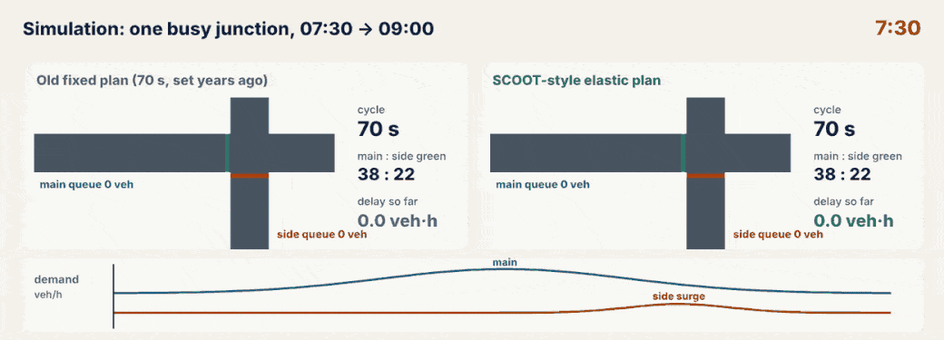
Simulation: one busy junction, old plan vs SCOOT-style plan
NOTICE 1 Demand on the main road peaks at 08:15; a side-road surge follows at 08:35.
NOTICE 2 The old 70 s plan cannot change, so queues build at both peaks.
NOTICE 3 The elastic plan shortens the cycle when it is quiet and shifts green to the side road during its surge.
Notes:
Play the animation once without talking, then once while pointing out each notice.
1. Demand on the main road peaks at 08:15; a side-road surge follows at 08:35.
2. The old 70 s plan cannot change, so queues build at both peaks.
3. The elastic plan shortens the cycle when it is quiet and shifts green to the side road during its surge.
Source: A simplified teaching model of SCOOT's ideas, not TRL's SCOOT. One isolated junction with a surge gains more than a whole network usually does (about 12–20% in TAL 7/99).

Slide 52
What the simulation shows
32% less delay
15.8 → 10.7 veh·h · 20.2 → 13.6 s per vehicle
› One junction, two stages, 90 minutes, simulated second by second (a fluid queue model).
› Old plan: 70 s cycle, green 38 s main : 22 s side, never changed.
› Elastic plan: splits move up to 4 s per cycle; the cycle is reviewed every 5 min (2.5 min while rising) towards 90% saturation.
› Result: 15.8 → 10.7 veh·h of delay; mean 20.2 → 13.6 s per vehicle.
HONEST NOTE A simplified teaching model of SCOOT's ideas, not TRL's SCOOT. One isolated junction with a surge gains more than a whole network usually does (about 12–20% in TAL 7/99).
Notes:
One junction, two stages, 90 minutes, simulated second by second (a fluid queue model).
Old plan: 70 s cycle, green 38 s main : 22 s side, never changed.
Elastic plan: splits move up to 4 s per cycle; the cycle is reviewed every 5 min (2.5 min while rising) towards 90% saturation.
Result: 15.8 → 10.7 veh·h of delay; mean 20.2 → 13.6 s per vehicle.
A simplified teaching model of SCOOT's ideas, not TRL's SCOOT. One isolated junction with a surge gains more than a whole network usually does (about 12–20% in TAL 7/99).

Slide 53
The design checklist on one page
Step | You collect | You decide | You hand on
1 Feasibility | before-study delay, costs | go / no go, scheme area | baseline, budget
2 Survey | maps, counts, s, journey times | what each node is | network inventory
3 Regions | node flows (Y), link lengths | regions, critical nodes, double cycling | region & node list
4 Detectors | lanes, speeds, kerb features | link list, loop positions | loop drawings
5 UTC & data | cable routes, controller types | comms, database values | first-guess database
6 Validation | stopwatch times on street | SATO, lags, journey times | validated model
7 Commission | after-study journey times | tuning features, maintenance | results report

Slide 54
Things beginners mix up
This… | …is not this | The fact that tells them apart
Region | Node | A node is one junction or crossing; a region is a group of nodes sharing one cycle.
Saturation flow s | SATO | s is vehicles per hour of green; SATO is SCOOT's version in LPU per second, set by validation.
Distance | Journey time | Loops are placed by seconds (8–15 s); metres depend on the street's speed.
Commissioning | Validation | Validation tunes each link's model; commissioning switches the system on and checks it.
Critical node | Biggest junction | It is the node needing the longest cycle (highest Y), not the one with most lanes.

Slide 55
Check yourself (1 of 2)
Two nodes need 60 s and 90 s cycles, 900 m apart. What is sensible?
At 48 km/h (13.3 m/s), which loop position is in the ideal zone?
A. One region at 60 s
B. One region at 90 s
C. Two regions, split at the long link
D. Turn SCOOT off at one node
A. 30 m from the stop line
B. 70 m
C. 160 m
D. At the stop line
Answers are in the speaker notes.
Notes:
Answer: C. A long link is a natural boundary; each region keeps the cycle its critical node needs.
Answer: C. 160 ÷ 13.3 = 12 s, inside 8–15 s. 30 m and 70 m give under 6 s.

Slide 56
Check yourself (2 of 2)
A 3-lane approach needs how many SCOOT loops?
Before 7.5 min, after 6.6 min on the same route and time. The saving is:
A. 1
B. 2
C. 3
D. 6
A. 9%
B. 12%
C. 14%
D. 0.9%
Answers are in the speaker notes.
Notes:
Answer: B. Each loop covers at most two lanes: lanes 1–2 share one, lane 3 gets its own.
Answer: B. (7.5 − 6.6) ÷ 7.5 = 0.12, so 12%.

Slide 57
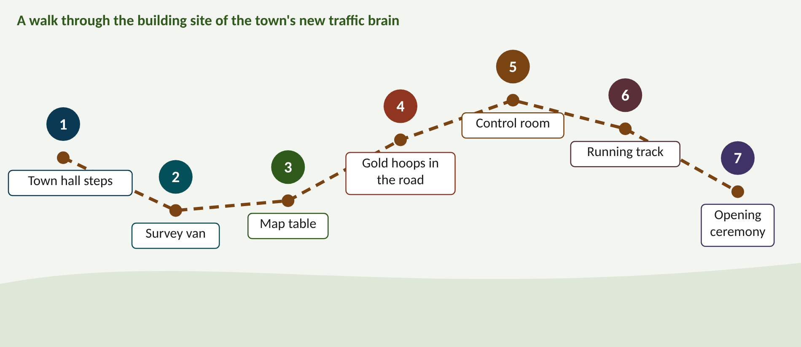
Walk the memory route
1 Town hall steps = Feasibility · 2 Survey van = Survey · 3 Map table = Regions · 4 Gold hoops in the road = Detectors · 5 Control room = UTC & database · 6 Running track = Validation · 7 Opening ceremony = Commission
Notes:
Stop 1, Town hall steps: On the town hall steps sits a giant piggy bank with a 20% slice cut out like a cake. Every year the mayor must feed it 3 coins or it goes stale and smelly. (Piggy bank = money case; 20% slice = saving vs typical plans; 3 coins a year = plans age about 3% a year.)
Stop 2, Survey van: A survey van has a giant stopwatch for a headlight. When it clicks, 15 tiny cars hop out of its door in 30 ticks, and a clipboard on the roof writes '1800'. (Stopwatch = timing; 15 cars in 30 s = 0.5 veh/s; 1800 = veh/h per lane.)
Stop 3, Map table: On a huge map table sit two jelly moulds full of junctions. In each mould a junction wearing a gold crown beats a drum, one at 60, the other at 90. A 900 m strip of liquorice keeps the moulds apart, and two tiny crossings tap twice per beat. (Jelly moulds = regions; crowned drummer = critical node and its cycle; liquorice = long-link boundary; double taps = double cycling.)
Stop 4, Gold hoops in the road: Gold hula hoops lie in the road 13 big strides before the traffic lights. Each hoop is just wide enough for two lanes, and a lookout sits in every hoop shouting 'coming!' at each car. (Hoops = loops; 13 strides = about 13 s (8–15 s zone); two lanes per hoop; the lookout = early warning.)
Stop 5, Control room: In the control room a hungry computer gobbles 144 jelly beans a second through a long straw from the street. Beside it a librarian files a recipe card for every road: '13.5 s to the stop line, 62 s to clear the queue'. (144 jelly beans = 36 loops × 4 readings/s; straw = comms; recipe cards = the link database.)
Stop 6, Running track: On a running track, engineers with stopwatches race a robot queue. The robot always finishes 4 seconds early, until an engineer turns the dial on its back from 0.67 down to 0.59. Now they cross the line together. (Race = model vs street; 4 s early = SATO too high; dial 0.67 → 0.59 = the validated SATO.)
Stop 7, Opening ceremony: At the opening ceremony giant scissors cut a ribbon of traffic lights. A scoreboard flips from 6.0 to 5.2, and a mechanic in overalls keeps tightening bolts on the lights long after the crowd has gone home. (Ribbon = switch-on; scoreboard = before/after study; the mechanic = fine-tuning and maintenance that never stop.)

Slide 58
Numbers to remember
› Savings ~12% vs fresh plans, ~20% vs typical (TAL 7/99)
› Plans age ~3% a year
› s ≈ 1800 veh/h per lane; count from vehicle 1
› Critical node target ≈ 90%; C = 0.9L ÷ (0.9 − Y)
› Loops 8–15 s upstream (≥ 6 s), 2 m, ≤ 2 lanes
› 48 km/h = 13.3 m/s: 8 s = 107 m, 15 s = 200 m
› Each loop read 4 times a second
› SATO = queue ÷ (clear time − start lag)

Slide 59
References (1 of 3)
1. Department for Transport (1999). Traffic Advisory Leaflet 7/99: The 'SCOOT' urban traffic control system. DfT, London. [steps 1, 3, 4, 5, 6, 7]
2. Department for Transport (2000). Traffic Advisory Leaflet 7/00: SCOOT gating. DfT, London. [step 7]
3. Department for Transport (2000). Traffic Advisory Leaflet 8/00: Bus priority in SCOOT. DfT, London. [step 7]
4. Department for Transport (2000). Traffic Advisory Leaflet 9/00: SCOOT estimates of emissions from vehicles. DfT, London. [practical: features]
5. DfT, DfI, Scottish Government and Welsh Government (2019). Traffic Signs Manual, Chapter 6: Traffic Control. TSO, London. Sections 9.5 (UTC) and 10 (Detection). [steps 2, 5]
6. Hunt, P.B., Robertson, D.I., Bretherton, R.D. and Winton, R.I. (1981). SCOOT: a traffic responsive method of coordinating signals. TRRL Laboratory Report LR1014. [background]
7. Robertson, D.I. and Bretherton, R.D. (1991). Optimizing networks of traffic signals in real time: the SCOOT method. IEEE Transactions on Vehicular Technology 40(1), 11–15. [background]
8. Bretherton, R.D., Wood, K. and Bowen, G.T. (1998). SCOOT Version 4. 9th International Conference on Road Transport Information and Control, IEE, London. [step 7]
9. Davies, J. Traffic signals under SCOOT control: effective design principles (practitioner paper). [steps 4, 6]
10. Department for Transport (1999). Traffic Advisory Leaflet 16/99: The use of above ground vehicle detectors. DfT, London. [practical: detectors]
Notes:
Square brackets show which design step each reference supports. The DfT leaflets and the Traffic Signs Manual are free on gov.uk.

Slide 60
References (2 of 3)
11. TRL. Published Project Report PPR087 (vehicle and pedestrian detector technologies, including SCOOT vehicle detectors). TRL, Crowthorne. [practical: detectors]
12. Clearview Intelligence (2019). The evolution of the magnetometer from traffic signals to MIDAS and beyond. JCT Traffic Signal Symposium. [practical: detectors]
13. Texas Transportation Institute (2009). Alternative vehicle detection technologies for traffic signal systems. Report 0-5845-1. [practical: detectors]
14. Fehon, K., Krueger, M., Peters, J., Denney, R., Olson, P. and Curtis, E. (2012). Model Systems Engineering Documents for Adaptive Signal Control Technology (ASCT) Systems. FHWA-HOP-11-027. [practical: scope, mistakes]
15. TRID 186642. The practical implementation of SCOOT traffic control systems. [step 2, practical: data]
16. Florida Department of Transportation (2016). Advanced Signal Control Technology, Technical Memorandum. [step 4]
17. Stevanovic, A. (2010). Adaptive Traffic Control Systems: Domestic and Foreign State of Practice. NCHRP Synthesis 403, Transportation Research Board. [steps 1, 7]
18. Stevanovic, A. and Martin, P.T. (2008). Split-Cycle Offset Optimization Technique and coordinated actuated traffic control evaluated through microsimulation. Transportation Research Record 2080, 48–56. [simulation]
19. Wood, K. (1995). Traffic restraint by SCOOT gating. WIT Transactions on the Built Environment 18. [step 7]
20. TRL Software. SCOOT version history. trlsoftware.com. [background]
Notes:
Square brackets show which design step each reference supports. The DfT leaflets and the Traffic Signs Manual are free on gov.uk.

Slide 61
References (3 of 3)
21. SCOOT Learning Lab: Foundation, Advanced and Mastery pages, SUMO labs. smrahmanbd.github.io/scoot-learning-lab. [all]
Notes:
Square brackets show which design step each reference supports. The DfT leaflets and the Traffic Signs Manual are free on gov.uk.

Slide 62
Keep going
Next: SCOOT Foundation deck (how the model works) · Design animations and simulation: smrahmanbd.github.io/scoot-learning-lab
Notes:
Point learners to the study guide for the full worked examples, quiz and revision plan, and to the website for the simulators.

