Slide 1
Three small optimisers that run a whole city's lights
SCOOT · Level 2 · Advanced
How SCOOT turns its link models into coordinated splits, offsets and cycle times, and copes with jams, buses and broken detectors.
smrahmanbd.github.io/scoot-learning-lab
Notes:
This guide continues from the Foundation guide. There you built SCOOT's model of one link: LPUs, profiles, the queue and the degree of saturation (DoS). Here you will see how SCOOT uses that model to make decisions for a whole group of junctions. You still need only school maths. There are eight ideas; each one is a small, simple rule, and the power comes from running all of them together.

Slide 2
8 ideas, each building on the last
1
Regions, nodes and double cycling
2
The split optimiser
3
The offset optimiser
40 → 17 s pedestrian wait when a 96 s crossing double cycles
88% split decisions that were 'keep' in our SUMO run
230 → 94 PI after four offset steps in the worked example
4
The cycle optimiser
5
Congestion, exit blocking and gating
6
Bus priority: extensions and recalls
40 → 88 s cycle growth in the worked peak
0.85 → 1.02 weighted DoS with 20% congestion, importance 1
22.9 s mean bus delay with priority (34.7 s without)
7
The wider SCOOT system
8
The full system on a SUMO region
2020 SCOOT 7: cooperative data and cloud-first design
−65% delay vs fixed time on the SUMO region
Notes:
Outcomes for today:
- Explain what a SCOOT region is and when a node may be double cycled.
- Run the split optimiser by hand: compare −4, 0 and +4 s by the highest DoS.
- Run the offset optimiser by hand: step ±4 s towards the lowest performance index.
- Apply the cycle optimiser's rules (90% target, 4/8/16 s steps) through a peak.
- Explain congestion importance, exit blocking and gating, and when each helps.
- Choose between a bus extension and a recall, and work out the time saved.
- Name ASTRID, INGRID and the main later SCOOT features and what they do.
- Read the SUMO comparison and ablation results honestly, including the surprises.

Slide 3
Three surprises to start
Most decisions change nothing.
The green wave is never designed.
Switching one thing off can help.
In our SUMO run the split optimiser made 846 decisions and chose 'keep the timing' 747 times, about 88%. TRL's original description says about two thirds. Doing nothing, most of the time, is a sign the plan is already about right.
Nobody tells SCOOT the best offset between two junctions. It tries 4 s earlier and 4 s later once per cycle and keeps whichever its model likes best. A few minutes later the platoons arrive on green.
In our ablation study, freezing the cycle at 60 s gave slightly lower delay (26.8 s) than full SCOOT (30.4 s). The reason teaches you why engineers set a maximum cycle for every region.

Slide 4
Words you will meet
Region | A group of junctions that all use the same cycle time, so they can be coordinated.
Node | One junction or crossing inside a region.
Stage change | The moment one stage's green ends and the next stage's starts.
DoS | Degree of saturation: how full a link's green is. SCOOT aims for 90% or less.
PI | Performance index: delay + K × stops. Lower is better.
Optimiser | A small rule that tries a few options in the model and keeps the best one.
Temporary / permanent change | A change applied to this cycle only, or stored in the plan for the future.
Critical node | The busiest junction in a region; it decides the region's cycle time.
Gating | Holding traffic back on purpose, where queues do no harm, to protect a bottleneck.
AVL / SVD | Ways to detect buses: automatic vehicle location (GPS) or a selective vehicle detector.
Notes:
You do not need to memorise these now; each is explained again when it first matters.

Slide 5
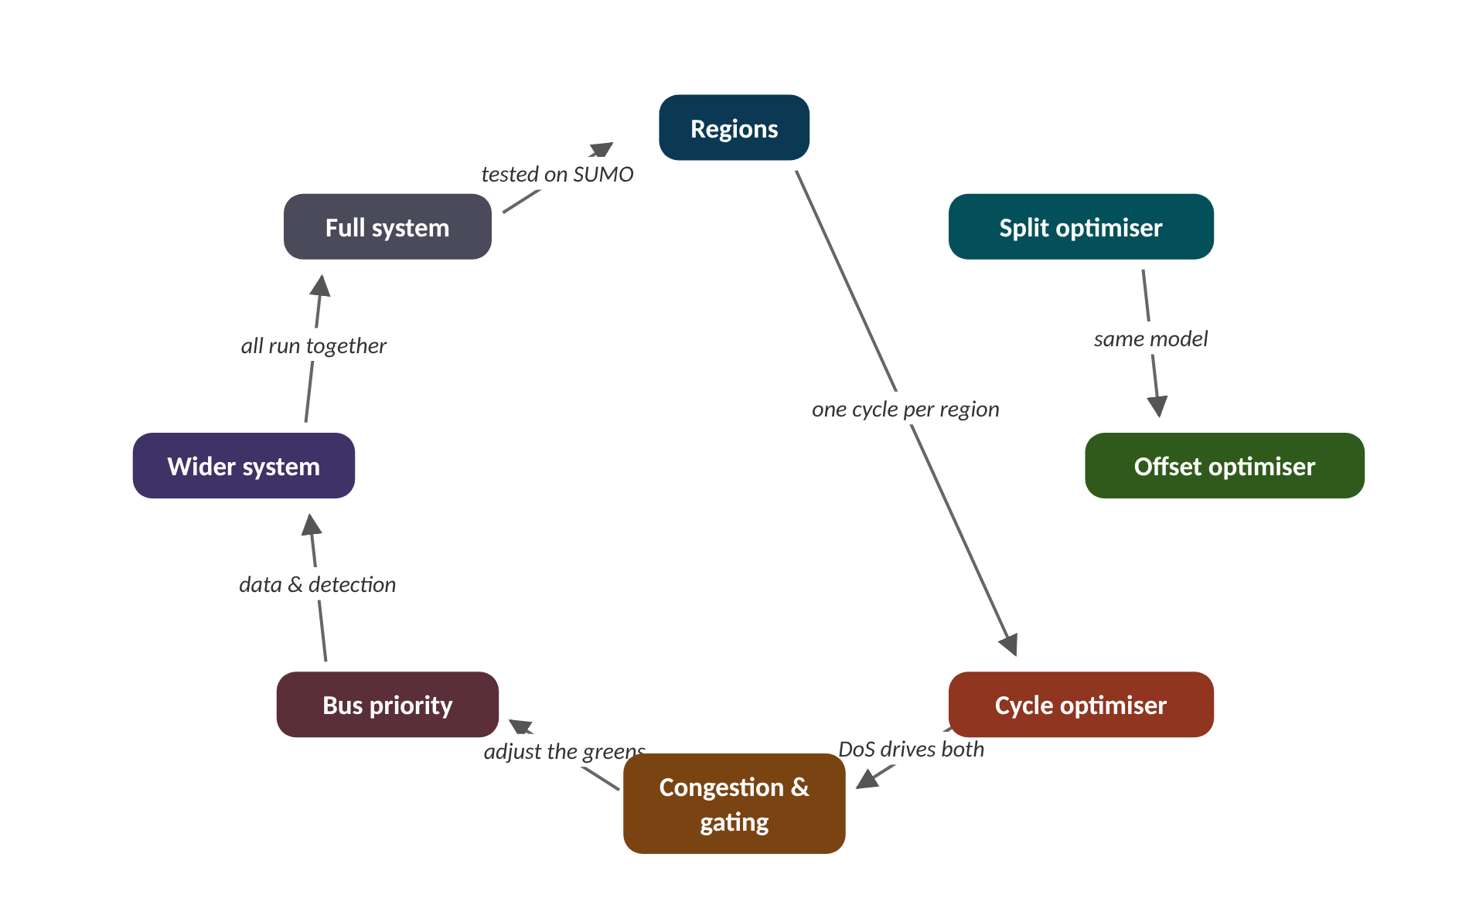
The map of today's ideas
Notes:
Each box is one idea; arrows say how one feeds the next. one cycle per region; same model; DoS drives both; adjust the greens; data & detection; all run together; tested on SUMO.

Slide 6
1 Regions, nodes and double cycling
IN PLAIN WORDS
An orchestra plays to one tempo so everyone stays together. A triangle player who has little to do can play two notes per beat and still stay in time. That is double cycling: a quiet node runs twice as fast but stays in step with its region.
A region shares one cycle time
Shared cycle makes offsets meaningful
Quiet nodes may double cycle
Only if DoS stays below 90%
40 → 17 s
pedestrian wait when a 96 s crossing double cycles
Notes:
A busy junction needs a long cycle. A quiet pedestrian crossing next to it does not. If they must share one cycle to stay coordinated, do pedestrians have to wait as long as the busy junction's traffic?
A region is a group of nodes (junctions and crossings) that all run on one common cycle time. A shared cycle is what makes offsets meaningful: if two junctions have different cycles, their greens drift apart and no green wave can last.
Region boundaries are drawn by the engineer where roads between junctions are long enough that coordination stops mattering. Unlike SCATS, SCOOT does not join or split regions on line; the boundaries are part of the design.
A lightly loaded node, often a pedestrian crossing, can be double cycled: it runs two of its own cycles for every region cycle. Pedestrians wait about half as long, and the node still keeps step with its neighbours. SCOOT allows it only if the node's DoS stays at or below its target at the shorter cycle.
Presenter tip: Use the orchestra image. Point out that region boundaries are a design decision in SCOOT, a contrast with SCATS marriage and divorce.

Slide 7
Worked example: Should this crossing double cycle?
average pedestrian wait ≈ (C − g)² ÷ 2C
double cycle allowed if DoS at C/2 ≤ 0.90
Region cycle C = 96 s. Pedestrian green g = 8 s. Vehicle demand 0.3 LPU/s, SATO 1.2 LPU/s. At C/2 = 48 s the vehicles get 30 s of effective green.
1. Wait at 96 s: (96 − 8)² ÷ (2 × 96) = 7744 ÷ 192 = 40.3 s.
2. Wait at 48 s: (48 − 8)² ÷ (2 × 48) = 1600 ÷ 96 = 16.7 s.
3. Vehicle demand per 48 s cycle: 0.3 × 48 = 14.4 LPU.
4. Capacity: 30 × 1.2 = 36 LPU. DoS = 14.4 ÷ 36 = 0.40.
5. 0.40 ≤ 0.90, so double cycling is allowed.
Double cycling cuts the average pedestrian wait from about 40 s to about 17 s while vehicles still have plenty of spare green.
Notes:
Average pedestrian wait against cycle length. What to notice: the wait grows almost in step with the cycle, so halving the cycle roughly halves the wait. Computed from (C − 8)² ÷ 2C with an 8 s pedestrian green (illustrative).
Try it with the audience: A crossing in a 120 s region has a 10 s pedestrian green. Find the average pedestrian wait at 120 s and at 60 s.
Answer: At 120 s: (120 − 10)² ÷ 240 = 12100 ÷ 240 = 50.4 s. At 60 s: (60 − 10)² ÷ 120 = 2500 ÷ 120 = 20.8 s.

Slide 8
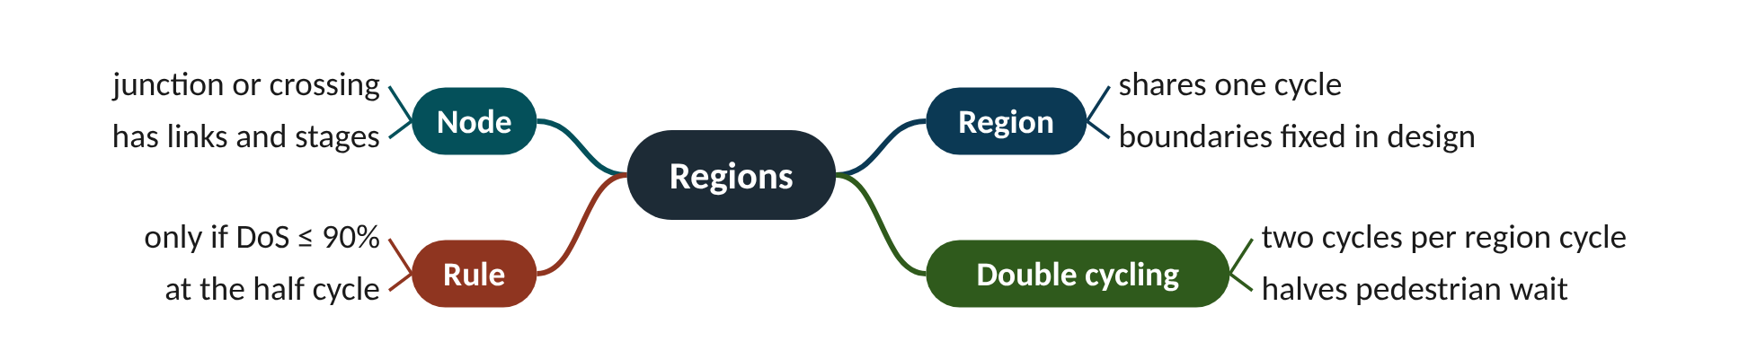
Remember it: Regions
PICTURE THIS · STOP 1: STAGE DOOR
TRAP
At the stage door the whole orchestra marches in, every foot landing on one giant metronome's tick. A tiny triangle player at the back skips two steps for every one tick, grinning, never falling out of time.
Double cycling does not give the crossing its own independent cycle. It runs exactly two cycles per region cycle, so it stays coordinated. A node with a truly different cycle would belong to another region.
Notes:
What the scene encodes: One metronome = one region cycle; the marching players = nodes; the triangle player's two steps per tick = double cycling.
Recap: Regions: nodes in a region share one cycle so offsets work; a quiet node may double cycle if its DoS stays ≤ 90% at half the cycle.

Slide 9
2 The split optimiser
IN PLAIN WORDS
Two children share a seesaw that should stay level. Every few seconds a helper may move a 4 kg bag to one side, or leave it. To remember the lesson, the helper also glues 1 kg to that side for good.
Before every stage change: −4, 0 or +4
Score each option by its worst DoS
Temporary ±4 s, permanent ±1 s
Most decisions are 'keep'
88%
split decisions that were 'keep' in our SUMO run
Notes:
Before every stage change SCOOT asks the simplest question imaginable: change now, 4 seconds earlier, or 4 seconds later? Why is such a tiny question enough?
A few seconds before every scheduled stage change, the split optimiser tries three options in the model: make the change 4 s earlier (the ending stage loses 4 s), on time, or 4 s later (the ending stage gains 4 s). Options that would break a minimum green are skipped.
For each option it predicts the DoS of every link in the ending stage and in the starting stage. The winner is the option whose highest DoS is lowest. In other words, it protects the link that is closest to overflowing.
The winning move is a temporary change: it applies to this cycle only. A permanent change of 1 s in the same direction is stored in the plan, so the plan drifts slowly towards the right split without overreacting to one noisy cycle.
Presenter tip: Run the example on the board as a three-row table. Emphasise the min-max rule: protect the worst link. Mention 747 of 846 keeps in the lab.

Slide 10
Worked example: Choose −4, 0 or +4
score(option) = highest DoS among links in both stages
DoS = demand per cycle ÷ (green × SATO)
Two stages, 60 s cycle, 50 s of green in total. Now: stage A 30 s, stage B 20 s. Demand A 24 LPU, B 10 LPU per cycle. SATO 1.0 LPU/s for both.
1. −4 (A 26, B 24): DoS A = 24 ÷ 26 = 0.92; B = 10 ÷ 24 = 0.42; highest 0.92.
2. 0 (A 30, B 20): A = 24 ÷ 30 = 0.80; B = 10 ÷ 20 = 0.50; highest 0.80.
3. +4 (A 34, B 16): A = 24 ÷ 34 = 0.71; B = 10 ÷ 16 = 0.63; highest 0.71.
4. Lowest highest DoS: +4. A runs 34 s this cycle.
5. Permanent change: stored green A goes from 30 to 31 s.
Stage A is the busier one, so SCOOT gives it 4 s more now and 1 s more for the future. If demand stays, the stored plan keeps creeping towards balance.
Notes:
Highest DoS for each option in the worked example. What to notice: the optimiser does not look for the lowest delay here, only for the option that keeps the worst link furthest from overflowing. Values from the worked example.
Try it with the audience: Same junction, but demand is A 18 LPU and B 16 LPU per cycle (A 30 s, B 20 s now). Which option wins, and what happens to the stored green A?
Answer: −4: 18/26 = 0.69, 16/24 = 0.67 → 0.69. 0: 0.60, 0.80 → 0.80. +4: 18/34 = 0.53, 16/16 = 1.00 → 1.00. −4 wins (change 4 s earlier); stored green A drops to 29 s.

Slide 11
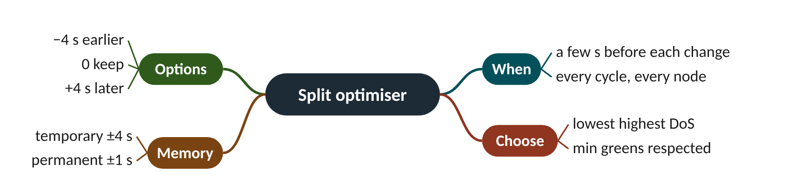
Remember it: Split optimiser
PICTURE THIS · STOP 2: SEESAW
TRAP
In the green room two singers sit on a seesaw. A stagehand stands ready with a 4 kg sandbag; every few seconds he drops it on one end, or shrugs and keeps it. Each time he also glues a single 1 kg weight to that end for ever.
'+4' does not mean 'add 4 s to every stage'. It moves one stage change 4 s later: the ending stage gains 4 s and the starting stage loses 4 s, so the cycle length stays the same.
Notes:
What the scene encodes: The 4 kg bag = the ±4 s temporary change; the glued 1 kg = the ±1 s permanent change; the shrug = 'keep', the most common decision.
Recap: Split optimiser: before each stage change try −4/0/+4 s, pick the lowest highest DoS; temporary ±4 s, permanent ±1 s.

Slide 12
3 The offset optimiser
IN PLAIN WORDS
Imagine finding the lowest point of a valley in thick fog. You can only feel the ground one step to the left and one step to the right. You step towards whichever is lower, again and again, until both sides are higher. You are at the bottom.
Once per cycle: node −4, 0 or +4
Score: PI on links in and out
Walks downhill to the best offset
Finds the green wave by itself
230 → 94
PI after four offset steps in the worked example
Notes:
A green wave needs each junction to turn green just as the platoon from the previous one arrives. SCOOT finds that moment without ever being told the distance or the speed. How?
The offset is when a node's cycle starts compared with the region's reference. Once per cycle, at a fixed point in each node's cycle, the offset optimiser asks: should this whole node run 4 s earlier, on time, or 4 s later?
For each option SCOOT re-runs its queue model on every link into the node and every link out of it to a neighbour, using the cyclic flow profiles from the Foundation guide. It adds up the performance index (PI = delay + K × stops) and keeps the option with the lowest total.
Because the step is small and taken every cycle, the offset 'walks downhill' on the PI curve to a good coordination and keeps tracking it as traffic changes. In our worked example the platoon takes about 22 s to travel 300 m, and the best offset turns out to be about 20 s.
Presenter tip: Draw the valley and walk a coin down it in 4 s steps. Make the point that SCOOT never needs the distance: the profiles carry that information.

Slide 13
Worked example: Walking down the PI curve
PI(offset) = Σ_{links in and out} (delay + K × stops)
new offset = best of { offset − 4, offset, offset + 4 }
Two nodes 300 m apart (cruise time 22 s), 60 s cycle. The model's PI at each offset is: 4 s → 289, 8 s → 230, 12 s → 167, 16 s → 112, 20 s → 94, 24 s → 108. The node starts at 8 s.
1. Cycle 1, at 8 s: options 4/8/12 give 289/230/167. Lowest: 12 s.
2. Cycle 2, at 12 s: 230/167/112. Move to 16 s.
3. Cycle 3, at 16 s: 167/112/94. Move to 20 s.
4. Cycle 4, at 20 s: 112/94/108. The middle is lowest: keep 20 s.
In four cycles (four minutes) the offset found the bottom of the curve, and PI fell from 230 to 94. SCOOT never needed to know the distance or the speed.
Notes:
Model PI for every possible offset between two nodes. What to notice: one clear valley near 20 s, about the platoon's travel time. SCOOT only ever looks 4 s either side of where it is. Computed with this lab's Robertson dispersion and queue model (0.6 LPU/s platoon, 30 s greens, SATO 1.0, K = 4).
Try it with the audience: Using the PI values in the worked example, where does the offset end up if it starts at 24 s?
Answer: At 24: options 20/24/28 give 94/108/153 → move to 20 s. At 20: 112/94/108 → keep 20 s.

Slide 14
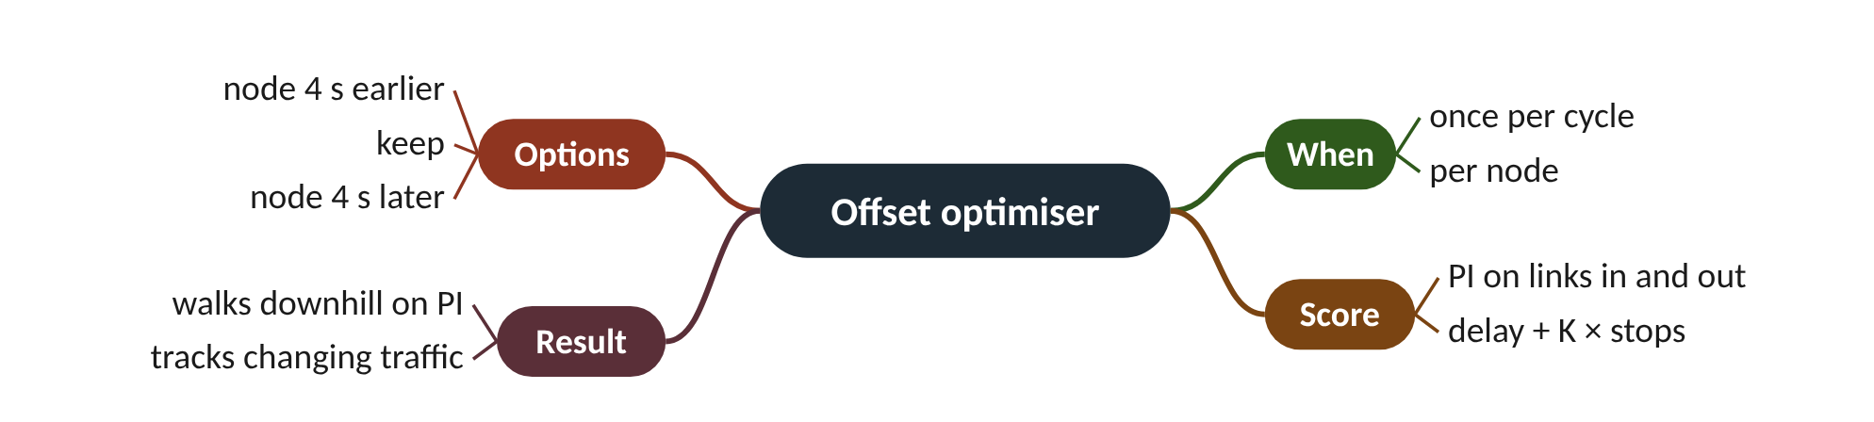
Remember it: Offset optimiser
PICTURE THIS · STOP 3: ECHO CORRIDOR
TRAP
In a long corridor two drummers try to make their beats meet in the middle. Each cycle the second drummer shuffles 4 steps forward or back, watching a glowing noise meter on the wall, and stops when the meter is at its lowest.
The offset optimiser uses PI (delay and stops), not DoS. DoS hardly changes with offset, because offset moves when the green happens, not how long it is.
Notes:
What the scene encodes: The drummers = two nodes; shuffling 4 steps = the ±4 s offset change; the noise meter = PI; stopping at the lowest = the valley of the PI curve.
Recap: Offset optimiser: once per cycle per node, try −4/0/+4 s, pick the lowest PI on links in and out; walks downhill to a green wave.

Slide 15
4 The cycle optimiser
IN PLAIN WORDS
A conductor sets the tempo for the whole orchestra. If the busiest section cannot fit its notes in, the conductor slows down a little. If everyone has time to spare, the conductor speeds up a little. The tempo changes only every few minutes, so the players are never confused.
Every 5 minutes, 2.5 while rising
Critical node decides for the region
Above 90% longer, below 80% shorter
Steps of 4, 8 or 16 s
40 → 88 s
cycle growth in the worked peak
Notes:
Longer cycles give more capacity but make everyone wait longer at red. How does SCOOT decide when the whole region should switch to a longer or shorter cycle?
Every 5 minutes (every 2.5 minutes while the cycle is going up) the cycle optimiser reviews the whole region. It finds the critical node: the junction whose busiest link needs the longest cycle.
The rule is simple. If the critical node's DoS is above about 90%, the cycle goes up. If every link is comfortably below target (this lab uses 80%), the cycle comes down. In between it holds. Steps are 4, 8 or 16 s, bigger at longer cycles, always within the region's minimum and maximum.
Why does a longer cycle help? Each stage change wastes some lost time L. In a cycle C only C − L seconds are useful green. A longer cycle makes L a smaller share, so the same flow ratio Y gives a lower DoS.
Presenter tip: Show why C/(C − L) falls as C grows. Then connect to the ablation surprise in concept 8: slow decreases can leave the cycle too long.

Slide 16
Worked example: A rising peak
critical DoS ≈ Y × C ÷ (C − L)
step = 4 s (C < 64), 8 s (C < 128), 16 s (C ≥ 128)
Critical node: lost time L = 12 s, flow ratio Y = 0.78 in the peak. The cycle is 40 s.
1. DoS = 0.78 × 40 ÷ (40 − 12) = 31.2 ÷ 28 = 1.11. Above 0.90 → up 4 s to 44 s.
2. 2.5 min later: 0.78 × 44 ÷ 32 = 1.07. Still above → 48 s.
3. At 64 s: 0.78 × 64 ÷ 52 = 0.96. The step is now 8 s → 72 s.
4. At 80 s: 0.78 × 80 ÷ 68 = 0.92 → 88 s.
5. At 88 s the peak eases (Y = 0.70): 0.70 × 88 ÷ 76 = 0.81. Between 0.80 and 0.90 → hold.
Going up takes small steps every 2.5 minutes. Coming down happens only every 5 minutes, so the region can spend a while on a cycle longer than it needs.
Notes:
The cycle optimiser through a peak. What to notice: DoS shoots above 100 as demand rises; the cycle climbs in 4 s and then 8 s steps until DoS is back under 90; after the peak it falls slowly. Simulated with this lab's rules (L = 12 s, Y from 0.45 to 0.78 and back).
Try it with the audience: A region runs a 56 s cycle. The critical node has Y = 0.70 and L = 12 s. What does the cycle optimiser do?
Answer: DoS = 0.70 × 56 ÷ 44 = 39.2 ÷ 44 = 0.89. That is between 0.80 and 0.90, so it holds at 56 s.

Slide 17
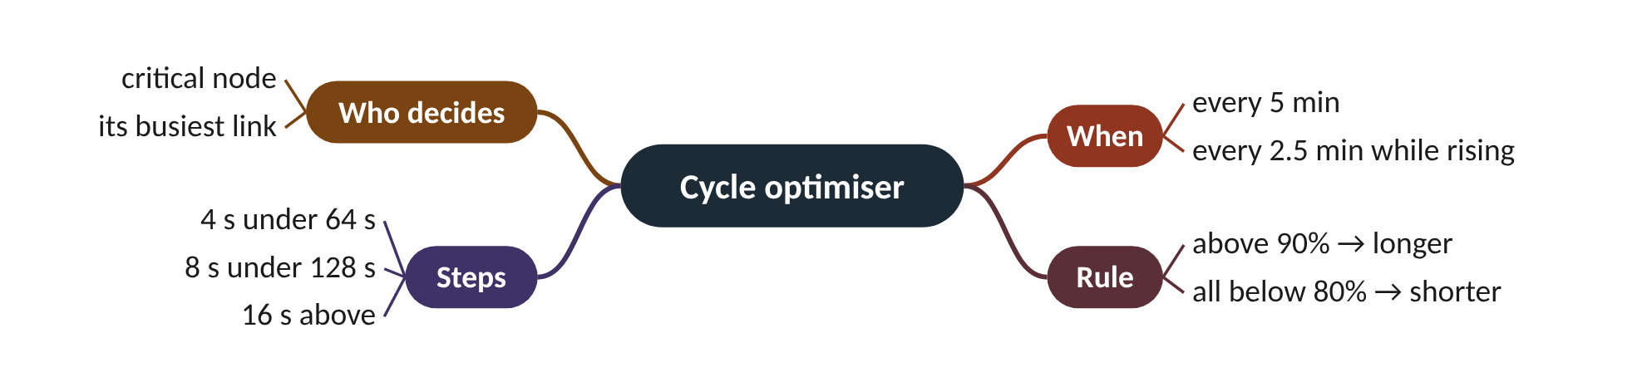
Remember it: Cycle optimiser
PICTURE THIS · STOP 4: METRONOME
TRAP
On the podium stands a metronome as tall as a giraffe. Three weights hang on it, stamped 4, 8 and 16. Every five minutes a cuckoo pops out; the conductor glances at a gauge painted red above 90 and slides one weight up or down.
A longer cycle is not always better. It lowers DoS but raises delay for everyone waiting at red. That is why the lab's optimiser also compares PI and why every region has a maximum cycle.
Notes:
What the scene encodes: Metronome = region cycle; weights = 4/8/16 s steps; cuckoo every five minutes = review every 5 min; the gauge = critical node DoS with its 90% target.
Recap: Cycle optimiser: every 5 min (2.5 rising) the critical node's DoS decides: > 90% up, all < 80% down, steps 4/8/16 s.

Slide 18
5 Congestion, exit blocking and gating
IN PLAIN WORDS
A cloakroom with a sensor at the door works fine until the queue for coats reaches the door and sits on the sensor. Then the staff must notice the queue itself. If the cloakroom is about to jam completely, an usher closes the outer door for a moment so the people inside can move.
Queue over detector: count no longer reliable
Congestion importance raises a link's weight
Exit blocking: no room beyond the junction
Gating stores queues where harmless
0.85 → 1.02
weighted DoS with 20% congestion, importance 1
Notes:
When a queue grows back over SCOOT's detector, the detector just sits there 'occupied'. It can no longer count arrivals. What does SCOOT do when its own eyes are covered?
When a queue reaches back over the upstream detector, the detector stays occupied by standing traffic. SCOOT measures congestion as the share of the cycle the detector is covered in this way.
The engineer gives each link a congestion importance factor. It raises that link's weight in the split optimiser, so a congested link gets green before its queue blocks the junction behind it. Later SCOOT versions also detect exit blocking: a link cannot discharge because the road beyond it is full, so giving it green is wasted.
Gating protects a critical bottleneck. When a critical link's DoS passes a threshold, SCOOT shortens the green on chosen gate links further out, where queues do no harm. The bottleneck keeps flowing instead of locking up.
Presenter tip: Be honest about the lab: congestion importance made no difference in our SUMO region because queues never reached the detectors. That is a finding, not a failure.

Slide 19
Worked example: A congested link asks for green
congestion f = seconds detector blocked by queue ÷ cycle
weighted DoS = DoS × (1 + importance × f)
A link has DoS 0.85. In a 60 s cycle its detector is covered by a standing queue for 12 s. Congestion importance = 1.0.
1. Congestion f = 12 ÷ 60 = 0.20.
2. Weight = 1 + 1.0 × 0.20 = 1.20.
3. Weighted DoS = 0.85 × 1.20 = 1.02.
4. Plain DoS 0.85 was under 0.90; weighted 1.02 is above it.
The split optimiser now treats this link as the worst one and moves green towards it, before its queue spills back into the junction upstream.
Notes:
Weighted DoS as congestion grows (plain DoS 0.80). What to notice: with importance 0 congestion is ignored; with importance 1 or 2 the link crosses the 90% target at f ≈ 0.13 or 0.06 and wins green. Computed from DoS × (1 + importance × f).
Try it with the audience: A link has DoS 0.75. Its detector is blocked for 18 s of a 60 s cycle; importance 1.0. Is its weighted DoS above the 90% target?
Answer: f = 18 ÷ 60 = 0.30; weighted DoS = 0.75 × 1.30 = 0.975. Yes, above 0.90, so it will be favoured.

Slide 20
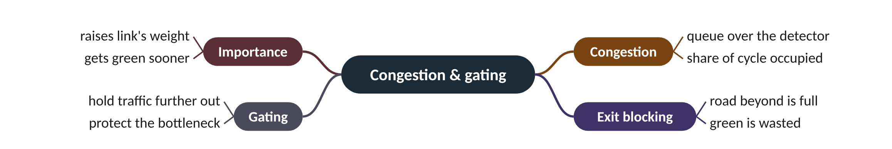
Remember it: Congestion & gating
PICTURE THIS · STOP 5: CLOAKROOM
TRAP
In the foyer a mountain of coats has piled up over the doorway's motion sensor, which flashes 'BUSY' forever. An usher in white gloves swings the outer gate shut, and outside on the long lawn concert-goers queue happily with picnic blankets.
Gating deliberately makes some drivers wait longer. It is worth it only if the queue it creates sits somewhere harmless (a long link) and the bottleneck it protects would otherwise lock up and lose capacity for everyone.
Notes:
What the scene encodes: Coats on the sensor = queue over the detector (congestion); the gate = gating; the long lawn = the harmless gate link where queues may wait.
Recap: Congestion and gating: queues over the detector raise a link's weight (DoS × (1 + importance × f)); exit blocking wastes green; gating holds traffic where queues are harmless.

Slide 21
6 Bus priority: extensions and recalls
IN PLAIN WORDS
A host holding a lift door for someone running down the corridor is an extension. Pressing 'close' early to fetch someone waiting on another floor is a recall. Either way, the lift then gets back to its normal routine.
Buses detected by GPS or detector
Extension: hold the green a little
Recall: bring the bus stage early
Recover the plan in 1-2 cycles
22.9 s
mean bus delay with priority (34.7 s without)
Notes:
A bus carries 50 people; a car carries one or two. If a bus arrives just as the light turns red, should the light wait for it?
Buses are detected by automatic vehicle location (AVL), using GPS, or by a selective vehicle detector (SVD) that only buses trigger. SCOOT then has two tools.
An extension holds the current green a few seconds so a bus about to arrive gets through. A recall brings the bus's stage in early by cutting the current stage short, but never below its minimum green.
After either, SCOOT recovers: the following stages are adjusted so the plan returns to its optimised timings within a cycle or two. The authority given to buses can be weighted by how important priority is on that route. In our SUMO region, bus priority cut bus delay from 34.7 s to 22.9 s.
Presenter tip: Draw the 80 s cycle as a bar and place the two buses on it. Ask the audience which tool each needs before revealing.

Slide 22
Worked example: Extension or recall?
extension possible if arrival ≤ green end + maximum extension
bus saving = wait without priority − wait with priority
Cycle 80 s. Stage A (bus road) green 0-40 s, intergreen 5 s, stage B green 45-75 s, intergreen 5 s. Max extension 12 s. Minimum green for B 7 s.
1. Bus 1 reaches the stop line at 46 s. Without priority it waits until A returns at 80 s: 34 s.
2. 46 ≤ 40 + 12 = 52, so extend A to 46 s: wait 0 s. Saving 34 s.
3. Bus 2 is detected at 56 s and will arrive at 65 s. Without priority: 80 − 65 = 15 s.
4. Recall: B has had 11 s (≥ 7 s minimum), so cut it at 56 s; after the 5 s intergreen A is green at 61 s.
5. Bus 2 arrives at 65 s on green: wait 0 s. Saving 15 s.
Extensions help buses that just miss the green; recalls help buses that arrive mid-red. Stage B lost 6 s and 19 s respectively, which SCOOT recovers over the next cycles.
Notes:
Mean bus delay on the SUMO region (Lab A1 and A2). What to notice: SCOOT's priority cut bus delay by about a third compared with SCOOT without priority, and to under a fifth of fixed time. From this repository's runs, seed 1.
Try it with the audience: Same junction. A bus will reach the stop line at 50 s. Which tool works, and how much bus delay does it save?
Answer: 50 ≤ 52 (40 + 12), so an extension to 50 s works. Without priority the bus waits 80 − 50 = 30 s, so it saves 30 s.

Slide 23
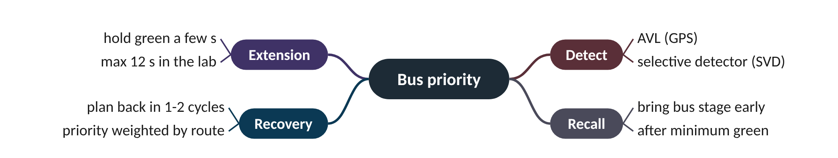
Remember it: Bus priority
PICTURE THIS · STOP 6: BUS IN THE PIT
TRAP
A red double-decker bus rolls into the orchestra pit. The conductor holds the last violin note on and on until the bus has squeezed past (extension), then later cuts a song short with a crash of cymbals to let a second bus in (recall).
Priority is not free. Every second given to the bus stage is taken from another stage this cycle. That is why extensions are capped, recalls respect minimum greens, and recovery restores the plan quickly.
Notes:
What the scene encodes: Held note = extension (max 12 s here); song cut short = recall after minimum green; the bus = a detected bus via GPS or a bus-only detector.
Recap: Bus priority: detect by AVL or SVD; extend green (≤ 12 s here) or recall the bus stage after minimum green; recover in 1-2 cycles. Lab: 34.7 → 22.9 s.

Slide 24
7 The wider SCOOT system
IN PLAIN WORDS
A good doctor keeps your records. When you come in with a temperature, she compares it with your normal readings, not with someone else's. ASTRID is the records cabinet; INGRID is the doctor who says 'this is not normal for you'.
ASTRID: stores history and profiles
INGRID: spots incidents from detector patterns
Emissions, pedestrians, cooperative vehicles
Same principles live on in newer systems
2020
SCOOT 7: cooperative data and cloud-first design
Notes:
SCOOT does more than time lights. It remembers what traffic usually looks like, notices when today looks wrong, and estimates the pollution on every street. What is it doing with all that data?
ASTRID is a database that stores SCOOT's data over days and weeks. Its historic profiles say what flow normally looks like at this link, on this kind of day, at this time. When a detector fails, SCOOT can substitute the historic profile instead of flying blind.
INGRID is real-time incident detection. It compares what the detectors see now with what ASTRID says is normal. A sudden drop in flow with very high occupancy downstream, for example, suggests a crash or a blocked lane, and an operator is alerted.
Later versions added emissions estimates (from version 4, 1997), better behaviour in oversaturation (version 5), pedestrian and low-flow features (version 6, 2010) and, in SCOOT 7 (2020), cooperative-vehicle data, pedestrian SCOOT, loop-failure logic and a cloud-first design. Some cities are now moving to newer systems such as Transport for London's FUSION, built on the same principles.
Presenter tip: Keep this section light: a tour of the toolbox. The INGRID calculation shows why low flow alone is ambiguous.

Slide 25
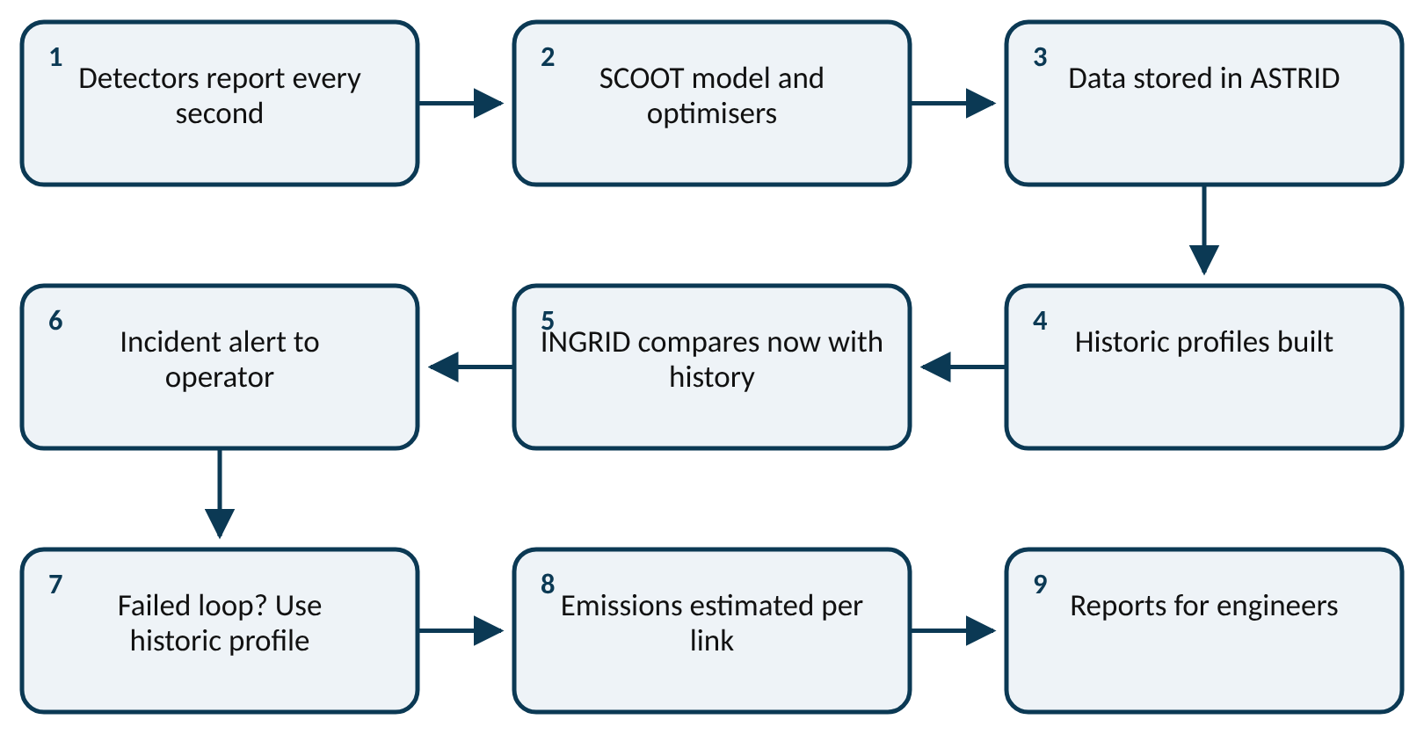
Worked example: Does today look normal?
ratio = flow now ÷ historic flow for this time
At 08:15 on a weekday, ASTRID's historic profile for a link says 60 LPU per 5 minutes. Today the detector shows 12 LPU, and the detector is occupied 85% of the time (normally 20%).
1. Flow ratio = 12 ÷ 60 = 0.20: one fifth of normal flow.
2. Occupancy ratio = 85 ÷ 20 = 4.25 times normal.
3. Low flow plus high occupancy means traffic is standing, not absent.
4. This pattern is typical of a blockage downstream: raise an incident alert.
Low flow alone could mean an empty road at night. Low flow with very high occupancy means a queue that is not moving. Comparing with history is what makes the difference visible.
Notes:
How the wider system uses SCOOT's data. What to notice: the same detector data feed three jobs: control, memory (ASTRID) and alarms (INGRID). Read left to right, then down.
Try it with the audience: A link's history says 40 LPU per 5 min at 02:00. Tonight it reads 8 LPU and occupancy is 3% (normally 4%). Incident or not?
Answer: Flow ratio 8 ÷ 40 = 0.2, but occupancy is low and about normal (3/4 = 0.75). Traffic is light and moving, not stuck: probably no incident (perhaps a quiet night or a diversion).

Slide 26
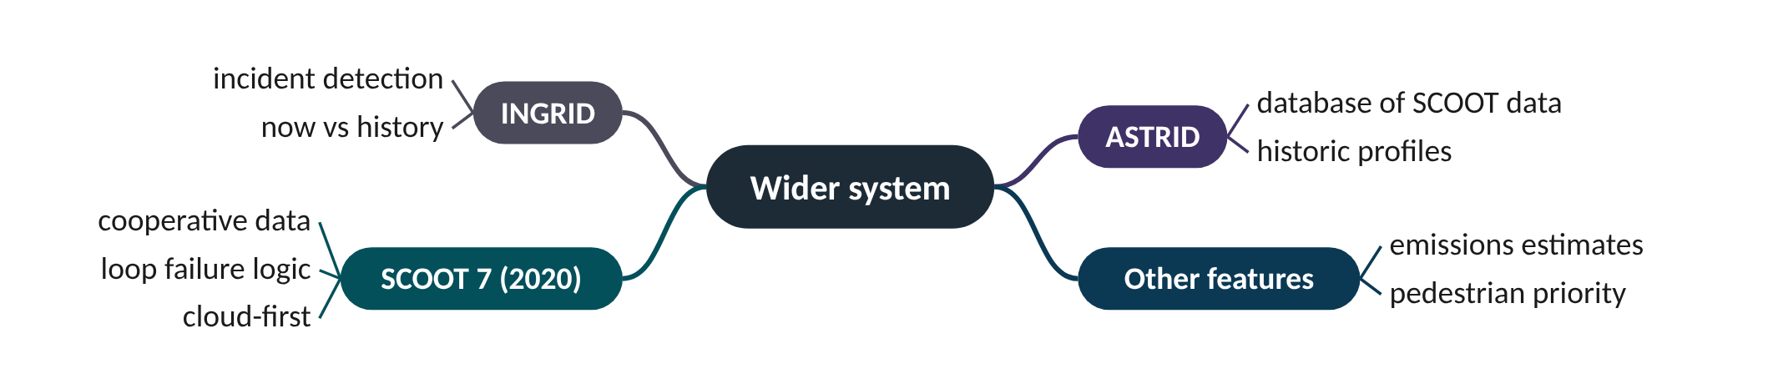
Remember it: Wider system
PICTURE THIS · STOP 7: ARCHIVE ROOM
TRAP
Behind the stage is a dusty archive where an archivist named Astrid files a recording of every concert. Her twin sister Ingrid listens to tonight's music through a brass trumpet and rings a fire bell the moment it sounds unlike the recordings.
Historic substitution is a fallback, not a fix. A link running on yesterday's profile cannot react to today's surprise, so failed detectors must still be repaired quickly. (Mastery tests exactly this.)
Notes:
What the scene encodes: Astrid's archive = the ASTRID database of historic profiles; Ingrid's bell = INGRID incident detection comparing now with history.
Recap: Wider system: ASTRID stores historic profiles (and backs up failed loops), INGRID flags incidents by comparing now with history; later versions added emissions, pedestrians and cooperative data.

Slide 27
8 The full system on a SUMO region
IN PLAIN WORDS
To learn what each part of a car does, a mechanic removes one part at a time and test-drives it. Remove the steering and you crash; remove the radio and nothing changes. An ablation study does the same with SCOOT's mechanisms.
Four junctions, tidal peaks, buses every 4 min
SCOOT: −65% delay against fixed time
Split optimiser matters most
Honest surprises: fixed cycle, congestion
−65%
delay vs fixed time on the SUMO region
Notes:
We put every mechanism together on four junctions in SUMO, then switched them off one at a time. Some results were expected. Two were surprises.
Four junctions 300 m apart form one SCOOT region. Demand starts low, then a 30-minute eastbound peak, a westbound peak, and low traffic again, with buses every 4 minutes each way. All the mechanisms run together.
Lab A1 compares controllers on the same demand: mean delay 86.95 s fixed, 29.07 s actuated, 30.44 s SCOOT. SCOOT had the fewest stops (1.10 per vehicle against 1.15 actuated) and much lower bus delay (22.9 against 38.0 s). On delay alone, good actuation was slightly ahead on this short corridor.
Lab A2 removes one mechanism at a time. Without the split optimiser delay more than doubles (77.3 s): a fixed 60/40 split cannot serve tidal peaks. Without offsets it rises to 39.7 s. Two surprises: freezing the cycle at 60 s did slightly better (26.8 s), because after the first peak the cycle came down only 8 s every 5 minutes; and congestion importance changed nothing, because queues never reached the detectors.
Presenter tip: Present the results honestly: actuation is level on delay; SCOOT wins on stops and buses. Use the two surprises to discuss tuning and test design.

Slide 28
Worked example: Reading the results
change = (new − old) ÷ old × 100%
Lab A1 and A2 mean delays (s per vehicle): fixed 86.95, actuated 29.07, SCOOT 30.44; no split optimiser 77.30. Bus delay: actuated 37.99, SCOOT 22.92.
1. SCOOT vs fixed: (30.44 − 86.95) ÷ 86.95 = −65% delay.
2. SCOOT vs actuated: (30.44 − 29.07) ÷ 29.07 = +4.7% delay.
3. Bus delay vs actuated: (22.92 − 37.99) ÷ 37.99 = −40%.
4. No split optimiser: 77.30 ÷ 30.44 = 2.5 times the delay.
SCOOT is far better than a fixed plan, about level with good actuation on general delay, and clearly better for buses and stops. The split optimiser is the mechanism that matters most here.
Notes:
Ablation (Lab A2): mean delay with one mechanism removed. What to notice: removing the split optimiser hurts most; removing the cycle optimiser actually helped on this demand; congestion importance had no effect. SUMO, same demand and seed for every bar.
Try it with the audience: Without offset optimisation the mean delay was 39.74 s; full SCOOT 30.44 s. By what percentage does offset optimisation reduce delay?
Answer: (39.74 − 30.44) ÷ 39.74 = 9.30 ÷ 39.74 = 23% less delay with offset optimisation.

Slide 29
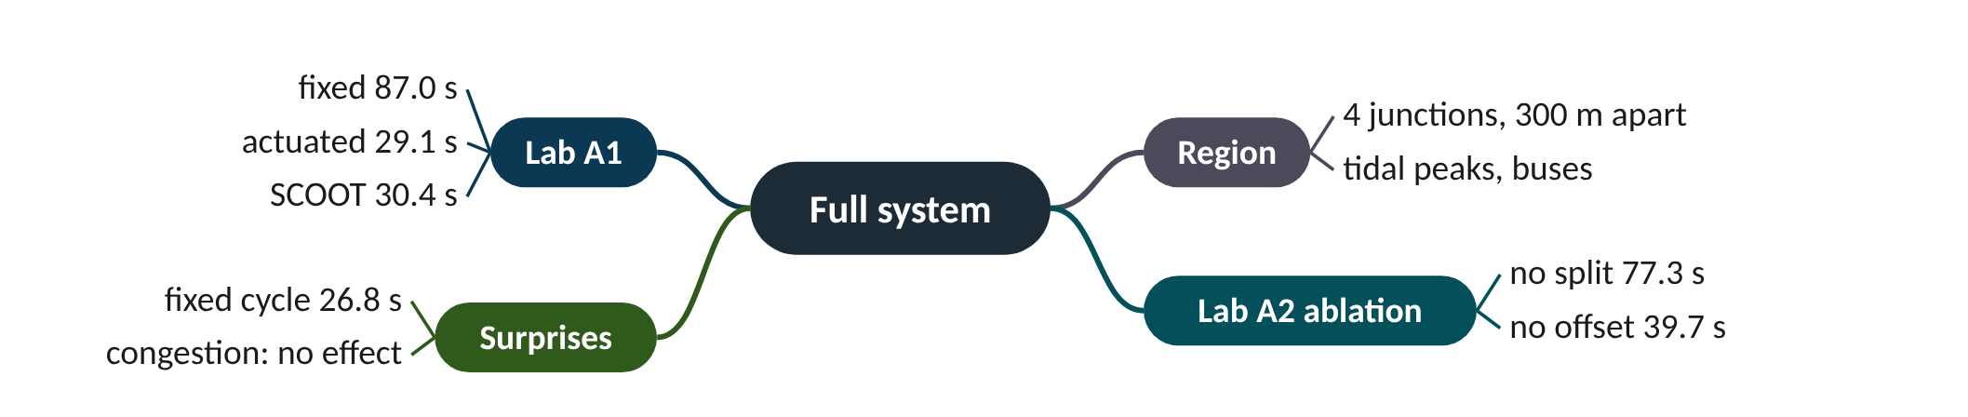
Remember it: Full system
PICTURE THIS · STOP 8: APPLAUSE METER
TRAP
At the final bow a giant applause meter shows the night's 'grumble' scores: a clockwork robot scores 87, a jumpy rabbit 29, the conductor 30. When the violinists are sent home the grumble leaps to 77; when the metronome is glued at 60, it drops to 27.
Do not conclude 'the cycle optimiser is useless'. On this demand the region's maximum (120 s) and slow decreases let the cycle stay too long after the peak. With a tuned maximum it would help; that is why engineers tune each region.
Notes:
What the scene encodes: Scores = Lab A1 delays (fixed 87, actuated 29, SCOOT 30 s); violins sent home = no split optimiser (77 s); glued metronome = fixed cycle (26.8 s).
Recap: Full system: Lab A1 delay fixed 87.0 / actuated 29.1 / SCOOT 30.4 s (bus 22.9 s); ablation: split matters most (77.3 s without); fixed cycle 26.8 s and congestion no effect are honest surprises.

Slide 30
The three optimisers side by side
 | Split | Offset | Cycle
Runs | before every stage change | once per cycle per node | every 5 min (2.5 rising)
Changes | one stage change −4/0/+4 s | whole node −4/0/+4 s | region cycle ±4/8/16 s
Chooses by | lowest highest DoS | lowest PI on links in and out | critical node DoS vs 90%
Memory | temporary ±4, permanent ±1 | kept until next step | kept until next review
Without it (Lab A2) | 77.3 s delay | 39.7 s delay | 26.8 s (surprise)

Slide 31
Things beginners mix up
This… | …is not this | The fact that tells them apart
Split optimiser | Offset optimiser | Split moves one stage change and scores by DoS; offset moves the whole node and scores by PI.
Temporary change | Permanent change | Temporary ±4 s applies to this cycle only; permanent ±1 s is stored in the plan.
Extension | Recall | Extension holds the bus's green on; recall brings the bus's stage in early.
ASTRID | INGRID | ASTRID stores history; INGRID compares now with history to spot incidents.
Double cycling | A separate region | A double-cycled node runs exactly 2 cycles per region cycle, so it stays coordinated.
Congestion | Exit blocking | Congestion: queue over this link's detector. Exit blocking: no room on the road beyond.

Slide 32
Check yourself (1 of 2)
Greens A 30 s, B 20 s; demand A 20 LPU, B 18 LPU; SATO 1.0. Which split option wins?
Cycle 60 s, L = 12 s, Y = 0.75. What does the cycle optimiser do?
A. −4 s
B. 0
C. +4 s
D. No option is allowed
A. Shorten by 4 s
B. Hold
C. Lengthen by 4 s
D. Lengthen by 8 s
Answers are in the speaker notes and in the study guide's answer key.
Notes:
Answer: A. −4: 20/26 = 0.77, 18/24 = 0.75 → 0.77. 0: 0.67, 0.90 → 0.90. +4: 0.59, 1.13 → 1.13. Lowest highest DoS is −4.
Answer: C. DoS = 0.75 × 60 ÷ 48 = 0.94 > 0.90, and 60 < 64 so the step is 4 s → 64 s.

Slide 33
Check yourself (2 of 2)
In Lab A2, which removed mechanism raised delay most?
Flow is 25% of the historic profile and occupancy is 4 times normal. INGRID would most likely:
A. Offset optimiser
B. Cycle optimiser
C. Split optimiser
D. Bus priority
A. Ignore it: low flow is normal at night
B. Flag a possible incident: traffic is standing
C. Lengthen the cycle
D. Switch the detector off
Answers are in the speaker notes and in the study guide's answer key.
Notes:
Answer: C. No split optimiser: 77.3 s against 30.4 s for full SCOOT.
Answer: B. Low flow with high occupancy means vehicles are stuck on the detector, not absent.

Slide 34
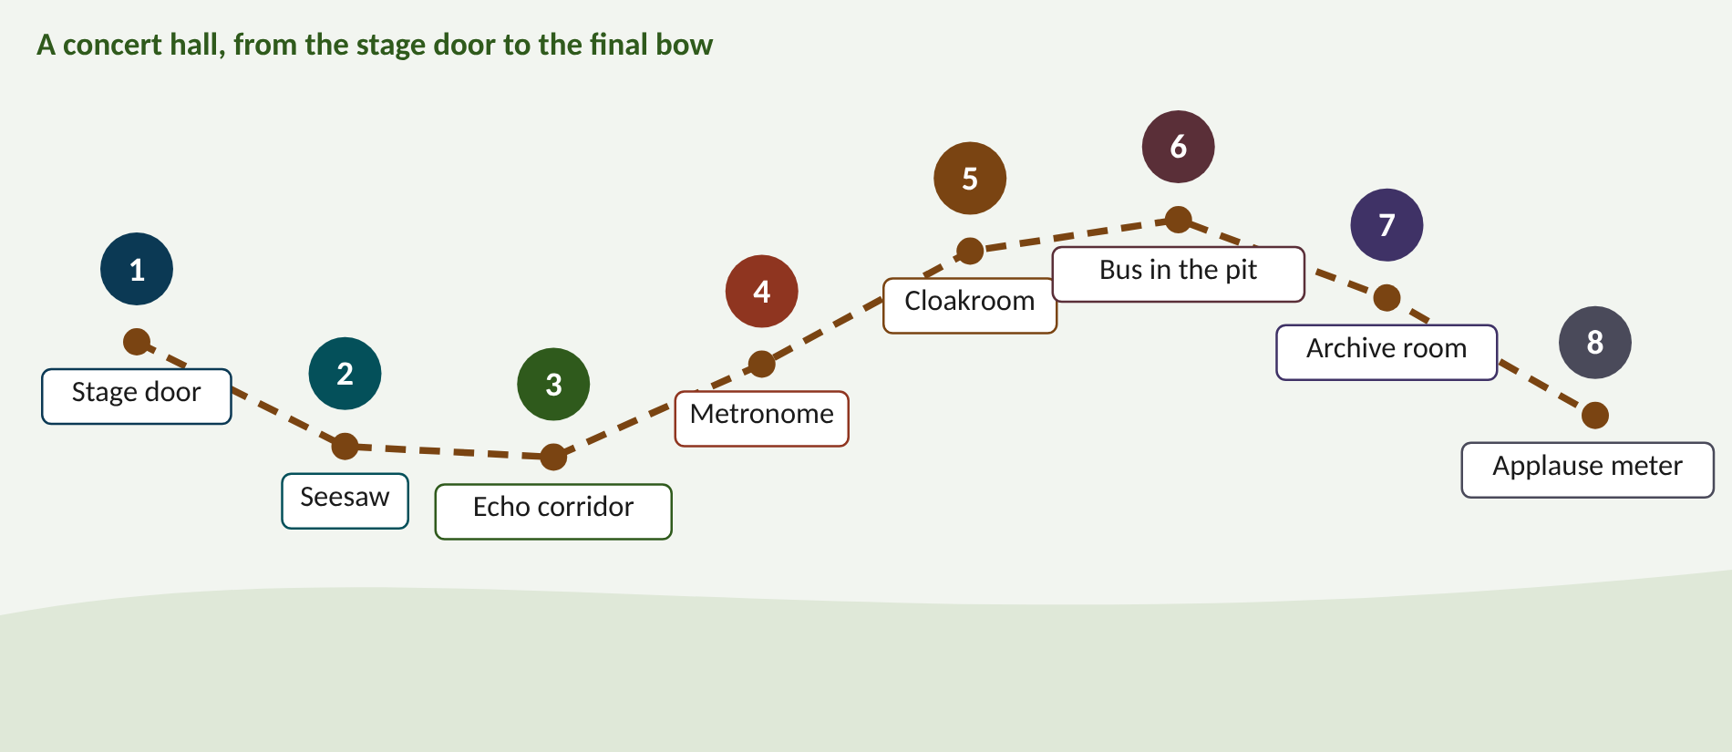
Walk the memory route
1 Stage door = Regions · 2 Seesaw = Split optimiser · 3 Echo corridor = Offset optimiser · 4 Metronome = Cycle optimiser · 5 Cloakroom = Congestion & gating · 6 Bus in the pit = Bus priority · 7 Archive room = Wider system · 8 Applause meter = Full system
Notes:
Stop 1, Stage door: At the stage door the whole orchestra marches in, every foot landing on one giant metronome's tick. A tiny triangle player at the back skips two steps for every one tick, grinning, never falling out of time. (One metronome = one region cycle; the marching players = nodes; the triangle player's two steps per tick = double cycling.)
Stop 2, Seesaw: In the green room two singers sit on a seesaw. A stagehand stands ready with a 4 kg sandbag; every few seconds he drops it on one end, or shrugs and keeps it. Each time he also glues a single 1 kg weight to that end for ever. (The 4 kg bag = the ±4 s temporary change; the glued 1 kg = the ±1 s permanent change; the shrug = 'keep', the most common decision.)
Stop 3, Echo corridor: In a long corridor two drummers try to make their beats meet in the middle. Each cycle the second drummer shuffles 4 steps forward or back, watching a glowing noise meter on the wall, and stops when the meter is at its lowest. (The drummers = two nodes; shuffling 4 steps = the ±4 s offset change; the noise meter = PI; stopping at the lowest = the valley of the PI curve.)
Stop 4, Metronome: On the podium stands a metronome as tall as a giraffe. Three weights hang on it, stamped 4, 8 and 16. Every five minutes a cuckoo pops out; the conductor glances at a gauge painted red above 90 and slides one weight up or down. (Metronome = region cycle; weights = 4/8/16 s steps; cuckoo every five minutes = review every 5 min; the gauge = critical node DoS with its 90% target.)
Stop 5, Cloakroom: In the foyer a mountain of coats has piled up over the doorway's motion sensor, which flashes 'BUSY' forever. An usher in white gloves swings the outer gate shut, and outside on the long lawn concert-goers queue happily with picnic blankets. (Coats on the sensor = queue over the detector (congestion); the gate = gating; the long lawn = the harmless gate link where queues may wait.)
Stop 6, Bus in the pit: A red double-decker bus rolls into the orchestra pit. The conductor holds the last violin note on and on until the bus has squeezed past (extension), then later cuts a song short with a crash of cymbals to let a second bus in (recall). (Held note = extension (max 12 s here); song cut short = recall after minimum green; the bus = a detected bus via GPS or a bus-only detector.)
Stop 7, Archive room: Behind the stage is a dusty archive where an archivist named Astrid files a recording of every concert. Her twin sister Ingrid listens to tonight's music through a brass trumpet and rings a fire bell the moment it sounds unlike the recordings. (Astrid's archive = the ASTRID database of historic profiles; Ingrid's bell = INGRID incident detection comparing now with history.)
Stop 8, Applause meter: At the final bow a giant applause meter shows the night's 'grumble' scores: a clockwork robot scores 87, a jumpy rabbit 29, the conductor 30. When the violinists are sent home the grumble leaps to 77; when the metronome is glued at 60, it drops to 27. (Scores = Lab A1 delays (fixed 87, actuated 29, SCOOT 30 s); violins sent home = no split optimiser (77 s); glued metronome = fixed cycle (26.8 s).)

Slide 35
Numbers to remember
› Split: −4/0/+4 s temporary, ±1 s permanent; 88% 'keep' in the lab
› Offset: once per cycle, ±4 s, PI = delay + 4 × stops
› Cycle: every 5 min (2.5 rising), > 0.90 up, < 0.80 down, steps 4/8/16 s
› Double cycling: 96 s → 48 s cuts ped wait 40.3 → 16.7 s
› Bus: max extension 12 s; bus delay 34.7 → 22.9 s
› Lab A1 delay: fixed 86.95, actuated 29.07, SCOOT 30.44 s
› Lab A2: no split 77.3, no offset 39.7, no cycle 26.8 s

Slide 36
Keep going
Study guide: SCOOT_Advanced_Study_Guide.pdf · Interactive labs and SUMO code: smrahmanbd.github.io/scoot-learning-lab
Notes:
Point learners to the study guide for the full worked examples, quiz and revision plan, and to the website for the simulators.

