Slide 1
The traffic light that sees the queue before it forms
SCOOT · Level 1 · Foundation
How SCOOT counts cars far up the road, predicts the queue at the lights, and nudges the timings a few seconds at a time.
smrahmanbd.github.io/scoot-learning-lab
Notes:
This guide is for complete beginners. You need no traffic engineering and only school maths. By the end you will understand how SCOOT, one of the world's most widely used adaptive traffic control systems, builds a live model of every road and uses it to time the lights. There are six ideas. Each builds on the one before.

Slide 2
6 ideas, each building on the last
1
What SCOOT is: the elastic plan
2
Detectors and link profile units
3
Profiles and platoon dispersion
~192 small timing decisions per hour at one junction
1.96 vs 3.07 LPUs for a car and a bus at 13.5 m/s
F = 0.263 smoothing factor on a 10-second link
4
The queue model and degree of saturation
5
Validation: making the model match the street
6
SCOOT against fixed time and actuation
90% SCOOT's usual degree-of-saturation target
4 s clear-time error from a 12% SATO error
12.8 s SCOOT mean delay in Lab F3 (fixed 19.0 s)
Notes:
Outcomes for today:
- Explain in two sentences what SCOOT changes (split, cycle, offset) and why it changes them in small steps.
- Turn a vehicle's length into link profile units (LPUs) and explain why long vehicles count more.
- Shift and smooth a platoon from the detector to the stop line with Robertson's formula.
- Draw the queue over one cycle and read off the delay, stops and degree of saturation.
- Say what an engineer 'validates' and fix a wrong saturation occupancy from a stopwatch reading.
- Explain why SCOOT beat fixed time and actuation in the SUMO lab, and where fixed plans come from (Webster).

Slide 3
Three surprises to start
The detector is in the 'wrong' place on purpose.
SCOOT never sees the queue.
It has been running since about 1980.
Most actuated signals put their loops at the stop line. SCOOT puts them near the far end of the road, just after the previous junction. That gives it 10 to 20 seconds of warning: it knows a platoon is coming before any driver reaches the lights.
There is no camera watching the queue. Every queue SCOOT uses is a prediction from its model. In our SUMO lab the model's queue still tracked the real queue closely, second by second.
SCOOT was developed in the UK by the Transport and Road Research Laboratory (now TRL) and is used in hundreds of towns and cities. SCOOT 7 (2020) added connected-vehicle data and pedestrian features.

Slide 4
Words you will meet
Junction / node | A place where roads meet and traffic lights take turns. SCOOT calls each one a node.
Link | One approach road into a junction, from the detector to the stop line.
Stage | A set of movements that get green at the same time, for example 'main road both ways'.
Cycle | One full turn through all stages, for example 60 seconds.
Split | How the cycle is shared between stages: 'main road 35 s, side road 20 s'.
Offset | When one junction's cycle starts compared with its neighbour, so a green wave can form.
Platoon | A bunch of cars travelling together, usually released by the previous green.
Detector (loop) | A wire loop in the road that knows when a vehicle is over it.
Saturation flow | The fastest a queue can leave on green, roughly one car every two seconds per lane.
Notes:
You do not need to memorise these now; each is explained again when it first matters.

Slide 5
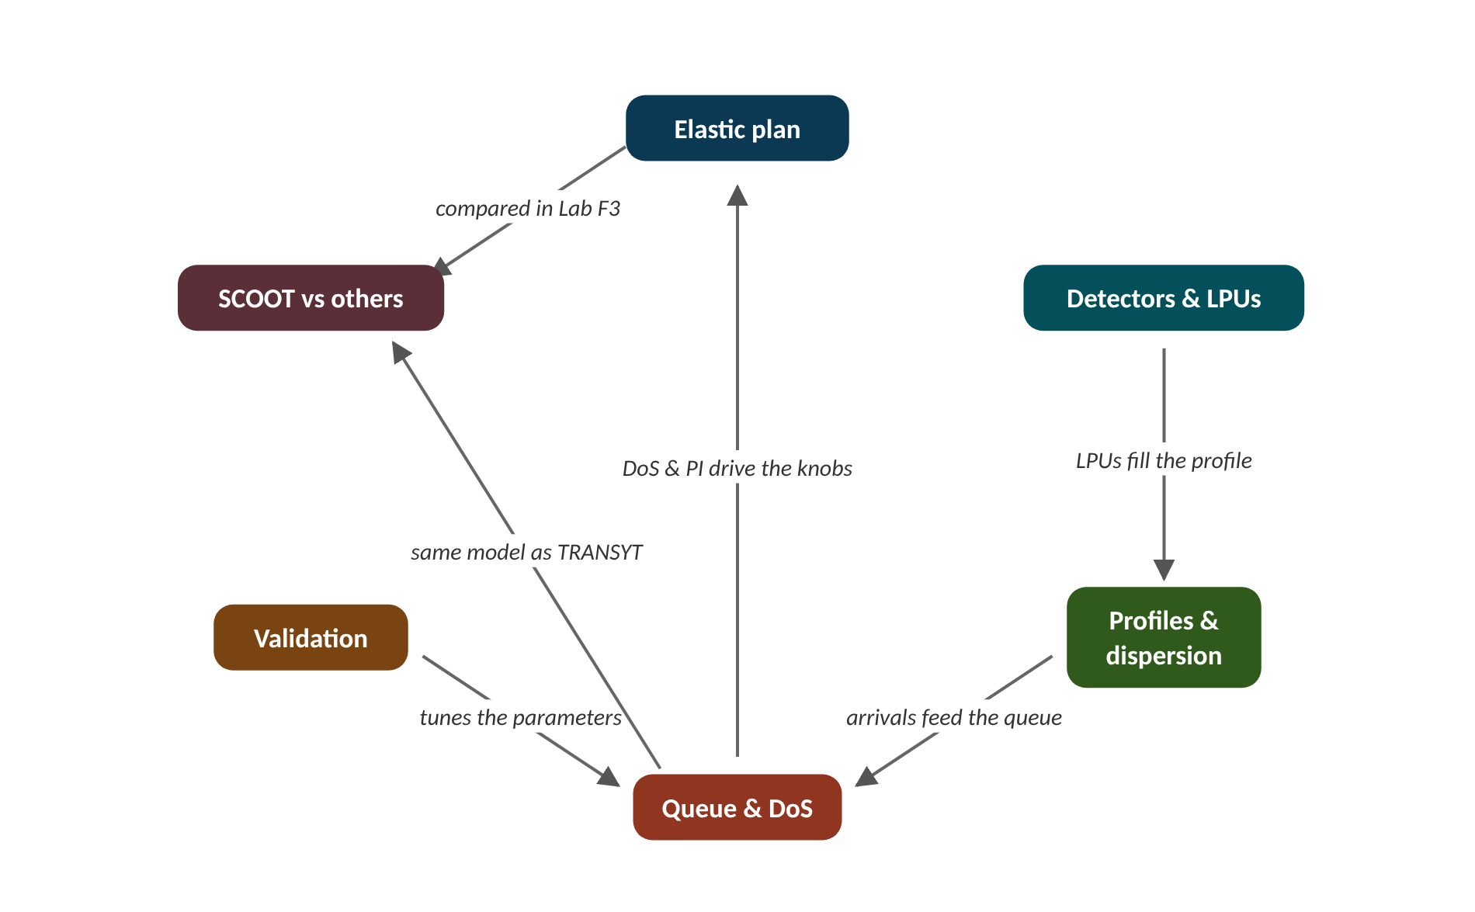
The map of today's ideas
Notes:
Each box is one idea; arrows say how one feeds the next. LPUs fill the profile; arrivals feed the queue; tunes the parameters; DoS & PI drive the knobs; compared in Lab F3; same model as TRANSYT.

Slide 6
1 What SCOOT is: the elastic plan
IN PLAIN WORDS
Think of a thermostat that nudges the heating a little every few minutes, rather than a timer that switches between 'winter' and 'summer' settings. Each nudge is small, so one wrong guess cannot do much harm, and the many nudges add up to follow the weather closely.
Split, Cycle, Offset: three timing knobs
Small, frequent changes: the elastic plan
Central computer, a model of every link
Three speeds: stage change, cycle, 5 minutes
~192
small timing decisions per hour at one junction
Notes:
A fixed-time traffic light runs the same plan whether the road is empty or jammed. SCOOT changes the plan all day long, but never by much at once. Why would small steps beat big jumps?
SCOOT stands for Split Cycle Offset Optimisation Technique. The name lists the three timing 'knobs' it turns. The split is how the green time is shared between stages. The cycle is how long one full round of stages takes. The offset is when a junction's cycle starts compared with its neighbour.
SCOOT is centralised and model-based. One computer in the control centre runs a small traffic model for every approach road (link) every second. The model's predictions, not the raw detector counts, decide the timings.
Each knob turns at its own speed. Splits change a few seconds before every stage change. Offsets change once per cycle. The cycle, which is shared by all junctions in a region, changes every 5 minutes (every 2.5 minutes while traffic is rising). This is the elastic plan: the timings stretch to fit demand instead of jumping between stored plans.
Presenter tip: Open with the thermostat analogy. Stress that SCOOT edits the running plan rather than choosing from a library. Walk the loop figure once, slowly.

Slide 7
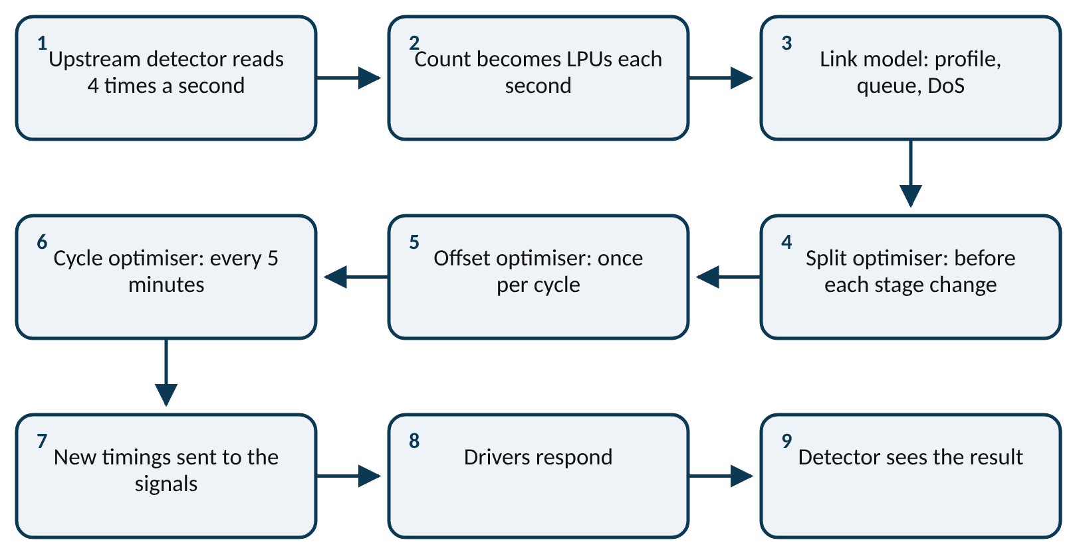
Worked example: How many decisions in one hour?
One junction, two stages, a 60 s cycle, in a region whose cycle is reviewed every 5 minutes.
1. Cycles per hour = 3600 ÷ 60 = 60.
2. Split decisions: one before each stage change, two changes per cycle, so 60 × 2 = 120.
3. Offset decisions: one per cycle, so 60.
4. Cycle decisions: one per 5 minutes, so 60 ÷ 5 = 12.
About 192 small decisions an hour at one junction. That is why each one can be small: there are plenty more to come.
Notes:
The SCOOT loop. What to notice: the detector feeds the model, the model feeds three optimisers working at three speeds, and the drivers' response is measured again by the detector. Read it left to right, then down.
Try it with the audience: A junction has three stages and an 80 s cycle. How many split decisions does SCOOT make in an hour?
Answer: 3600 ÷ 80 = 45 cycles; 3 stage changes per cycle gives 45 × 3 = 135 split decisions.

Slide 8
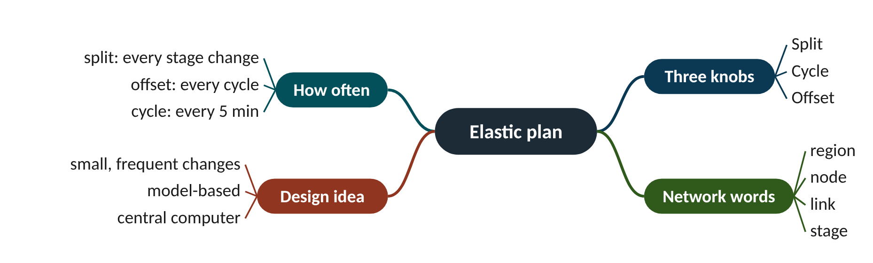
Remember it: Elastic plan
PICTURE THIS · STOP 1: TOWN GATE
TRAP
At the town gate a giant rubber band is stretched around the traffic light. Three dials on the pole are labelled S, C and O. A tiny engineer twangs the band every few seconds; it stretches, never snaps.
SCOOT does not pick a new plan from a library of plans (that is plan selection, an older idea). It edits the plan it is already running, a few seconds at a time.
Notes:
What the scene encodes: The rubber band is the elastic plan; the dials are split, cycle and offset; the frequent twangs are small, frequent changes.
Recap: Elastic plan: SCOOT turns three knobs (split every stage change, offset every cycle, cycle every 5 min) by small amounts, using a model.

Slide 9
2 Detectors and link profile units
IN PLAIN WORDS
Imagine a doorman who charges every person one coin to enter, plus two coins for every second they block the door. A quick walker pays a little over one coin; someone pushing a wide trolley pays three. The bill measures how much of the doorway each person used, not just how many came in.
Loops at the upstream end of each link
Gives 10-20 seconds of warning
LPU = vehicles + occupancy
Long or slow vehicles count more
1.96 vs 3.07
LPUs for a car and a bus at 13.5 m/s
Notes:
A bus takes up more green time than a car. How could a simple wire loop in the road know that, without knowing what a bus is?
A loop detector is a coil of wire under the road surface. When metal passes over it, it switches 'on'. SCOOT reads every loop four times a second, so it knows both how many vehicles crossed and how long the loop was covered (the occupancy).
SCOOT places its loops at the upstream end of each link, just after the previous junction. A vehicle crossing there will reach the stop line 10 to 20 seconds later, which gives the model time to act.
SCOOT turns each second of loop data into link profile units (LPUs), a blend of count and occupancy. Long vehicles cover the loop for longer, so they produce more LPUs, just as they need more green to clear. TRL's exact coding is not published; this lab uses the simple rule below, which behaves the same way.
Presenter tip: Use the doorman analogy before the formula. Do the car example on the board. Point out that slow traffic also scores higher, a useful side effect.

Slide 10
Worked example: A car and a bus at 13.5 m/s over a 2 m loop
occupancy time = (vehicle length + loop length) ÷ speed
LPU = 1 × vehicles + 2 × seconds occupied
Car length 4.5 m. Bus length 12 m. Speed 13.5 m/s (about 49 km/h).
1. Car occupancy: (4.5 + 2) ÷ 13.5 = 6.5 ÷ 13.5 = 0.48 s.
2. Car LPU: 1 + 2 × 0.48 = 1.96 LPU.
3. Bus occupancy: (12 + 2) ÷ 13.5 = 14 ÷ 13.5 = 1.04 s.
4. Bus LPU: 1 + 2 × 1.04 = 3.07 LPU.
5. Ratio: 3.07 ÷ 1.96 = 1.57.
The bus counts as about one and a half cars, without the loop ever 'knowing' it was a bus. The SUMO validation lab measured 1.95 LPU per vehicle on average, very close to our car.
Notes:
LPUs per vehicle at 13.5 m/s. What to notice: LPUs grow with length, so the model 'weights' each vehicle by the green it will use. Computed with the formula above (2 m loop).
Try it with the audience: A 16.5 m lorry crosses the 2 m loop at 9.25 m/s. How many LPUs does it produce?
Answer: Occupancy = (16.5 + 2) ÷ 9.25 = 18.5 ÷ 9.25 = 2.0 s. LPU = 1 + 2 × 2.0 = 5.0 LPU. Slower vehicles cover the loop longer, so they score more too.

Slide 11
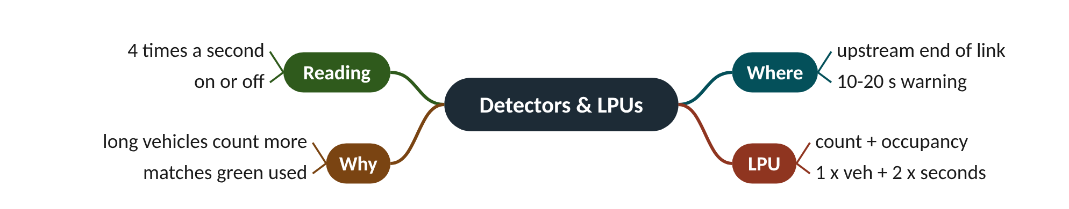
Remember it: Detectors & LPUs
PICTURE THIS · STOP 2: TOLL DOORMAT
TRAP
Just past the gate, a doormat across the whole road is a cash register. Every vehicle pays ONE gold coin to roll on, then TWO coins for every second it sits there. A long red bus groans, paying three coins and dropping one on its foot.
Do not think LPUs are 'vehicles'. A queue of 10 cars is about 20 LPUs in this lab. Always check whether a number is in vehicles or LPUs before you compare it.
Notes:
What the scene encodes: LPU = 1 × vehicles + 2 × seconds occupied; the bus costs about 3 LPUs, a car about 2. The mat is far from the lights: the upstream detector.
Recap: Detectors and LPUs: loops sit upstream (10-20 s warning); LPU = count + occupancy, so long or slow vehicles count more.

Slide 12
3 Profiles and platoon dispersion
IN PLAIN WORDS
Picture a school class leaving the gate together and walking to the bus stop. The fast walkers pull ahead, the slow ones fall behind. At the bus stop the class arrives over a longer time than it took to leave, and the busiest moment is less busy.
Cyclic flow profile: flow by second of the cycle
Shifted by about 0.8 × cruise time
Spread by Robertson's model
Same total, flatter and later peak
F = 0.263
smoothing factor on a 10-second link
Notes:
Cars leave a green light as a tight bunch. By the next junction the bunch has stretched out. Can you predict exactly how much, with one line of arithmetic?
Each second SCOOT adds the new LPUs into a cyclic flow profile: a bar chart of flow against 'second of the cycle'. Because the signals repeat every cycle, the profile shows where in the cycle platoons arrive. It is smoothed over several cycles (new value = 0.75 × old + 0.25 × new) so one odd cycle does not dominate.
To know when traffic reaches the stop line, SCOOT moves the profile forward by about the cruise time T (detector to stop line at cruising speed) and spreads it out. It uses Robertson's dispersion model, the same one used by the TRANSYT design program.
Read the formula like a recipe: each second's arrival at the stop line is a fraction F of what crossed the detector, plus the rest (1 − F) of the previous second's arrival. A small F means a lot of spreading. Longer roads (bigger T) give smaller F.
Presenter tip: Draw the two curves by hand and fill in the first three seconds of the recursion with the class. Emphasise that area is conserved.

Slide 13
Worked example: A 10-second platoon on a 10-second link
q_{stop}(t + βT) = F · q_{det}(t) + (1 − F) · q_{stop}(t + βT − 1)
F = 1 ÷ (1 + α β T), α = 0.35, β = 0.8
A platoon crosses the detector at 1 LPU per second for 10 seconds. Cruise time T = 10 s.
1. Lag βT = 0.8 × 10 = 8 s: the first arrivals appear 8 s after the first detection.
2. F = 1 ÷ (1 + 0.35 × 0.8 × 10) = 1 ÷ 3.8 = 0.263.
3. Second 1 at the stop line: 0.263 × 1 + 0.737 × 0 = 0.263.
4. Second 2: 0.263 × 1 + 0.737 × 0.263 = 0.457.
5. Second 3: 0.263 × 1 + 0.737 × 0.457 = 0.600.
6. Keep going: the arrivals reach a peak of 0.95 after 10 s and then fade away over roughly 15 more seconds.
The same 10 LPUs arrive, but spread over about 25 s with a lower peak (0.95 instead of 1.0). Nothing is lost; it is only rearranged in time.
Notes:
The same platoon at the detector and at the stop line. What to notice: the stop-line curve starts 8 s later, rises gradually, and has a long tail. The areas under the two curves are equal (10 LPU). Computed with Robertson's formula, T = 10 s.
Try it with the audience: Find F and the lag for a long link with cruise time T = 20 s. Will the platoon spread more or less than in the worked example?
Answer: F = 1 ÷ (1 + 0.35 × 0.8 × 20) = 1 ÷ 6.6 = 0.152; lag = 0.8 × 20 = 16 s. F is smaller, so the platoon spreads more.

Slide 14
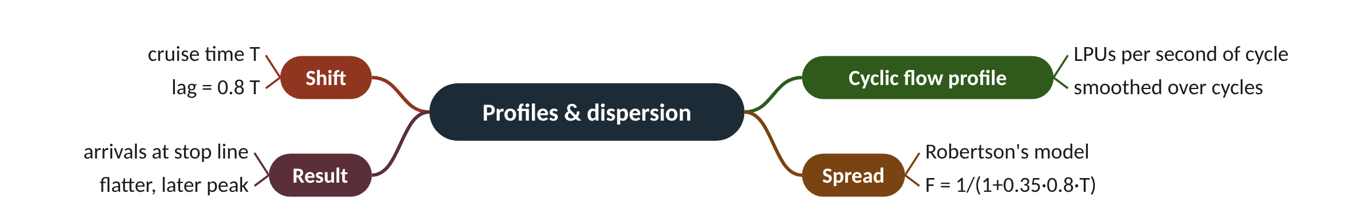
Remember it: Profiles & dispersion
PICTURE THIS · STOP 3: MARCHING-BAND BRIDGE
TRAP
On a bridge, a marching band of 35 players leaves in a tight block. A sign says 'walk at 80% speed'. By the far end of the bridge the trombones are way ahead and the drummers trail far behind, still playing.
The lag is not the full cruise time. In Robertson's model the platoon's front arrives at βT = 0.8 T, because the fastest drivers get there early. The rest arrive later in the tail.
Notes:
What the scene encodes: 35 players and 80% encode α = 0.35 and β = 0.8; the band spreading out is dispersion; the far end of the bridge is the stop line.
Recap: Profiles and dispersion: LPUs build a smoothed cyclic profile; Robertson shifts it by 0.8T and spreads it with F = 1/(1 + 0.35·0.8·T).

Slide 15
4 The queue model and degree of saturation
IN PLAIN WORDS
A queue is a bathtub. Arrivals are the tap, always running. During red the plug is in, so the water rises. During green the plug is out and the water drains at a fixed speed (the saturation occupancy). If the tap is slower than the drain, the tub empties during green.
Red fills the queue, green drains it at SATO
Delay is the area under the queue
DoS = demand ÷ what green can serve
Aim for 90% or less; PI = delay + K·stops
90%
SCOOT's usual degree-of-saturation target
Notes:
If you know when cars arrive and when the light is green, you can draw the queue without ever seeing it. SCOOT does exactly that, for every link, every second.
From the predicted arrivals at the stop line, the model follows simple rules. Arrivals during red join the queue. During effective green the queue leaves at the saturation occupancy (SATO), in LPUs per second. Effective green starts a start lag after the light turns green (drivers react) and ends an end lag after it turns amber (drivers keep going through amber).
From the queue the model reads three things. Delay is the area under the queue curve (LPU·seconds). Stops are arrivals that meet a red light or a queue. The degree of saturation (DoS) is how full the green is: demand in the cycle, plus any queue left over, divided by what the green could discharge.
SCOOT tries to keep every link's DoS at or below about 90%, leaving a margin for random surges. The optimisers compare options using a performance index (PI): delay plus a weight K times stops.
Presenter tip: Draw the triangle on the board and compute the area together. Explain that the optimisers in the Advanced level all compare PI values from this same model.

Slide 16
Worked example: One 60 s cycle on one link
DoS = (LPU arriving per cycle + residual queue) ÷ (effective green × SATO)
PI = delay + K × stops
Arrivals 0.2 LPU/s, steady. Effective red 35 s, effective green 25 s. SATO 0.6 LPU/s. No queue at the start.
1. Queue at the end of red: 0.2 × 35 = 7 LPU.
2. In green the queue shrinks at 0.6 − 0.2 = 0.4 LPU/s, so it clears after 7 ÷ 0.4 = 17.5 s.
3. Delay = triangle areas: ½ × 35 × 7 + ½ × 17.5 × 7 = 122.5 + 61.25 = 183.75 LPU·s per cycle.
4. Stops = everyone who arrived before the queue cleared: 0.2 × (35 + 17.5) = 10.5 LPU.
5. Demand per cycle = 0.2 × 60 = 12 LPU. Capacity = 25 × 0.6 = 15 LPU. DoS = 12 ÷ 15 = 0.80.
DoS is 80%, under the 90% target, so this link has some spare green to give away.
Notes:
The modelled queue over one cycle. What to notice: the queue grows in a straight line during red, falls faster during green, and is empty for the last 7.5 s of green. Delay is the area under the curve. Values from the worked example.
Try it with the audience: Same link, but arrivals rise to 0.24 LPU/s. What is the DoS? Is it under 90%?
Answer: Demand = 0.24 × 60 = 14.4 LPU; capacity 15 LPU; DoS = 14.4 ÷ 15 = 0.96. That is above the 90% target, so the split optimiser would want more green here.

Slide 17
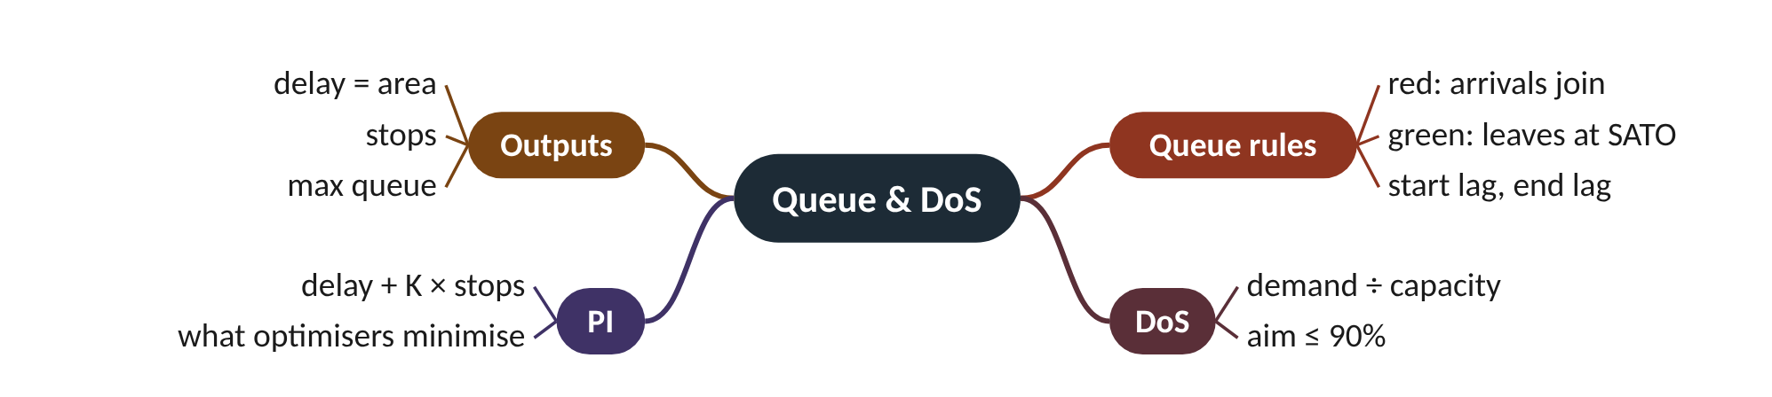
Remember it: Queue & DoS
PICTURE THIS · STOP 4: BATHTUB AT THE STOP LINE
TRAP
At the stop line stands a huge bathtub with a tap that never stops. When the light is red, a rubber plug shaped like a red light is in. On green the plug pops and water swirls out. A gauge on the side is painted red above the 90% mark.
A DoS of 100% does not mean the road is jammed forever; it means the green is exactly used up. Above 100% a residual queue carries into the next cycle and grows. Also: DoS uses effective green, not the displayed green.
Notes:
What the scene encodes: Tap = arrivals; drain speed = SATO; red plug = red; the 90% mark = SCOOT's DoS target; the water's area over time = delay.
Recap: Queue and DoS: red fills the 'bathtub', green drains it at SATO; delay = area, DoS = demand ÷ (green × SATO), target ≤ 90%; PI = delay + K·stops.

Slide 18
5 Validation: making the model match the street
IN PLAIN WORDS
Validation is like tuning a guitar by ear. The model is the guitar; the street is the tuning fork. You pluck, listen, and turn the peg until they agree. A perfectly built guitar still plays wrong notes if nobody tunes it.
The model is only as good as its parameters
Engineer compares model with the street
Queue clears early in model → SATO too high
Lab: SATO 0.67 / 0.89, lags 3 s / 4 s
4 s
clear-time error from a 12% SATO error
Notes:
Poor validation is the most common reason SCOOT underperforms. The cure is low-tech: an engineer at the kerb with a stopwatch.
The model has a few numbers that depend on the actual street: the cruise time from detector to stop line, the saturation occupancy (SATO) at which a queue discharges, the start lag and end lag, and the maximum queue clear time. When a link is commissioned, an engineer stands at the stop line and compares what they see with what SCOOT shows.
The simplest check: when does the queue clear? If the model's queue empties earlier than the real one, the model thinks traffic leaves faster than it does, so SATO is too high. If it empties later, SATO is too low.
In this lab's SUMO network, Lab F2 measured 1.95 LPU per vehicle, cruise speed 13.5 m/s, SATO 0.67 LPU/s per lane on the main road and 0.89 on the side road, a start lag of 3 s and an end lag of 4 s. Those became the controller's defaults.
Presenter tip: Show the Lab F1 figure. Ask the class which way to move SATO if the model clears early before revealing the answer.

Slide 19
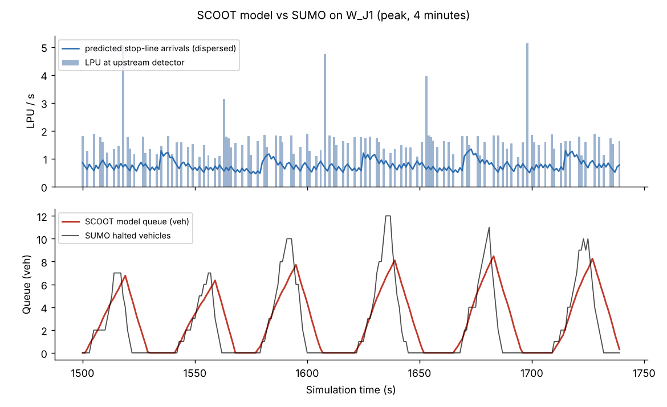
Worked example: Fixing SATO from a stopwatch
queue clear time = start lag + queue ÷ SATO
SATO = queue ÷ (observed clear time − start lag)
A queue of 10 cars (about 19.5 LPU) is waiting. Model SATO 0.67 LPU/s, start lag 3 s. The engineer sees the queue clear 36 s after green starts.
1. Model clear time: 3 + 19.5 ÷ 0.67 = 3 + 29.1 = 32.1 s.
2. Observed: 36 s. The model clears about 4 s early, so its SATO is too high.
3. Corrected SATO = 19.5 ÷ (36 − 3) = 19.5 ÷ 33 = 0.59 LPU/s.
4. Check: 3 + 19.5 ÷ 0.59 = 3 + 33.0 = 36.0 s. It now matches.
A 12% change in SATO moved the model's clear time by 4 s. Small parameter errors give big errors in delay and DoS.
Notes:
SCOOT's model queue against SUMO's real queue (Lab F1). What to notice: the model never sees the real queue, yet it follows it in timing and size. The model empties a few seconds later because SUMO stops counting a car as queued the moment it starts moving.
Try it with the audience: The model's queue clears at 30 s, but on the street it clears at 27 s (queue 18 LPU, start lag 3 s). Is SATO too high or too low? What should it be?
Answer: The model clears later than the street, so SATO is too low. SATO = 18 ÷ (27 − 3) = 18 ÷ 24 = 0.75 LPU/s.

Slide 20
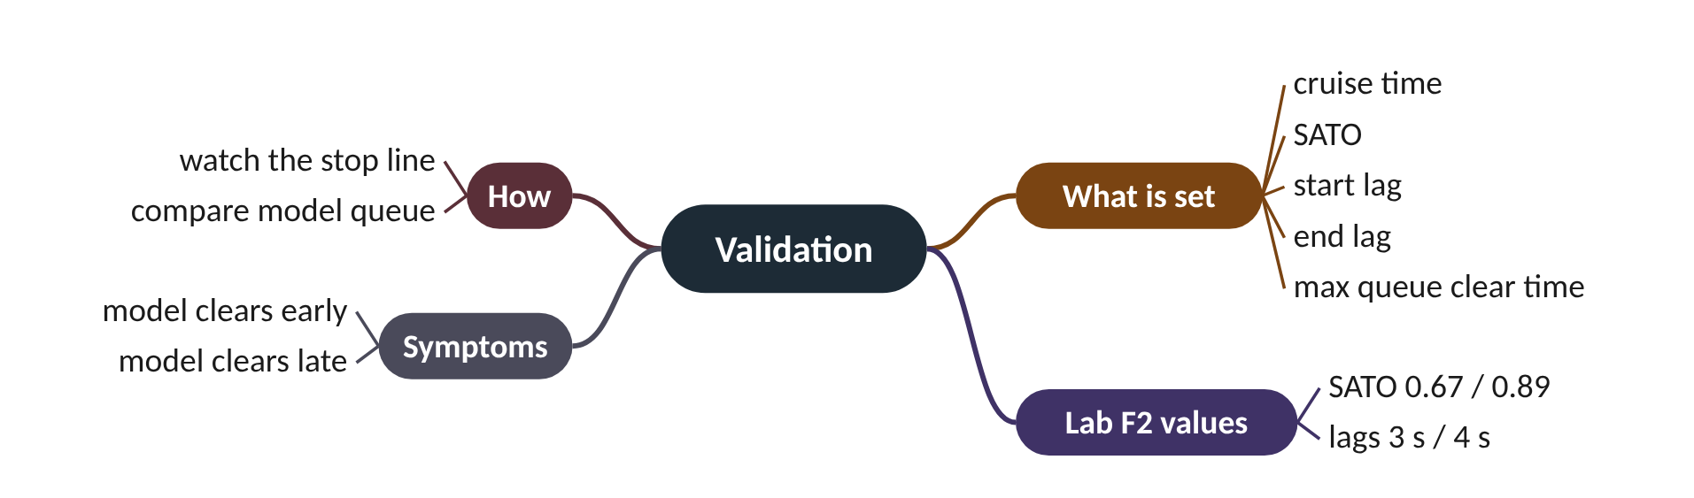
Remember it: Validation
PICTURE THIS · STOP 5: GUITAR SHOP
TRAP
Beside the stop line a guitar shop has a giant guitar strung across the road. An engineer with a stopwatch in her teeth twists a tuning peg marked SATO. The peg has two smaller pegs labelled 3 and 4.
Do not 'fix' a model by changing the target DoS or the optimiser. If the queue picture is wrong, every decision built on it is wrong. Validate the model first.
Notes:
What the scene encodes: Tuning = validation; the SATO peg = saturation occupancy; 3 and 4 = start lag 3 s and end lag 4 s; the stopwatch = observed queue clear time.
Recap: Validation: tune cruise time, SATO, start/end lag and max queue clear time so the model's queue clears when the real one does.

Slide 21
6 SCOOT against fixed time and actuation
IN PLAIN WORDS
Fixed time is a printed bus timetable. Actuation is a driver who leaves as soon as nobody else is running for the bus. SCOOT is a dispatcher with a radio who hears that a crowd is coming in 15 seconds and plans for it.
Fixed time: a stored plan (Webster, TRANSYT)
Actuated: reacts to gaps at the stop line
SCOOT: predicts from upstream, adapts gently
Lab F3: 19.0 vs 14.5 vs 12.8 s delay
12.8 s
SCOOT mean delay in Lab F3 (fixed 19.0 s)
Notes:
On one isolated junction, a simple actuated signal is already good. So how much does SCOOT add, and where does it really shine?
Fixed-time signals repeat a stored plan, designed offline from traffic counts. For one junction the classic design is Webster's formula. For networks, engineers used TRANSYT, which uses the same profile and dispersion model as SCOOT. SCOOT is often called an 'on-line TRANSYT'.
Actuated signals have loops at the stop line and end a green when the gap between vehicles gets too long. They react well to random gaps but cannot see what is coming and do not coordinate.
In Lab F3 (one junction, one simulated hour in SUMO, same arrivals for all) mean delay was 18.96 s for fixed time, 14.48 s for actuation and 12.79 s for SCOOT. SCOOT's cycle optimiser shortened the cycle in light traffic and held it while DoS rose in the peak.
Presenter tip: Be honest that actuation is strong at one junction. Set up the Advanced level: coordination across a region is where SCOOT's model matters most.

Slide 22
Worked example: Webster for a two-stage junction
C₀ = (1.5 L + 5) ÷ (1 − Y)
g_{i} = (C₀ − L) × y_{i} ÷ Y
Lost time L = 10 s. Main road flow ratio y_{A} = 0.35, side road y_{B} = 0.25.
1. Y = 0.35 + 0.25 = 0.60.
2. C₀ = (1.5 × 10 + 5) ÷ (1 − 0.60) = 20 ÷ 0.40 = 50 s.
3. Effective green to share = 50 − 10 = 40 s.
4. Main road: 40 × 0.35 ÷ 0.60 = 23.3 s. Side road: 40 × 0.25 ÷ 0.60 = 16.7 s.
A good fixed plan for these flows: 50 s cycle, 23.3 s and 16.7 s of effective green. It stays good only while the flows stay the same, which is why SCOOT adapts.
Notes:
Mean delay per vehicle in Lab F3 (SUMO, one junction, one hour). What to notice: SCOOT beats fixed time by about a third and actuation by about 12%. The gap to actuation is small at an isolated junction; coordination is where SCOOT's model pays off.
Try it with the audience: Use Webster with L = 12 s, yA = 0.40, yB = 0.30. Find C0 and both greens.
Answer: Y = 0.70. C0 = (18 + 5) ÷ 0.30 = 76.7 s. Green to share = 64.7 s. Main 64.7 × 0.40/0.70 = 37.0 s; side 64.7 × 0.30/0.70 = 27.7 s.

Slide 23
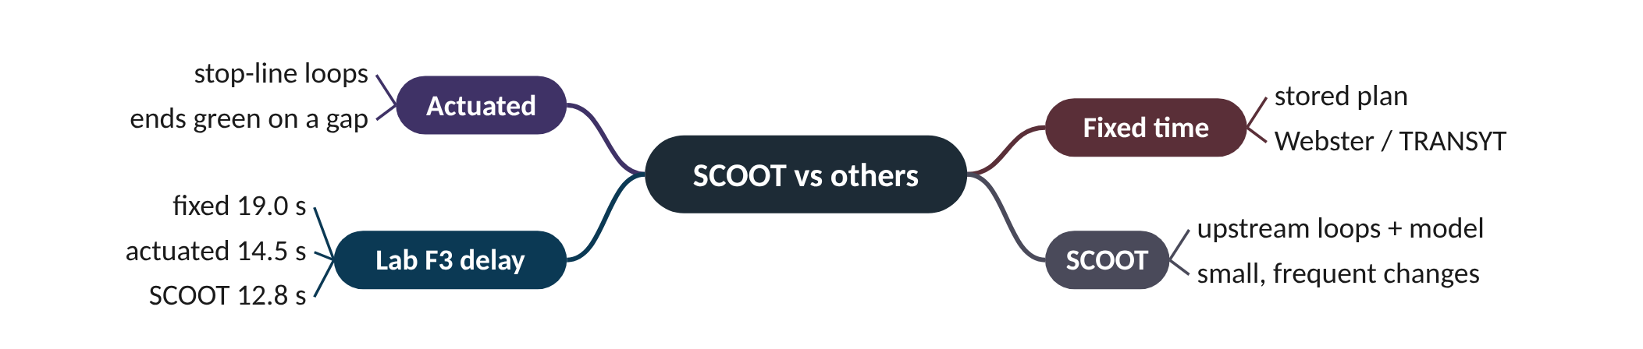
Remember it: SCOOT vs others
PICTURE THIS · STOP 6: FINISH LINE AT THE CONTROL CENTRE
TRAP
Outside the control centre three runners finish a race. A robot with a printed timetable on its chest crosses at 19, a jumpy rabbit at 14 and a half, and a calm dispatcher wearing headphones at just under 13. On the podium sits a set of scales labelled '1.5 L + 5'.
Webster's formula blows up as Y approaches 1: at Y = 0.9 and L = 10, C0 = 200 s. Real controllers cap the cycle, and when Y ≥ 1 the junction is simply over capacity: no cycle length can fix it.
Notes:
What the scene encodes: Finish times are the Lab F3 delays (19.0, 14.5, 12.8 s); the scales are Webster's formula C0 = (1.5L + 5)/(1 − Y).
Recap: SCOOT vs others: fixed plans come from Webster/TRANSYT; actuation reacts at the stop line; SCOOT predicts. Lab F3: 19.0 / 14.5 / 12.8 s delay.

Slide 24
Three ways to run a traffic light
 | Fixed time | Actuated | SCOOT
Detectors | none | at the stop line | upstream, 10-20 s before the stop line
Decides with | a stored plan | gaps between vehicles | a model of every link
Coordinates junctions? | yes, if designed so | no | yes, through offsets and a shared cycle
Reacts to change | no | every second | small steps: stage change, cycle, 5 min
Lab F3 delay | 18.96 s | 14.48 s | 12.79 s

Slide 25
Things beginners mix up
This… | …is not this | The fact that tells them apart
Vehicles | LPUs | LPUs add occupancy, so a car is about 2 LPU and a bus about 3.
Cruise time T | Lag βT | The platoon's front arrives at 0.8 T, not T.
Displayed green | Effective green | Effective green starts a start lag late and runs an end lag into amber.
DoS 100% | Gridlock | 100% means the green is just used up; queues grow only above it.
Elastic plan | Plan selection | SCOOT edits the running plan; plan selection swaps whole stored plans.

Slide 26
Check yourself (1 of 2)
A 7 m van crosses a 2 m loop at 13.5 m/s. Using this lab's LPU rule, how many LPUs?
Arrivals 0.25 LPU/s, effective green 30 s, SATO 0.5 LPU/s, cycle 60 s, no residual queue. DoS?
A. 1.00
B. 1.67
C. 2.33
D. 3.07
A. 0.50
B. 0.83
C. 1.00
D. 1.20
Answers are in the speaker notes and in the study guide's answer key.
Notes:
Answer: C. Occupancy 9 ÷ 13.5 = 0.667 s; LPU = 1 + 2 × 0.667 = 2.33. 3.07 is the bus; 1.00 forgets occupancy.
Answer: C. Demand 0.25 × 60 = 15 LPU; capacity 30 × 0.5 = 15 LPU; DoS = 1.00. The green is exactly full.

Slide 27
Check yourself (2 of 2)
In Lab F3 which controller had the lowest mean delay?
Webster with Y = 0.95 and L = 10 gives C₀ = 400 s. What is the right conclusion?
A. Fixed time
B. Actuated
C. SCOOT
D. All the same
A. Use a 400 s cycle
B. The junction is near capacity; cap the cycle and look at capacity, not timing
C. Webster is wrong for all junctions
D. Set Y to 0.6
Answers are in the speaker notes and in the study guide's answer key.
Notes:
Answer: C. SCOOT 12.79 s, actuated 14.48 s, fixed 18.96 s.
Answer: B. As Y → 1 no cycle can serve demand with reasonable delay; controllers cap the cycle (SCOOT's region maximum).

Slide 28
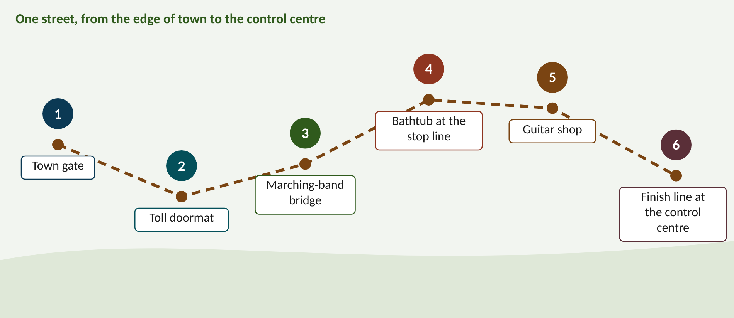
Walk the memory route
1 Town gate = Elastic plan · 2 Toll doormat = Detectors & LPUs · 3 Marching-band bridge = Profiles & dispersion · 4 Bathtub at the stop line = Queue & DoS · 5 Guitar shop = Validation · 6 Finish line at the control centre = SCOOT vs others
Notes:
Stop 1, Town gate: At the town gate a giant rubber band is stretched around the traffic light. Three dials on the pole are labelled S, C and O. A tiny engineer twangs the band every few seconds; it stretches, never snaps. (The rubber band is the elastic plan; the dials are split, cycle and offset; the frequent twangs are small, frequent changes.)
Stop 2, Toll doormat: Just past the gate, a doormat across the whole road is a cash register. Every vehicle pays ONE gold coin to roll on, then TWO coins for every second it sits there. A long red bus groans, paying three coins and dropping one on its foot. (LPU = 1 × vehicles + 2 × seconds occupied; the bus costs about 3 LPUs, a car about 2. The mat is far from the lights: the upstream detector.)
Stop 3, Marching-band bridge: On a bridge, a marching band of 35 players leaves in a tight block. A sign says 'walk at 80% speed'. By the far end of the bridge the trombones are way ahead and the drummers trail far behind, still playing. (35 players and 80% encode α = 0.35 and β = 0.8; the band spreading out is dispersion; the far end of the bridge is the stop line.)
Stop 4, Bathtub at the stop line: At the stop line stands a huge bathtub with a tap that never stops. When the light is red, a rubber plug shaped like a red light is in. On green the plug pops and water swirls out. A gauge on the side is painted red above the 90% mark. (Tap = arrivals; drain speed = SATO; red plug = red; the 90% mark = SCOOT's DoS target; the water's area over time = delay.)
Stop 5, Guitar shop: Beside the stop line a guitar shop has a giant guitar strung across the road. An engineer with a stopwatch in her teeth twists a tuning peg marked SATO. The peg has two smaller pegs labelled 3 and 4. (Tuning = validation; the SATO peg = saturation occupancy; 3 and 4 = start lag 3 s and end lag 4 s; the stopwatch = observed queue clear time.)
Stop 6, Finish line at the control centre: Outside the control centre three runners finish a race. A robot with a printed timetable on its chest crosses at 19, a jumpy rabbit at 14 and a half, and a calm dispatcher wearing headphones at just under 13. On the podium sits a set of scales labelled '1.5 L + 5'. (Finish times are the Lab F3 delays (19.0, 14.5, 12.8 s); the scales are Webster's formula C0 = (1.5L + 5)/(1 − Y).)

Slide 29
Numbers to remember
› Loop read 4 times a second; 10-20 s warning
› Car ≈ 1.96 LPU, bus ≈ 3.07 LPU (13.5 m/s, 2 m loop)
› α = 0.35, β = 0.8; T = 10 → F = 0.263
› DoS target ≈ 90%
› Lab F2: SATO 0.67 / 0.89 LPU/s per lane, lags 3 / 4 s
› Lab F3 delay: 18.96 / 14.48 / 12.79 s
› Webster: L 10, Y 0.6 → C₀ = 50 s

Slide 30
Keep going
Study guide: SCOOT_Foundation_Study_Guide.pdf · Interactive labs and SUMO code: smrahmanbd.github.io/scoot-learning-lab
Notes:
Point learners to the study guide for the full worked examples, quiz and revision plan, and to the website for the simulators.

