Slide 1
What comes after SCOOT? Six experiments, reported honestly
SCOOT · Level 3 · Mastery
Connected cars, learning agents, max-pressure, broken loops, emissions and speed advice: each idea built, tested in SUMO and measured fairly.
smrahmanbd.github.io/scoot-learning-lab
Notes:
This is the research level, but it is still written for beginners. Each idea is explained with an everyday picture first, then a small hand calculation, then what actually happened when we built it on the lab's SUMO controller. Some ideas did not beat standard SCOOT. That is normal in research, and knowing why is the most useful thing you can learn. There are seven ideas; the first one, how to test fairly, is used by all the others.

Slide 2
7 ideas, each building on the last
1
How to evaluate a new SCOOT idea
2
SCOOT on connected-vehicle data
3
A learning split optimiser
9 s spread of SCOOT's delay across three seeds
33.9 s delay with 25% connected cars (loops: 30.4 s)
67.7 s RL agent delay on unseen days (SCOOT 37.8 s)
4
Max-pressure and spill-back-aware SCOOT
5
Detector faults and historic substitution
6
Emissions-aware SCOOT: the price of a stop
224 s max-pressure delay on 120 m links (SCOOT 28.7 s)
70% of the fault damage recovered by historic profiles
~228 g CO2 per vehicle for K = 0, 4, 20 and 40
7
Predicting stage changes for GLOSA
1.3-2.6 s mean error of predicted end of green, up to 60 s ahead
Notes:
Outcomes for today:
- Design a fair test of a new SCOOT idea: one change, same demand, several seeds, every second of delay counted.
- Estimate LPUs from connected vehicles and say how the error depends on penetration.
- Describe a learning split optimiser (state, action, reward) and explain why our first one lost.
- Compute a max-pressure-style exit-blocking score and say when it should help.
- Explain what stuck-on and stuck-off detectors do to SCOOT and how historic substitution recovers.
- Show how the stop weight K changes the best decision, and why single runs can mislead.
- Judge whether a predicted end of green is good enough for speed advice (GLOSA).

Slide 3
Three surprises to start
Better data was worse.
The clever agent lost badly.
Old data rescued a broken network.
SCOOT running on connected-vehicle counts alone, with every car connected, beat SCOOT on its own loops: 26.3 s against 30.4 s of delay. A loop under a crawling queue over-counts; a simple count does not.
A reinforcement-learning split optimiser averaged 67.7 s of delay on unseen days; plain SCOOT averaged 37.8 s. A negative result, clearly measured, is a real research finding and a starting line.
When 13 of 40 detectors failed, trusting their readings more than doubled delay. Swapping in each link's own recorded history recovered about 70% of the loss.

Slide 4
Words you will meet
Baseline | The standard method you compare against: here fixed time, actuation and standard SCOOT.
Seed | The number that sets the 'random dice' of a simulation. Different seeds give different but equally likely days.
Ablation | Switching off one part to see how much it was worth.
Connected vehicle (CV) | A car that reports its position by radio or phone. Penetration p is the share of cars that do.
Reinforcement learning (RL) | A program that learns which action to take by trial, error and a score (the reward).
Max-pressure | A controller that serves the movement with the biggest upstream queue minus downstream queue.
Spill-back | A queue so long it backs into, and blocks, the junction behind it.
ASTRID | SCOOT's database of past link data, used here as a substitute for broken detectors.
GLOSA | Green Light Optimal Speed Advisory: telling a driver what speed will reach the light on green.
Notes:
You do not need to memorise these now; each is explained again when it first matters.

Slide 5
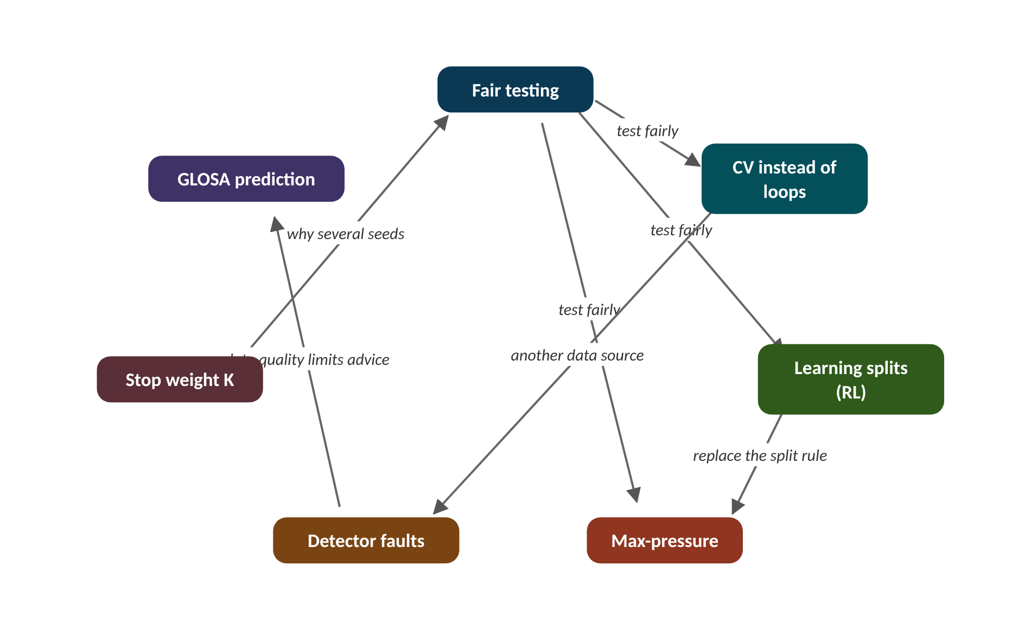
The map of today's ideas
Notes:
Each box is one idea; arrows say how one feeds the next. test fairly; test fairly; test fairly; another data source; why several seeds; data quality limits advice; replace the split rule.

Slide 6
1 How to evaluate a new SCOOT idea
IN PLAIN WORDS
Testing a new fertiliser? Grow two identical plants in the same soil and light, change only the fertiliser, and repeat with several pairs. One lucky plant proves nothing.
Change one thing only
Same demand, same seeds for all
Several seeds: report the spread
Count every second, many measures
9 s
spread of SCOOT's delay across three seeds
Notes:
It is easy to make a new controller look good: pick a lucky day, measure only what improves, or quietly push queues off the edge of the map. How do you make sure you are not fooling yourself?
Every study in this level swaps one part of SCOOT through a hook in the controller's settings (the data source, the split chooser, the sensor filter, or the stop weight) and keeps everything else standard. Then any difference in results comes from that one change.
All controllers see identical demand and seeds. A seed fixes the simulation's random dice, so each seed is one 'day'. Because days differ, we run several seeds and report the spread, not the best run.
We report more than delay: stops, bus delay and CO2 can move in different directions. And we count every second of delay, including time vehicles spend waiting to enter the network, so no method can look good by pushing queues off the map. Finally, ask what would stop real deployment: validation effort, explainability, data, and robustness to broken detectors.
Presenter tip: Start with the fertiliser analogy. Show that the same controller gives 33 to 42 s on different days, so any claimed gain must beat that spread.

Slide 7
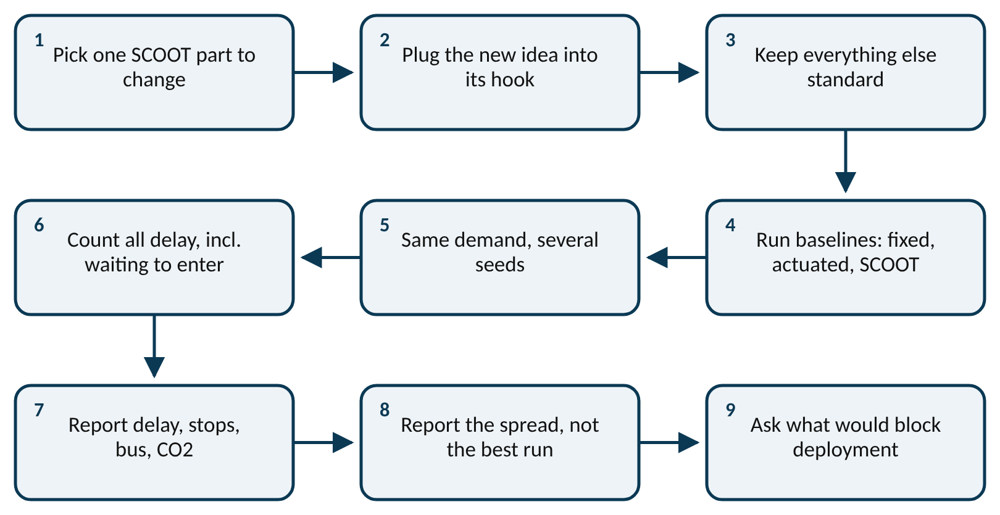
Worked example: Is the difference bigger than the day-to-day spread?
difference = new method − baseline, on the same seed
Standard SCOOT on three seeds: 33.1, 38.2, 42.1 s delay. The RL agent on the same seeds: 72.4, 60.8, 69.9 s.
1. SCOOT mean: (33.1 + 38.2 + 42.1) ÷ 3 = 113.4 ÷ 3 = 37.8 s.
2. SCOOT spread between days: 42.1 − 33.1 = 9.0 s.
3. Paired differences, RL − SCOOT: 72.4 − 33.1 = 39.3; 60.8 − 38.2 = 22.6; 69.9 − 42.1 = 27.8 s.
4. All three are positive and each is bigger than the 9 s spread.
5. Mean difference: (39.3 + 22.6 + 27.8) ÷ 3 = 29.9 s worse.
The RL agent is clearly worse, on every day. A 2 s 'improvement' from a single seed would have been inside the 9 s spread and meant nothing.
Notes:
A fair study, step by step. What to notice: the idea enters at one hook only, and the same seeds and demand go to every controller. Read left to right, then down.
Try it with the audience: A new idea gives 35.0 s on seed 7, against SCOOT's 33.1 s, and 36.0 s on seed 8 against 38.2 s. Can you say it is better or worse?
Answer: Differences: +1.9 s and −2.2 s. They point in opposite directions and are far smaller than the 9 s day-to-day spread. No conclusion yet; run more seeds.

Slide 8
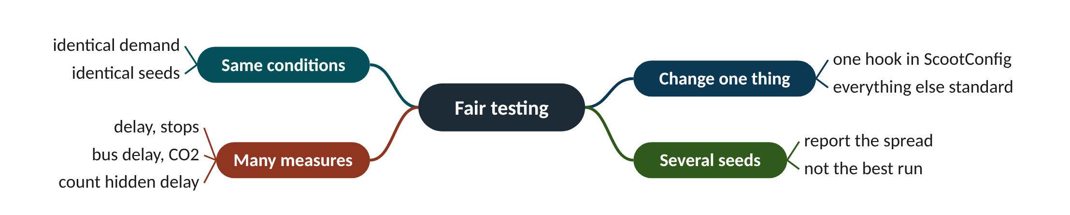
Remember it: Fair testing
PICTURE THIS · STOP 1: TWIN-PLANT ENTRANCE STAND
TRAP
At the entrance a judge in a white coat holds two identical potted plants, each with three seeds glued on the pot. She changes the label on ONE pot only, then weighs both on a huge brass scale while a vacuum cleaner under the table refuses to suck any queue off the stage.
Do not report your best seed. If the improvement is smaller than the difference between seeds, you have not shown anything yet: run more seeds.
Notes:
What the scene encodes: Two identical plants = same demand; one label = change one thing; three seeds = several seeds; the vacuum that won't hide queues = count all delay.
Recap: Fair testing: change one thing, same demand and seeds, several seeds with the spread, many measures, count every second of delay.

Slide 9
2 SCOOT on connected-vehicle data
IN PLAIN WORDS
A pollster asks 1 in 4 voters and multiplies by 4. Ask enough people and the guess is good; ask 1 in 20 and a few odd answers swing the result wildly.
Virtual detector: count CVs, divide by p
Noisy at low penetration
25% connected: 33.9 s vs loops 30.4
50-100% beat loops: no occupancy inflation
33.9 s
delay with 25% connected cars (loops: 30.4 s)
Notes:
Upstream loops are expensive and break often. Many cars already report where they are. If only one car in four does, can SCOOT still see the traffic?
A virtual detector is a line on the map where the loop used to be. Count the connected vehicles crossing it, divide by the penetration p (the share of cars that are connected), and multiply by LPUs per vehicle. That gives an estimated LPU count.
The estimate is noisy when p is small: a few connected cars more or less make a big difference after dividing by p. It also misses occupancy, the second part of an LPU. In the open-loop test (estimating LPUs on identical traffic) one-minute totals were off by 121% at p = 5%, 53% at 25% and still 23% at 100%.
In closed loop (SCOOT actually controlling with CV data) the picture was better, because SCOOT smooths profiles over cycles. Delay was 33.9 s at 25% against 30.4 s with loops, and better than loops at 50% and 100% (27.5 and 26.3 s): when queues crawl over a loop, occupancy inflates its LPUs, and counts avoid that. Below 10% control degraded clearly (43.7 s at 5%).
Presenter tip: Use the pollster analogy. Emphasise the open-loop vs closed-loop difference: a noisy sensor can still give good control.

Slide 10
Worked example: How noisy is one cycle's estimate?
LPU_{est} = (connected vehicles crossing) ÷ p × LPU per vehicle
spread of the estimate ≈ √(N p (1 − p)) ÷ p
20 vehicles cross per cycle. Penetration p = 25%.
1. Expected connected cars: 20 × 0.25 = 5; estimate 5 ÷ 0.25 = 20. Correct on average.
2. Spread of the CV count: √(20 × 0.25 × 0.75) = √3.75 = 1.94 cars.
3. Spread of the estimate: 1.94 ÷ 0.25 = 7.7 vehicles, about 39% of 20.
4. At p = 5%: √(20 × 0.05 × 0.95) ÷ 0.05 = 0.97 ÷ 0.05 = 19.5, about 97%.
5. Chance a cycle sees no CV at 5%: 0.95²⁰ = 0.36.
At 5% a third of cycles see no connected car at all. At 25% one cycle is rough, but smoothing over several cycles brings the error down.
Notes:
SCOOT's delay on CV data alone, by penetration. What to notice: delay falls as more cars are connected, crosses the loop-based line between 25% and 50%, and is clearly worse below 10%. SUMO region scenario, seed 1.
Try it with the audience: With 40 vehicles per cycle and p = 50%, what is the spread of the estimate, in vehicles and as a percentage?
Answer: √(40 × 0.5 × 0.5) = √10 = 3.16 connected cars; ÷ 0.5 = 6.3 vehicles, about 16% of 40.

Slide 11
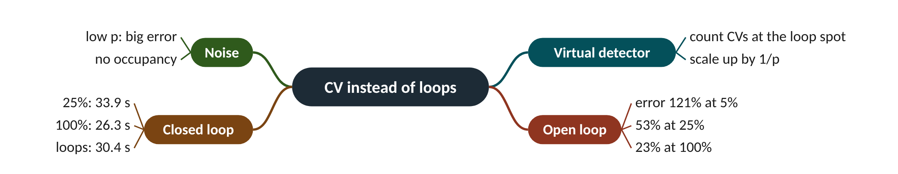
Remember it: CV instead of loops
PICTURE THIS · STOP 2: GLOWING-PHONE CROWD
TRAP
At the second stand a crowd walks past a chalk line. Only one in four people carries a glowing phone. A bouncer counts the glowing phones and shouts the number times four through a megaphone. When only one person in twenty glows, his guesses jump wildly and he falls off his stool.
A big open-loop error does not mean bad control. SCOOT smooths and keeps adjusting, so 53% error per minute still gave delay within 11% of loops. Always test in closed loop too.
Notes:
What the scene encodes: Chalk line = virtual detector; one in four = p = 25% (33.9 s, close to loops 30.4 s); one in twenty = 5%, where control broke down (43.7 s).
Recap: CV data: count connected cars at a virtual detector and divide by p; noisy below 10%, near loops at 25% (33.9 vs 30.4 s), better at 50-100%.

Slide 12
3 A learning split optimiser
IN PLAIN WORDS
Teaching a puppy: it tries something, gets a treat or not, and slowly learns. With a clear signal and many tries it learns tricks. With confusing treats and only ten lessons, it just gets excited and knocks things over.
Learn only the split choice
Action: −4, 0 or +4 seconds
Reward: minus the queue change
First agent lost: 67.7 vs 37.8 s
67.7 s
RL agent delay on unseen days (SCOOT 37.8 s)
Notes:
SCOOT's split optimiser chooses between three moves using a rule written by people. Could a program that learns from trial and error choose better, while keeping all of SCOOT's safety limits?
Reinforcement learning (RL) learns a table of how good each action is in each situation. The state is a short description of the situation: which stage is ending, the DoS of the ending and next stage (sorted into bins) and the modelled queue. The action is SCOOT's own choice: −4, 0 or +4 s on the stage change. The reward is minus the change in modelled queue until the next decision.
Only the split choice is learned. Minimum greens, offsets and the cycle optimiser stay as standard SCOOT. That keeps the safety envelope and makes the agent easier to explain and certify than a controller learned from scratch.
What happened. Ten short training runs were unstable (33 to 214 s per episode). On three unseen seeds the greedy agent averaged 67.7 s against SCOOT's 37.8 s, with more than twice the bus delay. The state was too coarse, the reward too noisy and the training far too short. The browser toy on the website shows the idea can work on a small problem.
Presenter tip: Present this as an honest negative result. Discuss richer state, longer training and offline RL from logged SCOOT decisions as next steps.

Slide 13
Worked example: One Q-learning update
Q(s, a) ← Q(s, a) + α [ r + γ max_{a′} Q(s′, a′) − Q(s, a) ]
Q(s, +4) = −2.0. The agent takes +4, the queue grows by 1 LPU, so r = −1. In the next state the best Q value is −3.0. α = 0.5, γ = 0.9.
1. Target: r + γ × best next = −1 + 0.9 × (−3.0) = −1 − 2.7 = −3.7.
2. Error: target − old = −3.7 − (−2.0) = −1.7.
3. Update: −2.0 + 0.5 × (−1.7) = −2.0 − 0.85 = −2.85.
The action +4 now looks worse in that state (−2.85), so the agent will try it less. Thousands of such updates are needed; our training had far too few.
Notes:
Delay on three unseen seeds: SCOOT and the RL agent. What to notice: the agent is worse on every seed, by more than SCOOT's own day-to-day spread. SUMO region scenario.
Try it with the audience: Q(s, 0) = −1.0. The agent holds (0), the queue shrinks by 2 LPU so r = +2, and the best next Q is −1.0. With α = 0.5 and γ = 0.9, what is the new Q(s, 0)?
Answer: Target = 2 + 0.9 × (−1.0) = 1.1. Error = 1.1 − (−1.0) = 2.1. New Q = −1.0 + 0.5 × 2.1 = 0.05.

Slide 14
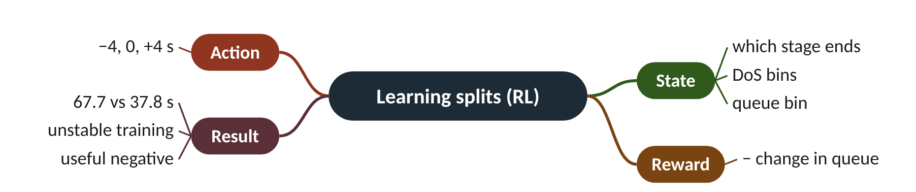
Remember it: Learning splits (RL)
PICTURE THIS · STOP 3: ROBOT-PUPPY STAND
TRAP
A clockwork robot puppy has three bones labelled −4, 0 and +4. It grabs a bone, gets a treat or a buzz, and after only ten lessons it is spinning in circles, knocking over a sign reading 67.7, while an old sheepdog calmly herds traffic under a sign reading 37.8.
A learning agent is not automatically better than a rule. Without enough state information, a reliable reward and enough training, it can be much worse, and its failures are harder to explain.
Notes:
What the scene encodes: Three bones = the action set; treat/buzz = reward; ten lessons = too little training; 67.7 vs 37.8 s = the RL agent against SCOOT.
Recap: RL splits: learn only SCOOT's −4/0/+4 choice (state: DoS and queue bins; reward: −Δqueue); first agent 67.7 s vs SCOOT 37.8 s.

Slide 15
4 Max-pressure and spill-back-aware SCOOT
IN PLAIN WORDS
A doorman letting people into a room looks at the queue outside. A smarter one also checks whether the room is full: if it is, letting more in only jams the doorway.
Max-pressure: upstream minus downstream
No cycle, so no green waves
Exit-aware SCOOT: discount blocked exits
Here SCOOT already kept exits clear
224 s
max-pressure delay on 120 m links (SCOOT 28.7 s)
Notes:
SCOOT looks at the approach road. Max-pressure also looks at where the traffic is going. If the exit is full, giving green is pointless. Should SCOOT steal that idea?
Max-pressure (Varaiya, 2013) gives green to the movement with the biggest 'pressure': upstream queue minus downstream queue. It reacts to blocked exits, but it is acyclic (no fixed cycle), so it cannot keep green waves between junctions.
The lab also built an exit-aware SCOOT: when scoring split options, each link's DoS is divided by (1 + λ × blocking), where blocking measures how far the downstream link's modelled queue is above 30% of its storage. A stage whose exit is filling up looks less urgent.
What happened. Pure max-pressure doubled delay on 300 m links (68.3 against 30.4 s) and almost tripled stops. On 120 m links it collapsed into spill-back gridlock (224.4 s). Exit-aware SCOOT changed no decisions on 300 m links (no exit filled) and 8 decisions on 120 m links, ending slightly worse (29.7 against 28.7 s). SCOOT's own optimisers already kept exits clear here.
Presenter tip: Ask the audience to predict the max-pressure result before showing it. Point out the next step: a grid with short links where spill-back really dominates.

Slide 16
Worked example: Should stage A get more green?
blocking = max(0, (q_{down} ÷ storage − 0.3) ÷ 0.7)
score = DoS ÷ (1 + λ × blocking), λ = 2
DoS stage A = 0.95, stage B = 0.80. A's exit link stores 40 vehicles and holds 26. B's exit is empty. λ = 2.
1. A's exit fill: 26 ÷ 40 = 0.65.
2. Blocking A: (0.65 − 0.3) ÷ 0.7 = 0.35 ÷ 0.7 = 0.5. Blocking B: 0.
3. Score A: 0.95 ÷ (1 + 2 × 0.5) = 0.95 ÷ 2 = 0.475.
4. Score B: 0.80 ÷ (1 + 0) = 0.80.
5. Plain DoS says A (0.95 > 0.80); exit-aware says B (0.80 > 0.475).
Extra green for A would mostly push cars into a filling exit, so the exit-aware rule gives the time to B.
Notes:
Mean delay: SCOOT, max-pressure and exit-aware SCOOT. What to notice: max-pressure is far worse on both spacings and collapses on short links; exit-aware SCOOT is close to plain SCOOT. Same demand and seed.
Try it with the audience: Same junction, but A's exit holds only 14 of 40 vehicles. Which stage does exit-aware SCOOT favour?
Answer: Fill 14 ÷ 40 = 0.35; blocking = (0.35 − 0.3) ÷ 0.7 = 0.071. Score A = 0.95 ÷ (1 + 2 × 0.071) = 0.95 ÷ 1.143 = 0.83 > 0.80, so it still favours A.

Slide 17
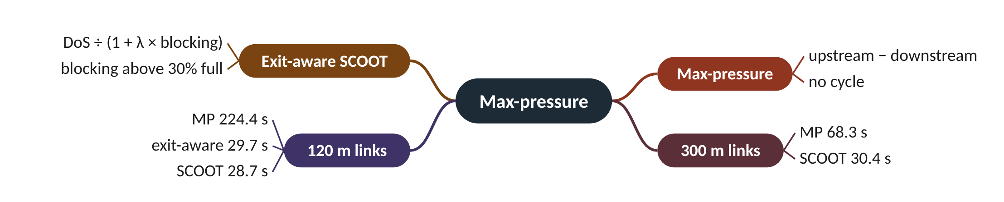
Remember it: Max-pressure
PICTURE THIS · STOP 4: PLUMBING STAND
TRAP
A wall of pipes with pressure gauges. A plumber opens whichever valve shows the biggest pressure difference, so water squirts in random bursts and never flows smoothly. On the short pipes (120 cm) they burst, soaking a sign reading 224. Next door, a careful plumber divides each gauge by a 'fullness' dial before turning a valve.
Max-pressure has strong theory on paper, but it ignores progression and cycle structure. On a coordinated arterial, losing green waves cost far more than its exit awareness gained.
Notes:
What the scene encodes: Pressure difference = max-pressure; no smooth flow = no progression (68.3 s on 300 m); short pipes bursting = spill-back gridlock (224.4 s at 120 m); fullness dial = exit-aware score.
Recap: Max-pressure: upstream − downstream, no cycle: 68.3 s (300 m), 224 s (120 m) vs SCOOT 30.4 / 28.7 s; exit-aware SCOOT 29.7 s, no gain here.

Slide 18
5 Detector faults and historic substitution
IN PLAIN WORDS
If your bathroom scale breaks and says 300 kg every morning, you should not start a crash diet. Better: notice it is impossible and use last month's weight until it is fixed.
Stuck on: a fake permanent queue
Stuck off: green shrinks to minimum
Flag implausible loops, use history
69.6 s back to 42.4 s (healthy 30.4)
70%
of the fault damage recovered by historic profiles
Notes:
Each SCOOT link depends on one upstream loop. Loops break. A broken loop does not go quiet politely: it can shout 'traffic!' forever. What does that do to the whole network?
A stuck-on detector reports a solid queue. SCOOT sees huge demand and congestion, starves the other stages and lengthens the cycle. A stuck-off detector reports no traffic, so the link's green shrinks to its minimum while real vehicles queue.
SCOOT's fault logic flags implausible detectors. In the lab a detector is flagged after 2 minutes continuously occupied or 10 minutes silent. Then each link's cyclic profile recorded before the failure is used instead, as SCOOT does with its ASTRID database of history.
What happened. 30% of detectors were set to fail at minute 25: 13 of 40, half stuck on, half stuck off. Using their data as if real more than doubled delay (69.6 against 30.4 s). Substituting history brought it back to 42.4 s, recovering about 70% of the loss, with stops slightly below the healthy run.
Presenter tip: Use the broken bathroom scale. Stress that history goes stale on unusual days; ask what other substitute data could be used.

Slide 19
Worked example: How much did history recover?
recovered share = (faulty − substituted) ÷ (faulty − healthy)
Healthy 30.44 s, faults with raw data 69.62 s, faults with historic substitution 42.44 s.
1. Loss from faults: 69.62 − 30.44 = 39.18 s.
2. Gained back by substitution: 69.62 − 42.44 = 27.18 s.
3. Recovered share: 27.18 ÷ 39.18 = 0.69, about 70%.
4. Still missing: 42.44 − 30.44 = 12.0 s per vehicle.
History recovers most, not all, of the damage. Better substitutes (neighbouring links, connected vehicles) could close the remaining 12 s.
Notes:
Delay with 13 failed detectors. What to notice: trusting broken detectors costs far more than using last week's pattern. 90-minute region scenario, failures from minute 25.
Try it with the audience: Suppose a better substitute brought delay with faults to 35.0 s. What share of the loss would it recover?
Answer: (69.62 − 35.0) ÷ (69.62 − 30.44) = 34.62 ÷ 39.18 = 0.88, about 88%.

Slide 20
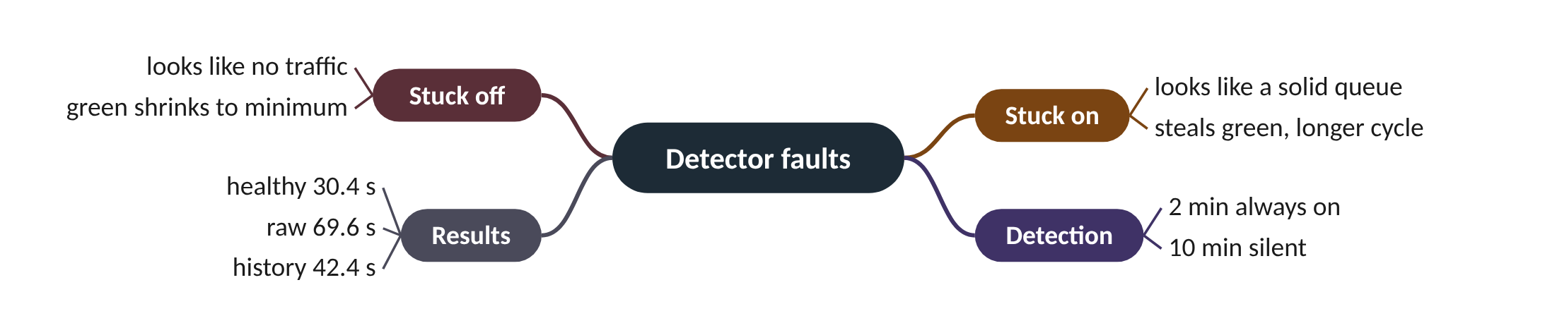
Remember it: Detector faults
PICTURE THIS · STOP 5: BROKEN-SCALE STAND
TRAP
A row of 40 bathroom scales; 13 are broken. Some flash 999 forever, others show zero while an elephant stands on them. A librarian with a dusty photo album walks along, covering each broken scale with an old photo of what it used to read. A banner shows 70% in big letters.
A stuck-on detector is not 'more data'. It is the most harmful fault, because the model believes there is a permanent queue and reshapes the whole region's timings around it.
Notes:
What the scene encodes: 13 of 40 broken = failed detectors; 999 = stuck on, zero = stuck off; the photo album = historic (ASTRID) substitution; 70% = share of the loss recovered.
Recap: Faults: stuck-on and stuck-off loops mislead the model; flag implausible ones and substitute history: 69.6 → 42.4 s (healthy 30.4), ~70% recovered.

Slide 21
6 Emissions-aware SCOOT: the price of a stop
IN PLAIN WORDS
Choosing a route home: you can minimise minutes, or also count each traffic light stop as 'costing' some minutes because stopping is annoying and wasteful. The bigger that cost, the more you prefer a smooth, slightly longer route.
PI = delay + K × stops
Tested K = 0, 4, 12, 20, 40
Most K: ~30 s and ~228 g CO2
K = 12 outlier: path dependence
~228 g
CO2 per vehicle for K = 0, 4, 20 and 40
Notes:
Every stop burns extra fuel to get moving again. SCOOT's performance index already has a knob, K, for how much a stop matters. Turn it up and you should get fewer stops and less CO2. Did we?
The optimisers minimise PI = delay + K × stops. K is in seconds of delay per stop. K = 0 ignores stops; a large K prefers smooth flow even if waits get a little longer. TRANSYT's fuel-minimising weighting is about 20 s per stop; SCOOT normally uses much less. SCOOT has offered emissions optimisation since version 4.4.
The lab ran K = 0, 4, 12, 20 and 40 on the region, with SUMO's HBEFA emission model giving CO2 for every vehicle.
What happened. No clean trade-off. K = 0, 4, 20 and 40 all gave about 30 s delay, 1.05 to 1.15 stops per vehicle and 227 to 230 g CO2 per vehicle. K = 12 was worse on every measure (42.0 s, 244 g) because one early decision sent the cycle optimiser down a different path. Lesson: SCOOT runs are path-dependent; test settings over several seeds.
Presenter tip: Work the break-even example on the board. Then use the K = 12 outlier to teach why single runs mislead, linking back to concept 1.

Slide 22
Worked example: Which offset wins as K changes?
PI = delay + K × stops
break-even K = (delay_{B} − delay_{A}) ÷ (stops_{A} − stops_{B})
Offset A: delay 300 veh·s, 8 stops per cycle. Offset B: delay 320 veh·s, 5 stops.
1. K = 4: PI_{A} = 300 + 4 × 8 = 332; PI_{B} = 320 + 4 × 5 = 340. A wins.
2. K = 20: PI_{A} = 300 + 160 = 460; PI_{B} = 320 + 100 = 420. B wins.
3. Break-even: (320 − 300) ÷ (8 − 5) = 20 ÷ 3 = 6.7 s per stop.
Below K ≈ 6.7 SCOOT picks the lower-delay offset; above it, the smoother one. K changes decisions, but not always the final results.
Notes:
Mean delay for each stop weight K. What to notice: K = 0, 4, 20 and 40 all give about 30 s (and 227-230 g of CO2 per vehicle); K = 12 is the odd one out on every measure (42.0 s, 244 g), a sign of path dependence rather than a real effect of K. SUMO region scenario, seed 1.
Try it with the audience: Offset A: delay 250, 10 stops. Offset B: delay 280, 4 stops. Find the break-even K, and the winner at K = 4.
Answer: Break-even = (280 − 250) ÷ (10 − 4) = 30 ÷ 6 = 5 s per stop. At K = 4: PIA = 250 + 40 = 290, PIB = 280 + 16 = 296, so A wins (K is below break-even).

Slide 23
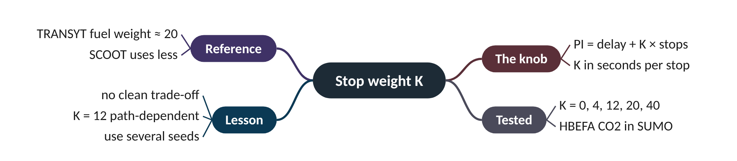
Remember it: Stop weight K
PICTURE THIS · STOP 6: EXHAUST-BALLOON STAND
TRAP
A toy car drives a little track with a dial labelled K. Every time it stops, a balloon inflates on its exhaust. At K = 0, 4, 20 and 40 the balloons are all the same size, about 228 grams. At K = 12 the car takes a wrong turn at the very first corner and a giant balloon pops.
Do not conclude 'K = 12 is bad' from one run. When one setting is worse on every measure and its neighbours are fine, suspect path dependence and run more seeds.
Notes:
What the scene encodes: K dial = stop weight; balloon = CO2 (227-230 g); the wrong first turn at K = 12 = path dependence (42 s, 244 g).
Recap: Stop weight K: PI = delay + K·stops; K = 0/4/20/40 gave ~30 s and 227-230 g; K = 12 was a path-dependent outlier (42 s, 244 g).

Slide 24
7 Predicting stage changes for GLOSA
IN PLAIN WORDS
A bus timetable that a driver adjusts a little at every stop. Ask 'when does it reach my stop?' a minute ahead and the answer may slip by a couple of minutes; ask when it is one stop away and it is nearly exact, unless something sudden happens.
GLOSA needs the end of green
Predict from SCOOT's own schedule
Mean error 1.3-2.6 s, 90% under 6 s
Advise with a confidence band
1.3-2.6 s
mean error of predicted end of green, up to 60 s ahead
Notes:
A car 200 m from the lights could slow gently and arrive just as they turn green, never stopping. But only if someone can say, seconds ahead, when the light will change. Can SCOOT?
GLOSA (Green Light Optimal Speed Advisory) tells a driver which speed will reach the stop line on green. It needs to know when the current green will end. SCOOT keeps a schedule and changes it only in small steps, so its current schedule is a natural prediction.
At every second of every green the lab predicted the end of green from SCOOT's current schedule and compared it with what really happened. The horizon is how far ahead the prediction was made. MAE (mean absolute error) is the average size of the miss.
What happened. MAE was between 1.3 and 2.6 s for horizons up to a minute, and 90% of predictions were within 6 s. The last 10 s had higher error (2.6 s) than 10 s ahead (1.3 s), most likely from bus extensions and recalls; longer horizons add split, offset and cycle changes.
Presenter tip: Do the driver example together. Discuss freezing SCOOT's schedule once a prediction has been published, and the trade-off with adaptivity.

Slide 25
Worked example: Can this driver make the green?
advised speed = distance ÷ time until green
safety margin = predicted time left − time needed
Green predicted to end in 15 s. Car 180 m away, speed limit 13.9 m/s (50 km/h). At this horizon: MAE about 1.5 s, 90th percentile about 5 s.
1. Time needed at the limit: 180 ÷ 13.9 = 12.9 s.
2. Margin: 15 − 12.9 = 2.1 s.
3. Compare with MAE 1.5 s: on an average day, the driver makes it.
4. Compare with 90th percentile 5 s: 2.1 s is below 5 s, so on a bad day the green ends first.
5. Advice: do not tell this driver to hurry; plan to stop or advise for the next green.
Average accuracy is good, but advice must respect the worst cases. That is why a confidence band is better than a single predicted time.
Notes:
How accurate is the predicted end of green? What to notice: the average error stays small (1.3-2.6 s) out to a minute, while the 90th percentile stays under 6 s. The last 10 s are worse than 10 s ahead.
Try it with the audience: Green predicted to end in 20 s; the car is 220 m away at 13.9 m/s. Margin? Safe to advise 'keep going' if the 90th percentile error is 5.3 s?
Answer: Time needed 220 ÷ 13.9 = 15.8 s; margin 20 − 15.8 = 4.2 s. That is below 5.3 s, so not safe on a bad day; advise caution.

Slide 26
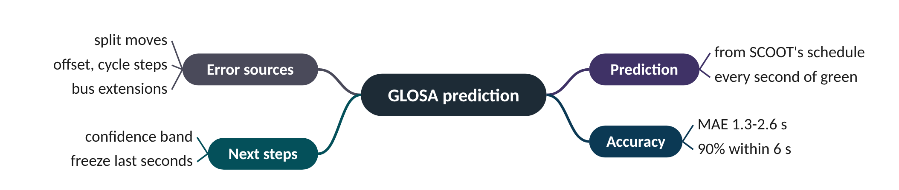
Remember it: GLOSA prediction
PICTURE THIS · STOP 7: FORTUNE-TELLER TENT
TRAP
In the last tent a fortune teller gazes into a crystal ball shaped like a traffic light and announces 'green ends in 15 seconds!'. She is usually off by only one or two seconds, but a bus keeps barging into the tent at the last moment and she yells 'six!' to cover herself.
A small average error is not enough for safe advice. Drivers act on single predictions, so the tail (90th percentile, about 5-6 s) decides whether advice is trustworthy.
Notes:
What the scene encodes: Crystal ball = prediction from SCOOT's schedule; 1-2 s = MAE 1.3-2.6 s; the bus = bus extensions at short notice; 'six' = 90th percentile under 6 s.
Recap: GLOSA: predict end of green from SCOOT's schedule; MAE 1.3-2.6 s up to 60 s ahead, 90% within 6 s; advice must respect the tail.

Slide 27
Six research studies at a glance
Study | What changed | Baseline result | New result | Verdict
CV data | data source | loops 30.4 s | 25%: 33.9 s; 100%: 26.3 s | promising
RL splits | split chooser | SCOOT 37.8 s | 67.7 s | not yet
Max-pressure | whole controller | SCOOT 30.4 s | 68.3 s (300 m) | worse here
Exit-aware SCOOT | split score | SCOOT 28.7 s (120 m) | 29.7 s | needs harder test
Detector faults | fault handling | raw faults 69.6 s | history 42.4 s | recovers ~70%
Stop weight K | PI weight | K = 4: 30.4 s, 227 g | no clean trade-off | use more seeds
GLOSA | prediction | n/a | MAE 1.3-2.6 s | usable with a band

Slide 28
Things beginners mix up
This… | …is not this | The fact that tells them apart
Open-loop error | Closed-loop performance | 53% error per minute at 25% CV still gave delay within 11% of loops.
Best seed | The result | Report the spread over seeds; SCOOT alone varied by 9 s.
Max-pressure | Exit-aware SCOOT | Max-pressure drops the cycle; exit-aware SCOOT only rescales the split score.
Stuck on | Stuck off | Stuck on fakes a queue and steals green; stuck off hides traffic and starves it.
Mean error | Worst-case error | GLOSA advice must respect the 90th percentile (~5-6 s), not just MAE.

Slide 29
Check yourself (1 of 2)
20 vehicles per cycle, p = 25%. What is the spread of the CV-based estimate?
Why did pure max-pressure do badly on 300 m links?
A. 1.9 vehicles
B. 5 vehicles
C. 7.7 vehicles
D. 19.5 vehicles
A. It ignores the upstream queue
B. It has no cycle, so it loses progression (green waves)
C. Its detectors failed
D. It used CV data
Answers are in the speaker notes and in the study guide's answer key.
Notes:
Answer: C. √(20 × 0.25 × 0.75) = 1.94 connected cars, ÷ 0.25 = 7.7. 1.9 forgets to divide by p; 19.5 is the 5% case.
Answer: B. Acyclic switching breaks platoon progression; delay doubled to 68.3 s.

Slide 30
Check yourself (2 of 2)
Offset A: delay 300, 8 stops; B: delay 320, 5 stops. Which wins at K = 20?
Exit-aware SCOOT changed no decisions on 300 m links. Why, and what test would be better?
A. A
B. B
C. They tie
D. Cannot tell
A. Bug; rerun
B. No exit ever filled; test a grid of short links with spill-back
C. λ was too large; set λ = 0
D. CV data was missing
Answers are in the speaker notes and in the study guide's answer key.
Notes:
Answer: B. PI A = 460, PI B = 420. The break-even is 6.7 s per stop.
Answer: B. Blocking is 0 below 30% fill; the idea needs a network where exits actually fill.

Slide 31
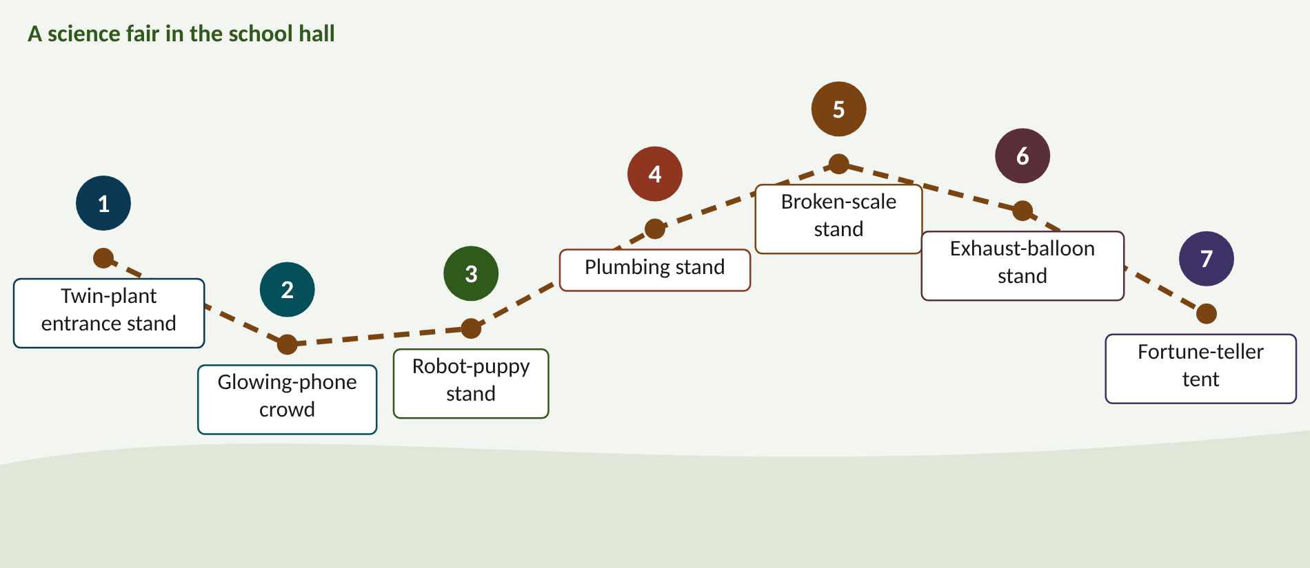
Walk the memory route
1 Twin-plant entrance stand = Fair testing · 2 Glowing-phone crowd = CV instead of loops · 3 Robot-puppy stand = Learning splits (RL) · 4 Plumbing stand = Max-pressure · 5 Broken-scale stand = Detector faults · 6 Exhaust-balloon stand = Stop weight K · 7 Fortune-teller tent = GLOSA prediction
Notes:
Stop 1, Twin-plant entrance stand: At the entrance a judge in a white coat holds two identical potted plants, each with three seeds glued on the pot. She changes the label on ONE pot only, then weighs both on a huge brass scale while a vacuum cleaner under the table refuses to suck any queue off the stage. (Two identical plants = same demand; one label = change one thing; three seeds = several seeds; the vacuum that won't hide queues = count all delay.)
Stop 2, Glowing-phone crowd: At the second stand a crowd walks past a chalk line. Only one in four people carries a glowing phone. A bouncer counts the glowing phones and shouts the number times four through a megaphone. When only one person in twenty glows, his guesses jump wildly and he falls off his stool. (Chalk line = virtual detector; one in four = p = 25% (33.9 s, close to loops 30.4 s); one in twenty = 5%, where control broke down (43.7 s).)
Stop 3, Robot-puppy stand: A clockwork robot puppy has three bones labelled −4, 0 and +4. It grabs a bone, gets a treat or a buzz, and after only ten lessons it is spinning in circles, knocking over a sign reading 67.7, while an old sheepdog calmly herds traffic under a sign reading 37.8. (Three bones = the action set; treat/buzz = reward; ten lessons = too little training; 67.7 vs 37.8 s = the RL agent against SCOOT.)
Stop 4, Plumbing stand: A wall of pipes with pressure gauges. A plumber opens whichever valve shows the biggest pressure difference, so water squirts in random bursts and never flows smoothly. On the short pipes (120 cm) they burst, soaking a sign reading 224. Next door, a careful plumber divides each gauge by a 'fullness' dial before turning a valve. (Pressure difference = max-pressure; no smooth flow = no progression (68.3 s on 300 m); short pipes bursting = spill-back gridlock (224.4 s at 120 m); fullness dial = exit-aware score.)
Stop 5, Broken-scale stand: A row of 40 bathroom scales; 13 are broken. Some flash 999 forever, others show zero while an elephant stands on them. A librarian with a dusty photo album walks along, covering each broken scale with an old photo of what it used to read. A banner shows 70% in big letters. (13 of 40 broken = failed detectors; 999 = stuck on, zero = stuck off; the photo album = historic (ASTRID) substitution; 70% = share of the loss recovered.)
Stop 6, Exhaust-balloon stand: A toy car drives a little track with a dial labelled K. Every time it stops, a balloon inflates on its exhaust. At K = 0, 4, 20 and 40 the balloons are all the same size, about 228 grams. At K = 12 the car takes a wrong turn at the very first corner and a giant balloon pops. (K dial = stop weight; balloon = CO2 (227-230 g); the wrong first turn at K = 12 = path dependence (42 s, 244 g).)
Stop 7, Fortune-teller tent: In the last tent a fortune teller gazes into a crystal ball shaped like a traffic light and announces 'green ends in 15 seconds!'. She is usually off by only one or two seconds, but a bus keeps barging into the tent at the last moment and she yells 'six!' to cover herself. (Crystal ball = prediction from SCOOT's schedule; 1-2 s = MAE 1.3-2.6 s; the bus = bus extensions at short notice; 'six' = 90th percentile under 6 s.)

Slide 32
Numbers to remember
› SCOOT over seeds 7/8/9: 33.1 / 38.2 / 42.1 s (mean 37.8)
› CV delay: 43.7 / 37.6 / 33.9 / 27.5 / 26.3 s at 5-100%; loops 30.4
› RL agent 67.7 s vs SCOOT 37.8 s
› Max-pressure 68.3 s (300 m), 224.4 s (120 m)
› Faults: 30.4 / 69.6 / 42.4 s; 13 of 40 failed; ~70% recovered
› K = 0, 4, 20, 40: ~30 s, 227-230 g; K = 12: 42 s, 244 g
› GLOSA MAE 1.3-2.6 s; p90 under 6 s

Slide 33
Keep going
Study guide: SCOOT_Mastery_Study_Guide.pdf · Interactive labs and SUMO code: smrahmanbd.github.io/scoot-learning-lab
Notes:
Point learners to the study guide for the full worked examples, quiz and revision plan, and to the website for the simulators.

