Slide 1

01

Slide 2









Vision
YOUR PATH TO BETTER FINANCIAL CHOICES
10K+
matched users
90k ₼
in seed funding
15+
key financial partners
Goals
80%
accuracy in AI matches
02

Slide 3






Persona Analysis
Hokuma Gurbanova
Parent
Age: 25-35
Occupation: Middle-income professional
Goals: Save for a family deposit
Pain Points: No clear way to start long-term savings
Haji Zeynalabdin Taghiyev
Businessman
Age: 30-45
Occupation: High-income professional
Goals: Get long-term low-rate credit
Pain Points: No time to search, needs big amount with low-interest loans for long-term goals
How Techleaf Helps:
User’s loan request is forwarded to
banks
Uzeyir Hajibeyov
Frequent Traveler
Age: 25-40
Occupation: Freelancer or remote employee
Goals: Travel insurance, cost-effective
cards
Pain Points: Hard to find reliable travel insurance & cards for international use
How Techleaf Helps:
Quick comparisons for insurance &
travel-friendly cards
How Techleaf Helps: Easily compares best family deposit plans
03

Slide 4

Manual Search
Automated Search
Time-Consuming
Time-Saving
AS-IS
Complicated
Comparisons
Smart
Comparison
TO-BE
Scattered Information
All-in-One Platform
Lack of
Personalization
Personalized Experience
No Exclusive Offers
Exclusive Offers
04

Slide 5












Customer Life Cycle
Comparison
"I need to compare offers from different banks and insurance companies."
Consideration
"Is this really beneficial for me? How is the service quality?"
Voice of the Audience
Awareness
“I need the most affordable and beneficial financial offer.”
Decision
"I have chosen the best option. How do I apply?"
Advocacy
"I will recommend this platform to my friends."
05

Slide 6
Business Model
B2C
B2B
Premium Subscriptions
Referral Fee
10₼
per user
Advertising
350₼
monthly
4.99₼
monthly
50.90₼
annually \ save 15%
Data-Driven Insights
1₼
per user
06

Slide 7


Customer Acquisition
Events and Webinars
Social media ads
SEO & Google Search
Word of Mouth & Referrals
YouTube & Influencer Marketing
07

Slide 8




Techleaf System
Search and Compare Loan Offers
Use Financial Assistant for Personalized Offers
End User
Verify phone number via SMS
Use Case Diagram
Display “Loan of the Month”
Compile & forward user profile
Admin Panel (Internal)
Review & respond to request
Bank Loan
Specialist
08

Slide 9



















Competitor Analysis
Techleaf
HangiKredi
Banks.az
NerdWallet
Finder.com
Chatbot, Live support
Chat support
Contact details
Chat support
09
E-mail

Slide 10
Risk and Response Strategies
Risk ID
Cause
Effect
Response Strategy
Response Actions
Action
Risk Review
Implement basic validation checks for scraped data (e.g., checking dates, format consistency).
Inaccurate or outdated financial data from institutions
Poor user experience, reduced trust in platform
Ensure accuracy by validating data regularly, monitor for discrepancies
RISK 001
Mitigate
Development Team
RISK 002 | Regulatory and legal compliance challenges | Legal penalties, platform shutdown | Transfer | Partner with legal consultants to ensure compliance; use trusted legal services for reviews | Legal Team | Review compliance biannually, adjust practices based on legal advice
RISK 003 | Low user trust or adoption | Reduced user engagement, lower platform usage | Mitigate | Provide transparency on data sources, build partnerships with trusted institutions | Marketing & Partnerships | Monitor user feedback, adjust messaging and educational content as needed
RISK 004 | AI/Algorithmic bias | Unfair product recommendations, user dissatisfaction | Accept | Keep the AI simple in early stages and adjust based on user feedback | Data Science Team | Quarterly review of AI decisions
 |  |  |  | Use reliable scraping tools
 | Technical glitches or | Service disruption, loss of |  | and services to avoid |  | Conduct regular system
RISK 005 | downtime | users, reputation damage | Mitigate | downtime; Set up simple | IT & Operations Team | tests, ensure recovery
 |  |  |  | monitoring of the platform to |  | processes are fast
 |  |  |  | catch downtime early.
10

Slide 11
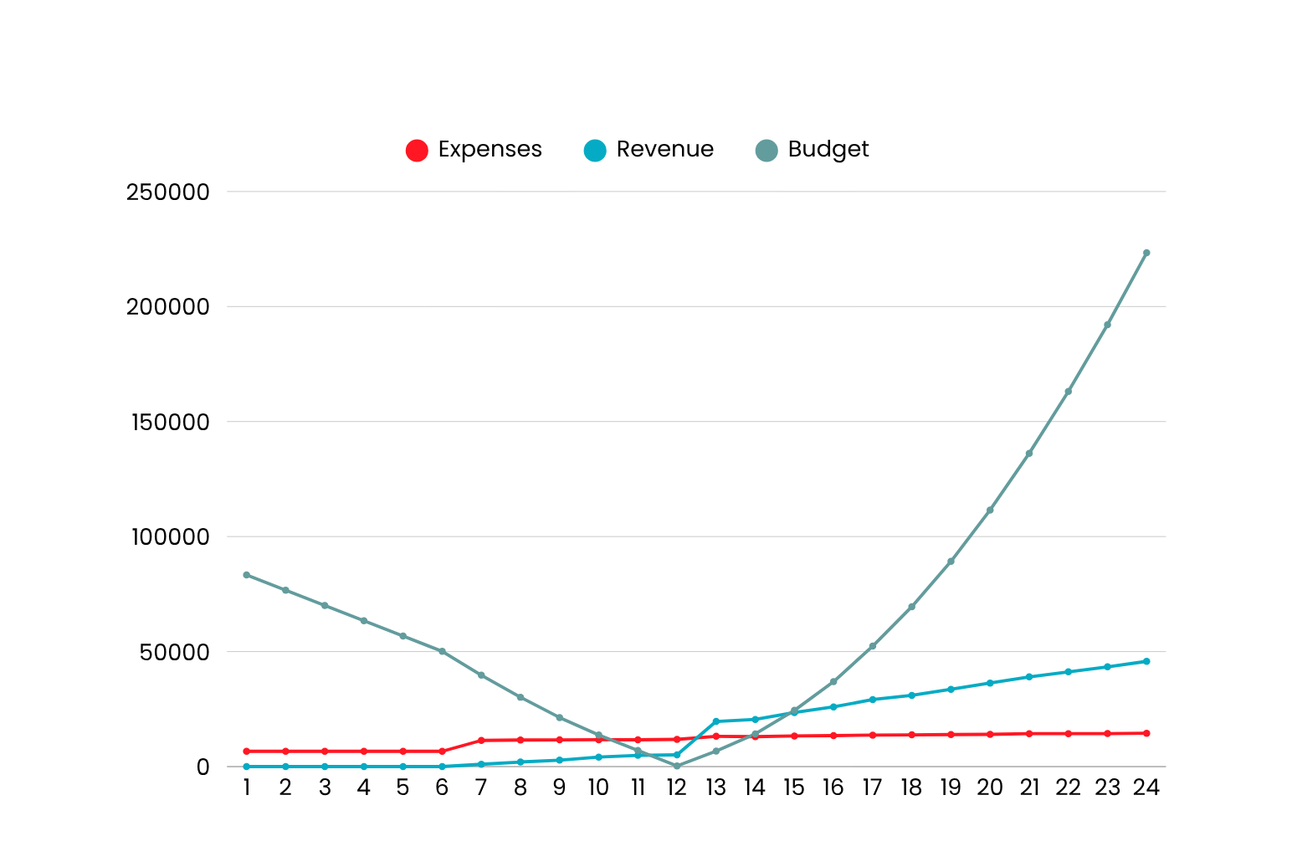


ROI
ROI calculation
Budget expected to grow 1.5 times in 2 years.
MVP

Slide 12















Roadmap
inspired by Formula 1's speed and innovation
2nd Wave March 31st, 2026
AI-Based Recommendations Additional Filters
Enhanced Product Comparison
Basic Gamification & Rewards
3rd Wave September 30th , 2026
Chatbot Integration Mobile Application Product Reviews & Ratings
MVP
October 31st, 2025
Product Search & Comparison Admin Panel
Basic User Profile Product Data Display Notifications
4th Wave January 31st , 2027
Gamification & Rewards Peer-to-Peer credit Kids & Family Finance

Slide 13
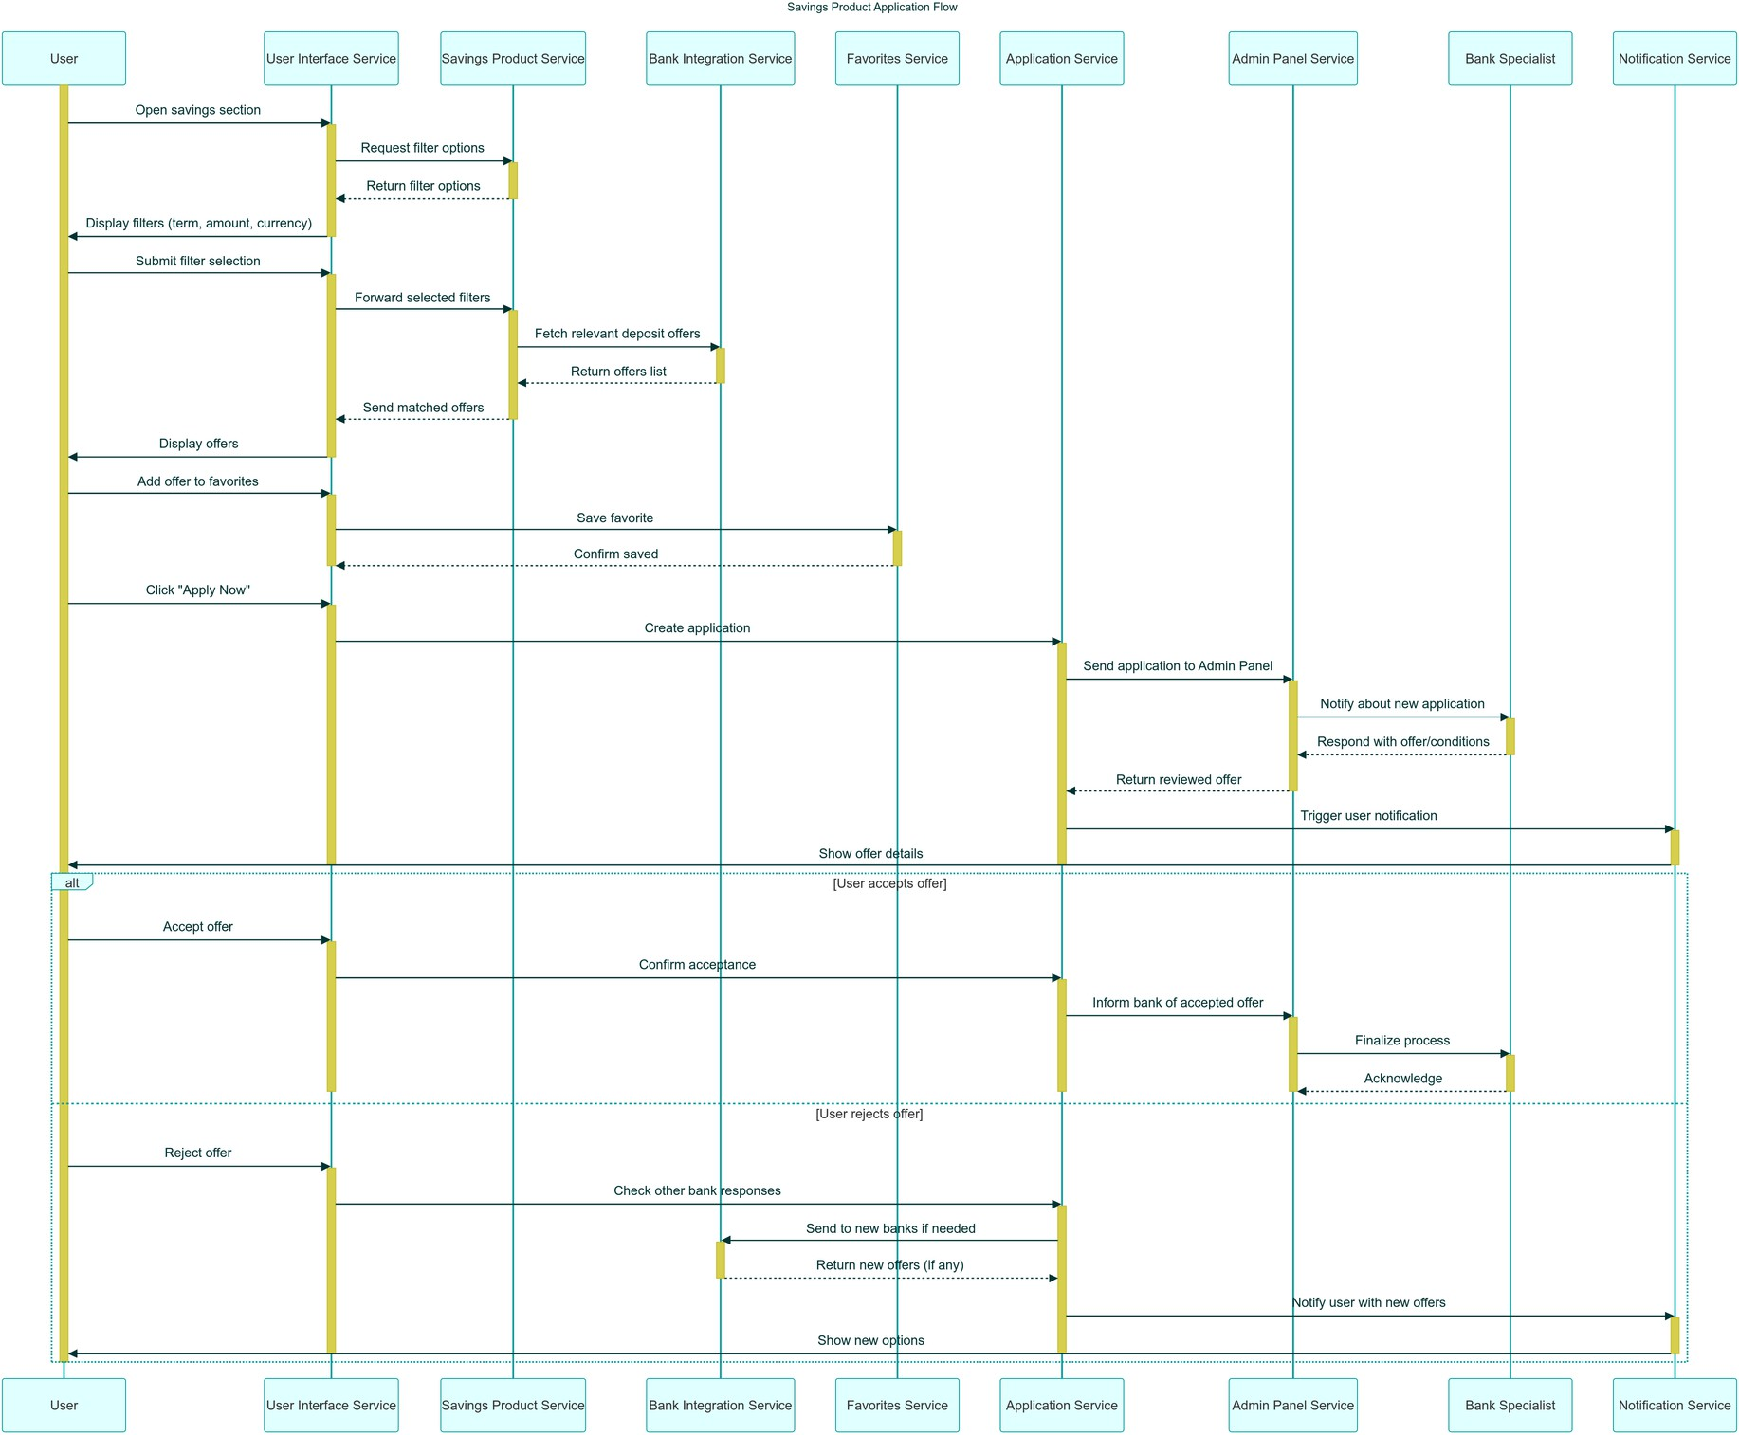
Sequence diagram

Slide 14

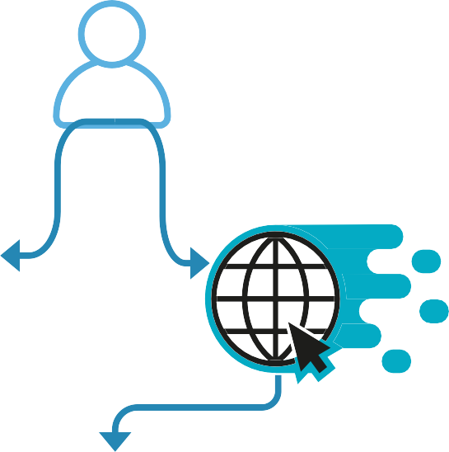



















PostgreSQL
Payment Agregator
External
Financial
İnstitutions
Auth
MS
User Management MS
Order Management MS
Gamification MS
Payment MS
WAF Protection
Product MS
Notification MS
Search MS
Logs & Analytics & AI MS
Prometheus
Grafana
Load Balancer
14
PostgreSQL
PostgreSQL

Slide 15
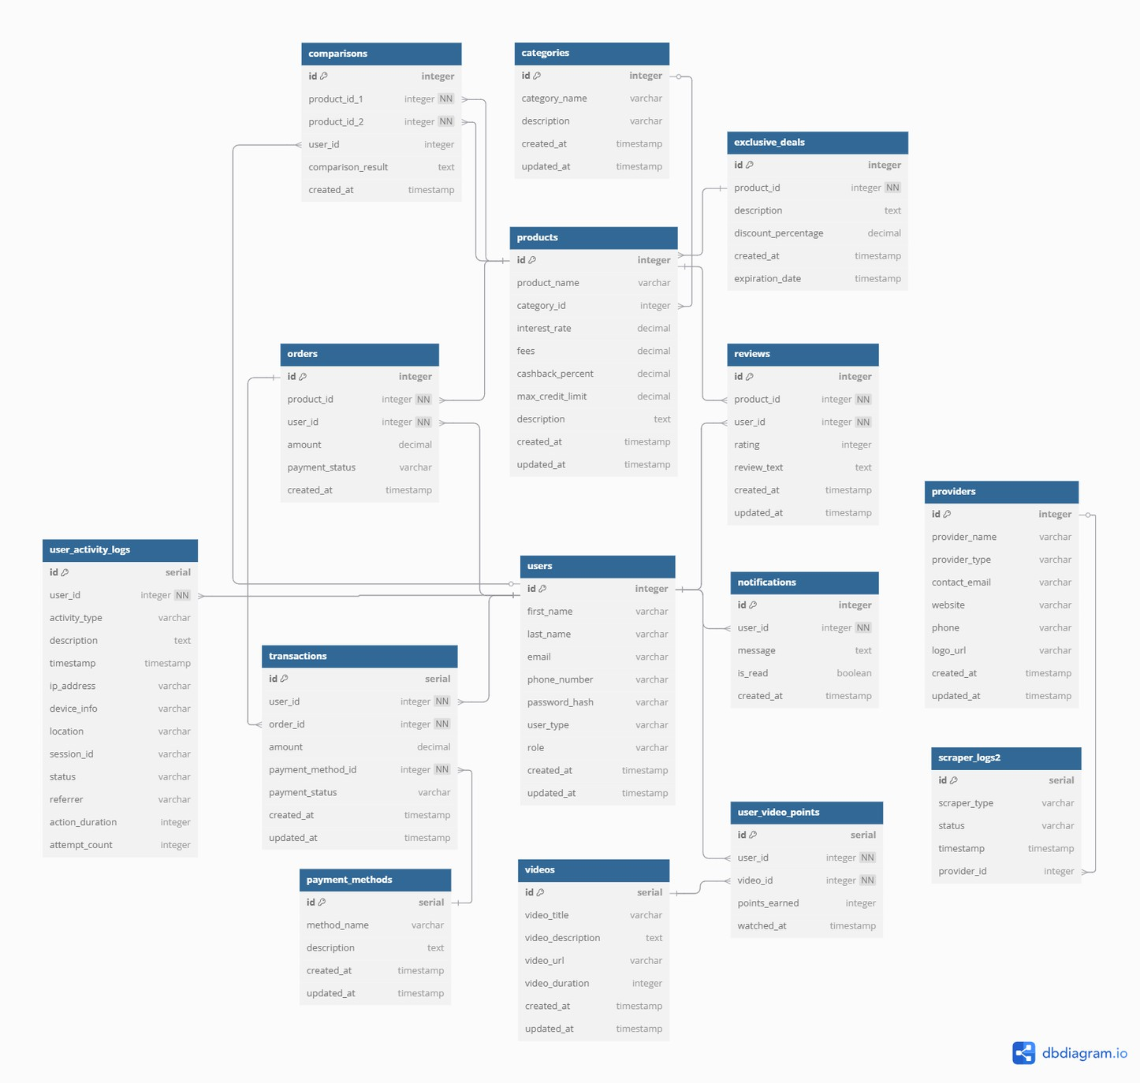
Database Design

Slide 16
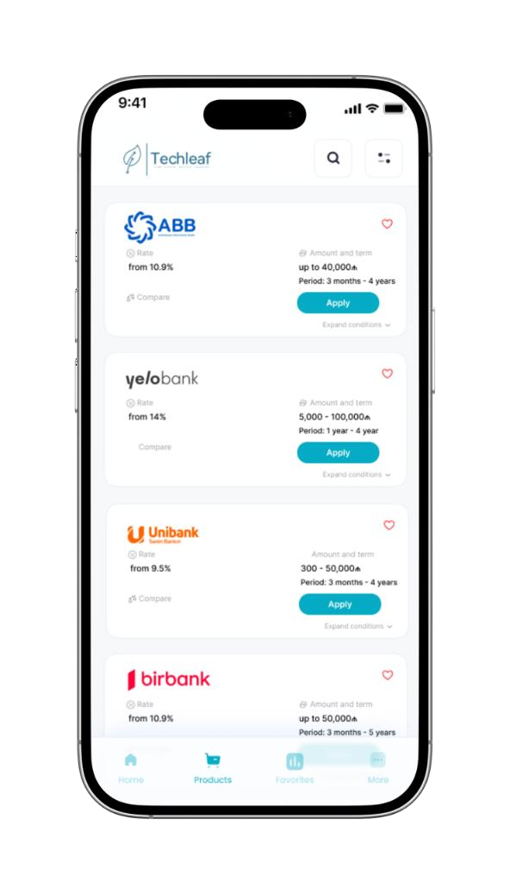
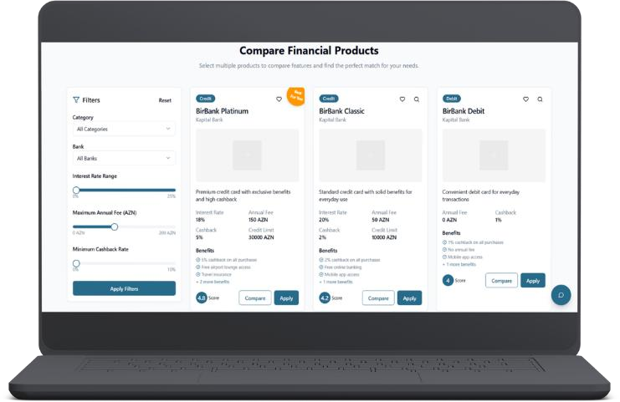
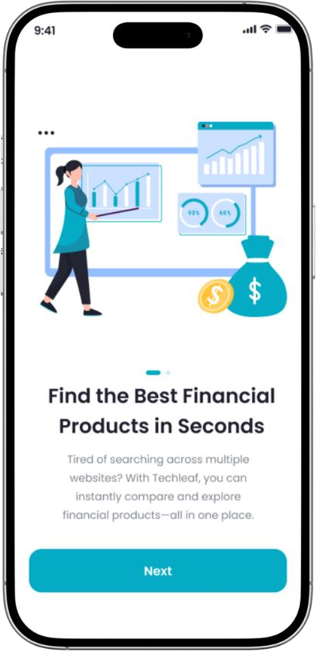
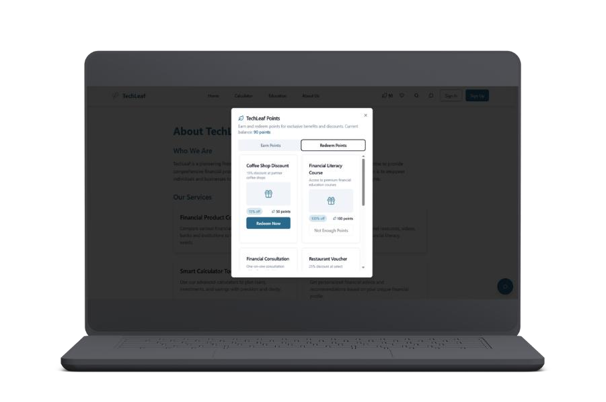

Slide 17
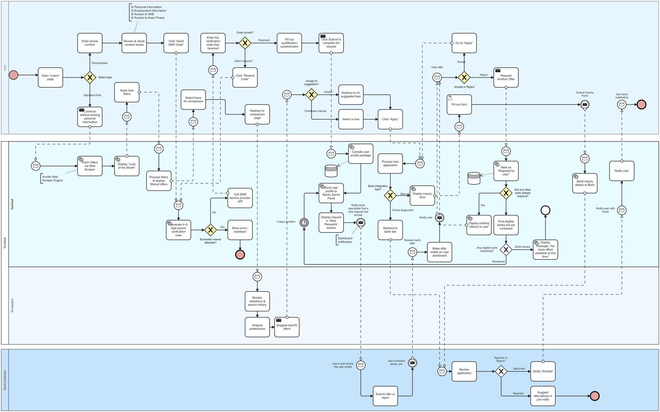
BPMN Diagram

