Slide 1

Prepared by
Umar Niaz
Red Team Instructor at Cyberster

Slide 2
WEEK 1
4 TASKS

Slide 3
Advanced Recon & Attack Surface Mapping
Objective: To master the art of information gathering and identifying the digital footprint of a target without being detected
Task 01 – Passive OSINT & Subdomain Enumeration
Description: Conduct a thorough passive reconnaissance on a given target domain (e.g., a bug bounty target or a dummy corporate domain).
Technical Requirements:
○ Perform subdomain discovery using a combination of tools: Subfinder, Assetfinder, and Amass.
○ Use DNS Dumpster and CRT.sh to find historical subdomains and SSL certificate leaks.
○ Identify "hidden" assets that are not indexed by search engines.
Learning Goal: Understand that no single tool is enough; cross-referencing results is key to a successful Red Team operation

Slide 4

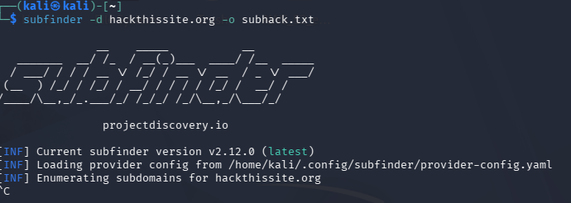
Create a directory
Subfinder
subfinder -d target.com -o subfindertargetname.txt
subfinder -d target.com -silent -o subfinder
-silent suppresses banners
If we use silent it will suppress this banner
extra output so only the discovered subdomains are printed, making the results clean for saving to a file.
Pulls passive data from multiple sources.

Slide 5

Assetfinder
Used to discover subdomains associated with a target domain.
Queries multiple public sources like:
• Certificate Transparency logs
• Threat intelligence APIs
• DNS-related services
assetfinder --subs-only hackthissite.com | tee subs.txt
assetfinder --subs-only hackthissite.com > assetfinder.txt
--subs-only
Outputs only subdomains of the target domain.
Prevents unrelated domains from polluting results.
Different data sources.
Used for cross-verification.

Slide 6
Amass (Passive)
Discovering and organizing all externally exposed assets of a target.
In simple terms: it helps us discover domains, subdomains, IPs, ASN info, and infrastructure relationships for a target organization.
· Servers
· IP addresses
· Cloud platforms
· DNS servers
· Load balancers
· CDNs
· Email servers
· Databases
· Hosting providers
amass enum -passive -d target.com -o amass.txt

Slide 7
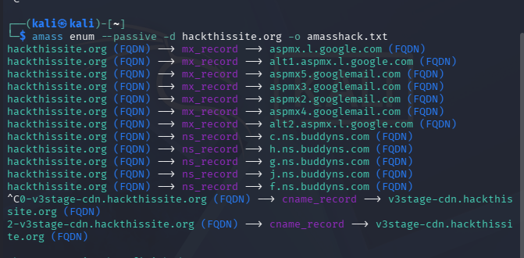
Gather broader datasets.
Often discovers additional domains.

Slide 8
🧠 Why Amass Keeps Going(take longer time)
Even in --passive mode, Amass:
• Queries dozens of OSINT data sources
• Pulls certificate transparency logs
• Checks reverse DNS
• Resolves discovered subdomains
• Maps ASN + netblocks
• Recursively expands findings
For a large enterprise like Robinhood, that can mean:
• Thousands of historical records
• CDN expansions
• Multiple AWS accounts
• Delegated subdomains
It can run 10–30+ minutes depending on:
• Internet speed
• API limits
• Number of sources enabled
• Target size

Slide 9
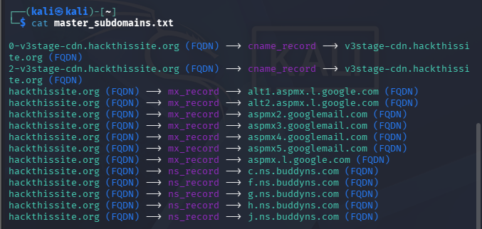
Merge Results
cat subfinder.txt assetfinder.txt amass.txt | sort -u > master_subdomains.txt
cat master_subdomains.txt

Slide 10

sort –u Removes duplicates, Sorts entries alphabetically
Creates single clean attack surface list. In totality we merged the results from our three tools ,subfinder, amass, assetfinder. Let’s try more tools to get more subdomains
Count Unique Assets
wc -l master_subdomains.txt
wc→ Counts lines, words, or bytes in a file.-l
-i → Counts number of lines in a file. Shows total entries in your list.
here:
1034 = number of lines in the file
master_subdomain.txt = the file that was counted
There are 1034 lines inside master_subdomain.txt.
Shows real attack surface size. Removes inflated numbers.

Slide 11
Overlap Check by combining multiple subdomain files
We will combine multiple subdomain files and process them to measure how often each subdomain appears across sources.
sort subfinder.txt assetfinder.txt amass.txt | uniq -c | sort -nr | head
Higher repetition = higher confidence. Single-source findings need validation.
sort Orders lines alphabetically. Organizes data for processing.
uniq -c Counts duplicate occurrences of each line. Shows how many times each subdomain appears.
sort -nr Sorts numerically in descending order. Shows highest duplicate counts first.
head Shows first 10 lines of output by default. Displays top results only.

Slide 12
‘
We did this step to prioritize and validate our recon data.
Combined multiple files, count repetition= Which assets are more likely real and important.

Slide 13
Part 2 Use DNS Dumpster and CRT.sh to find historical subdomains and SSL certificate leaks. ○ Identify "hidden" assets that are not indexed by search engines.
crt.sh queries Certificate Transparency logs to extract:
Subdomains
Historical domains
Staging environments
Forgotten assets
Wildcard certificates
Internal naming leaks
crt_v2.sh –d hackthissite.com > crt_hack.txt

Slide 14
DNS Dumpster:-
Go to:
https://dnsdumpster.com
Search:
target.com
Download / copy the Subdomain list → save as:
Dnsdumpster.xlsx
Then install in Kali linux
sudo apt install xlsx2csv –y
xlsx2csv -a robinhood.xlsx > all_sheets.csv
After Conversion
grep -oE "[a-zA-Z0-9.-]+\.robinhood\.com" all_sheets.csv | sort -u > dnsdump_robinhood.txt
combine safely all:
cat dnsdump_robinhood.txt robinsub.txt robinasset.txt robinamass.txt crt_robin.txt | sort -u > combined.txt
OR
cat master_subdomain.txt dnsdumpster.txt | sort -u > attack_surface.txt

Slide 15
Why We Use DNS Dumpster
Pulls DNS records
Sometimes finds subdomains tools miss.
Shows related IP infrastructure.
Add To Master List
cat final_master.txt dnsdumpster.txt | sort -u > attack_surface.txt
Now this is your expanded dataset.

Slide 16
Task 02 – Infrastructure & Tech Profiling
WhatWeb
whatweb https://sub.target.com
Web Server (Apache, Nginx, IIS)
CMS (WordPress, Drupal, Joomla)
Frameworks (Laravel, Django, React)
Analytics & tracking tools
CDN usage
Why it matters:
If you detect:
WordPress → Plugin vulnerabilities become relevant
Laravel → Look for .env exposure
Apache + outdated version → Known CVEs
Cloudflare → Real IP discovery needed

Slide 17
Wappalyzer CLI
wappalyzer --target https://www.google.com/ --disable-ssl --output output.txt –json
Confirms tech stack. Verifies what technologies the website is actually using (e.g., server, framework, CDN, analytics). Cross-check fingerprint accuracy. Double-checks that the detected technologies are correct by comparing multiple indicators (headers, scripts, responses) to avoid false positives.
But if the wappalyzer doesn’t give correct result use
Use Node Wappalyzer
Install Node (if not installed):
sudo apt install nodejs npm
Check version:
node -v npm -v
Now run:
npx wappalyzer https://robinhood.com

Slide 18
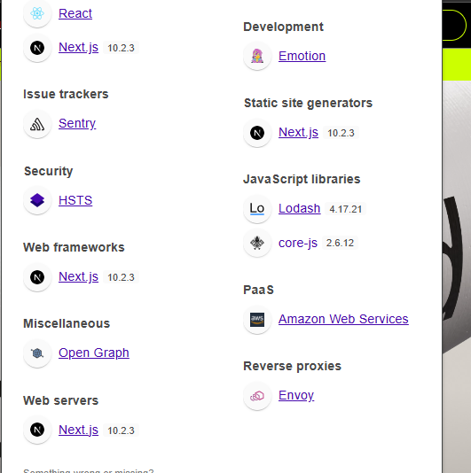

Slide 19
Executive Summary Version
Layer | Technology
Frontend | React + Next.js 10.2.3
Hosting | AWS
CDN | CloudFront
Reverse Proxy | Envoy
Monitoring | Sentry
Tracking | LinkedIn Insight Tag
Security Control | HSTS Enabled

Slide 20

WHOIS
whois target.com
Look for:
Registrar
Organization name
Name Servers
NetRange / CIDR blocks
Abuse contacts

Slide 21
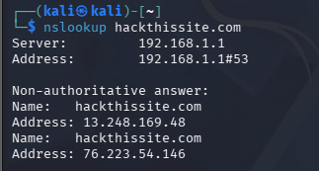

Identifies ownership and ASN clues. network (ASN) Useful for infrastructure mapping. how the target’s servers and networks are structured and connected.
NSLookup
nslookup sub.target.com
Resolves IP and DNS info. Finds the IP address and DNS records linked to the domain. Helps detect hosting patterns. Shows where and how the domain is hosted (e.g., same IP for many subdomains, CDN usage, shared hosting).
CDN A network of distributed servers that deliver website content from locations closer to users.

Slide 22
🔎 Query Specific Records
A Record
nslookup -type=A target.com
MX Record
nslookup -type=MX target.com
NS Record
nslookup -type=NS target.com
TXT Record
nslookup -type=TXT target.com
🔥 Alternative (More Powerful) — dig
dig target.com ANY
Or:
dig target.com MX
dig target.com NS
dig target.com TXT
📡 What You’re Actually Mapping(Creating a structured overview target’s infrastructure)
You’re building:
Hosting provider identification
Cloud provider detection (AWS / Azure / GCP)
CDN detection (CloudFront / Akamai / Cloudflare)
Email infrastructure mapping
Subdomain discovery hints

Slide 23
Task 2 Part 2
Perform advanced Google Dorking to find sensitive files like
phpinfo(), .env, robots.txt, and backup directories (.bak, .zip).
Finding phpinfo() Pages
Search in Google
site:target.com inurl:phpinfo.php
site:target.com intitle:"phpinfo()"
Why this matters:
Reveals PHP version
Shows loaded modules
Displays server paths
Environment variables

Slide 24
🎯 Finding .env Files (Critical)
site:target.com filetype:env
site:target.com inurl:.env
These may expose:
Database credentials
API keys
Mail server passwords
Secret tokens
⚠️ Most real-world breaches start from exposed .env.
🎯 Finding robots.txt
site:target.com inurl:robots.txt
Robots often reveal:
Admin panels
Private directories
Staging environments
API paths
Always manually inspect it.

Slide 25
🎯 Finding Backup Files (.bak, .zip, .old, .tar)
site:target.com filetype:bak
site:target.com filetype:zip
site:target.com inurl:backup
site:target.com ext:sql
site:target.com ext:old
Backup archives sometimes contain:
Full source code
SQL dumps
Configuration files
🎯 Directory Listing Discovery
site:target.com intitle:"index of"
If directory listing is enabled, you may find:
Uploaded files
Logs
Backups
Internal documents

Slide 26
Task 03: GitHub Dorking & Credential Leaks
Description: Search for leaked secrets and hardcoded credentials in public repositories.
Practical Demonstration – Manual GitHub Search
Go to: https://github.com
Use the search bar at the top
Basic Organization-Based Search
Example
org:targetorg "API_KEY" org:targetorg "PASSWORD" org:targetorg "AWS_SECRET" org:targetorg "SQL_CONNECTION“
Broad Public Search (Outside Org Scope)
"target.com" "API_KEY"
"targetorg" "AWS_SECRET_ACCESS_KEY"
"targetorg" "PRIVATE_KEY“
Sometimes employees push code to personal repos instead of official org repos.

Slide 27
Use Advanced Search Filters
After searching:
Click Code (not Issues, not Users)
Filter by: Recently updated
Language
Better structured query:
org:target "API_KEY"
Or:
"target.com" AND "API_KEY"
🎯 File-Specific Searches
filename:.env "target"
filename:config "DB_PASSWORD"
filename:settings.py "SECRET_KEY"
extension:json "apiKey"
Common risky files:
.env
config.js
settings.py
application.properties
web.config

Slide 28
What to Look For
You are NOT hunting for exploitation.
You are checking:
Is the value hardcoded?
Is it real-looking or test?
Is it commented out?
Is it part of documentation?
Example risky patterns:
const API_KEY = "sk_live_93ksk29..." AWS_SECRET=AKIAIOSFODNN7... password = "Admin@123"

Slide 29
Commit History Analysis (Why Deleting Is Not Enough)
If a repository within is public:
Open the file.
Click History (top right).
Browse older commits.
“Even if a secret was removed later, Git preserves previous versions.”
Look for:
Added credentials in older commits
Secrets later removed
Config files changed
Using GitHacker (Authorized Repos Only)
githacker --url <URL_TO_.GIT_FOLDER> --output-folder <OUTPUT_DIRECTORY>
OR
githacker https://target.com/.git/ ./dumped_repo
After dumping:
cd dumped_repo
git log
This allows you to inspect commit history.

Slide 30
Analyzing Commit History for Deleted Secrets.
Developers often:
Commit credentials
Realize mistake
Delete them in next commit
But Git preserves full history.
🔍 Check Full History
git log -p
🔎 Search Entire History for Keywords
git grep -i "password" $(git rev-list --all)
Or:
git log -S "API_KEY" --all
This shows commits where the string was added or removed.

Slide 31
Task 04 – Live Asset Filtering & Visual Recon
Description: Filter out dead assets and visualize the live attack surface
Technical Requirements:
○ Use Httprobe or Httpx to verify which subdomains identified in Task 01 are actually alive.
○ Capture screenshots of all live web assets using Aquatone or Gowitness to identify interesting login panels or dev environments.
Learning Goal: Save time by focusing only on active, high-value targets.

Slide 32
In Task 01 you probably collected:
• 200 subdomains
• 500 subdomains
• Maybe 1000+
But here’s reality:
👉 Many are dead
👉 Many don’t respond
👉 Many are parked
👉 Many are useless
If you try to test everything manually, you waste hours.
So Task 04 = Filter → Focus → Visualize

Slide 33
Take that merged file of subdomains enumeration (subdomains.txt) of Task 1 and
cat subdomains.txt | httprobe --prefer-https > live-urls.txt
This will:
Test both HTTP and HTTPS for each subdomain.
Output only those that respond.
Prefer HTTPS (if available) over HTTP.
Check the results:
cat live-urls.txt
cat subdomains.txt | httpx -status-code -title -tech-detect -o live-httpx.txt
Capture Screenshots with Aquatone or Gowitness
cat live-urls.txt | aquatone -out ~/aquatone_results

Slide 34
After the scan finishes, open the generated HTML report:
firefox ~/aquatone_results/aquatone_report.html
You'll see all screenshots in a grid – perfect for spotting login panels or dev environments.
Option B: Using Gowitness
gowitness file -f live-urls.txt --screenshot-path ~/gowitness_screenshots
To view the results, start the built‑in web server:
gowitness report serve
Then open your browser to http://127.0.0.1:7171. You'll get a clean dashboard with all screenshots.

Slide 35
📊 What Goes in the Report
After filtering + screenshots, you document:
• Total subdomains found
• Total live hosts
• Interesting panels discovered
• Technologies observed
• Any obvious exposure (like open directories)
No exploitation.
Just surface mapping.

Slide 36
Task 04 is literally:
1. Remove dead domains.
2. Screenshot what’s alive.
Focus on valuable assets.
🎯 Learning Goal
“Recon is not about collecting everything.
Recon is about reducing noise and identifying high-value active targets.”
That’s it.

Slide 37
Document Your Findings
For your assignment, you'll likely need to document:
Which subdomains were live.
Screenshots of interesting assets.
Observations about potential security risks (e.g., exposed admin panels).
You can save relevant screenshots from the Aquatone folder or take additional manual screenshots using tools like flameshot or gnome-screenshot.

Slide 38
THANK YOU

