Slide 1
FashionIsta To Elevate Clothing Style
Siddharth M : Blue Yonder

Slide 2
Contents
Introduction
Functionalities
Technologies
Microservice Architecture Used
Flow Diagram
Demo

Slide 3
Introduction
This project is a clothing application crafted with Spring Boot as the backend and React as the frontend, harnessing the power of cloud-native microservices architecture. Integrated with JWT-based Authorization and Authentication, it ensures secure user access. Docker is utilized for containerizing the application, simplifying deployment and scalability. With deployment on Azure, the application is hosted seamlessly. Additionally, it relies on PostgreSQL Database for data management.

Slide 4
Functionalities
Login
Register
Role Based Authorization
CRUD Operations Implemented
Purchase Products
Filter Product By Category
Documentation through Swagger-UI

Slide 5
Technologies
Java Spring Boot
Html
Css
React
Bootstrap
Postgres SQL
Docker
Azure

Slide 6
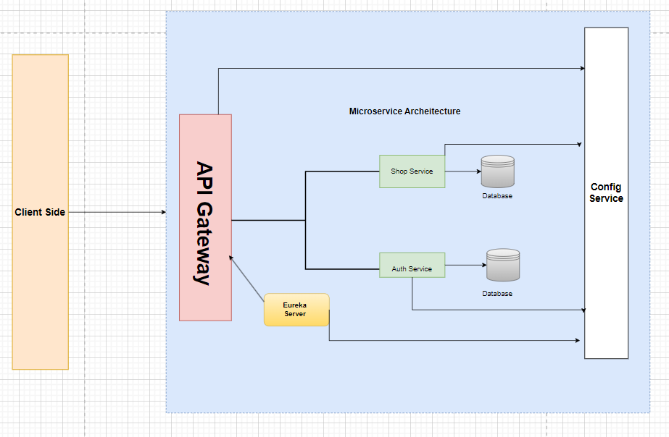
Microservice Architecture

Slide 7
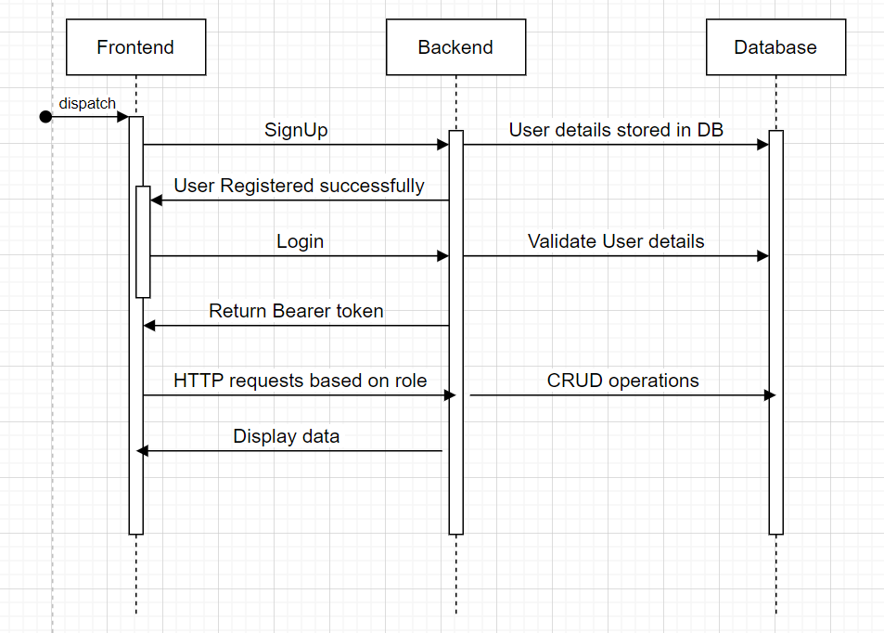
Flow Diagram
Y

