Slide 1
STAT 214 Spring 2026
Week 13 Discussion
Lab 3.2: BERT & LoRA Fine-Tuning
4/17/2026
GSI: Sean Richardson

Slide 2
Announcements
Office hours
Is W 12-3PM (Zoom) OK? Would you prefer in-person options?
Lab 3 reminders
Part 3.2 check-in due 11:59pm, April 24
Final report due 11:59pm, May 8
Reference guides
smrichardson.github.io/stat214
Lab 3 Reference Guide (pipeline, notation, PCS)
Lab 3.2 LoRA Fine-Tuning Guide

Slide 3
Where we are in Lab 3
 | What | Due | Status
3.1 | BoW, Word2Vec, GloVe → ridge → CC | Apr 10 | Done!
3.2 | BERT + LoRA → ridge → compare all | Apr 24 | ← you are here
3.3 | SHAP/LIME interpretation + final report | May 8
Today's focus: everything you need for 3.2
The good news: your pipeline from 3.1 carries over. The only new part is the embedding step.
Remaining discussions:
Apr 24 — SHAP & LIME interpretation (for 3.3)
May 1 — topic of your choice (last class!)

Slide 4
Outline
About me
~ 5 min
3.1 debrief: what went well, what was hard?
~ 5 min
LoRA and parameter-efficient fine-tuning
~ 15 min
Practical tips for 3.2
~ 10 min
Questions + lab work time
~ 15 min

Slide 5


About me
Sean Richardson
he/him · seanrichardson@berkeley.edu
1st year PhD student in Statistics
MS in Statistics from UChicago (causal inference, interpretability)
BA in Philosophy from UCLA, 1 year of law school
Research interests:
AI evaluation, causal inference, mechanistic interpretability
Taking over from Sequoia for the rest of the semester

Slide 6
3.1 Debrief
What was your experience with 3.1?
What worked well?
What was the hardest part?
Memory? Storage? Bridges-2?
What correlation coefficients did you get?
Most voxels near zero is expected!
Any questions before we move to 3.2?

Slide 7
Why fine-tune BERT?
Pretrained BERT already produces contextual embeddings
But it was trained on Wikipedia + BookCorpus, not podcast stories
Fine-tuning adapts the representations to our domain:
Informal, conversational narrative language
Specific vocabulary and phrasing from The Moth Radio Hour
Question: BERT has ~110 million parameters. Our story data has ~24,000 words. Does anyone see a problem?

Slide 8
Why fine-tune BERT?
Pretrained BERT already produces contextual embeddings
But it was trained on Wikipedia + BookCorpus, not podcast stories
Fine-tuning adapts the representations to our domain:
Informal, conversational narrative language
Specific vocabulary and phrasing from The Moth Radio Hour
Question: BERT has ~110 million parameters. Our story data has ~24,000 words. Does anyone see a problem?
Massive overfitting risk! We need a way to fine-tune with far fewer parameters → “parameter-efficient finetuning.” Also offers big compute savings!

Slide 9
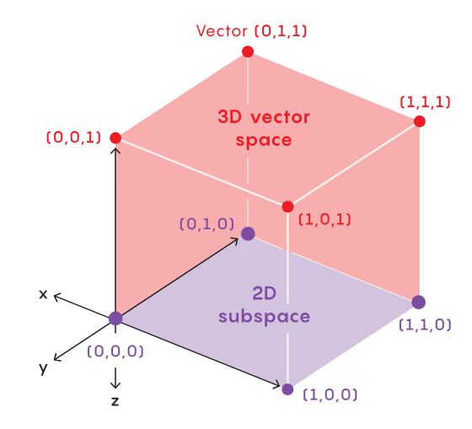
LoRA: Low-Rank Adaptation
Key idea
We can probably find a good task-specific weight update within a low-dimensional subspace
Linear algebra review:
Q: What’s a subspace?
Q: What does it mean for it to be low-dimensional?

Slide 10
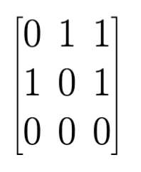
LoRA: Low-Rank Adaptation
Key idea
We can probably find a good task-specific weight update within a low-dimensional subspace – which corresponds to the span of some low-rank matrix

Slide 11
LoRA: Low-Rank Adaptation
Key idea
We can probably find a good task-specific weight update within a low-dimensional subspace – which corresponds to the span of some low-rank matrix
Q: How can we constrain the rank of a matrix when its parameters are being optimized by SGD?

Slide 12
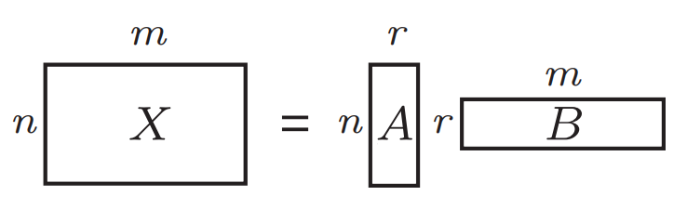
LoRA: Low-Rank Adaptation
Key idea
We can probably find a good task-specific weight update within a low-dimensional subspace – which corresponds to the span of some low-rank matrix
Q: How can we constrain the rank of a matrix when its parameters are being optimized by SGD?

Slide 13
LoRA: Low-Rank Adaptation
Steps
Instead of updating the full weight matrix W:
1. Freeze W (e.g., all original BERT parameters)
2. Add small trainable matrices A and B
3. The update is: ΔW = (γ/r) · A · Bᵀ
We could add this to W, but because matrix multiplication distributes over addition, can also keep W fixed and just route the inputs through both W and the LoRA update (you might see both formulations)
where r is the rank (e.g. 4 or 8), and γ is a scaling hyperparameter
Example dimensions
Original W: 768 × 768
= 590K parameters
LoRA (rank 8):
A: 768 × 8
B: 768 × 8
= 12K parameters
98% reduction!

Slide 14
LoRA intuition: PCA for weight updates
Think of it like PCA:
In PCA, a few principal components capture most of the variance in your data
In LoRA, a few "principal directions" capture most of the needed adaptation
The rank r controls how many directions you allow
Where do we apply LoRA?
BERT's attention layers have query, key, and value matrices
Standard approach: apply LoRA to query and value matrices

Slide 15
Hyperparameters to explore
Parameter | What it controls | Start with | Try
Rank (r) | Capacity of adaptation | 8 | 4, 8, 16
lora_alpha (γ) | Update magnitude | 8 | r to 2r
Target modules | Which attention weights | Q + V | Add K
Learning rate | Optimizer step size | 1e-4 | 1e-4 to 5e-4
Epochs | Passes over data | 3 | 3-5
A full sweep of all hyperparameters is not expected. More systematic approaches exist (e.g. Bayesian optimization), but grid search over a few values is fine for this lab.

Slide 16
Practical: extracting BERT embeddings
Quick question: how many r's are in "strawberry"?
Why do LLMs famously get this wrong?

Slide 17
Practical: extracting BERT embeddings
LLMs don't see letters — they see tokens (subwords).
The subword problem
BERT tokenizes into subwords, not words:
"playing" → ["play", "##ing"] (2 vectors, but we need 1)
Solution: mean-pool subtokens belonging to the same word
Use word_ids() to get the subtoken-to-word mapping
Sanity check: len(embeddings) must equal len(words)
The 512-token limit
Most stories > 512 subtokens. Process in overlapping windows.
Average embeddings for words seen in multiple windows.

Slide 18
Important: two different BERT classes
BertModel
(for extracting embeddings)
Output: last_hidden_state
Shape: (seq_len, 768)
These are the contextual embeddings you want for the pipeline
BertForMaskedLM
(for training with MLM loss)
Output: logits
Shape: (seq_len, 30522)
These are vocabulary predictions, NOT embeddings!
Train with BertForMaskedLM (need the MLM loss head)
Extract embeddings from BertModel + LoRA adapter (need hidden states)
The LoRA adapter modifies the attention layers, which are shared between both classes

Slide 19
The 3.2 pipeline (what's new vs 3.1)
Same as 3.1:
Downsample → Delays → Trim → Ridge → CC evaluation
New for 3.2 (the embedding step only):
1. Extract embeddings from pretrained BERT (no training)
→ Handle subword aggregation and 512-token limit
2. Fine-tune BERT with LoRA on MLM objective
→ Tokenize stories into overlapping chunks
→ Train with DataCollatorForLanguageModeling (handles masking)
→ Save the LoRA adapter
3. Extract embeddings from fine-tuned BERT
→ Load adapter onto BertModel, use same extraction code
4. Compare all methods: BoW, W2V, GloVe, BERT, BERT+LoRA

Slide 20
Questions to address in your report
Does fine-tuning actually help?
Compare pretrained vs LoRA-finetuned BERT. If it doesn't help, why?
Do contextual embeddings predict different voxels?
Jaccard similarity of top voxel sets across embedding methods
Data leakage?
You fine-tune on story text, then use the same text for ridge. The MLM never sees fMRI data. Discuss.
Stability of LoRA hyperparameters
If changing rank flips which voxels are well-predicted, the conclusions are fragile (PCS!)
Weight interpretability
Why can't we just look at the ridge weights? (Answer: embedding dimensions aren't interpretable. SHAP/LIME in 3.3.)

Slide 21
Upcoming sessions
Next week (4/24): SHAP & LIME interpretation
You'll need this for Lab 3.3. I'll cover the wrapper pattern, how SHAP and LIME work, and practical tips for running them on your models.
Last session (5/1): your choice!
Causal inference
Potential outcomes, DAGs, common identification strategies
RL and RLHF/RLVR/RLAIF for LLMs
Reward modeling, policy optimization, DeepSeek-style reasoning RL
Both (overview of each)
Show of hands at the end?

Slide 22
Questions?
Lab work time — I'm here to help with 3.2

