Slide 1
APACHE SPARK
Smrithi Ajit
BIG DATA WORKSHOP

Slide 2
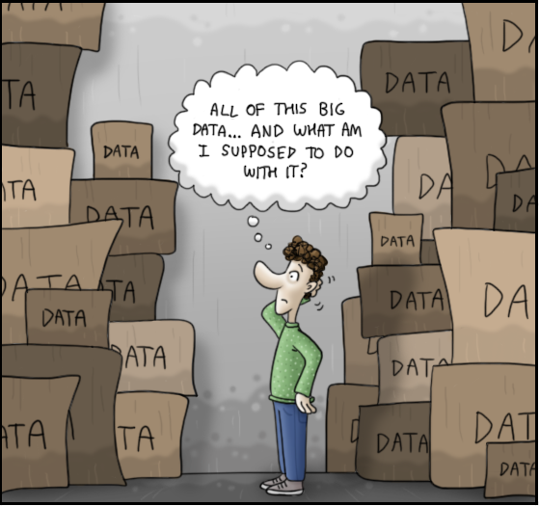
BIG DATA
“Data that is so big and complex that it is hard to process it”
VOLUME
3Vs of Big Data:
BIG DATA
VELOCITY
VERACITY
Notes:
If you want to know more about cabinet hardware, see this description written by Rob Klug (Clark County, Washington): http://howtrafficsignalswork.blogspot.com/2010/05/so-what-is-inside-traffic-signal.html

Slide 3

CONCEPT OF HADOOP
OPEN SOURCE
SOFTWARE PLATFORM
DISTRIBUTED STORAGE
DISTRIBUTED PROCESSING
LARGE DATA SETS
COMPUTER CLUSTERS
Notes:
If you want to know more about cabinet hardware, see this description written by Rob Klug (Clark County, Washington): http://howtrafficsignalswork.blogspot.com/2010/05/so-what-is-inside-traffic-signal.html

Slide 4
HADOOP DISTRIBUTED FILE SYSTEM(HDFS)
Big data file of large size(several GBs)
Large files to smaller chunks of standard size 128MB

Slide 5
SIMPLE HDFS COMMANDS and function
hdfs dfs –ls
hdfs dfs –copyToLocal <hdfs source>/filename <destination>
hdfs dfs –put <source> <hdfs destination>
hdfs dfs –mv <source> <destination>
hdfs dfs -cp <source> <destination>
List the files on the HDFS
Copy files from HDFS to local folder
Put files from the local folder to HDFS
Move file from one location on HDFS to another
Copy files from one location on HDFS to another

Slide 6
CONCEPT OF DISTRIBUTED COMPUTING AND BIRTH OF SPARK
Google introduced: distributed data, distributed processing and fault tolerance
MapReduce, a resilient distributed processing framework, which enabled Google to index the exploding volume of content on the web, across large clusters of commodity servers.
After Google’s white paper in 2004,Doug Cutting and Mike Cafarella created Apache Hadoop
Apache Spark born in 2009,AMPLab at the University of California, Berkeley.
Spark incubated by Apache Software Foundation in 2013, and promoted early in 2014
Today it is one of the most active projects managed by the Foundation
Well-funded corporate backers: Databricks, IBM, and China’s Huawei.

Slide 7
CONCEPT OF MAPREDUCE
Deer, 1
Bear,1
River,1
Bear, 1
Bear,1
Bear,2
Deer Bear River
Bear,2
Car,3
Deer,2
River,2
Deer Bear River
Car Car River
Deer Car Bear
Car, 1
Car,1
Car,2
Car, 1
Car,1
River,1
Car Car River
Deer, 1
Deer,1
Deer,2
Deer, 1
Car,1
Bear,1
Deer Car Bear
River, 1
River,1
River,2
Input
Splitting
Final result
Mapping
Shuffling
Reducing

Slide 8
APACHE SPARK
“An open-source big data processing framework built around speed, ease of use, and sophisticated analytics”
Paid and Free services: AWS,Microsoft Azure,Google Colabs, Databricks
On-premise: Local system, Hadoop cluster
Notes:
If you want to know more about cabinet hardware, see this description written by Rob Klug (Clark County, Washington): http://howtrafficsignalswork.blogspot.com/2010/05/so-what-is-inside-traffic-signal.html

Slide 9
HADOOP MAP REDUCE versus APACHE SPARK
APACHE SPARK
MAP REDUCE
Both batch processing and real time data processing
100x faster in memory and 10x faster on disk since intermediate results not written to disk
DAG has multiple vertices
Only batch processing
Slower than Apache spark because of I/O latency
Write all intermediate results to disk
Spend 90% of the time on HDFS read write operations
Notes:
If you want to know more about cabinet hardware, see this description written by Rob Klug (Clark County, Washington): http://howtrafficsignalswork.blogspot.com/2010/05/so-what-is-inside-traffic-signal.html

Slide 10
ITERATIVE PROCESSES
Map reduce job
Map reduce job
Result
Data

Slide 11
ITERATIVE PROCESSES
Distributed memory
Spark

Slide 12
INTERACTIVE PROCESS(SQL Query)
Map Reduce

Slide 13
INTERACTIVE PROCESS(SQL QUERY)
Distributed memory
Spark Process

Slide 14
WHERE DO YOU SEE SPARK IN THE BIG DATA PIPELINE?
Reports stored on HDFS
HDFS Storage
Data Source
Spark Process
Spark Process
Data preprocessing: Cleaning, partitioning
Data processing: Filtering, joining, aggregating
Performance Reports

Slide 15
ADVANTAGES of SPARK
Capable of handling several petabytes of data
Simplicity
Speed-100 times faster than Hadoop Map Reduce
Spark is often used with distributed data stores such as MapR XD, Hadoop’s HDFS, and Amazon’s S3, with popular NoSQL databases such as MapR Database, Apache HBase, Apache Cassandra, and MongoDB, and with distributed messaging stores such as MapR Event Store and Apache Kafka.

Slide 16
Components of Spark
Spark SQL Structured data
Spark Streaming real time
MLlib machine learning
GraphX graph processing
Spark core
Standalone Scheduler
YARN
MESOS

Slide 17
COMPONENTS OF SPARK
All the functionalities of Apache Spark built on the top of Spark Core.
Significant in programming and observing the role of the Spark Cluster
Spark SQL is a Distributed framework for structured data processing and acts as a distributed SQL query engine.
Spark streaming is an add-on to core Spark API which allows scalable, high-throughput, fault-tolerant stream processing of live data streams.
GraphX in Spark is API for graphs and graph parallel execution.
MLlib creation is to make machine learning scalable and easy.

Slide 18
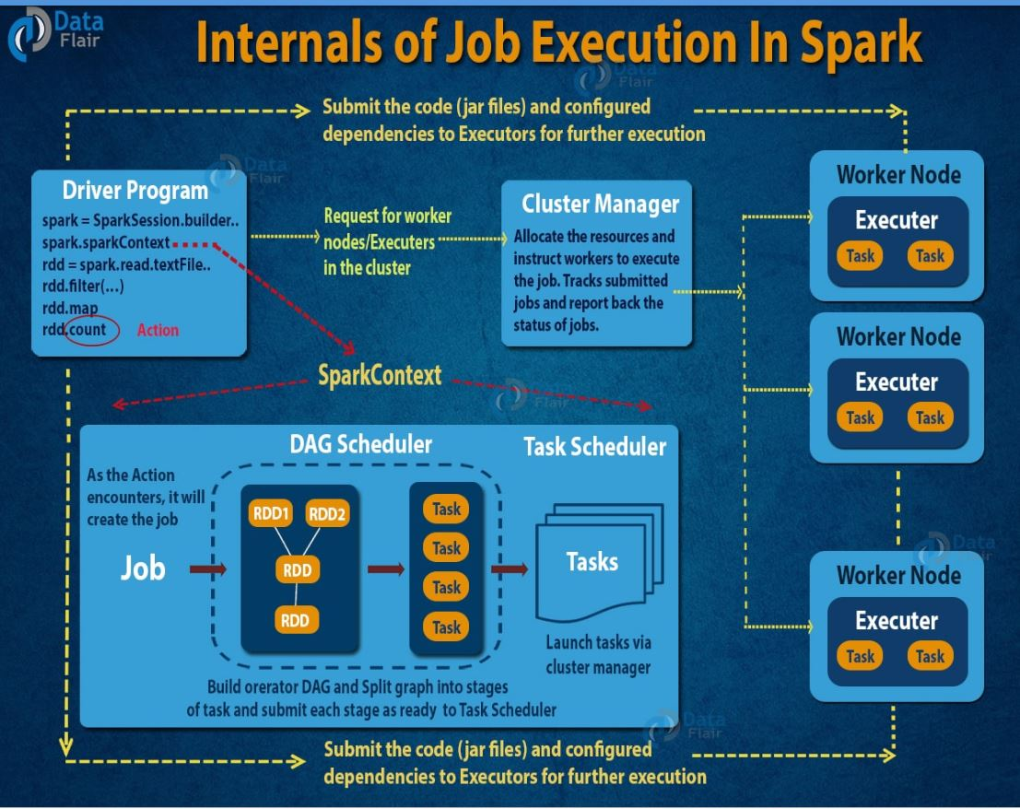
HOW IT WORKS?
https://data-flair.training/blogs/dag-in-apache-spark/

Slide 19
MODES OF OPERATION
Client Mode
Spark Driver and Spark Context run on client node outside Yarn Cluster
Cluster mode
They run inside the YARN cluster
Local mode
Process run in within a node

Slide 20
USE CASES
Stream processing
Machine learning
Interactive analytics
Data integration

Slide 21
Who is using spark??
IBM and Huawei have invested significant sums in the technology,
The major Hadoop vendors, including MapR, Cloudera, and Hortonworks, have all moved to support YARN-based Spark alongside their existing products,
Chinese search engine Baidu, e-commerce operation Taobao, and social networking company Tencent, all run Spark-based operations at scale, with Tencent’s 800 million active users reportedly generating over 700 TB of data per day for processing on a cluster of more than 8,000 compute nodes.
Pharmaceutical company Novartis depends upon Spark to reduce the time required to get modeling data into the hands of researchers
Internet powerhouses such as Netflix, Yahoo, and eBay have deployed Spark at massive scale, collectively processing multiple petabytes of data on clusters of over 8,000 nodes. It has quickly become the largest open source community in big data, with over 1000 contributors from 250+ organizations.

Slide 22
DATA PREPROCESSING USING SPARK
Handling missing values
Filtering of Garbage data
Changing datatypes and data with non-conformities
Notes:
If you want to know more about cabinet hardware, see this description written by Rob Klug (Clark County, Washington): http://howtrafficsignalswork.blogspot.com/2010/05/so-what-is-inside-traffic-signal.html

Slide 23
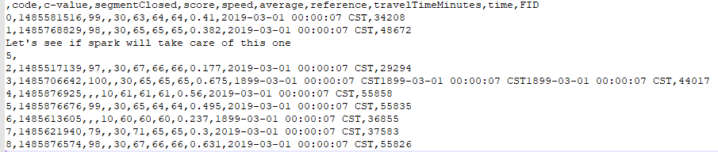
What are the issues that come up when we do pre-processing?
Issue with timestamps
Absence of headers
Malformed data

Slide 24
ISSUES AND SOLUTIONS
Data issue | PySpark solution
Malformed data | An extra parameter included when reading data into spark data frame
Timestamp issue | The data can be dropped by first converting time string to timestamp and then filtering out based on year or regex pattern
Absence of headers | The headers and the datatypes of the columns can be specified in the initial step when defining the schema

Slide 25
Handling Malformed data
df1 = spark.read.csv('Data_cleaning6.csv',inferSchema=True, header =True)
This additional parameter helps drop the malformed data
df2=spark.read.format('csv').option("mode","DROPMALFORMED").option('header','true’)
.load('Data_cleaning6.csv',inferSchema=True)

Slide 26
DATA PosT- PROCESSING USING SPARK
Join datasets
Filter data based on certain conditions
Aggregate data by a column or group of columns and find average,sum etc
Notes:
If you want to know more about cabinet hardware, see this description written by Rob Klug (Clark County, Washington): http://howtrafficsignalswork.blogspot.com/2010/05/so-what-is-inside-traffic-signal.html

Slide 27
RDD and SPARK DATAFRAME
Spark Data frame holds data in column and row format
Column represents feature or variable
A row represents an individual datapoint
Spark started with RDD but Spark 2 and higher uses data frame syntax which is much easier to work with
Dataframes used to apply transformations
Results of the transformations can be display using shown or collected
Let’s start coding….

Slide 28
PANDAS DATAFRAME
A 2- dimensional data structure aligned in a tabular fashion in rows and columns
Registration | Name | Marks
11010110 | Steve | 87
11010110 | Jose | 90
11010110 | Patty | 72
11010110 | Vin | 85

Slide 29
NUMPY ARRAY
NumPy or Numerical Python helps with computing large sets of numerical data where python lists fail.
In numpy arrays all the elements are of the same type and are fast and efficient
Pandas is built on NumPy

Slide 30
IN a nutsheLL
Spark works on in memory processing and DAG
while MapReduce involves more reading and writing from disk.
Fast and efficient
Spark is Open source and constantly evolving and there is growing interest and contribution
It is a great option for transformation and analysis of big data (distributed operation)

Slide 31
REferences
http://static.googleusercontent.com/media/research.google.com/en/us/archive/mapreduce-osdi04.pdf
https://data-flair.training/blogs/apache-spark-ecosystem-components/
https://databricks.com/spark/
kdnuggets.com/2018/10/apache-spark-introduction-beginners.html

