Slide 1
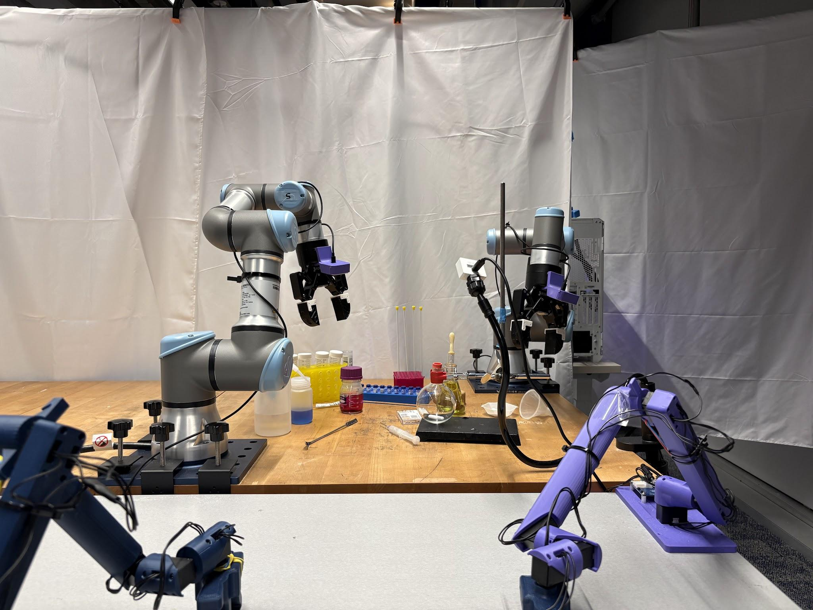
Learning bimanual manipulation from demonstrations
Smrithi Lokesh
Janus Intelligent Robot Lab · University of Pennsylvania
Internal camera views · successful needle rollout
Notes:
Open with the central question: what does it take to convert a small set of chemistry demonstrations into reliable, multi-stage execution on physical robots? Emphasize that this is an end-to-end systems project, not only a policy-training project.
[Sources]
- User-provided needle.mp4
[/Sources]

Slide 2
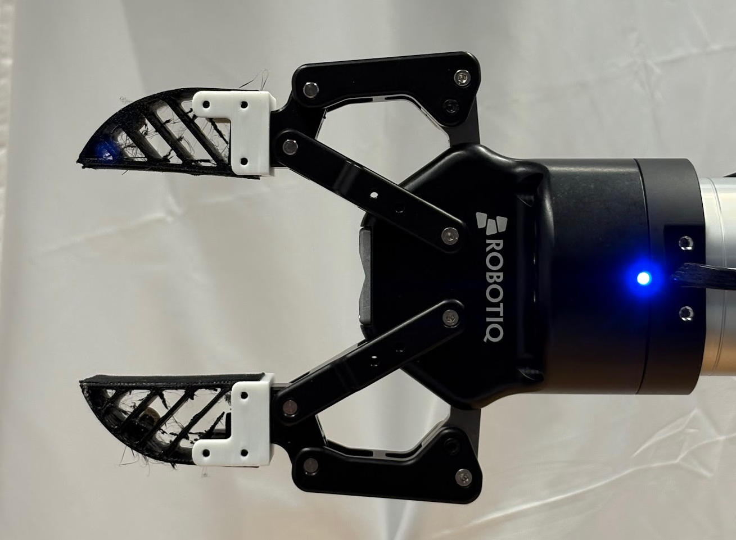
PROBLEM FORMULATION
A robotically complete motion may still fail the experiment
Success had to be defined with a chemist
Worked with a chemistry PhD student to formulate experiments and identify action details that affected scientific validity.
(will be added)
ADD PHOTO
CAD photos of redesigned spatula / clamp
External view of successful experiment
Refined success criteria beyond reaching a pose: complete transfer, correct insertion, stable grasp, and contamination-aware handling.
Redesigned tools and containers when the original hardware created unnecessary manipulation difficulty.
Design implication
Reliable automation required joint design of the policy, demonstrations, tools, environment, and task-level success criteria.
Notes:
Explain that success labels evolved with chemist feedback. Use the screw-cap versus press-on-lid example and the redesigned spatulas/clamps. The scientific objective constrained what counted as a valid rollout.
[Sources]
- User-provided project description
- Open Science Stack collaboration notes provided in conversation
[/Sources]

Slide 3
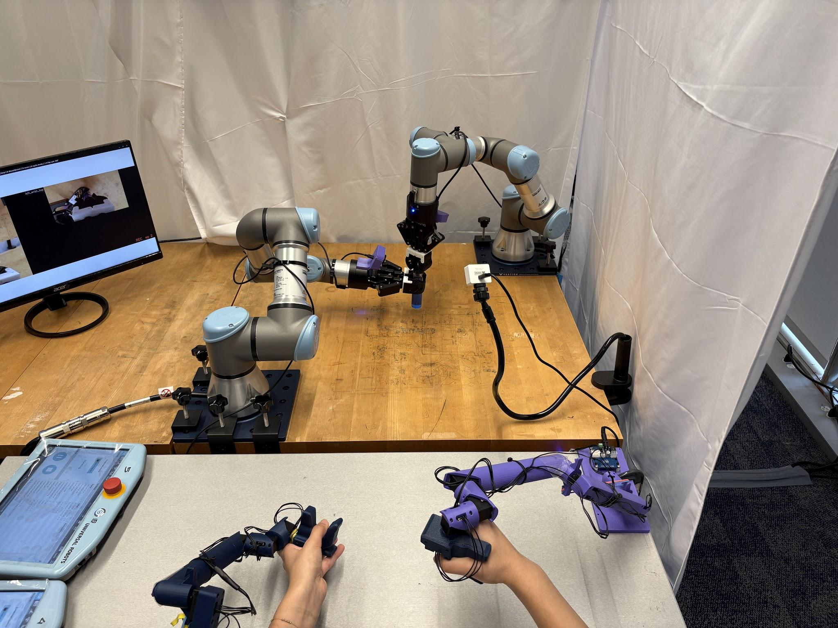
SYSTEM AND DATA
A synchronized multimodal record links what the robot sees, senses, and executes
(a) Front view
(b) Left wrist
(c) Right wrist
(d)Proprioception
Iᶠₜ
Iˡₜ
Iʳₜ
qₜ ∈ ℝ¹⁴
oₜ = [ Iᶠₜ, Iˡₜ, Iʳₜ, qₜ ]
GELLO + dual UR3e setup
aₜ ∈ ℝ¹⁴ · left joints + gripper, then right joints + gripper
10 Hz recording loop
Latest ROS joint states and GELLO commands were sampled with one frame per camera into a common LeRobot episode.
Critical invariant
train / deploy schemas match
joint order · camera identity · crop/resize · normalization · frequency
Notes:
Clarify that synchronization was software-level sampling in one 10 Hz loop, not hardware-triggered synchronization. State and action were both 14-D: six UR3e joints plus gripper per arm. The images and numerical trajectories were stored in the LeRobot schema.
[Sources]
- User-provided lerobot_ros2-dagger_re codebase
- config/gello.yaml
- record.py and data_loader.py
[/Sources]

Slide 4
POLICY DEVELOPMENT
Four targeted interventions improved supervision, observability, recovery, and transfer
(a) SUPERVISION
(b) OBSERVABILITY
(c) COVARIATE SHIFT
(d) TRANSFER
Plateau removal
Temporal context
DAgger
LBM fine-tuning
Removed low-motion hesitation frames as loss anchors to reduce freezing and slow execution.
Added previous images and in some variants previous commanded actions to disambiguate task phase.
Collected human corrections from policy-induced states to add recovery behavior.
Canonicalized short-horizon datasets, pretrained across tasks, then adapted to a target experiment.
Scratch
vs.
Fine-tuned LBM
πθ(a | o, h)
random initialization
multitask data → canonical schema → pretraining → target-task adaptation
Notes:
Do not present these as equivalent tricks. Plateau removal changes which frames supervise learning; history targets partial observability; DAgger targets the state-distribution mismatch; LBM fine-tuning tests cross-task transfer. Mention that variants were sometimes combined.
[Sources]
- User-provided lerobot_ros2-dagger_re codebase
- canonicalize.py
- plateau.py
- dagger.py
- strided/action-history policy plugins
[/Sources]

Slide 5
DEPLOYMENT
Closed-loop deployment couples action generation, execution, and replanning
(a) Diffusion-policy deployment
(b) Checkpoint
Training loss was insufficient; multiple saved policies were tested on hardware.
Predict an action horizon, execute a prefix, then observe and replan.
oₜ → denoise N times → âₜ:ₜ+H
(c) Action steps (K)
Larger K improved smoothness but increased open-loop commitment; smaller K replanned more often.
execute K actions → observe oₜ₊ₖ → replan
At 10 Hz, four minutes ≈ 2,400 control steps
(d) Inference steps (N)
More denoising could improve action quality, but increased latency and reduced responsiveness.
Small early errors alter the next observation and compound across stages.
Example: Needle trials with K = 4, 8, or 16 could stall before insertion; the successful plateau-processed run used K = 32.
Notes:
Explain the closed-loop versus smoothness tradeoff. Mention that needle sweeps included checkpoints at 20k and 40k, action-step values 2/4/8/16/32, and inference-step values 20/30. The final behavior had to be selected through repeated physical deployment.
[Sources]
- Google Sheet: needle — Jul 3, Jul 6, jul 9, Jul 17 tabs
- User-provided deployment logs
[/Sources]

Slide 6
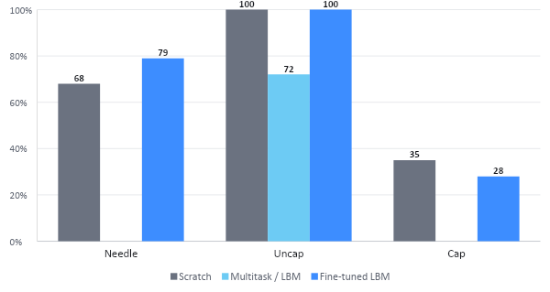
SHORT-HORIZON RESULTS
Fine-tuning transferred useful behavior in short-horizon tasks
+11 pp
Needle: fine-tuning improved 68% → 79%
Uncap
Fine-tuning matched the 100% scratch baseline.
Cap
0
0
Fine-tuning did not improve the low-performing baseline.
Task selection: varied scratch success (68%, 100%, 35%) across precise and contact-rich manipulation. Fine-tuning helped selectively, not uniformly.
Notes:
These are measured rollout success percentages. Avoid saying the LBM always outperformed scratch. The important result is that fine-tuning recovered transferable structure for needle and uncap, while cap remained difficult.
[Sources]
- Weekly_analysis.pptx
- Google Sheets: needle, uncap, cap
[/Sources]

Slide 7
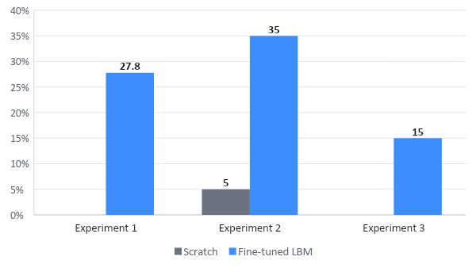
LONG-HORIZON RESULTS
Fine-tuning improved all three long-horizon tasks
Experiment 1 stage-level completion
Stir bar
80%
Funnel on
56%
Solid
100%
Liquid
89%
0
0
Funnel off
100%
Septum
63%
30k checkpoint · K = 32
Overall success 27.8%; septum remained the terminal bottleneck.
Notes:
Explain why full-task success is lower than individual stage success: every stage must succeed in sequence. In LH1, solid and funnel-off reached 100% stage success, while funnel-on and septum remained weaker. LH2 used the 30k checkpoint with K=8 and reached 35%, versus 5% scratch.
[Sources]
- Weekly_analysis.pptx
- Google Sheets: long horizon1, long horizon2, long horizon3
- User-provided syntehsis.mp4
[/Sources]

Slide 8
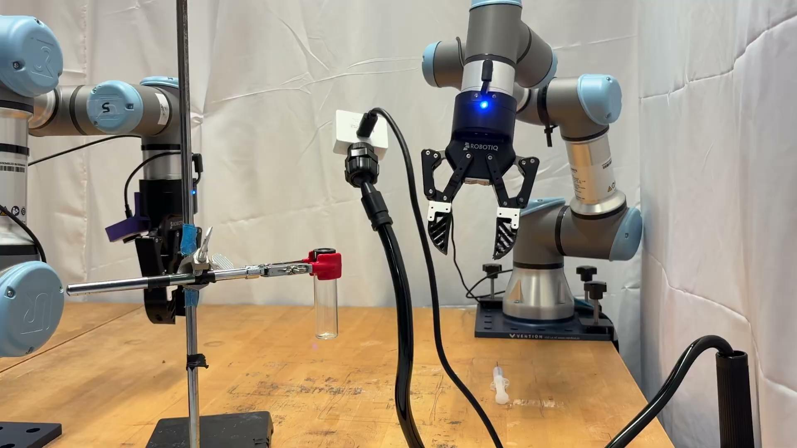
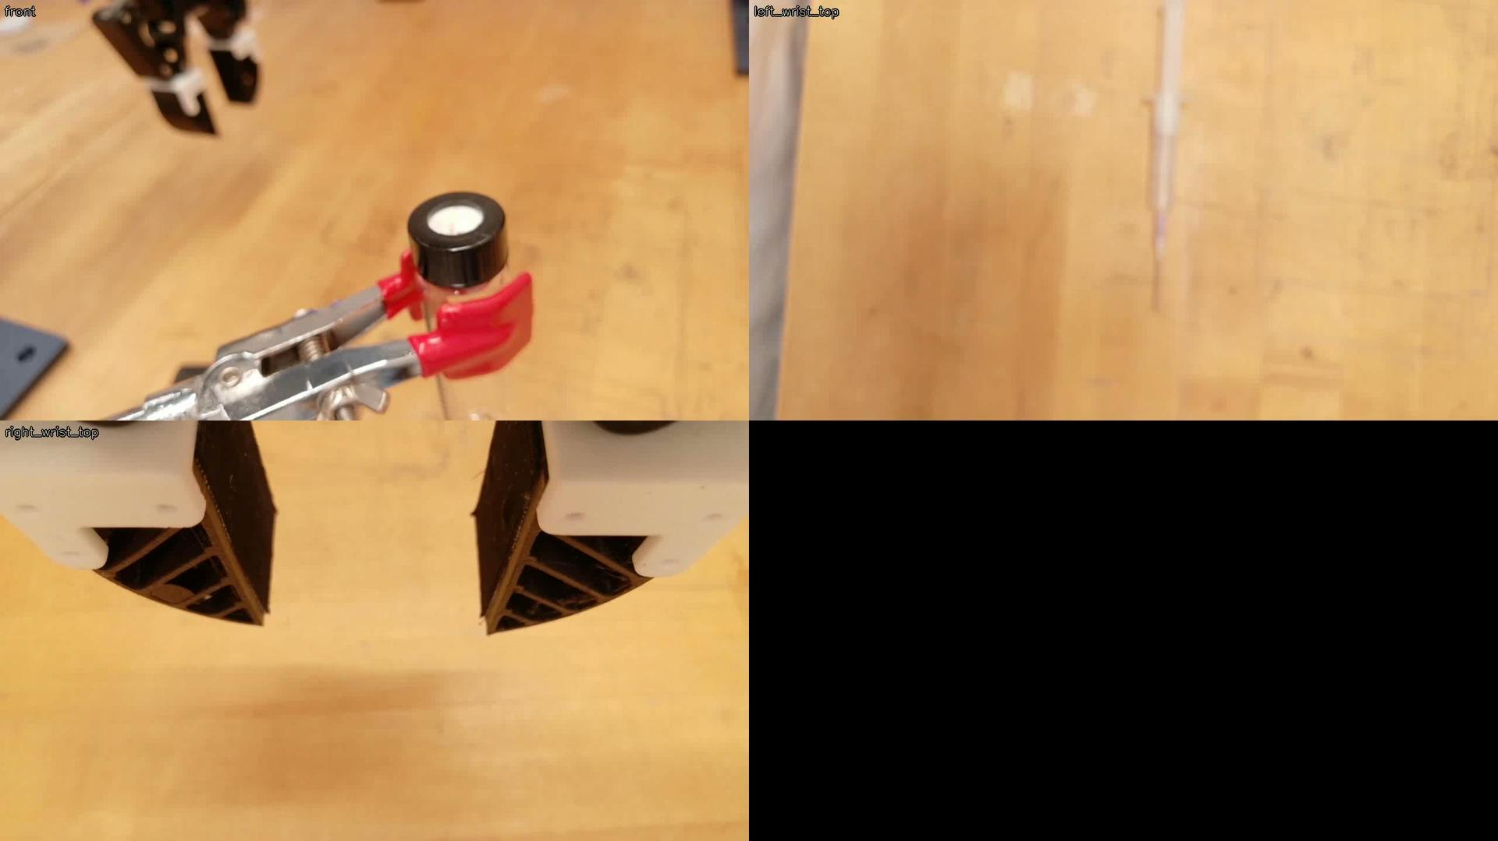
DEPLOYMENT
Needle insertion: precision manipulation under visual feedback
(a) External camera recording
(b) Internal camera views
Plateau-processed · 30k checkpoint · K = 32
The rollout succeeds visually, but contact onset and septum penetration remain only indirectly observable.

Slide 9
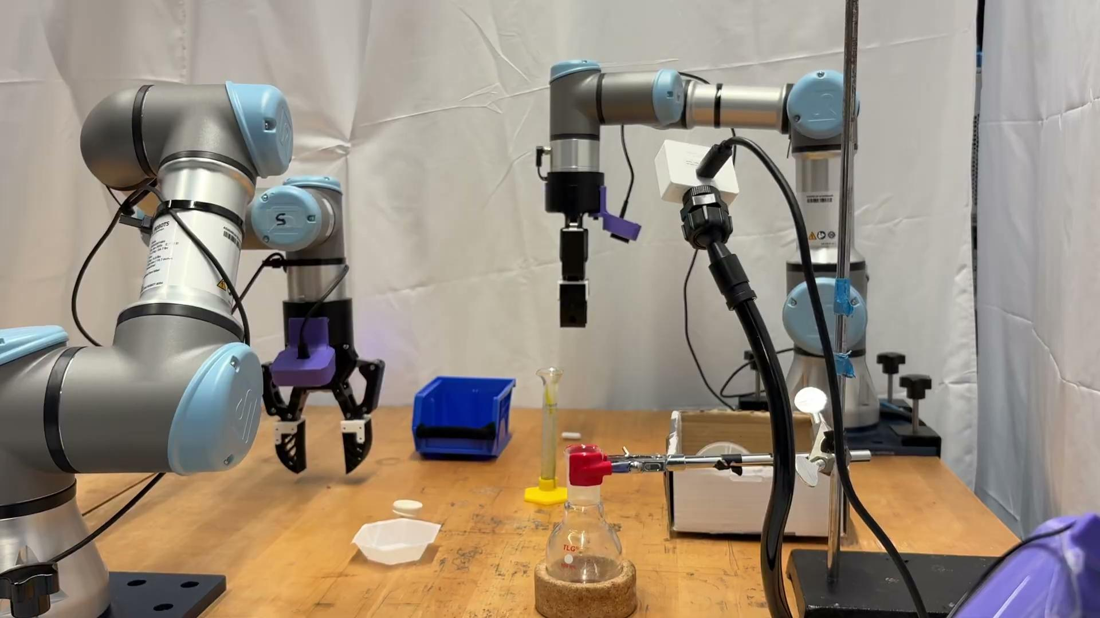
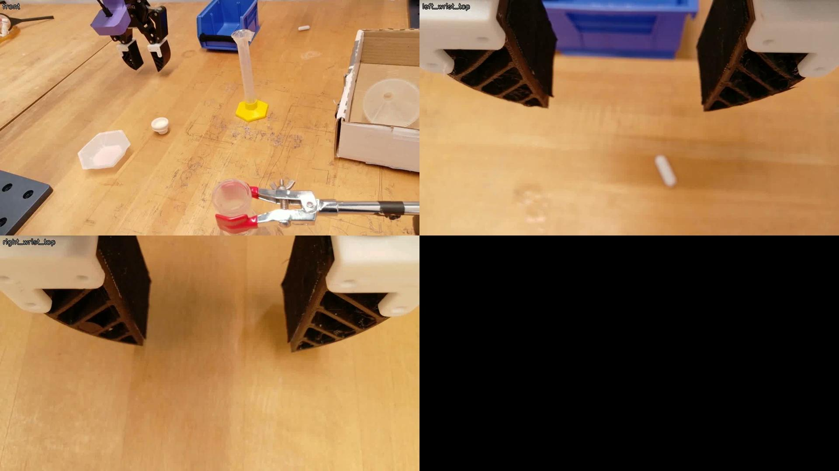
DEPLOYMENT
Long Horizon: a successful synthesis rollout
(a) External camera recording
(b) Internal camera views
Plateau-processed · 30k checkpoint · K = 32
Internal views expose bimanual coordination; the external recording shows full-task continuity and physical outcomes.

Slide 10
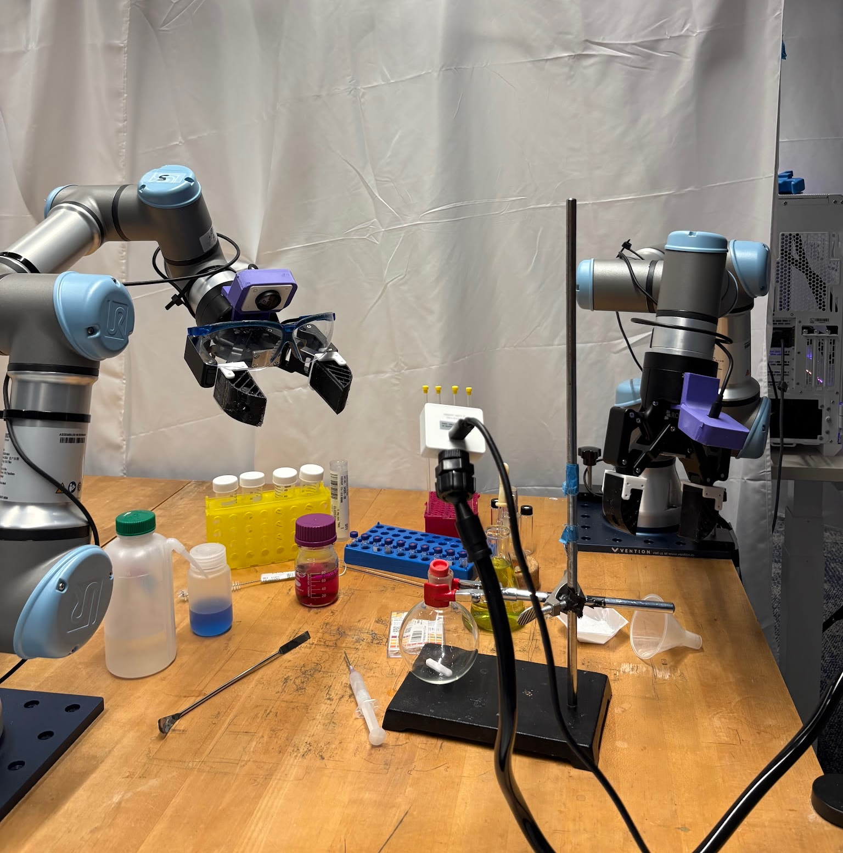
IMPLICATIONS
The remaining failures were often contact-state estimation failures
(a) Vision + proprioception
(b) Add tactile sensing
Provided scene geometry and robot configuration but not direct evidence of contact, force, slip, or successful penetration.
Could reveal contact onset, pressure distribution, slip, and the transition from touching the septum to entering it.
Central takeaway
Reliable manipulation emerged from aligning task semantics, data quality, temporal context, physical design, and deployment and not from model scaling alone.
Notes:
Close with the concrete motivation for tactile sensing: during septum insertion, the policy could see the needle and knew the robot configuration, but could not feel whether it had contacted or penetrated the septum or how much pressure it applied. This is the direct bridge to future tactile-conditioned data and policies.
[Sources]
- User-provided needle.mp4
- User-provided project observations
[/Sources]

Slide 11





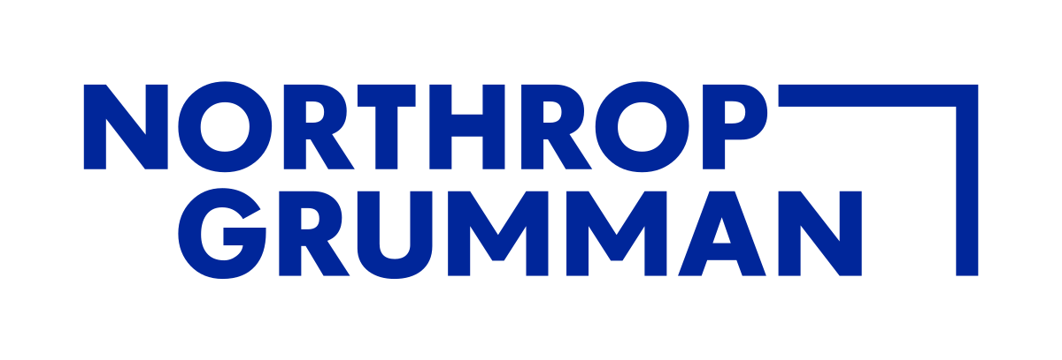
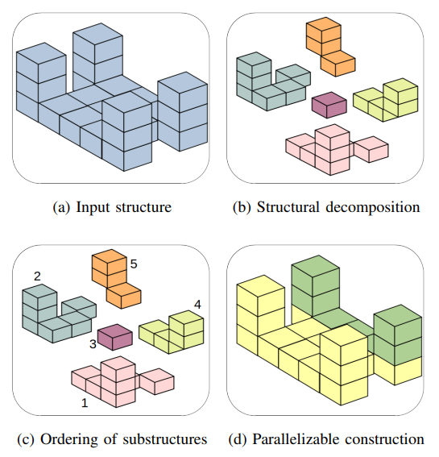
Hierarchical planning for multi-agent collective construction
Smrithi Lokesh
Biorobotics Lab · Carnegie Mellon University
July 2024 – January 2025 · Prof. Howie Choset
Notes:
Open with the core extension: unit cubes become heterogeneous cuboids, so occupancy and motion depend on orientation. Position this as an end-to-end planning project across abstraction levels.
[Sources]
- Final presentation: Smrithi Lokesh.pptx, slides 20–35
[/Sources]

Slide 12
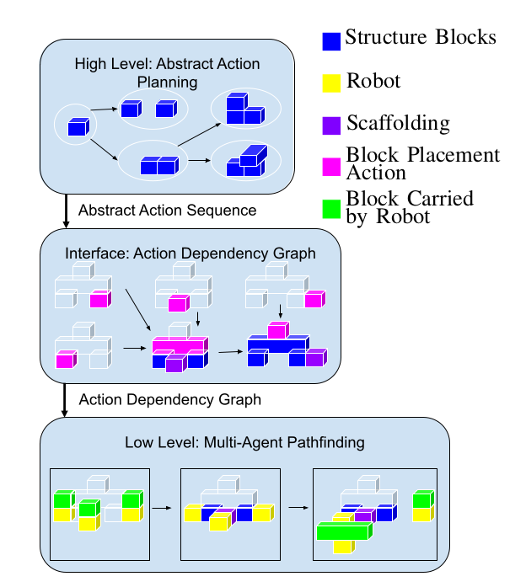
HIERARCHICAL PLANNER
From a structure goal to an executable, collision-free multi-robot schedule
1 High-level A*
Sequences block placements and removals while enforcing structural validity.
2 Interface / ADG
Adds support, access, and temporal precedence; independent actions remain parallel.
3 Allocation + CBS
Assigns actions to robots and resolves robot, block, and carried-load conflicts.
Flat-surface assumption: robots traverse the partial structure or scaffolding from a boundary depot; every action preserves support and a return path.
Notes:
Walk left to right. The interfaces matter: abstract A* outputs actions; access checks establish executability; the ADG exposes concurrency; allocation and CBS produce robot paths.
[Sources]
- Final presentation: Smrithi Lokesh.pptx, slides 20, 30–34
- Prior ETH Zürich preparation context
[/Sources]

Slide 13
SEARCH ENGINEERING
A better heuristic exposed the cost of search
1. Search-based h(S)
Reusable: outgoing costs from the depot. Not reusable: direction-dependent return costs.
2. Cache repeated work
For each unreachable goal block, estimate the scaffolding needed to reach a valid placement pose and return to the boundary.
3. Repair consistency
Cache outgoing costs only; enqueue cached cells so pre-assigned values do not change exploration order.
f(S) = g(S) + h(S)
forward + return scaffolding estimate
More accurate, but slower
4. Relax optimality
Weighted A* and ARA* gave only slight gains because heuristic evaluation still dominated runtime.
The executable round-trip estimate improved guidance, but every heuristic call ran multiple reachability searches.
Caching helped. Suboptimal search did not remove the heuristic bottleneck.
Notes:
Do not claim the new heuristic dominated. It was more informative but expensive; caching introduced correctness subtleties; ARA* could still be slowed by repeated heuristic evaluation.
[Sources]
- Final presentation: Smrithi Lokesh.pptx, slides 3–19
- GitHub commit-history PDFs supplied in Google Drive
[/Sources]

Slide 14
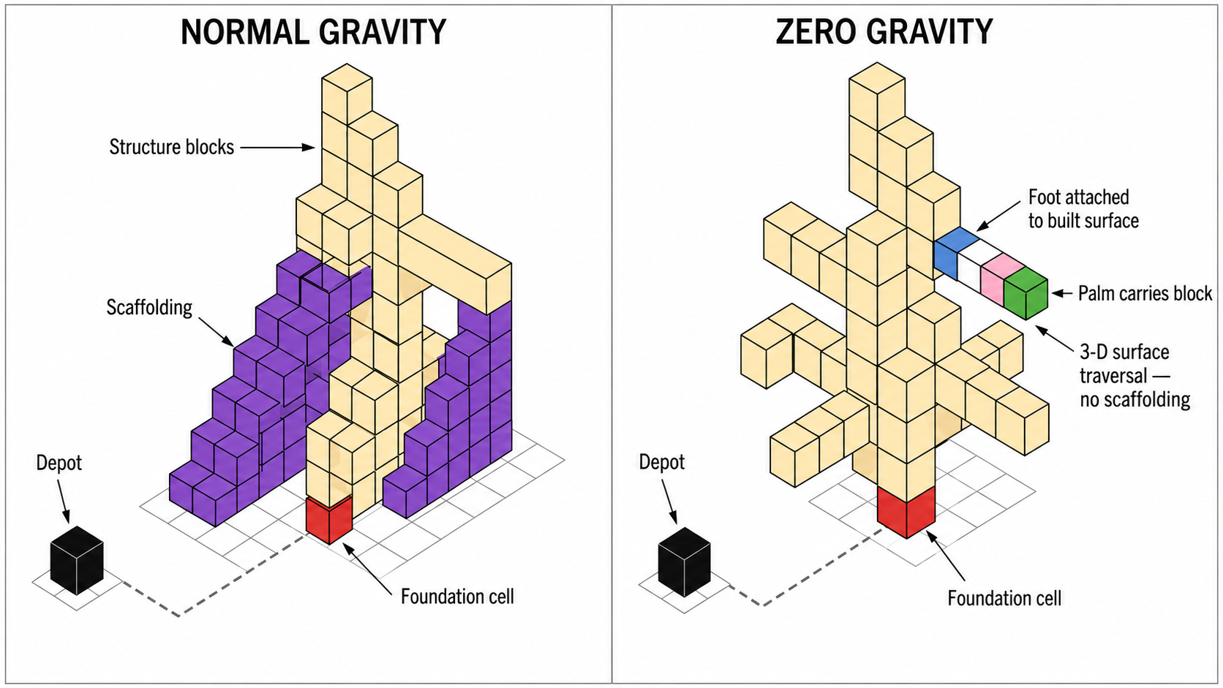
MODELING TRANSITION
Gravity changes the role of scaffolding
Notes:
Use the figure to show how the same helper functions change when blocks occupy several cells and robots may approach with different roll/pitch/yaw.
[Sources]
- Final presentation: Smrithi Lokesh.pptx, slides 21–24
- GitHub commit-history PDFs supplied in Google Drive
[/Sources]

Slide 15
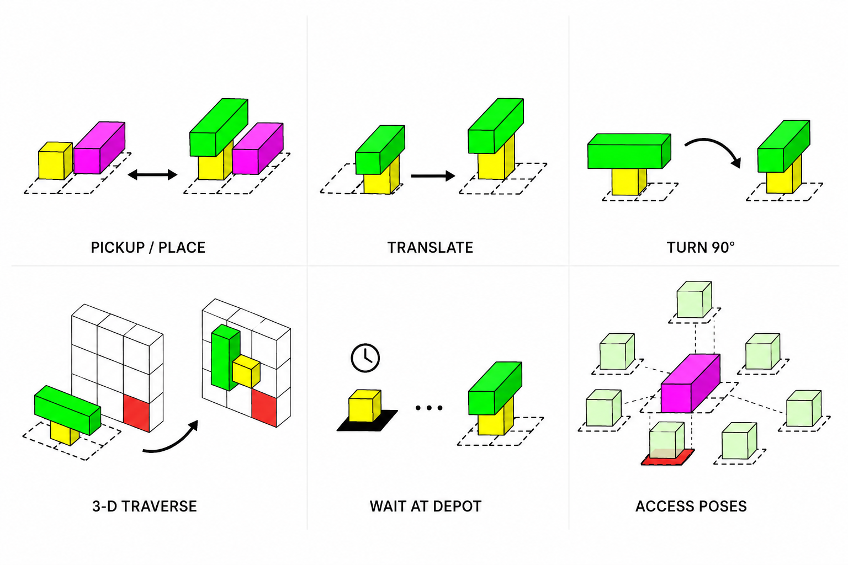
GEOMETRY
Zero-gravity cuboids change action semantics
PUBLISHED CUBOID-MACC
Planar translation · yaw rotation · pickup/place · orientation-dependent occupancy
THESIS EXTENSION
3-D traversal · 26-neighbor access poses · length-aware support · depot waiting · placement/removal constraints
Yellow: robot
Green: carried cuboid
Magenta: placed/goal cuboid
Notes:
Use the figure to show how the same helper functions change when blocks occupy several cells and robots may approach with different roll/pitch/yaw.
[Sources]
- Final presentation: Smrithi Lokesh.pptx, slides 21–24
- GitHub commit-history PDFs supplied in Google Drive
[/Sources]

Slide 16
ZERO-GRAVITY SEARCH
Zero gravity removes scaffolding and the need for heuristic search
(a) Realization
Greater depth first: favor states with more completed block actions.
(b) Depth tie-break
In zero gravity, robots can approach blocks in 3-D; temporary scaffolding is no longer required.
(c) Spatial tie-break
Smaller Euclidean distance from the foundation: retain an inside-out spatial preference.
h(S) = 0
no scaffolding cost
Inside-out construction
(d) Why A* is unnecessary?
With no scaffolding, every complete plan uses the same number of block actions; there is no unique optimum.
A zero-heuristic search ordered primarily by depth and secondarily by Euclidean distance from the foundation.
Across 15 structures, A* took 61.38% longer on average than inside-out (range −26.66% to +390.63%).
Notes:
Do not claim the new heuristic dominated. It was more informative but expensive; caching introduced correctness subtleties; ARA* could still be slowed by repeated heuristic evaluation.
[Sources]
- Final presentation: Smrithi Lokesh.pptx, slides 3–19
- GitHub commit-history PDFs supplied in Google Drive
[/Sources]

Slide 17
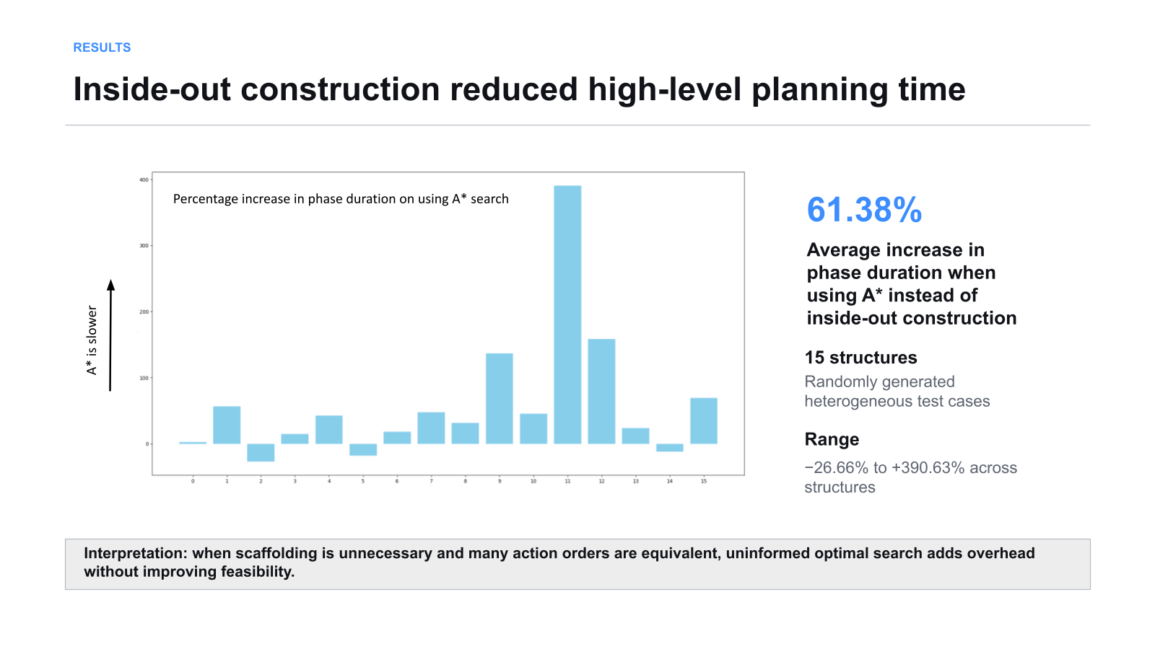
Notes:
Close by connecting this work to a broader research direction: explicit high-level decisions can remain interpretable while continuous execution models or learned costs handle richer dynamics. Empirical paper context reports validation on 200 random structures and three cuboid types.
[Sources]
- Prior ETH Zürich preparation context and IROS paper context
- Final presentation: Smrithi Lokesh.pptx
[/Sources]

Slide 18
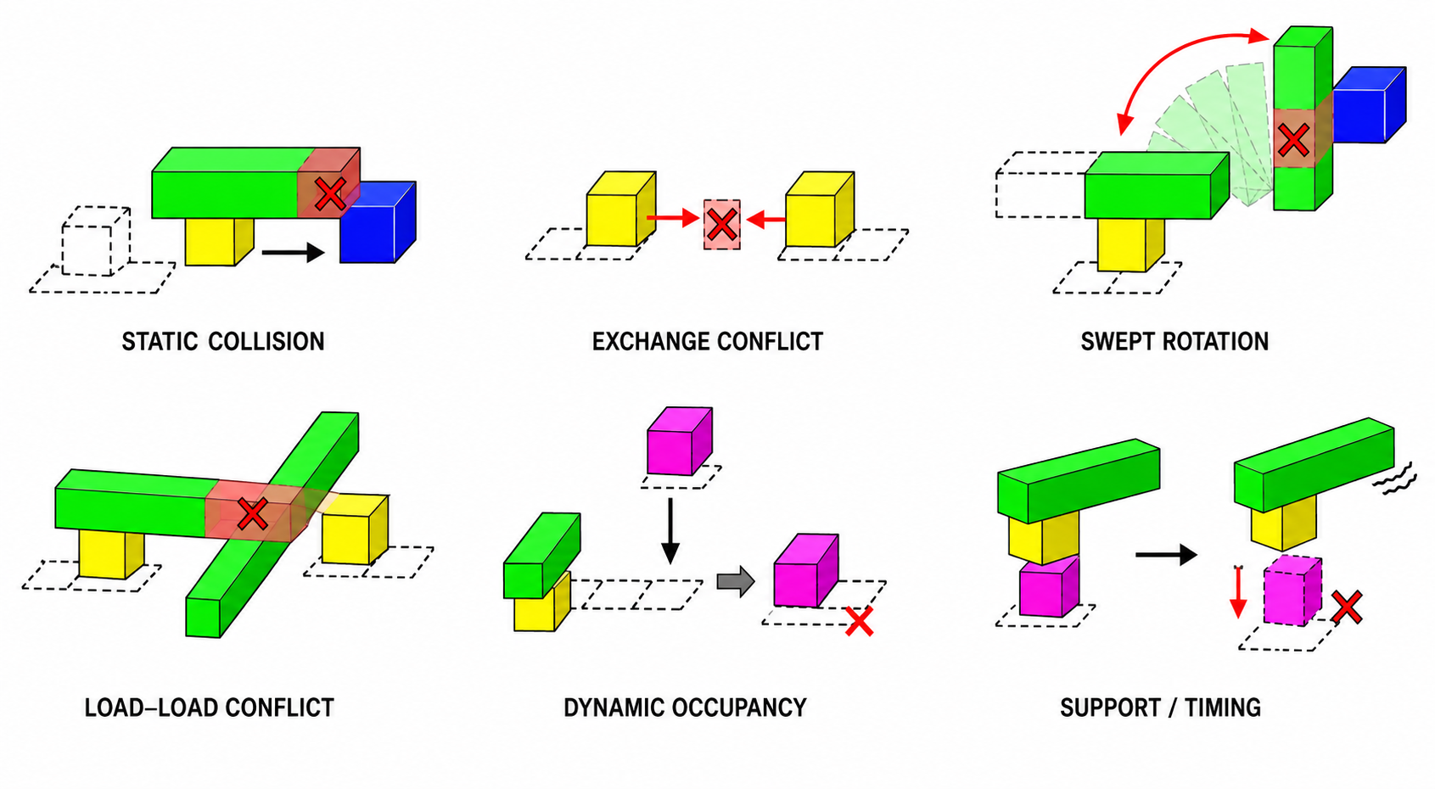
MULTI-AGENT PLANNING
Modified CBS coordinates robots, cuboids, and depot access
Notes:
CBS was adapted beyond point-agent vertex/edge conflicts because agents carry extended cuboids and interact with the changing structure and depot.
[Sources]
- Final presentation: Smrithi Lokesh.pptx, slides 33–35
- GitHub commit-history PDFs supplied in Google Drive
[/Sources]

Slide 19
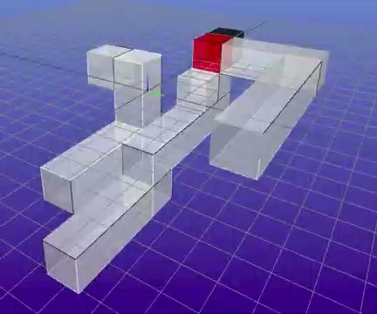
RESULTS
Extended the planner from search engineering to 3-D execution
(a) Formal and algorithmic
(b) Systems and evaluation
Developed the search-based heuristic and caching; evaluated A*, Weighted A*, ARA*, and inside-out construction; extended reachability, support, and action semantics to 3-D cuboids.
Implemented the zero-gravity planner, generated ADGs on the zerogravity branch using standard A*, and integrated modified CBS constraints.
Central takeaway
Algorithm choice depended on structure: caching amortized costly heuristic evaluation, while inside-out construction was faster when zero gravity removed scaffolding.
Next: couple discrete construction decisions with continuous trajectory optimization and learned models of execution cost.
Discrete planning visualization—not physics-based or physical-robot simulation.
Notes:
Close by connecting this work to a broader research direction: explicit high-level decisions can remain interpretable while continuous execution models or learned costs handle richer dynamics. Empirical paper context reports validation on 200 random structures and three cuboid types.
[Sources]
- Prior ETH Zürich preparation context and IROS paper context
- Final presentation: Smrithi Lokesh.pptx
[/Sources]

Slide 20
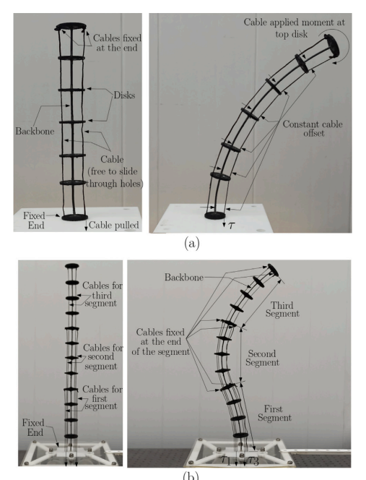
Kinematic modeling of cable-driven continuum robots
Smrithi Lokesh
BITS Pilani · Published: Mechanism and Machine Theory 200, 2024
Variable routing · multi-segment kinematics · experimental validation
Notes:
Introduce this as a geometry-first modeling project: cable routing was used to create non-constant-curvature shapes, then modeled and validated on physical prototypes.
[Sources]
- User-provided published paper: Bhalkikar, Lokesh, and Ashwin, Mechanism and Machine Theory 200 (2024), 105701
[/Sources]

Slide 21
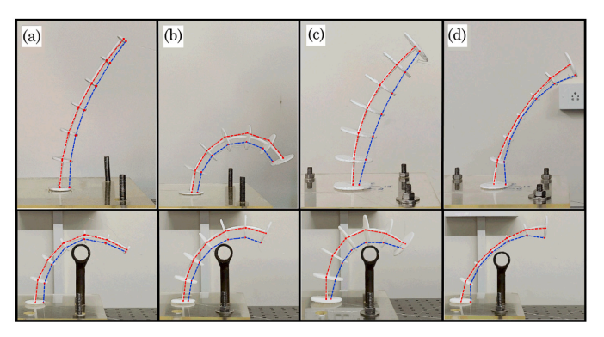
KINEMATIC MODELING
Variable cable routing invalidates constant curvature
A geometry-based optimization model
Discretized the backbone into constrained 4-bar elements and recovered the deformed profile from cable lengths.
VARYING OFFSET
MULTI-SEGMENT
Cable offset changes along the backbone
Independent cables shape each segment
Extended the formulation to spatial bending, varying radial offsets, and independently actuated multi-segment robots.
Solved forward kinematics and obstacle-aware inverse kinematics without requiring a contact-force model.
Modeling contribution
A unified optimization framework maps cable actuation to complex robot profiles beyond circular arcs.
Notes:
Explain why constant offset produces circular-arc bending and why varying offsets invalidate that simplification. The optimization retains geometric constraints while minimizing deformation variation across discretized elements.
[Sources]
- User-provided published paper, especially Figures 2–3 and Sections 2–4
[/Sources]

Slide 22
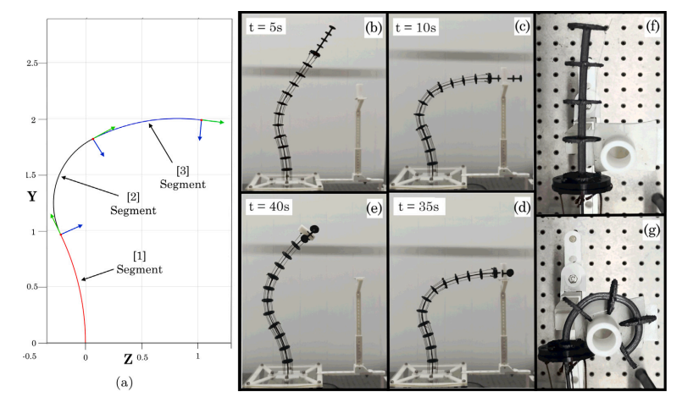
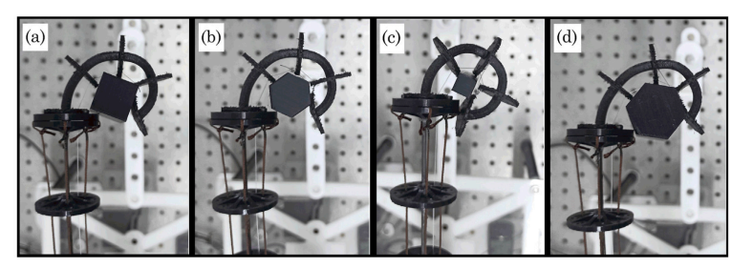
VALIDATION AND IMPACT
The model predicted physical robot profiles with <5% RMS error
(a) Physical validation
(b) Demonstrated utility
Compared predicted backbone profiles against multiple planar and spatial deformations on fabricated cable-driven prototypes.
Applied the same formulation to obstacle-aware inverse kinematics and a three-segment arm with a variably routed soft gripper.
Central takeaway
Cable-routing geometry can be designed for richer shapes while remaining computationally tractable for modeling and control.
Notes:
Lead with the quantitative result, then connect it to design: varying routing is not just a modeling complication; it is a mechanism for deliberately shaping curvature and grasping behavior.
[Sources]
- User-provided published paper, experimental validation and application sections
[/Sources]

