Slide 1

SQL RESEARCH PROJECT
BY SMRITI AGNIHOTRI

Slide 2
BACKGROUND
Overview of Netflix: Netflix is a leading subscription-based streaming service that has revolutionized the entertainment industry. With a vast library of movies, TV shows, documentaries, and original content, Netflix has become a household name worldwide.
Purpose of the Project: The purpose of this project is to analyze the rich dataset provided by Netflix to gain insights into content available on Netflix , user behavior and their interaction. By examining various aspects of Netflix's content catalog and user interactions, the aim is to uncover valuable insights that can lead to strategic decisions, enhance user experience, and drive business growth.
Dataset Description: The dataset used in this project consists of two main tables:"netflix_data" and "netflix_user_data." The "netflix_user_data" table provides insights into user demographics, subscription types, and viewing behavior. To connect these two tables and understand how users interact with Netflix content, a third table is created called "Netflix_data2_table." This table links the shows from "Netflix_data" with the users from "Netflix_user_data." It's like a bridge between what people watch and who they are.

Slide 3
PROJECT SCOPE
Content Distribution Trends Analysis
Director Influence and Recent Releases
User Behavior and Revenue Impact Analysis
User Engagement Patterns
Content Popularity Assessment
User Retention and Content Growth Trends Observation
Analysis Using Stored Procedures
Conclusion

Slide 4
Analyzing Content Distribution Trends in Netflix’s data
Total movies
6131
Total Tv Shows
2676
30.38%
69.62%

Slide 5
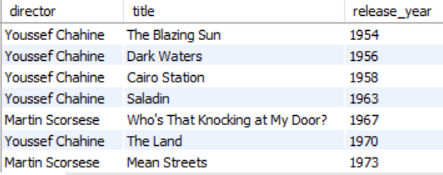
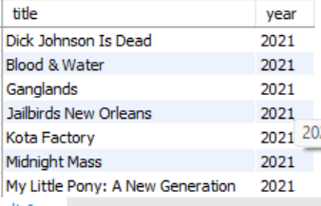
Strategic Insights: Leveraging Director Influence and Recent Releases
The analysis provides insight into the filmography of directors with a substantial presence on Netflix, indicating their contributions to the platform’s content catalog.
It shows the trends in the release years of these movies and tv shows, giving us a glimpse of how the directors' work has changed or developed over time.
Movies added to netflix in 2021 and 2020 represent the latest additions to Netflix's catalog, offering up to date entertainment options.

Slide 6
Understanding User Behavior and Revenue Impact: Age Group Segmentation, Device Usage Analysis

Slide 7
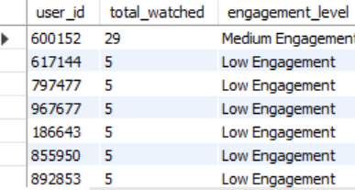
User Engagement Patterns on Netflix
The majority of Netflix users fall into the low engagement category, watching fewer than 20 shows, indicating varying levels of interest and activity on the platform.
Very small number of users fall into medium engagement category and even smaller fall into high engagement category.

Slide 8


Content Popularity Analysis
The popularity of "Friends" suggests a strong affinity among Netflix users for classic sitcoms, highlighting the interest in this timeless classic series.
The high viewership of "The Lord of the Rings: The Return of the King“ movie indicates a strong interest in epic fantasy movies, reflecting the diverse preferences of Netflix's user base.

Slide 9
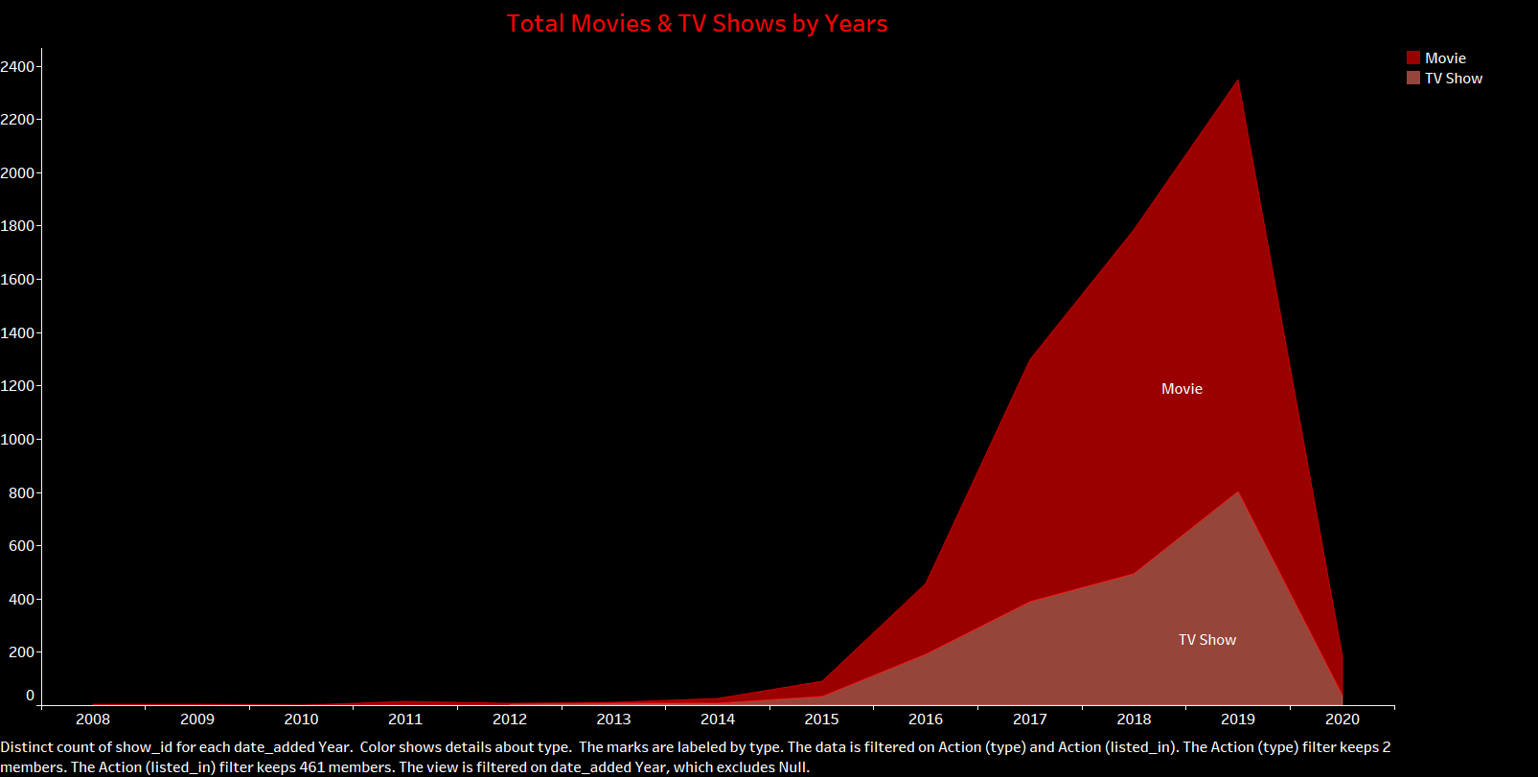
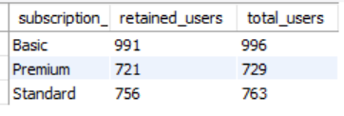
Observing Netflix User Retention and Content Growth Trends
This query shows growth in the movies and tv shows in Netflix’s library over time. The years 2018 , 2019 and 2020 witnessed the highest number of movie additions indicating a peak.
Out of 996 total users that subscribed to the Basic plan, 991 users have renewed their subscription within 30 days of their last payment date. This indicates a high retention rate, with only a small proportion of users not renewing their subscriptions promptly.
Among 729 total users subscribed to the Premium plan, 721 users have renewed their subscriptions. The retention rate for the Premium plan is slightly lower compared to the Basic plan but still relatively high.
The Standard plan, out of 763 total users, 756 have renewed their subscriptions within 30 days of their last payment date.

Slide 10
The analysis of user behavior, revenue trends, and content consumption and growth patterns on Netflix using stored procedures.
Call GetRatingOfMovie(“title”)
Call GetAvgRevnbySubsType(“subscription_type");
Call GetShowsWatchedByUser(user_id);
call GetAvgRevenueByGenderAndDevice(“gender",”device");
It helps to quickly retrieve the rating of a specific movie on Netflix
It helps to gain insights into revenue streams and customer segmentation.
It helps to understand individual viewing habits, personalize content
calculates the average monthly revenue generated from users of a specific gender and device type

Slide 11
CONCLUSION
Netflix boasts a diverse content library, spanning multiple genres, countries, and rating categories. This diversity caters to a wide range of audience preferences and interests, contributing to the platform's popularity and success. Certain movies and TV shows emerge as clear favorites among Netflix users, driving high viewer engagement These insights empower Netflix to stay competitive in the ever-evolving streaming landscape.
Through in-depth analysis of Netflix's data, I have gained valuable insights into various aspects of the platform, including content distribution, user behavior, and revenue generation. These insights enable data-driven decision-making and strategic planning.
I've gained hands-on experience with SQL queries, database management, and data manipulation techniques, which are essential skills in the field of data analysis and business intelligence.

