Slide 1
PROJECT : DOODLING (PLATFORM
FOR DETECTING HANDWRITTEN DIGITS)
!
Submitted to:
DR. ARCHANA SINGH
Submitted by:
SMRITI 102116094
3CS11

Slide 2
OBJECTIVE:
The MNIST dataset of handwritten digits is widespread among the data scientists and machine learning enthusiasts. It is an amazing project to get started with the data science and understand the processes involved in a project.
The project is implemented using the CNN and then for real-time prediction we also build a nice graphical user interface to draw digits on a canvas and then the model will predict the digit.

Slide 3

Using the concepts of Deep-learning, A Doodling hands-free digital drawing that utilizes PyGame,OpenCV, (designed an interface) machine learning software library to recoginize the digit written on Screen using hand

Slide 4
Project Components: The "Doodling" project consists of the following components: 1. Data Loading and Preprocessing: -The MNIST dataset is used, which contains 60,000 training images and 10,000 testing images. -Data preprocessing includes normalizing images to the [0, 1] range and expanding image dimensions to (28, 28, 1). Techniques Of Data Pre-Processing: -Normalization -Re-Shaping of Dataset -One-hot Encoding -Data Augmentation -Gaussian Blur

Slide 5
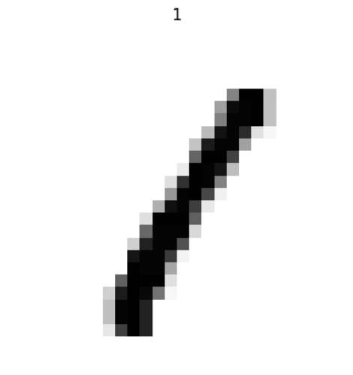
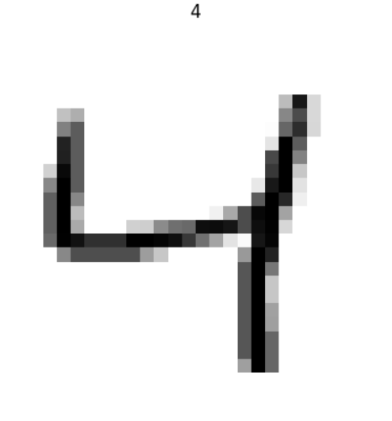
2. Model Architecture:
-A Convolutional Neural Network (CNN) is used for digit recognition. The model includes: -Two 2D Convolutional layers with activation. -Two Max-Pooling layers to reduce spatial dimensions. -A Flatten layer to transform feature maps into a 1D vector. -A Dropout layer to prevent overfitting. -A Dense (fully connected) layer with SoftMax activation for digit classification

Slide 6
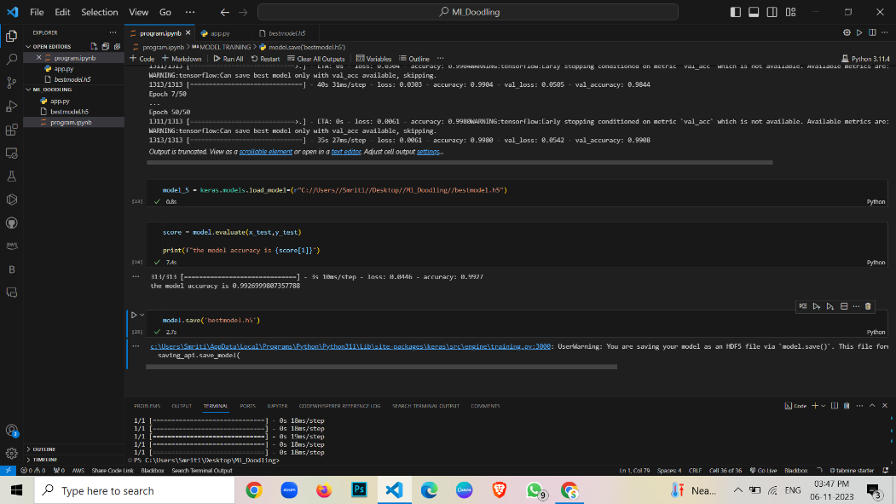
3. Model Compilation:
-The model is compiled with an optimizer (e.g., Adam) and a categorical cross-entropy loss function.
-Metrics for tracking include accuracy and accuracy after training the model is 99.26%

Slide 7
4. Model Training:
-The model is trained using the training data with specified batch size and epochs.
-Callbacks like Early Stopping and Model Checkpoint can be utilized for enhanced training control.
5. Model Evaluation:
-The model's performance is evaluated using the testing data.
-Evaluation metrics, such as accuracy, are calculated.
-Confusion matrices and other relevant metrics can be generated for detailed analysis.

Slide 8
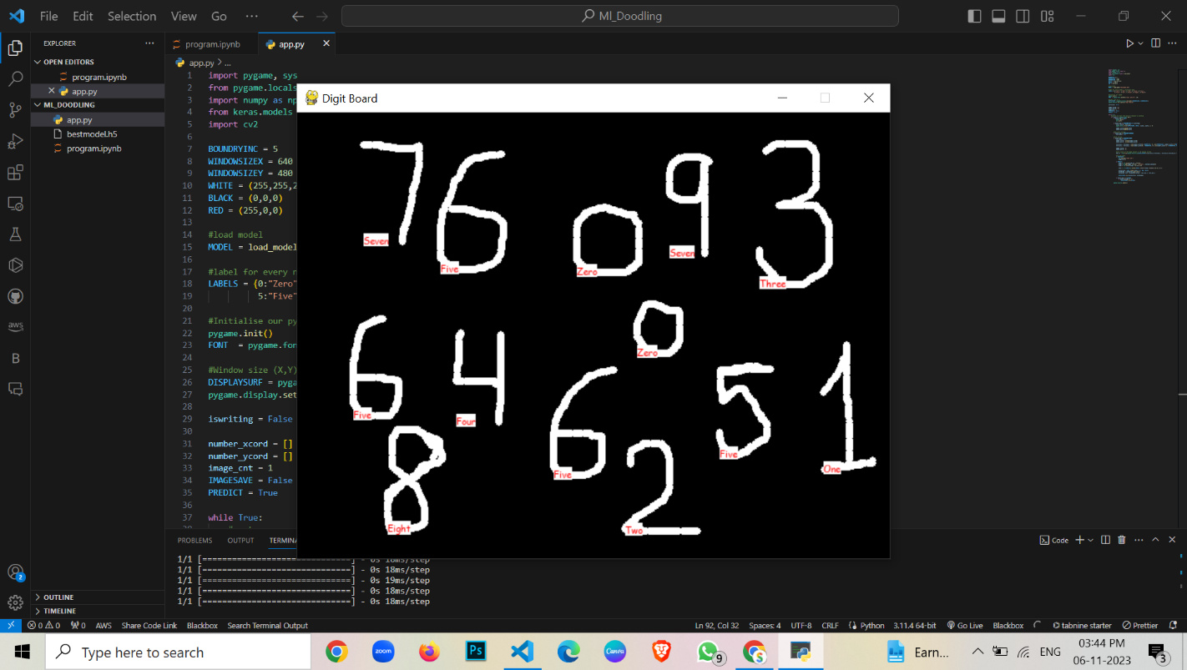
Model Performance:
-To assess the effectiveness of the "Doodling" project, we have generated a performance comparison chart. The chart illustrates the recognition accuracy for each digit (0-9) using the trained model.

Slide 9
Research Papers:
▶ RESEARCH PAPER-1 : https://www.researchgate.net/profile/Younes- Alwan/publication/316938847_Handwritten_Digit_Recognition_Using_Convolutional_Neural_Networks/links/5919e2a e0f7e9b1db652885b/Handwritten-Digit-Recognition-Using-Convolutional-Neural-Networks.pdf
▶ RESEARCH PAPER-2: https://d1wqtxts1xzle7.cloudfront.net/58212013/Bangla-Handwritten-Character-Recognition- using-Convolutional-Neural-Network-libre.pdf?1547846190=&response-content- disposition=inline%3B+filename%3DBangla_Handwritten_Character_Recognition.pdf&Expires=1697048717&Signature= FVn3CjxTI4DEVo~wBeVRVyEAEhwyAu-QTCHWsUK8r64Orj3gUG~-SneXcCOecWHtNbOYfy9pSTDTlYgeg5egYZwcO- u6oCO~gzSELAl4bQ~-2xWzeaHQSQpr3-tqw21BGqhl6yorIGynXdVT-qW9aAzlXvxAlXkZN5oZtLTquEbUT8mXHl7oaqt- vTsbVlkrwNALnxTAX-l7lgWCd177H65~EHWPY39DGoZkd6X3- LwOKfVQgr14T3LS7BYFeVWinQQMb5hULshvEUtxhTmxhX746gs9qVSKcj15yb5W4gebG9VJ~D9MLONOPdRDJxuV1uSIDnZj 3oPVryIBMmPFsw &Key-Pair-Id=APKAJLOHF5GGSLRBV4ZA
▶ RESEARCH PAPER-3 :
https://d1wqtxts1xzle7.cloudfront.net/67881176/Handwritten_Digit_Recognition_using_Conv20210705-17075- 5z5naf.pdf?1625496753=&response-content- disposition=inline%3B+filename%3DHandwritten_digit_recognition_using_conv.pdf&Expires=1697048777&Signature=f 7XzYN5LNf3EuxS89h2G~RJ~-KWVHVID7ILscK3eGgGNckNTxWIB5vJfdvzLpDCw1waFZ5eItSwYype6aJDZ- kzgzyUFp9zl5P5WM47pBha~k6ooGBgMpgDY8fAgE3AUXrCMEDdu9mMEvIy3DfpOOmXpcpU- PBY2PWU~~dQaLtLxyQ9bzRyneucL3jdvGU0WV4gei-Td9Mu0Pu9pvayWyvWWG4KZ~eKWQbXcmjcvLhU2z~diDSJ- h3YixPp1YiA5SZfwo2WdQCLUfPrO3D42lx~Se3msZihslkROtilH1ZW2i28fPirtF02PPFgBakIBb2ZJKt~mNXbzEw5izQzx5Q & Key-Pair-Id=APKAJLOHF5GGSLRBV4ZA
▶ RESEARCH PAPER-4 : https://www.mdpi.com/2076-3417/9/15/3169
▶ RESEARCH PAPER-5 https://www.mdpi.com/1424-8220/20/12/3344

Slide 10
Camparison Chart:
Let's compare code snippets which we are having in research paper and which we implemented:
Commonalities:
--Both codes involve the MNIST dataset, a popular dataset for handwritten digit recognition.
--They split the data into training and testing sets.
--They evaluate the performance of the models on the test set using accuracy and confusion matrix.
--They visualize some randomly selected test images along with their original and predicted labels.
--Both use external libraries such as OpenCV, NumPy, Matplotlib, and scikit-learn.

Slide 11
Differences:
The Code which is implemented in project uses (Convolutional Neural Network - CNN):
--Uses a deep learning model (Convolutional Neural Network) implemented with Keras.
--Utilizes a gradient descent optimizer (Stochastic Gradient Descent - SGD) for model training.
--Involves convolutional layers for feature extraction and pooling layers for down-sampling.
--The model is trained over multiple epochs.
--The script allows for saving and loading the trained model and weights.
The Code which is provided in Research Paper uses KNN and some have used CNN

Slide 12
RESULT :
Check Processing and Fraud Detection: HDR is embedded in check processing systems at banks and financial institutions. It allows machines to read handwritten amounts on checks, automate data entry, and detect potential fraud by identifying inconsistencies or anomalies in handwriting patterns.
Signature Verification and Authentication: HDR is used in signature verification systems for security purposes. By analyzing handwritten signatures and comparing them to stored reference signatures, these systems can authenticate individuals and prevent unauthorized access.
Educational Assistive Technologies: HDR is integrated into educational assistive tools that aid individuals with visual impairments or learning disabilities. These tools can convert handwritten notes and worksheets into digital text, enabling students to access and utilize educational materials more effectively.

Slide 13


