Slide 1

REVIVO
A Time-Aware Food Recovery Network
Sell → Rescue → Transform. Technology races the clock; community turns saved food into a meal.
Team Neura • AWS Student Builder Group Hackathon 2026 • SDG 2 — Zero Hunger
Notes:
Open with the hook. India wastes 67M tonnes of food a year while 190M go hungry. Revivo treats surplus produce as a degrading asset with a live countdown. Two layers: Sell and Rescue. Fully serverless on AWS.

Slide 2



THE PROBLEM
A timing problem, not a marketplace problem
67M t
190M
of food wasted in India every year
people going hungry, every day
Vegetables lead the waste — short shelf life — and it starts at the last-mile vendor.
Every evening vendors dump edible produce while a hotel 1 km away buys the same at full price.
Existing apps are static boards: they ignore perishability and never ensure food becomes a meal.
Notes:
The core reframing: it is a timing problem. Perishability is ignored by every existing platform.

Slide 3




OUR SOLUTION
Add time-awareness, automation & measurement
Live freshness bands + price decay
A live marketplace, not a board
Good / Use-soon / Rescue, recomputed from wall-clock time on every view — identical on client and server.
Prices fall as produce ages, in real time. What a buyer sees is exactly what they pay.
A rescue safety net
Real, measured impact
Surplus about to expire unsold is routed to NGO kitchens, with an AI-written reason to rescue it now.
Every rescue counted in meals, CO₂ avoided and ₹ saved — traceable to real orders.
Notes:
Four pillars. Emphasize that pricing and bands are recomputed live and identically on client and server.

Slide 4



HOW IT WORKS
One flow, grounded in the same live countdown
1 · SELL
2 · RESCUE
3 · TRANSFORM
Vendor photographs surplus → Rekognition IDs it → freshness band + auto price → live marketplace → order tracked through a Step Functions lifecycle.
Listings about to expire unsold surface on a Rescue board → routed to an NGO kitchen → Bedrock writes “why rescue this now”.
Inedible surplus → compost / biogas so nothing is wasted. On the roadmap — the natural next tier.
Notes:
Sell and Rescue are live in the app. Transform (compost/biogas) is future scope.

Slide 5



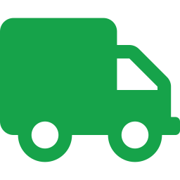


KEY FEATURES — LIVE TODAY
What the app does, end to end
Photo → auto-ID → publish
Live countdown + dynamic price
Rekognition names the vegetable; band + price are computed for the seller.
market × freshness factor, ticking in real time.
Multi-vendor marketplace
Visible order lifecycle
Bands, decaying prices, categories, filters, one-tap order.
Confirmed → Preparing → Ready → Completed via Step Functions.
AI insights + waste-risk
Impact + ratings
Bedrock recommendations + “N kg hits Rescue within 24h”.
kg / meals / CO₂ / ₹ saved, plus reviews and a rescue board.
Notes:
Every one of these is implemented and demoable on the live AWS backend.

Slide 6



AI & AUTOMATION
Where AWS AI does the heavy lifting
Amazon Rekognition
Amazon Bedrock (Nova)
Identifies the vegetable from the vendor’s photo — no manual tagging.
Data-grounded seller insights + rescue explanations via Converse; deterministic fallback so it never hard-fails.
Freshness engine
AWS Step Functions
Shelf-life DB × storage × temperature → honest ranges, not false precision.
Automates the order lifecycle straight off a DynamoDB Stream.
Notes:
Judges reward visible AI. Call out Rekognition and Bedrock explicitly during the demo.

Slide 7
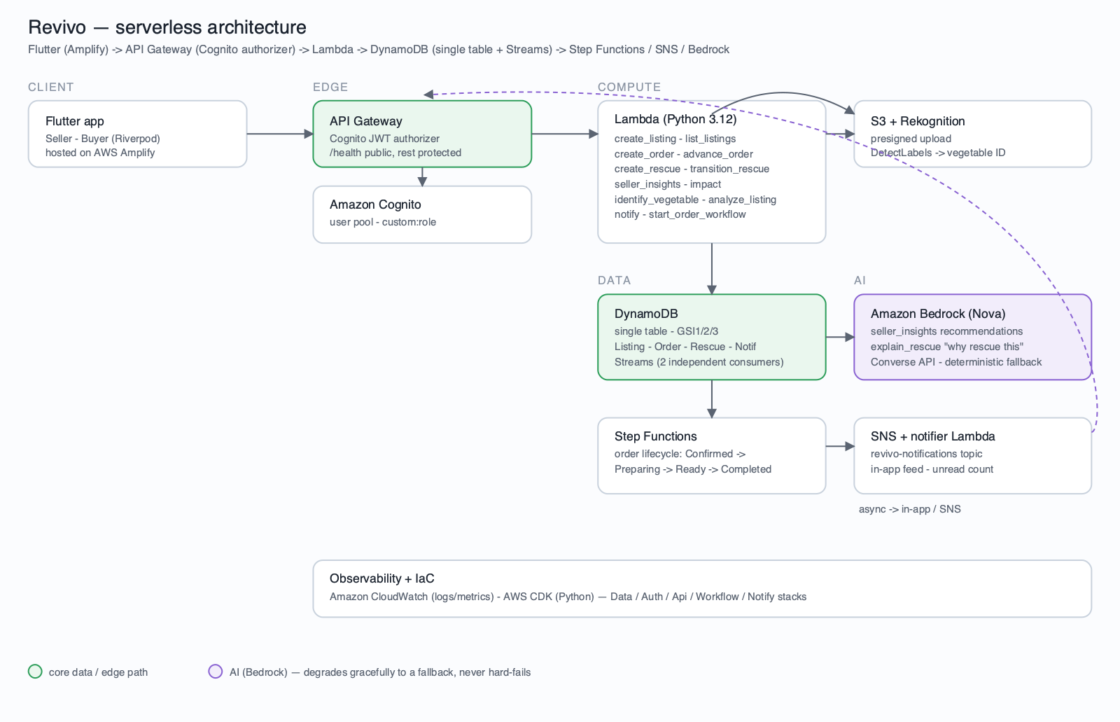
AWS ARCHITECTURE
Fully serverless — 5 CDK stacks
Notes:
Flutter (Amplify) → API Gateway (Cognito JWT) → Lambda → DynamoDB + Streams → Step Functions / SNS; Lambda ↔ S3+Rekognition and Bedrock.

Slide 8







TECHNOLOGY STACK
Serverless, AI-native, IaC-deployed
Frontend Flutter + Riverpod, hosted on AWS Amplify
Backend API Gateway + Lambda (Python 3.12)
Data DynamoDB single-table + Streams
Auth Amazon Cognito — role-based JWT
AI Rekognition + Bedrock Nova (Converse)
Orchestration Step Functions + SNS notifier
Storage / Obs S3 (presigned + SSE) · CloudWatch
IaC AWS CDK — Data / Auth / Api / Workflow / Notify
Notes:
Emphasize: fully serverless, deployed as five CDK stacks with one command.

Slide 9


MEASURING IMPACT
Every order becomes a number that matters
2.5
2.5 kg
₹ saved
meals per kg rescued
CO₂ avoided per kg
vs market, per order
Buyers see their own verified impact — computed from their real completed orders — plus a leaderboard for top contributors.
Notes:
Impact numbers use FAO/UNEP-style conversion factors and trace to real orders — nothing fabricated.

Slide 10


SCOPE
Live today vs future implementations
Live today
Future implementations
Rekognition vegetable ID
Bedrock insights + rescue reasons
Freshness bands + dynamic pricing
Step Functions order lifecycle
Impact tracking + ratings
Read-only rescue network
Full serverless AWS backend (CDK)
Standalone Cook/NGO app + login
Real-time GPS geofencing + photo-at-source
Payment gateway (UPI / Razorpay)
Push notifications (FCM / APNs)
Live mandi / Agmarknet price feed
ML visual freshness grading
Route optimization + 3PL delivery
Compost/biogas ‘Transform’ tier · carbon credits
Notes:
Be upfront about scope. Everything on the left is demoable; the right is the roadmap.

Slide 11



WHY REVIVO STANDS OUT
Time-aware, escalating, AI-native, honest
Produce as a degrading asset
Escalation built in
A live countdown, not a static listing — the only entry that prices perishability.
If a sale fails, surplus doesn’t just expire — it routes to rescue.
Genuinely serverless + AI
Honest data
Rekognition + Bedrock + Step Functions, IaC-deployed and live on AWS.
No fabricated stats — impact and prices trace to real orders.
Notes:
Land the differentiation: time-aware + escalating + serverless AI + honest.

Slide 12

THE TEAM
Team Neura
Smriti T M
Pooja S
Thaenmozhi A
Lead
Member
Member
AWS Student Builder Group Hackathon 2026 • SDG 2 — Zero Hunger
Notes:
Introduce the team quickly, then move into the live demo.

Slide 13


Thank you
Small actions today, bigger change tomorrow.
github.com/smriti51818/Revivo
Demo video (YouTube) + live AWS deployment link
Notes:
Close, then switch to the live app demo.

