Slide 1

STUDENT CARRER PREDICTION USING ML ALGORITHMS
KOMAL NANWANI
SHREYA
ABHAY GUPTA
SHAKSHAM JHA
SMRITI RANI

Slide 2
TABLE OF CONTENT
INTRODUCION
PROBLEM STATEMENT
IDENTIFICATION OF TASK
LITERATURE REVIEW(TIMELINE)
EXISTING SOLUTIONS
IMPLEMENTATION
FUTURE WORK
CONCLUSION
REFERENCES
​​

Slide 3
Introduction
The aim is to develop a machine learning-based prediction model that can accurately predict the career paths of students based on their academic performance, skills, and personal attributes. The research will focus on leveraging machine learning algorithms and techniques to analyze a wide range of data points, such as grades, extracurricular activities, interests, and aptitude test results, to predict the most suitable career options for students.

Slide 4
Problem statement
What is a ‘Wrong Career Choice’?
Any choice which causes us to perform less than optimal or a Career which you regret later or one which makes you unhappy is a Wrong Career Choice.
There are three main parties who are usually responsible for career decision – Students, parents, society (environment). There are many reasons for one to choose the wrong career like-
Students do not fully appreciate the importance of Career,
Peer influence- “Everyone is unique” this is the reality but many people still chooses their career by the influence of their friends without analyzing their weakness, strength and interests and hence taking a wrong step.
Lack of awareness of Career Options

Slide 5
IDENTIFICATION OF TASK
The tasks involved in developing a system for student career prediction include:
1) Data Collection: Collecting a large datasets of parameters like students’ knowledge in various subjects, specializations, programming and analytical capabilities, hackathons, workshops, certifications, interested course and many more.
2) Data Preprocessing: Preprocessing the collected data to ensure it is of high quality and suitable for use in training the machine learning algorithms.
3) Algorithm Development: Developing machine learning algorithms, such as convolutional neural networks (CNNs) and Decision Tree for predicting the most suitable career based on various parameters.
4) Model Training: Training the developed algorithms on the collected and prepossessed data to create a model that can accurately predict the best career for individual.
5) Model Testing and Evaluation: Testing and evaluating the performance of the trained model on a separate set of validation data to ensure its accuracy and efficiency.

Slide 6
Literature review
Aim: This literature review examines the use of ML algorithms in predicting students' career paths.
Methodology: Comprehensive search across academic databases, considering recent peer-reviewed articles.
Key Findings:
Feature Selection: Identifying relevant predictors is crucial for accurate predictions.
ML Algorithms: Decision Trees, Random Forests, SVM, and ANN are commonly used.
Evaluation Metrics: Accuracy, precision, recall, F1-score, and ROC area are common metrics.
Data Sources and Preprocessing: Academic records, demographics, and assessments are utilized. Preprocessing techniques ensure data quality.
Challenges: Data scarcity, class imbalance, and evolving career choices pose challenges.
Conclusion: ML algorithms show promise, but challenges remain. Future research should focus on data availability, interpretability, and dynamic career trends.

Slide 7
E x I s t I s n o g l u t I o n s
Solution Name | Description | Features
CareerVillage | A platform that uses machine learning algorithms to match students with career-related questions to volunteer mentors who can provide answers. | -Natural language processing Topic modeling Mentoring matching Student Q&A forum.
MY PATH | A tool that uses machine learning algorithms to provide personalized career guidance to high school students. | - Academic record analysis Extracurricular activity analysis Interest analysis Recommended careers with education/training requirements
LinkedIN Carrer explorer | A tool that uses machine learning algorithms to help users explore different career paths based on their LinkedIn profile. | -Skill and experience analysis Job recommendations Career path recommendations
IBM WATSON | A machine learning platform that can be used to develop custom career prediction models | - Multiple machine learning algorithms Data preprocessing and feature engineering tools Model selection and training Model evaluation and deployment Integration with existing systems

Slide 8
implementation
Data Collection: Collect data on students' academic performance, extracurricular activities, personal information, and career outcomes.
Data Preprocessing: Clean the data by handling missing values, removing outliers, and encoding categorical variables.
Feature Selection: Select the most relevant features for predicting students' career outcomes using techniques like correlation analysis or feature importance.
Model Selection: Choose a suitable machine learning algorithm for the prediction task, such as logistic regression, decision trees, random forests, or support vector machines.
Model Training: Split the dataset into training and testing sets. Train the selected ML algorithm on the training data.
Model Evaluation: Evaluate the trained model's performance on the testing data using metrics like accuracy, precision, recall, and F1 score.
Model Optimization: Fine-tune the model by adjusting hyperparameters and performing techniques like cross-validation or grid search.
Result Visualization: Visualize the results, such as accuracy or prediction outcomes, using appropriate graphs or charts.
President

Slide 9
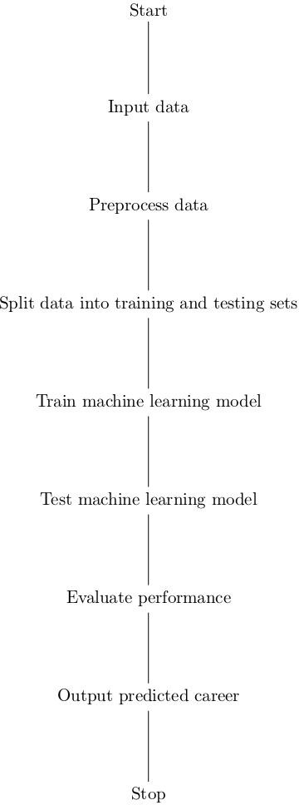
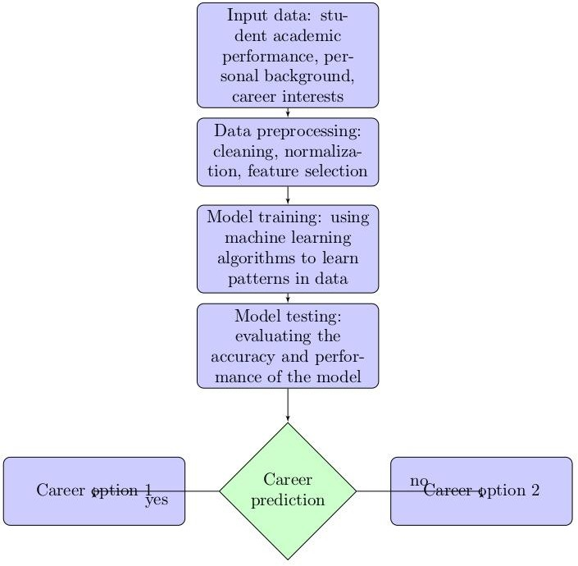

Slide 10
Future work
Ideas for Follow-up Research on Machine Learning for Student Career Forecasting:
Add new data sources: Include additional data from social media, academic performance, demographics, etc., to enhance prediction accuracy.
Explore alternative machine learning algorithms: Test decision trees, neural networks, support vector machines, and other algorithms to improve prediction accuracy.
Experiment with feature engineering: Extract relevant features from the data to increase prediction precision. Try different feature engineering strategies.
Monitor model performance over time: Implement a mechanism to periodically assess the model's performance and retrain it as needed for reliable predictions.
Evaluate model bias: Check for bias in the model resulting from training data and explore ways to mitigate it.
Extend the model to other domains: Apply similar methods to forecast stock prices, employee attrition, consumer behavior, and other fields.

Slide 11
CONcLUSION
ML predicts student career outcomes, aiding learners, institutions, and policymakers. It offers personalized recommendations based on data like academics, hobbies, and demographics. ML enables early interventions, supports students at risk, and improves career planning. Data limitations exist, requiring human guidance alongside ML. ML revolutionizes education and enhances student success. Future research should address data constraints and assess long-term effects.

Slide 12
references
[1] Min Nie , ZhaohuiXiong , RuiyangZhong , Wei Deng and Guowu Yang (2020),
“ Career Choice Prediction Based on Campus Big Data—Mining the Potential Behavior of College Students” , Journal of Appl. Sci. pp. 1-14.
[2]K. B. Eashwar, R. Venkatesan and D. Ganesh (2017), “Student Performance Prediction Using SVM”, International Journal of Mechanical Engineering and Technology (IJMET) Vol. 8, No. 11, pp. 649–662.
[3]AnkitaKadambande, Snehal Thakur, AkshataMoholand A.M.Ingole (2017), “Predict Student Performance by Utilizing Data Mining Technique and Support Vector Machine”, International Research Journal of Engineering and Technology (IRJET), Vol. 04, No. 05, pp 2818-2821.
[4]S.A. Oloruntoba1 and J.L.Akinode (2017), “Student Academic Performance Prediction Using Support Vector Machine”, International Journal Of Engineering Sciences & Research Technology, pp. 588-598

Slide 13
refrences
[5] AhmedSharafElDen ,Malaka A. Moustafa, Hany M. Harb and AbdelH.Emara (2013), “Adaboost Ensemble With Simple Genetic Algorithm For Student Prediction Model”, International Journal of Computer Science & Information Technology (IJCSIT) , Vol. 5, No 2, pp 73-85.
[6] MeimeiHan ,Mingwen Tong , Mengyuan Chen , Jiamin Liu and Chunmiao Liu (2017), “Application of Ensemble Algorithm in Students' Performance Prediction“, IEEE 6th IIAI International Congress on Advanced Applied Informatics (IIAI-AAI).
[7] V. Prasannakumari B. Bavani, S. Nirmala SugirthaRajini, M.S. Josephine (2019), “Heart Disease Prediction System based on Decision Tree Classifier”, Jour of Adv Research in Dynamical & Control Systems, Vol. 11, 10-Special Issue, 2019, Volume 11, Issue 10.
[8] FaridJauhari and Ahmad AfifSupianto (2019), “Building student’s performance decision tree classifier using boosting algorithm”, Indonesian Journal of Electrical Engineering and Computer Science Vol. 14, No. 3, June 2019, pp. 1298 - 1304.

Slide 14
THANK YOU

