Slide 1
Uber: revolutionary transportation rethinking how the world moves Name-Smriti Patel Admn no-2025B01010338 Branch and Sec-CSE-27 SUBJECT-Design Thinking (25HU102) SESSION-(2025-26)

Slide 2
Core 5 Stage model CASE STUDY-UBER
BACKGROUND AND EMPATHIZE 3-4
DEFINE 5
IDEATE 6
PROTOTYPE 7
TEST 8 ________________________________ OUTCOME AND RESULT 9-10

Slide 3
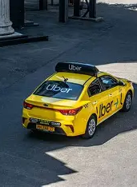
Background And Empathize
​Problem: Severe inefficiency in urban transportation.​
User (Rider) Pain Points:​
Difficult to find/hail a taxi, especially in bad weather or non-central areas.
​High uncertainty; no idea when a cab would arrive.
​Inconvenient "cash-only" payments.
​Opaque pricing and risk of "taking the long route."​
General safety and trust concerns.​

Slide 4
​User (Driver) Pain Points:
​Inefficient; significant unpaid time spent "cruising" for passengers.
​Rigid schedules and high costs of taxi medallions/dispatch fees.
.Safety risks and inconvenience of handling cash.
​Need: A reliable, safe, convenient, a affordable on-demand solution.

Slide 5
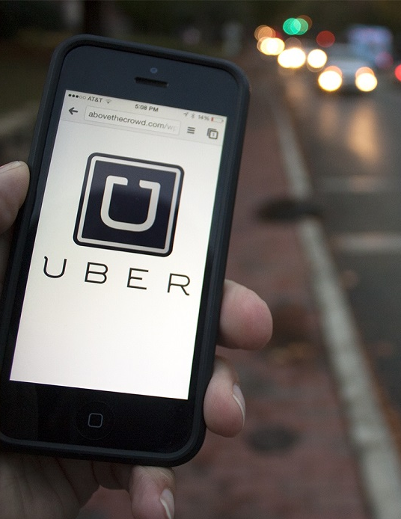
DEFINE
​Core Problem Statement:
How might we use technology to connect passengers who need a ride with available drivers in a simple, reliable, and cashless way that benefits both?
This Photo by Unknown Author is licensed under CC BY-NC-ND

Slide 6
IDEATE
​Core Idea: "Push a button, get a ride.“
​Explored Solutions:
​Use smartphone GPS to pinpoint both rider and driver locations on a map.
​
Create a mobile app for all interactions.
​Develop a secure, in-app payment system (cashless).​
Build a two-way rating system to establish trust.​Use drivers' personal vehicles to scale the "fleet" quickly and flexibly.

Slide 7
PROTOTYPE
​First Prototype (UberBlack):​
A simple app launched in San Francisco.​
Tested only with professional black car drivers and a small user group.
​Focused on testing the core loop:
1. Request, 2. Match, 3. Ride, 4. Pay (cashless).​
Second Prototype (UberX):
​A significant iteration based on the initial test.
​Opened the platform to non-professional drivers with their own personal, pre-vetted vehicles.​
Prototyped a lower-cost, more scalable model.​

Slide 8
TEST
Ongoing Test (UberX Launch):
​Feedback: Massive adoption by both riders (for cost) and drivers (for flexibility).
​Iteration: This model became the core business. All new features (Uber Pool, upfront pricing, safety tools) are further cycles of prototyping and testing
​Initial Test (UberBlack):​
Feedback: Users loved the "magical" convenience. Drivers valued the new income source.
​Problem Found: Huge supply/demand gaps during peak hours (e.g., New Year's Eve).​
Iteration: Led to the idea and implementation of "Surge Pricing" to incentivize more drivers.​

Slide 9
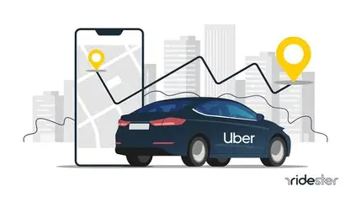
Outcomes & Impact
Market Disruption: Fundamentally changed the global taxi and logistics industries.​
Creation of the "Gig Economy": Popularized a new model of flexible, independent work for millions.
​Scale: Operates in over 10,000 cities, providing a primary transport alternative.
Platform Expansion: The success of the model allowed for diversification into Uber Eats, Uber Freight, and more.
​

Slide 10
Thank you
Key Lesson:
Showed that a human-centered design (focusing on the pain points of riders and drivers) was the key to unlocking a massive new market.

Slide 11
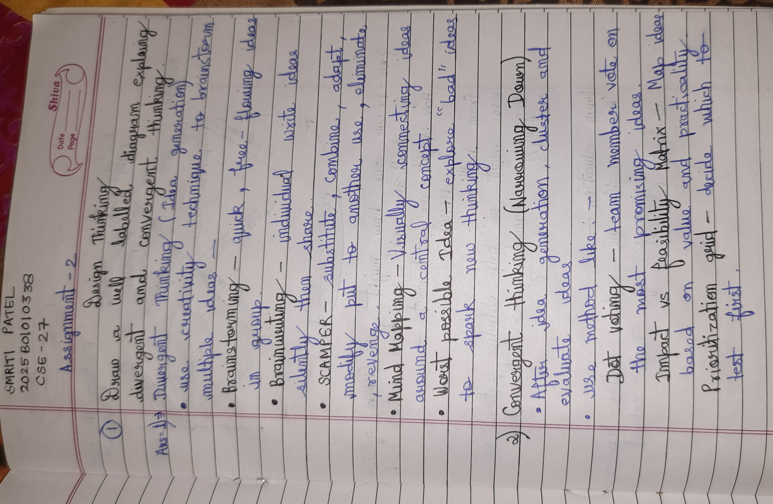

Slide 12
