Slide 1
Group Assignment - TED Talk Data
Presented By- Group 3
Temple University
October 2022

Slide 2
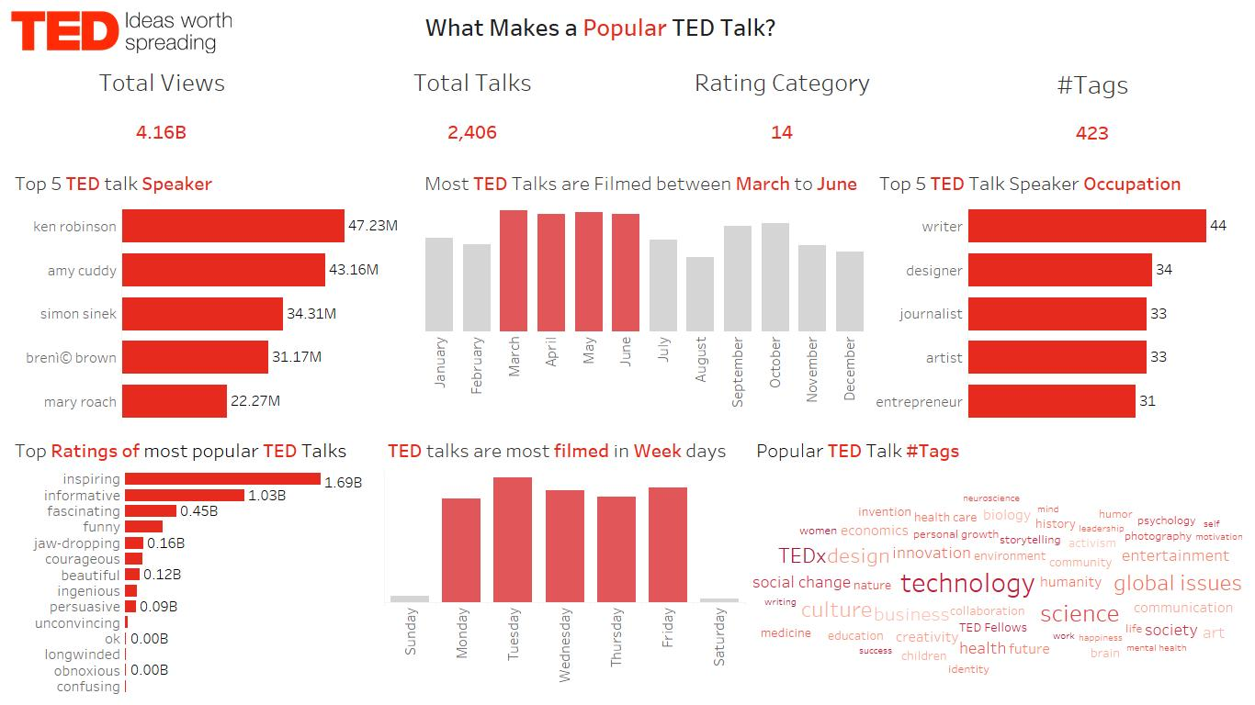

Slide 3
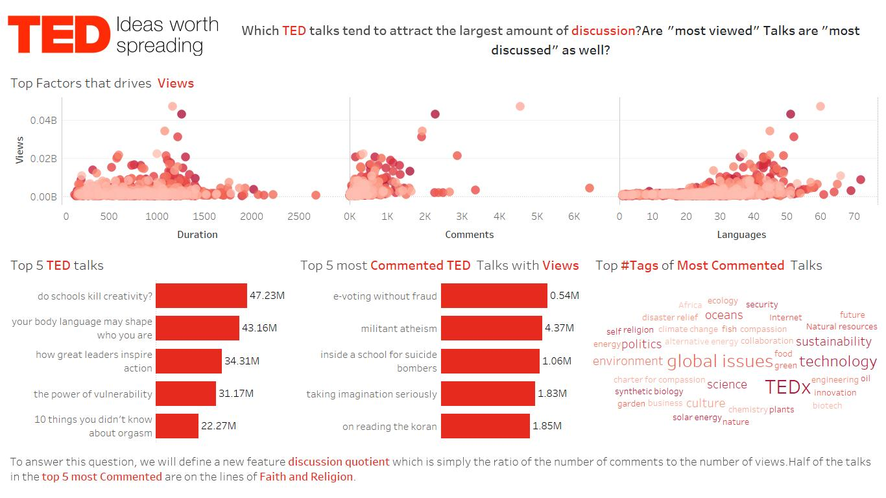

Slide 4
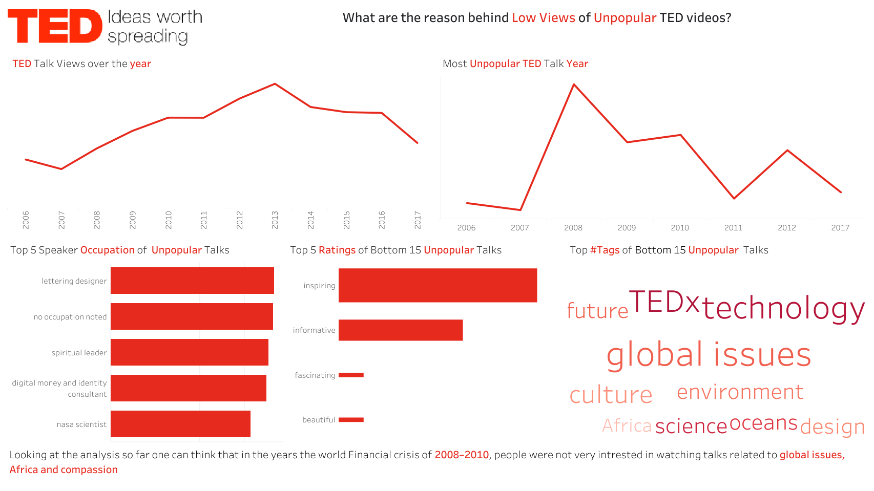

Slide 5
Thank You
https://github.com/smritiroy14/tableau
Profile - smriti.roy8034 | Tableau Public

