Slide 1
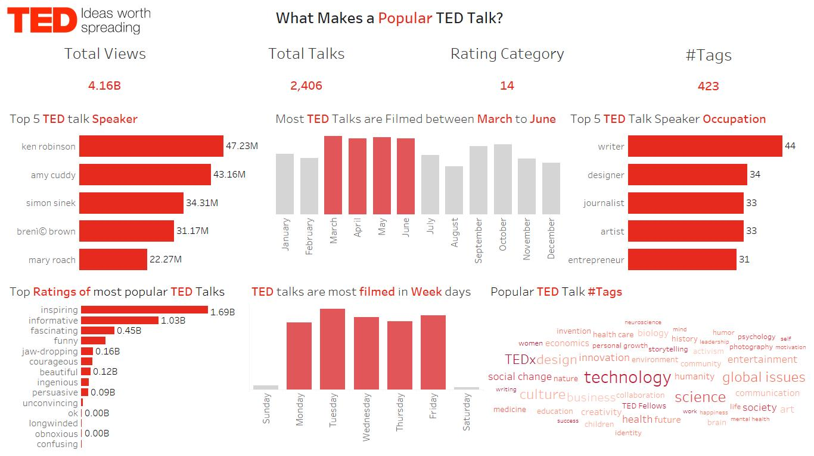

Slide 2
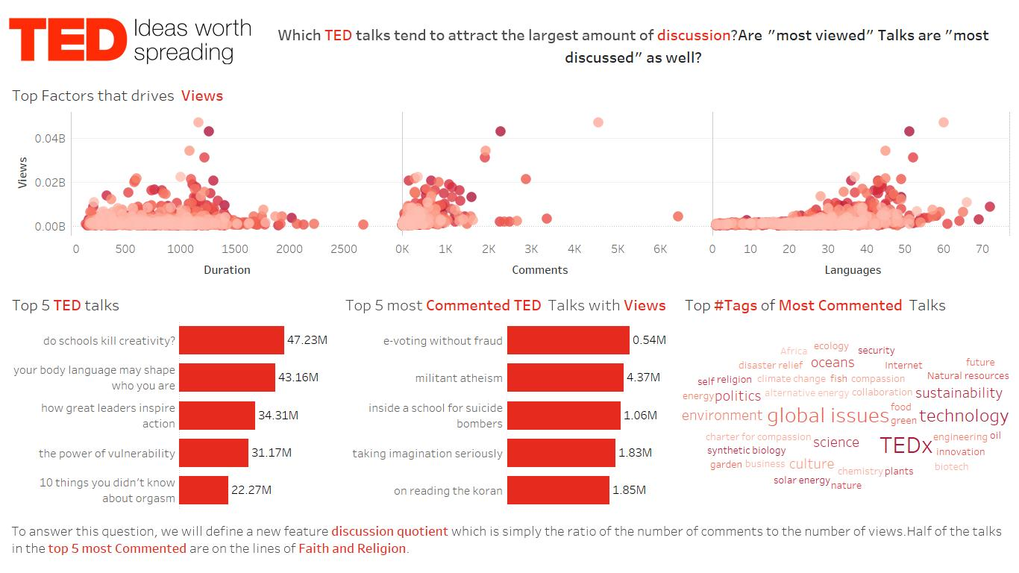

Slide 3
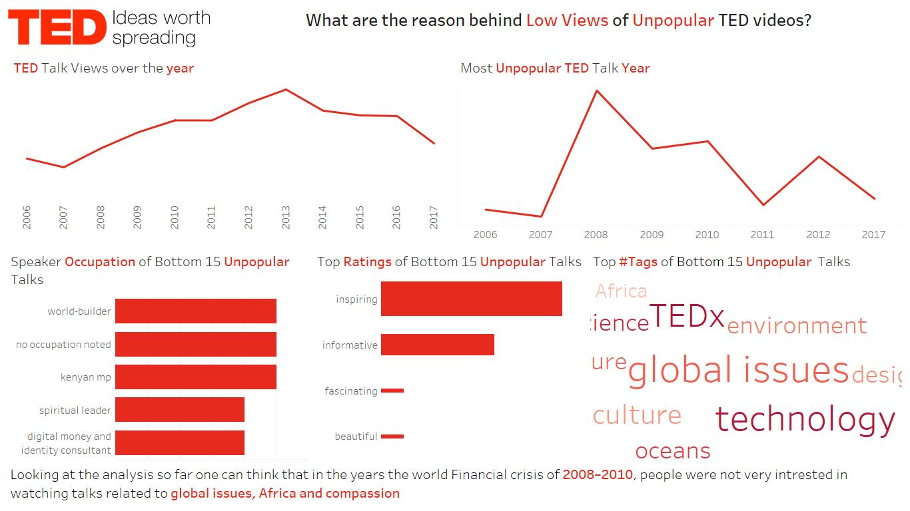

Slide 4
Thank You
https://github.com/smritiroy14/tableau
Profile - smriti.roy8034 | Tableau Public

