Slide 1

Yahoo! Music Data Analysis
By:
Abhishek Naik
Samarth Shah

Slide 2
Contents
Introduction
The Database
Technologies Used
The Analysis
Findings
References

Slide 3
Introduction
Motivation: Popularity of song streaming, Popular song charts and Recommend songs based on user ratings
Yahoo! Music offers a wealth of information and services related to many aspects of music.
The released data represents a sampled snapshot of the Yahoo! Music community's preferences for various musical items.
Represented as anonymous numbers so that no identifying information is revealed.
Yahoo! KDD Cup 2011

Slide 4
The Database
262 Million Entries
.txt format
Compressed 1.5 GB, Uncompressed 6 GB.
Original Format:
<userid>|<count>
<songid> <score> <no. of days> <time>
Converted Format :
<userid> <songid> <score> <no. of days> <time>

Slide 5
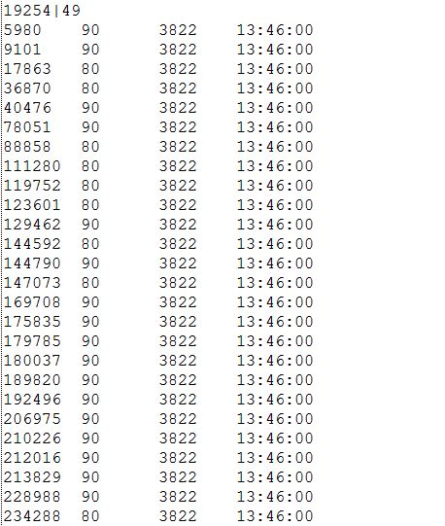
Data- Before

Slide 6
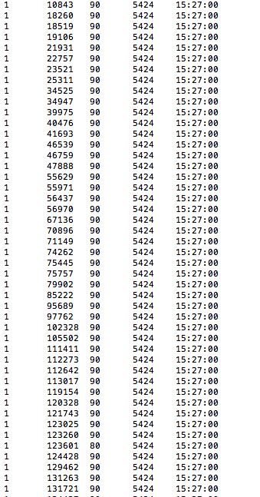
Data- After

Slide 7

Technologies Used
Python scripts
Implemented Map Reduce using Python on Palmetto Cluster
Uses Concepts of Unix (Pipe and Sort)
Mapper reads the dataset and prints the key value pair.
Reducer after fetching the data from the sort function, performs various functionalities

Slide 8
Problem Faced
Data transfer to Palmetto Cluster
Slow Processing (Bash script)
Data transfer to Hadoop VM
While sorting, temporary memory got full
Availability of “bigmem”

Slide 9

Analysis
Using Python script, we calculated the number of occurrences of score value.
Notes:
Co relation between no of rating to highest rating

Slide 10
Count of each Score value

Slide 11
Analysis
Using MapReduce, we calculated the top 10 songs with 90+ score.
Notes:
Co relation between no of rating to highest rating

Slide 12
Top 10 songs having 90+ score

Slide 13
Analysis
We calculated the total score and average score for each song id and sorted the output based on the count.
Top 100 based on count.
Notes:
Co relation between no of rating to highest rating

Slide 14
Top 100 songs based on the Count

Slide 15
Contd.

Slide 16
Analysis
We calculated the total score and average score for each song id and sorted the output based on the average.
Top 100 based on average.
Notes:
Co relation between no of rating to highest rating

Slide 17
Top 100 songs based on Average

Slide 18
Contd.

Slide 19
Analysis
We calculated the total score and average score for each song id and sorted the output based on the count.
Bottom 100 based on count.
Notes:
Co relation between no of rating to highest rating

Slide 20
Bottom 100 songs based on count

Slide 21
Contd.

Slide 22
Analysis
Top 100 Artist with most number of hit songs.
63,485 songs having ‘none’ artist id.
File: trackData.txt

Slide 23
Artist with most number of songs

Slide 24
Top 100 Artist
Calculate the top rated songs based on their scores
<TrackId>|<ArtistId>|<Optional GenreId_1>|...|<Optional GenreId_k>
Get list of Popular Artists who gave the most Top Score Songs
Problem: Songid missing in trackData.txt

Slide 25
Analysis
Top 100 Artist with most number of albums.
10,094 albums having ‘none’ artist id.
File: albumData.txt

Slide 26
Artist with most number of Albums

Slide 27
Other Analysis
Calculated the average of the overall score.
The number of occurrences of each song id.
Calculated the total score and average score for each song id and sorted based on the total score.
Notes:
Co relation between no of rating to highest rating

Slide 28
References
http://kddcup.yahoo.com/datasets.php
http://www.michael-noll.com/tutorials/writing-an-hadoop-mapreduce-program-in-python/
http://www.cloudera.com/blog/2011/04/simple-moving-average-secondary-sort-and-mapreduce-part-3/

Slide 29
Thank You !

