Slide 1

Machine Learning – Forecasting Energy (Electricity) Consumption
Spencer Rubin
March 18, 2021

Slide 2
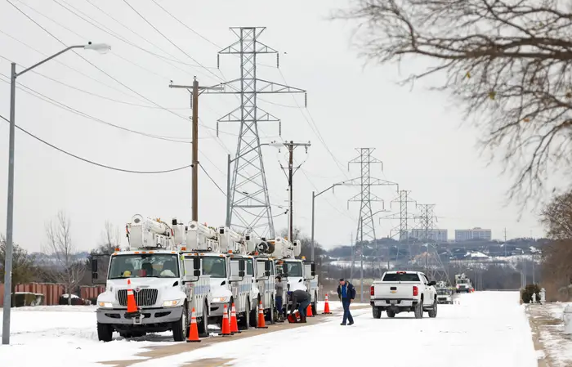
Project Summary
Energy consumption fluctuates by season, period of the day, and climate
Extreme weather events may impact peaks in energy demand
Projecting demand for electricity can reduce power outages, improve customer satisfaction
Can we utilize time series data, machine learning on electricity consumption to improve forecasting?

Slide 3
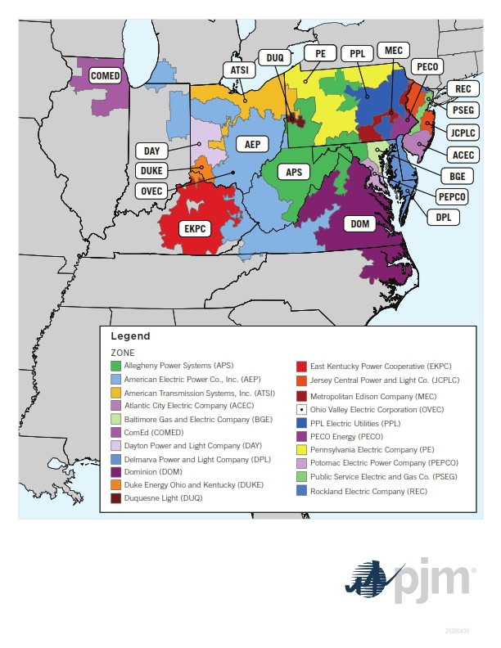
Data
PJM Interconnection, Inc. – transmission line serving multi-state, multi-utility region in eastern U.S.
Hourly data of electricity consumption by utility company (megawatts)
Data freely available via Kaggle: https://www.kaggle.com/robikscube/hourly-energy-consumption
Multiple .csv files per utility company under PJM

Slide 4
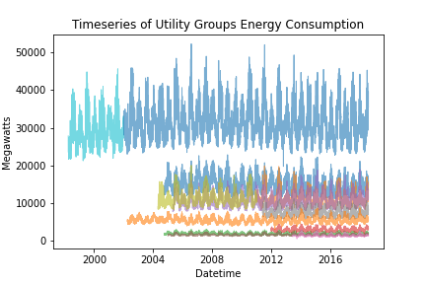
Data Wrangling
Plotting all utility power as individual features
Inconsistent time frames
Utility changes w/in PJM

Slide 5
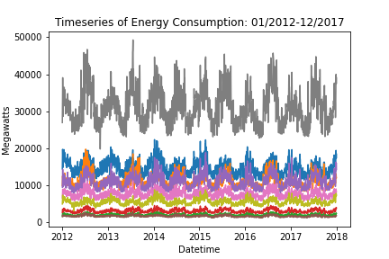
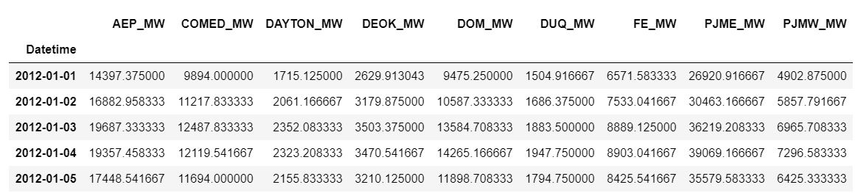
Data Wrangling

Slide 6
Data Wrangling
Join individual features (columns):
Index – Timeseries
Column = daily sum of utility power consumption

Slide 7
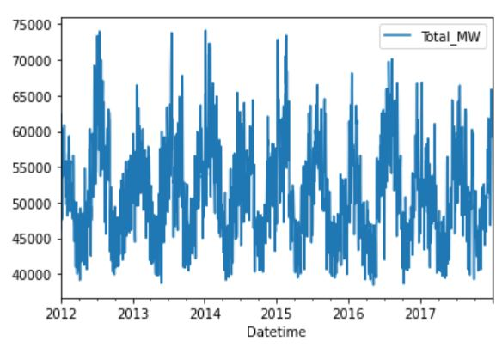
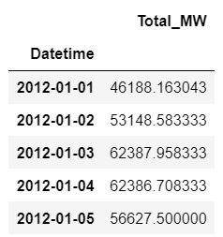
Data Wrangling
Daily Summed Power

Slide 8
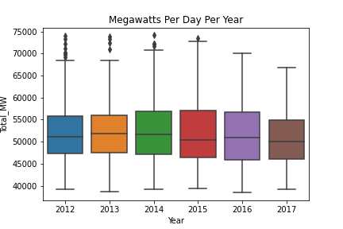
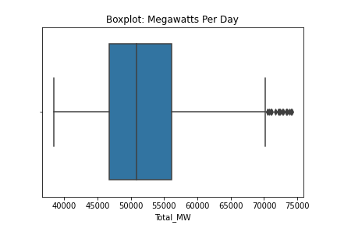
Exploring The Data

Slide 9
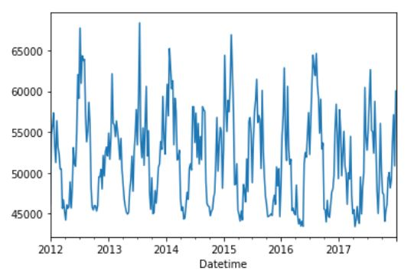
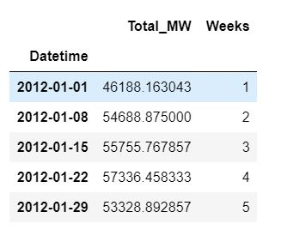
Exploring The Data
Resampled for weekly average
Weekly Mean Power

Slide 10
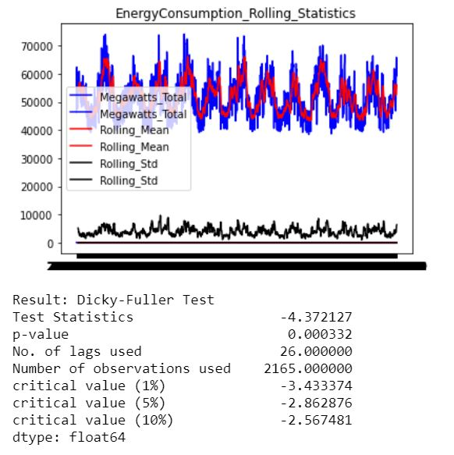
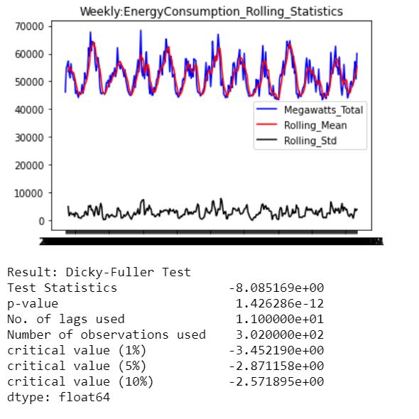
Augmented Dicky-Fuller Test: Stationarity
Daily Summed Weekly Summed

Slide 11
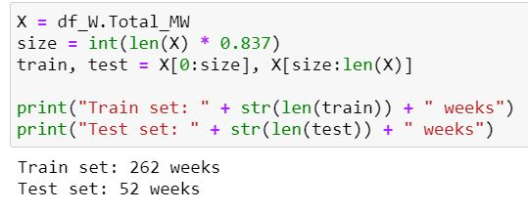
Train – Test Sets
6 years ~ 314 weeks
Train set: 262 weeks (5-yr)
Test set: 52 (1yr)

Slide 12
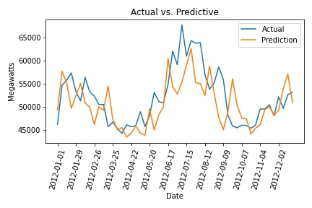
Persistence Model
Baseline model using the previous step (t-1) to predict the following step (t+1)
RMSE: 4344
Can we improve on the accuracy of this model?

Slide 13
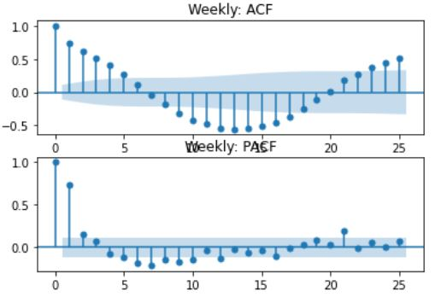
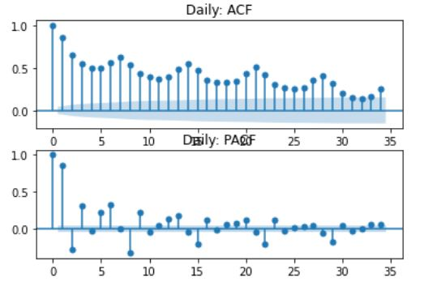
Autocorrelation – Partial Autocorrelation

Slide 14
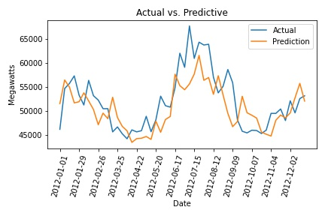
Autoregressive Integrated Moving Average (ARIMA)
ARIMA(6,1,1)
RMSE: 4093
Slightly reduced RMSE compared to persistence

Slide 15
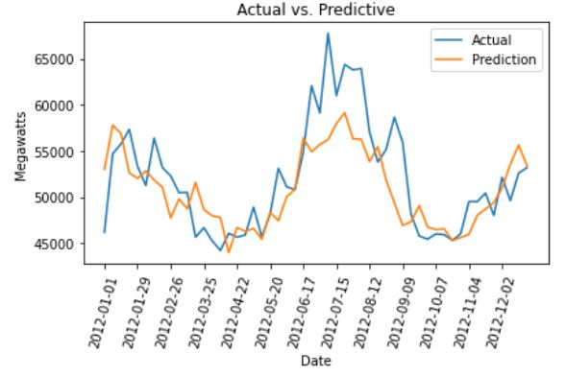
ARIMA: Hyperparameter Tuning
Search over (p,d,q) values…
ARIMA(7,0,2) smaller RMSE
RMSE: 3684
Slightly reduced RMSE compared to persistence

Slide 16
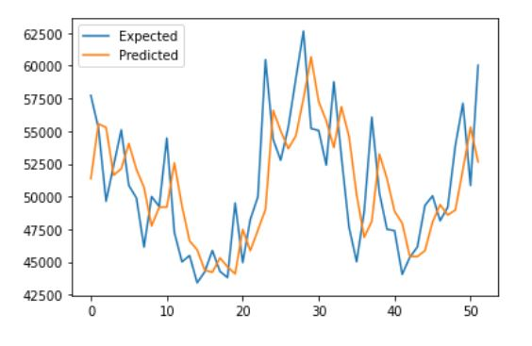
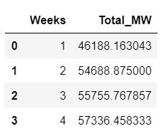
Random Forest Regression Model
Random Forest Regression Model
Add column “Weeks”
Create “supervised learning”
RMSE: 4060
Better than “persistence”
Megawatts
Week of Year

Slide 17
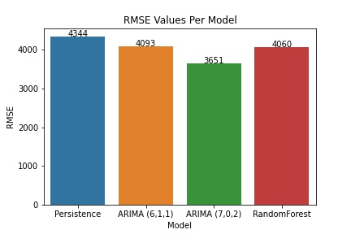
Model Performance

Slide 18
Conclusions
All models performed well in predicting trends of power consumption
Predicting peaks from unseasonal weather, extreme events may require further feature engineering
Hyperparameter tuning can provide additional error reduction, improved accuracy
Generalized trends can be well understood using ARIMA, Persistence Modeling, and Random Forest Regression

Slide 19
Future Considerations
Adding additional features (e.g. weather, population of utility regions) can further support supervised learning models
Correlation of features relating to predicting spikes in power may allow the model to more accurately predict summer and winter power consumption extremes
This can be critical for transmission line planning and performance
Additional hyperparameter tuning of well performing models may increase accuracy
ARIMA(p,d,q) grid search
Testing additional model types (e.g. Prophet, LSTM) can provide more detailed comparisons

