Slide 1
Ground-Level Ozone In U.S. Counties and Air Quality Health
By
Spencer Rubin
Springboard: Capstone2

Slide 2
Background - Problem:
Ground-level Ozone (O3) - hazardous air-pollutant
Result of anthropogenic and natural forces
Monitored by the EPA
O3 can result in respiratory disease and illness
How does O3 health concern differ between major counties in the U.S?

Slide 3
Applying Data Science
Classifying county-level O3 concentration:
Not of health concern (<0.06ppm)
Health concern (>0.06ppm)
County population as a feature contributing to O3 health quality
10-most populous counties in U.S.

Slide 4
Acquiring Datasets
EPA Daily Air Quality data for 2019 in 10-counties (.csv): https://www.epa.gov/outdoor-air-quality-data/download-daily-data
Population estimation data for each county in 2019 (.csv): https://www.census.gov/data/datasets/time-series/demo/popest/2010s-counties-total.html
Counties:
Los Angeles County, CA
Orange County, CA
San Diego County, CA
Riverside County, CA
Dallas County, TX
Harris County, TX
Miami-Dade County, FL
Cook County, IL
Queens County, NY
Maricopa County, AZ

Slide 5
Data Wrangling
Maximum Daily 8-hour Ozone averaged for county-wide EPA air measurement stations.
One Ozone concentration value (ppm) per day (observation) per county
Population (per million/people) add for each observation by county
Time series (date) indexed.
Dataframe:
3606 observations
No missing values
Variance with number of averaged EPA air measurement stations per county

Slide 6
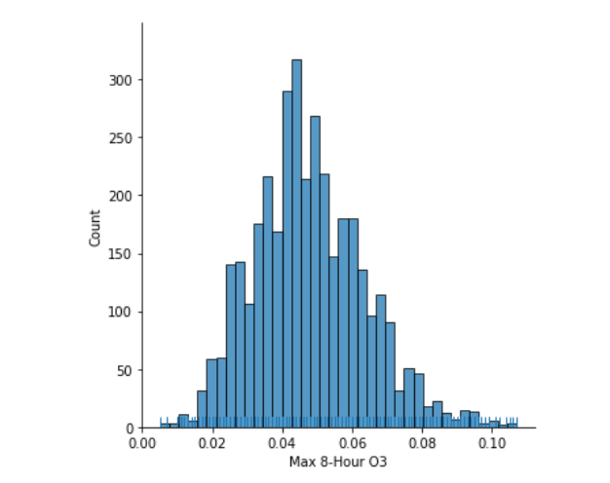
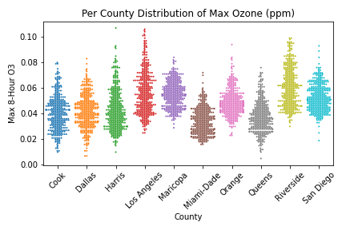
Exploratory Data Analysis
Overall distribution of Maximum 8-hour O3 ppm
County-level distribution of Maximum 8-hour O3 ppm

Slide 7
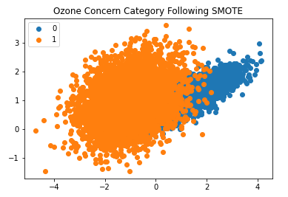
Dataset Balancing
Classifying days per county O3 >0.06ppm:
Most days are not above this threshold
imblearn - SMOTE for resampling an unbalanced dataset
Synthetic resampling of unbalanced dataset to reduce bias

Slide 8
Dataset Preprocessing
Categorical variables (pandas get_dummies()):
County
Population (above or below the median of 10-counties
“ozone_concern”: above or below 0.06ppm
“ozone_threshold”: above or below 0.007ppm
Scale “Max 8-hour Ozone (ppm)”:
sklearn’s StandardScaler()

Slide 9
Model Selection
Supervised learning models for classification:
Logistic Regression
Decision Tree Classifier
Random Forest Classifier
Metric for selection: “Accuracy”
Which model can classify best if a county has O3 related air quality health concern?

Slide 10
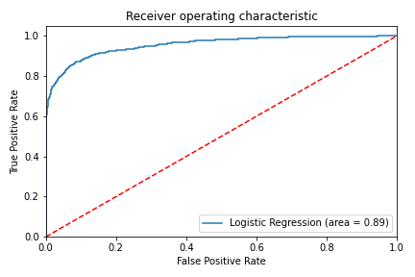
Model Selection
Logistic Regression: ROC_AUC
Model accuracy:
classifying “ozone_concern” by county relative to population
Random Forest: 90% Accuracy
classifier model type | model metric
 | Accuracy Score
Logistic Regression | 0.8876
Decision Tree | 0.8856
Random Forest | 0.899

Slide 11
Conclusions
Supervised learning classification models can have high accuracy for determining O3 health concern
Random Forest Classifier performed best
Balancing the dataset is critical to developing classification model
Most days of the year are not O3 related air quality issues
County population is a strong indicator of high concentrations of O3
Larger population ~ more anthropogenic forcing of O3 production

Slide 12
Future Considerations
Feature selection considerations:
Population density
Seasonality
Meteorological components: sunshine, temperature, wind
County-size
Geography of county; EPA measurement stations
O3 < 0.06ppm of no significant health concern
O3 0.06 – 0.07ppm: health concern!
O3 >0.07ppm: EPA non-attainment zones; serious respiratory health concerns
Los Angeles and Riverside counties have notable days with O3 above 0.07ppm!

Slide 13
Questions?

