Slide 1
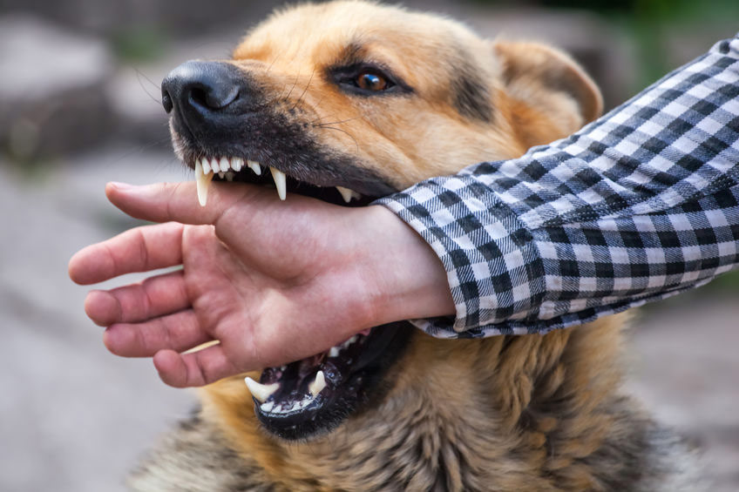

Springboard Data Science: 20.3 Data Storytelling
Assessing Potential Dog Bites:
Are certain dogs more dangerous than others?
https://www.devaughnjames.com/blog/has-your-child-been-a-victim-of-a-dog-bite/
https://www.petinsurance.com/healthzone/ownership-adoption/pet-ownership/pet-behavior/why-dogs-bite-kids/

Slide 2
Springboard Data Science: 20.3 Data Storytelling
What features are important to avoid when selecting a domestic dog as a pet?
Hundreds of dog breeds, hybrids available as domestic pets
Dog bites can cause bodily harm, infection, disease, community danger
Choice in dog breed, sex may have health, safety consequences
Data Source: Kaggle “Animal Bites” dataset (https://www.kaggle.com/rtatman/animal-bites)
Over 9000 records of animal bites near Louisville, KY between 1985-2007

Slide 3
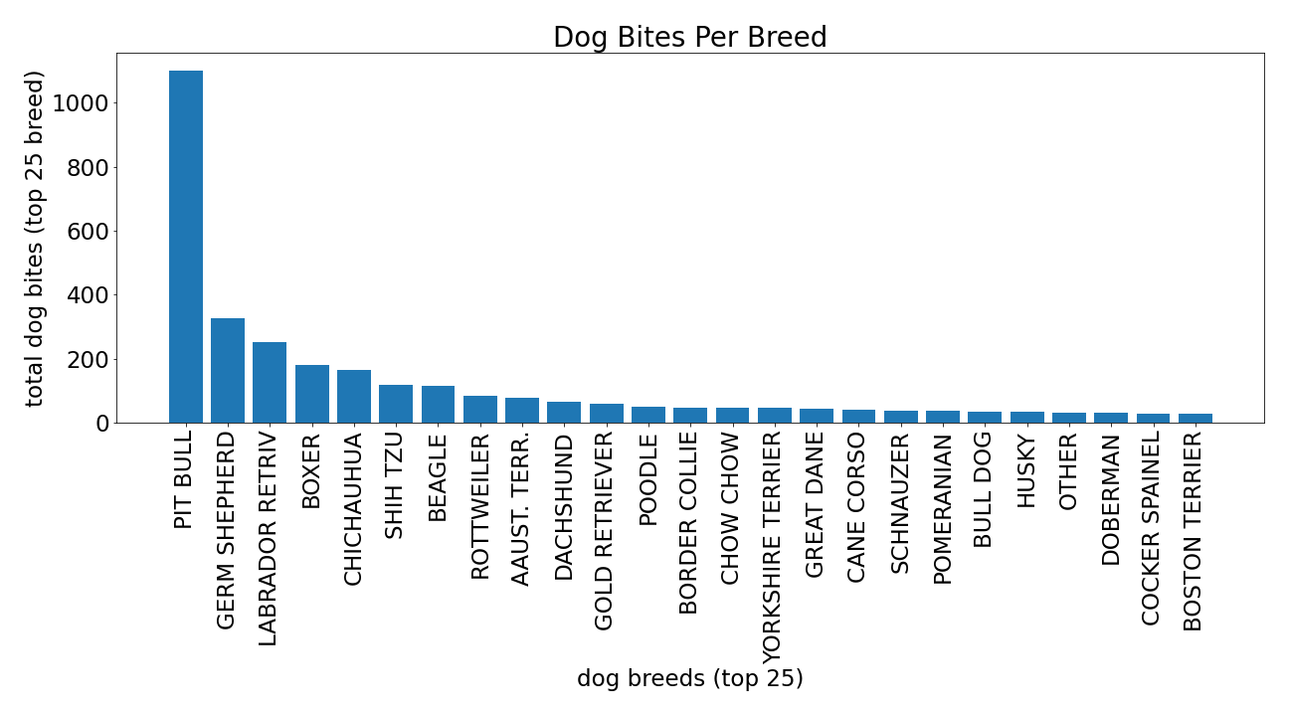
Springboard Data Science: 20.3 Data Storytelling
Top 5:
Pitbull
Ger-Shephard
Lab-Retriever
Boxer
Chihuahua

Slide 4
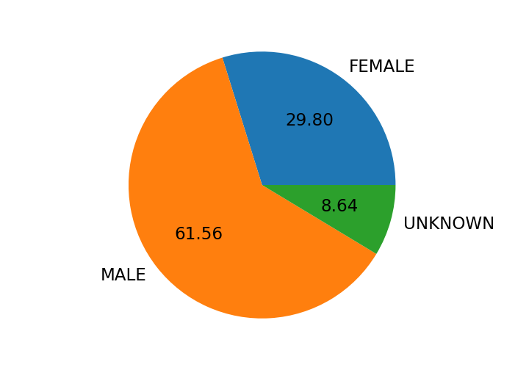
Springboard Data Science: 20.3 Data Storytelling
Male to Female ratio >2:1

Slide 5
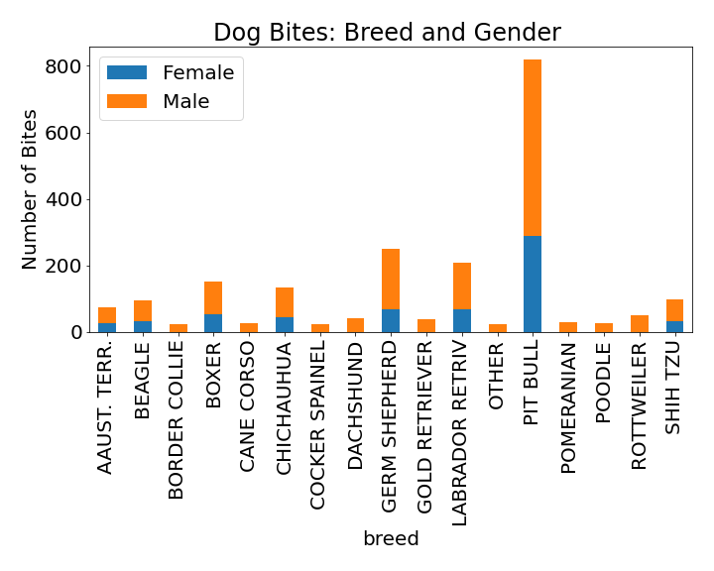
Springboard Data Science: 20.3 Data Storytelling
All breeds in top of list are dominated by males doing the biting

Slide 6

Springboard Data Science: 20.3 Data Storytelling
What features are important to avoid when selecting a domestic dog as a pet?
Pit bulls are the most prevalent breed for dog bites
Medium-Large dog breeds dominate the ten most prevalent dog breeds
Male dogs bite more often than females
Small dogs (e.g. Chihuahuas and Shih Tzus) still bite
Male pit bulls seem to be the most likely dog to bite – avoid as pets
https://ilovemychi.com/chihuahua-aggression/

