Slide 1
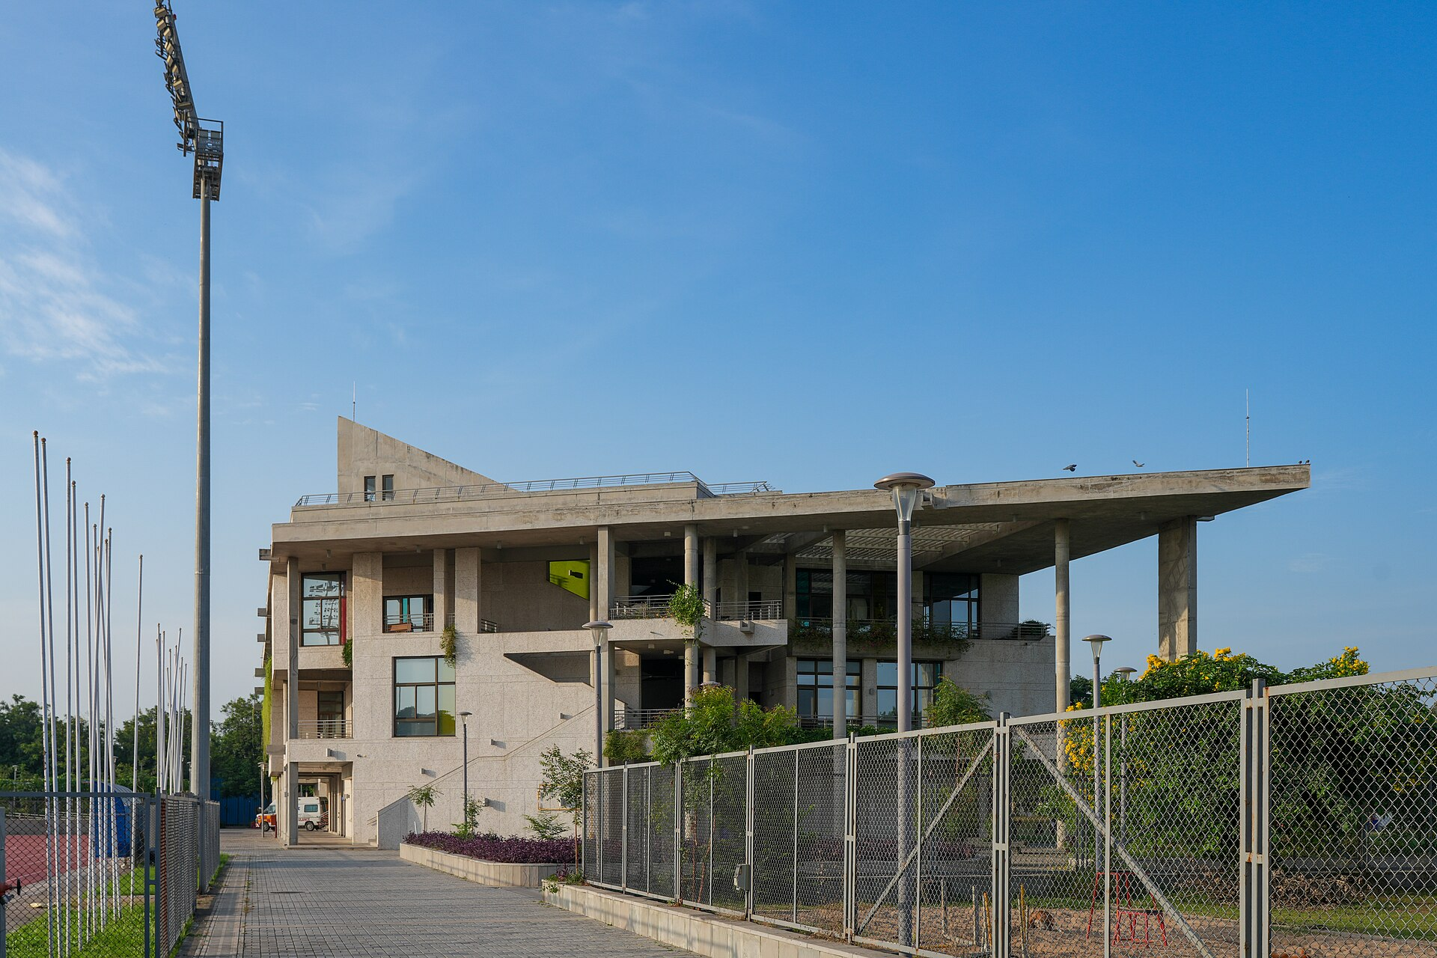

5G AND BEYOND · SEMESTER I · 2026
A Ray-Traced 5G Digital Twin of the IIT Gandhinagar Campus
Channel-aware resource allocation, mobility, what-if analysis and 5G core signalling
Anuj Tiwari
26310013 · PhD, CSE
Smrutee Behera
25250041 · M.Tech, CSE
Indian Institute of Technology Gandhinagar
Notes:
Good morning. We are Anuj Tiwari and Smrutee Behera from IIT Gandhinagar. Our 5G and Beyond project is a ray-traced digital twin of our own campus: a virtual copy of a 5G network on the IITGN buildings, which we use to make better radio resource decisions, to follow a walking user through handovers, to predict the effect of network changes, and to show the 5G core signalling behind it all.

Slide 2
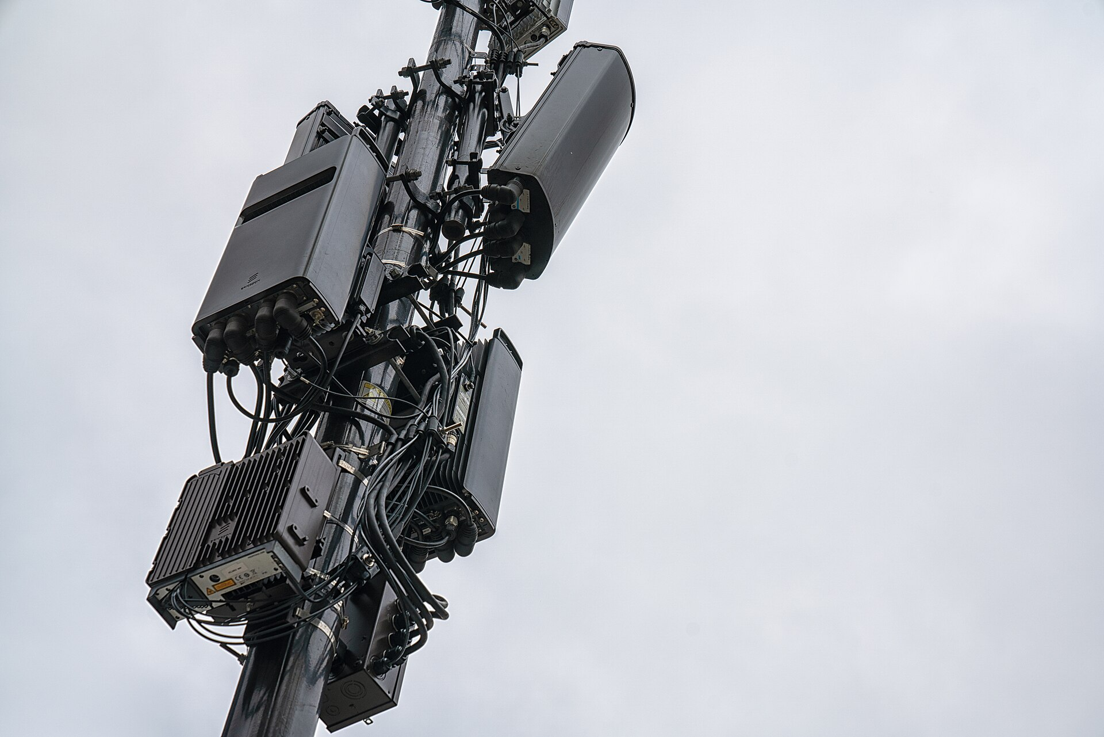

A live 5G network is a costly, unrepeatable testbed
01 · PROBLEM STATEMENT & CORE OBJECTIVE
The problem
Network performance depends on where users are, how signals bounce off buildings, and how loaded each cell is. Testing a different channel or PRB allocation on a real network disrupts users, and the same conditions never come back, so results are hard to compare.
Core objective
Build a physics-based digital twin of a 5G network on the IITGN campus, and use it to choose a better serving sector and PRBs for each user, and to predict the effect of a change before applying it.
What the brief asked us to show
Scenario of gNBs + UEs
Site-specific channels
Baseline vs twin allocation
Moving UEs
KPI comparison
What-if prediction
Platform cost & limits
Notes:
The problem: performance on a 5G network depends on user positions, the propagation environment and load. Trying a different allocation on a live network is disruptive and not repeatable. A digital twin, as defined in 3GPP TR 28.915, gives a replica we can experiment on. Our core objective was to build one for the IITGN campus and use it for two things: better per-user decisions on serving sector and PRBs, and predicting the effect of network changes before applying them. These chips are the eight points from the project brief that we covered.

Slide 3





A ray-traced copy of the campus with a 5G network running inside it
01 · WHAT WE BUILT
01
02
03
04
05
Campus scene
Ray tracing
Allocation
Walks + what-if
5G core + demo
74 buildings from OpenStreetMap, turned into 3D blocks
RSRP, SINR, path loss and line of sight for every UE–sector link
Baselines B1 (fixed PRBs), B2 (random) vs channel-aware Twin
3 walking routes with A3 handover; 3 what-if changes
Registration, PDU session, Xn handover and paging, message by message
3 × 3
3.5 GHz
273
20 × 100
1520 m
sites × sectors
band n78, 100 MHz
PRBs at 30 kHz
drops × UEs
square campus area
Notes:
This is the pipeline. We took the campus buildings from OpenStreetMap, placed three sites with three sectors each at 3.5 GHz, and used NVIDIA Sionna RT to ray-trace every link between a user and a sector. On top of that we compared allocation strategies, simulated walking users with A3 handovers, ran what-if changes, and modelled the 5G core procedures message by message in an interactive 3D page. Experiments use 20 random drops of 100 users.

Slide 4

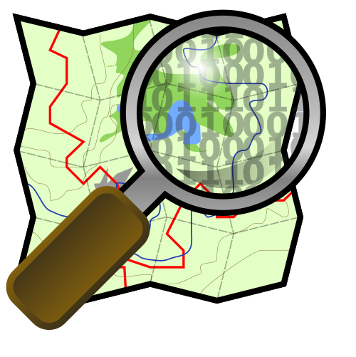


Open-source tools let the whole twin run on one laptop CPU
02 · TECHNOLOGY & TOOLS
Sionna RT 2.2
Mitsuba 3 · Dr.Jit
Why Sionna RT, not NVIDIA AODT
NVIDIA's open-source ray tracer: reflection, diffraction, scattering
Scene engine and JIT compiler under Sionna (CPU via LLVM)
AODT needs data-centre NVIDIA GPUs, Docker and an NGC licence key
Sionna RT has the same ray-tracing physics, installs with pip and runs on CPU
OpenStreetMap
Python · NumPy
Campus building outlines and heights
Allocation, KPIs, mobility, what-if; Matplotlib plots
20–30 ms
per UE–sector link, 1 M rays
< 1.1 GB
memory
three.js
5G core model
Interactive 3D campus in one offline HTML page
Our Python model of UE, gNBs, AMF, SMF, UPF, AUSF, UDM…
≈ 25 min
whole study from scratch
Measured on an Apple M4 laptop CPU, no GPU
Notes:
The stack is fully open source. Sionna RT does the ray tracing on top of Mitsuba and Dr.Jit, OpenStreetMap gives the buildings, Python and NumPy do the allocation and KPIs, and three.js draws the interactive campus. The brief suggested NVIDIA AODT, but it needs data-centre GPUs and Docker, so we used Sionna RT, which has the same ray-tracing physics and runs on a laptop CPU. A UE-sector link costs 20 to 30 milliseconds at a million rays, memory stays under 1.1 GB, and the whole study runs in about 25 minutes.

Slide 5
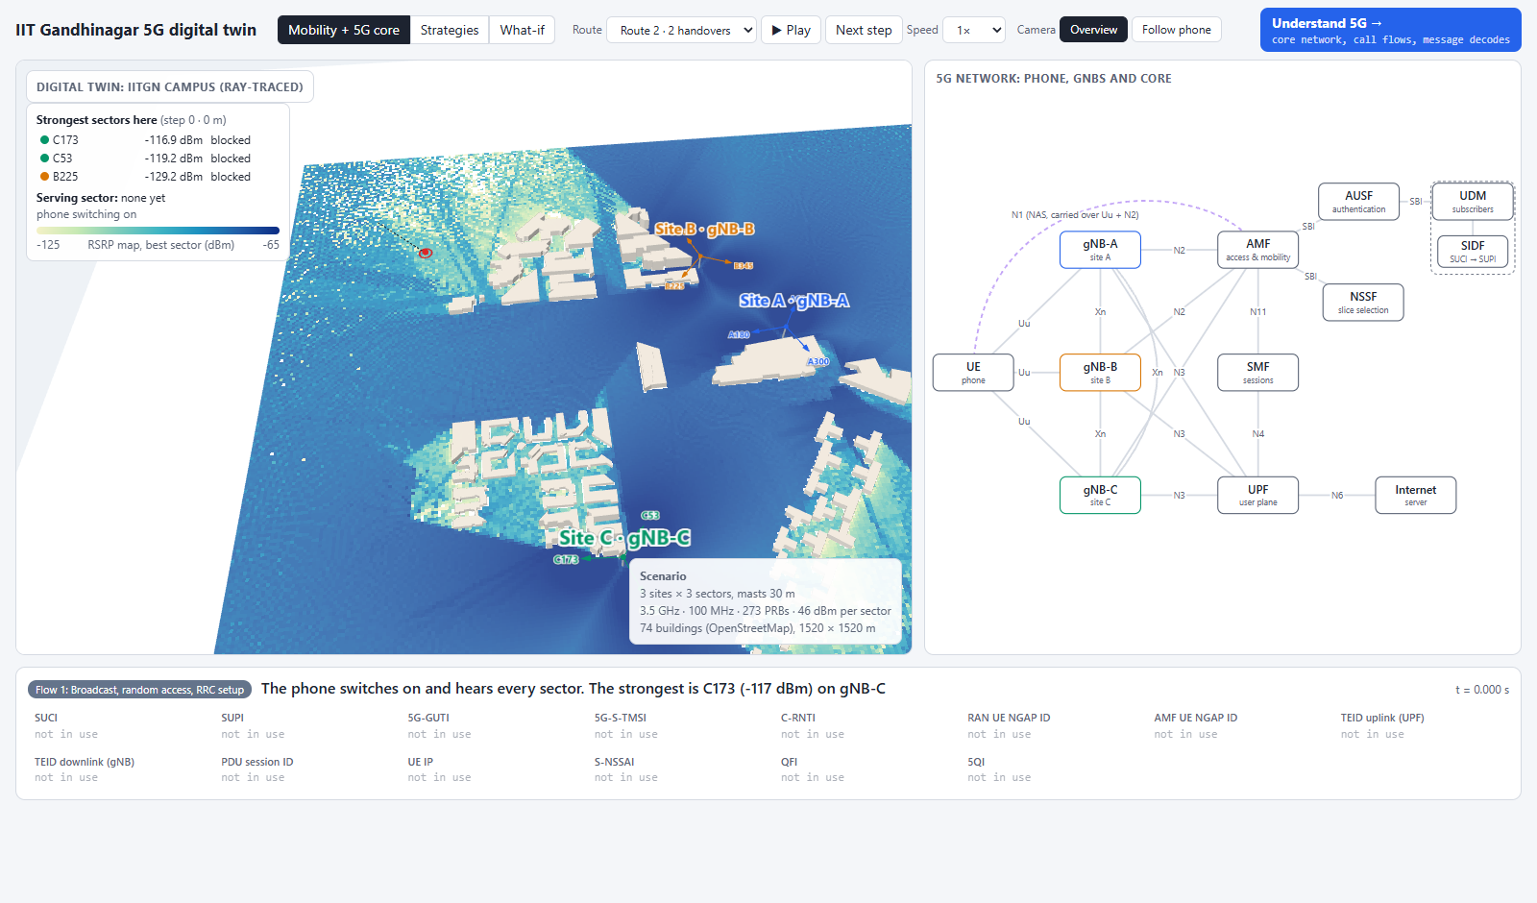
One page shows the radio twin and the 5G core side by side
02 · THE TWIN IN ACTION
Left: ray-traced campus
RSRP map of the best sector, 3 sites, the walking phone and its serving sector
Right: 5G network
UE, gNBs and core functions; each message moves along its interface
Bottom: identities
SUCI, SUPI, 5G-GUTI, C-RNTI and tunnel IDs as they change
Open: python run.py → twin.html (works offline)
Notes:
This is the actual demo page. On the left is the ray-traced campus with the RSRP map, the three sites and the walking phone. On the right is the 5G network: phone, gNBs and the core. As the phone walks, each signalling message moves along its interface, and the bottom bar shows the identities in use. The Understand 5G button at the top right opens our core-network explorer.

Slide 6
The twin's channel data raised mean throughput by 69 %
02 · WHAT THE TWIN DELIVERED
10.92 Mbps
mean user throughput, vs 6.48 (B1) and 8.67 (B2)
1.33 Mbps
for the worst 5 % of users, vs 0 with B1
−72.0 dBm
interference per PRB, vs −66.8 dBm with B1
Notes:
Across 20 drops of 100 users, the Twin strategy gives 10.92 Mbps mean throughput against 6.48 for fixed PRBs and 8.67 for random PRBs: 69 percent more than fixed. The biggest change is for the worst-served users: the 5th percentile goes from zero to 1.33 Mbps. Interference per PRB also drops to minus 72 dBm because the twin gives strongly interfering sectors different PRBs.

Slide 7
Walkers stayed connected; predictions landed within 0.9 Mbps
02 · MOBILITY & WHAT-IF
Walking user, 3 campus routes
Steps with zero throughput
0–6.5 %
50–76 %
Twin strategy
B1 (nearest site, fixed PRBs)
Xn handovers (A3: 3 dB offset, 2-step time-to-trigger)
Route 1 | Route 2 | Route 3
0 | 2 (C173→B225→C173) | 1 (B105→C173)
Route data: figures/routes.png in the repo
Notes:
For mobility, a phone walks three campus routes and hands over with an A3 rule. With the Twin strategy the walker has zero throughput on at most 6.5 percent of steps, against 50 to 76 percent with the baseline. Route 2 has two Xn handovers, route 3 has one. On the right, the what-if analysis: the twin predicts the effect of doubling users, switching off site B, or moving users 30 metres. We then re-simulate each change with random 4 dB shadowing the twin never sees. Predictions are within 0.9 Mbps. Note the 'actual' is a second simulation, not a real network.

Slide 8

What building the twin taught us about 5G
02 · WHAT WE LEARNT
Buildings decide who should serve whom
PRBs only matter under partial load
Line of sight, not distance, picks the best sector. Rooftop masts left 60 of 65 nearby users without line of sight.
When every sector uses the whole band, any assignment interferes equally. Coordination needs a load model.
The 5G core, end to end
A twin is only as good as its data
Registration, 5G-AKA, PDU session, Xn handover and paging, and how SUPI, SUCI, GUTI and TEIDs change.
Predictions are trustworthy only when the twin is synchronised with real measurements (3GPP TR 28.915).
Notes:
Four things we learnt. First, buildings decide who should serve whom: line of sight matters more than distance. When we first put masts on roofs, 60 of 65 users near a mast had no line of sight, so we moved them beside buildings. Second, PRB choice only matters under partial load. Third, we learnt the 5G standalone core procedures end to end, including how the identities change. Fourth, a digital twin is only as good as its synchronisation with real data.

Slide 9
Who did what
03 · OUR SPECIFIC CONTRIBUTIONS
Anuj Tiwari
26310013 · PhD, CSE
Smrutee Behera
25250041 · M.Tech, CSE
5G core procedures: registration, PDU session, Xn handover and paging
Linked the core message flow to the walking user in the 3D demo
Built the Understand 5G core-network explorer inspired from mpirical (netx)
Prepared the presentation
Platform evaluation (jointly)
Built the IITGN campus scenario in Sionna RT and collected ray-traced channels
Designed and evaluated baseline and twin allocation strategies
Mobility study, KPI comparison and what-if analysis
Interactive 3D campus page; project report
Platform evaluation (jointly)
Notes:
Our split of work, as recorded in the report. Anuj modelled the 5G core procedures, linked them to the walking user in the 3D demo, built the Understand 5G explorer and prepared this presentation. Smrutee built the IITGN scenario in Sionna RT, collected the ray-traced channels, designed and evaluated the allocation strategies with the mobility, KPI and what-if studies, built the 3D campus page and wrote the report. We evaluated the platform together.

Slide 10
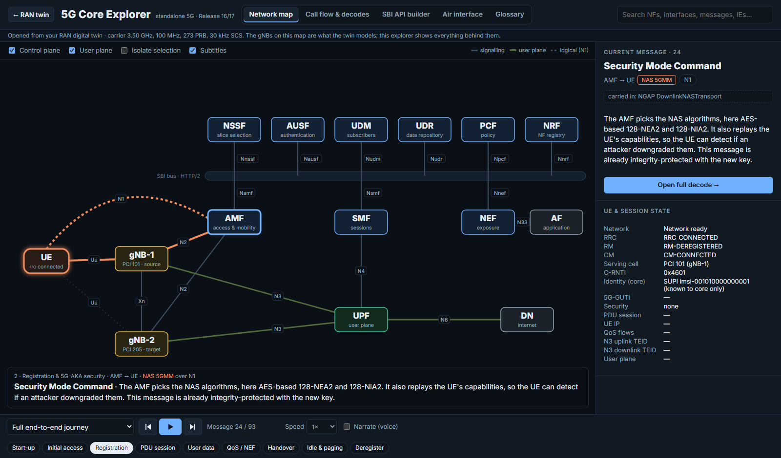
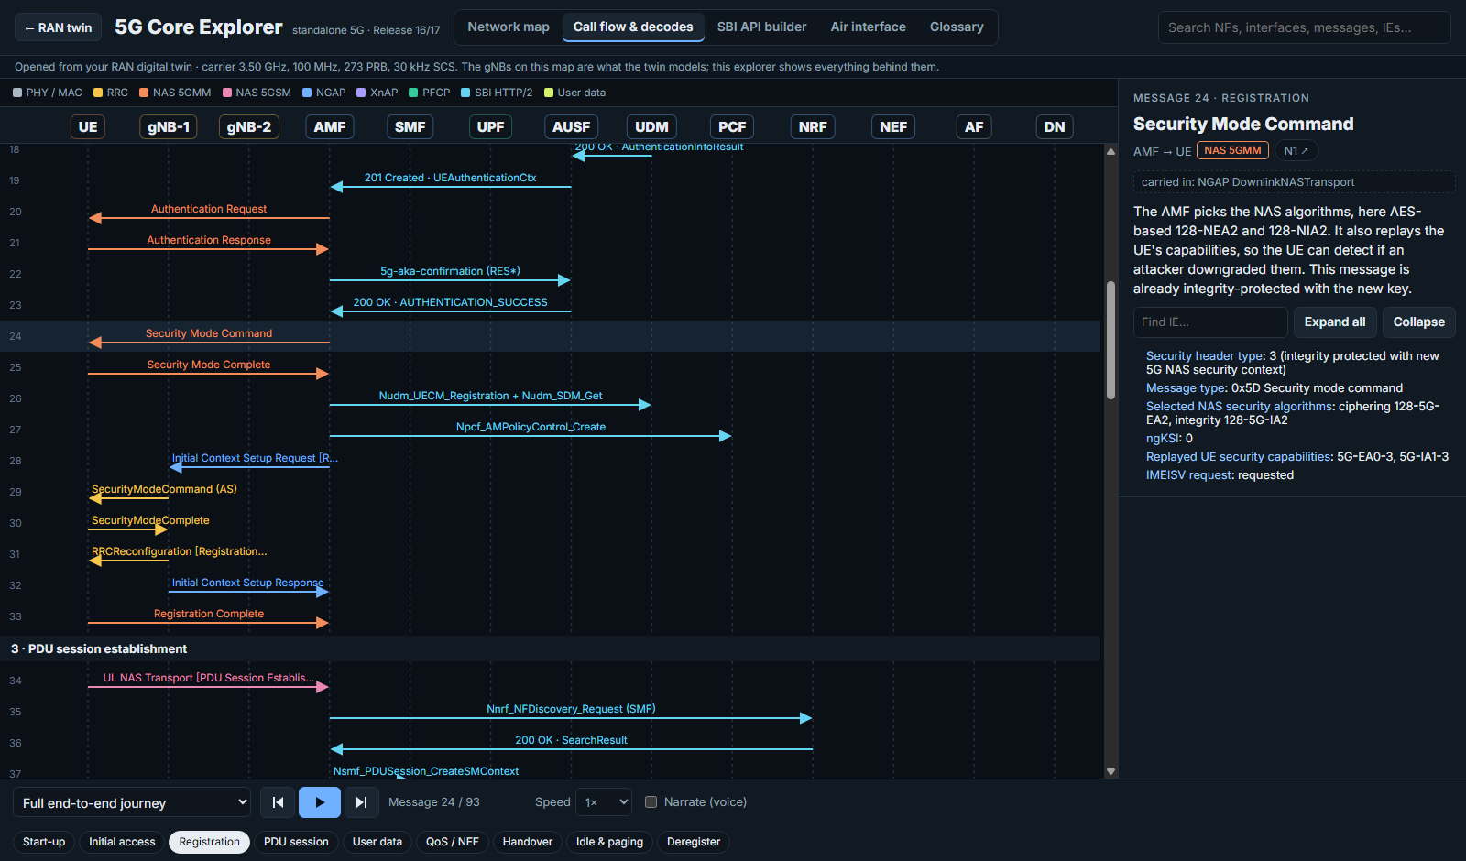
Understand 5G: an explorer for the core network behind the twin
03 · UNDERSTAND 5G EXPLORER
Network map: each message highlighted on its interface
Call flow with full message decode (here: Security Mode Command)
93
messages, start-up to deregistration
9
procedures, incl. Xn handover and paging
5
views: map, call flow, SBI API, air interface, glossary
Notes:
To help people understand the flow behind the twin, we built Understand 5G, opened from the button on the twin page. It plays 93 messages across 9 procedures, from start-up to deregistration, on a map of the 5G core, and decodes every message field by field. There is also an SBI API builder and an air-interface view with CQI, modulation and the frame structure, using the twin's own carrier settings.

Slide 11
Six problems we hit, and what we changed
04 · CHALLENGES & HOW WE OVERCAME THEM
Problem | How we overcame it
NVIDIA AODT needs data-centre GPUs, Docker and an NGC key | Used Sionna RT: same ray-tracing physics, runs on a laptop CPU
Masts on rooftops: 60 of 65 nearby users had no line of sight | Placed 30 m masts beside buildings instead
Fixed and random PRBs gave identical results | Partial-load model: 12 PRBs per user, interference only where PRBs overlap
Very weak ray-traced links distorted average SINR | Kept raw values, counted any user below −20 dB as −20 dB
Walking user was always last in the list, favouring B1 | Random position in the list, averaged over 10 user sets
CPU ray tracing not exactly repeatable; laptop throttles | Report mean ± 95 % CI; median of three timing runs
Notes:
These are the main problems we faced. AODT was not runnable without data-centre GPUs, so we moved to Sionna RT. Rooftop masts left most nearby users without line of sight, so we put masts beside buildings. Fixed and random PRB allocations initially gave the same numbers because every sector used the whole band; a partial-load model fixed that. Very weak links distorted averages, so we floor SINR at minus 20 dB when averaging. The walking user was always last in the user list, which favoured the baseline, so we randomised its position. And because CPU ray tracing is not exactly repeatable, we report confidence intervals and median timings.

Slide 12



The real campus is greener than our twin
04 · WHAT THE TWIN STILL MISSES
No trees or terrain
OpenStreetMap has buildings only, yet roads like this one are lined with trees that absorb 3.5 GHz signals
Assumed building heights
Some buildings have no height in OpenStreetMap
One gain per link
No fast fading; every user needs the same 12 PRBs
Simulated ground truth
What-if 'actual' is a re-simulation with shadowing; core message timings are illustrative
Notes:
This photo of our campus shows the biggest gap: trees. OpenStreetMap only has buildings, so the twin has no foliage or terrain, and some building heights are assumed. Each link has a single gain without fast fading, and every user needs the same 12 PRBs. And our 'actual' what-if numbers come from a second simulation, not a real network.

Slide 13



How we would take this further, or do it better
05 · EXTENSIONS & A BETTER WAY
Richer scene
Calibrate with real data
Real 5G core
Add trees, terrain and measured heights (e.g. drone or LiDAR survey) with real wall materials
Feed drive-test or UE measurement reports back so the twin stays synchronised
Run Open5GS with a RAN simulator (UERANSIM) instead of a modelled message flow
GPU and AODT
Smarter scheduling
Optimise the network
Use a GPU server for denser ray tracing and AODT's full RAN: PHY/MAC, MU-MIMO
Joint handover + PRB decisions for cell-edge users; learning-based schedulers
Use Sionna's differentiability to tune antenna tilt, site placement and energy saving
Notes:
If we did this again, or extended it: first, a richer scene with trees and measured heights. Second, calibrate the twin with real measurements so predictions can be checked against reality. Third, replace our modelled message flow with a real open-source 5G core such as Open5GS with UERANSIM. Fourth, move to a GPU server, and to AODT for the full RAN stack. Fifth, smarter scheduling that decides handover and PRBs jointly for cell-edge users. And sixth, because Sionna is differentiable, the twin can directly optimise antenna tilt, site placement and energy saving.

Slide 14
Video demo
06 · VIDEO DEMO
Notes:
Video demo of the twin page and the Understand 5G explorer. (Insert the video in the empty area: Insert > Video.)

Slide 15
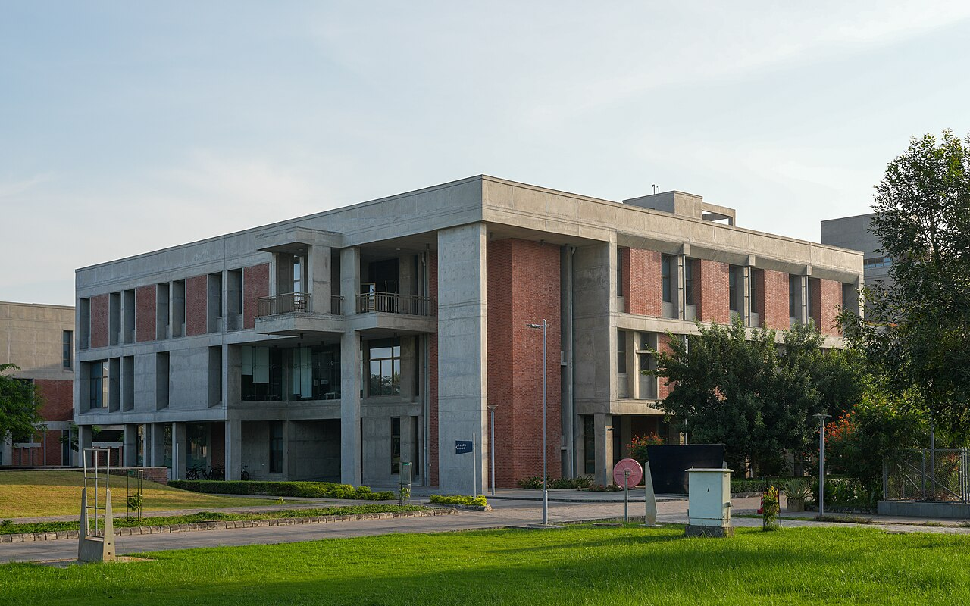
Thank you
Questions?
Anuj Tiwari · 26310013 · PhD, CSE
Smrutee Behera · 25250041 · M.Tech, CSE
Code: github.com/smrutee20/5G-digital-twin
Notes:
Thank you. We are happy to take questions. The code and data are on GitHub.

