Slide 1
Library management system
Technology
Spring boot
React
Mongo DB
Module
Admin
User
LMS

Slide 2
Admin
Dashboard
Batch details (CRUD)
Book details (CRUD)
Issue
Admin (CRUD)
Notification
logout
User
Books
My books
Favorite
Notification
Profile
logout
LMS

Slide 3
Collections
User
Book
Transaction
Notification
favorite
LMS

Slide 4
Spring library
Web
Dev tool
Data mongo
Lombok
Validator
Swagger
Security (later part)
Spring package
model
constants
dto
repository
services
exception
admin.controller
user.controller
LMS

Slide 5
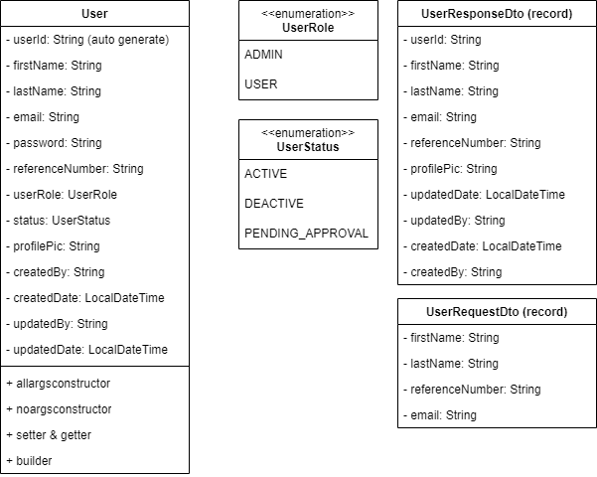
LMS

Slide 6
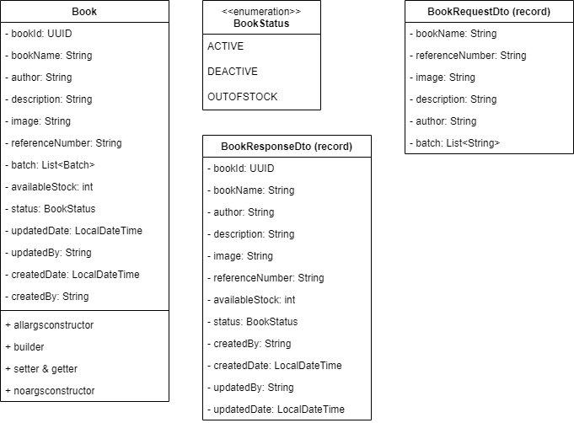
LMS

Slide 7
React library
React router
Axois
React icon
Tailwind
Shadcn
Vite bundler
LMS

