Slide 1

Machine Learning Unit-II
Mrs. B. Ujwala, Asst. Professor

Slide 2
Linear regression
Regression is essentially finding a relationship (or) association between the dependent variable (Y) and the independent variable(s) (X), i.e. to find the function ‘f ’ for the association Y = f (X).
Linear regression is a statistical model that is used to predict a continuous dependent variable from one or more independent variables
It is called "linear" because the model is based on the idea that the relationship between the dependent and independent variables is linear.
In a linear regression model, the independent variables are referred to as the predictors and the dependent variable is the response/target.

Slide 3
Linear regression
The goal is to find the "best" line that fits the data. The "best" line is the one that minimizes the sum of the squared differences between the observed responses in the dataset and the responses predicted by the line.
For example, if you were using linear regression to model the relationship between the temperature outside and the number of ice cream cones sold at an ice cream shop, you could use the model to predict how many ice cream cones you would sell on a hot day given the temperature outside.

Slide 4
Linear regression Cont…
Linear Regression is Supervised Learning
The most common regression algorithms are
Simple linear regression
Multiple linear regression
Polynomial regression
Multivariate adaptive regression splines
Logistic regression
Maximum likelihood estimation (least squares)

Slide 5
Simple linear regression
Simple linear regression is the simplest regression model which involves only one predictor. This model assumes a linear relationship between the dependent variable and the predictor variable.
For example, you might use simple linear regression to model the relationship between the temperature outside and the number of ice cream cones sold at an ice cream shop.
The temperature would be the independent variable and the number of ice cream cones sold would be the dependent variable.

Slide 6
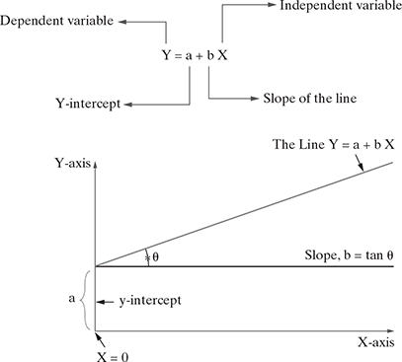
Slope = Change in Y/Change in X
Simple linear regression
The value of intercept indicates the value of Y when X = 0. It is known as ‘the intercept or Y intercept’ because it specifies where the straight line crosses the vertical or Y-axis.
Slope of a straight line represents how much the line in a graph changes in the vertical direction (Y-axis) over a change in the horizontal direction (X-axis)

Slide 7
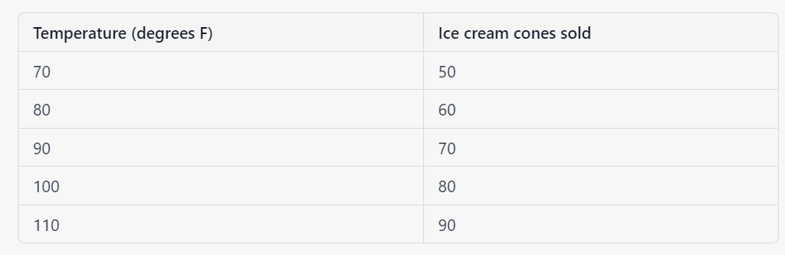
Simple linear regression Cont…
To fit a line to this data, we can use the following equation:
y = ax + b
Where:
y is the dependent variable (the number of ice cream cones sold)
x is the independent variable (the temperature)
a is the slope of the line
b is the y-intercept (the point at which the line crosses the y-axis)

Slide 8
Simple linear regression Cont…
Example: If we take Price of a Property as the dependent variable and the Area of the Property (in sq. m.) as the predictor variable, we can build a model using simple linear regression.
Price_{Property} = f(Area_{Property} )
Assuming a linear association, we can reformulate the model as
Price_{Property} = a + b. Area_{Property}
where ‘a’ and ‘b’ are intercept and slope of the straight line, respectively.

Slide 9
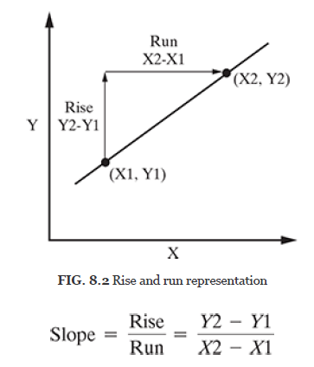
Slope of the simple linear regression model
Slope of a straight line represents how much the line in a graph changes in the vertical direction (Y-axis) over a change in the horizontal direction (X-axis) as shown in Figure 8.2.
Slope = Change in Y/Change in X
Rise is the change in Y-axis (Y − Y ) and Run is the change in X-axis (X − X ). So, slope is represented as given below:

Slide 10
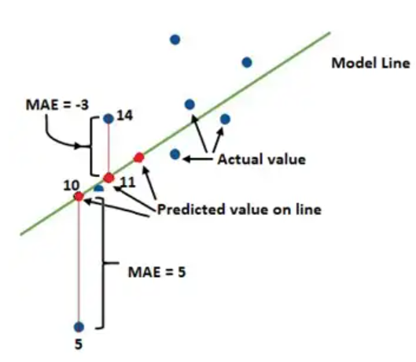
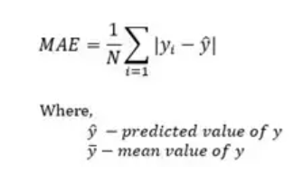
Loss functions
Suppose the model is trained and gives the predicted output then the loss is the difference between the predicted values and actual data values.
Type of loss in a linear model
MAE-This is the difference between the predicted and actual values. It is also called mean absolute error (MAE).

Slide 11
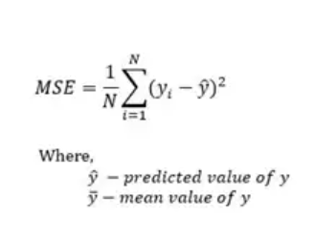
Loss functions
Type of loss in a linear model
MSE- the squared average difference between the predicted and actual value. It is also known as Mean Squared Error (MSE). The formula of MSE loss is shown below.

Slide 12
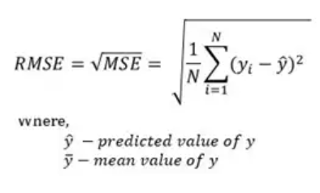
Loss functions
Type of loss in a linear model
RSME Error: It tells the error rate by the square root of the L2 loss i.e. MSE. The formula of RSME is shown below.

Slide 13
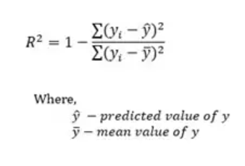
Loss functions
Type of loss in a linear model
R-squared error: It tells the good fit of the model-predicted line with the actual values of data. The coefficient value range is from 0 to 1 i.e. the value close to 1 is a well-fitted line. The formula is shown below.

Slide 14

Slope Equation
Least Square Regression is a method which minimizes the error in such a way that the sum of all square error is minimized. Here are the steps you use to calculate the Least square regression.
First, the formula for calculating m = slope is
The lower the error, lesser the overall deviation from the original point.

Slide 15
Ordinary Least Squares (OLS) algorithm
Step 1: Calculate the mean of X and Y
Step 2: Calculate the errors of X and Y
Step 3: Get the product
Step 4: Get the summation of the products
Step 5: Square the difference of X
Step 6: Get the sum of the squared difference
Step 7: Divide output of step 4 by output of step 6 to calculate ‘b’
Step 8: Calculate ‘a’ using the value of ‘b’

Slide 16

Exercise Problem
A college professor believes that if the grade for internal examination is high in a class, the grade for external examination will also be high. A random sample of 15 students in that class was selected, and the data is given below:

Slide 17
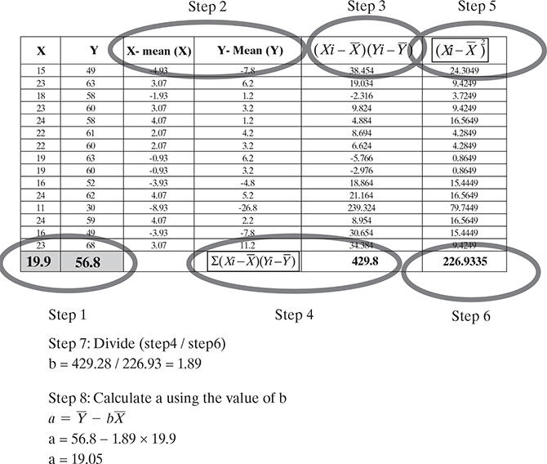
Solution

Slide 18
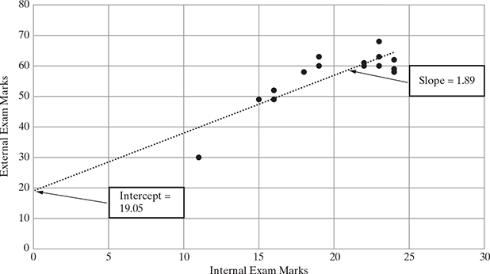

Slide 19
Maximum and minimum point of curves
Maximum and minimum points on a graph are found at points where the slope of the curve is zero.
The maximum point is the point on the curve of the graph with the highest y-coordinate and a slope of zero.
The minimum point is the point on the curve of the graph with the lowest y-coordinate and a slope of zero.

Slide 20
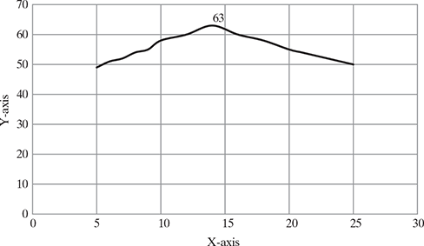
Maximum point

Slide 21
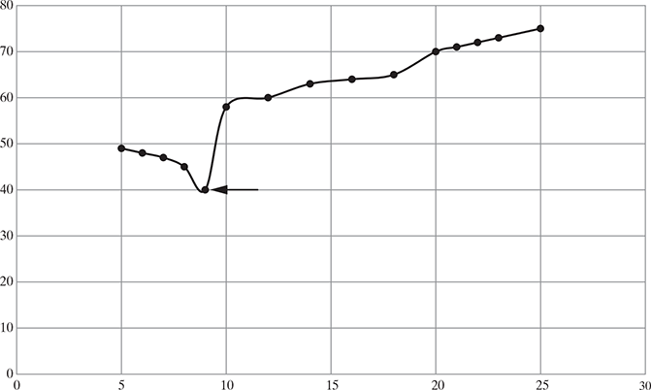
Minimum point

Slide 22

Multiple Linear Regression
In a multiple regression model, two or more independent variables, i.e. predictors are involved.
Example: A model which can predict the correct value of a real estate if it has certain standard inputs such as area (sq. m.) of the property, location, floor, number of years since purchase, amenities available etc as independent variables.
We can form a multiple regression equation as shown below:
Price_{Property} = f (Area_{Property} , location, floor, Ageing, Amenities)
The following expression describes the equation involving the relationship with two predictor variables, namely X₁ and X₂ .

Slide 23
Multiple Linear Regression
The model describes a plane in the three-dimensional space of Ŷ, X₁ , and X₂ . Parameter ‘a’ is the intercept of this plane. Parameters ‘b₁’ and ‘b₂’ are referred to as partial regression coefficients.
Parameter b₁ represents the change in the mean response corresponding to a unit change in X₁ when X₂ is held constant.
Parameter b₂ represents the change in the mean response corresponding to a unit change in X₂ when X₁ is held constant.

Slide 24

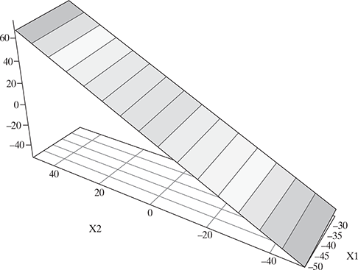
Multiple Linear Regression
Consider the following example of a multiple linear regression model with two predictor variables, namely X₁ and X₂
Multiple regression plane

Slide 25

Multiple Linear Regression
Multiple regression for estimating equation when there are ‘n’ predictor variables is as follows:
While finding the best fit line, we can fit either a polynomial or curvilinear regression. These are known as polynomial or curvilinear regression, respectively.

Slide 26
Use the following steps to fit a multiple linear regression model
Step 1: Calculate X₁², X₂², X₁y, X₂y and X₁X₂
Step 2: Calculate Regression Sums.(Ex1^2 Ex2^2 Ex1y Ex2y Ex1x2 )
Step 3: Calculate b₀, b₁, and b₂.
Step 4: Place b₀, b₁, and b₂ in the estimated linear regression equation.

Slide 27
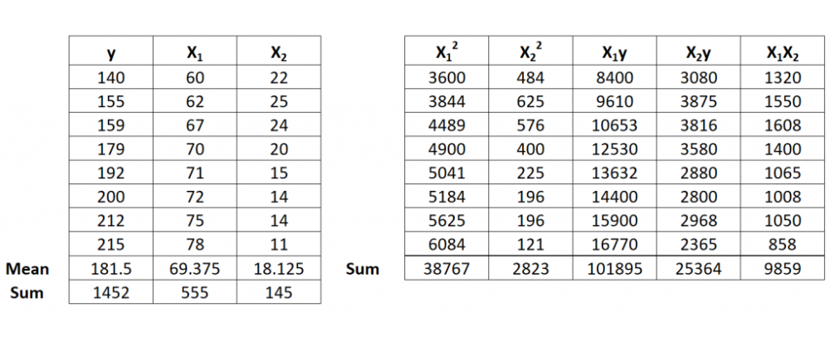
Step 1: Calculate X₁², X₂², X₁y, X₂y and X₁X₂

Slide 28
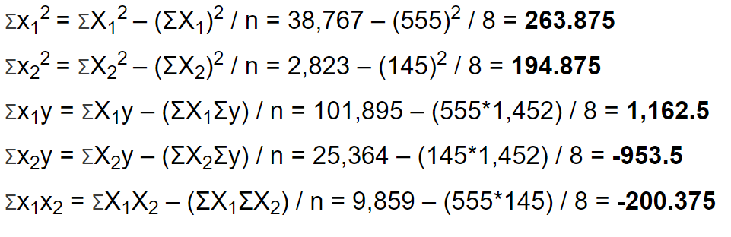
Step 2: Calculate Regression Sums.

Slide 29
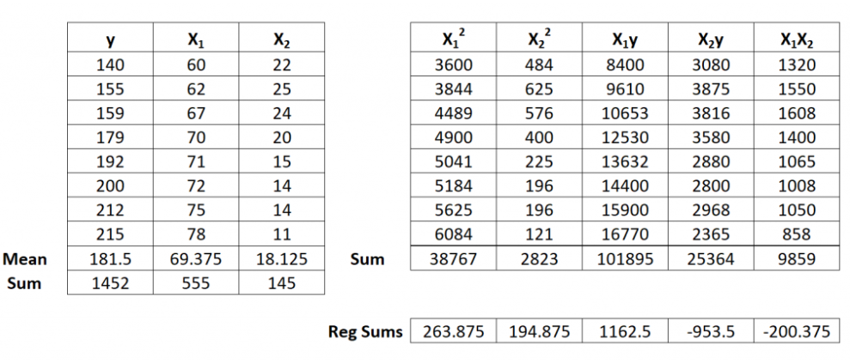
Step 2: Calculate Regression Sums.

Slide 30
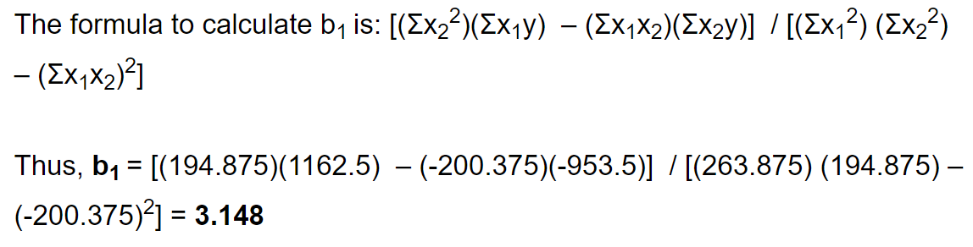
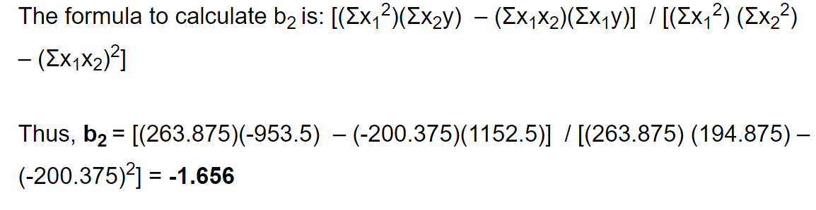
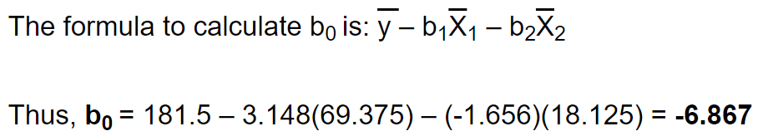
Step 3: Calculate b₀, b₁, and b₂

Slide 31
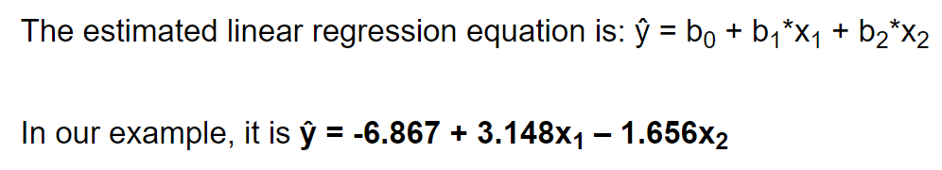
Step 4: Place b₀, b₁, and b₂ in the estimated linear regression equation.

Slide 32
Assumptions in Regression Analysis
Linear relationship between the features and target
Little or no multicollinearity between the features
Normal Distribution of error terms
Little or no autocorrelation among residuals
Homoscedasticity of the errors i.e., the variance of the residuals must be constant across the predicted values

Slide 33
Improving Accuracy of the Linear Regression Model
Accuracy refers to how close the estimation is near the actual value
Prediction refers to continuous estimation of the value.
Bias and Variance is similar to accuracy and prediction
High bias = low accuracy (not close to real value)
High variance = low prediction (values are scattered)
Low bias = high accuracy (close to real value)
Low variance = high prediction (values are close to each other)

Slide 34
Improving Accuracy of the Linear Regression Model
A regression model which is highly accurate and highly predictive, the overall error of the model will be low, implying a low bias (high accuracy) and low variance (high prediction) - highly preferable
Similarly, if the variance increases (low prediction), the spread of our data points increases, which results in less accurate prediction. As the bias increases (low accuracy), the error between our predicted value and the observed values increases.
Balancing out bias and accuracy is essential in a regression model.

Slide 35
Improving Accuracy of the Linear Regression Model
In the linear regression model, it is assumed that the number of observations (n) is greater than the number of parameters (k) to be estimated, i.e. n > k, and in that case, the least squares estimates tend to have low variance and hence will perform well on test observations.
However, if observations (n) is not much larger than parameters (k), then there can be high variability in the least squares fit, resulting in overfitting and leading to poor predictions.
If k > n, then linear regression is not usable.

Slide 36
Improving Accuracy of the Linear Regression Model
Accuracy of linear regression can be improved using the following three methods:
1. Shrinkage Approach
2. Subset Selection
3. Dimensionality (Variable) Reduction

Slide 37
Shrinkage (Regularization) approach
This approach involves fitting a model involving all predictors. However, the estimated coefficients are shrunken towards zero relative to the least squares estimates.
This shrinkage (also known as regularization) has the effect of reducing the overall variance. Some of the coefficients may also be estimated to be exactly zero, thereby indirectly performing variable selection.
The two best-known techniques for shrinking the regression coefficients towards zero are
1. ridge regression
2. lasso (Least Absolute Shrinkage Selector Operator)

Slide 38
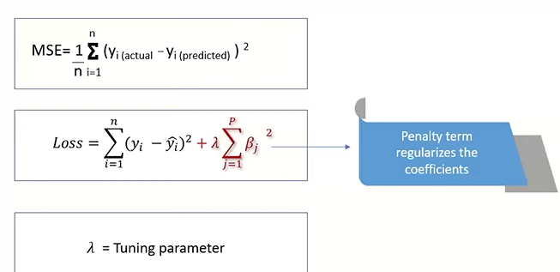
Shrinkage (Regularization) approach
Ridge Regression : It modifies the over-fitted or under fitted models by adding the penalty equivalent to the sum of the squares of the magnitude of coefficients.
Ridge Regression performs regularization by shrinking the coefficients present.

Slide 39
Ridge Regression
Ridge regression decreases the complexity of a model but does not reduce the number of variables since it never leads to a coefficient been zero rather only minimizes it
As the regularization parameter increases, the value of the coefficient tends towards zero. This leads to both low variance (as some coefficient leads to negligible effect on prediction) and low bias (minimization of coefficient reduces the dependency of prediction on a particular variable)
Ridge regression is not good for feature reduction

Slide 40
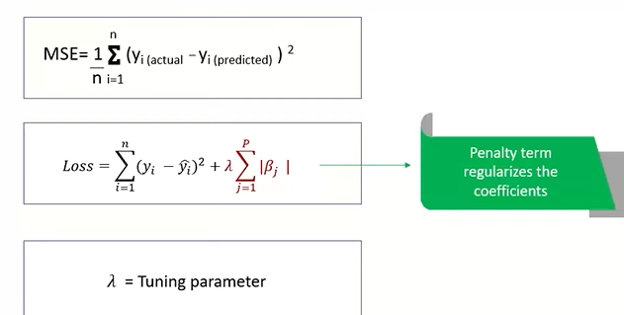
Shrinkage (Regularization) approach
2. lasso (Least Absolute Shrinkage Selector Operator): It modifies the over-fitted or under-fitted models by adding the penalty equivalent to the sum of the absolute values of coefficients.

Slide 41
Lasso Regression
If the regularization parameter is very high in In Lasso Regression, then it can be used to select important features of a dataset and shrinks the coefficients of less important features to exactly 0
If the number of features (p) is greater than the number of observations (n), Lasso will pick at most n features as non-zero, even if all features are relevant
Lasso can be used to select important features of a dataset
The difference between ridge and lasso regression is that lasso tends to make coefficients to absolute zero as compared to Ridge which never sets the value of the coefficient to absolute zero

Slide 42
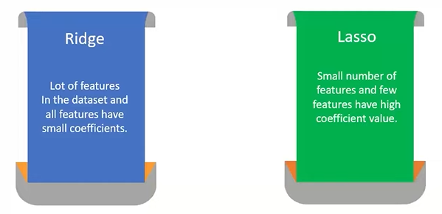
Shrinkage (Regularization) approach

Slide 43
Subset selection
Identify a subset of the predictors that is assumed to be related to the response and then fit a model using OLS on the selected reduced subset of variables.
There are two methods in which subset of the regression can be selected:
1. Best subset selection (considers all the possible (2^{k} ))
2. Stepwise subset selection
Forward stepwise selection (0 to k)
Backward stepwise selection (k to 0)

Slide 44
Dimensionality reduction (Variable reduction)
In dimensionality reduction, predictors (X) are transformed, and the model is set up using the transformed variables after dimensionality reduction.
The number of variables is reduced using the dimensionality reduction method.
Principal component analysis is one of the most important dimensionality (variable) reduction techniques.

Slide 45
Thank You

