Slide 1
K-means Clustering

Slide 2
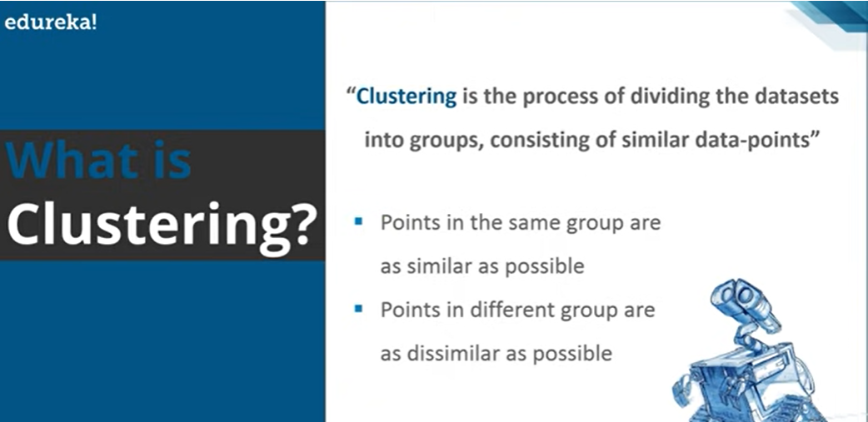

Slide 3
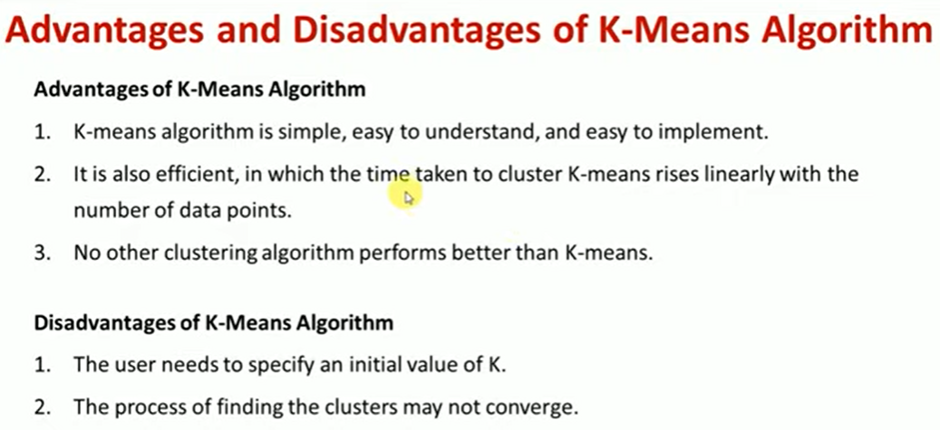

Slide 4
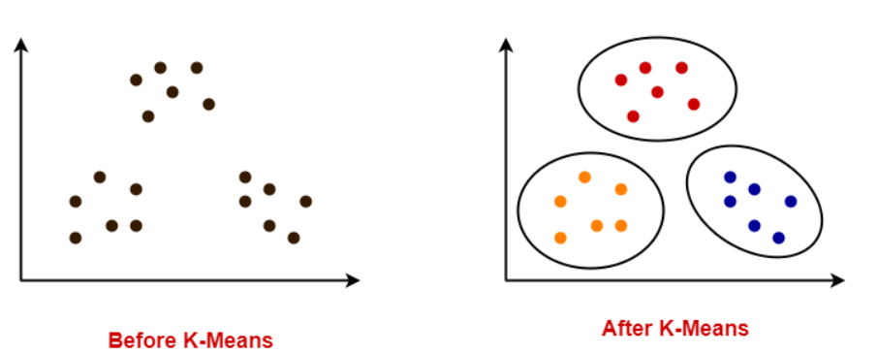
K-means:
K-means algorithm is an algorithm to cluster n objects based on attributes into k partitions, where k<n.
K-Means clustering is an unsupervised clustering technique.
It is a partitions based clustering algorithm.
A cluster is defined as a group of objects that belongs to the same class.

Slide 5
K-Means Clustering Algorithm
K-Means Clustering Algorithm involves the following steps-
Step-01:
Choose the number of clusters K.
Step-02:
Randomly select any K data points as cluster centres.
Select cluster centers in such a way that they are as farther as possible from each other.
Step-03:
Calculate the distance between each data point and each cluster center.
The distance may be calculated either by using given distance function or by using Euclidean distance formula.

Slide 6
K-Means Clustering Algorithm
Step-04:
Assign each data point to some cluster.
A data point is assigned to that cluster whose center is nearest to that data point.
Step-05:
Re-compute the center of newly formed clusters.
The center of a cluster is computed by taking mean of all the data points contained in that cluster.
Step-06:
Keep repeating the procedure from Step-03 to Step-05 until any of the following stopping criteria is met-
Center of newly formed clusters do not change
Data points remain present in the same cluster
Maximum number of iterations are reached

Slide 7
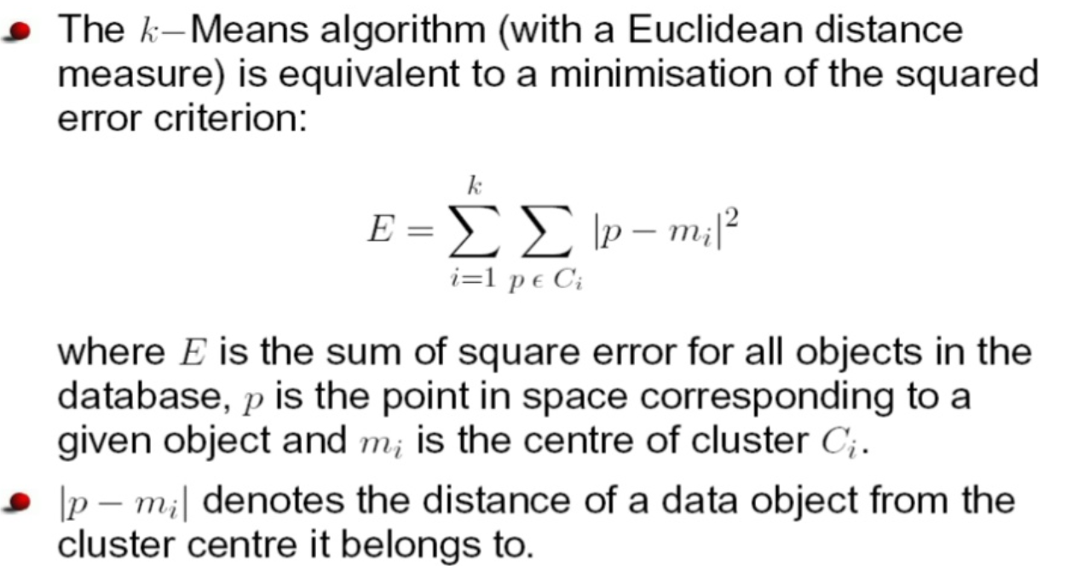
Squared Error criteria

Slide 8
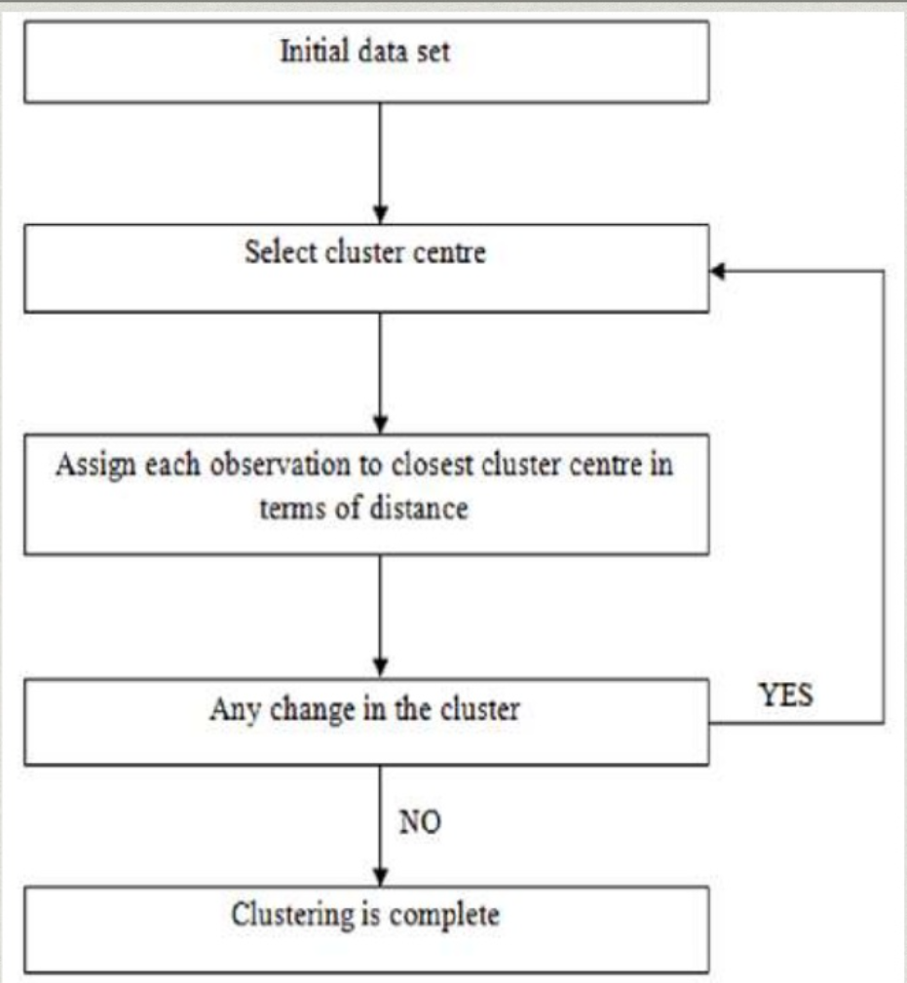
Flowchart

Slide 9
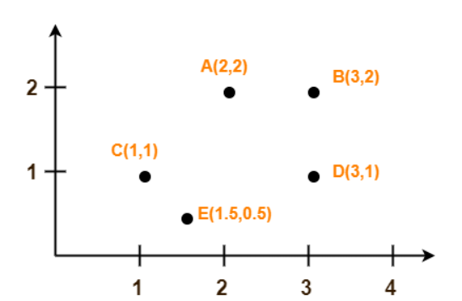
Example
Use K-Means Algorithm to create two clusters-
Solution-
We follow the above discussed K-Means Clustering Algorithm.
Assume A(2, 2) and C(1, 1) are centers of the two clusters.

Slide 10
Iteration-01:
We calculate the distance of each point from each of the center of the two clusters.
The distance is calculated by using the Euclidean distance formula.
The following illustration shows the calculation of distance between point A(2, 2) and each of the center of the two clusters-
Calculating Distance Between A(2, 2) and C1(2, 2)-
Ρ(A, C1)
= sqrt [ (x2 – x1)² + (y2 – y1)² ]
= sqrt [ (2 – 2)² + (2 – 2)² ]
= sqrt [ 0 + 0 ]
= 0
Calculating Distance Between A(2, 2) and C2(1, 1)-
Ρ(A, C2)
= sqrt [ (x2 – x1)² + (y2 – y1)² ]
= sqrt [ (1 – 2)² + (1 – 2)² ]
= sqrt [ 1 + 1 ]
= sqrt [ 2 ]
= 1.41

Slide 11
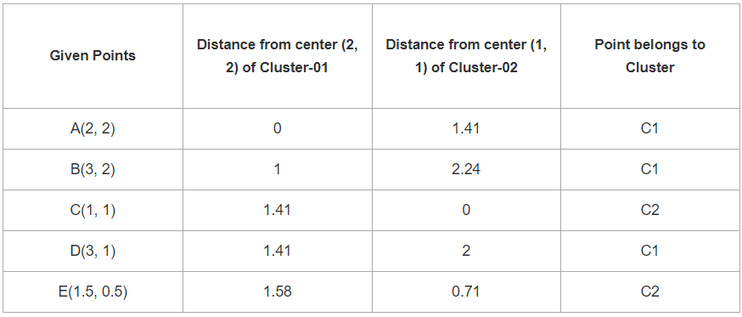
In the similar manner, we calculate the distance of other points from each of the center of the two clusters.
From here, New clusters are-
Cluster-01:
First cluster contains points-A(2, 2), B(3, 2), D(3, 1)
Cluster-02:
Second cluster contains points-C(1, 1), E(1.5, 0.5)

Slide 12
Now,
We re-compute the new cluster centers.
The new cluster center is computed by taking mean of all the points contained in that cluster.
For Cluster-01:
Center of Cluster-01
= ((2 + 3 + 3)/3, (2 + 2 + 1)/3)
= (2.67, 1.67)
For Cluster-02:
Center of Cluster-02
= ((1 + 1.5)/2, (1 + 0.5)/2)
= (1.25, 0.75)
This is completion of Iteration-01.
Next,
we go to iteration-02, iteration-03 and so on until the centers do not change anymore.
Notes:
n

Slide 13
Iteration-02:
Given points | Distance from cluster(2.67,1.67) of data points | Distance from cluster(1.25,0.75) of data points | Points belongs to cluster
A(2,2) | 0.73 | 1.45 | C1
B(3,2) | 0.44 | 2.14 | C1
C(1,1) | 1.79 | 0.34 | C2
D(3,1) | 0.54 | 1.76 | C1
E(1.5,0.5) | 1.45 | 0.34 | C2
From here, New clusters are-
Cluster-01:
First cluster contains points-A(2, 2), B(3, 2), D(3, 1)
Cluster-02:
Second cluster contains points-C(1, 1), E(1.5, 0.5)
Here,
Cluster elements are same as in the previous iteration then stop the process.

Slide 14
K-means Advantages
Relatively simple to implement.
Scales to large data sets.
Guarantees convergence.
Easily adapts to new examples.
Generalizes to clusters of different shapes and sizes, such as elliptical clusters.

Slide 15
K-means Disadvantages
It requires to specify the number of clusters (k) in advance.
It can not handle noisy data and outliers.
It is not suitable to identify clusters with non-convex shapes.

Slide 16
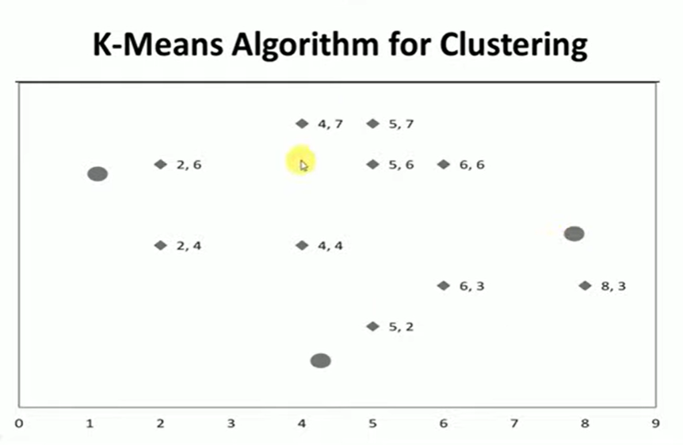
Exercise Problem

Slide 17
Challenges in KMEANS
Number of clusters are normally not known a priori.
For clustering algorithms, such as K-means, different initial centers may lead to different clustering results, moreover K is unknown.
Time complexity - parititional clustering algorithms are O(N) whereas hierarchical are O(N2).
The similarity criteria is not clear - should we use Euclidean or Manhattan or Hamming?
In hierarchical clustering, at what stage should we stop?
Evaluating clustering results are difficult because labels are not available at the beginning.

Slide 18
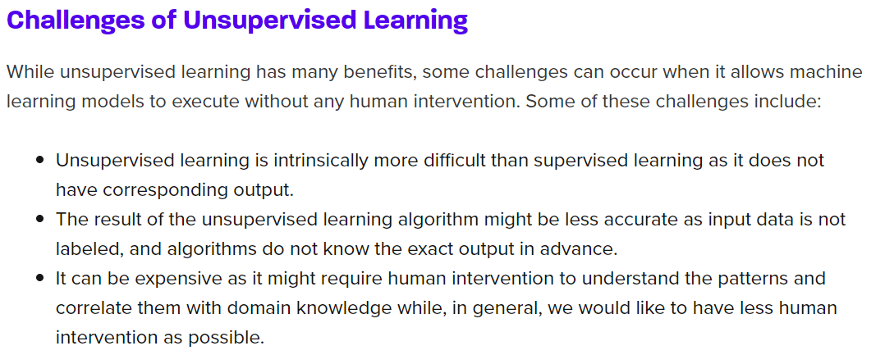

Slide 19
Hierarchical clustering
The hierarchical clustering methods are used to group the data into hierarchy or tree-like structure.
For example, in a machine learning problem of organizing employees of a university in different departments, first the employees are grouped under the different departments in the university, and then within each department, the employees can be grouped according to their roles such as professors, assistant professors, supervisors, lab assistants, etc. This creates a hierarchical structure of the employee data and eases visualization and analysis.

Slide 20
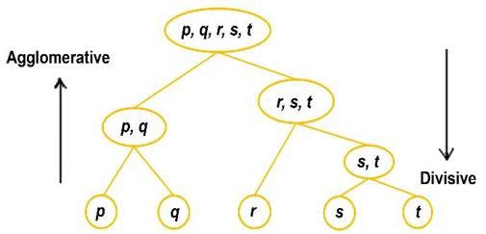
Types of Hierarchal Clustering
There are two types of hierarchal clustering:
Agglomerative clustering
Divisive Clustering

Slide 21
Types of Hierarchal Clustering
Agglomerative Clustering is a type of hierarchical clustering algorithm. It is an unsupervised machine learning technique that divides the population into several clusters such that data points in the same cluster are more similar and data points in different clusters are dissimilar.
Points in the same cluster are closer to each other.
Points in the different clusters are far apart.
On the other hand, the divisive method starts with one cluster with all given objects and then splits it iteratively to form smaller clusters

Slide 22
The agglomerative hierarchical clustering method uses the bottom-up strategy. It starts with each object forming its own cluster and then iteratively merges the clusters 2 according to their similarity to form larger clusters. It terminates either when a certain clustering condition imposed by the user is achieved or all the clusters merge into a single cluster.

Slide 23
Some pros and cons of Hierarchical Clustering
Pros
No assumption of a particular number of clusters (i.e. k-means)
May correspond to meaningful taxonomies
Cons
Once a decision is made to combine two clusters, it can’t be undone
Too slow for large data sets, O(𝑛2 log(𝑛))

Slide 24
Agglomerative Clustering: It uses a bottom-up approach. It starts with each object forming its own cluster and then iteratively merges the clusters according to their similarity to form large clusters. It terminates either
When certain clustering condition imposed by user is achieved or
All clusters merge into a single cluster

Slide 25
variants of Agglomerative methods:
1. Agglomerative Algorithm: Single Link
Single-nearest distance or single linkage is the agglomerative method that uses the distance between the closest members of the two clusters.
Question. Find the clusters using a single link technique. Use Euclidean distance and draw the dendrogram.

Slide 26
Sample No. | X | Y
P1 | 0.40 | 0.53
P2 | 0.22 | 0.38
P3 | 0.35 | 0.32
P4 | 0.26 | 0.19
P5 | 0.08 | 0.41
P6 | 0.45 | 0.30

Slide 27
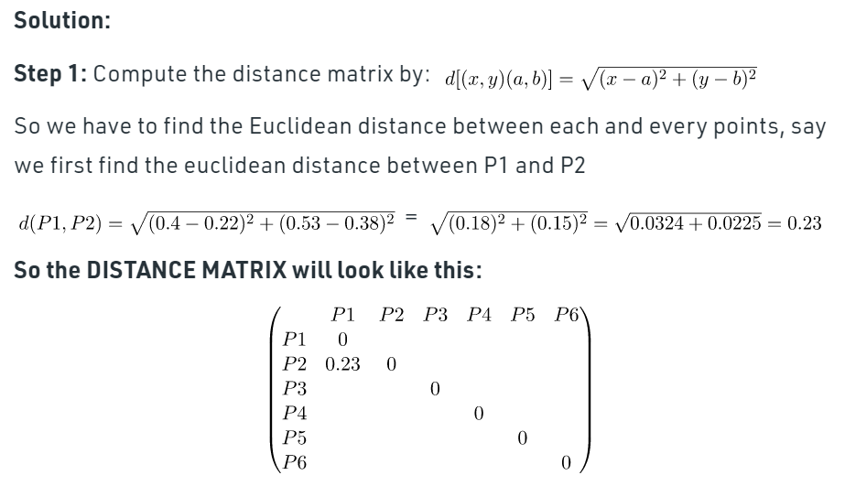

Slide 28
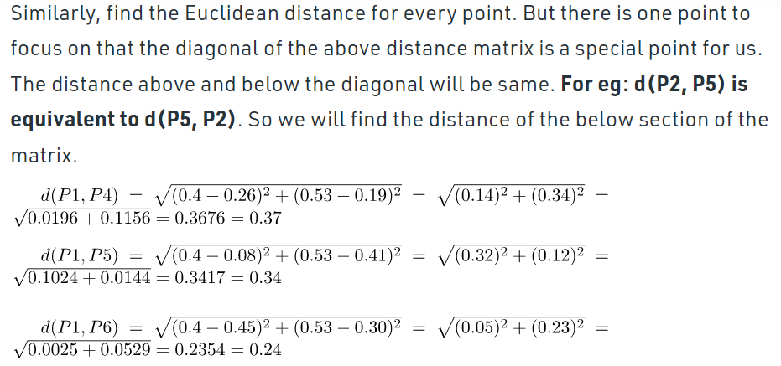

Slide 29
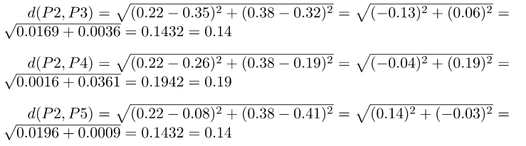

Slide 30
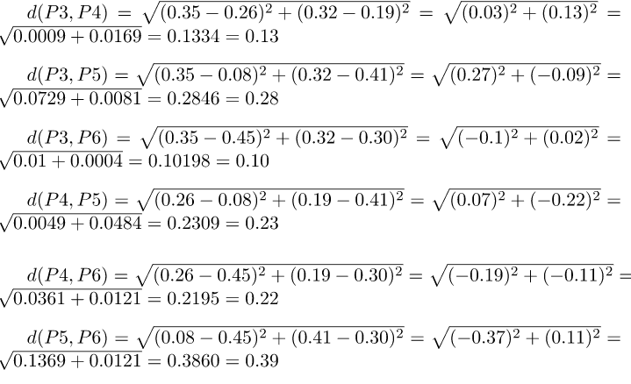

Slide 31
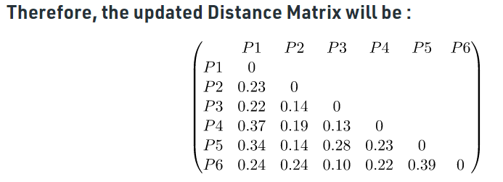
Step 2: Merging the two closest members of the two clusters and finding the minimum element in distance matrix. Here the minimum value is 0.10 and hence we combine P3 and P6 (as 0.10 came in the P6 row and P3 column).

Slide 32
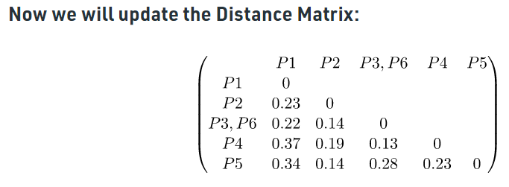
Now, form clusters of elements corresponding to the minimum value and update the distance matrix. To update the distance matrix:
min ((P3,P6), P1) = min ((P3,P1), (P6,P1)) = min (0.22,0.24) = 0.22
min ((P3,P6), P2) = min ((P3,P2), (P6,P2)) = min (0.14,0.24) = 0.14
min ((P3,P6), P4) = min ((P3,P4), (P6,P4)) = min (0.13,0.22) = 0.13
min ((P3,P6), P5) = min ((P3,P5), (P6,P5)) = min (0.28,0.39) = 0.28

Slide 33
Now we will repeat the same process. Merge two closest members of the two clusters and find the minimum element in distance matrix. The minimum value is 0.13 and hence we combine P3, P6 and P4. Now, form the clusters of elements corresponding to the minimum values and update the Distance matrix. In order to find, what we have to update in distance matrix,
min (((P3,P6) P4), P1) = min (((P3,P6), P1), (P4,P1)) = min (0.22,0.37) = 0.22
min (((P3,P6), P4), P2) = min (((P3,P6), P2), (P4,P2)) = min (0.14,0.19) = 0.14
min (((P3,P6), P4), P5) = min (((P3,P6), P5), (P4,P5)) = min (0.28,0.23) = 0.23

Slide 34
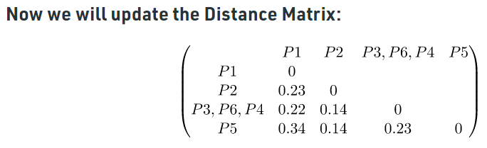
Again repeating the same process: The minimum value is 0.14 and hence we combine P2 and P5. Now, form cluster of elements corresponding to minimum value and update the distance matrix. To update the distance matrix:
min ((P2,P5), P1) = min ((P2,P1), (P5,P1)) = min (0.23, 0.34) = 0.23
min ((P2,P5), (P3,P6,P4)) = min ((P3,P6,P4), (P3,P6,P4))
= min (0.14. 0.23) = 0.14

Slide 35
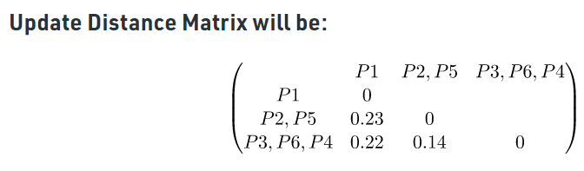
Again repeating the same process: The minimum value is 0.14 and hence we combine P2,P5 and P3,P6,P4. Now, form cluster of elements corresponding to minimum value and update the distance matrix. To update the distance matrix:
min ((P2,P5,P3,P6,P4), P1) = min ((P2,P5), P1), ((P3,P6,P4), P1))
= min (0.23, 0.22) = 0.22

Slide 36
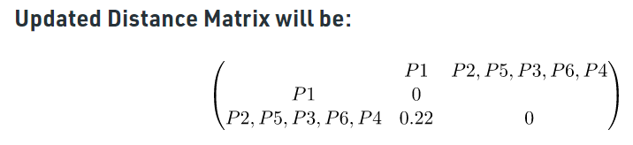
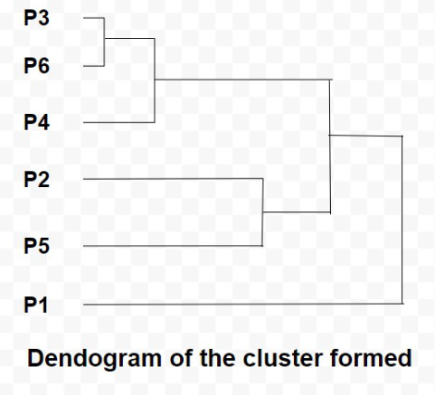
So now we have reached to the solution finally, the dendrogram for those question will be as follows:

Slide 37
DBSCAN Clustering
There are different approaches and algorithms to perform clustering tasks which can be divided into three sub-categories:
Partition-based clustering: E.g. k-means, k-median
Hierarchical clustering: E.g. Agglomerative, Divisive
Density-based clustering: E.g. DBSCAN

Slide 38
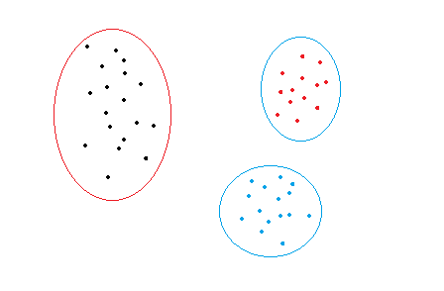
Density-based clustering
Partition-based and hierarchical clustering techniques are highly efficient with normal shaped clusters. However, when it comes to arbitrary shaped clusters or detecting outliers, density-based techniques are more efficient.
For example, the dataset in the figure below can easily be divided into three clusters using k-means algorithm.
k-means clustering

Slide 39
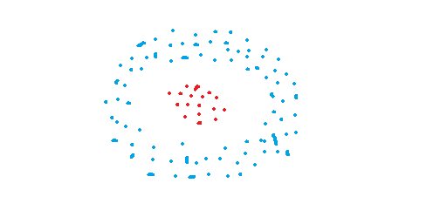
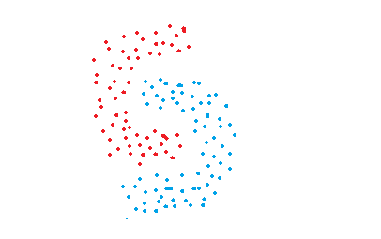
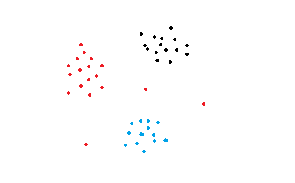
Consider the following figures:
The data points in these figures are grouped in arbitrary shapes or include outliers. Density-based clustering algorithms are very efficient at finding high-density regions and outliers. It is very important to detect outliers for some task, e.g. anomaly detection.

Slide 40
DBSCAN Algorithm
DBSCAN stands for Density-Based Spatial Clustering of Applications with Noise. It is able to find arbitrary shaped clusters and clusters with noise (i.e. outliers).
In DBSCAN, instead of guessing the number of clusters, will define two hyper parameters: epsilon and minPoints to arrive at clusters.
Epsilon (ε): The distance that specifies the neighborhoods. Two points are considered to be neighbors if the distance between them are less than or equal to epsilon
minPoints(n): Minimum number of data points to define a cluster.

Slide 41
DBSCAN Algorithm
Based on Epsilon (ε) and minPoints(n) parameters, points are classified as core, border, and outlier or noise points:
Core point: A point is a core point if there are at least minPoints number of points (including the point itself) in its surrounding area with radius epsilon.
Border point: A point is a border point if it is reachable from a core point and there are less than minPoints number of points within its surrounding area.
Outlier or Noise point: A point is an outlier if it is not a core point and not reachable from any core points.

Slide 42
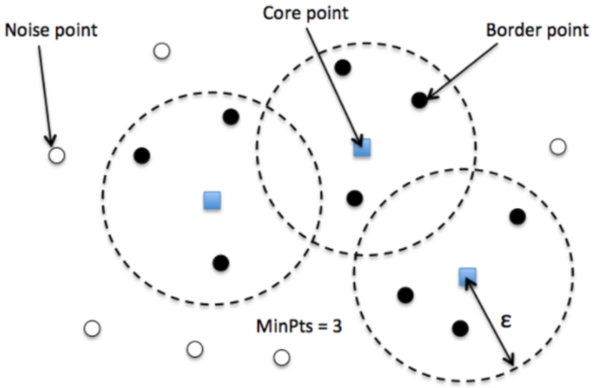
DBSCAN Algorithm
These points may be better explained with visualizations.

Slide 43
Density connected
Three terms are necessary to understand in order to understand DBSCAN:
Direct density reachable: A point is called direct density reachable if it has a core point in its neighbourhood.
Density Connected: Two points are called density connected if there is a core point which is density reachable from both the points.
Density Reachable: A point is called density reachable from another point if they are connected through a series of core points.

Slide 44
Evaluation Metrics of DBSCAN
We will use the Silhouette score and Adjusted rand score for evaluating clustering algorithms.
Silhouette score is in the range of -1 to 1. A score near 1 denotes the best meaning that the data point i is very compact within the cluster to which it belongs and far away from the other clusters. Values near 0 denote overlapping clusters.
Absolute Rand Score is in the range of 0 to 1. More than 0.9 denotes excellent cluster recovery, above 0.8 is a good recovery. Less than 0.5 is considered to be poor recovery.

Slide 45
DBSCAN
Pros
The DBSCAN is better than other cluster algorithms because it does not require a pre-set number of clusters.
It identifies outliers as noise, unlike the Mean-Shift method that forces such points into the cluster in spite of having different characteristics.
It finds arbitrarily shaped and sized clusters quite well.
Cons
It is not very effective when you have clusters of varying densities.
If you have high dimensional data, the determining of the distance threshold Ɛ becomes a challenging task.

Slide 46
DBSCAN Algorithm
Step1: Label Core point and Noise point
Select a random starting point, say x
Identify neighborhood of point x using the radius ε
Count the number of points, say k, in this neighborhood including point x
If k>=Minpts of points then mark x as a core point else mark x as noise point
Select a new unvisited point and repeat the above steps
Step2: Check if noise point can become boundary point
If noise point is directly density reachable (That is within the boundary of radius ε from the core point), mark it as boundary and it will form the part of the cluster
A point which is neither core point nor boundary point is marked as noise point

Slide 47
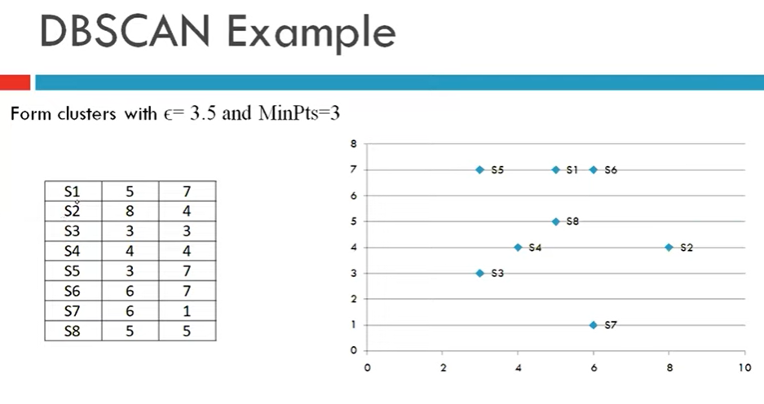

Slide 48
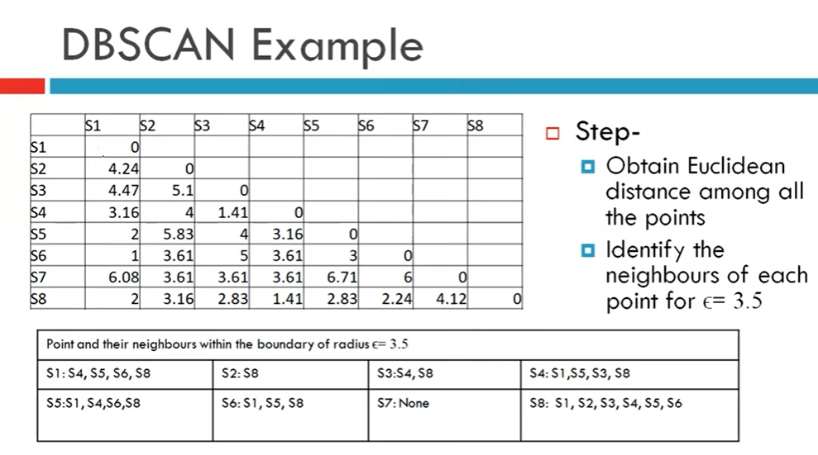

Slide 49
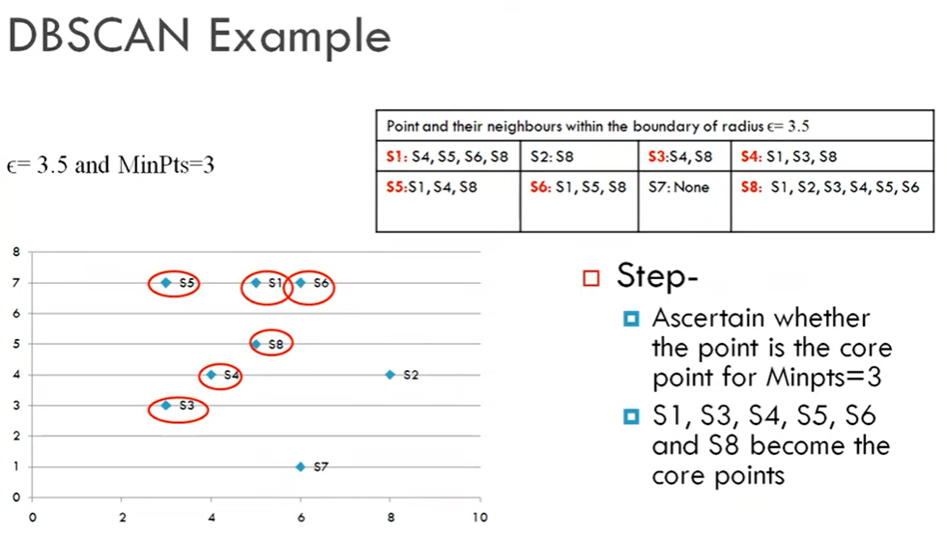

Slide 50
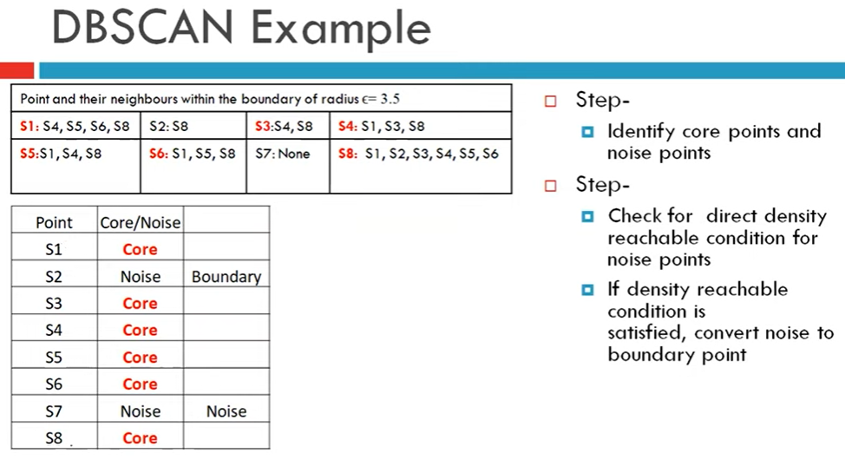

Slide 51
Thank you

