Slide 1


Data Interfaces in R
Tushar B. Kute,
http://tusharkute.com

Slide 2
Data Interfaces
In R, we can read data from files stored outside the R environment.
We can also write data into files which will be stored and accessed by the operating system.
R can read and write into various file formats like csv, excel, xml etc.

Slide 3
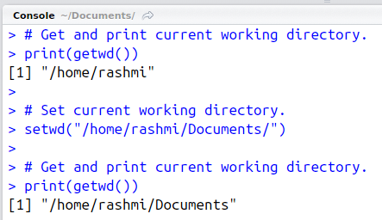
Getting and setting working directory
You can check which directory the R workspace is pointing to using the getwd() function.
You can also set a new working directory using setwd()function.

Slide 4
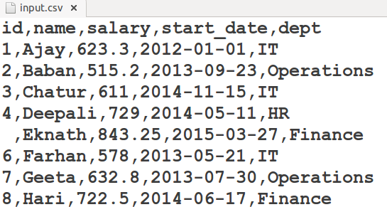
Input as CSV file
The csv file is a text file in which the values in the columns are separated by a comma. Let's consider the following data present in the file named input.csv.
You can create this file using windows notepad or Ubuntu gedit by copying and pasting this data. Save the file as input.csv using the save As All files(*.*) option in notepad/gedit.
•

Slide 5
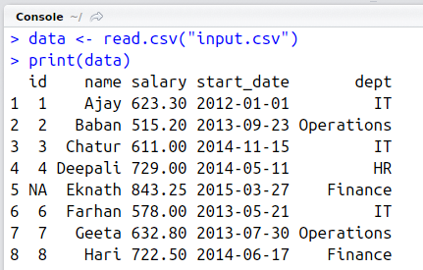
Reading a CSV file

Slide 6
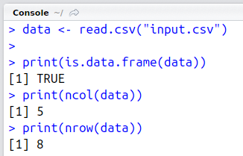
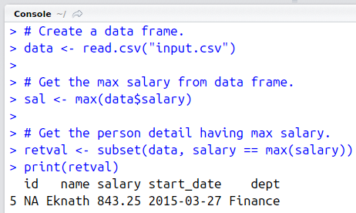
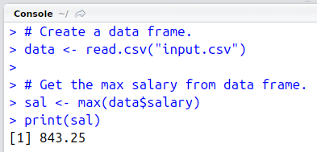
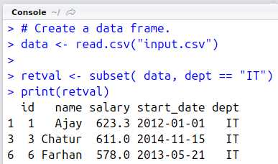
Analysing a CSV file

Slide 7
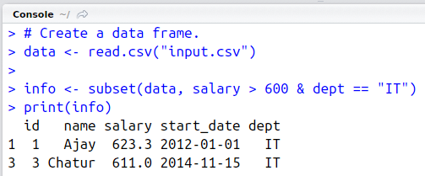
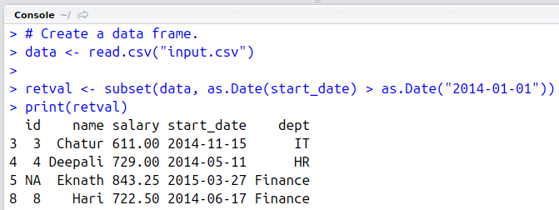
Analysing a CSV file

Slide 8
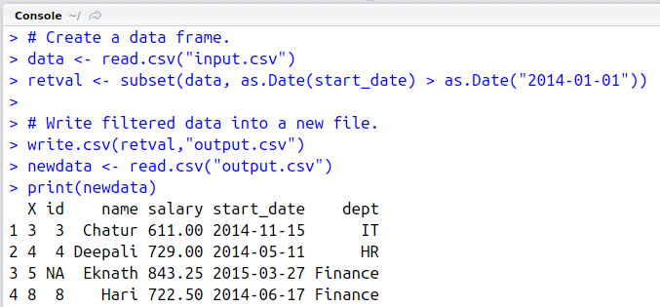
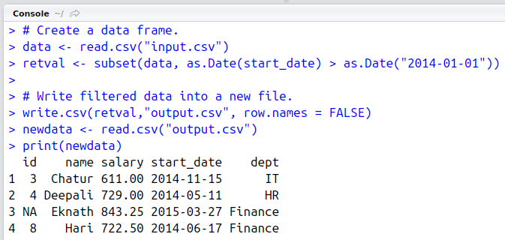
Writing into a CSV file

Slide 9
XLSX file
Microsoft Excel is the most widely used spreadsheet program which stores data in the
.xls or .xlsx format.
R can read directly from these files using some excel specific packages.
Few such packages are - XLConnect, xlsx, gdata etc.
We will be using xlsx package. R can also write into excel file using this package.

Slide 10
XLSX package installation
You can use the following command in the R console to install the "xlsx" package.
It may ask to install some additional packages on which this package is dependent.
Follow the same command with required package name to install the additional packages.
install.packages("xlsx")

Slide 11
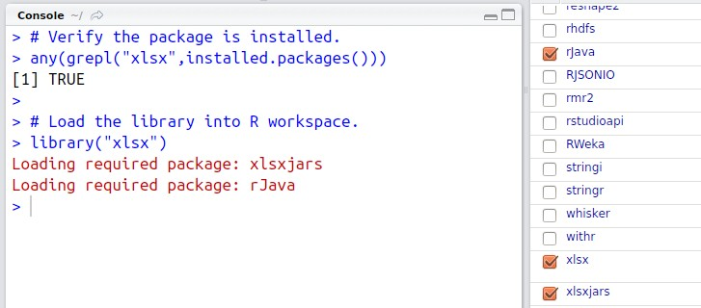
Verify installation

Slide 12
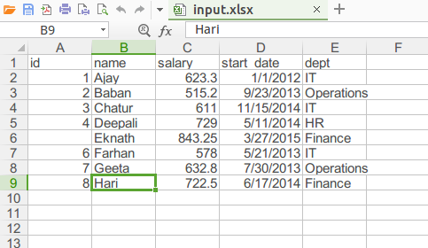
Create an xlsx file

Slide 13
Reading xlsx file
The input.xlsx is read by using the read.xlsx() function as shown below. The result is stored as a data frame in the R environment.
# Read the first worksheet in the file input.xlsx. data <- read.xlsx("input.xlsx", sheetIndex = 1) print(data)

Slide 14
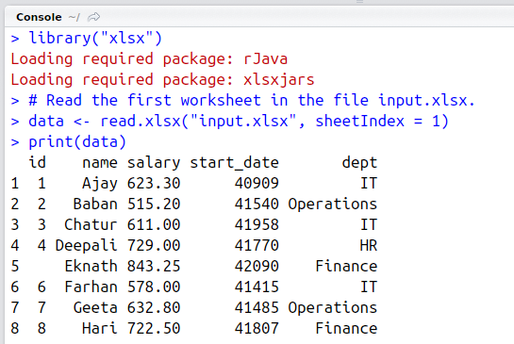
Reading xlsx file

Slide 15
The XML file
XML is a file format which shares both the file format and the data on the World Wide Web, intranets, and elsewhere using standard ASCII text.
It stands for Extensible Markup Language (XML). Similar to HTML it contains markup tags. But unlike HTML where the markup tag describes structure of the page, in xml the markup tags describe the meaning of the data contained into the file.
You can read a xml file in R using the "XML" package. This package can be installed using following command.
install.packages("XML")

Slide 16
Input data
Create a XMl file by copying the below data into a text editor. Save the file with a .xml extension and choosing the file type as all files(*.*).
<RECORDS>
<EMPLOYEE>
<ID>1</ID>
<NAME>Param</NAME>
<SALARY>623.3</SALARY>
<STARTDATE>1/1/2012</STARTDATE>
<DEPT>IT</DEPT>
</EMPLOYEE> …….

Slide 17
Reading XML file
The xml file is read by R using the function xmlParse(). It is stored as a list in R.
# Load the package required to read XML files. library("XML")
# Also load the other required package. library("methods")
# Give the input file name to the function. result <- xmlParse(file = "input.xml")
# Print the result. print(result)

Slide 18
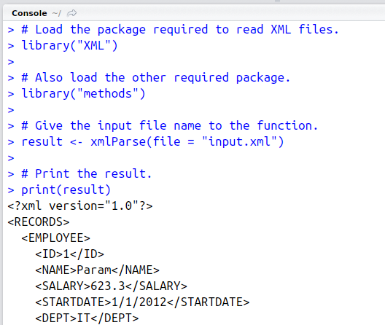
Reading XML file

Slide 19
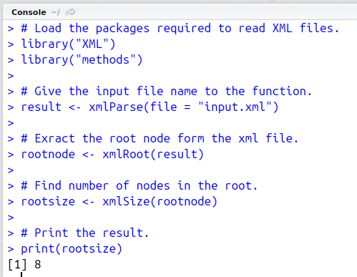
Get number of nodes

Slide 20
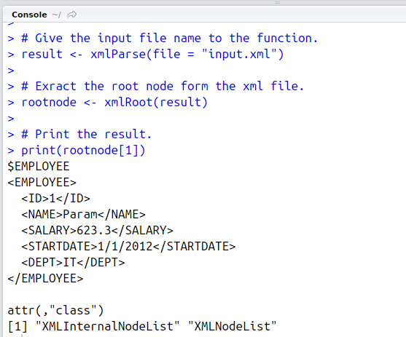
Get details of first node

Slide 21
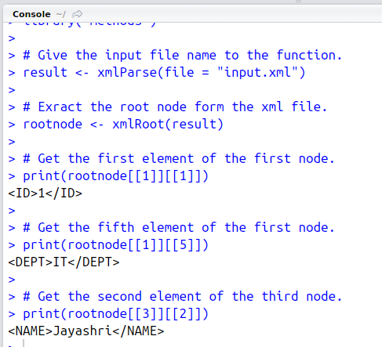
Get different elements of the node

Slide 22
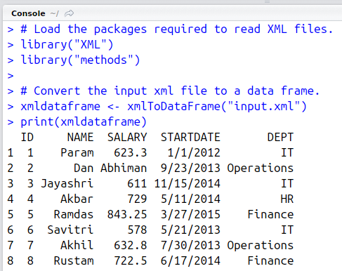
XML to data frame
•
# Load the packages required to read XML files.
library("XML") library("methods")
# Convert the input xml file to a data frame.
xmldataframe <- xmlToDataFrame("input.xml") print(xmldataframe)

Slide 23
Web data
Many websites provide data for consumption by its users.
For example the World Health Organization(WHO) provides reports on health and medical information in the form of CSV, txt and XML files.
Using R programs, we can programmatically extract specific data from such websites.
Some packages in R which are used to scrap data from the web are − "Rcurl", “XML", and "stringr".
They are used to connect to the URL’s, identify required links for the files and download them to the local environment.

Slide 24
Install and input
Install R Packages
The following packages are required for processing the URL’s and links to the files. If they are not available in your R Environment, you can install them using following commands.
install.packages("RCurl") install.packages("XML") install.packages("stringr") install.packages("plyr")
Input Data
We will visit the URL <http://www.geos.ed.ac.uk/~weather/jcmb_ws/> weather data and download the CSV files using R for the year 2015.

Slide 25
Example:
We will use the function getHTMLLinks() to gather the URLs of the files.
Then we will use the function download.file() to save the files to the local system.
As we will be applying the same code again and again for multiple files, we will create a function to be called multiple times.
The filenames are passed as parameters in form of a R list object to this function.

Slide 26
Example:
# Read the URL.
url <- "http://www.geos.ed.ac.uk/~weather/jcmb_ws/"
# Gather the html links present in the webpage. links <- getHTMLLinks(url)
# Identify only the links which point to the JCMB 2015 files. filenames <- links[str_detect(links, "JCMB_2015")]
# Store the file names as a list. filenames_list <- as.list(filenames)
# Create a function to download the files by passing the URL and filename list. downloadcsv <- function (mainurl,filename) {
filedetails <- str_c(mainurl,filename) download.file(filedetails,filename)
}
# Now apply the l_ply function and save the files into the current R working directory.
l_ply(filenames,downloadcsv,mainurl = "http://www.geos.ed.ac.uk/~weather/jcmb_ws/")

Slide 27
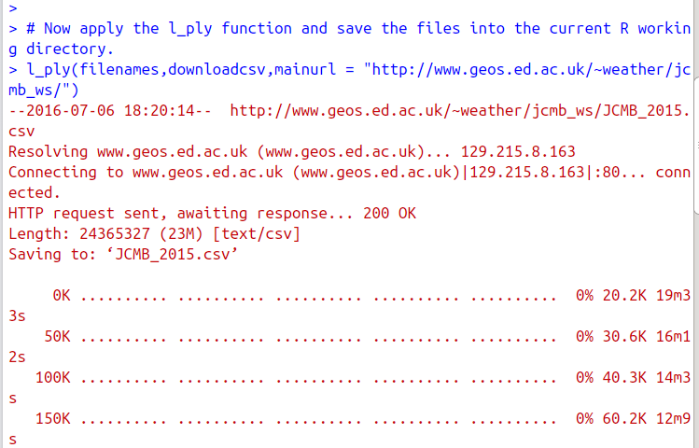
Web data download

Slide 28
Verify file download
After running the above code, you can locate the following files in the current R working directory.
– "JCMB_2015.csv"
"JCMB_2015_Apr.csv"
"JCMB_2015_Feb.csv"
"JCMB_2015_Jan.csv"
"JCMB_2015_Mar.csv"

Slide 29
Connecting to MySQL
The data is Relational database systems are stored in a normalized format.
So, to carry out statistical computing we will need very advanced and complex Sql queries.
But R can connect easily to many relational databases like MySql, Oracle, Sql server etc. and fetch records from them as a data frame.
Once the data is available in the R environment, it becomes a normal R data set and can be manipulated or analyzed using all the powerful packages and functions.

Slide 30
The RMySQL package
R has a built-in package named "RMySQL" which provides native connectivity between with MySql database.
You can install this package in the R environment using the following command.
install.packages("RMySQL")

Slide 31
Connecting R to MySQL
Once the package is installed we create a connection object in R to connect to the database.
It takes the username, password, database name and host name as input.
# Create a connection Object to MySQL database.
# We will connect to the sample database named "testdb" that comes with MySql installation.
mysqlconnection = dbConnect(MySQL(), user = 'root', password = 'epsilon', dbname = 'testdb', host= 'localhost')
# List the tables available in this database. dbListTables(mysqlconnection)

Slide 32
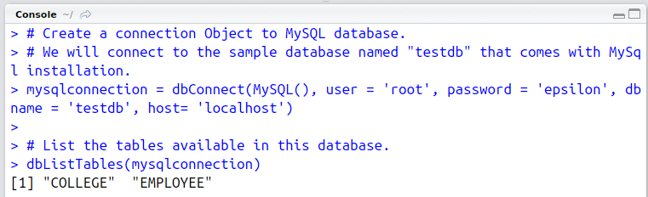
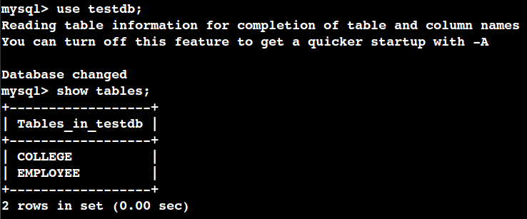
Connecting R to MySQL

Slide 33
Querying the tables
# Query the "college" tables to get all the rows.
result = dbSendQuery(mysqlconnection, "select * from COLLEGE")
# Store the result in a R data frame object. n = 3 is used to fetch first 3 rows.
data.frame = fetch(result, n = 3) print(data.frame)

Slide 34
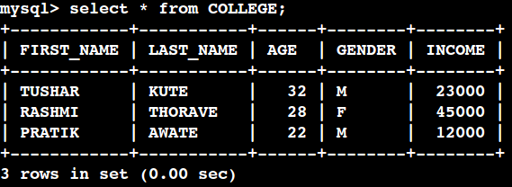
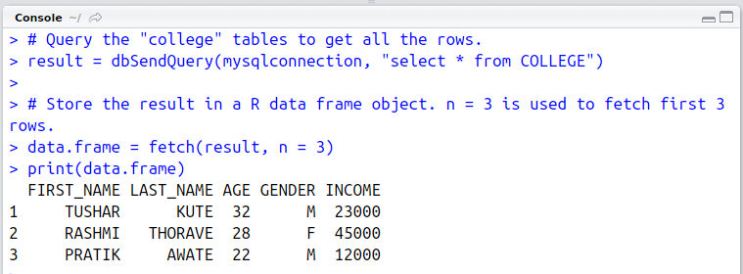
Querying the tables

Slide 35
Querying the filters
result = dbSendQuery(mysqlconnection, "select
* from COLLEGE where INCOME > 20000")
# Fetch all the records(with n = -1) and store it as a data frame.
data.frame = fetch(result, n = -1) print(data.frame)

Slide 36
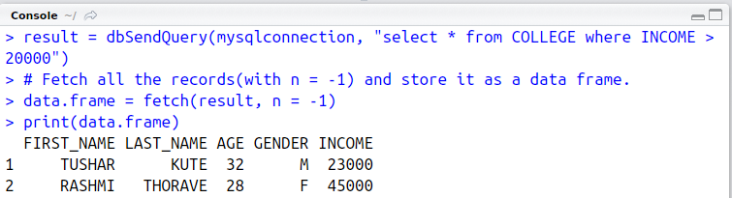
Querying the filters

Slide 37
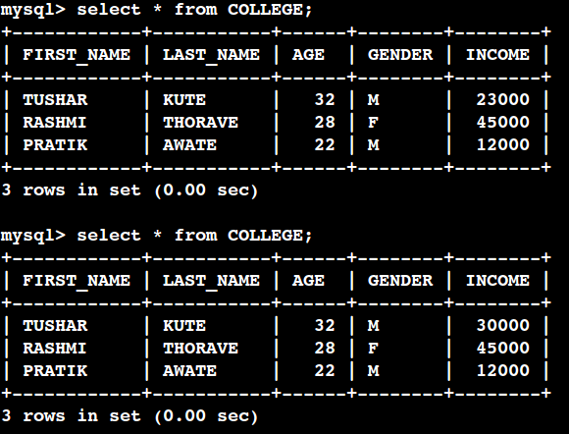
Update

Slide 38
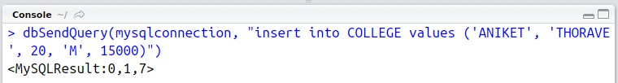
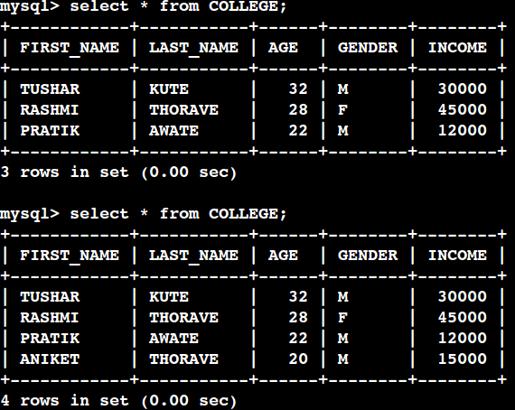
Insert

Slide 39
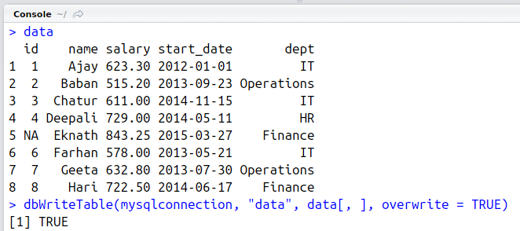
Insert

Slide 40
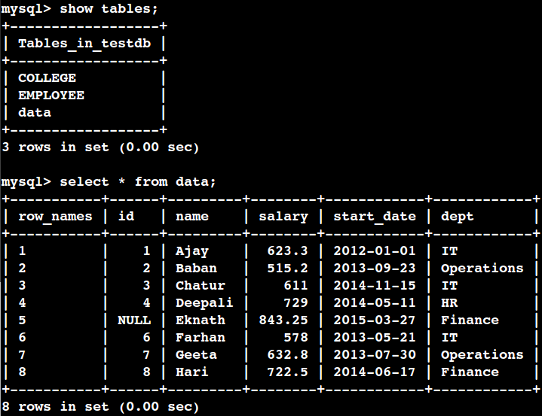
Insert

Slide 41
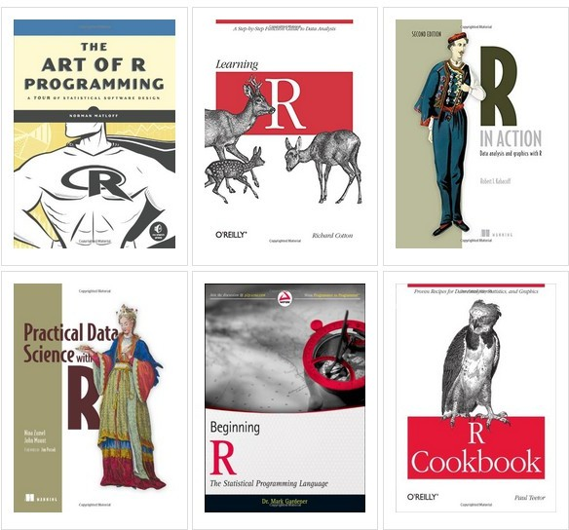
Useful resources

Slide 42
Thank you
This presentation is created using LibreOffice Impress 4.2.8.2, can be used freely as per GNU General Public License
Web Resources http://mitu.co.in http://tusharkute.com
Blogs http://digitallocha.blogspot.in http://kyamputar.blogspot.in
tushar@tusharkute.com

