Slide 1


MindBloom
An AI-Powered Platform for Mental Health & Emotional Well-Being
Presented by:
Sayan Biswas: 25C202A21
Smruti Sanjeebani: 25C219A32
Sharmistha Panda: 25C216A12
Shreeja Sayena: 25C219A34
AI Chat Support · Mood Tracking · Journaling · Peer Stories
Notes:
For Testing

Slide 2

What We'll Cover Today
A structured walkthrough of MindBloom — from the problem we're solving to the technology behind it and where we're headed next.
Problem Statement
Scope of Innovation
Tools & Technologies
Why current mental health tools fall short
What makes MindBloom different
The stack powering MindBloom
Recommendation System
Architecture Diagram
Future Scope
Curated content that surfaces at the right time
How the pieces fit together
Where MindBloom grows next
Conclusion
Key takeaways and vision

Slide 3



Problem Statement
Why current mental health tools fall short
Expensive & Stigmatized
Mental health support is often costly, stigmatized, or difficult to access on demand.
Fragmented Features
Existing apps focus on a single feature — only mood tracking, or only meditation.
No Private Space
Users lack a safe, private space to reflect, express emotions, and get instant help.
No Unified Platform
No single platform combines AI chat support, self-reflection, and peer stories together.

Slide 4





Scope of Innovation
What makes MindBloom different
All-in-One Platform
Real-Time Empathetic AI
Anonymous Storytelling
Combines AI chatbot support, mood tracking, journaling, and community storytelling in one place.
Uses Google Gemini AI for real-time, empathetic conversations through BloomBot.
Enables anonymous story sharing to encourage open expression without fear of judgment.
Curated, Safe Content
Privacy by Design
Admin-managed daily quotes and affirmations ensure curated, safe content — not AI-generated.
Designed with privacy in mind — no permanent chatbot chat history is stored.

Slide 5









Tools & Technologies Used
The full stack powering MindBloom
Frontend
Backend
Database
React.js, Tailwind CSS
Django, Django REST Framework
PostgreSQL
Authentication
AI Engine
Development
JWT Authentication, Google OAuth
Google Gemini 2.5 API
Visual Studio Code
Version Control
Payment Integration
Deployment
Git, GitHub
Razorpay
Vercel

Slide 6

Recommendation System
Curated content that surfaces the right thing at the right time
Daily Quotes & Affirmations
Mood & Reflection Summaries
Community Story Surfacing
Suggests relevant daily quotes and affirmations based on admin-curated content.
Highlights recent mood and reflection summaries on the dashboard for quick self-awareness.
Surfaces community stories to encourage engagement and peer support.
Currently rule/content-based, not a personalized ML-driven recommendation engine — this is planned as a future enhancement.

Slide 7
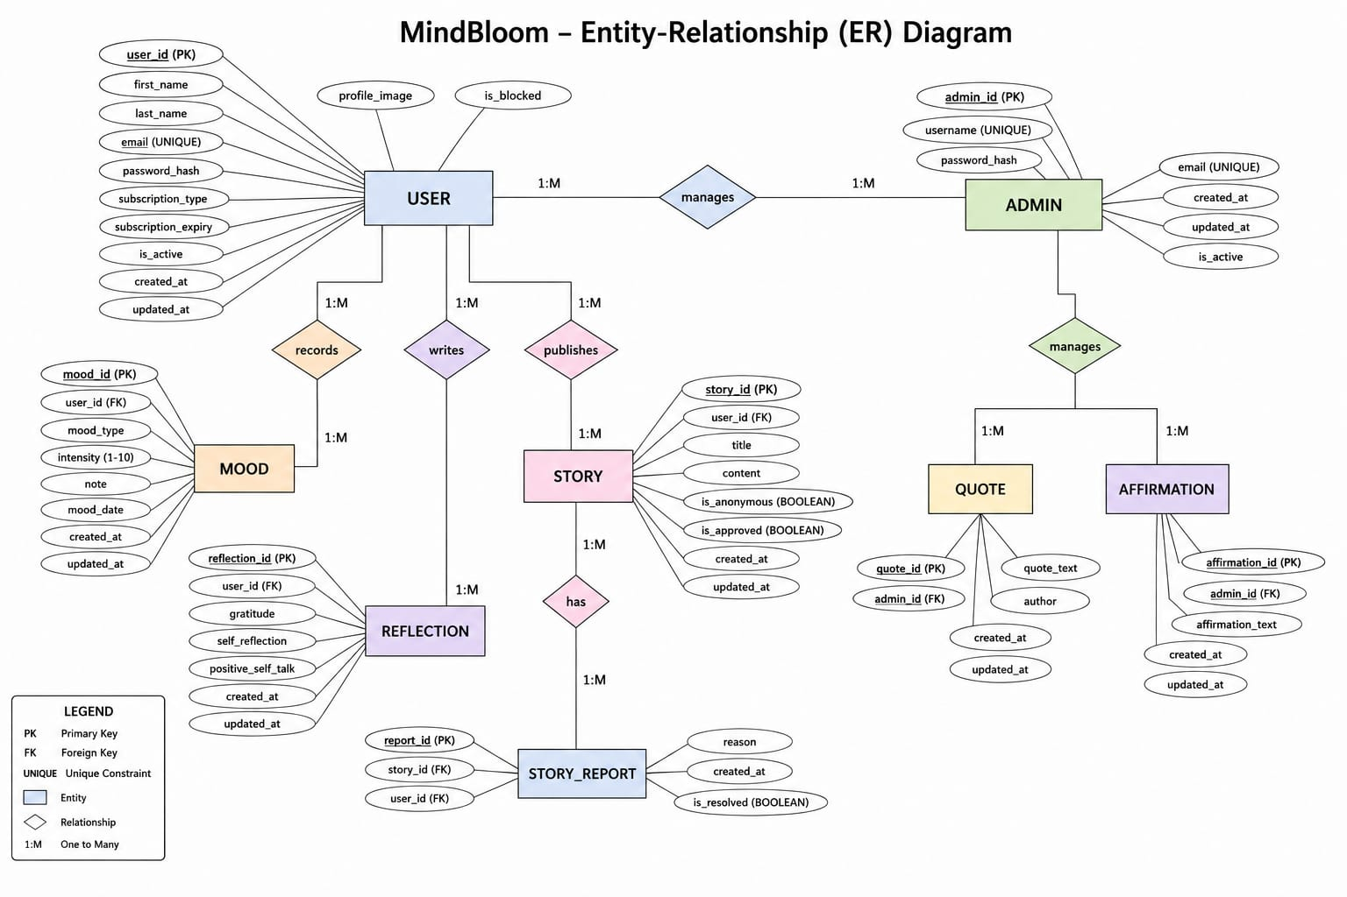
Architecture Diagram
ER Diagram-

Slide 8
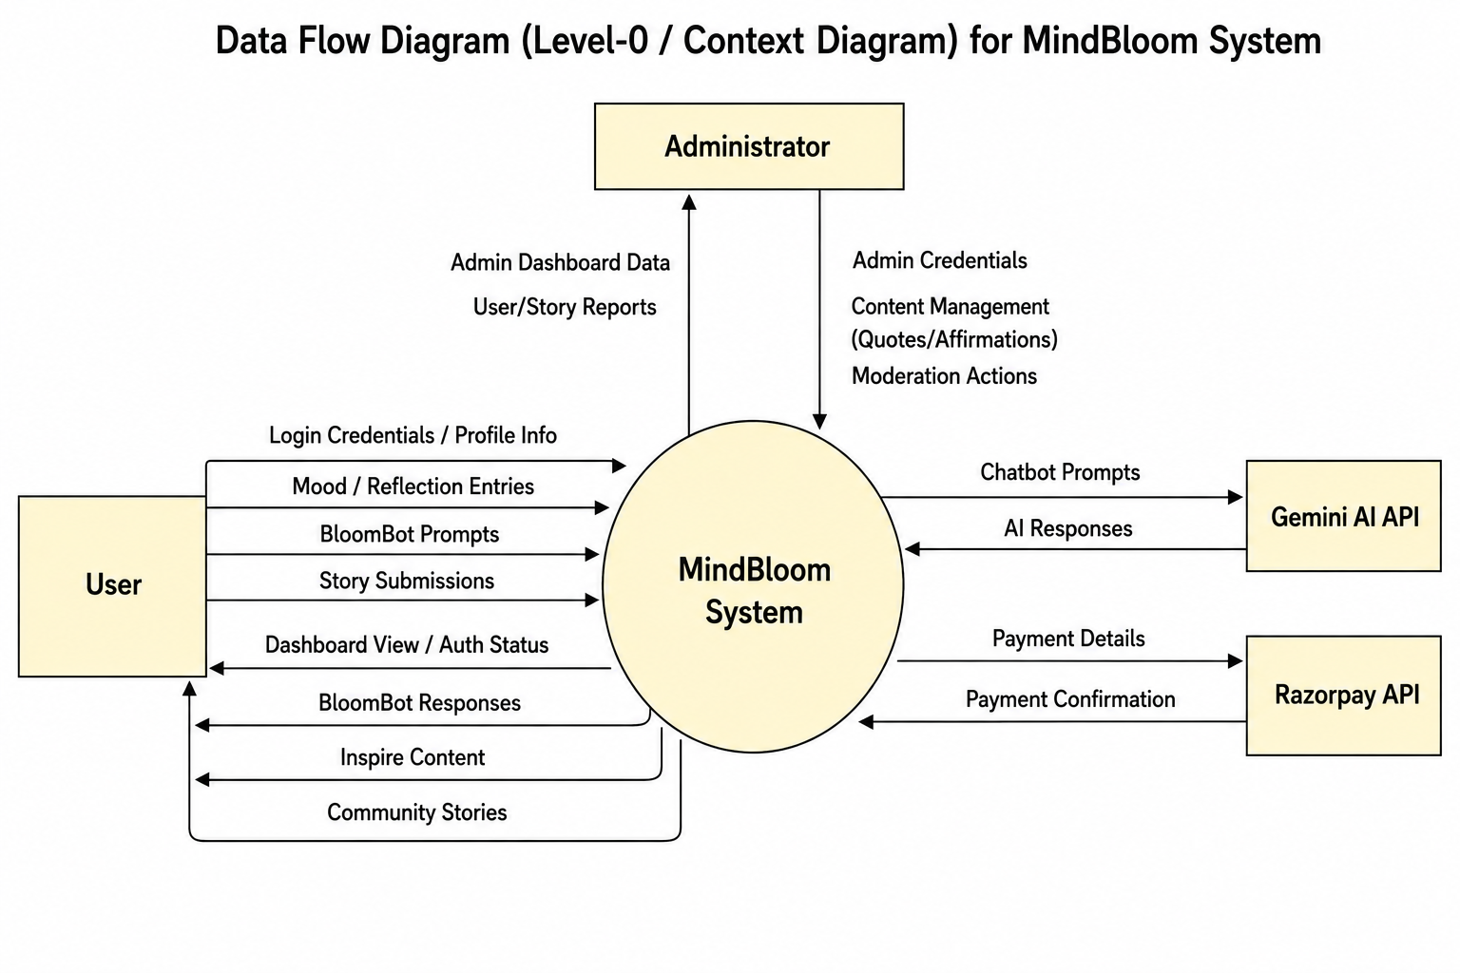
Data Flow Diagram (Level- 0 DFD)

Slide 9
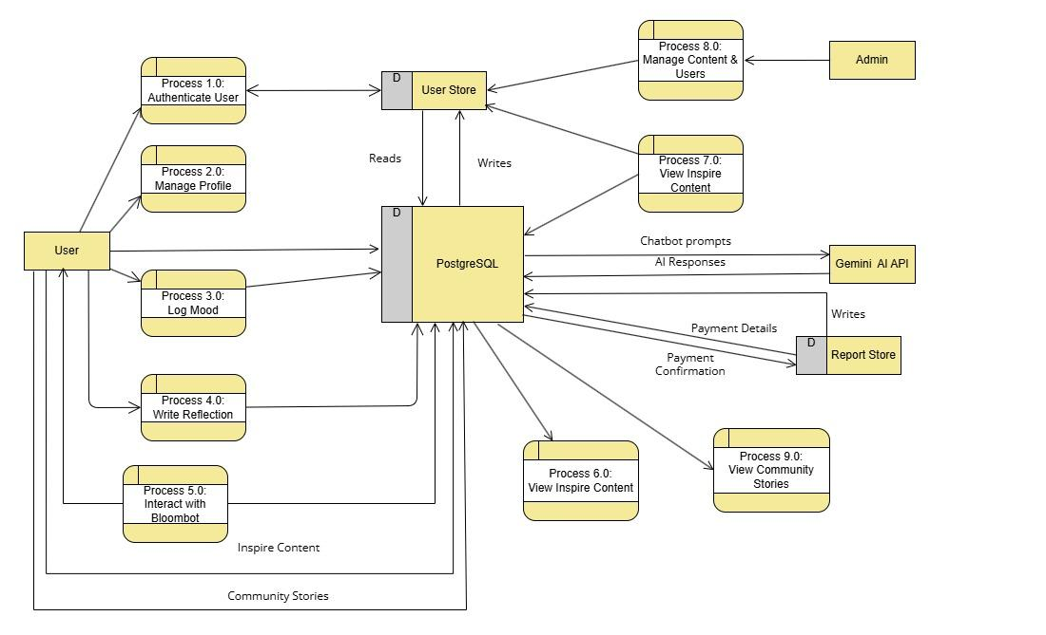
Data Flow Diagram (Level- 1 DFD)

Slide 10






Future Scope
Where MindBloom grows next
Premium Subscriptions
Full Razorpay integration for premium subscription features.
Mobile Apps
Mobile app version (Android/iOS) for wider accessibility.
AI-Personalized Recommendations
ML-driven suggestions mapping moods to reflections, quotes, or coping activities.
Advanced Admin Analytics
Engagement trends and mood pattern insights for admins.
Multi-Language Support
Reach a broader, more diverse user base.
Professional Escalation
Optional integration with professional therapists and counselors for escalation support.

Slide 11

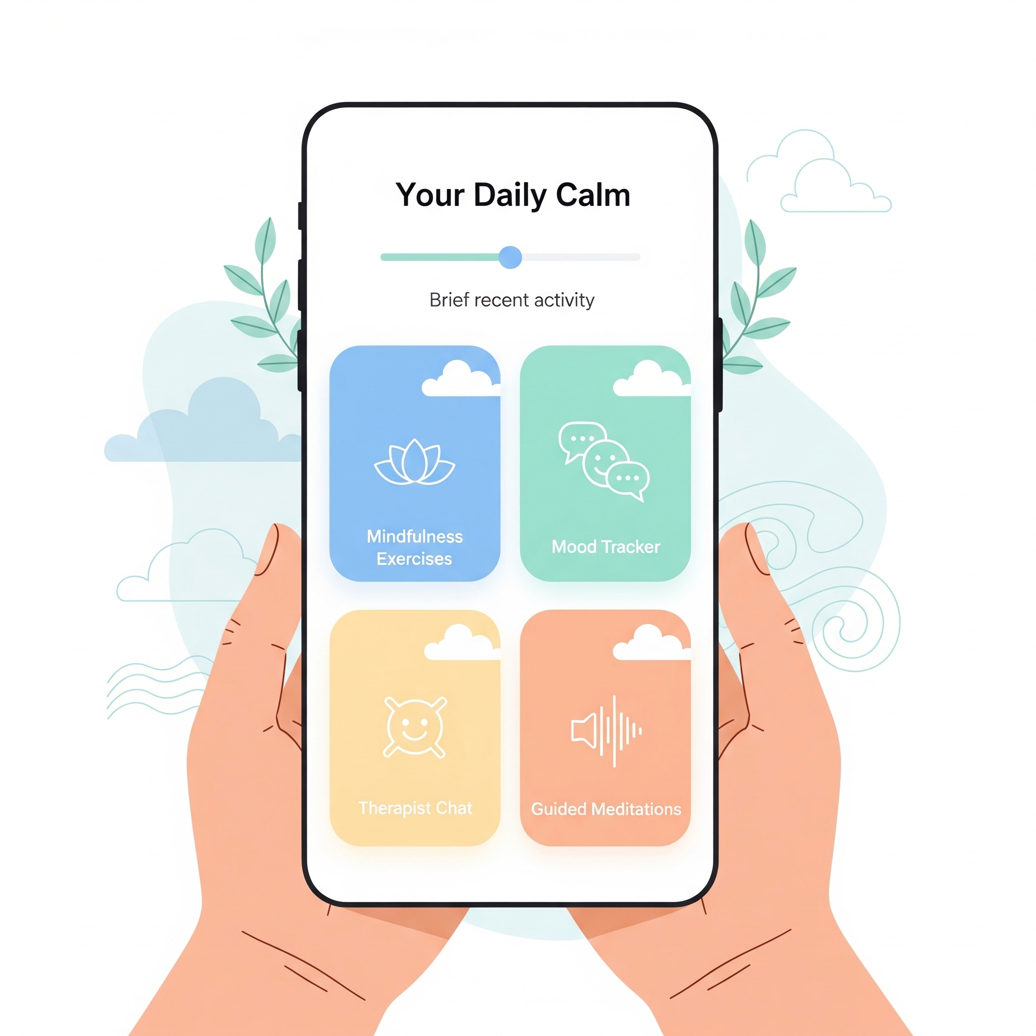
Conclusion
Accessible, Private & Integrated
MindBloom offers an accessible, private, and integrated platform for emotional well-being.
Unified in One System
Combines AI assistance, self-reflection tools, and community support in a single system.
Built to Scale
Built on a scalable tech stack (React, Django, PostgreSQL) suitable for future growth.
A Supportive First Step
A self-help and peer-support tool — a supportive first step, not a replacement for professional therapy.
MindBloom — Emotional care, made accessible.

Slide 12
