Slide 1

Credit card financial Dashboard
Smruti Priyadarsani Swain

Slide 2
Overview
To develop a comprehensive credit card weekly dashboard that
provides real-time insights into key performance metrics and trends,
enabling stakeholders to monitor and analyze credit card operations
effectively.
The Credit Card Financial Dashboard empowers users to take control of their finances by providing them with a holistic view of their credit card activity and financial health. With its intuitive interface and powerful analytical capabilities, users can make informed decisions to achieve their financial goals and secure their financial future

Slide 3
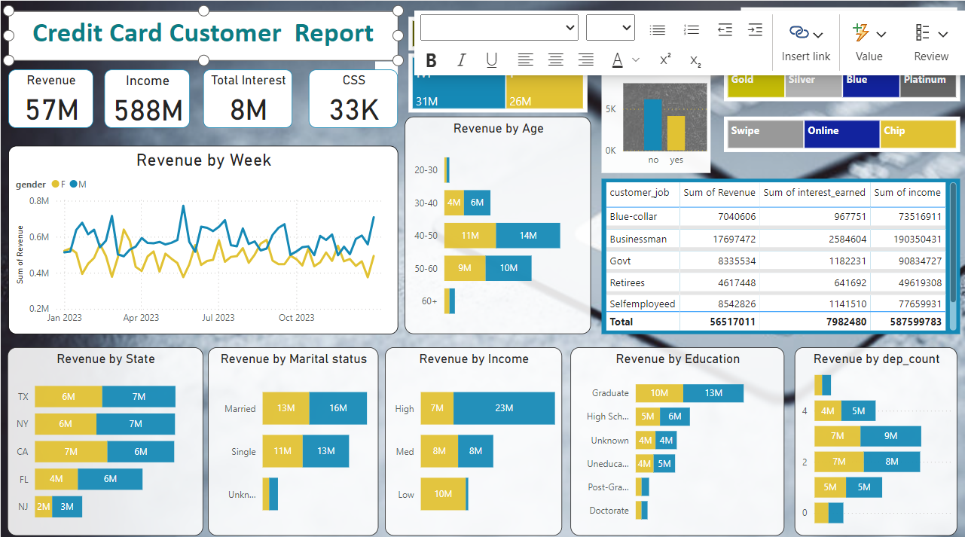

Slide 4
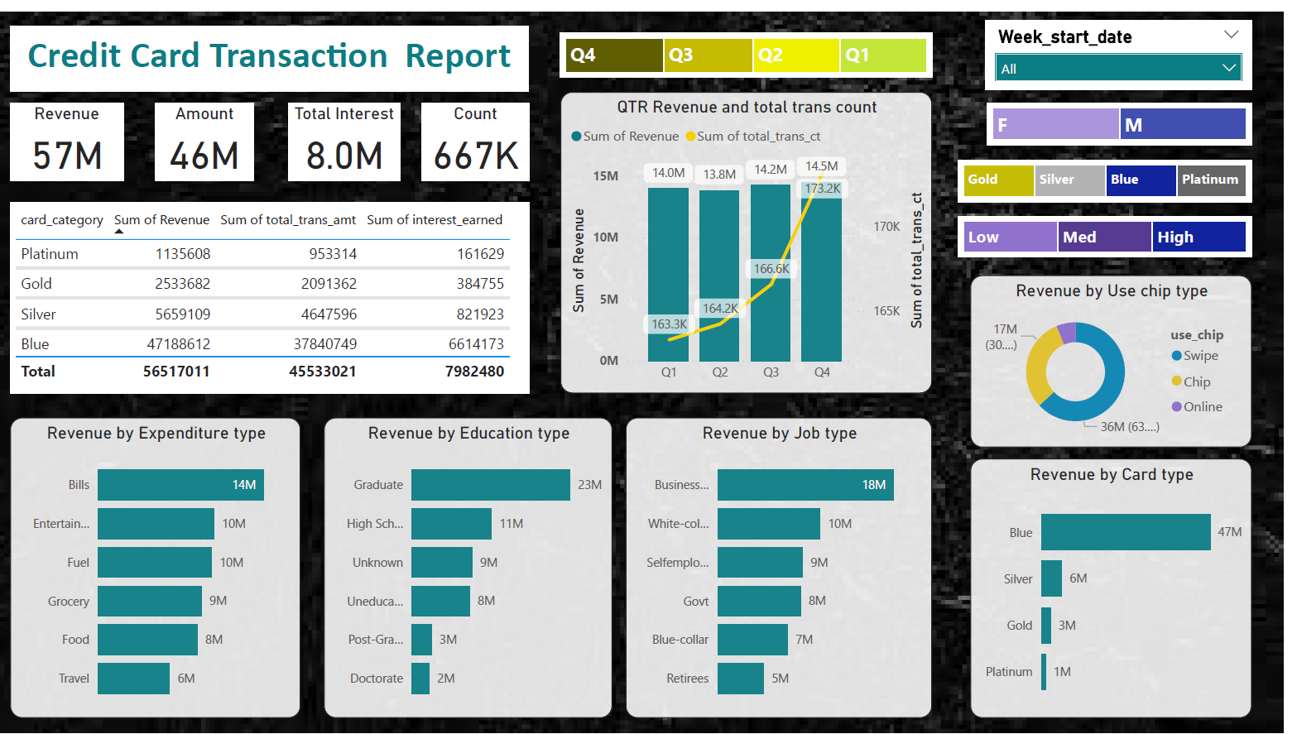

Slide 5
Data collection Methods and Categories
Import data to SQL database
1. Prepare csv file
2. Create tables in SQL
3. import csv file into SQL

Slide 6
Observation
WoW change:
• Revenue increased by 28.8%,
• Total Transaction Amt & Count increased by xx% & xx%
• Customer count increased by xx%
Overview YTD:
• Overall revenue is 57M
• Total interest is 8M
• Total transaction amount is 46M
• Male customers are contributing more in revenue 31M, female 26M
• Blue & Silver credit card are contributing to 93% of overall
transactions
• TX, NY & CA is contributing to 68%
• Overall Activation rate is 57.5%
• Overall Delinquent rate is 6.06%

