Slide 1

Predict Price of Airlines Industry
Smruti Priyadarsani Swain

Slide 2
Overview
Predicting airline industry prices using machine learning involves analyzing vast datasets that include historical ticket prices, fuel costs, demand patterns, economic indicators, and other relevant factors.
Machine learning models, such as regression algorithms, time series analysis, and neural networks, can identify complex patterns and trends to forecast future prices.
These models continuously improve their predictions by learning from new data, making them increasingly accurate over time.

Slide 3
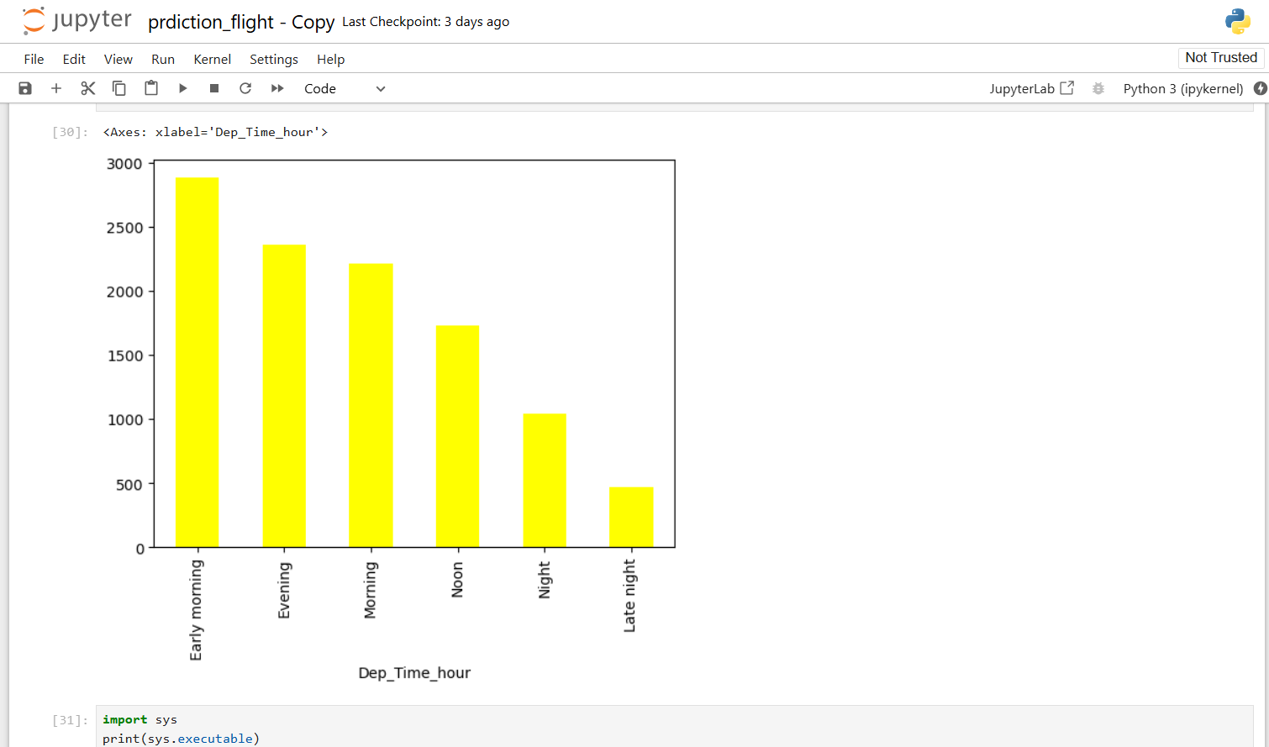
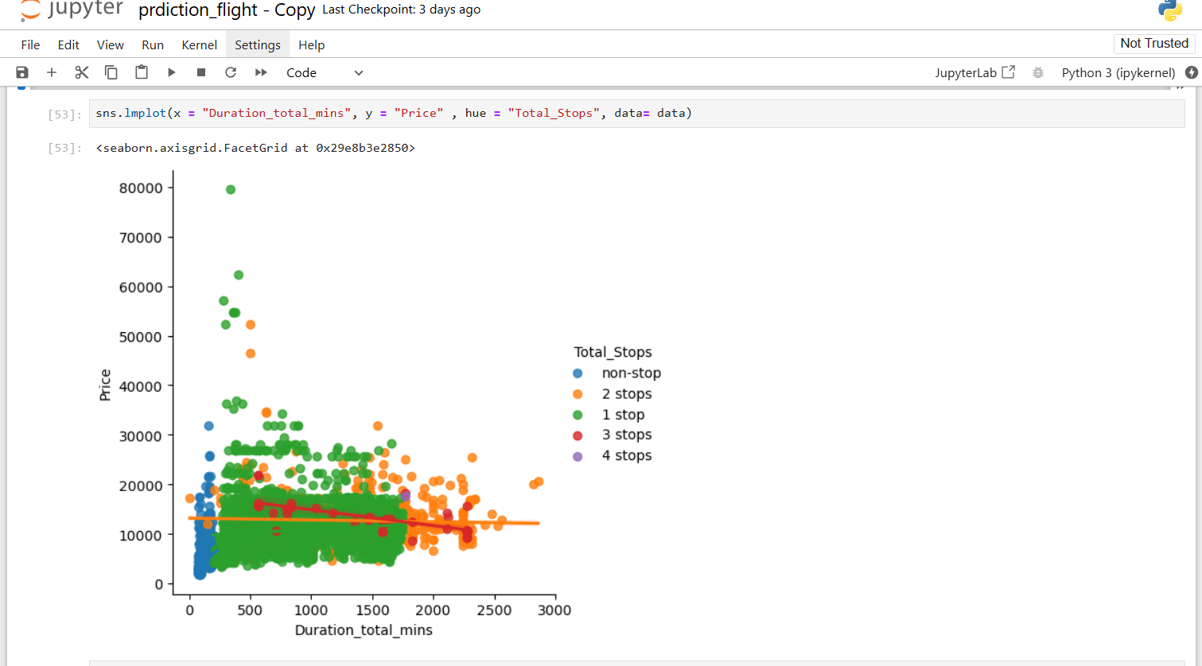
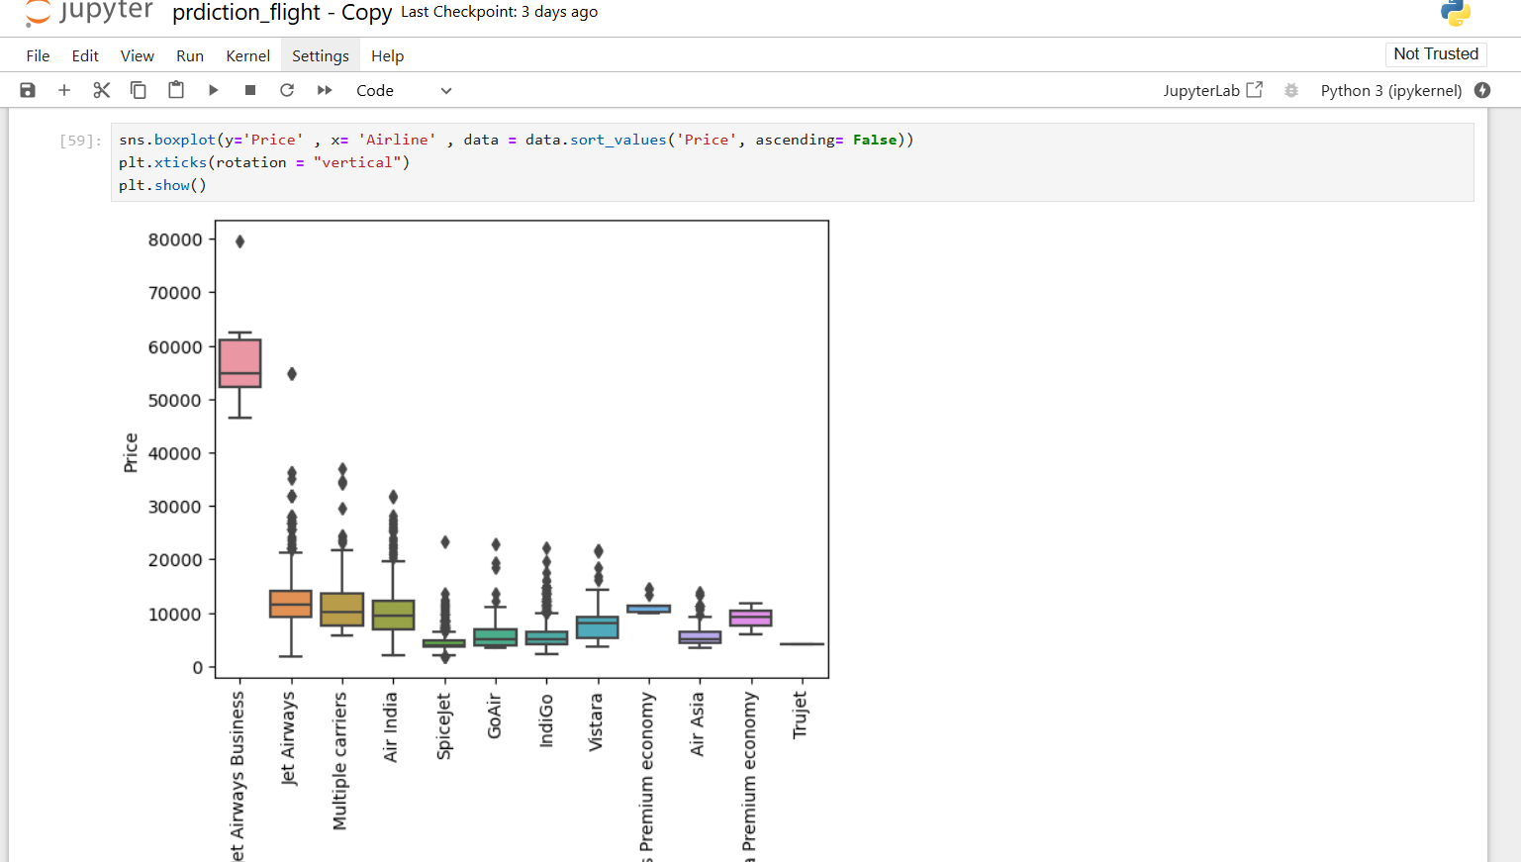
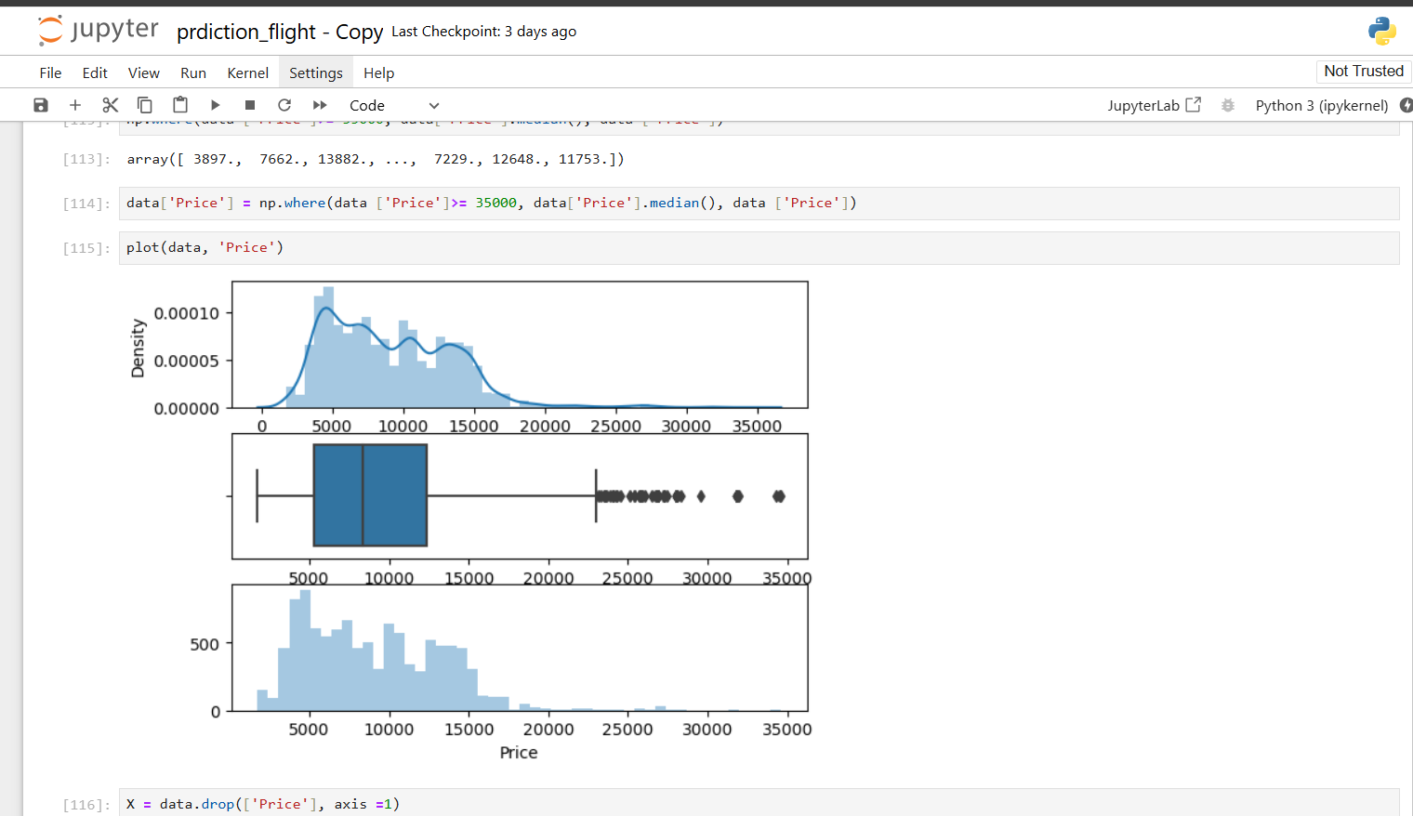
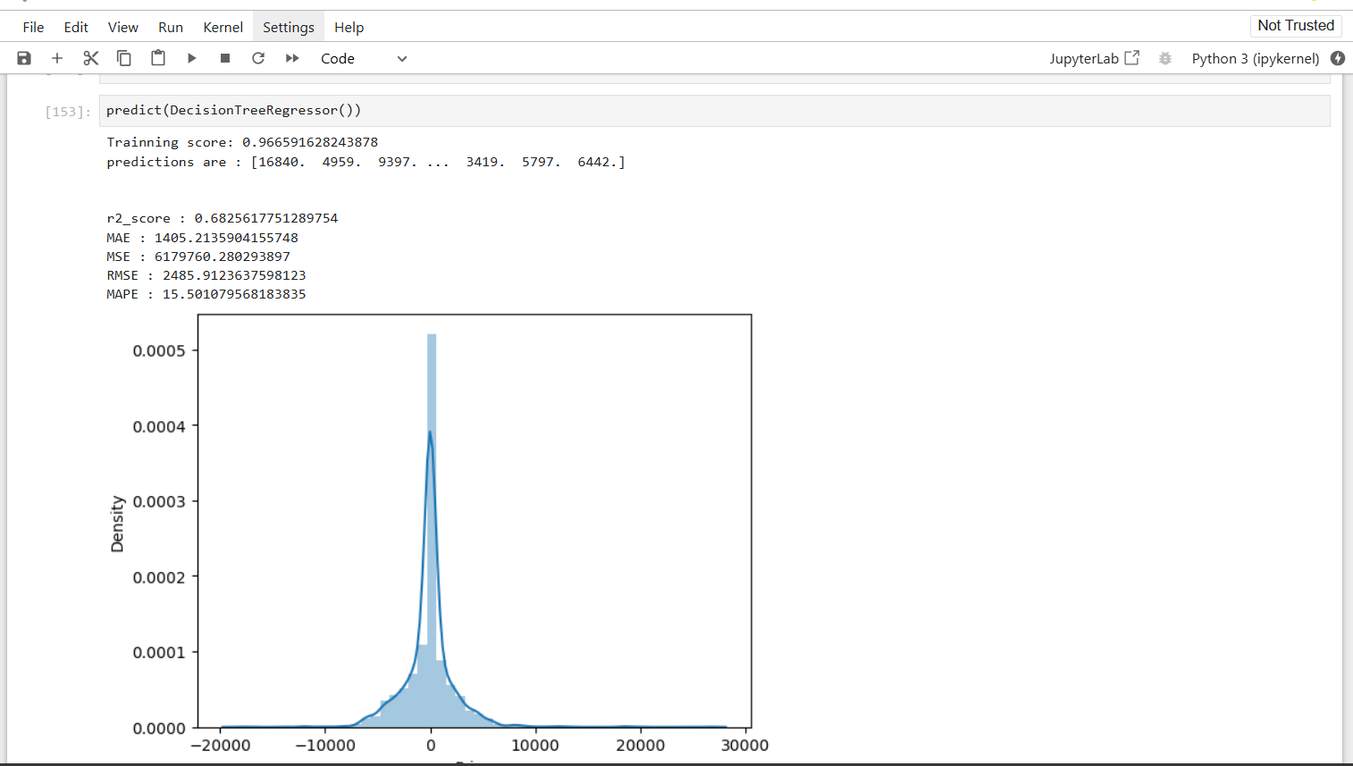
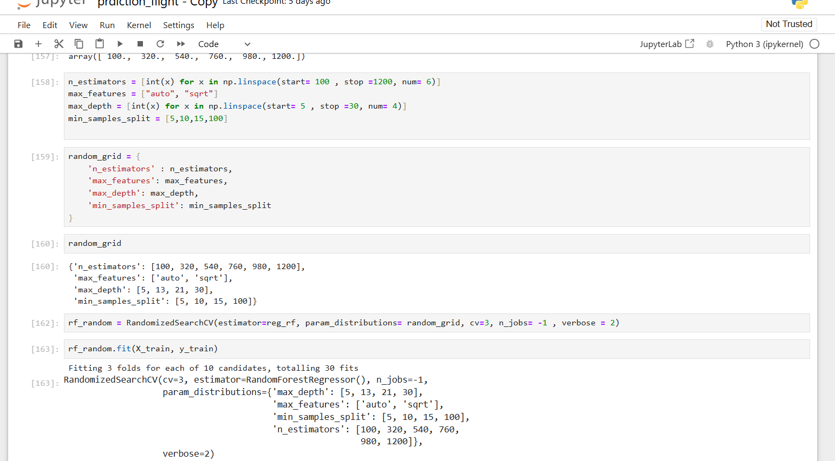
Approach & Implementation

Slide 4

Data Preprocessing:
Data Cleaning: Handle missing values, outliers, and incorrect data entries.
Feature Engineering: Create relevant features from raw data, such as seasonality indicators, economic indicators, and fuel price trends.
Normalization/Standardization: Scale features to ensure uniformity, especially for algorithms sensitive to feature scales.
Model Selection:
Choose appropriate machine learning models like linear regression, decision trees, random forests, or neural networks.
Deployment and Monitoring:
Model Deployment: Integrate the model into production systems for real-time price prediction.
Continuous Monitoring: Regularly check model performance and update it with new data to maintain accuracy.

Slide 5
Data Analysis
1)Handling Categorical Data
Airline Variable, Source and Destination Variable, Route variable, Total_Stops Variable, Additional_Info variable
2) Final Dataframe
-> Now we created the final dataframe by concatenating all the One-hot and Label-encoded features to the original dataframe. We will also remove original variables using which we have prepared new encoded variables.
->Using cross validation ML
->Hyperparameter tuning

Slide 6
Conclusion
With this, we did flight price prediction using machine learning. Our regression models have successfully forecasted airline ticket prices with notable accuracy. Through rigorous feature engineering and optimization, particularly in decision tree regression, we’ve gained valuable insights into market dynamics.
As AI continues to evolve, machine learning techniques play a crucial role in accurately predicting airfare prices. Ensemble methods like random forest hold promise for further improving prediction accuracy, ensuring robustness in our models.
In summary, our study demonstrates the effectiveness of machine learning in forecasting airfare prices. Continued advancements in deep learning techniques will likely lead to even more precise predictions, benefiting travelers and industry stakeholders alike.

