Slide 1
TAX DEDUCTED AT SOURSE UNDER GST
BY MUKTI RANJAN ACHARYA
(OFS-SG)
JOINT COMMISSIONER, CT&GST

Slide 2
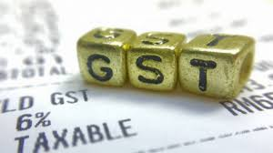
Goods and Services Tax (GST),
India's biggest tax reform, was launched at midnight on 30.06.2017 at Parliament's historic Central Hall, by The then President Sri Pranab Mukherjee and The Prime Minister Sri Narendra Modi
&
THE LAW CAME INTO FORCE W.E.F 01.7.2017

Slide 3
Indirect Tax Structure of India
Entry No. 52 &62 List II, Schedule VII
Entry Tax/ Entertainment Tax
Taxable Event is Sale
Entry No. 54 of List II (VAT) and 92A of List I (CST)
Sales Tax / VAT/ CST
Taxable Event is Provision of Service
Residuary Entry No. 97, List I, Schedule VII
Service Tax
Taxable Event is Manufacture
Entry No. 84, List I, Schedule VII
Excise Duty
Pre- GST Tax Structure
[ Important Components]
Customs Duty
Taxable Event is Import & Export
Entry No. 83, List I, Schedule VII
Taxable Event is Entertainment & Entry of Goods

Slide 4

Limitations of Earlier Tax regime
1. Cascading Effect of Tax
Credit of Excise duty, service tax, CST & ET Not Available

Slide 5
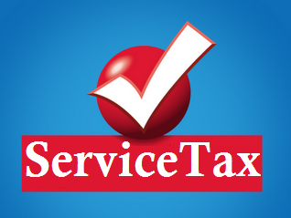
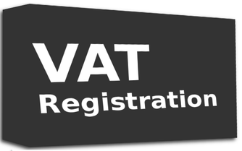

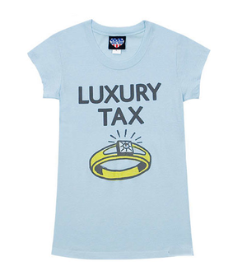

2. Multiple Registrations
Central Excise

Slide 6




3. Different Points of Taxation
Central Excise
(On Manufacturing)
Service Tax
(On provision of Service)
VAT
( On sale of Goods)

Slide 7
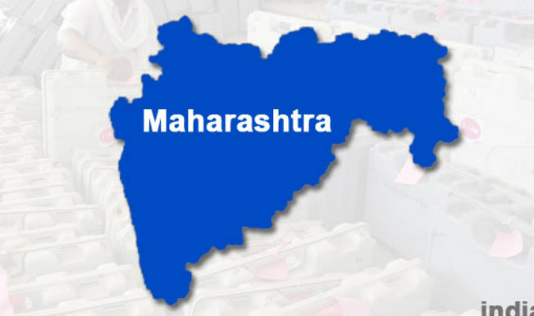
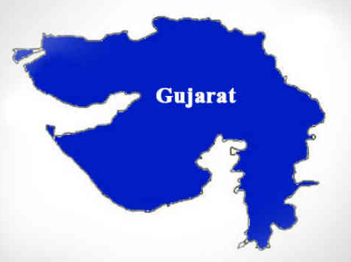
4. Lack of Uniformity
No tax / NIL
Tax @ 4%
Value Added Tax
e.g. on Sugar

Slide 8



5. Goods Vs. Services dilemma ?
License Software in CD
Sale of Food In Restaurant
Sale of
Services OR goods

Slide 9
Genesis of GST
India is a federal country where both the Centre and the States have been assigned the powers to levy and collect taxes through appropriate legislation
list II ( State list)
Entry No.54
State is empowered to levy tax on sale
List-I (centre list),
Entry No.84
Centre to levy tax on manufacturing
&Entry No.97
Centre to levy tax on services

Slide 10
The GST subsumed taxes of both Central and State Authority.
Taxes levied and collected by the Centre:
1. Central Excise duty
2. Duties of Excise (Medicinal and Toilet Preparations)
3. Additional Duties of Excise (Goods of Special Importance)
4. Additional Duties of Excise (Textiles and Textile Products)
5. Service Tax
8. Central Surcharges and Cesses so far as they
relate to supply of goods and services

Slide 11
State taxes that would be subsumed under the GST are:
1. State VAT
2. Central Sales Tax
3. Luxury Tax
4. Entry Tax (all forms)
5. Entertainment and Amusement Tax (except when levied by the local bodies)
6. Taxes on advertisements
7. Taxes on lotteries, betting and gambling
8. State Surcharges and Cesses so far as they relate to supply of goods and services

Slide 12
Need for constitutional Amendment; A dual GST ; the Constitutional requirement of fiscal federalism.
Introduction of the GST required amendments in the Constitution so as to simultaneously empower the Centre and the States to levy and collect this tax
The Constitution 101st Amendment Act has received presidential assent on 8th September 2016. This act paves the way for introduction of Goods & Services Tax (GST) by making Special provision with respect to goods and services tax

Slide 13
Outcome of 101st Amendment Act;
Article 246A
Article 269A
Concurrent Powers for Levy
Exclusive power with Parliament for taxation of Inter-state supplies
Article 279A
Levy by Centre and to be apportioned
Imports –Interstate supply
GST Council

Slide 14
Outcome of 101st Amendment Act;
Introduced new Article 246A---
This articles provides that both parliament and state legislatures shall have concurrent powers to make laws with respect to goods and services tax (GST). The Parliament will retain exclusive power to legislate on inter-state trade or commerce.

Slide 15
Goods and Service Tax Council:
As per the Insertion of Article 279A – President is to Constitute GST Council
Composition of the GST Council:
• Union Finance Minister – Chairman
• Union Minister of State in charge of Revenue or Finance- Member
• State Finance Ministers- Members
• Members to choose Vice Chairperson
Role of GST Council
The Council make recommendations to the Union and the States on important issues like tax rates, exemption list, threshold limits, etc.

Slide 16
GST COUNCIL MEETING
QUORUM- Half of the total number of members of GSTC
DECISION- Not less than 3/4th of weighted votes cast
-Centre & minimum 20 states required for majority
-Centre have 1/3rd weightage of total votes cast
- All states taken together would have 2/3rd
weightage of the total votes cast

Slide 17
IMPORTANT Features of GST
1-The GST is applicable on the supply of goods or services.
All goods except Alcohol for human consumption, & 5 Petroleum Products viz. petroleum crude, motor spirit (petrol), high speed diesel, natural gas and aviation turbine fuel.
The GST would apply to all services barring a few to be specified
2-GST is a destination based consumption tax.
The tax would accrue to the taxing authority which has jurisdiction over the place of consumption which is also termed as place of supply
3-Dual GST; GST will be levied by both tiers of Governments concurrently
There will be Central GST to be administered by the Central Government and there will be State GST to be administered by State Governments
Thus, the GST would comprise a Central GST ( CGST)and State GST(SGST)
The CGST and SGST would be levied at rates to be jointly decided by the Centre and States.

Slide 18
HSN (Harmonised System Nomenclature) is an internationally standardized system of names and numbers to classify traded products.
These codes are basically used to fix rate of tax on various products at the time of export and import.
In Indian context it is proposed to use HSN codes at invoice level to make taxation system of international standard. Under GST supply invoices will be made by capturing HSN codes in case of goods and service accounting codes in case of services.

Slide 19
Types of transactions & taxes
Under GST, there are three major taxes namely IGST, CGST & SGST.
In the case of intra-state supply of goods/services:
Central GST that goes in Central Government account
State GST that goes in State Government account
In the case of inter-state supply i.e supply of goods/services between states
Integrated GST (IGST) where the revenue is shared by the state government and central government as per the rates fixed by the authorities.

Slide 20
Taxable Events under GST
The taxable event under GST shall be the supply of goods or services or both except on the supply of alcoholic liquor for human consumption
Intra-State
Based on Location
CGST + OGST
Inter-state
IGST, which is a combination of CGST n OGST

Slide 21
Tax structure in GST( Tax Rate)
Exempt Supplies:
Zero-Rated Supplies: Exports and supplies to SEZ Supplies taxable at 3%
Supplies taxable at 5%;
Supplies taxable at 12%
Supplies taxable at 18%
Supplies taxable at 28%

Slide 22
Input & Output Tax Matrix
 |  | Destination of Supply
 |  | Inside the state | Outside the state
Origin of Supply | Inside the state | Input - CGST & SGST Output - CGST & SGST | Input - CGST & SGST Output - IGST
 | Outside the state | Input – IGST Output - CGST & SGST | Input - IGST Output - IGST

Slide 23
Registration under GST
Liability to be registered
Every person who is registered under existing indirect laws being subsumed in GST
Every person whose turnover in a year exceeds
Rs. 40 lakhs
Rs. 20 lakhs (for special category states)
Voluntary registration permitted even if no liability.

Slide 24
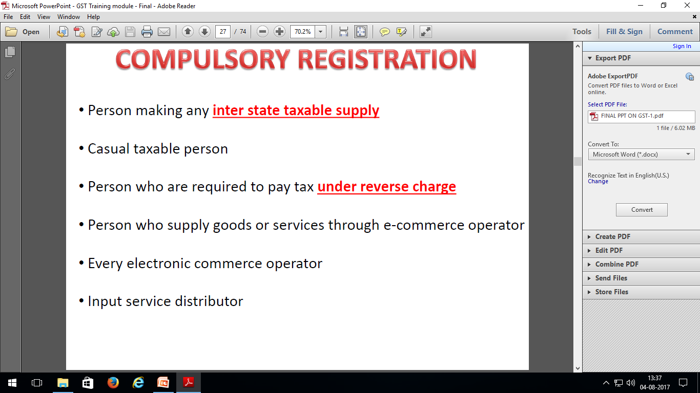

Slide 25
Composition Levy
Optional Scheme
Pay an amount in lieu of tax
No tax to be collected; No Input Tax Credit available
Conditions for Composition:
Aggregate Turnover < Rs. 1 CRORE (all-India basis for taxable persons having same PAN – who shall also opt for composition) but excludes Sch III & IV
The goods held in stock on appointed days have not been purchased/received in course of inter state trade

Slide 26

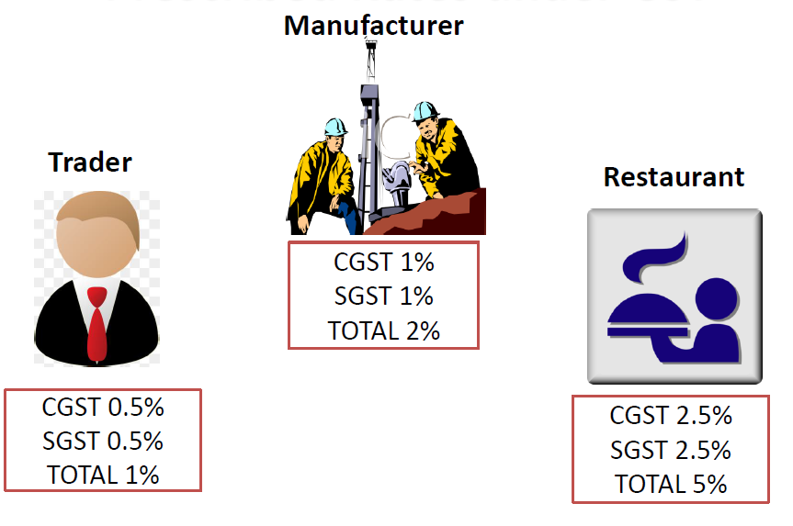
Prescribed Rate for Composition Schemes

Slide 27
BENEFITS OF GST
A single tax would replace multiple taxes..
GST would replace various taxes currently levied & collected by
the Centre & States:
Central Taxes: Central Excise Duty, Duties of Excise (Medicinal & Toilet Preparations), Additional Duties of Excise (Textiles & Textiles Products), Additional Duties of Customs, Special Additional Duty of Customs, Service Tax.
State Taxes: State VAT ,Central Sales Tax, Luxury Tax, Entry Tax, Entertainment & Amusement Tax, ,Taxes on lotteries, betting & gambling.

Slide 28
Set-off of prior-stage taxes would mitigate the ill effects of cascading.
Tax burden on goods and services would decrease, benefiting common man.
Implementation of GST would make our products competitive in domestic and international markets.
It would boost economic activity and create more jobs.

Slide 29
Business Transaction Matrix
 |  | Trade Targets
 |  | Government | Business | Individuals
Trade Origins | Government
 | Business
 | Individuals
G2G*
G2B
G2C*, G2E*
B2G
B2B
B2C, B2E*
C2G, E2G
C2B, E2B
C2C

Slide 30
Compensation Mechanism for States
Compensation = (State’s Revenue for FY 2015-16)*
14%^{n} -State’s Revenue (for the said year)
Revenue of all taxes subsumed in GST by the State for 2015 – 16 as the base
Assumption of 14% Annual Growth Rate
Compensation to be provided through Cess
Cess only on few specified luxury and sin goods
10

Slide 31
TDS
certain categories of registered persons will be required to deduct taxes while making payments to supplier i.e TDS and deposit it with the government.
Let’s try to understand TDS related procedures.

Slide 32
TAX DEDUCTED AT SOURSE
Specified percentage of tax is deducted by the deductor from payment made to deductee.
Tax Deduction at Source (TDS) is a system, which was initially introduced by the Income Tax Department.
It is one of the modes/methods to collect tax, under which, certain percentage of amount is deducted by a recipient at the time of making payment to the supplier of goods & services.

Slide 33
Benefits of TDS provision
It facilitates sharing of responsibility of collection between the deductor and the tax administrator.
It ensures regular inflow of cash resources to Government.
It tracks the transaction & therefore it acts as a powerful instrument to prevent tax evasion & expands the tax net.

Slide 34
Who are responsible for deduction
Central and State Government Departments / Establishments
Local Authority (e.g. Municipalities, Panchayati Raj Institutions etc.)
Government Agencies (e.g. DRDA, ITDA etc.)
An Authority / Board / Any other Body set up by an Act of Parliament / State Legislature or established by any Government with Fifty-One percent or more participation by way of equity or control to carry out any function.
Society established by Central Government or State Government or a Local Authority under Societies Registration Act, 1860 (21 of 1860)
Public Sector Undertakings (Central and State) (e.g. OMC, OPGC etc.)
SEC (51)(1)

Slide 35
VALUE OF SUPPLY
where the total value of supply of goods & services, under a contract, exceeds Rs 2,50,000/- (excluding the amount of Central tax, State tax, Union Territory tax, Integrated tax and cess indicated in the invoice)
THAT ATTRACTS DEDUCTION OF TDS
Thus, individual supplies may be less than Rs. 2,50,000/-, but if contract value is more than Rs. 2,50,000/-, TDS will have to be deducted.
SEC (51)(1)

Slide 36
Rate of TDS under GST;
The deductor is required to deduct tax at the rate of
1% CGST + 1% SGST (in intrastate supply)
2% IGST ( in interstate supply)
from the payment made or credited to the supplier of taxable goods and/or services.
TIME FOR DEDUCTION OF TDS
TDS is to be deducted by the deductor from the payment made to the supplier, at the time of making payment to him.

Slide 37
Required Procedures For TDS
the following steps are required to be taken:-
Registration as Tax Deduction in the GST common portal
Deduction of TDS amount as per the provisions from the bills to be paid to the suppliers/deductees.
Deposit the TDS amount in to appropriate government account.
File Tax Returns( GSTR-7) for TDS within the prescribed time limit.

Slide 38
REGISTRATION
Persons, who are required to deduct TDS shall be required to get registered under the GST Act. SEC 24(vi)
the registration is compulsory for deductors

Slide 39
For Registration as Tax Deductor, the following are required:
TAN/PAN of the entity
Proof of Address of the place of the entity (Any proof issued by Government Authority / by Local Authority / Municipal Khata Copy / Electricity Bill / Legal Ownership Document / Rent or Lease Agreement etc. ) – to be uploaded
PAN of the DDO (or Authorized Signatory)
Photograph of the DDO (or Authorized Signatory) – to be uploaded
Aadhar Card / Digital Signature Certificate (DSC) of the DDO (or Authorized Signatory)
Valid email ID (preferably official email ID) of the DDO (or Authorized Signatory)
Mobile Phone Number of the DDO (or Authorized Signatory)

Slide 40
Procedure of registration RULE 12
Through common portal or through facilitation centre notified by the Commissioner
Application :-
In Form GST REG -07
To declare the followings, in the application
PAN/ TAN,
mobile no,
e-mail address,
name of the state

Slide 41
Continued...........
(F) Verification & approval of Application & grant of registration certificate:-
verified by an departmental officer.
If approved, registration is granted & registration certificate in FORM GST REG- 06 is issued within 3 working days from date of submission of application.
(G)Cancellation of R.C
When the proper officer is satisfied that a person to whom a certificate of registration in FORM GST REG 06 has been issued is no longer liable to deduct tax at source, he may cancel the registration certificate and such cancellation shall be communicated to the said person electronically in FORM GST REG-08.

Slide 42
Continued...........
(G) Issue of registration certificate :- RULE 10
The registration certificate in FORM GST REG -06 shall be made available to the applicant on the common portal & a Goods and Services Tax Identification Number (15 digit) shall be assigned to it.
2 characters for the state code
Ten characters for PAN/ TAN
2 characters for entity code
1 checksum character

Slide 43
Deduction of TDS for DDOs drawing from Treasuries through Bills:
Preparation of Expenditure Sanction order. It shall contain
Total amount,
Net amount payable to the Contractor/Supplier/ Vendor and
2% TDS amount of GST.
Generation of CPIN Number (common portal identification number)
The DDO shall login into the GST Portal

Slide 44
fill in the desired amount of payments against one/many Major Head(s) (OGST/CGST/IGST) and the relevant component (e.g TAX / Interest / Penalty / Fees, as the case may be) under each of the Major Head.
select mode of payments as NEFT
select “Reserve Bank of India PAD” as the remitting Bank.
Generate A 14 digit CPIN.
Preparation of Bill
followings be clearly indicated:
The net amount payable to the Supplier / Deductee;
2% as TDS (1% Odisha GST + 1% central GST or 2% IGST) will be specified.
Deduction of TDS should not be in fraction of rupees and the calculated value should be next higher rupee.

Slide 45
Submission of Bill
payment of the net amount to the vendor/supplier/contractor
enter the beneficiary account details of the as the case may be his/her Bank Account.
remittance of TDS to Govt,
“Beneficiary Type” -- “GST TDS”
beneficiary’s account number -the CPIN Number
Beneficiary -- RBI
IFSC Code -- of RBI
( all from beneficiary master)

Slide 46
Upon successful payment, a CIN (chalan identification number) will be generated by the RBI and will be shared electronically with the GST Portal.
TDS amount will get credited in the Electronic Cash Ledger of the concerned DDO / Tax Deductor in the GST Portal. This can be viewed and the details of CIN can be noted by the DDO anytime on GST portal using his Login Credentials.
The DDO should maintain a register as per proforma given in Annexure ‘A’ to keep record of all TDS deductions made by him during the month. This Record will be helpful at the time of filling Monthly Return (FORM GSTR-7) by the DDO.

Slide 47
Annexure ‘A’
Sl no | GSTIN of the deductee | Trade Name | Amount paid to the deductee on which tax is deducted | Integrated tax | Central Tax | State Tax | Total

Slide 48
TDS DEPOSIT
DUE DATE OF TDS DEPOSIT
Tax deducted by the deductor shall be paid to the Govt. Within 10 days from end of the month of deduction. SEC 51(2)
Tax may be CGST/ SGST OR IGST depending upon the nature of transaction.
Deductor would be liable to pay interest as provided u/s 50(1), if the tax deducted is not deposited within the prescribed time limit.
SEC 51(6)

Slide 49
RETURN
Every registered person required to deduct tax at source under section 51 shall furnish a return, electronically, for the month, in which the deduction has been made, within 10 days after the end of such month.
SEC 39(3)
Every registered person required to deduct tax at source under section 51 (deductor) shall furnish a return in FORM GSTR-7 electronically through the common portal either directly or from a Facilitation Centre notified by the Commissioner.
RULE 66 (1)

Slide 50
TDS Certificate
The deductor shall furnish a certificate in FORM GSTR-7A (electronically on common portal) to the deductee within 5 days after crediting the amount to Govt. SEC 51(3)
Contents of TDS certificate
Contract value
Rate of deduction
Amount of TDS deducted
Amount paid to Govt.
Other prescribed information details

Slide 51
Continued..................
Defaulter to furnish TDS certificate
Late fee Rs 100/- per day. (Maximum Rs 5000/-).
Defaulter to pay deducted amount to Govt.
Interest @ not exceeding 18% (to be notified by Govt.) SEC 50(1)

Slide 52
Continued..................
The details furnished by the deductor under sub-rule (1) shall be made available electronically to each of the suppliers in Part C of FORM GSTR-2A and FORM-GSTR- 4A on the common portal after the due date of filing of FORM GSTR-7.
RULE 66(2)
The TDS certificate referred to shall be made available electronically to the deductee on the common portal in FORM GSTR-7A on the basis of the return furnished by the deductor.
RULE 66(3)

Slide 53
REFUND
On account of excess & erroneous deduction of amount, refund of the excess amount shall be made to the deductor or deductee.
Provided that the amount deducted has not been credited to electronic cash ledger of the deductee.
SEC 51(8)

Slide 54
PROCEDURE FOR REFUND
The deductor / deductee who needs refund may file an application electronically in FORM GST RFD-01 through the common portal, either directly or through a Facilitation Centre notified by the Commissioner.
Accompanied with the documentary evidences to establish that refund is due.
acknowledgement in FORM GST RFD-02, in common portal.

Slide 55
Continued..............
When deficiency in application, communicated to the application in FORM GST RFD-03, in common portal requiring rectification.
If approved. refund order in FORM GST RFD-04.
Payment advice in FORM GST RFD-05.
Amount credited to bank account.

Slide 56

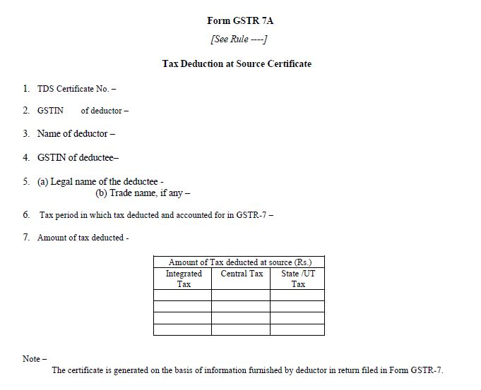
FORM: GSTR 7A

