Slide 1
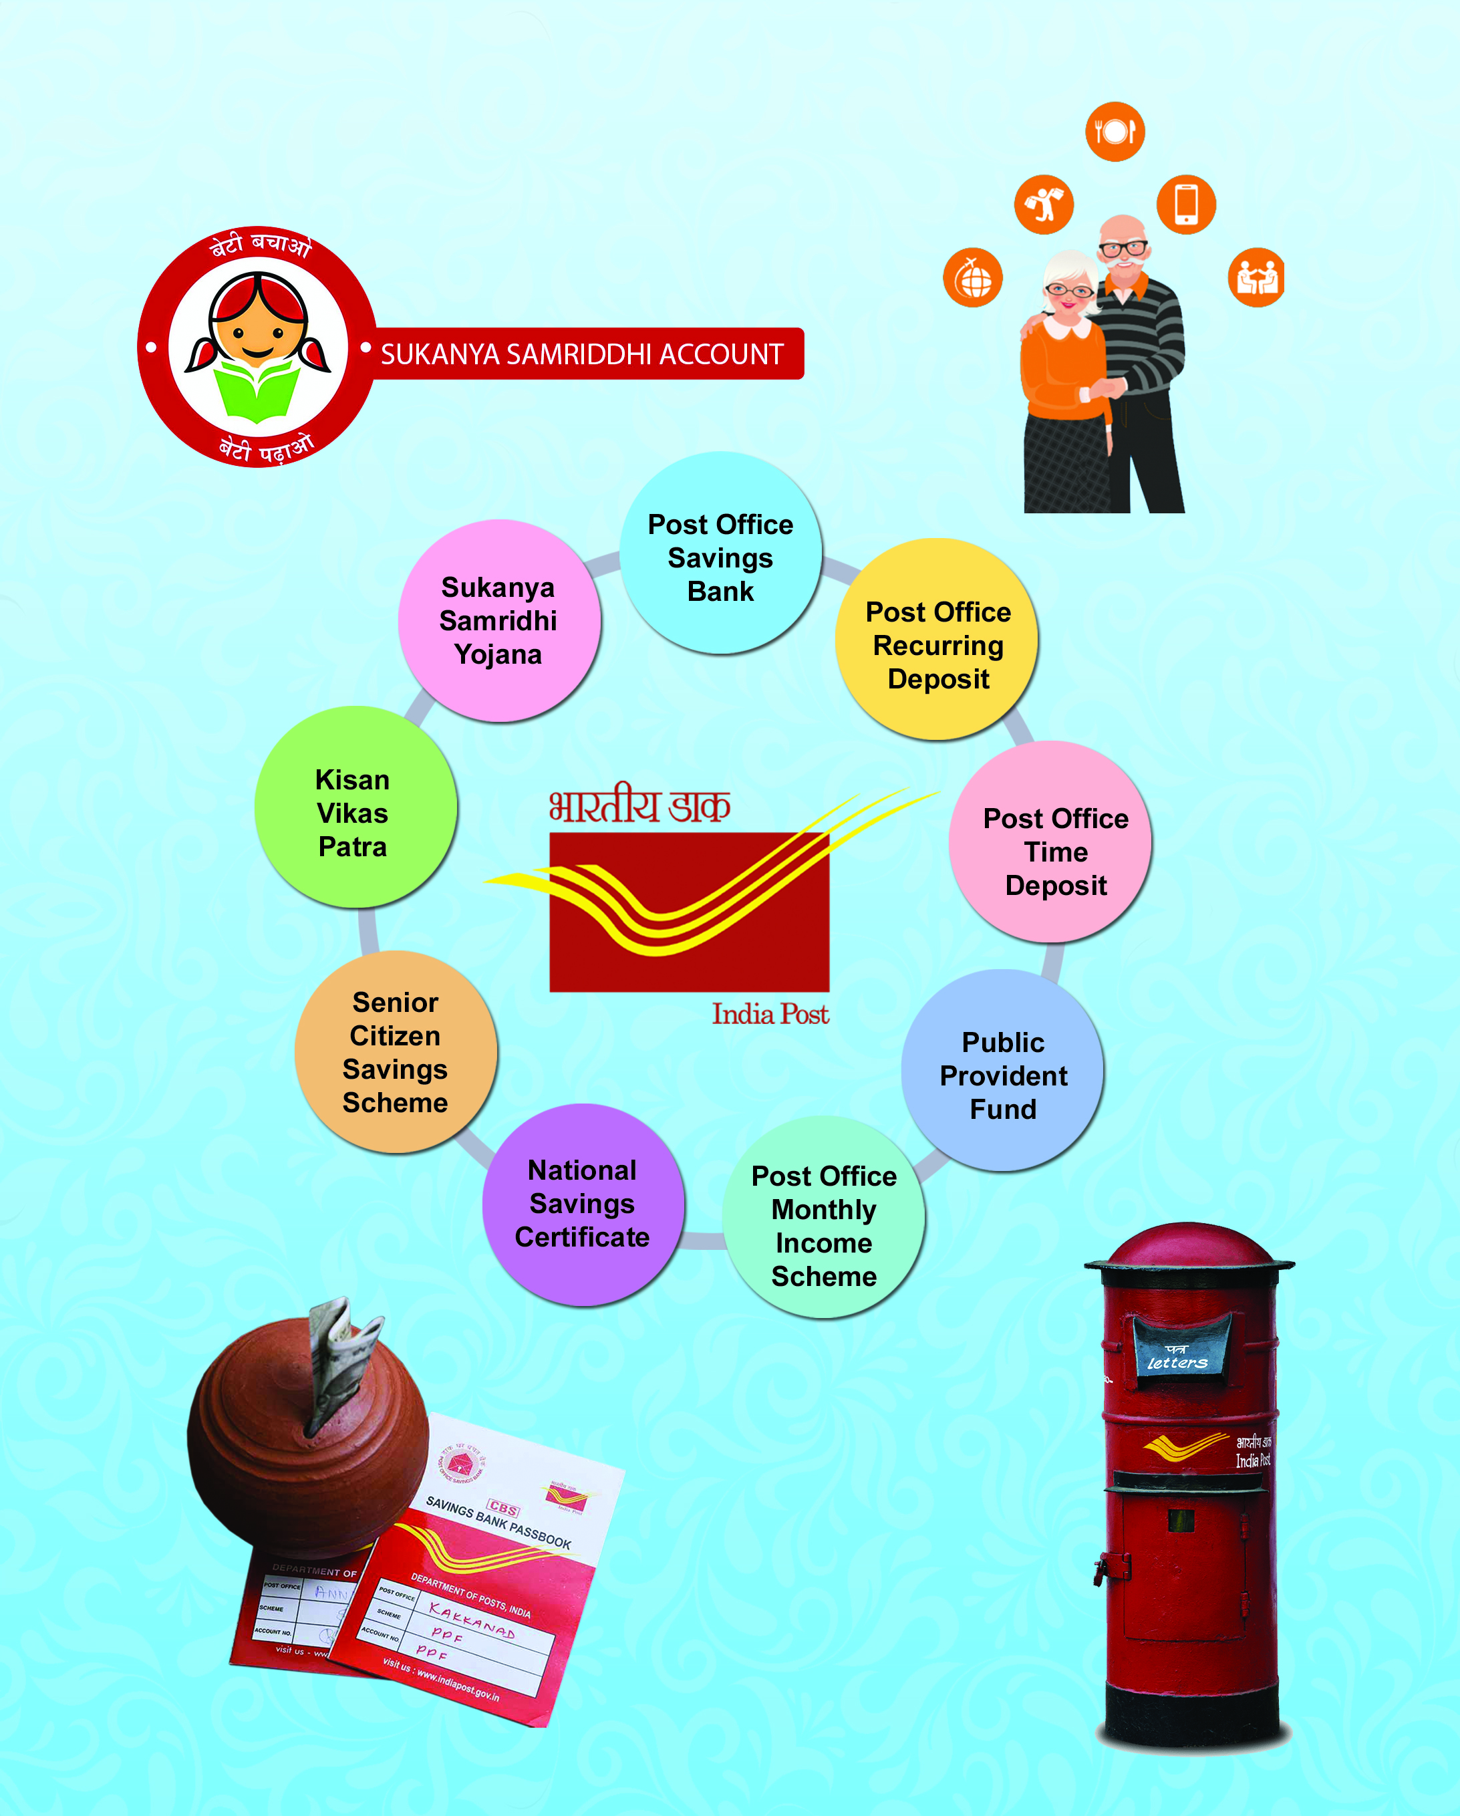

Directorate of Small Savings Finance Department

Slide 2
Presentation Path
1. Role and Function of the Directorate.
2. Organisational Structure.
3. Man power position.
4. Mobilisation activities.
5. Awareness campaign, publicity and financial literacy drive.
6. Target and Achievement of Small Savings Collection.
7. Odisha Small Savings Incentive Scheme.
8. Target and Achievement on issue of incentive scheme coupon.
9. Future plan.

Slide 3
Role and function of the Directorate
Directorate of Small Savings of the State is a composite Directorate under Finance Department.
It is working to inculcate the habit of thrift and savings among the common people.
It also undertakes Financial Literacy drive and work in the area of Financial Inclusion movement.
It also endeavours to dissuade people from making riskful investment in suspicious financial institutions.
The Directorate is working in co-ordination with the National Savings Institute and Postal Department of Govt. of India. for smooth management of Small Savings matters and redressal of grievances of depositors and Small Savings agents.
Conducts training programmes for the Small Savings officers.
For spreading of financial literacy and to promote financial inclusion Directorate of Small Savings works in close co-ordination with Reserve Bank of India.
Performs the establishment related work in respect of officers of Small Savings cadre.

Slide 4
Organisational Structure:-
Principal Secretary Finance
Director, Small Savings
Deputy Director Small Savings & Financial Inclusion-cum-Deputy Secretary to Govt. (One)
Asst. Director Small Savings & Financial Inclusion-cum-Under Secretary to Govt. (One)
Desk Officer (one)
District Small Savings & Financial Inclusion Officer. (Hqrs.) (One)
Section Officer (One)
Sub-Divisional Small Savings & Financial Inclusion Officer. (Hqrs.) (One)
Assistant Section Officer (One)

Slide 5
Manpower position under Directorate of Small Savings.:-
Sl. No. | Name of the Cadre Post | Total Sanctioned Strength | Man in position | Vacancy
1 | 2 | 3 | 4 | 5
1 | Deputy Director, Small Savings & Financial Inclusion-Cum-Deputy Secretary to Govt. Group-‘A’. Level-13 | 1 | NIL | 1
2 | Assistant Director, Small Savings-& Financial Inclusion Cum-Under Secretary to Govt. Group-‘A’. Level-12 | 1 | NIL (Promotion to the post has already been made) | 1
3 | District Small Savings & Financial Inclusion Officer, Group- ‘B’ Level -11 | 32 | 11 | 21
4 | Sub-Divisional Small Savings & Financial Inclusion Officer, Group-‘B’ Level-10 | 19 | 9 | 10
5 | Small Savings & Financial Inclusion Officer, Group-‘B’ Level--9 | 27 | 3 | 24 (Requisition has been placed with OSSC for fill up 15 nos. of Posts)
TOTAL : |  | 80 | 23 | 57
District Small Savings Sections function with 01 DSS & FIO, 01 Jr.Asst. and 01 Peon.
Sub-divisional Small Savings Sections function with 01 SDSS & FIO or SS & FIO.

Slide 6
Mobilisation activities:-
This organisation promotes the habit of thrift and savings, mobilise different Small Savings Schemes and augments Collection under these schemes.
Mobilisation of Small Savings Schemes and obtaining of deposits thereof is mainly conducted through the help of Small Savings Agents working under Standardised Agency System (SAS) and Mahila Pradhan Kshetriya Bachat Yojana (MPKBY) who are appointed by Collectors and Sub-Collectors.
This agency scheme generates employment for such agents.
SAS agents are authorised to mobilise Term deposit, MIS, NSC and KVP.
MPKBY agents are authorised to mobilise Post Office Recurring Deposit scheme.
Small Savings Schemes now in operation:-
1 | Savings Bank account | 4 % P.A
2 | Post Office Recurring Deposit (5 Years) | 5.8% P.A
3 | 1 Yr/2Yr/3Yr Term Deposit 5 Yr Term Deposit | 5.5% P.A 6.7% P.A
4 | Monthly Income Scheme (5 Years) | 6.6% P.A
5 | 5 Yr National Savings Certificate VIII Issue | 6.8% P.A
6 | Kisan Vikas Patra (124 months) | 6.9% P.A
7 | Senior Citizen Savings Scheme (5 Years) | 7.4% P.A
8 | Public Provident Fund (15 Years) | 7.1% P.A
9 | Sukanya Samridhi Yojana (21 years) | 7.6% P.A

Slide 7
Awareness campaign, publicity and financial literacy inclusion drive.
Awareness oriented advertisements are published in the daily newspapers containing the highlights, salient features, facilities offered by different Small Savings Schemes. Sambad.jpg Dharitri.jpg
Publicity leaflets are being distributed among the people at district, Sub-division, block and panchayat level. Poster and Banner.pptx
Flex and banners are displayed at different strategic places in all the districts. Flex and Banners.pptx
To incentivise Small depositors free web based coupons are being issued in each calendar year under Odisha small Savings Incentive Scheme and cash awards are given to the winners of the lucky draw. Incentive Scheme Draw.pptx
Publicity stalls have been arranged during Cuttack Baliyatra and Bolangir Lok Utsav. Publicity stall.pptx
Financial literacy camps are being organised in the districts in coordination with Banks and Post offices. Students, SHG groups, traders, workers are included in these camps. Financial Literacy camp.pptx
World Thrift Day and Savings Fortnight are being observed in each year from 30th October to 14th November. Observation of World Thrift Day.pptx VID-20201030-WA0094.mp4 VID-20201030-WA0012.mp4
Website “assaodisha” is maintained with technical support of Finance Informatics Division. Smallsavings (assaodisha.nic.in)

Slide 8
Target and Achievement
The State target for net Small Savings Collection for last five financial years are shown in the table:-
Sl. No | Financial Year | Annual Target (in Crores) | Annual Net Collection (in Crores) | Percentage of achievement
1 | 2 | 3 | 4 | 5
1. | 2016-17 | 2570 | 2361.27 | 91.87%
2. | 2017-18 | 2600 | 2933.31 | 112.81%
3. | 2018-19 | 3000 | 4089.14 | 136.30%
4. | 2019-20 | 4150 | 6227.35 | 150.05%
5. | 2020-21 | 6250 | 6589.34 | 105.42%
6. | 2021-22 | 6730 | 2316.59 (till July-2021)

Slide 9
Odisha Small Savings Incentive Scheme:-
Prize profile:-
To spread the message of thrift, safe savings and to promote Small Savings by incentivising the depositors. Odisha Small Savings Incentive Scheme has been introduced by this department.
Minimum deposit of Rs. 2,000/- in a calendar year in the Small Savings Schemes like KVP, POMIS, PORD, 5 Yr. TD, NSC VIII Issue, SSY, PPF & SCSS within the State of Odisha is eligible to get a free web generated Odisha Small Savings Incentive Coupon in that year.
Attractive cash prizes, minimum of Rs. 2,000/- and maximum of Rs. 5,00,000/- can be won in this scheme under seven categories of prize through an annual lucky draw.
Issue of coupon “AR” series Odisha Small Savings Incentive Scheme for the calendar year 2020 has come to an end on 31.07.2021.
The draw of the series is scheduled to be held on 26.09.2021.
Sl. No. | Category of Prize | No. of Prizes | Amount of Prize | Total Amount of Prize
1 | 2 | 3 | 4 | 5
1 | 1st | 1 | Rs. 5 Lakhs | Rs. 5 Lakhs
2 | 2nd | 1 | Rs. 3 Lakhs | Rs. 3 Lakhs
3 | 3rd | 2 | Rs. 1 Lakhs | Rs. 2 Lakhs
4 | 4th | 4 | Rs. 50,000 | Rs. 2 Lakhs
5 | 5th | 20 | Rs. 10,000 | Rs. 2 Lakhs
6 | 6th | 400 | Rs. 5,000 | Rs. 20 Lakhs
7 | 7th | 2000 | Rs.2000/- | Rs.40 Lakhs
TOTAL |  | 2428 |  | Rs. 74 Lakhs

Slide 10
Target and Achievement for issue of free web based coupon under Odisha Small Savings Incentive Scheme
Odisha Small Savings Incentive Scheme has been very effectively used as a major mobilisation tool to create awareness among the people regarding Govt. Small Savings Schemes and attract them to deposit in the said schemes. The same has successfully attracted deposit in various Small Savings Schemes. The achievement of target in this regard during the last five series is shown in the table:-
Sl. No. | Year | Name of the series | State target for issue of coupon | Achievement | Percentage of achievement
1 | 2 | 3 | 4 | 5 | 6
1. | 2015 | AM | 69,42,111 | 66,15,612 | 95.29%
2. | 2016 | AN | 73,00,000 | 60,58,108 | 82.98%
3. | 2017 | AO | 73,00,000 | 76,45,032 | 104.72%
4. | 2018 | AP | 79,00,000 | 88,66,717 | 112.23%
5. | 2019 | AQ | 90,00,000 | 1,10,29,198 | 122.54%
6. | 2020 | AR | 90,00,000 | 79,28,158 | 88.09%

Slide 11
Future Action Plan:-
An one week training programme of Small Savings & Financial Inclusion officers is scheduled to be held at MDRAFM, Bhubaneswar.
For further strengthening of publicity campaign and as part of I.E.C activity, we may organise publicity stalls and camps during Laxmipuja at Kendrapada and Dhenkanal, Dusehera at Cuttack and Bhubaneswar, Dhanu Yatra at Baragarh, Ratha Yatra at Puri and Thakurani Yatra at Ganjam etc.
Odisha Small Savings Incentive Scheme “AS” series for the calendar year 2021 to be organised and launched shortly.
As a part of pilot projects, savings villages may be organised in different districts.
For the welfare of the girl child Sukanya Samridhi Yojana may be popularised in co-ordination with School and Mass education department.
Effort may be made to reach out all the pensioners to mobilise Small Savings schemes and create awareness against any riskful investment with the help of Treasury Officers all over the state.
All out effort may be made for achievement of the State target for net Small Savings collection of Rs. 6730 crores for the current financial year 2021-22.

Slide 12


