Slide 1
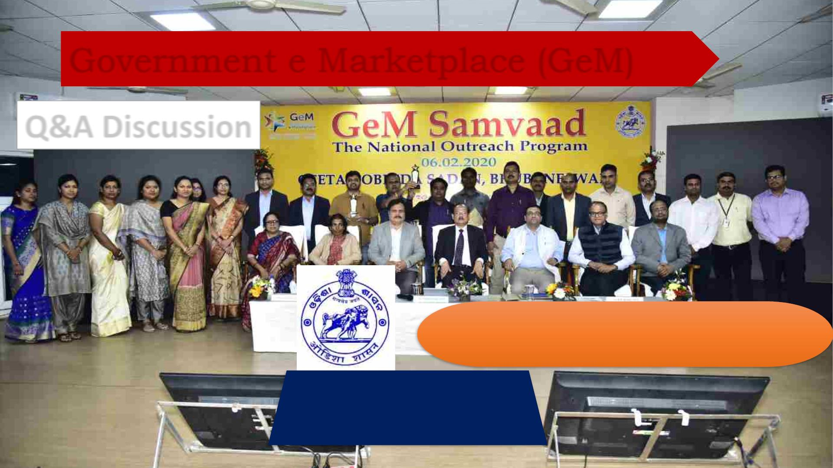
Government e Marketplace (GeM)
Q&A Discussion
Welcome to all Participants
Presented by
Manas Ranjan Das
Assistant Director
DT&I , Odisha
Presented by
SGEMPU ,DTI ,
Finance Department ,
Government of Odisha
Kishor KuJena
Account Officer
DT&I , Odisha

Slide 2
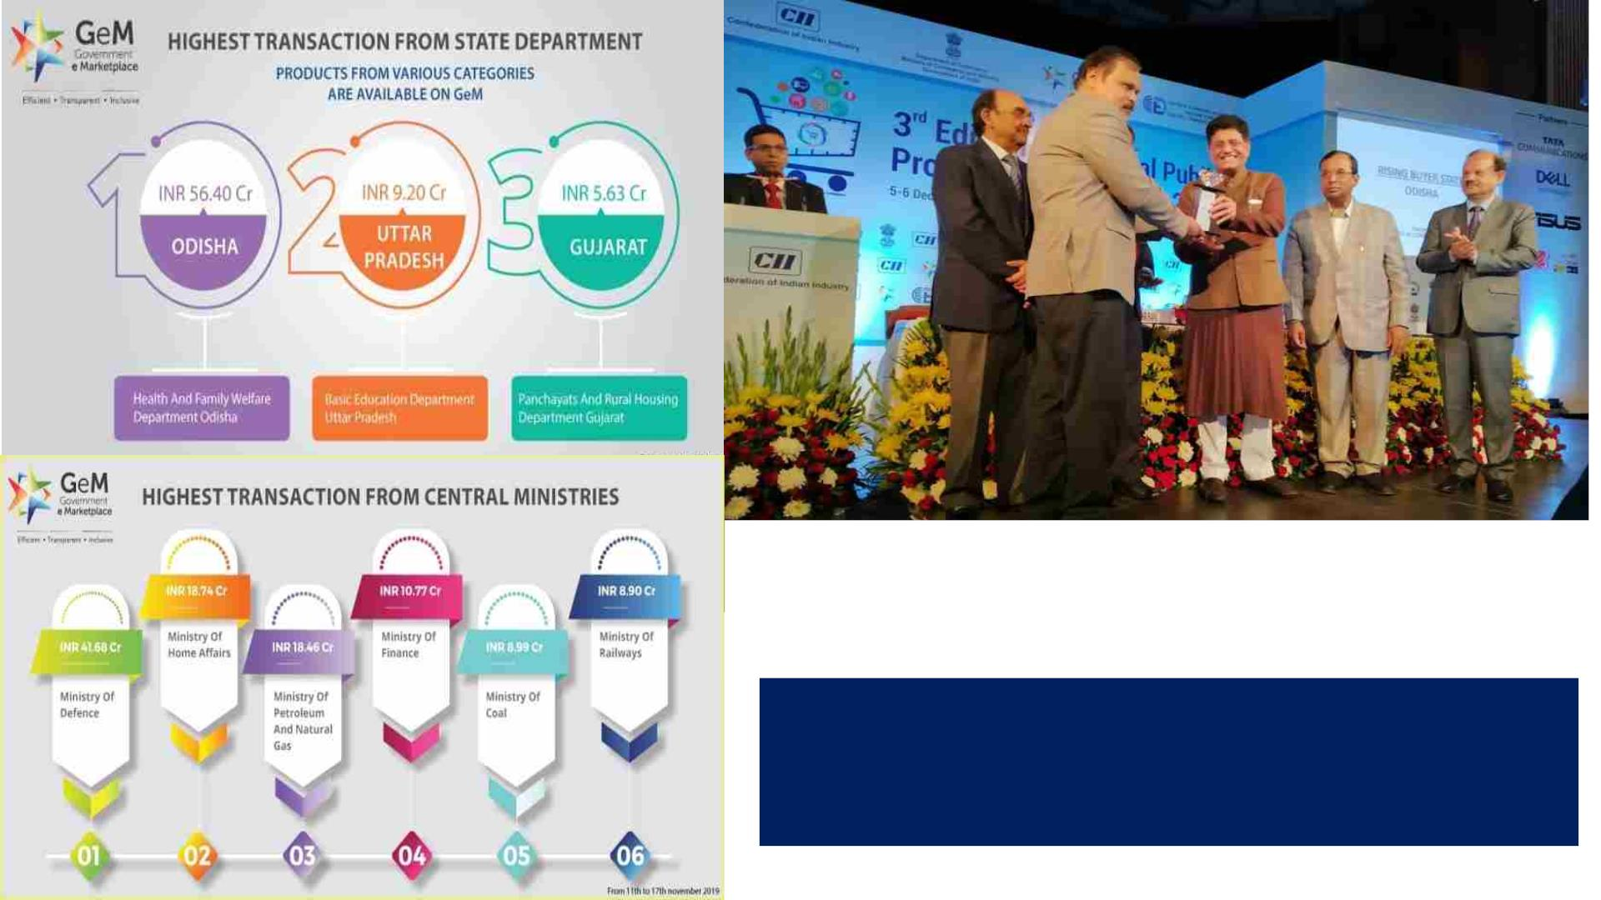
GeMꢀwitnessedꢀactiveꢀparticipationꢀfromꢀStateꢀGovt:ꢀ
Department for procuring goods and services.
The Top States with highest transaction in a week
(ꢀNovemberꢀ2019ꢀ)ꢀare Odisha,ꢀUttarꢀPradeshꢀ&ꢀGujrat.
Congratulations!!!!!!!!!
State of Odisha has won the
“Rising Buyer award 2019 ’’
SGeMPU Odisha

Slide 3

Q1. Government e-Market works on the concept of which
types of Model.
A.Inventory based
B.Marketplace
C.Hybrid
D.None of these

Slide 4
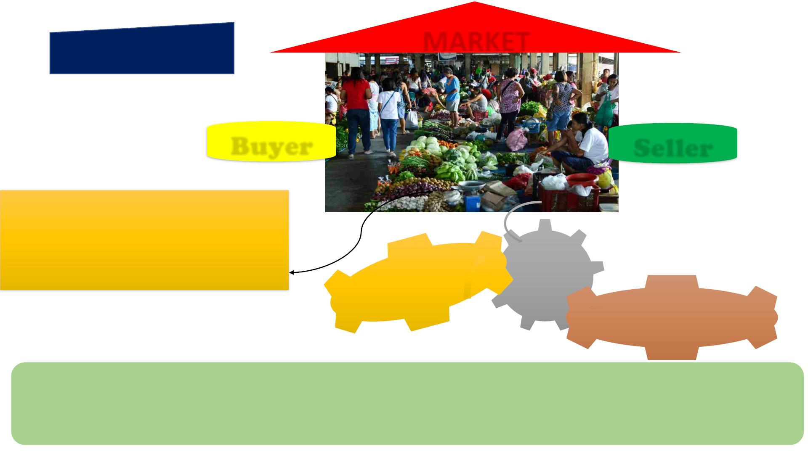
MARKET
1. What is GeM
Buyer
Seller
e-Commerceꢀ
aꢀtypeꢀofꢀbusinessꢀmodel,ꢀorꢀsegmentꢀofꢀaꢀ
largerꢀbusinessꢀmodel,ꢀthatꢀenablesꢀaꢀfirmꢀorꢀ
individualꢀtoꢀconductꢀbusinessꢀoverꢀanꢀ
electronicꢀnetwork,ꢀtypicallyꢀtheꢀinternet
Hybrid
Model
Marketplace Model
q providing an Information technology platform by an e-commerce entity on a digital & electronic network to act as a facilitator
between the buyerꢀandꢀseller.
q In a marketplace model, the e-commerce firm is not allowed to directlyꢀorꢀindirectlyꢀinfluenceꢀtheꢀsaleꢀpriceꢀofꢀgoodsꢀorꢀ
servicesꢀand is required to offerꢀaꢀlevelꢀplayingꢀfieldꢀtoꢀallꢀvendors.

Slide 5

Q1. Government e-Market works on the concept of which
types of Model.
A.Inventory based
B. Marketplace
C.Hybrid
D.None of these

Slide 6
Q2. Which of the following amount of procurement can be said as L1
purchase on GeM portal?
A.11,000
B.24,000
C. 27000
D.All of the above

Slide 7

6.
Offering Multiple
Procurement
Options
5. Intentꢀof
Buyingꢀ-
Bid
ifꢀobjectiveꢀisꢀto
goꢀforꢀBIDꢀ(ONLY
ꢀ ꢀ
BID) – there is
Forꢀamounts
Lessꢀthan
INR.25,000/-
ꢀ
1. Direct
Purchase
no
ꢀneedꢀof
comparison
4. Intentꢀof
Buyingꢀ-PAC
Procurementꢀof
specificꢀproduct
ꢀper
2. L1
Purchase
3. Bid/RA
as
Forꢀamount
requirementꢀis
alsoꢀpossible
Greaterꢀthan
INR.25,000/-
andꢀLess
thanꢀINR.5
Lakhs
Procurementꢀvia Bid/RAꢀtoꢀgetꢀ
theꢀbest priceꢀquote BidꢀtoꢀRAꢀ
optionꢀisꢀalso availableꢀafterꢀof
evaluationꢀinꢀBid
12

Slide 8

ProprietaryꢀArticleꢀCertificateꢀ(PAC)ꢀ
Buying:ꢀWhile making procurement under
PAC Buying on GeM, Buyer has to comply with
following conditions:
Note:- If Buyer wants to buy any specific OEM’s product then he has to go
for Proprietary Article Certificate (PAC) buying after obtaining necessary
approvals of competent authorities for PAC buying as per GFR-2017.
(a) In case a Govt. Buyer on GeM wants to make procurement
on proprietary basis on the GeM Portal after obtaining the
requisite approvals/PAC certificate from their competent
authority as per Rule 166 of GFR-2017, the Buyer can use
PAC filter provided on GeM for selecting a specific model/
make available from a particular GeM Seller.
(c) Except for direct buying up to Rs. 25,000/- subject to
establishing the reasonableness of price, the bidding will be
mandatory for procurements above Rs. 25,000/-. As result of
bidding, the response could be as under:
i. Only OEM is available or only single authorised seller is
available.
ii. OEM as well as multiple authorized Sellers are available.
iii. Multiple authorised Sellers of the OEM are available.
(b) The Seller’s price on the Portal is just their offer prices
and the proper discovery of price generally happens through
bidding/RA. Moreover, in PAC procurement irrespective of
multiple listing by authorised sellers, the important issue of
price control remaining with the OEM cannot be overlooked.
Therefore, in case of all the PAC procurements, the Buyers
will have to carry out extra due diligence in establishing the
reasonableness of prices before placement of contract as
per Para (vii) of Rule -149 of GFR-2017.
(d) After bidding, under PAC buying, the Buyer may take
decision with the approval of the competent authority to
process the procurement subject to establishing the
reasonableness of prices before placement of contract as per
Para (vii) of Rule -149 of GFR-2017.

Slide 9
Q2.ꢀWhichꢀofꢀtheꢀfollowingꢀamountꢀcanꢀbeꢀsaidꢀasꢀL1ꢀpurchaseꢀonꢀGeMꢀ
portal?
A.11,000
B. 24,000
C.27000
D.Allꢀofꢀtheꢀabove
According to the provisions of Rule 149 (ii) of GFR, 2017, GeM shall be
utilized by Government buyers for direct on-line purchases above
Rs. 25,000/- and up to Rs. 5,00,000/- however such purchase has to be
through the Seller having the lowest price (L-1) amongst the available Sellers
on the GeM. In order to ensure that buyers select only L-1 available offer, the
GeM portal requires that buyer first compares all the product options available
on GeM to ensure that it meets its requirements/ specifications. While
comparing, care should be taken that comparison has to be done between
products of at least three different Manufacturers / OEMs. For L-1 buying,
comparison has to be made between products of at least three different
OEMs.

Slide 10
Q3. If a Buyer want to purchase a Sony TV of price Rs. 60,000/-
then through which procurement mode he/she can purchase ?
A.Direct Purchase
B.L1 Purchase
C.PAC Direct Purchase
D.PAC Bid

Slide 11
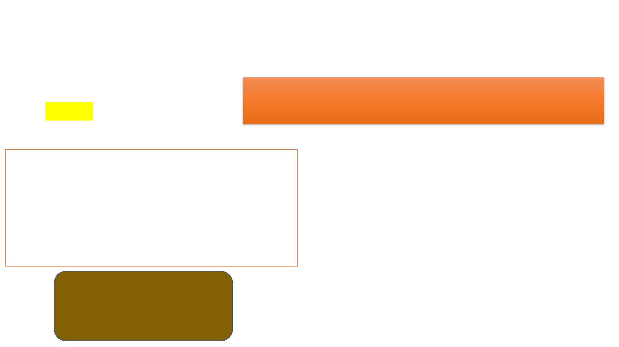
Q3. If a Buyer want to purchase a Sony TV of price Rs. 60,000/-
then through which procurement mode he/she can purchase ?
A.Direct Purchase
B.L1 Purchase
C.PAC Direct Purchase
D.PAC Bid
Note:- If Buyer wants to buy any specific OEM’s product then he has to go
for Proprietary Article Certificate (PAC) buying after obtaining necessary
approvals of competent authorities for PAC buying as per GFR-2017.
(a) In case a Govt. Buyer on GeM wants to make procurement
on proprietary basis on the GeM Portal after obtaining the
requisite approvals / PAC certificate from their competent
authority as per Rule 166 of GFR-2017, the Buyer can use
PAC filter provided on GeM for selecting a specific model/
make available from a particular GeM Seller. As per GFR,
Proprietary Article Certificate in the following form should be
available with Buyer before procuring the goods under PAC
Buying:
(i)The indented goods are manufactured by M/s. ...................
(ii) No other make or model is acceptable for the following
reasons: ..................
(iii) Concurrence of Finance wing to the proposal vide: ………..
(iv) Approval of the competent authority vide: ……………..
Except for direct buying up to Rs. 25,000/- subject to
establishing the reasonableness of price, the bidding will
be mandatory for procurements above Rs. 25,000/-. As
result of bidding, the response could be as under:
i. Only OEM is available or only single authorised seller is
available.
ii. OEM as well as multiple authorized Sellers are available.
iii. Multiple authorised Sellers of the OEM are available.
PAC Buying Limit
• 0-25,000 = PAC Direct Purchase
• > 25000= Mandatorily PAC BID

Slide 12
Q4. From which of the amount and above participation of
Bid/Reverse auction is mandatory?
A.25,000
B. 50000
C. 5,00,000
D.1,00,000

Slide 13
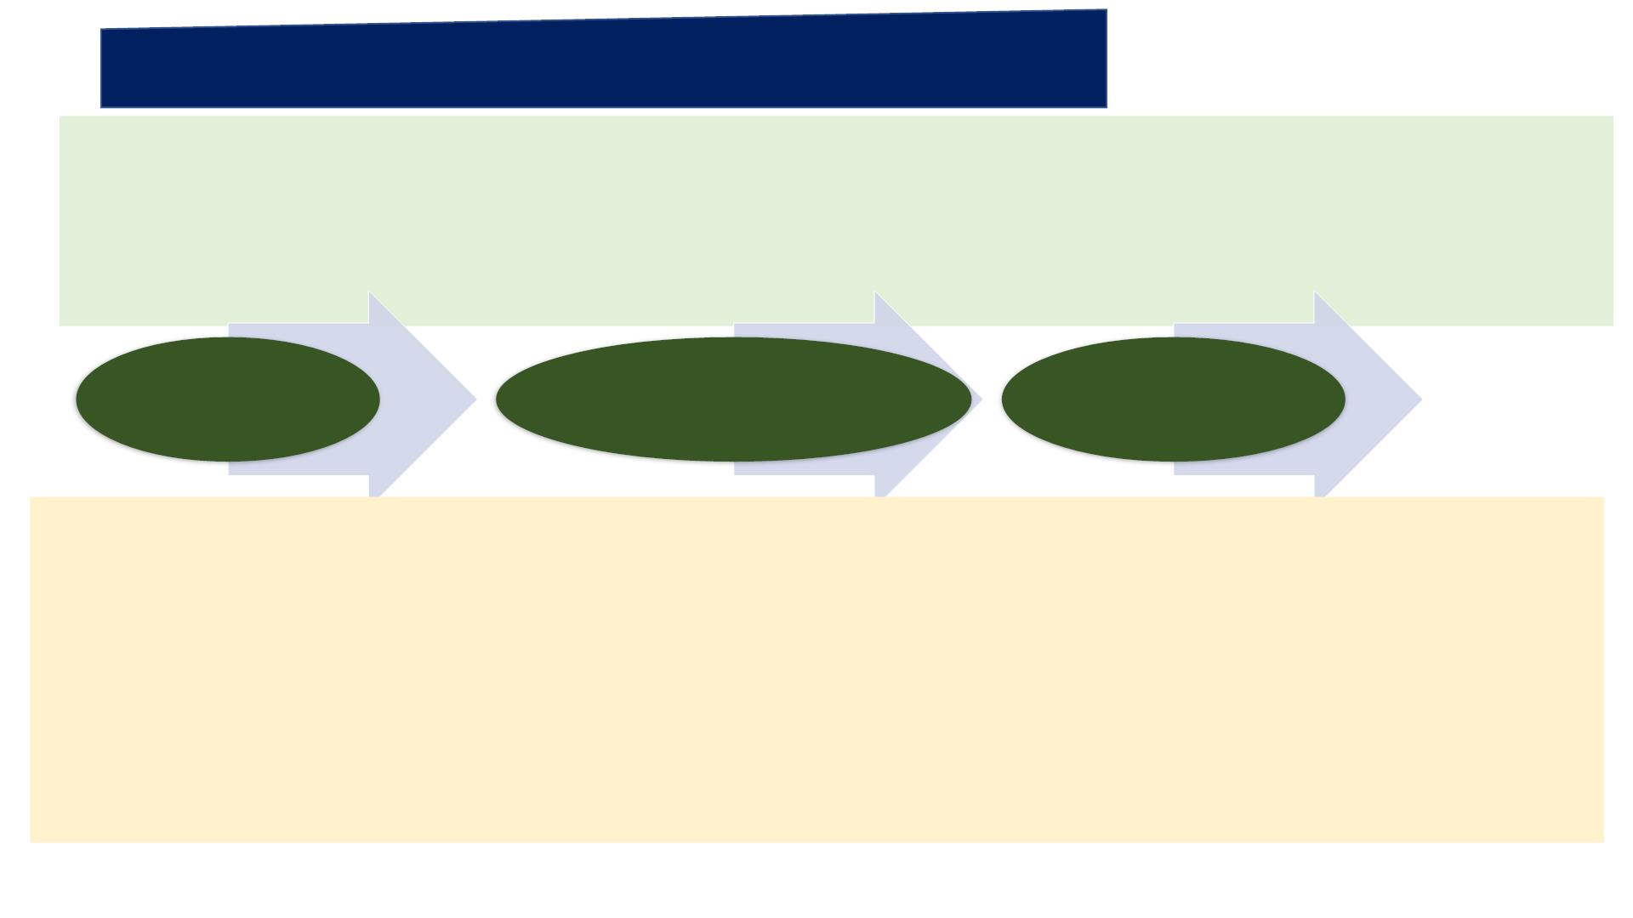
5.ꢀAMENDMENTSꢀTOꢀGENERALꢀFINANCIALꢀRULES,ꢀ2017
→ꢀBuyersꢀandꢀSellersꢀmayꢀpleaseꢀnoteꢀthatꢀMinistryꢀofꢀFinance,ꢀGovernmentꢀofꢀIndiaꢀhasꢀmadeꢀSIGNIFICANTꢀamendmentsꢀtoꢀGFRsꢀ
2017ꢀwhichꢀimmediatelyꢀcomeꢀintoꢀeffect.ꢀꢀꢀ
Asꢀperꢀtheꢀofficeꢀorder,ꢀRuleꢀ149ꢀhasꢀbeenꢀamendedꢀasꢀfollows:ꢀ
→ꢀ"TheꢀGeMꢀportalꢀshallꢀbeꢀutilizedꢀbyꢀtheꢀGovernmentꢀBuyersꢀforꢀdirectꢀon-lineꢀpurchasesꢀasꢀunder:ꢀ
< Rs. 25,000/-
Rs. 25,000-5,00,000/-
> Rs. 500000/-
(I)ꢀUpꢀtoꢀRs.ꢀ25,000ꢀthroughꢀanyꢀofꢀtheꢀavailableꢀsuppliersꢀonꢀtheꢀGem,ꢀmeetingꢀtheꢀrequisiteꢀquality,ꢀspecificationꢀandꢀ
deliveryꢀperiod.ꢀ
(ii)ꢀAboveꢀRs.ꢀ25,000ꢀandꢀupꢀtoꢀRs.ꢀ5,00,000ꢀthroughꢀtheꢀGeMꢀSellerꢀhavingꢀlowestꢀpriceꢀamongstꢀtheꢀavailableꢀsellersꢀ
(excludingꢀAutomobilesꢀwhereꢀcurrentꢀlimitꢀofꢀ30ꢀlakhꢀwillꢀcontinue),ꢀofꢀatꢀleastꢀthreeꢀdifferentꢀmanufacturers,ꢀonꢀGEM,ꢀ
meetingꢀtheꢀrequisiteꢀquality,ꢀspecificationꢀandꢀdeliveryꢀperiod.ꢀTheꢀtoolsꢀforꢀonlineꢀbiddingꢀandꢀonlineꢀreverseꢀauctionꢀ
availableꢀonꢀGeMꢀcanꢀbeꢀusedꢀbyꢀtheꢀBuyersꢀevenꢀforꢀprocurementsꢀlessꢀthanꢀRs.ꢀ5,00,000.ꢀ
(iii)ꢀAboveꢀRs.ꢀ5,00,000ꢀthroughꢀtheꢀsupplierꢀhavingꢀlowestꢀpriceꢀmeetingꢀtheꢀrequisiteꢀquality,ꢀspecificationꢀandꢀdeliveryꢀ
periodꢀafterꢀmandatorilyꢀobtainingꢀbidsꢀusingꢀonlineꢀbiddingꢀorꢀreverseꢀauctionꢀtoolꢀprovidedꢀonꢀGeMꢀ
(excluding Automobiles where current limit of 30 lakh will continue)."
https://admin.gem.gov.in/news/admin/showFile/AmendmentsinGeneralFinancialRulesGFR20171556037795.pdf

Slide 14
Q4. From which of the amount and above participation of Bid/Reverse
auction is mandatory?
A. 25,000
B. 50000
C. 5,00,000
D. 1,00,000

Slide 15
Q5. What is the purchase limit of automobiles as direct purchase?
A.2,50,000
B.5,00,000
C. 20,00,000
D.30,00,000

Slide 16
5.ꢀAMENDMENTSꢀTOꢀGENERALꢀFINANCIALꢀRULES,ꢀ2017
→ꢀBuyersꢀandꢀSellersꢀmayꢀpleaseꢀnoteꢀthatꢀMinistryꢀofꢀFinance,ꢀGovernmentꢀofꢀIndiaꢀhasꢀmadeꢀSIGNIFICANTꢀamendmentsꢀtoꢀGFRsꢀ
2017ꢀwhichꢀimmediatelyꢀcomeꢀintoꢀeffect.ꢀꢀꢀ
Asꢀperꢀtheꢀofficeꢀorder,ꢀRuleꢀ149ꢀhasꢀbeenꢀamendedꢀasꢀfollows:ꢀ
→ꢀ"TheꢀGeMꢀportalꢀshallꢀbeꢀutilizedꢀbyꢀtheꢀGovernmentꢀBuyersꢀforꢀdirectꢀon-lineꢀpurchasesꢀasꢀunder:ꢀ
< Rs. 25,000/-
Rs. 25,000-5,00,000/-
> Rs. 500000/-
(I)ꢀUpꢀtoꢀRs.ꢀ25,000ꢀthroughꢀanyꢀofꢀtheꢀavailableꢀsuppliersꢀonꢀtheꢀGem,ꢀmeetingꢀtheꢀrequisiteꢀquality,ꢀspecificationꢀandꢀ
deliveryꢀperiod.ꢀ
(ii)ꢀAboveꢀRs.ꢀ25,000ꢀandꢀupꢀtoꢀRs.ꢀ5,00,000ꢀthroughꢀtheꢀGeMꢀSellerꢀhavingꢀlowestꢀpriceꢀamongstꢀtheꢀavailableꢀsellersꢀ
(excludingꢀAutomobilesꢀwhereꢀcurrentꢀlimitꢀofꢀ30ꢀlakhꢀwillꢀcontinue),ꢀofꢀatꢀleastꢀthreeꢀdifferentꢀmanufacturers,ꢀonꢀGEM,ꢀ
meetingꢀtheꢀrequisiteꢀquality,ꢀspecificationꢀandꢀdeliveryꢀperiod.ꢀTheꢀtoolsꢀforꢀonlineꢀbiddingꢀandꢀonlineꢀreverseꢀauctionꢀ
availableꢀonꢀGeMꢀcanꢀbeꢀusedꢀbyꢀtheꢀBuyersꢀevenꢀforꢀprocurementsꢀlessꢀthanꢀRs.ꢀ5,00,000.ꢀ
(iii)ꢀAboveꢀRs.ꢀ5,00,000ꢀthroughꢀtheꢀsupplierꢀhavingꢀlowestꢀpriceꢀmeetingꢀtheꢀrequisiteꢀquality,ꢀspecificationꢀandꢀdeliveryꢀ
periodꢀafterꢀmandatorilyꢀobtainingꢀbidsꢀusingꢀonlineꢀbiddingꢀorꢀreverseꢀauctionꢀtoolꢀprovidedꢀonꢀGeMꢀ
(excluding Automobiles where current limit of 30 lakh will continue)."
https://admin.gem.gov.in/news/admin/showFile/AmendmentsinGeneralFinancialRulesGFR20171556037795.pdf

Slide 17
Q5. What is the purchase limit of automobiles as direct purchase?
A.2,50,000
B.5,00,000
C. 20,00,000
D.30,00,000

Slide 18
Q6. Buyer who selects and process order through the GeM portal
is which type of user?
A. Primary user
B. Secondary user
C. Verifying authority
D. Any one of the above

Slide 19
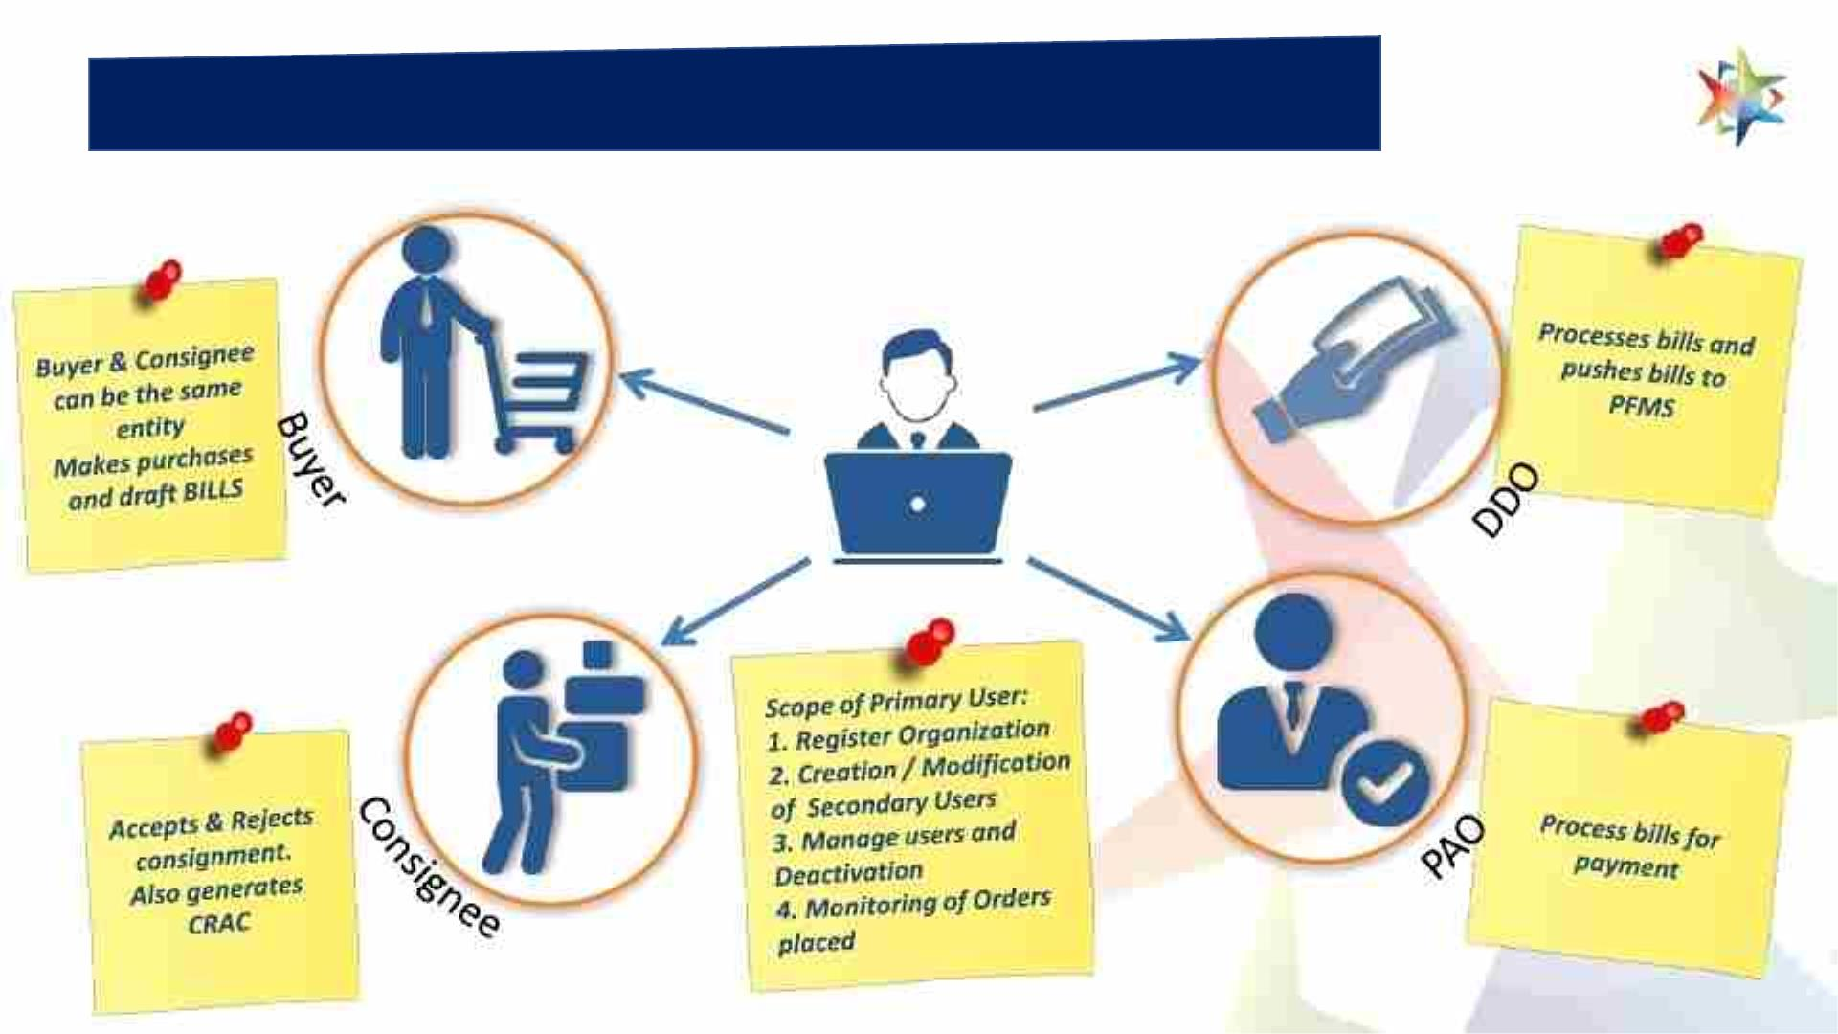
9. Buyer User Roles based on Segregationof Duties
PrimaryꢀUser

Slide 20

Q6. Buyer who selects and process order through the GeM portal is which
type of user?
A. Primary user
RoleꢀandꢀResponsibilitiesꢀofꢀBuyerꢀ
onꢀGeM:
Buyer Registration on GeM is divided in two categories:
i. Any officer of Central / State Government / PSU / Autonomous Bodies /
Local Bodies / Constitutional Bodies / Statuary Bodies at the level of Deputy
Secretary of the Government of India or equivalent
ii. Head of the Office at Sub Centre / Unit / Branch, can Register his / her
organization / unit on GeM portal as Primary User.
Primary User shall be responsible for registering the organization on GeM, for
creating User accounts for Secondary Users, assigning them roles and
responsibilities on GeM and for supervision of all transactions performed by
Secondary Users under him / her.
Primary User shall also be vicariously responsible for ensuring compliance of
General Financial Rules and / or Rules Governing Public Procurement in respect of
their organization, all GeM terms and conditions and other Procurement Policies /
Guidelines notified by the government from time to time, by all the secondary
users including timely payments and for dispute resolutions as per GeM terms and
conditions.
B. Secondary user
C. Verifying authority
D. Any one of the above
→ꢀ“BUYER”ꢀis the Contract
placing authority, which includes
Central/State Government
Ministries/Departments including
its attached/subordinate offices,
Central/State Public Sector Units
(PSUs) and Autonomous Bodies
acting through its authorized
officer(s) for and on behalf of
President of India/Governor of the
State /PSU/Autonomous Bodies, ,
as the case may be, for purchase of
Goods/Services offered by Sellers
on GeM.
Primary user cannot perform any Procurement related transactions on GeM portal.

Slide 21
Q7. The payment authority/DDO has to pay the sellers with in how many days?
A. Within 48 hr of the delivery
B. Within 10 days of Delivery
C. Within 48 hour of generation of CRAC
D. Within 10 days of generation of CRAC

Slide 22
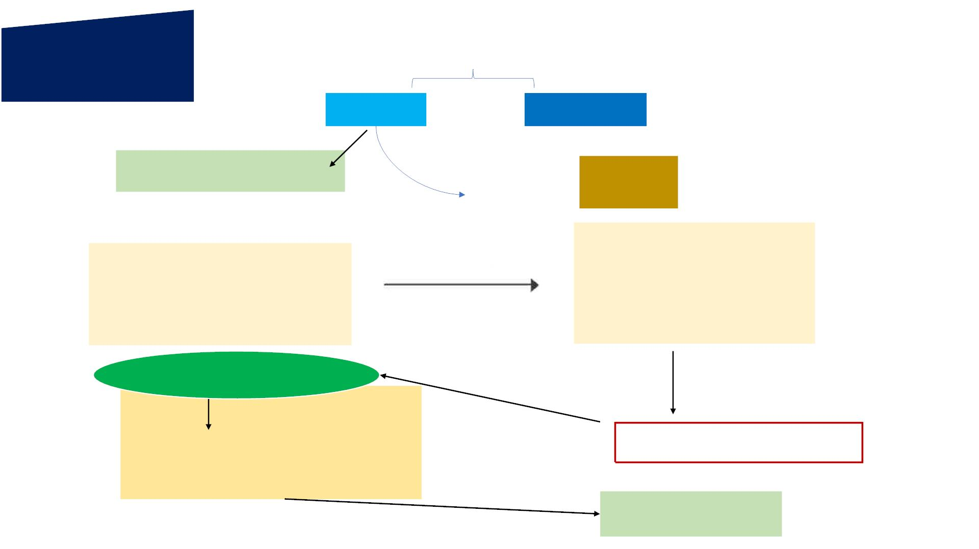
10. Workflow
and
timelines
CompetentAuthority
PrimaryꢀUser
SecondaryꢀUser
OOrrggaanni zi zaat ti oi onnꢀꢀRꢀReeggi si sttrraatti oi onn
Fillꢀtheꢀrequiredꢀfieldsꢀtoꢀregisterꢀthe
organizationꢀwithꢀGeM.
• Buyer
ꢀꢀꢀꢀ
SecondaryꢀUserꢀRegistration
ꢀ
ꢀConsignee
•
•ꢀDDO/PAO
BUYER
CONSIGNEE
SellerꢀConfirmation
•ꢀSelectꢀProductꢀꢀꢀꢀꢀꢀꢀꢀꢀꢀPriceꢀHoldingꢀ–ꢀ5ꢀdaysꢀforꢀDP
•ꢀSelectꢀmodeꢀofꢀProcurementꢀ(DP/L1/Bidding/RA)
•ꢀUploadꢀscannedꢀFinancialꢀApprovalꢀ–ꢀE-sign
•ꢀSanctionꢀOrderꢀ–ꢀE-sign
andꢀDeliveryꢀofꢀGoods
•ꢀReceiptꢀofꢀGoodsꢀꢀꢀꢀꢀꢀꢀꢀꢀꢀꢀꢀꢀꢀꢀꢀꢀꢀꢀꢀꢀꢀꢀꢀꢀꢀꢀꢀꢀꢀꢀꢀꢀꢀꢀWithin
•ꢀPRCꢀGenerationꢀꢀꢀꢀꢀꢀꢀꢀꢀꢀꢀꢀꢀꢀꢀꢀꢀꢀꢀꢀꢀꢀꢀꢀꢀꢀꢀꢀꢀꢀꢀꢀꢀꢀꢀꢀꢀ48ꢀHrs
DefaultꢀDelivery
Period
Withinꢀ15ꢀdays
•ꢀInspectionꢀofꢀGoods
•ꢀRightꢀtoꢀRejectꢀOrderꢀWITHINꢀ10ꢀDays
•ꢀGenerateꢀContractꢀorderꢀ–ꢀEꢀsign
•ꢀProcessꢀDraftꢀInvoice
•ꢀClaimꢀLDꢀ(Ifꢀany)
GoꢀBackꢀtoꢀBuyer
CRACꢀGeneration
Withinꢀ10ꢀDays
PAYMENTꢀAUTHORITY
•ꢀInvoiceꢀPayment
Noteꢀ:ꢀSellerꢀtoꢀtakeꢀawayꢀGoodsꢀwithinꢀ10
daysꢀIfꢀConsigneeꢀexercisesꢀRightꢀtoꢀreject.
•ꢀDDOꢀ–ꢀThroughꢀPFMS
•ꢀPAOꢀ–ꢀThroughꢀSBIꢀMOPS/ꢀThroughꢀOfflineꢀmode
SellerꢀConfirmsꢀand
OrderꢀClosed

Slide 23
Q7. The payment authority/DDO has to pay the sellers with in how many days?
A. Within 48 hr of the delivery
B. Within 10 days of Delivery
C. Within 48 hour of generation of CRAC
D. Within 10 days of generation of CRAC

Slide 24

8. RegistrationGuide - 5 Simple Steps
q CompetentꢀAuthorityꢀToꢀNominateꢀResponsibleꢀOfficialsꢀAsꢀPrimaryꢀ&ꢀSecondaryꢀUsersꢀ
VideꢀAnꢀInternalꢀOfficeꢀNote.
§ GFR Rule 149 & OGFR
q TheꢀPrimaryꢀUserꢀIsꢀRecommendedꢀToꢀFamiliarizeꢀWith:
§ Special Terms and Condition of GeM
§ Work Flow of GeM operation
§ Primary user Manual
q PrimaryꢀUserꢀisꢀrequiredꢀtoꢀopenꢀinboxꢀmailꢀfromꢀhis/herꢀofficial
e-mailꢀidꢀasꢀfilledꢀinꢀstep2ꢀꢀandꢀclickꢀonꢀverifyꢀemailꢀlink.
q PrimaryꢀUserꢀisꢀrequiredꢀtoꢀloginꢀwithꢀuserꢀidꢀandꢀpassword https://gem.gov.in/loginꢀ
CreatedꢀInꢀꢀStepꢀ2
(ꢀNotꢀPersonalꢀnameꢀorꢀPersonalꢀEmailꢀIDꢀ)
q PrimaryꢀꢀUserꢀꢀisꢀꢀrequiredꢀꢀtoꢀꢀfillꢀꢀupꢀꢀotherꢀꢀorganizationꢀꢀdetailsꢀꢀand detailsꢀofꢀverifyingꢀofficerꢀandꢀ
createꢀsecondaryꢀusersꢀasꢀnominated i.e.ꢀBuyer,ꢀConsignee,ꢀDDO ,ꢀandꢀpaoꢀasꢀtheꢀcaseꢀmayꢀbe.
TheꢀOrganizationꢀisꢀnowꢀfunctionallyꢀregisteredꢀwith
Note:ꢀVerifyingꢀOfficerꢀhasꢀnoꢀroleꢀtoꢀplayꢀinꢀRegistrationꢀprocessꢀexceptꢀDisableꢀPrimaryꢀUser,ꢀonlyꢀifꢀrequired

Slide 25
Q8. There shall be no EMD for Bids / RA having estimated value less
than
A.Rs. 25 lakh
B. Rs. 5 lakh
C. Rs. 30 lakh
D.Rs. 50 Lakh

Slide 26
Q8. There shall be no EMD for Bids / RA having estimated value less than
A. Rs. 5 lakh
ii. Start-ups as recognized by Department of Industrial Policy
and Promotion (DIPP).
iii. KVIC, ACASH , WDO, Coir Board, TRIFED and Kendriya
Bhandar.
B. Rs. 5 lakh
C. Rs. 30 lakh
D. Rs. 50 Lakh
iv. Sellers who have got their credentials verified through the
process of Vendor Assessment by Vendor Assessment
Agencies for the particular product for which Bid / RA has
been invited.
v. Sellers/ Service Provider having annual turnover of Rs 500
Crore.
vi. Micro and Small Enterprises registered with NSIC for the
particular product category whose credentials are
validated through NSIC database.
vii. Micro and Small Enterprises registered with DIC for the
particular product category whose credentials are
validated through DIC database.
There shall be no EMD for Bids / RA having estimated value less
than Rs. 25 lakh. For bids / RA having estimated value more
than Rs 25 Lakh, while finalizing e-Bid / RA, Buyer shall indicate
the exact amount of EMD required to be submitted by bidders
in the form of Bank Guarantee on GeM portal in the prescribed
format. Scanned copy of the same shall be uploaded by Seller
in the online bid and hard copy of the same will have to be
submitted directly to the Buyer within 5 days of bid
opening. GeM recommends quantum of EMD @ 1% of
estimated value of procurement. The Buyer also has the option
to select EMD between 1% to 5%. The same should be valid for
45 days beyond the bid validity.
viii. Sellers / Service Providers holding BIS License for the
particular product category whose credentials are
validated through BIS database.
Following categories of Sellers
shall however, be exempted from furnishing EMD:
i. Micro and Small Enterprises who are manufacturer of the
offered product category or service provider of that
category and give specific confirmation to this effect at
the time of bid submission and whose credentials are
validated online through Udyog Aadhaar
ix. Central / State PSUs.
x. Seller / Service Provider registered with designated
Agency / Authority as specified in the bid document by
the Buyer – such bidder shall have to upload scanned
copy of relevant registration document in place of EMD
document while bidding.

Slide 27
Q9. There shall be no Performance security / PBG requirement for
contracts:
A. Placed under Direct Purchase / L-1 Purchase Option
B. Placed through Bids / RA with estimated bid value up to Rs 5 Lakh (in case of Goods
contracts)
C. Placed through Bids / RA with estimated bid value up to Rs 5 Lakh (in case of Services
contracts)
D. A, B & C

Slide 28
Q9. There shall be no Performance security / PBG requirement for contracts:
A. Placed under Direct Purchase / L-1 Purchase Option
B. Placed through Bids / RA with estimated bid value up to Rs 5 Lakh
(in case of Goods contracts)
C. Placed through Bids / RA with estimated bid value up to Rs 5 Lakh
(in case of Services contracts)
7. PerformanceꢀSecurityꢀandꢀPerformance:
D. A , B & C
i. There shall be no Performance security / PBG requirement for contracts:
a) Placed under Direct Purchase / L-1 Purchase Option under Para (i) and (ii) of GFR
rule 149;
b) Placed through Bids / RA with estimated bid value up to Rs 5 Lakh (in
case of Goods contracts); and
c) Placed through Bids / RA with estimated bid value up to Rs 5 Lakh (in
case of Services contracts)
ii. In case of contracts placed following e-Bidding / RA, Performance Security /
Performance Bank Guarantee (PBG) (in format provided on GeM) valid for 2
months beyond the date of completion of all contractual obligations
including warrantee obligations, will be obtained from the successful Bidder,
for ensuring due performance of the contract. GeM recommends quantum of
Performance Security @ 2% of the value of contract. The Buyer also has the
option to select Performance Security between 2% to 10%. While finalizing e-
Bid / RA, Buyer shall indicate the % of Performance Security required to be
submitted by successful bidders. In case of any extension of contract
obligation period, the seller shall be liable to suitably extend the validity of

Slide 29
Q10 . Deviations from the terms and conditions of procurement on GeM, including general
terms and conditions, special and additional terms and conditions and any other relevant
Government rules and guidelines, are termed as “deviation”.
When a seller deviating such terms/guideline buyer has to
A. Call the respective seller
B. Call the help desk of GeM
C. Raise an incident against respective seller
D. Send a mail to GeM

Slide 30

Q10 . Deviations from the terms and conditions of procurement on GeM, including general terms and
conditions, special and additional terms and conditions and any other relevant Government rules and
guidelines, are termed as “deviation”.
When a seller deviating such terms/guideline buyer has to
A. Call the respective seller
B. Call the help desk of GeM
C. Raise an incident against respective seller
D. Send a mail to GeM
IncidentꢀmanagementꢀPolicyꢀonꢀGeM:ꢀGeM is a
All administrative actions under this Incident
trust based system and selfdeclaration is the key, along with a
strong automated process to penalize any deviant behaviour on
part of Sellers / Buyers. For this purpose, deviations from the terms
and conditions of procurement on GeM, including general terms
and conditions, special and additional terms and conditions and any
other relevant Government rules and guidelines, are termed as
“deviation”. A deviation can occur while listing the products on
GeM, at pre-contract stage, during bidding or at post contract stage
on GeM. The mechanism for reporting and initiating action on such
deviation has been detailed in the Incident Management Policy
available on GeM portal under Resources. All stake holders of GeM
shall be bound by the actions as detailed in the Incident
Management Policy.
management Policy, taken by GeM against
any of the stakeholders shall not cause any
limitation on the legal and/or contractual
remedies including any financial recoveries,
available to Buyers/Sellers under the Terms
and Conditions of contract and/or GeM policies.
In case the Buyer / Seller choose to
pursue any of these remedies, GeM shall not be
made party to such proceedings /
remedial actions taken by Buyer/Seller under the
contractual provisions.

Slide 31
Q12. As per the notification No- 28899 DT- 22/08/2019 in which case
Buyer organization can purchase outside GeM ?
A.The required product is not available on GeM portal
B.The price of GeM is more than local market (Outside GeM)
C.The Bidding price of GeM is more than Locan market ( Outside GeM)
D.None of the above

Slide 32
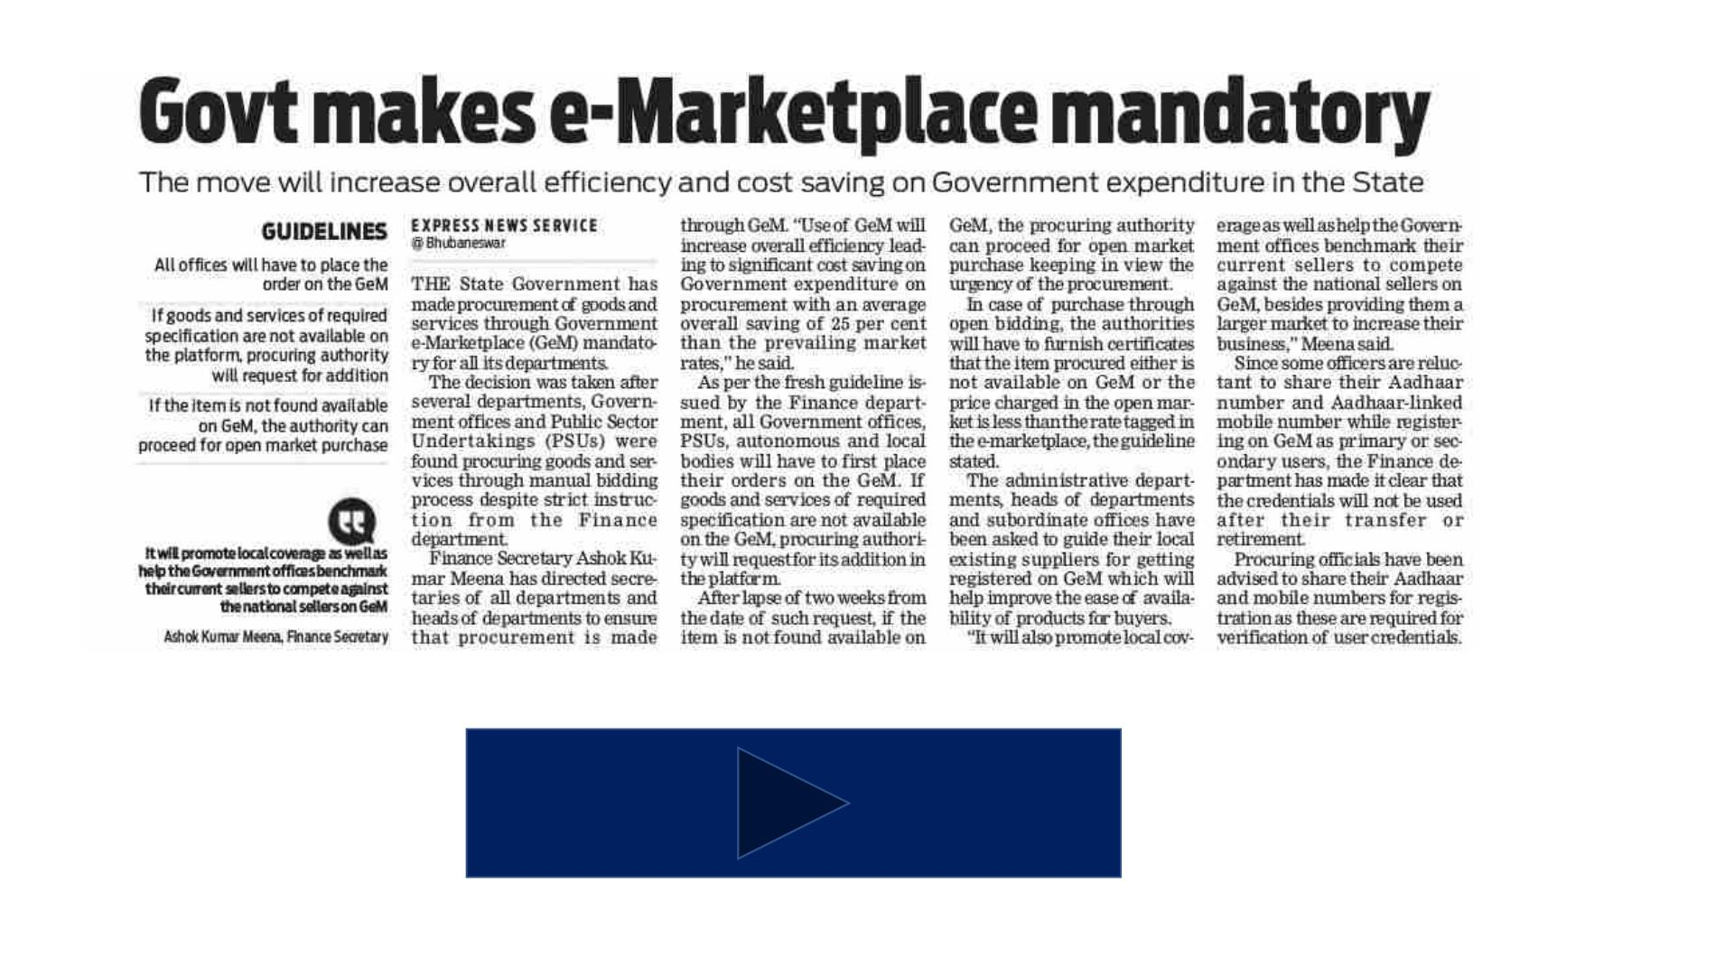
Notification No-28899
Date- 22/08/2019

Slide 33
Q12. As per the notification No- 28899 DT- 22/08/2019 in which case
Buyer organization can purchase outside GeM ?
A.The required product is not available on GeM portal
B.The price of GeM is more than local market (Outside GeM)
C.The Bidding price of GeM is more than Local market ( Outside GeM)
D.None of the above

Slide 34

13. Support
→ Tollfree No
→ Officials
→ Business
Facilitator
→ LMS
→ FAQ
GeM Odisha
→ YouTube
Channel
DTI , Finance Dept
GeM
SGEMPU ,DTI ,
Finance Department ,
Government of Odisha
Address:ꢀ5th Floor, Unit, 3, Unit 3,
Kharabela Nagar, Bhubaneswar, Odisha
751001
MANAS RANJAN DAS
ASSISTANT DIRECTOR ( GeM)
9437289394

