Slide 1
National Pension System
Under
Government of Odisha
NPS Cell, DT&I(O)
Notes:
Green Colour should be highlighted

Slide 2
Features of NPS
Replacement to existing Pension system stipulated by O.C.S.Pension Rule-1992
1
2
Regulated by PFRDA Act-2013 & a Defined Contribution system
3
Mandatory for State Government Employees who have joined on or after 1st Jan, 2005 under regular pensionable Establishment
Features of NPS
4
Applicable to Contractual Employees joined vide Contractual Appointment Rule-2013 by GA Dept.
5
Unique and Portable PRAN
6
Tire-I & Tire –II accounts
7
Tax Benefits (U/S 80 CCD(1) ( up to 1.50 lacs), 80 CCD(1B) up to 50Thousand, 80 CCD(2) (10% of salary -MC)
8
Investment in secured fund by PFMs & Annuity at Retirement
Notes:
Green Colour should be highlighted

Slide 3
Benefits of NPS
Unique Tax Benefits
01
Portability
06
02
05
Benefits Of Low Cost
Transparency
04
03
Protection of subscriber's interest
Unique 12 Digit PRAN
Notes:
Green Colour should be highlighted

Slide 4
NPS Intermediaries
Custodian
Annuity Service Providers (ASPs)
NPS Trust
NPS Intermediaries
Trustee Bank
Central Recordkeeping Agencies (CRA)
Pension Fund Managers
Nodal Office
Notes:
Green Colour should be highlighted

Slide 5





NPS Architecture
Information Flow
Directorate of Treasuries & Accounts
Centralised
NPS TRUST
District
Treasury
Office
Fund Flow
Trustee Bank
Fund
Receipt
Confirmation
Custodian
NAV
Drawing &
Disbursement Officer
PFM’s
Annuity Service Providers
Subscriber
Notes:
Green Colour should be highlighted

Slide 6
Tier-I & Tier-II Accounts under NPS
Tire-I
Mandatory
Monthly Contribution of employee :10% of (Pay + DA)
Tire-II
Optional
Withdrawal partially/ Fully at any point of time
Investment in secured fund
No restriction of contribution amount/ period
Opened at PoP / e-NPS
No matching contribution
Matching Contribution by Employer (14%)
Tax exemption (EEE)
Partial Withdrawal up to 25%of own contribution
Taxable
Initial deposit – 1000/-
Notes:
Green Colour should be highlighted

Slide 7





Units
Units
Units
How NPS works
Employee Contribution
(10%)
Employer Contribution
(14%)
Trustee Bank
Through Accredited Bank
Pension Funds
Lump sum
Pension Corpus
(NAV X Units)
Annuity (Pension)
Notes:
Green Colour should be highlighted

Slide 8
Growth in Contributions & AUM in State Govt.
There is an appreciation of Rs 80,964 crores as on 31-03-2021
Notes:
Green Colour should be highlighted

Slide 9



Investment Pattern for Tier-I Account
Pension Funds
Default Pension Funds for State Govt. employee - SBI Pension Fund , UTI Retirement Solutions, and LIC Pension Fund.
Notes:
Green Colour should be highlighted

Slide 10
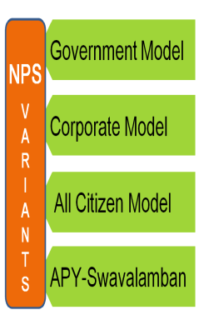
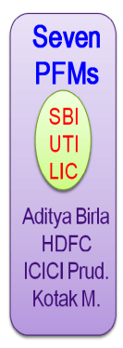

Choice of Investment Pattern for Tier-I Account
Vide F.D. Notification No-15727/F, Dt.08.06.2021
Investment
As per the norms of PFRDA
(Max. 15% of Equity Exposure)
85% under Fixed Return Asset
SBI (39%)
Pension
Wealth
UTI (17%)
LIC (44%)
Investment Choice
E: 75% (High Risk)
C: 100% (Medium Risk)
G: 100% (Low Risk)
Pension
Wealth
PFM
Conservative
(Max 25% of Equity Exposure)
Pension
Wealth
PFM
Moderate
(Max 50% Equity Exposure)
Aggressive
(Max 75% Equity Exposure)
Based on Life Cycle Matrix
Notes:
Green Colour should be highlighted

Slide 11
Choice of Investment Pattern for Tier-I Account
Individual Subscriber
Exercises choice of PF and Investment Pattern
Pension Fund
Investment Pattern
No Choice ≡ Default Scheme
Contributions in pre-defined PFs (3) and as per pre-defined asset allocation
Allowed once per year
Allowed twice per year
Notes:
Green Colour should be highlighted

Slide 12
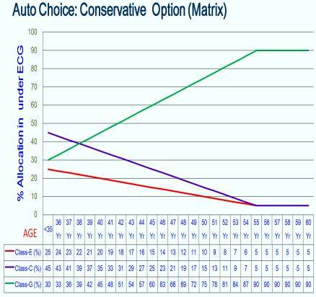
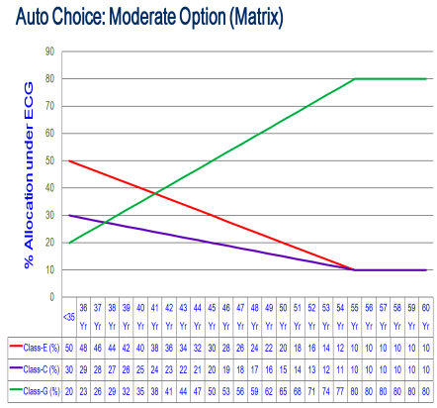
Choice of Investment Pattern for Tier-I Account
Vide F.D. Notification No-15727/F, Dt.08.06.2021
LOW RISK At Higher age
No need to place separate request.
Every Year it will happen Automatically
Notes:
Green Colour should be highlighted

Slide 13




Procedure for Processing Change Request
Subscriber
Drawing & Disbursing Officer
Treasury Officer
Pre-Requisites:
Checking of PFMs/ Scheme Details ( https://npscra.nsdl.co.in/nav-search.php )
Subscriber can Apply online/ Offline
Application shall be submitted to Dist./Spl. Treasury through DDO in Form-GoS-S3 (Mandatory in all cases for record keeping)
Form can be downloaded from https://npscra.nsdl.co.in/download/non-government-sector/all-citizens-of-india/forms/GoS_S3_Scheme_Preference_Change_Form_1.4.pdf
Conditions for Change request:
Scheme can be changed twice a year and PFM can be changed once a year.
Already invested corpus will be redeemed and reinvested as per new PFM and Scheme combination chosen
To be considered at the time of ISS
Notes:
Green Colour should be highlighted

Slide 14
Role of Dist./Spl. Treasury (DTO)
Updation of Subscriber details
Registration
Withdrawal
Deduction of monthly contribution
Update Contact details, Mail Id, Nominee Details on receipt of Application
Processing of Online CSRF
Online processing of partial withdrawals
Ensure deduction of NPS contributions from 2nd month’s salary
Submit Physical CSRFs to NPS Cell
Intimate auto generated Claim Ids to Retiring employees
Online process withdrawal Applications with guidance for Annuitisation
Procesing of Inter Sector Shifting Applications
Report Missing Credits to NPS Cell with due enquiry
Approval of Arrear NPS
Notes:
Green Colour should be highlighted

Slide 15
Role of DDO
1
Acts as interface between Subscriber & Treasury
2
Timely Registration of Newly joined Employee under NPS
Role of DDO
3
Timely Deduction of monthly Regular Contributions
4
Forwarding Requests of Subscribers to Treasury
5
Verify Withdrawal Applications and to forward to Try.
6
Intimate the Missing Credits of Subscribers to Treasury
7
Log In DDO interface in CRA-NSDL for monitoring
8
Grievance Management
Notes:
Green Colour should be highlighted

Slide 16
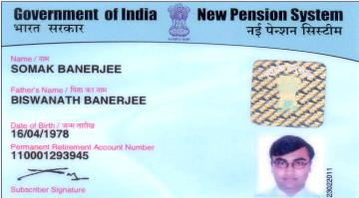
Role of CRA-NSDL
SMS & Email Alert for PRAN generation and Credit of contribution amount
Registration of Nodal Offices in the CRA system
Issuance of unique PRAN to Subscribers
Contribution Accounting
Issuance of annual PRAN Transaction Statement
Providing regular MIS to PFRDA and other entities such as SABs
Grievance Resolution
Dashboard for PFRDA & State Government
16
Notes:
Green Colour should be highlighted

Slide 17
Exit from NPS
On attaining the Age of superannuation age
Min. 40% to be utilized for purchase of Annuity
Exit before attaining the superannuation age or voluntary retirement
Min. 80% to be utilized for purchase of Annuity
Death due to any cause before superannuation
Min. 80% to be utilized by Nominee for purchase of Annuity.
The lump sum can be deferred which can be withdrawn at any time between superannuation and 70
Annuity purchase can also be deferred for maximum period of 3 years
If Corpus < =Rs. 5.00 Lakh- Option to withdraw complete pension wealth (Only in superannuation cases)
If Corpus <= Rs. 2.50 Lakh- Option to withdraw complete pension wealth
If age of the subscriber less min. age required for the purchase of annuity, such subscriber shall continue to subscribe to the National Pension System, until he or she attains the age of eligibility for purchase of any annuity
If Corpus < =Rs. 5.00 Lakh- Option to withdraw complete pension wealth by the Nominees.
Notes:
Green Colour should be highlighted

Slide 18
Partial Withdrawal from NPS
Conditions
Subscriber should be in NPS for 3 years Amount should not exceed 25% of the contributions made by the subscriber
Purpose for which partial withdrawal allowed
Higher education of his/her children Marriage of his/her children Purchase or construction of residential house or flat Treatment of specified illnesses (including covid) Disability of more than 75% Skill development/re-skilling or any other self-development activities Establishment of own venture or any start-ups
Frequency
Maximum 3 (three) times during entire tenure Partial withdrawal on declaration basis, no documentary proof required
Notes:
Green Colour should be highlighted

Slide 19
Amount permissible under Partial Withdrawal
 | Employee Contribution (Rs.) | Employer Contribution (Rs.) | Total Contribution | Market value
Month 1 | 4000 | 4000 | 8000 | 9000
Month 2 | 4000 | 4000 | 8000 | 8750
Month 3 | 4000 | 4000 | 8000 | 8250
Total (1+2+3) | 12000 | 12000 | 24,000 | 26,000
Amount of 1st Partial Withdrawal (max. permissible) ?
a.) 25% of 26,000/- = Rs.6,500/-
b.) 25% of Rs.24,000/- = Rs.6,000/-
c.) 25% of 12,000/- = Rs.3,000/-
c.) 1st Partial Withdrawal = 25% of Rs.12,000/-= Rs.3,000/-
Rationale- Partial withdrawal = up to 25% of own contribution only; will not include returns hence, not calculated on total corpus.
Amount of 2nd Partial Withdrawal (max. permissible) ?
a.) 25% of 48,000/- = Rs.12,000/-
b.) 25% of Rs.24,000/- = Rs.6,000/-
c.) 25% of 12,000/- = Rs.3,000/-
Month 4 | 4000 | 4000 | 8000 | 8,200
Month 5 | 4000 | 4000 | 8000 | 8,150
Month 6 | 4000 | 4000 | 8000 | 8,100
Total (4+5+6) | 12,000 | 12,000 | 24,000 | 24,450
Grand Total (1+2…+6) | 24,000 | 24,000 | 48,000 | 50,450
c.) 2nd Partial Withdrawal (= up to 25% of own contribution only)
25% of Rs.12,000/- = Rs.3,000/-
Rationale- If once withdrawn, the subsequent withdrawal upto 25% will be calculated on subsequent contributions only (i.e. Incremental contributions)
Notes:
Green Colour should be highlighted

Slide 20
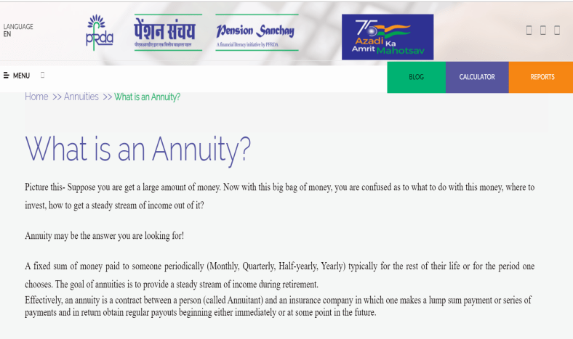

Annuity Purchase
Notes:
Green Colour should be highlighted

Slide 21


Annuity Purchase
Execution of Contract with ASP
Transfer of Money (Purchase Price)
Choice of Annuity Plan
+
+
Pension Corpus
Pension Corpus
Annuity Service Provider
Annuity Plan
Superannuating Subscriber
Purchase Price
Annuitant
₹
₹
₹
₹
Annuity
Pension
Notes:
Green Colour should be highlighted

Slide 22
Factors Affecting Annuity Size
Entry Age of Annuitant
Plan Chosen
Gender
Age of Spouse
Options added
Higher the entry age, higher is the pension amount.
Plans where good annuity rates may not be available-
where there is return of Purchase Price,
where payment of annuity/ pension extends beyond the life of the annuitant
payment of annuity/ pension extends beyond the life of the annuitant i.e. pension is payable to spouse and then purchase price is returned to the nominee.
Factors Affecting Annuity Size (Pension)
Women may get less money than men of the same entry age because they are expected to live longer.
In case one chooses a plan in which the pension is payable to spouse, the age of spouse would also impact the annuity rate and the pension available.
One gets the highest pension income (annuity) with the basic plan that covers only the Annuitant (plan (i)). Any options one adds (like annuity to spouse and/ or ROC to last survivor) only lowers the pension amount. That’s because the extra additions increases the cost of the Insurer/ Annuity Provider (remember- always understand the annuity from the Insurer’s side!)
Notes:
Green Colour should be highlighted

Slide 23
Annuity Types
01
Annuity for life --payment of annuity ceases on death
Annuity guaranteed for 5, 10, 15 or 20 years and for life thereafter
02
03
Annuity for life with return of purchase price on death
04
Annuity for life increasing at simple rate of 3% p.a
Annuity for life with a provision for 50% of the annuity to the spouse of the annuitant for life on death of the annuitant
05
06
Annuity for life to the subscriber, after death of subscriber 100% annuity to the spouse and after death of spouse return of the purchase price to the nominee
Notes:
Green Colour should be highlighted

Slide 24
Types of Annuity Plan
Annuity Payable for | Particulars
life | Pension for life to the Annuitant till he/she is alive. After death of Annuitant, no pension to surviving spouse/ nominee and the purchase price is lost.
5/10/15/20 yrs and life thereafter | Pension for life to the Annuitant till he/she is alive. In case the Annuitant dies within 5/10/15/20 years, spouse gets Annuity for the remaining period only. After such period, the purchase price is lost. For eg. say an Annuitant chooses a 15 year plan. If Annuitant dies after 10 years, pension will be available to the surviving spouse. But if the Annuitant dies after 15 years, no pension will be available to the surviving spouse and the purchase price will be lost. Also, in case the spouse has died before the Annuitant, the Purchase price is lost.
life with ROC (Return of Capital) on death of annuitant- | Pension for life to the Annuitant till he/she is alive. After death of Annuitant, the Purchase price i.e. lump sum used to buy Annuity is returned to the nominee.
life increasing at 3% simple p.a | Pension for life to the Annuitant till he/she is alive increasing at simple rate of 3% per annum. After death of Annuitant, no pension to surviving spouse/ nominee and the purchase price is lost.
life with 50% annuity payable to spouse on death of annuitant | Pension for life to the Annuitant till he/she is alive. After death of Annuitant, 50% pension to surviving spouse. After death of spouse the purchase price is lost. Also, in case the spouse has died before the Annuitant, the Purchase price is lost
life with 100% annuity payable to spouse on death of annuitant | Pension for life to the Annuitant till he/she is alive. After death of Annuitant, 100% pension to surviving spouse. After death of spouse the purchase price is lost. Also, in case the spouse has died before the Annuitant, the Purchase price is lost.
life with 100% annuity payable to spouse on death of annuitant with ROC on death of Last Survivor | Pension for life to the Annuitant till he/she is alive. After death of Annuitant, 100%
Notes:
Green Colour should be highlighted

Slide 25
Annuity Providers
Life Insurance Corporation of India
SBI Life Insurance Co. Ltd
ICICI Prudential Life Insurance Co. Ltd
HDFC Standard Life Insurance Co Ltd Star
Star Union Dai-ichi Life Insurance Co. Ltd
Edelweiss Tokio Life Insurance Company Limited
Bajaj Allianz Life Insurance Company Limited
India First Life Insurance Company Limited
Canara HSBC Oriental Bank of Commerce Life
Kotak Mahindra Life Insurance Company Limited
Tata AIA Life Insurance Company Limited
Max Life Insurance Company Limited
PNB MetLife Insurance Company Limited
Aditya Birla Sun Life Insurance Company Limited
Notes:
Green Colour should be highlighted

Slide 26
Default Annuity
It provides for annuity for life of the subscriber and his or her spouse (if any) with provision for return of purchase price of the annuity and upon the demise of such subscriber, the annuity shall be re-issued to the family members in the order as specified below:
living dependent mother of the deceased subscriber
living dependent father of the deceased subscriber
After the coverage of all the family members specified above, the purchase price shall be returned to the surviving children of the subscriber and in the absence of children, the legal heirs of the subscriber, as may be applicable
The subscriber who wishes to opt out of the default option and wishes to choose the annuity contract of his choice from the available annuity contracts with the ASPs, shall be required to specifically opt for such an option
Notes:
Green Colour should be highlighted

Slide 27
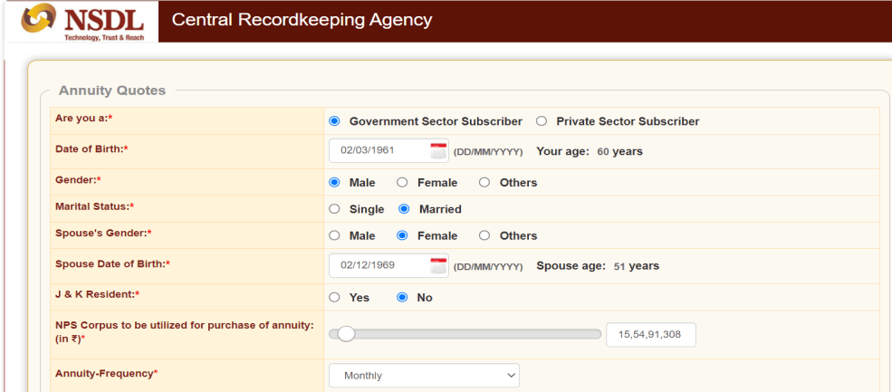
Annuity Quotes DEtails
Notes:
Green Colour should be highlighted

Slide 28
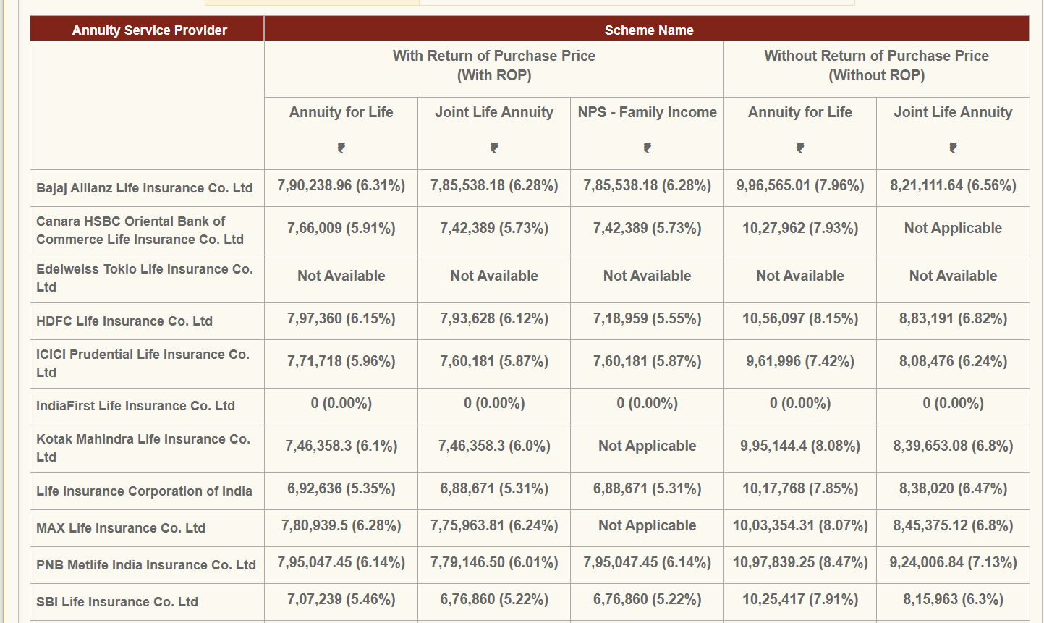
Annuity Quotes DEtails
Notes:
Green Colour should be highlighted

Slide 29
Types of Annuity Plans & Rates
 |  | Entry Age
 | Annuity Option | 30-39 | 40-49 | 50-59 | 60-69 | 70-79 | 80-84 | 85
1 | Annuity payable for life | 6.55% | 6.89% | 7.54% | 8.79% | 11.52% | 17.33% | 21.90%
2.a | Annuity payable for 5 yrs and life thereafter | 6.55% | 6.89% | 7.52% | 8.70% | 11.14% | 15.11% | 17.26%
2.b | Annuity payable for 10yrs and life thereafter | 6.54% | 6.87% | 7.45% | 8.51% | 10.30% | 12.11% | 12.67%
2.c | Annuity payable for 15 yrs and life thereafter | 6.53% | 6.84% | 7.37% | 8.25% | 9.34% | 9.98% | 10.09%
2.d | Annuity payable for 20 yrs and life thereafter | 6.51% | 6.80% | 7.27% | 7.94% | 8.48% | 8.66% | 8.68%
3 | Annuity payable for life with ROC on death of annuitant | 6.21% | 6.25% | 6.30% | 6.38% | 6.50% | 6.69% | 6.80%
4 | Annuity payable for life increasing at 3% simple p.a. | 4.69% | 5.06% | 5.75% | 7.00% | 9.70% | 15.34% | 19.83%
5 | Annuity payable for life with 50% annuity payable to spouse on death of annuitant | 6.44% | 6.69% | 7.16% | 8.07% | 10.01% | 14.07% | 17.27%
6 | Annuity payable for life with 100% annuity payable to spouse on death of annuitant | 6.33% | 6.49% | 6.81% | 7.46% | 8.84% | 11.84% | 14.26%
7 | Annuity payable for life with 100% annuity payable to spouse on death of annuitant with ROC on death of last survivor | 6.19% | 6.21% | 6.25% | 6.30% | 6.40% | 6.53% | 6.62
*Only for Illustrative purposes
Notes:
Green Colour should be highlighted

Slide 30
Pension / Annuity Formula
Concept | Particulars
Pension/ Annuity Formula | Pension = Annuity Rate X Purchase Price
Calculating Pension Amount | Annuity rate (type 7; age= 61 years) = 6.30% p.a. Purchase price = Rs.60,00,000/- Pension = 6.30% X 60,00,000 = Rs.3,80,000 p.a. In other words, with an Annuity Rate of 6.30% and a Purchase Price (initial lump sum amount placed with an Insurer/ Annuity Provider), the Annuitant ( recipient of Pension) would receive a Pension of Rs.3.80 Lakh per annum.
*Only for Illustrative purposes
Notes:
Green Colour should be highlighted

Slide 31
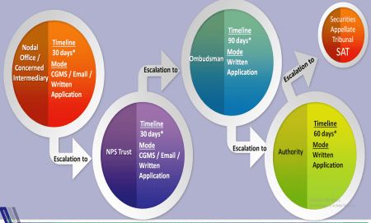
Grievance Management
Contribution amount not reflected in account
Not Processed/Delay in Processing Subscriber Changes Request
Delay in remitting contribution amount
Incorrect contribution amount
Incorrect processing of subscriber details
PRAN card related
SOT (Statement of Transaction) related
S2 form not processed(Delay in Processing Subscriber Changes Request)
Notes:
Green Colour should be highlighted

Slide 32
Nomination in NPS
Nomination is mandatory.
Definition of ‘FAMILY’ for “Nomination” (in NPS) purpose-
Male subscriber- his legally wedded wife, his children, whether married or unmarried, his dependent parents and his deceased son’s widow and children: | Female subscriber- her legally wedded husband, her children, whether married or unmarried, her dependent parents, her husband’s dependent parents and her deceased son’s widow and children
Examples of Invalid Nominations- Any nomination in favour of a person not belonging to his family shall be INVALID Nomination made before marriage shall be deemed to be INVALID; fresh nomination shall be made by the subscriber on his marriage and any If at the time of making a nomination the subscriber has no family, the nomination may be in favour of any person or persons but if the subscriber subsequently acquires a family, such nomination shall forthwith be deemed to be invalid and the subscriber shall make a fresh nomination in favour of one or more persons belonging to his family
Where no valid nomination exists, at the time of exit of such subscriber on account of death, the nomination, if any existing in the records of such subscriber with his or her employer shall be treated as nomination
Notes:
Green Colour should be highlighted

Slide 33
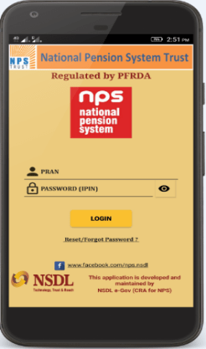
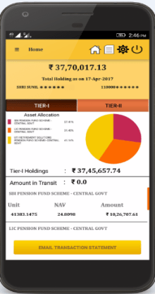
Mobile App
Subscribers can avail the following Benefits:
Make Voluntary Contributions
FATCA Certification
View Tier 1 & 2 Holding Value, Units & NAV on a Daily Basis
Request an email for Transaction Statements of all Financial Years
View Last Five Contribution Details
Tier II Withdrawal
Change Address on the basis of AADHAAR
Update Mobile, Landline Numbers and email ID
Receive in-App Updates from PFRDA & CRA
Change Security Settings i.e. Password / Secret Q&A
Remember PRAN and Password Facility enabled
Now, also available in Hindi Version
Notes:
Green Colour should be highlighted

Slide 34
E-NPS
Useful for Employees under O.C.S. Pension Rule-1992 for
Registration under NPS
Contribution to PRANs (Tier I)
Tier II Activation
Useful for Employees under NPS for
Additional Contribution to PRAs (Tier I)
Tier II Activation
Contribute to PRAN by using
Debit Card / Credit Card / Net Banking
Notes:
Green Colour should be highlighted

Slide 35
NPS under Govt. of Odisha
No. of Subscribers | 2.25Lakh
No. of DDOs Registered | 8624
No. of DTOs | 39
PENSION SYSTEM
in Govt. of Odisha
Defined Benefit System
Defined Contribution System
(NPS)
1st Jan’2005
Feb’2011
Pre-PFRDA Period
(Legacy Period)
PFRDA Period
The O.C.S. (Pension) Amendment Rule-2005
The O.C.S. (Pension) Rule-1992
Notes:
Green Colour should be highlighted

Slide 36
Implementation of NPS
Finance Department
Directorate of Treasuries & Inspection (DTA)
NPS Cell, DT&I(O)
Treasury Drawal
39 District/Special Treasuries (DTOs)
8456 Drawing & Disbursing Officers (DDOs)
Non-Treasury Drawal
2.25 Lakh Subscribers
Notes:
Green Colour should be highlighted

Slide 37
Steps Taken for better Implementation of NPS
Online PRAN Generation through Integration of IFMS with CRA-NSDL
Online Preparation & Uploading of Contribution Files by way of Server Integration
Remittance of Contributions centrally from the level of NPS Cell, DT&I(O)
Updation of Subscribers’ detail at the level of Treasuries (DTOs)
Central Monitoring of Grievances for quick Redressal
Online Preparation of Schedule & Deposit of Cont_to Govt. A/c by Foreign Bodies
Notes:
Green Colour should be highlighted

Slide 38
Historic Decisions Taken at the level of Govt.
DCRG in respect of Employees covered under NPS
Family Pension as per O.C.S. (Pension) Rule-1992 on in service Death
Enhancement of Govt. Cont. From10% to 14% w.e.f. 01.04.2019
Release of EC out of the balance arrear amount of 7th CPC
Constitution of Committee for preparation of Draft NPS Rule
Notes:
Green Colour should be highlighted

Slide 39
User creation by DDO & submission of Application by Employee
Verification, Approval, Consolidation & Submission to Treasury by DDO
Verification, approval & forward to NPS Cell by Treasury
Approval & submit to CRA-NSDL by NPS Cell
Online PRAN Generation
Features :
HRMS ID is mandatory
Scanned copies of documents to be uploaded (.jpg/.png files, 4-12Kb)
DDO shall submit physical Application (CSRF) to Treasury prior to drawal of 1st month’s salary
Dist/ Spl Treasury will process online Applications after receipt of print copies of CSRFs with documents
Tracking Mechanism
Notes:
Green Colour should be highlighted

Slide 40
Focus Area
Minimize Delay in Subscriber Registration
Minimize Rejection of Subscriber Registration Application
01
02
Quick Redressal of Grievances
08
03
Timely submission of Salary Bill by DDO
Outward Funds returned to Trustee Bank due to wrong bank details
Minimize the Gap in number of Subscribers Registered and Subscribers receiving Credits
07
04
Delayed or non-initiation of online withdrawals
06
05
Minimize NIL credit PRANs
Notes:
Green Colour should be highlighted

Slide 41
Way Forward
Online NPS-ESS in IFMS
Framing of NPS Rule
Notes:
Green Colour should be highlighted

Slide 42
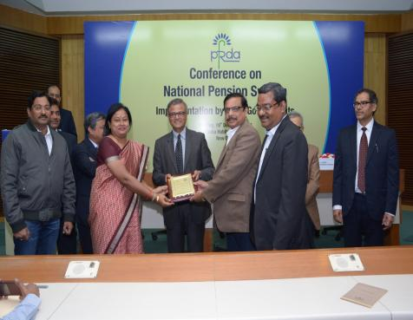

Foot Prints at National Level
42
42
Best State - “Subscriber Record Maintenance’’ Award for 2016 by PFRDA, New Delhi
SKOCH Award- 2019 for “ Pension Reforms under Govt. of Odisha
Notes:
Green Colour should be highlighted

Slide 43
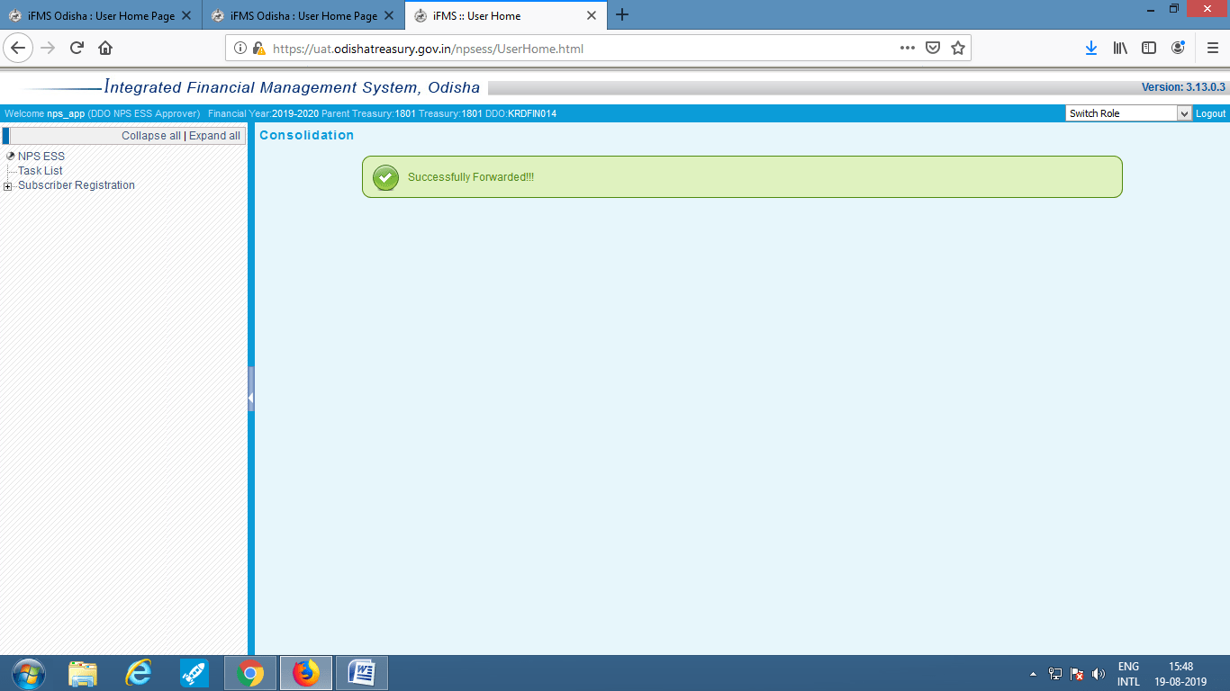
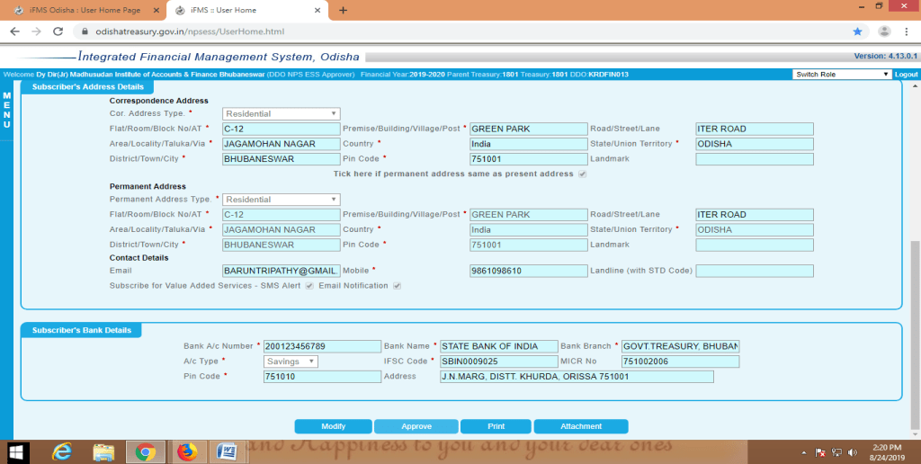
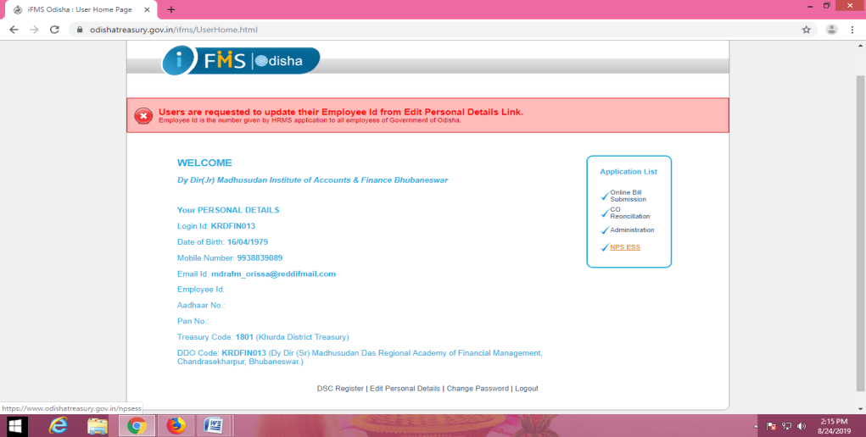
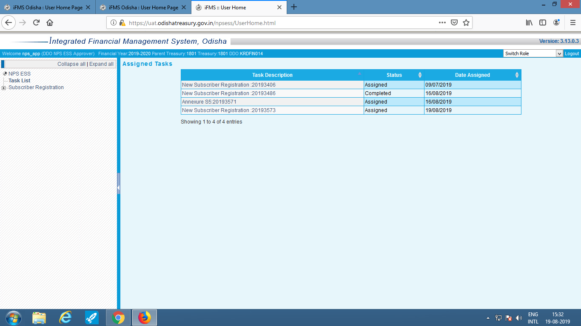
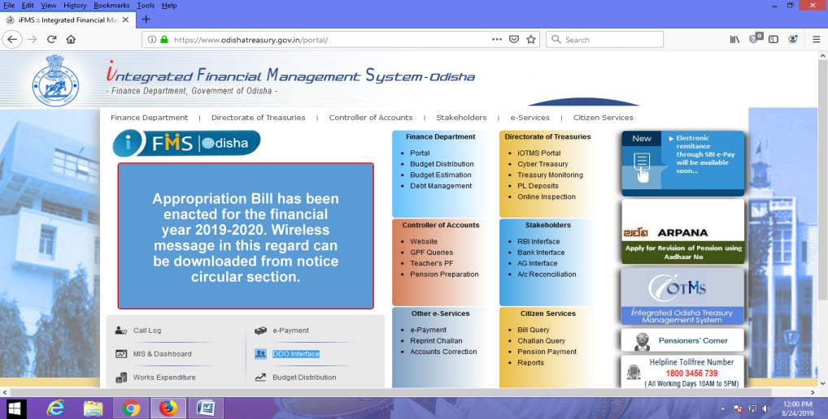
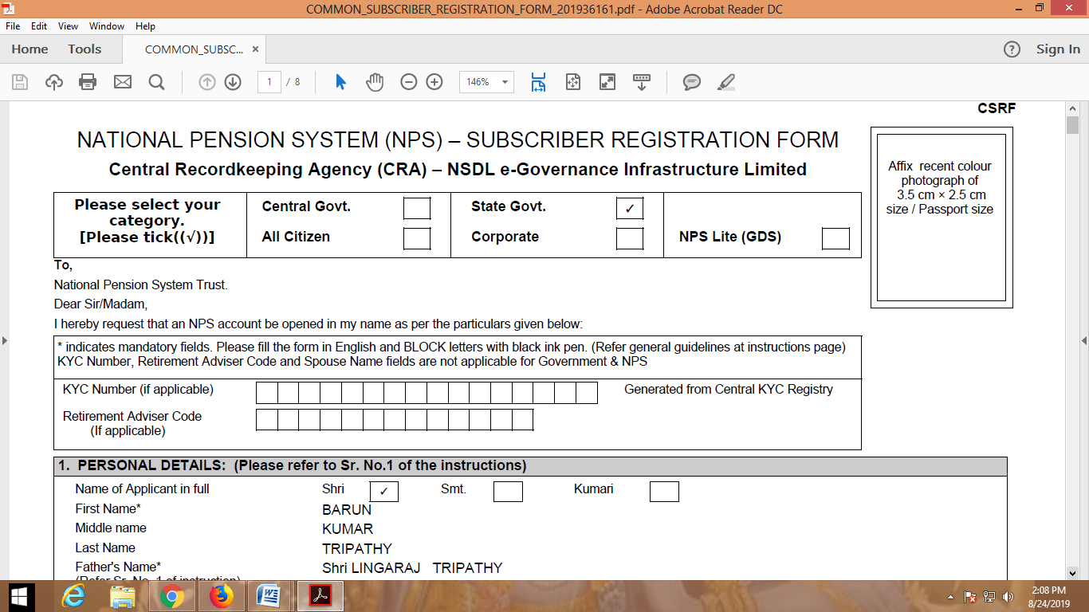
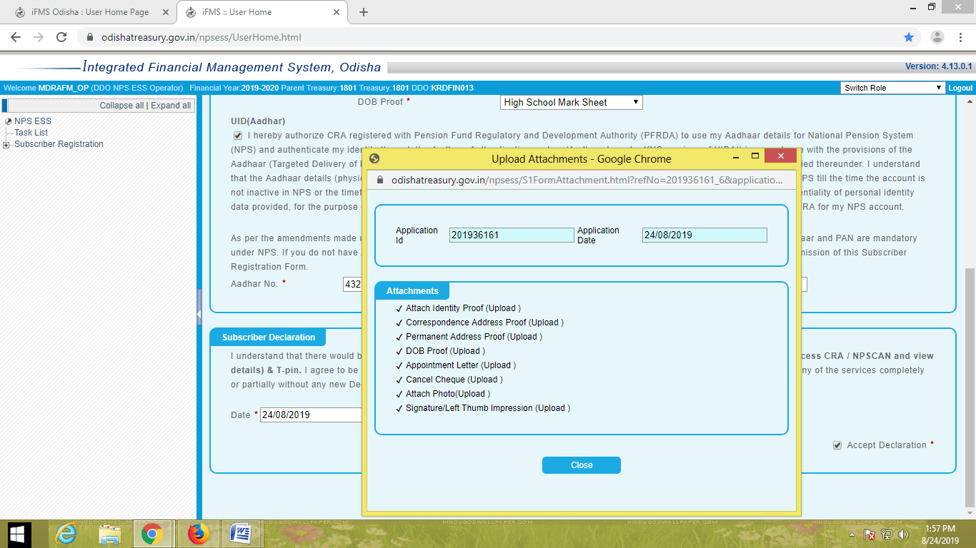
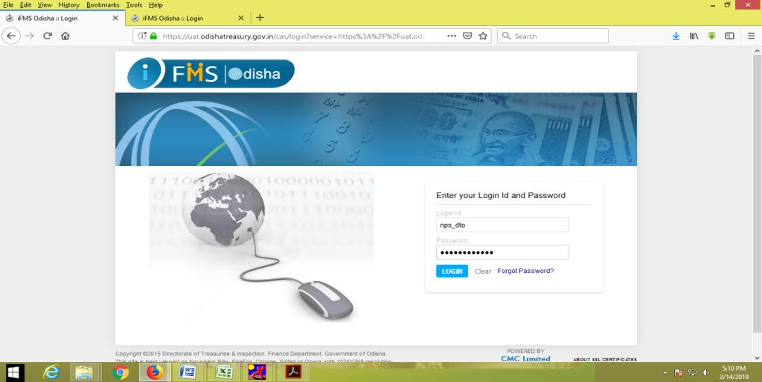
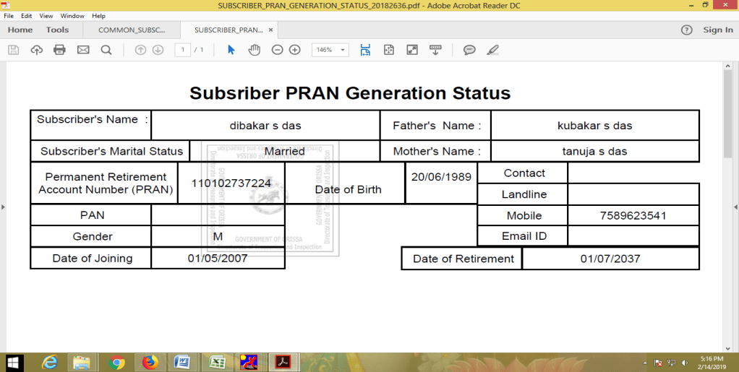
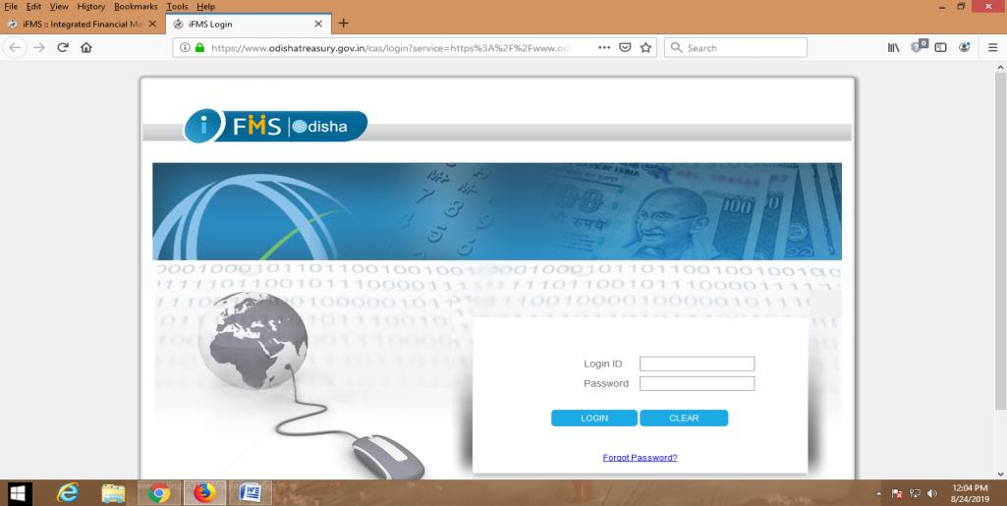
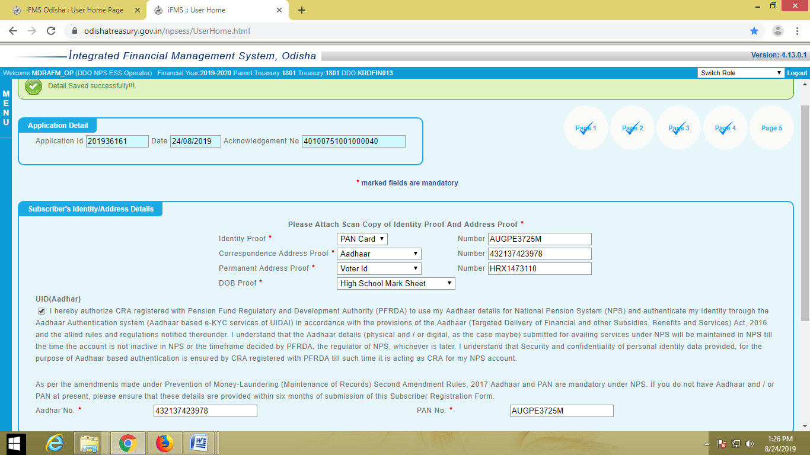
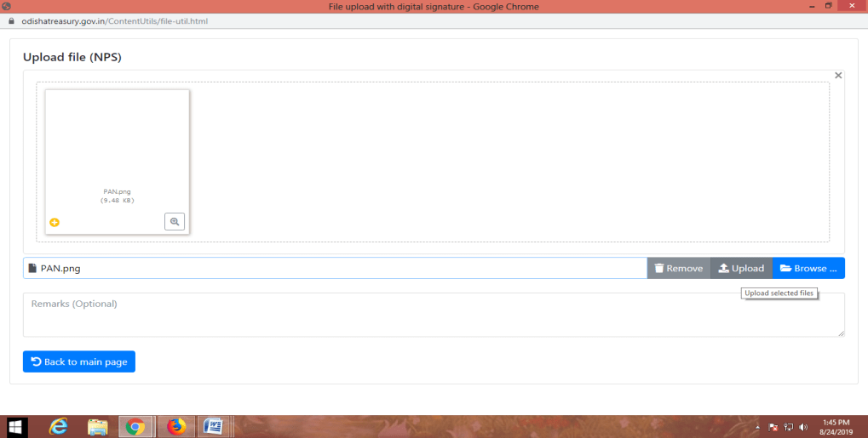
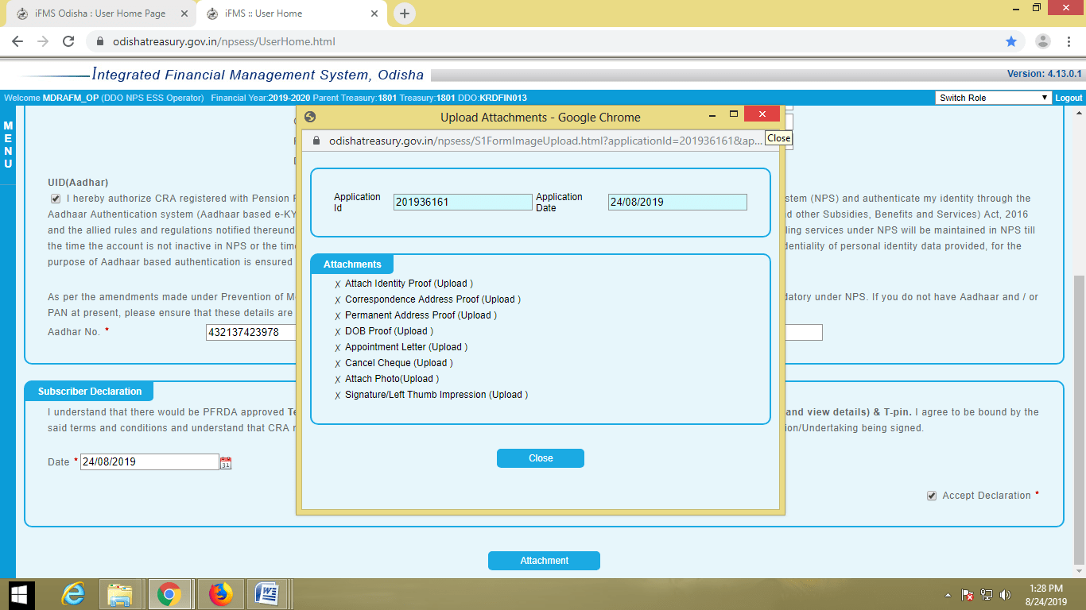
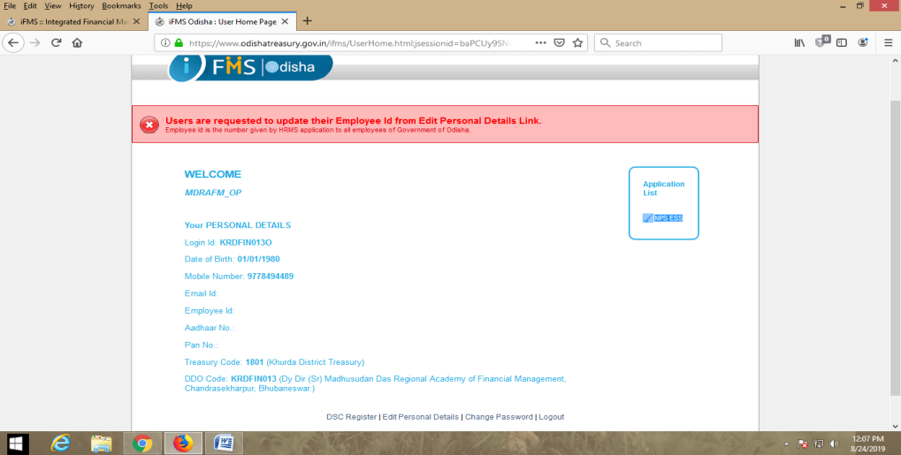
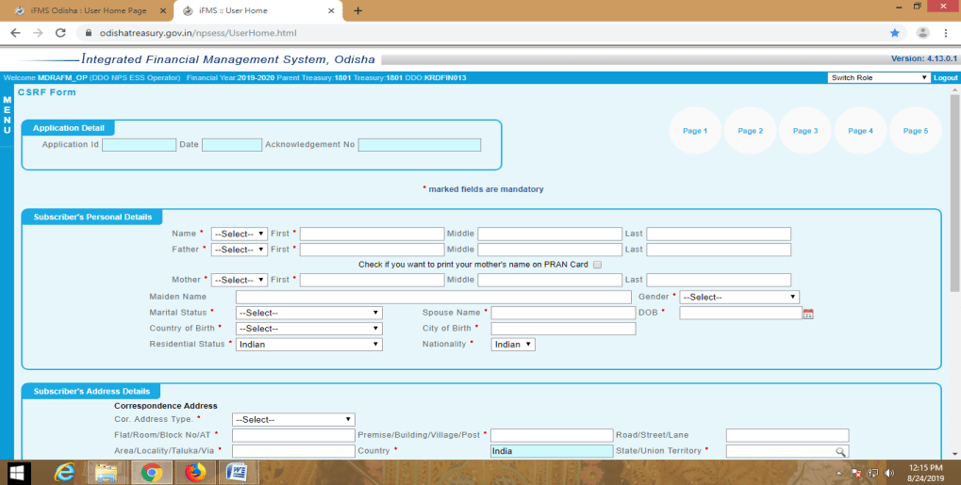
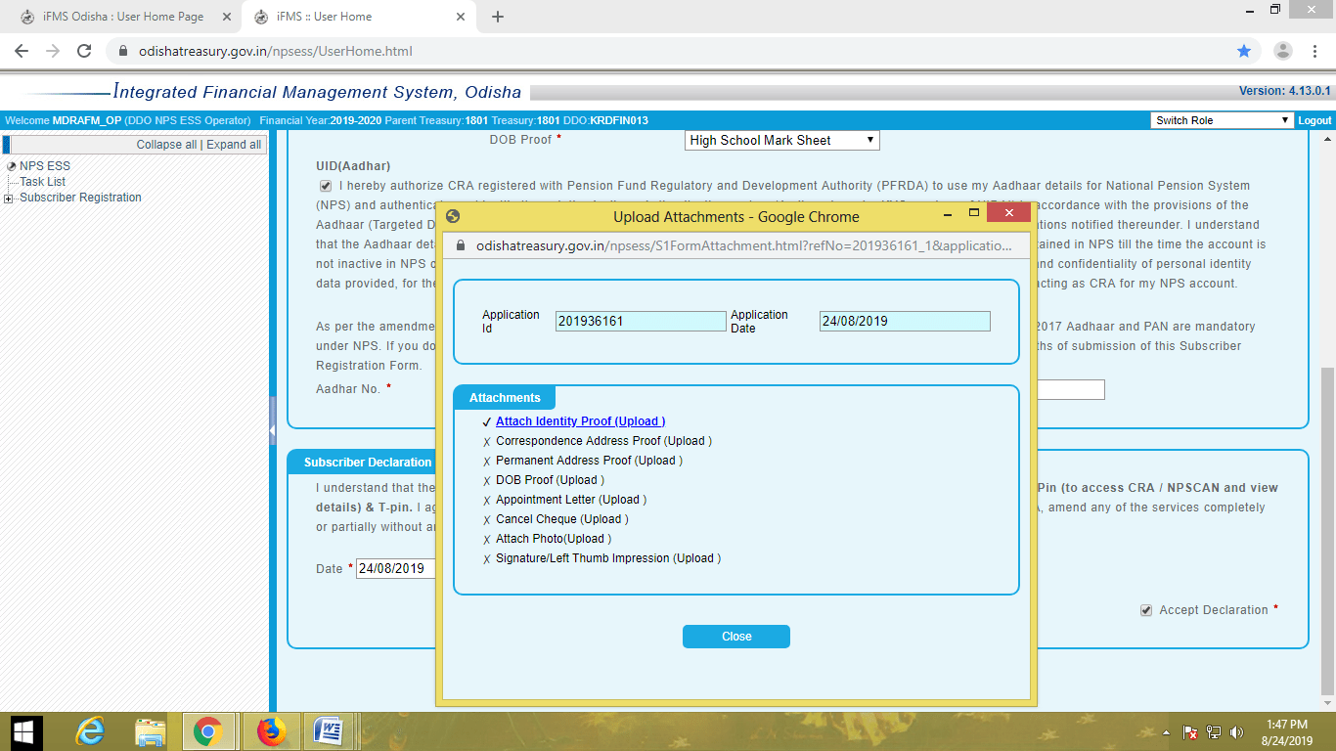
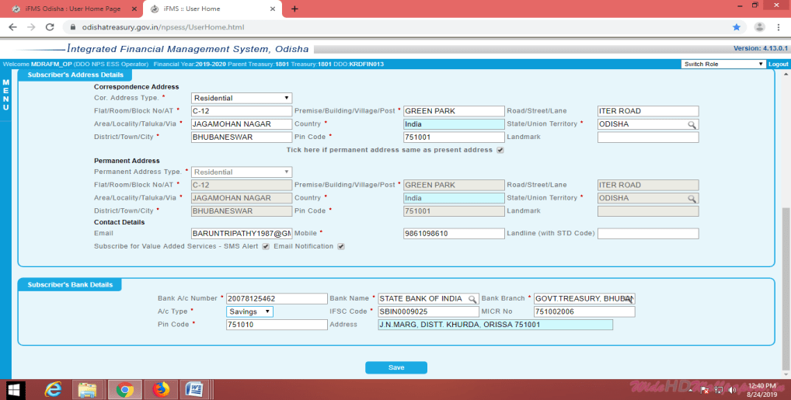
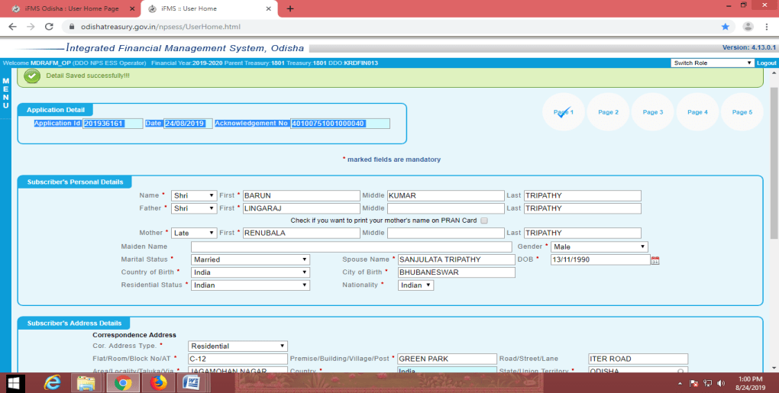
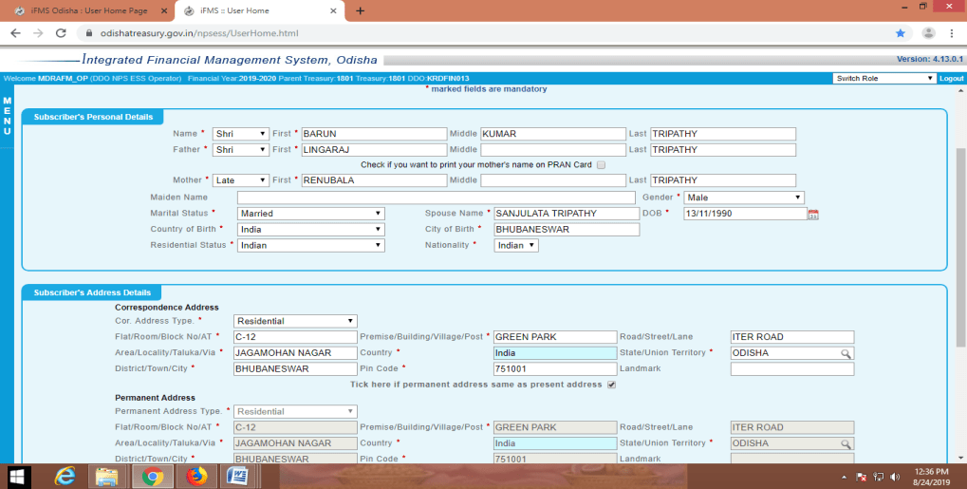
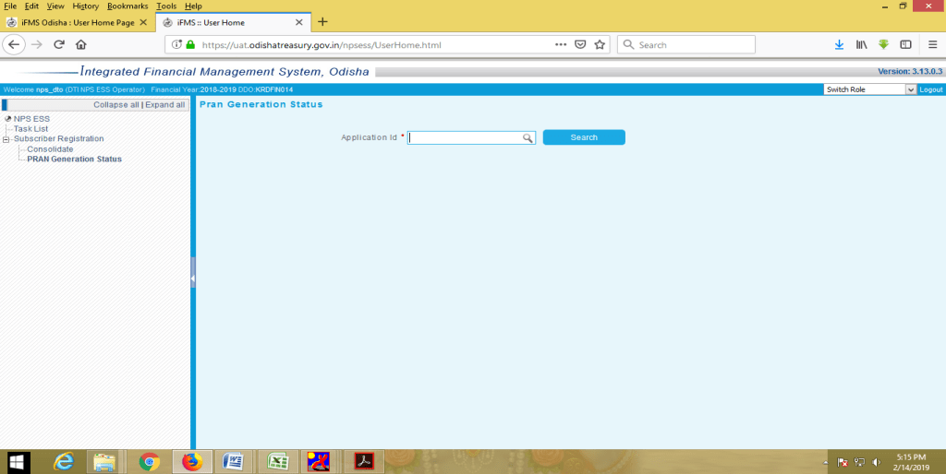
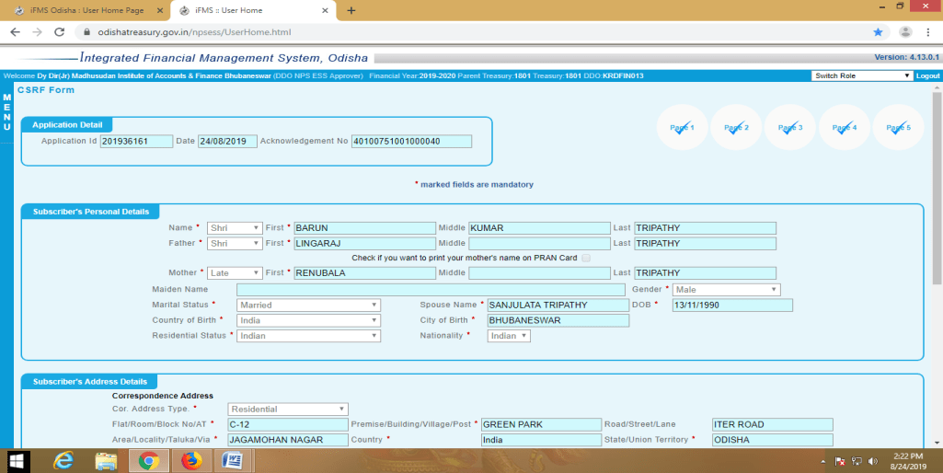
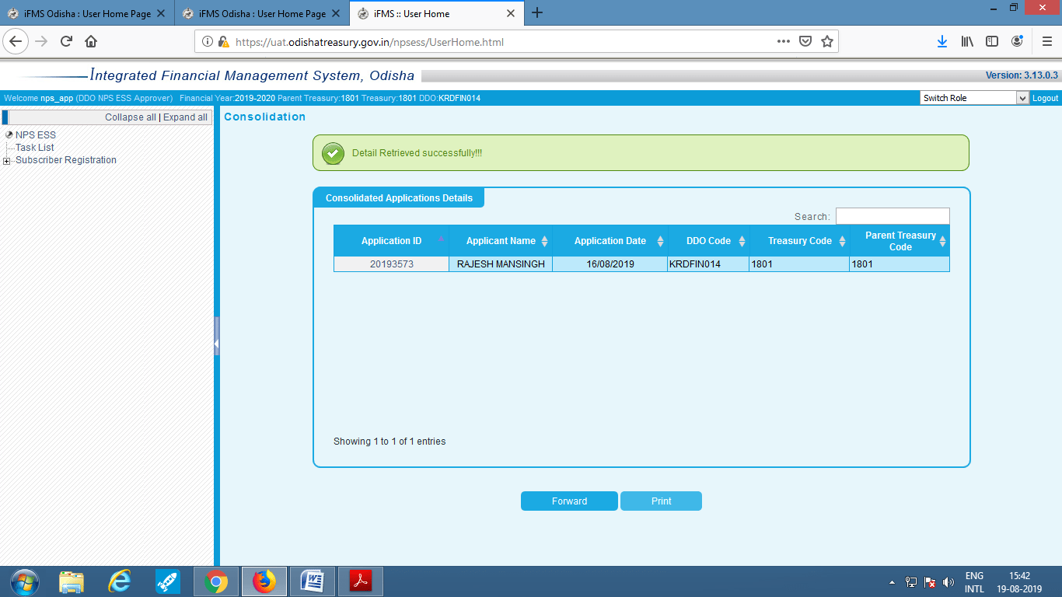
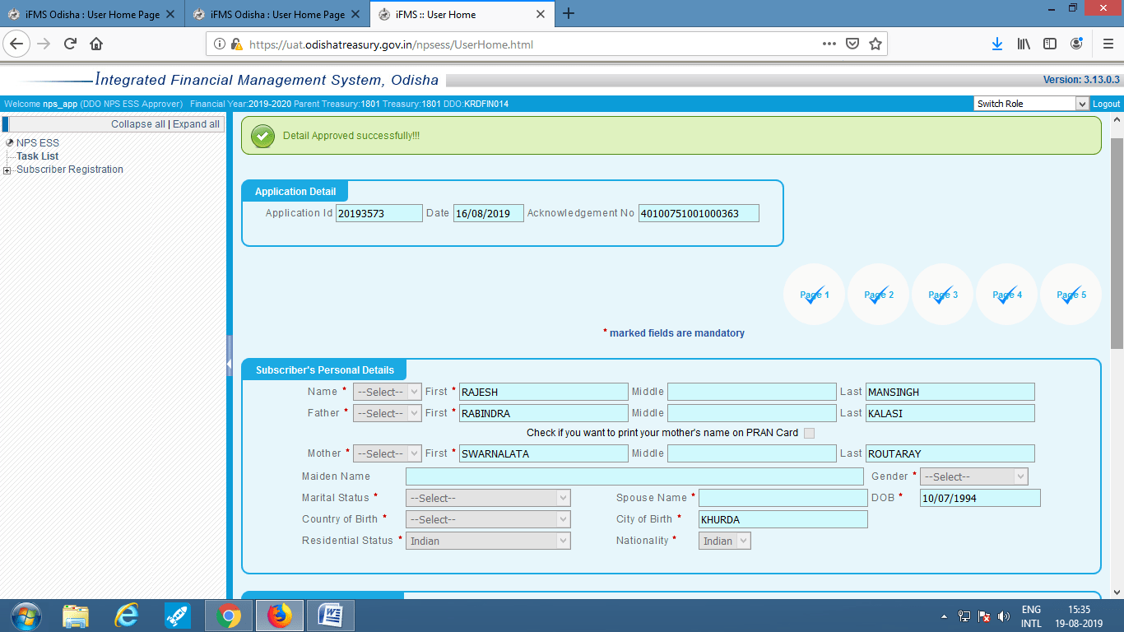
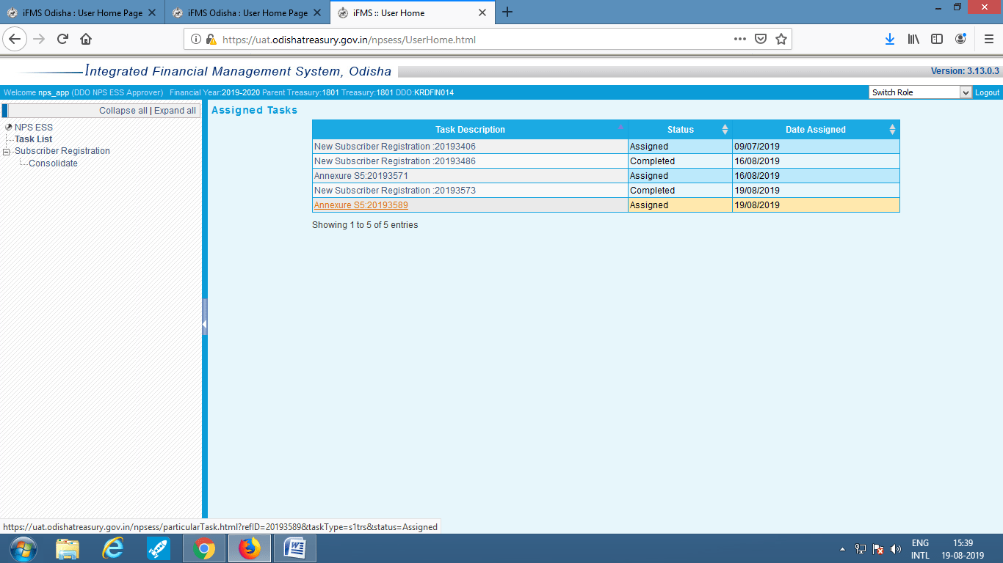
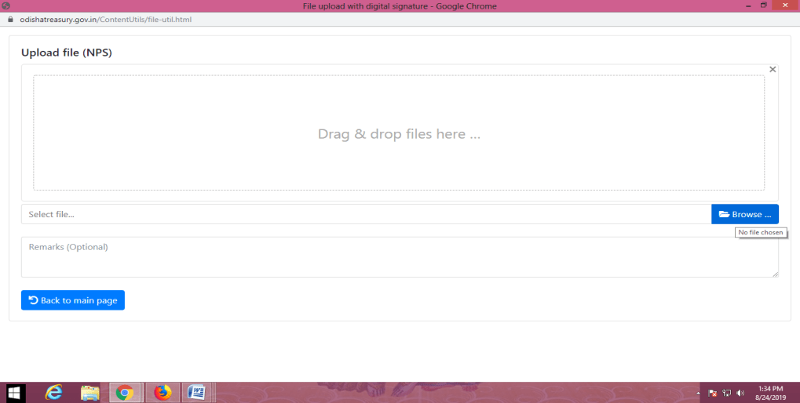
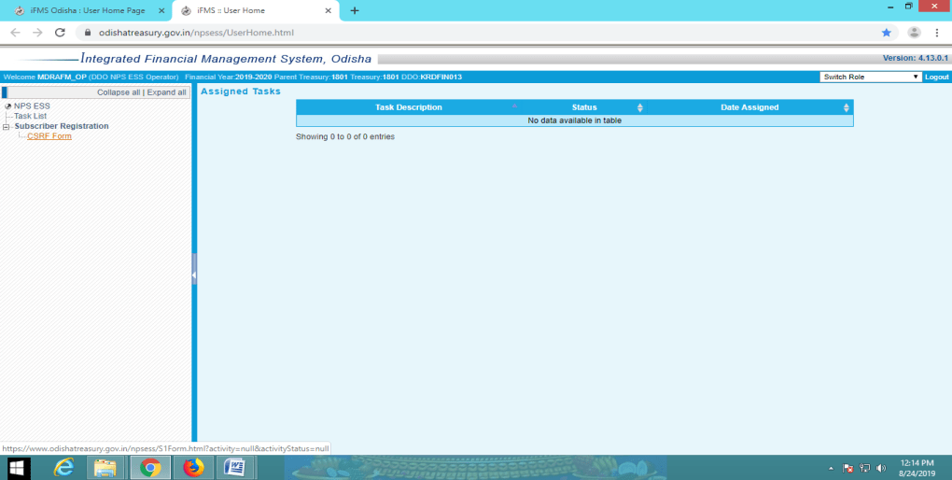
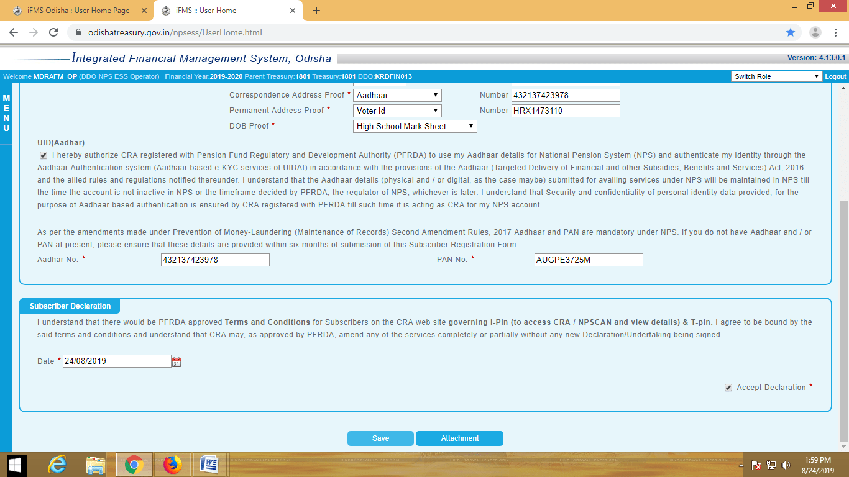
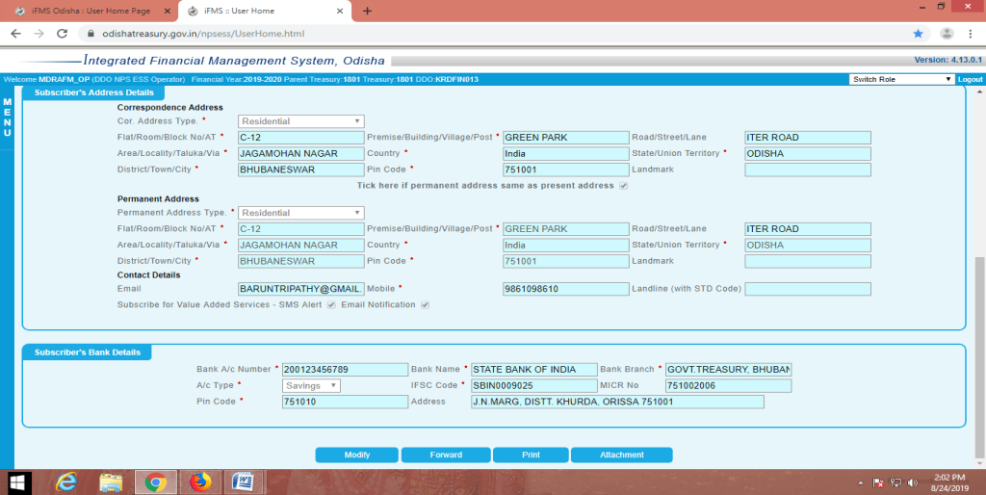
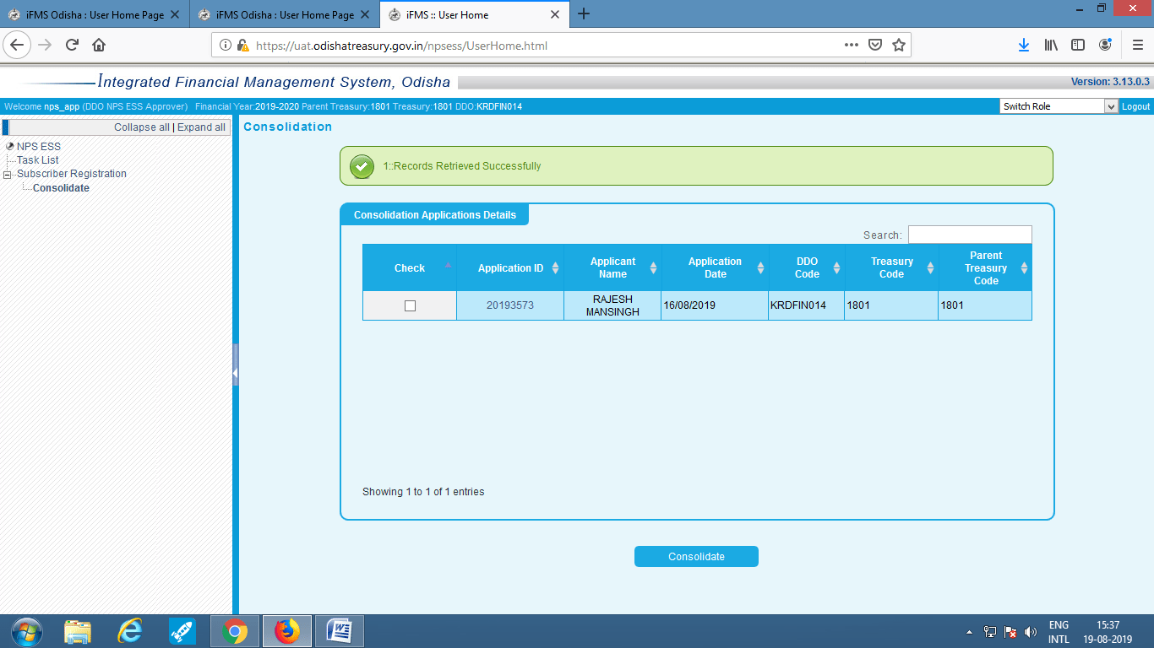
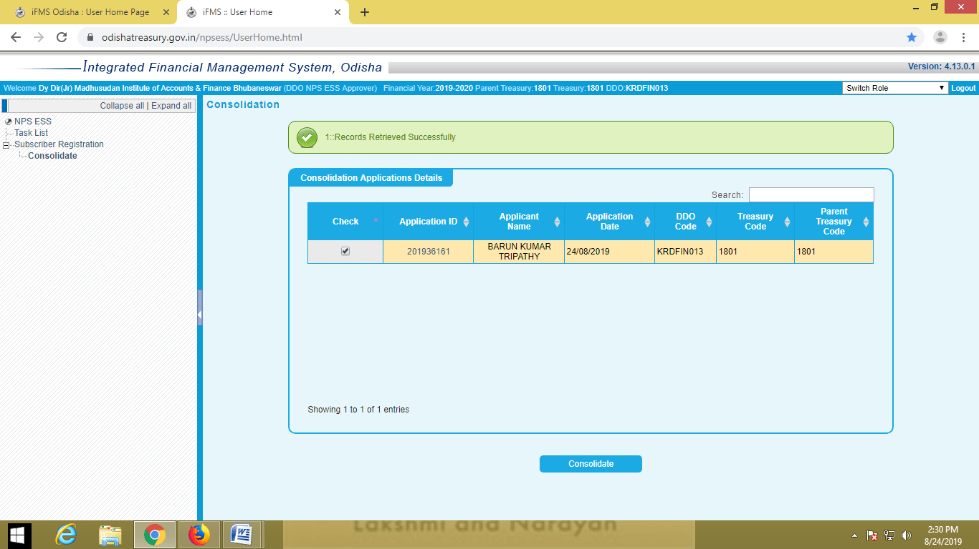
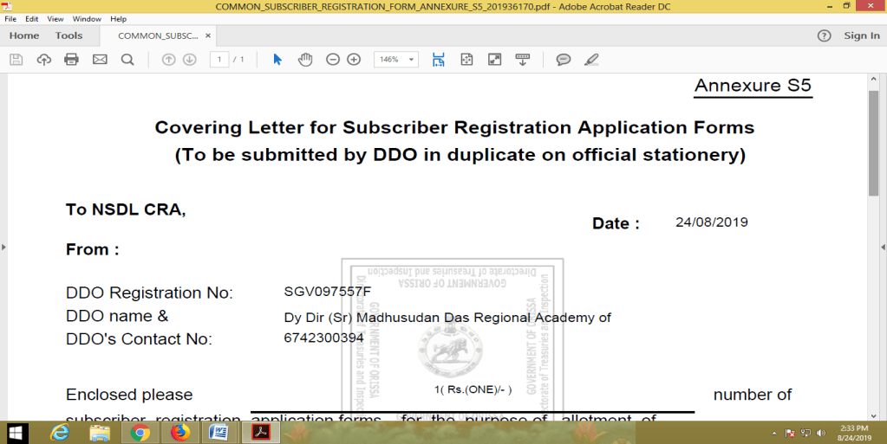
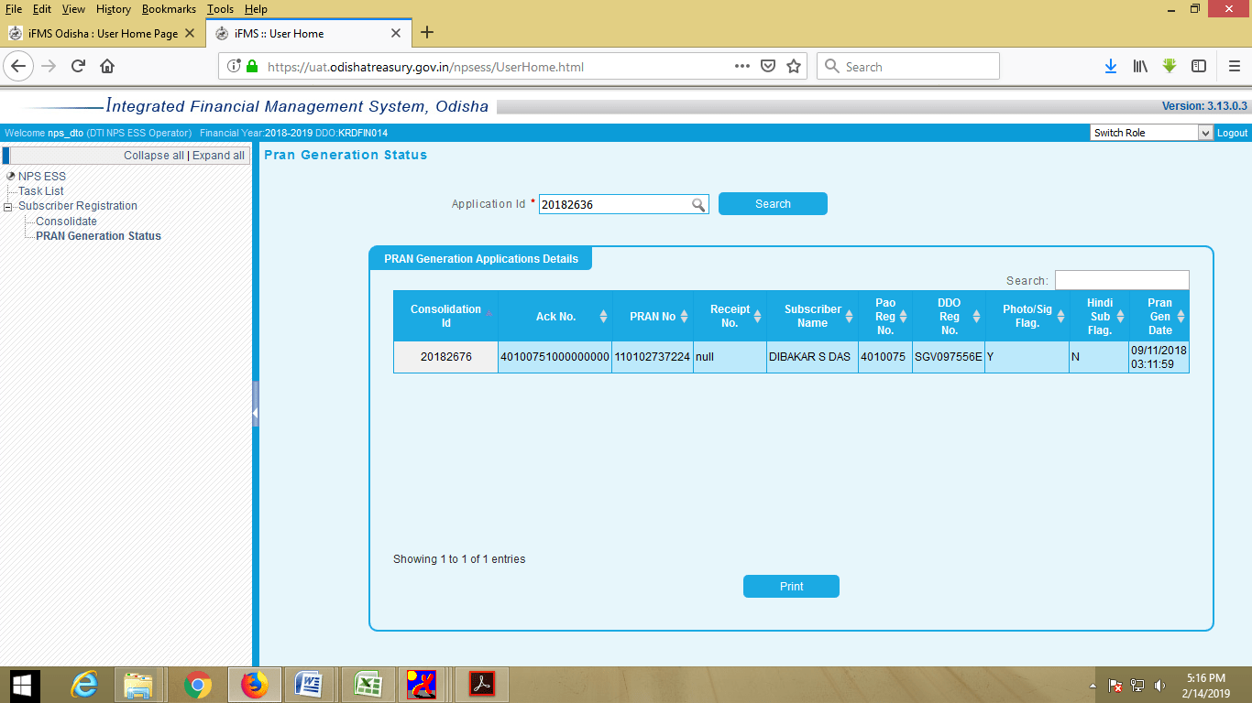
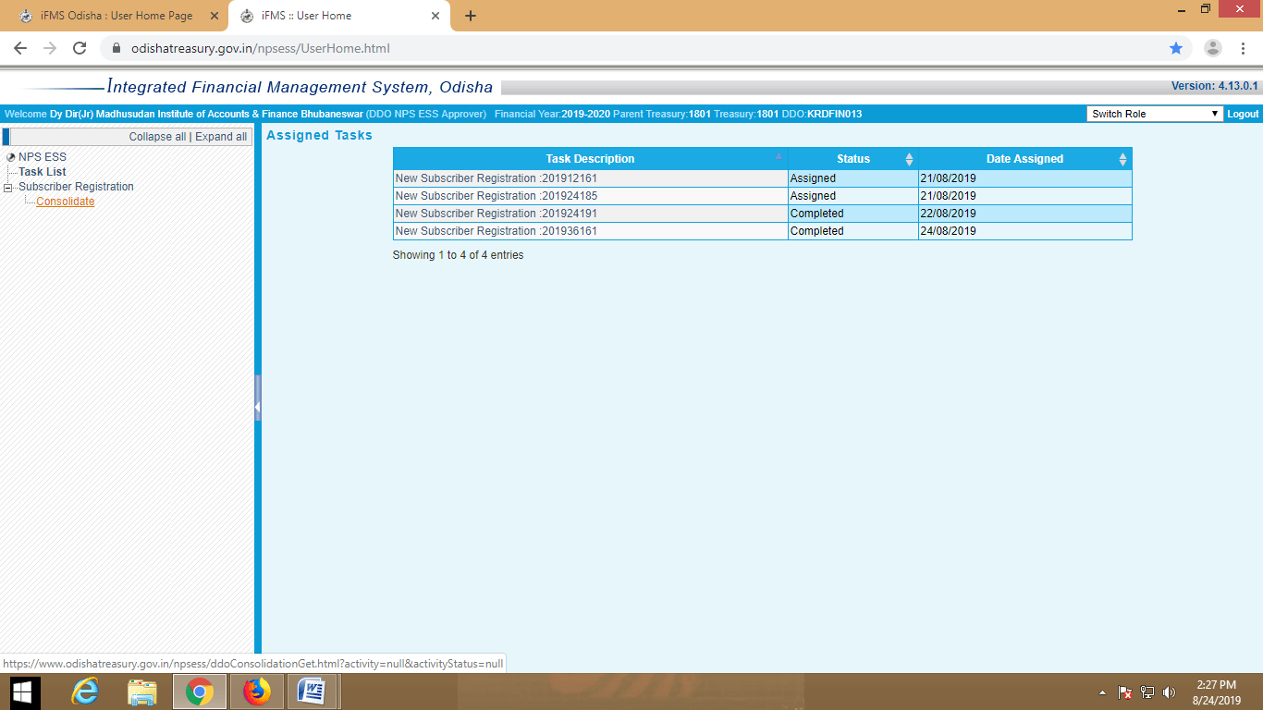
Access DDO Interface by using Login Id & Password
Fill all the mandatory fields of the 1st page of CSRF & save
ONLINE PRAN - PROCESS FLOW
Open DDO Interface of IFMS- Odisha
Fill up the information in all pages
Generation of Form- S5
Select the Application from Task List for checking
Upload Attachments
Upload all the Attachments in similar manner
Click on NPS-ESS
Click on Subscriber Registration - CSRF
Save to create Application Id
Forward to DTO
Consolidation from Task list
Generation of Application Id/ Date
Click on Save to save the Application
PROCESSING AT DDO Login (APPROVER)
DDO will verify & Approve
Take the print out of the CSRF from 1st Page
Forward the Application to DDO Login
Take the Print Out of CSRF
Tracking of the status of Application

Slide 44

Thank You !
Notes:
Green Colour should be highlighted

