Slide 1

Government e Marketplace (GeM)
Welcome to all Participants
Presented by
Manas Ranjan Das
( Assistant Director , GeM )
Mob- 9437289394
SGEMPU , DT&I ,
Finance Department , Government of Odisha

Slide 2
Our Agenda of Discussion
GeM Concept & Evolution
1
2
State Govt’s endorsement of GeM & Subsequent Policy Decisions
3
Offering Multiple Procurement Options
Presentation of direct Purchase & L1 buy through GeM
Presentation of BID & Reverse Auction through GeM
4
Key Advantages of Buyers
5
How to get Register on GeM
6
Work flow & Time Line
7
Questions & Answers session
SGeMPU Odisha

Slide 3



1. What is GeM
MARKET
Buyer
Seller
e-Commerce
A type of business model, or segment of a larger business model, that enables a firm or individual to conduct business over an electronic network, typically the internet
Marketplace Model
Marketplace Model
Provides an Information technology platform by an
e-commerce entity on a digital & electronic network to act as a
facilitator between the buyer and seller.
e-commerce firm is not allowed to directly or indirectly influence the sale price of goods or services and is required to offer a level playing field to all vendors.

Slide 4

Key Stakeholders of GeM
Internal Stakeholders
Execution Engine
• GeM SPV
• MSP
• PMU
External Govt. Systems
• UIDAI
• GSTN
• PFMS/IFMS
• MCA 21
• PAN Database
Sellers
• OEMs
• MSE
• Startup
• AuthorizedResellers
• Service Providers
Partners
• Banks
• Rating Agencies
• Third-party logistics
• Commercial Agencies
Buyers
• CentralGovt.
• Central PSUs
• State Govt.
• State PSUs
• Autonomous Bodies
Inspection Systems
• CAG
• CVC
• CGDA
• RTI
GeM
SGeMPU Odisha

Slide 5
4. Aim and Objective Of The GeM
Transparency
Speed
Efficiency
It provides the tools of e-bidding, reverse e-auction and demand aggregation to facilitate the government users, achieve the best value for their money.
Government of India (Allocation of Business) Rules, 1961, vide notification dated 8th December 2017 has made the following entry
32. Development, operation and maintenance of National Public Procurement Portal—Government e Marketplace”.
The purchases through GeM by Government users have been authorized and made mandatory by Ministry of Finance by adding a new Rule No. 149 in the General Financial Rules, 2017.
SGeMPU Odisha

Slide 6


3. 5 Years Journey of GeM
GeM 1 : 9th August 2016- March 2017
GeM 2 :
March–Dec 2017
GeM 3 : January 2018- Present
→ End-to-end online portal
→ Basic functionalities
→ Integration with Partners (UIDAI, MCA-21, Banks)
→ MSP on board
→ Multi language support
→ Advanced search
→ Multi-cart
SGeMPU Odisha

Slide 7
2
State Govt’s endorsement of GeM & Subsequent Policy Decisions
Date | Notification No | Details
28-04-2017 | 14214 | Govt Organizations are advised to refrain using GeM till the detail procedures on GeM for state government offices
26-04-2017 | 22252 | Completion of Vender registration & Preparatory steps to various department
30-11-2017 | 35243 | State Govt decided to onboard on GeM with Proper guidelines
19-04-2018 | 13681 | Exemption of EMD for local start ups
19-06-2018 | 19357 | Establishment of State level GeM Procurement Unit (SGeMPU) for Roll out of Government e-Marketplace in Odisha.
08-08-2018 | 26291 | Clarification regarding the expression "Government Departments & Agencies" which includes Government Departments, State PSUS, Boards, Development Authorities, Improvement Trusts, Local Bodies, Co-operative Institutions and Statutory & Autonomous Bodies
31-08-2018 | 28277 | Establishment of State level GeM Procurement Unit (SGeMPU) for Roll out of Government e-Marketplace in Odisha.
31-08-2018 | 28282 | Appointment of Nodal Officer for implementation of Government e-Marketplace (GeM)
22-11-2018 | 36401 | Opening and Operation of GeM Pool Accounts (GPAs) by PSUs / Autonomous bodies / Societies / ULBs for ensuring timely payment to GeM suppliers / vendors.
20-02-2019 | 5972 | Guideline to follow when item procured either is not available on GeM or the price discovered in open bidding is less than the price available at GeM portal
26-02-2019 | 7073 | Drawl of AC Bills for Procurement of Goods and Services regarding.
16-08-2019 | 28021 | New Products category addition
19-08-2019 | 28367 | Payment to vendors within ten days of issue of Consignee's Receipt-cum-Acceptance Certificate (CRAC) on Government e-Marketplace (GeM)
22-08-2019 | 28899 | In case procurement is made outside GeM, a certificate as mandated in FD Letter No 5972/F Dated 20.02.2019 signed by the procuring officer and countersigned by the Head of Office with the record of e- bid floated through GeM should be kept in the file before placing the order for future reference.
30-09-2019 | 33486 | OGFR prevails over other manuals of University, PSUs and other semi Govt Organizations
SGeMPU Odisha

Slide 8
Sr. No. | Title | Date | Details/Download
1 | Performance Security | 05/01/2022 | Download(760.26 KB)
2 | Bid Security/ Earnest Money Deposit (EMD) | 05/01/2022 | Download(710.33 KB)
3 | Preference to Local MSEs/Start-ups in Procurement of Works | 20/05/2021 | Download(1.69 MB)
4 | Sanction of Grant-in-Aid, Maintenance of accounts thereof and submission of Utilization Certificate | 28/04/2021 | Download(1.9 MB)
5 | CORRIGENDUM – Bid Security / Earnest Money Deposit (EMD) | 13/04/2021 | Download(1.2 MB)
6 | Additional Performance Security in case of abnormally Low Bids (ALBs) | 05/04/2021 | Download(1.3 MB)
7 | Performance Security | 18/03/2021 | Download(2.34 MB)
8 | Bid Security / Earnest Money Deposit (EMD) | 18/03/2021 | Download(2.1 MB)
9 | Procurement of Goods and Services in electronic Marketplace | 13/01/2021 | Download(2.21 MB)
10 | Restriction on Public Procurement from bidders of certain Countries | 16/10/2020 | Download(778.47 KB)
11 | Preference to Local MSMEs/Start Ups in Public Procurement | 16/10/2020 | Download(485.48 KB)
Important Circulars & Notifications for buyers of State Government of Odisha
https://finance.odisha.gov.in/notification/ogfr
SGeMPU Odisha

Slide 9
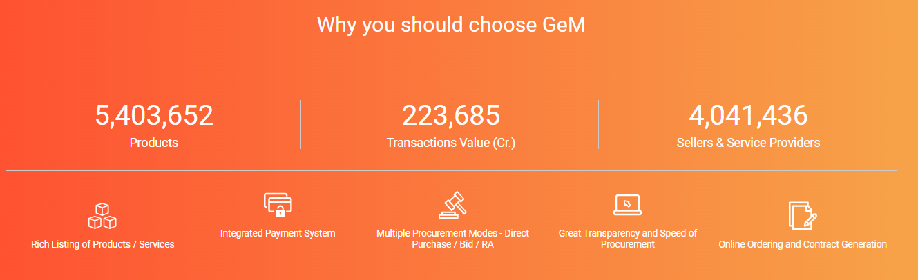
Present Status
SGeMPU Odisha

Slide 10
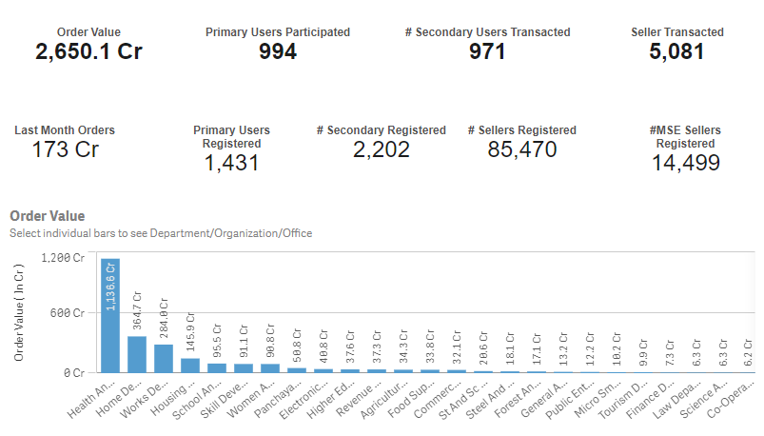
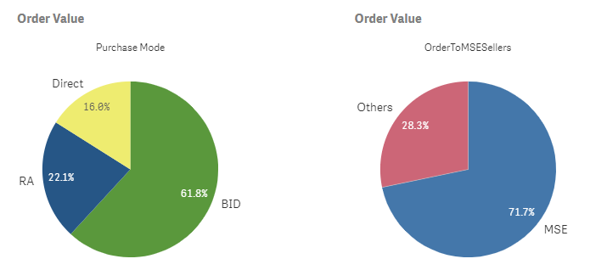
GeM Status Odisha
SGeMPU Odisha

Slide 11
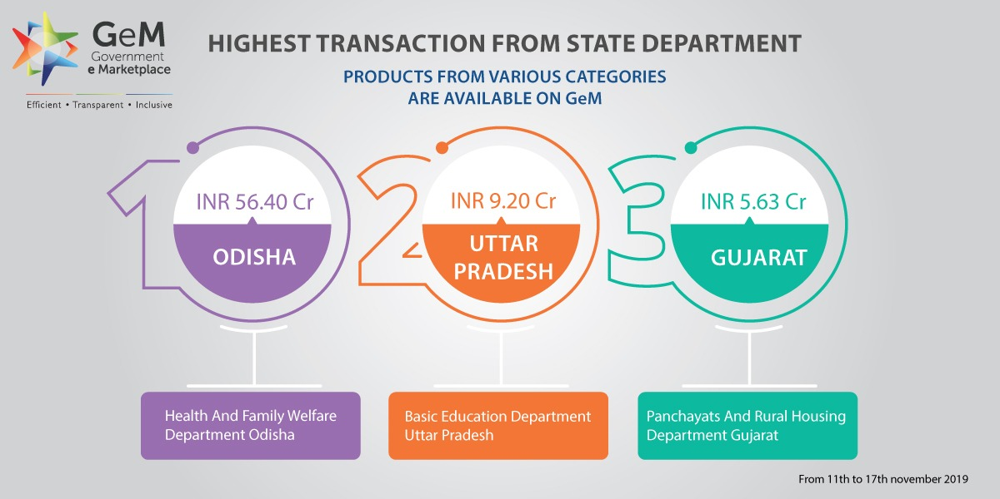
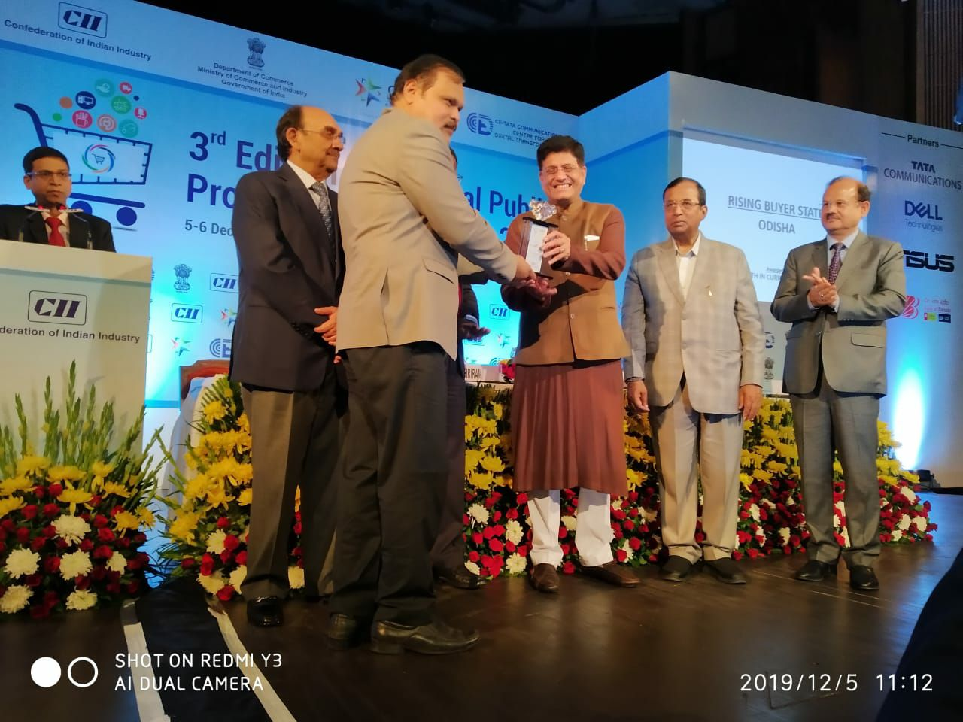
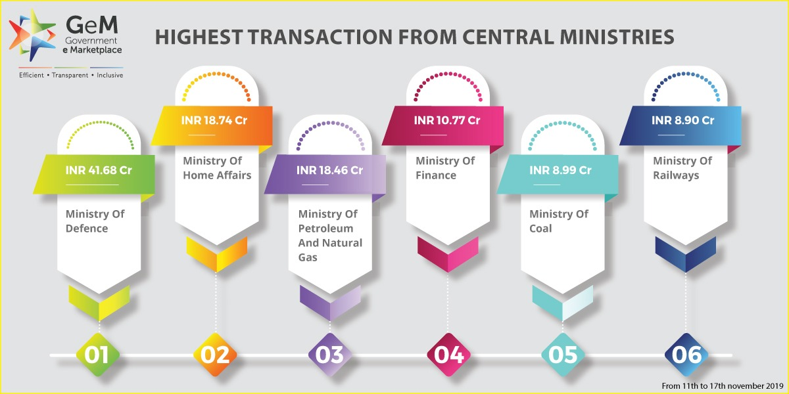
Last week transaction from top 6 Central Ministries crosses 100cr Value.
GeM witnessed active participation from State Govt: Department for procuring goods and services.
The Top States with highest transaction in a week
( November 2019 ) are Odisha, Uttar Pradesh & Gujrat.
Congratulations!!!!!!!!!
State of Odisha has won the
“Rising Buyer award 2019 ’’
SGeMPU Odisha

Slide 12
AMENDMENTS TO GENERAL FINANCIAL RULES, 2017
→ Buyers and Sellers may please note that Ministry of Finance, Government of India has made SIGNIFICANT amendments to GFRs 2017 which immediately come into effect.
As per the office order, Rule 149 has been amended as follows:
→ "The GeM portal shall be utilized by the Government Buyers for direct on-line purchases as under:
< Rs. 25,000/-
Rs. 25,000-5,00,000/-
> Rs. 500000/-
(I) Up to Rs. 25,000 through any of the available suppliers on the Gem, meeting the requisite quality, specification and delivery period.
(ii) Above Rs. 25,000 and up to Rs. 5,00,000 through the GeM Seller having lowest price amongst the available sellers (excluding Automobiles where current limit of 30 lakh will continue), of at least three different manufacturers, on GEM, meeting the requisite quality, specification and delivery period. The tools for online bidding and online reverse auction available on GeM can be used by the Buyers even for procurements less than Rs. 5,00,000.
(iii) Above Rs. 5,00,000 through the supplier having lowest price meeting the requisite quality, specification and delivery period after mandatorily obtaining bids using online bidding or reverse auction tool provided on GeM
SGeMPU Odisha

Slide 13
Multiple Procurement Options
5. Intent of
Buying -
Bid
if objective is to
go for BID (ONLY
BID) – there is
no need of
comparison
For amounts
Less than
INR.25,000/-
1. Direct
Purchase
4.
4. Intent of
Buying -PAC
Procurement of
2. L1
Purchase
specific product
as per
requirement is
also possible
For amount
Greater than
INR.25,000/-
and Less
than INR.5
Lakhs
3. Bid/RA
Procurement via Bid/RA to get the best price quote Bid to RA option is also available after of
evaluation in Bid
SGeMPU Odisha
12

Slide 14
Mode of Procurement |  | Rs. 1- Rs. 25 ,000 /- | Rs. 25,000 /- Rs. 500,000 /- | Rs. 500,000 /- and Above
Direct Purchase (For amounts Less than INR.25,000/-) |  | Yes | No | No
L1 Purchase (For amount Greater than Rs.25,000/- and Less than INR.5 Lakhs ) |  | Yes | Yes | No
BID /RA (Procurement via Bid/RA to get the best price quote Bid to RA option is also available after of evaluation in Bid ) |  | Yes | Yes | Yes
PAC ( Procurement of specific product as per requirement is also possible) | Direct Purchase | Yes | No | No
PAC Bid | BID | Yes | Yes | Yes

Slide 15





7. Key Advantages for Buyer
End to End System
from Registration to
Payment
Provides transparency
and ease of buying
Provides options for
search, compare, select
and buy facility
Offers rich listing of
products for individual
categoriesof
Goods/Services
Up-to-date user-
friendly dashboard for
buying, monitoring
Order Process
redesigned for ease
of use
Option to provide
multiple consignee
locations and quantity
Bunching for
products/services
Price Trend for
Products
supplies and
after authentication
payments
SGeMPU Odisha

Slide 16
9. Buyer User Roles based on Segregation of Duties
Who can be a Primary User ?
Any officer of Central / State Government / PSU / Autonomous Bodies / Local Bodies / Constitutional Bodies / Statuary Bodies at the level of Deputy Secretary of the Government of India or equivalent Head of the Office at Sub Centre / Unit / Branch, can Register his / her organization / unit on GeM portal as Primary User.
Responsibility of Primary User :-
Registering the organization on GeM, creating User accounts for Secondary Users, Assigning them roles and responsibilities on GeM Supervision of all transactions performed by Secondary Users under him / her . Responsible for ensuring compliance of General Financial Rules and / or Rules Governing Public Procurement in respect of their organization, all GeM terms and conditions and other Procurement Policies / Guidelines notified by the government from time to time, by all the secondary users including timely payments and for dispute resolutions as per GeM terms and conditions.
Responsibility of Secondary User
The access rights permissible to registered Secondary users would be decided by the Primary User of the Department. Secondary Users may be given the roles of Buyer / Consignee / Drawing and Disbursement Office (DDO) / Paying Authority etc. Responsible for, procurement transactions on GeM including Placement of Contracts, Receipt of Stores, and Payments to the Sellers etc.
Buyer: -Rresponsible for processing procurement transaction up to Order Placement stage.
Consignee: -Rresponsible for certifying receipt and acceptance of the goods procured.
DDO: - Responsible for Payment to the sellers.
b. Secondary Users:
Buyer
Consignee
DDO/PAO
Note:- Primary user Cannot perform any Procurement related transactions on GeM portal.
SGeMPU Odisha

Slide 17
5
How to get Register on GeM
Documents required for Primary User Registration:-
1. Competent Authority will decide Who will be the Primary user
Govt Mail id ( e.g. gov.in/nic.in )
Aadhaar Number
Aadhaar Linked Mobile Number
2. Primary user resistration by providing
Goto www. https://gem.gov.in/→ Sign UP→ Buyer
Click on “Review Terms & Conditions”→ Accept
Put Your Adhaar No and Mobile no
Check Wheather Organisation name is available on organisation list or not . If Available proceed with Your govt. mail id → Create your User id & Password → Confirm As primary user
If Organisation name is not available, click on “request for new Organisation” → Coose your Department → put Your organisation name and proceed (It will take 2-3 days for addition on list ) with registration.
3. Go to user
Create division ( if required )
Add secondary users ( Buyer, Consignee , DDO) by providing their respective Govt mail id → give a suitable User ID
Invitation link sent to Govt. mail of respective Buyer/Consignee/DDO
Status of Buyer/Consignee/DDO is “inactive”
4. Buyer, Consignee DDOOpen their respective Govt. mail id and check invitation mail from GeM
Clik on “ Verify me now”
put Adhaar No and Mobile No
Submit OTP sent to Adhaar linked mobile No
Create the password
5. Check the status from primary user log in
Buyer/Consignee/DDO will be “Active”
Buyers/Consignee/DDO are ready to procure though GeM
SGeMPU Odisha

Slide 18
10. Workflow
and
timelines
Competent Authority
Primary User
Secondary User
Organization Registration
• Buyer
• Consignee
• DDO/PAO
Organization Registration
Fill the required fields to register the organization with GeM.
BUYER
Log on to GeM
Select Product
Price Holding – 5 days for DP
Select mode of Procurement (DP/L1/Bidding/RA)
Upload scanned Financial Approval – E-sign
Sanction Order – E-sign
Generate Contract order – E sign
Secondary User Registration
CONSIGNEE
Receipt of Goods
PRC Generation Within 48 Hrs
Inspection of Goods
Right to Reject Order With in 10 Days
Seller Confirmation
and Delivery of Goods
Default Delivery
Period
Within 15 days
• Process Draft Invoice
• Claim LD (If any)
Note : Seller to take away Goods within 10 days If Consignee exercises Right to reject.
Go Back to Buyer
CRAC Generation
PAYMENT AUTHORITY
Invoice Payment
DDO/PAO – Through SBI MOPS/ Through Offline mode
Log on to GeM & Update Payment details
Seller Confirms and
Order Closed
SGeMPU Odisha

Slide 19
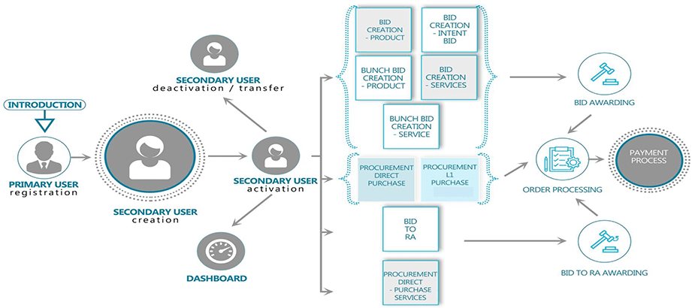
SGeMPU Odisha

Slide 20
Special Terms & Conditions for GeM Procurement: -
The use of GeM Portal for Sale / Purchase of Goods / Services and the resulting Contracts shall be governed by the following General Terms and Conditions (GTC) (unless otherwise superseded by Product / Service specific Special Terms and Conditions (STC), Product / Track / Domain Specific STC of Particular Service including its SLA (Service Level Agreement) and BID /Reverse Auction Specific Additional Terms and Conditions (ATC) as applicable).
 | Payment Authority and Payment Terms: | i. For Goods :-In case of goods, 100% payment will be released within ten (10) days of issue of consignee receipt-cum-acceptance certificate (CRAC) and on-line submission of bills unless otherwise specified in STC / ATC. ii. For Services:-In case of services, 100% payments on the basis of monthly (unless otherwise specified) bills will be paid within ten (10) days of issue of consignee receiptcum-acceptance certificate (CRAC) and on-line submission of bills unless otherwise specified in STC / ATC.
2 | All Inclusive Price | → Prices shall be quoted by Sellers on all inclusive basis i.e. including excise duty taking into account the MODVAT benefits if any, sales tax (ST/CST/VAT/), Service Tax, Customs duty, Entry Tax etc. Statutory variation, if any, shall be to the Seller’s account and no variation in contract price, on account of such variations shall be allowed during the delivery period.
3 | Guarantee/Warrantee | → All Products supplied under the Contract(s) shall have Guarantee /Warrantee for ONE year period from the date of receipt. Seller at the time of listing /offering their products may choose to provide longer guarantee period (i.e. more than 1 year)
4 | Consignee’s Right to Rejection (Return Policy): | → The Goods delivered shall bear the self certified Warranty/Guaranty. Buyer shall have the right to reject on proper Justification any consignment of the Goods received within a period of 10 days of receipt. No payment shall be made for rejected goods and the Seller would be liable to take back such rejected Goods within 10 days without any charge.
5 | Reasonableness of rates | → GFR rule 149 allows direct on-line purchases on GeM up to Rs.25 ,000/- through any of the available suppliers on the GeM, meeting the requisite quality, specification and delivery period. However, GeM being a dynamic online marketplace this is subject to procuring authorities convinced about the reasonability of rates.
SGeMPU Odisha

Slide 21
7 | EMD | → No EMD for Bids / RA having estimated value less than Rs. 25 lakhs. → For bids / RA having estimated value more than Rs 25 Lakh, while finalizing e-Bid / RA, Buyer shall indicate the exact amount of EMD required to be submitted by bidders in the form of Bank Guarantee on GeM portal in the prescribed format.
8 | Performance Security and Performance | → There shall be no Performance security / PBG requirement forcontracts: a) Placed under Direct Purchase / L-1 Purchase Option under Para (i) and(ii) of GFR rule 149; b) Placed through Bids / RA with estimated bid value up to Rs 5 Lakh (incase of Goods contracts); and c) Placed through Bids / RA with estimated bid value up to Rs 5 Lakh (in case of Services contracts) # GeM recommends quantum of Performance Security @ 2% of the value of contract. The Buyer also has the option to select Performance Security between 2% to 10%.
9 | Bid Life Cycle | → It is the period within which a buyer has to complete the entire life cycle i.e. technical evaluation, financial evaluation and order creation of Bid process. By default, it is 90 days from the date of Bid publication. This can be configured to 120 / 150 or 180 days in exceptional cases through catalogue Management System (CMS) for a particular product category (not for a particular Buyer or Bid).
10 | Original Equipment Manufacturer (OEM) | → Oowner of the Brand / Trademark of the product being offered or incase of un-registered brand’s products / products with own brand, the actual manufacturer of the final product.
 | Resellers | → Seller having authorization to sell products manufactured by the OEM in open market.
11 | Annual Procurement Plan | → The Buyer will provide projection of their annual demands in the GeM indicating required Goods/Services with specification & quality, quantity, consignee location and Delivery Period requirements etc by way of Annual Procurement Plan.
SGeMPU Odisha

Slide 22

13. Support
GeM
→ LMS
→ FAQ
→ YouTube Channel
→ Tollfree No
→ Officials
→ Business Facilitator
GeM Odisha
DTI , Finance Dept
Manas Ranjan Das
( Assistant Director , GeM )
Mob- 9437289394
Sudhanshu Pradhan
( Business Facilitator)
Mob- 8093694688
SGEMPU ,DTI ,
Finance Department , Government of Odisha
Address: 5th Floor, Unit, 3, Unit 3, Kharabela Nagar, Bhubaneswar, Odisha 751001
https://t.me/gemodisha
SGeMPU Odisha

