Slide 1
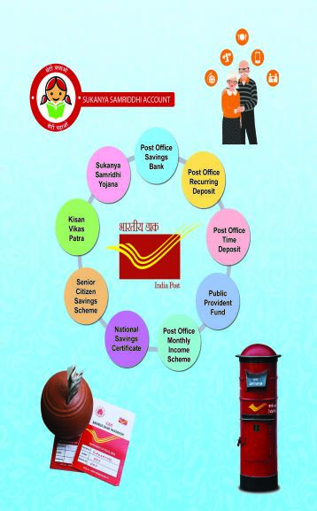

Directorate of Small Savings Finance Department

Slide 2
INDUCTION TRAINING PROGRAMME FOR THE NEWLY JOINED OFFICERS OF THE DIRECTORATE OF SMALL SAVINGS. *********

Slide 3
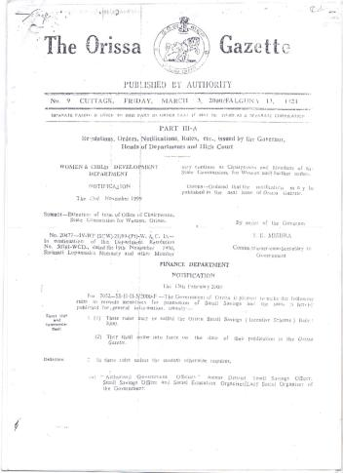
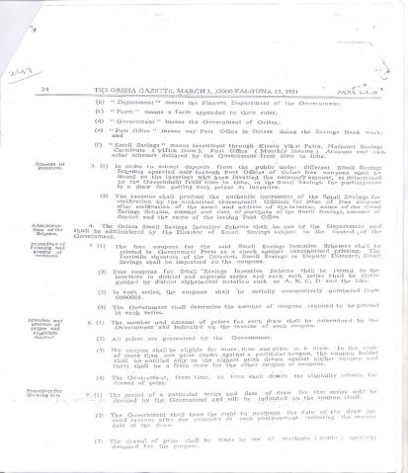
Odisha Small Savings (Incentive Scheme) Rules, 2000

Slide 4
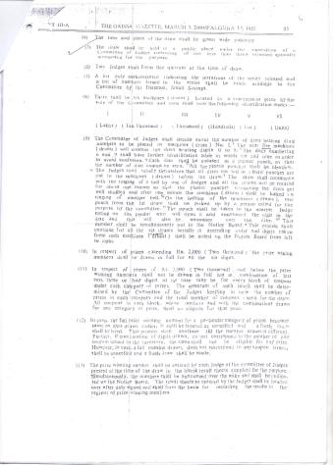
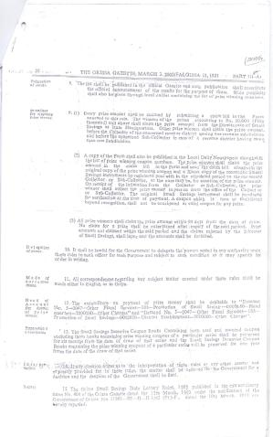
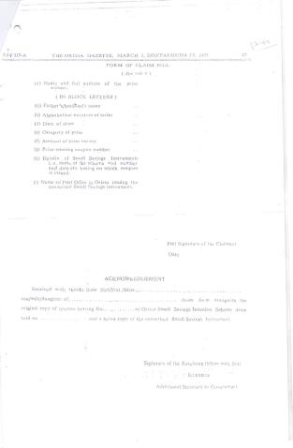
Odisha Small Savings (Incentive Scheme) Rules, 2000

Slide 5
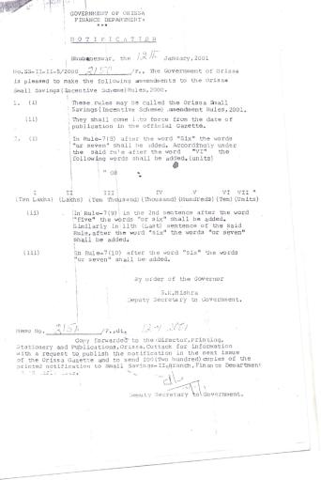
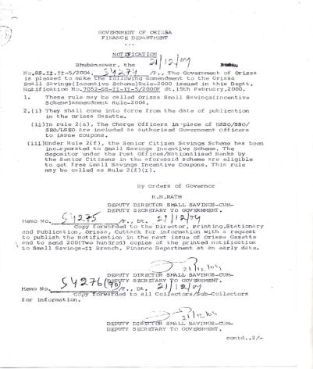
Odisha Small Savings (Incentive Scheme) Rules, 2001 & 2004

Slide 6
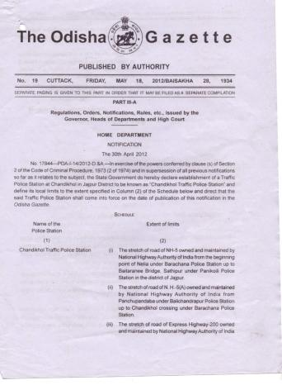
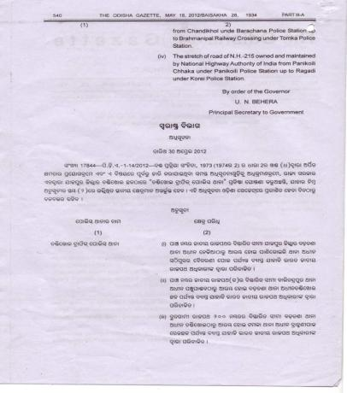
Odisha Small Savings (Incentive Scheme) Rules, 2012

Slide 7
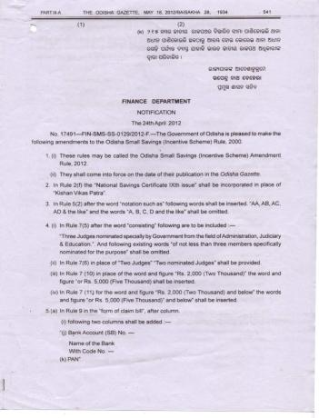
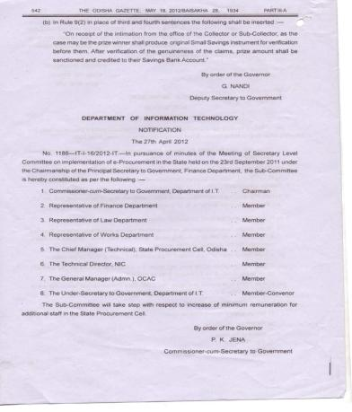
Odisha Small Savings (Incentive Scheme) Rules, 2012

Slide 8
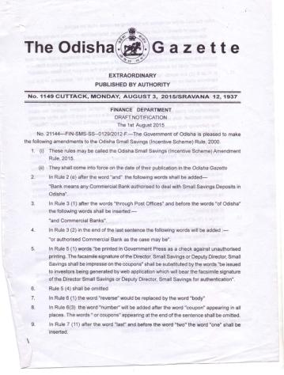
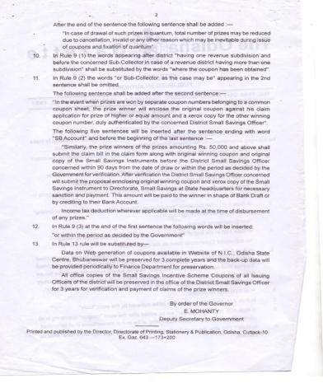
Odisha Small Savings (Incentive Scheme) Rules, 2015

Slide 9
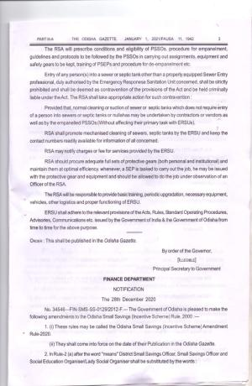
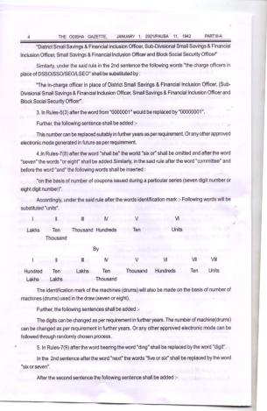
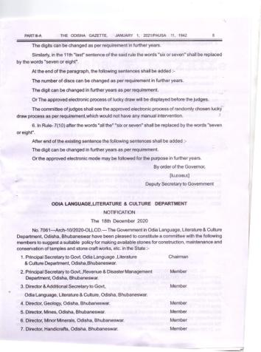
Odisha Small Savings (Incentive Scheme) Rules, 2020

Slide 10
Odisha Small Savings Incentive Scheme:-
Prize profile:-
To spread the message of thrift, safe savings and to promote Small Savings by incentivising the depositors. Odisha Small Savings Incentive Scheme has been introduced by this department.
Minimum deposit of Rs. 2,000/- in a calendar year in the Small Savings Schemes like KVP, POMIS, PORD, 5 Yr. TD, NSC VIII Issue, SSY, PPF & SCSS within the State of Odisha is eligible to get a free web generated Odisha Small Savings Incentive Coupon in that year.
Attractive cash prizes, minimum of Rs. 2,000/- and maximum of Rs. 5,00,000/- can be won in this scheme under seven categories of prize through an annual lucky draw.
Sl. No. | Category of Prize | No. of Prizes | Amount of Prize | Total Amount of Prize
1 | 2 | 3 | 4 | 5
1 | 1st | 1 | Rs. 5 Lakhs | Rs. 5 Lakhs
2 | 2nd | 1 | Rs. 3 Lakhs | Rs. 3 Lakhs
3 | 3rd | 2 | Rs. 1 Lakhs | Rs. 2 Lakhs
4 | 4th | 4 | Rs. 50,000 | Rs. 2 Lakhs
5 | 5th | 20 | Rs. 10,000 | Rs. 2 Lakhs
6 | 6th | 400 | Rs. 5,000 | Rs. 20 Lakhs
7 | 7th | 2000 | Rs.2000/- | Rs.40 Lakhs
TOTAL |  | 2428 |  | Rs. 74 Lakhs

Slide 11
Small Savings Schemes now in operation:-
1 | Savings Bank account | 4 % P.A
2 | Post Office Recurring Deposit (5 Years) | 5.8% P.A
3 | 1 Yr/2Yr/3Yr Term Deposit 5 Yr Term Deposit | 5.5% P.A 6.7% P.A
4 | Monthly Income Scheme (5 Years) | 6.6% P.A
5 | 5 Yr National Savings Certificate VIII Issue | 6.8% P.A
6 | Kisan Vikas Patra (124 months) | 6.9% P.A
7 | Senior Citizen Savings Scheme (5 Years) | 7.4% P.A
8 | Public Provident Fund (15 Years) | 7.1% P.A
9 | Sukanya Samridhi Yojana (21 years) | 7.6% P.A

Slide 12
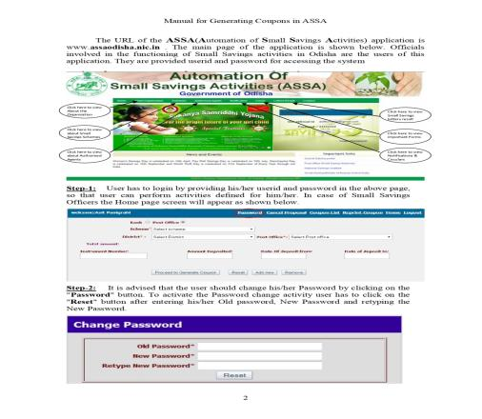
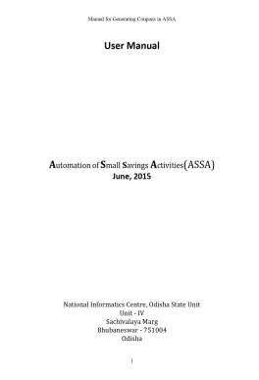
User Manual/procedures for Generation of Odisha Small Savings Incentive Scheme coupon:-

Slide 13
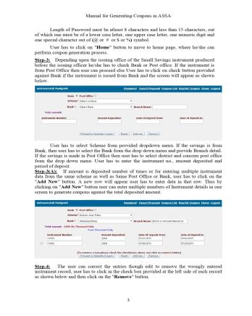
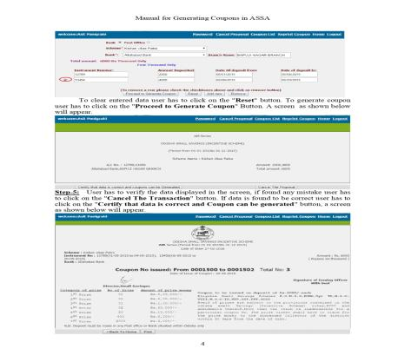
User Manual/procedures for Generation of Odisha Small Savings Incentive Scheme coupon:-

Slide 14
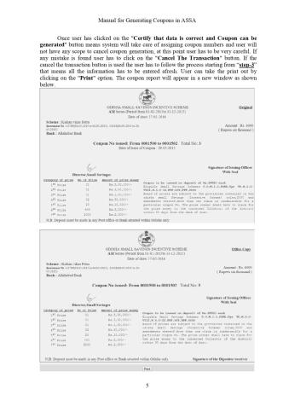
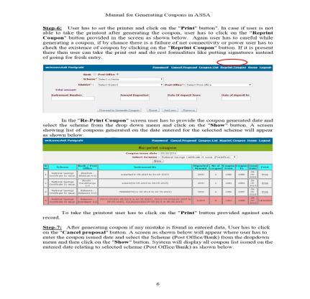
User Manual/procedures for Generation of Odisha Small Savings Incentive Scheme coupon:-

Slide 15
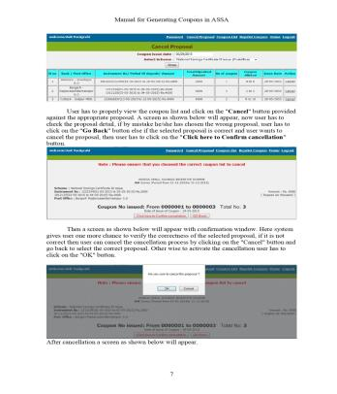
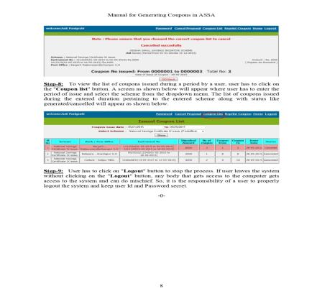
User Manual/procedures for Generation of Odisha Small Savings Incentive Scheme coupon:-

Slide 16
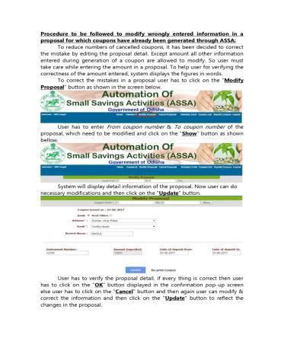
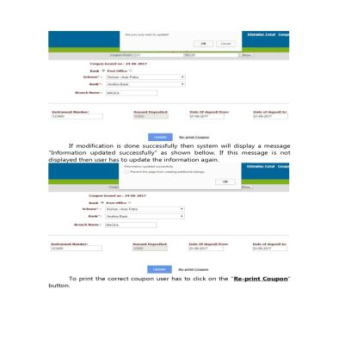
Modify proposal for Odisha Small Savings Incentive Scheme coupon:-

Slide 17
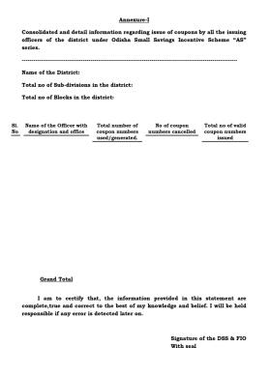
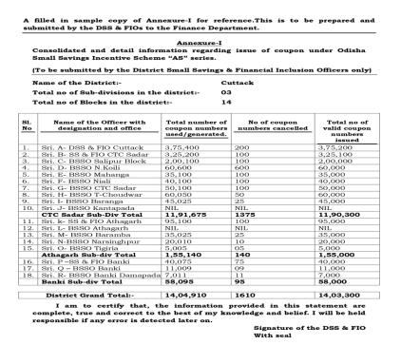
Submission of detail report regarding valid and invalid coupon format

Slide 18
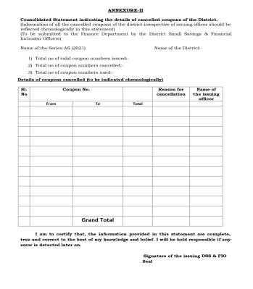
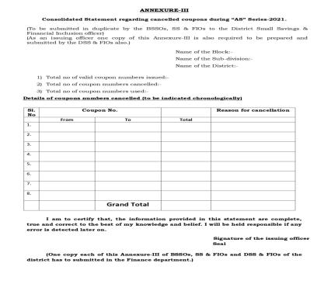
Submission of detail report regarding valid and invalid coupon format

Slide 19
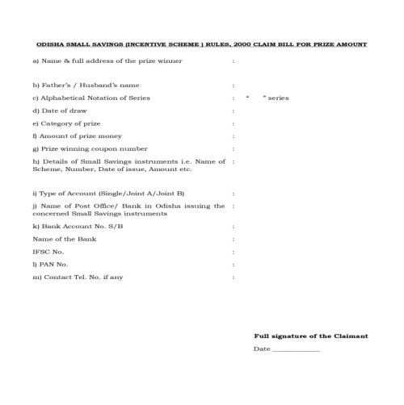
Prize Claim Format

Slide 20




Slide 21


