Slide 1

Function and Role of Treasury
in Financial Administration

Slide 2
Contents
Need
Role & Functions
Responsibility of Treasury Officer
Ecosystem of Treasury
Treasury in financial administration

Slide 3
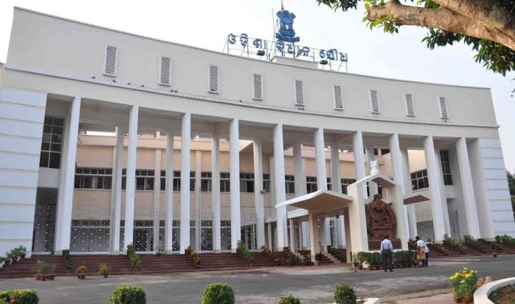
Budget – A legislative Sanction

Slide 4
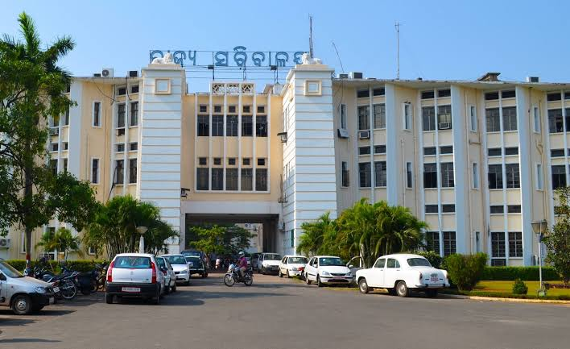
Budget Execution

Slide 5
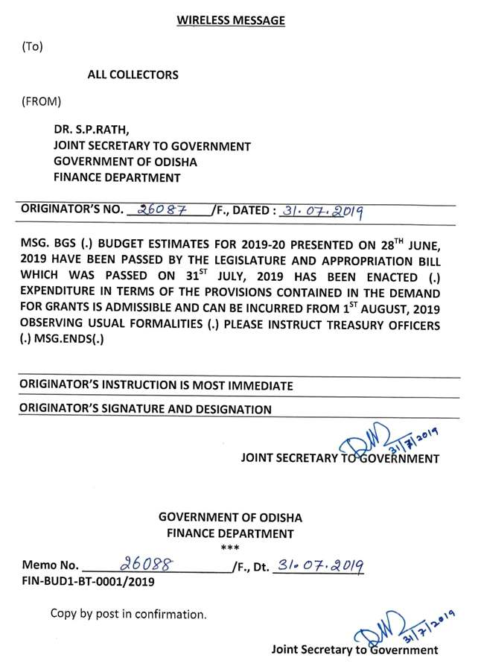
Enactment of the Budget

Slide 6
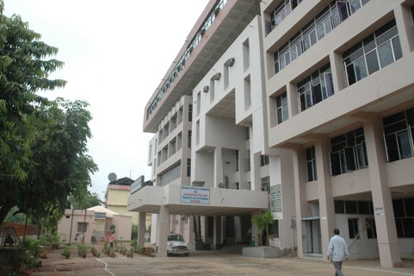
Budget Enforcement

Slide 7
Organization Structure
DIRECTORATE OF TREASURIES & INSPECTION, ODISHA
DISTRICT TREASURY (30)
SPECIAL TREASURY (8)
SPECIAL TREASURY (NDLS)
CYBER TREASURY (1)
STATE PENSION TREASURY
SUB-TREASURY (128)

Slide 8
ROLE OF TREASURY
ENSURE CORRECT PAYMENT AND RECEIPT OF GOVT. MONEY.
CUSTODIAN OF VALUABLES AND OTHER IMPORTANT ITEMS.
TO PREPARE THE ACCOUNTS OF GOVT. TRANSACTION.
ADMINISTRATORS OF NATIONAL PENSION SYSTEM
HUB OF AUTOMATION IN FINANCIAL ADMINISTRATION

Slide 9
Functional Chart of Treasury
Treasury Officer
Bill Receive Counter
(Front Desk)
Advice Section
Compilation
Section
Strong Room

Slide 10
PAYMENT PROCESS
DDO
BILL RECEIVING
BILL PROCESSING
BILL PASSING
ADVICE GENERATION
SENT TO BANK

Slide 11
RECEIPT PROCESS
Treasury passes challan
Bank receives the money
Bank gives the acknowledgement

Slide 12
ACCOUNTING PROCESS
BANK RETURNS SCROLL & VOUCHER
COMPILIATION OF VOUCHER
TREASRY PREPARES MONTHLY ACCOUNTS
A.G MAKES VOUHER COMPILIATION

Slide 13
CONTROLS IN TRESURY TRANSACTION
BUDGETARY CONTROL
RULES, CODES & OTHER INSTRUCTIONS.
DOCUMENTARY CHECKS.
SYSTEM CHECK.

Slide 14
TREASURY ECOSYSTEM
MIS on RBD
DTI (O)
A.G. Odisha
Accounts
CITIZEN
Deposit (Govt.Dues)
TREASURY
Claims
DDO
Scroll
Advice
LINK BANK
RBI
Deposit (Govt. Dues)
Scroll
DMS
VDMS

Slide 15
Enhancements of iOTMS to a desired level providing the state government with a complete state of art solution for financial management
Decentralized Treasury Application System
Integrated Financial Management System
(IFMS).
Odisha Treasury Management System (OTMS
2001
2006
2009
2013
2018
Treasury Computerization Started across 21 District Treasuries.
Integrated Treasury Management System (iOTMS).
Integrated Financial Management System
(IFMS) 2.0.
Primarily used for Accounts Preparation
Introduction of Mobile Apps, Paper less system
Centralized Architecture
Works Expenditure System
Cyber Treasury and Online Challan
e-Accounts to AG
HRMS Integration

Slide 16
Functionalities of IFMS
Budget Estimation
Online Bill
Electronic Sanction order
Electronic Disbursement
Budget Distribution
Pension Payment / NPS
Works and Forest Provisioning
Account Correction and CO Reconciliation
UC Management
Electronic Receipt
IFMS Odisha
Notes:
Blank slide or a freeform slide you may use this to insert or show screenshots etc
If content is added in this slide you will need to use bulleted text

Slide 17

Integrations of IFMS
Departments
HRMS
RBI
PFMS
&
NSDL
iFMS
WAMIS
Bank
AG
BETA

Slide 18
IFMS 2.0

Slide 19
End to end Digital Transaction-(e-Voucher)
Stakeholders
All DDOs
All Treasuries
AG (A&E), Odisha
Use of DSC by DDOs and Treasuries for processing the claim.
Storage, retrieval and access of electronic document to all stakeholders.
Procurement of DSC and e-Sign
Procurement of Digital Signatures (DSC) for users of Deptts., HoDs is complete.
Procurement of e-Sign for all DDOs completed.
Phased implementation plan
Implementation of e-Voucher using DSC among all departments at OLA Treasury
Piloting of e-Voucher among all DDOs using e-Sign is going on
Background
Bills along with all its attachment are digitally signed at DDO level
Treasury approves and advises the claim by using DSC
All account statements like SoR, SoP, Closing abstract, RBD statement etc are transmitted to AG(O) by using DSC

Slide 20
Bulk Disbursement
Stakeholders
All Administrative Departments
Features
To facilitate DBT to large number of beneficiaries using server to serve integration.
Status:
Integrations completed with HRMS, ALPHA, KAALIA, SRC, Higher education department, MAMATA, Common Scholarship Portal etc.
Scheme Implementing Agencies
HRMS
Common Utility Portal for Electricity dues
Complete automated system of disbursement including system generated Sanction order and Bill

Slide 21
Mobile Application-
Stakeholders
Features
User specific reports and information will be provided through the Mobile app
Status
Citizen
Pensioners
IFMS/ MIS Users
Live in production environment
Available in both Android and Apple Version

Slide 22
Revamping of e-Receipt
Major new Features
Integration with different departments and Banks to be more secure
Additional Payment modes available
UPI
Encryption/Decryption Algorithm for Department Integration
Facility like automated double verification of any transaction
Wallet
Payment Gateways
PoS
NEFT/ RTGS
User profile for tax payers- to keep track of all the transactions done
Department console for HoA addition/ modification and Transaction Monitoring & Downloading
Web Service/ SFTP for Department for Downloading Scroll
Web Service for Department to pull payment status from IFMS
Pre-generated Challan reference number for department which has it’s own bank integration

Slide 23
Commitment Management
Commitment Management Scope
To record intra or interior commitments.
Commitment Management Status:
Integration with GeM for blocking of allotments and release of fund directly to the GeM supplier from IFMS is developed and deployed in production environment.
Integration with Government e-Marketplace (GeM)
Integration with WAMIS
Integration with BETA
With the IFMS SARTAC team, the conceptual requirement for developing commitment recording and management system is underway

Slide 24
Identity and Access Management (IDAM)
Features
Single sign-on
Activation and De-Activation of user- what-if analysis to be done for the pending works associated with that User-id
Multi factor authentication (OTP, DSC, e-Sign, biometric etc.) facility will be available
Audit trail- Time-stamped records of every access change request, approval/denial, justification and change to a managed resource
Clear segregation of duties between user groups
Status
Integration with HRMS
Finalization of requirement has been completed
User acceptance testing is completed
Feature of Dual factor Authentication is Live with limited/optional Usage (Skip for now option)

Slide 25
Role of Treasury in Financial Administration

Slide 26
THANK YOU

