Slide 1
RESERVE BANK OF INDIA BHUBANESWAR
FIELD LEVEL FINANCIAL LITERACY EVENT
JUNE 8, 2022
BARIPADA, MAYURBHANJ

Slide 2
SAFE DIGITAL BANKING PRACTICES
Never share your account details such as account number, login ID, password, PIN, UPI-PIN, OTP, ATM / Debit card / credit card details with anyone, not even with bank officials, however genuine they might sound.
Any phone call / email threatening the blocking of your account on the pretext of non-updation of KYC and suggestion to click link for updating the same is a common modus operandi of fraudsters. Do not respond to offers for getting KYC updated / expedited. Always access the official website of your bank / NBFC / e-wallet provider or contact the branch.
Do not download any unknown app on your phone / device. The app may access your confidential data secretly.
Transactions involving receipt of money do not require scanning barcodes / QR codes or entering MPIN. Thus, exercise caution if asked to do so.

Slide 3
SAFE DIGITAL BANKING PRACTICES
Always access the official website of bank / NBFC / e-wallet provider for contact details. Contact numbers on internet search engines may be fraudulent.
Check URLs and domain names received in emails / SMSs for spelling errors. Use only verified, secured, and trusted websites / apps for online banking, that is, websites starting with ‘’https’’. In case of suspicion, notify local police / cybercrime branch immediately.
If you receive an OTP for debiting your account for a transaction not initiated by you, inform your bank / e-wallet provider immediately. If you receive a debit SMS for a transaction not done, inform your bank / e-wallet provider immediately and block all modes of debit, including UPI. If you suspect any fraudulent activity in your account, check for any addition to the beneficiary list enabled for internet / mobile banking.

Slide 4
SAFE DIGITAL BANKING PRACTICES
Do not share the password of your email linked to your bank / e-wallet account. Do not have common passwords for e-commerce / social media sites and your bank account / email linked to your bank account. Avoid banking through public, open or free networks.
Do not set your email password as the word “password” while registering in any website / application with your email as user-id. The password used for accessing your email, especially if linked with your account, should be unique and used only for email access and not for accessing any other website / application.
Do not be misled by advices intimating deposit of money on your behalf with RBI for foreign remittances, receipt of commission, or wins of lottery.

Slide 5
SAFE DIGITAL BANKING PRACTICES
Regularly check your email and phone messages for alerts from your financial service provider. Report any un-authorized transaction observed to your bank / NBFC / Service provider immediately for blocking the card / account / wallet, so as to prevent any further losses.
Secure your cards and set daily limit for transactions. You may also set limits and activate / deactivate for domestic / international use. This can limit loss due to fraud.

Slide 6
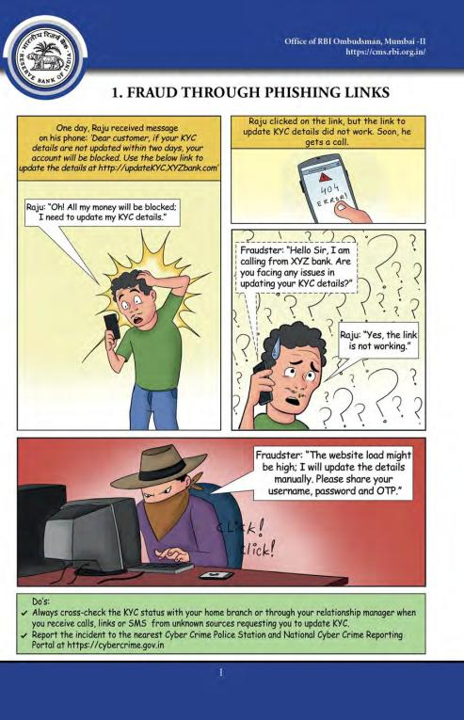

Slide 7
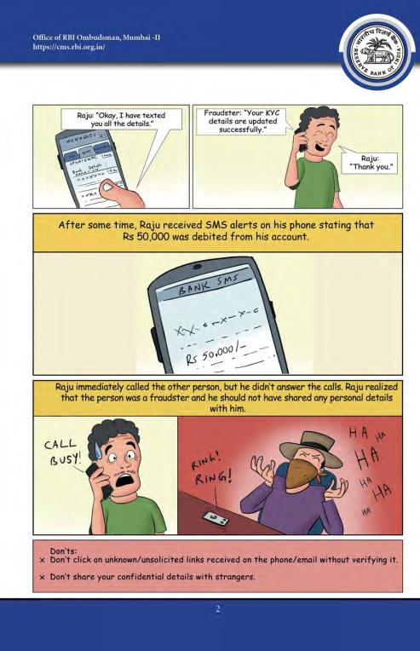

Slide 8
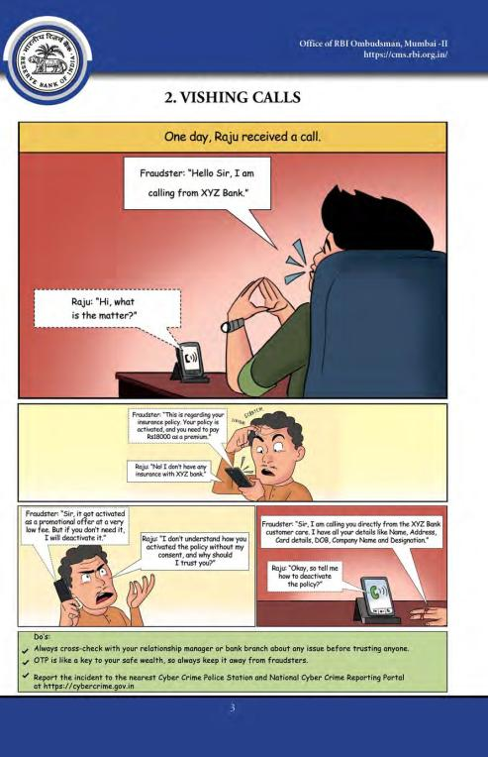

Slide 9
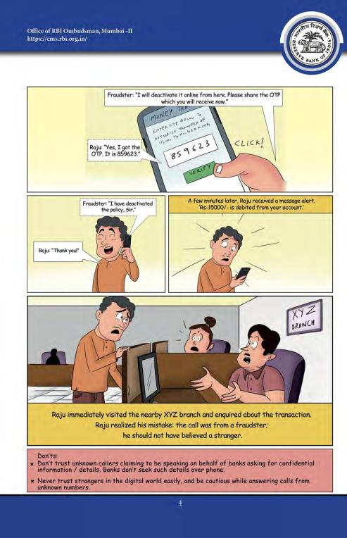

Slide 10
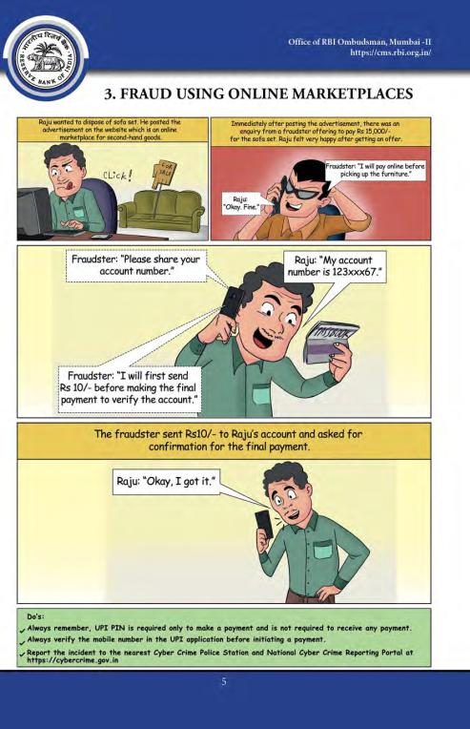

Slide 11
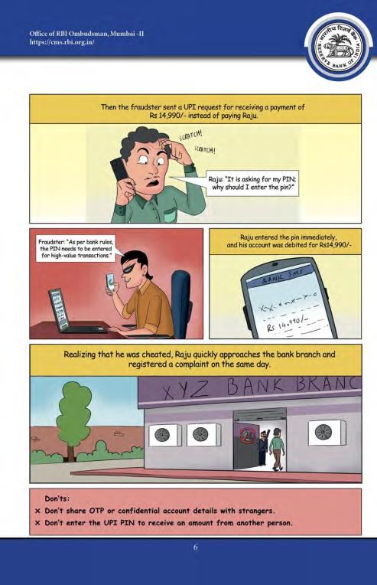

Slide 12
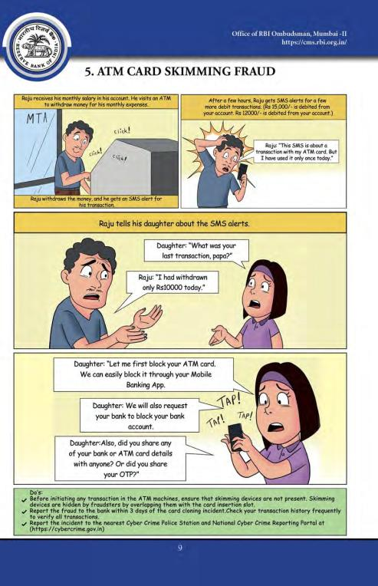

Slide 13
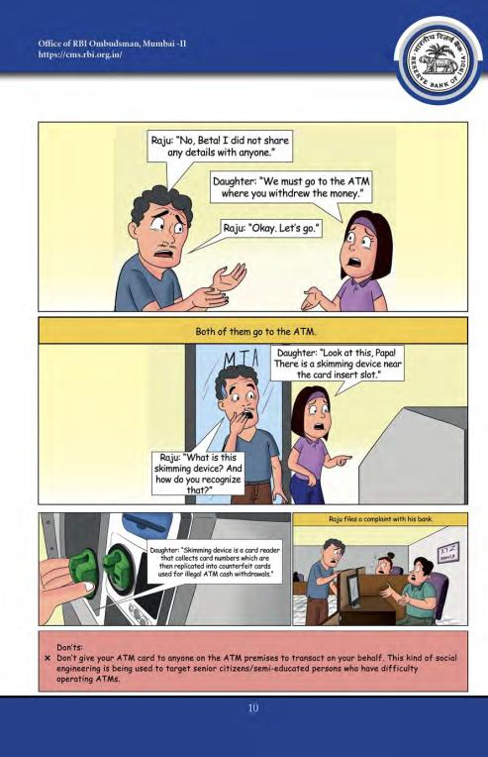

Slide 14
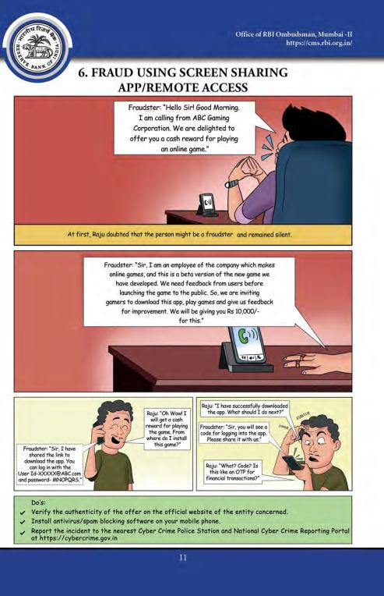

Slide 15
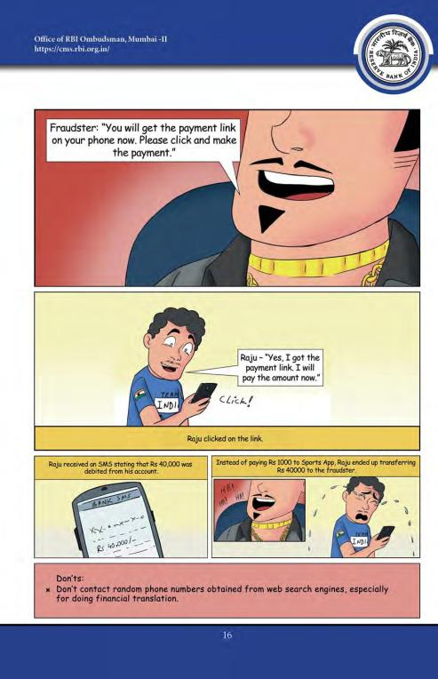

Slide 16
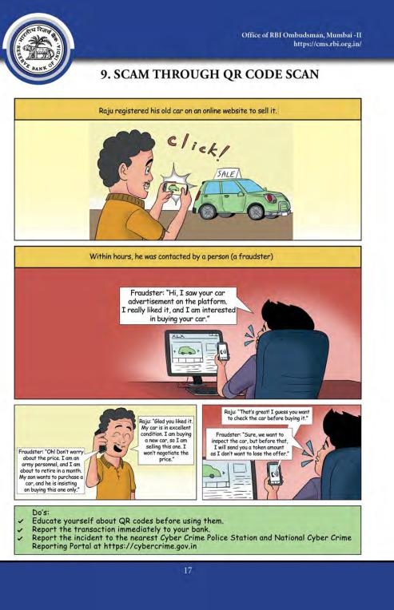

Slide 17
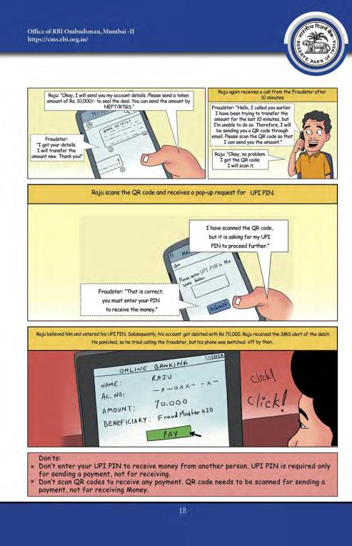

Slide 18
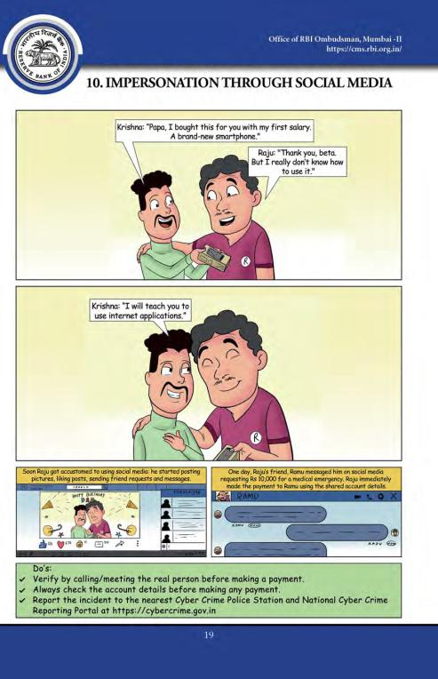

Slide 19
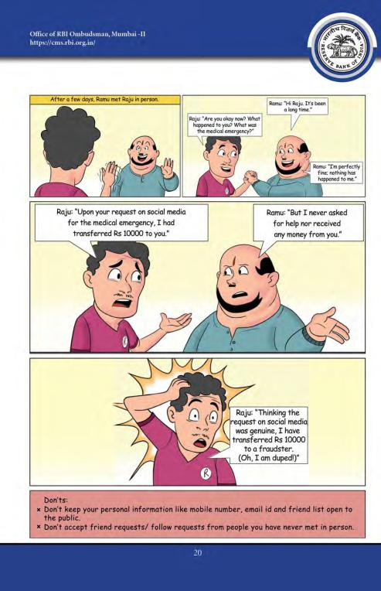

Slide 20
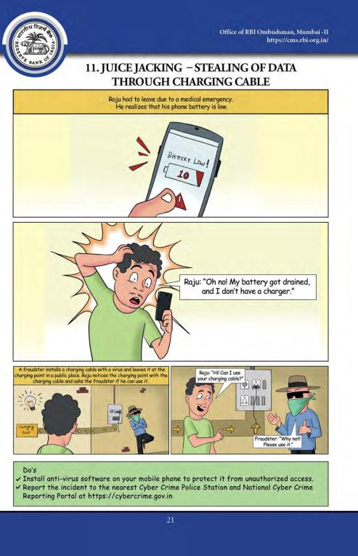

Slide 21
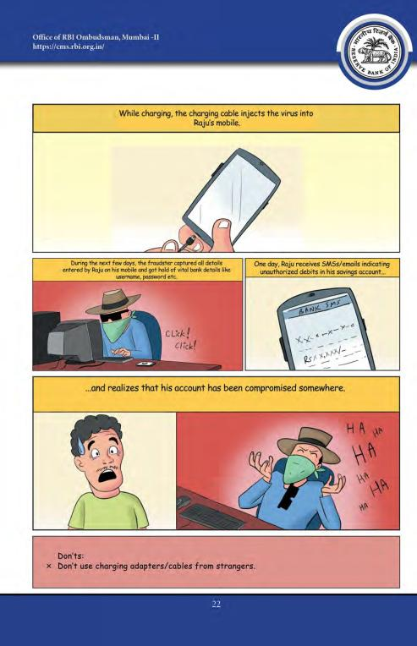

Slide 22
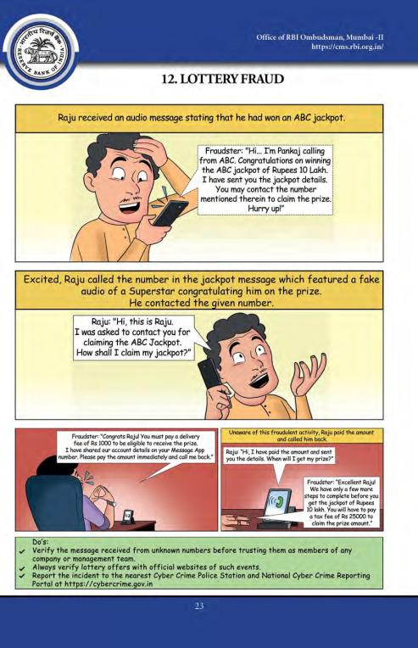

Slide 23
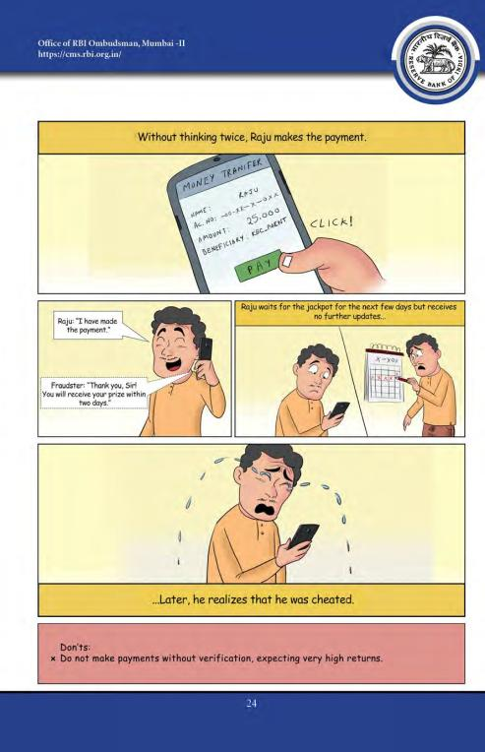

Slide 24
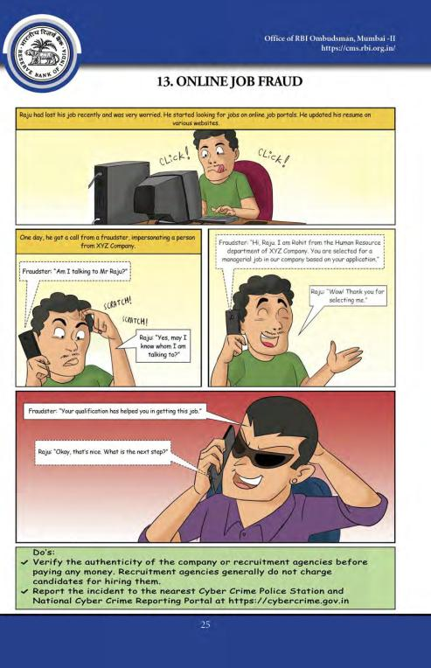

Slide 25
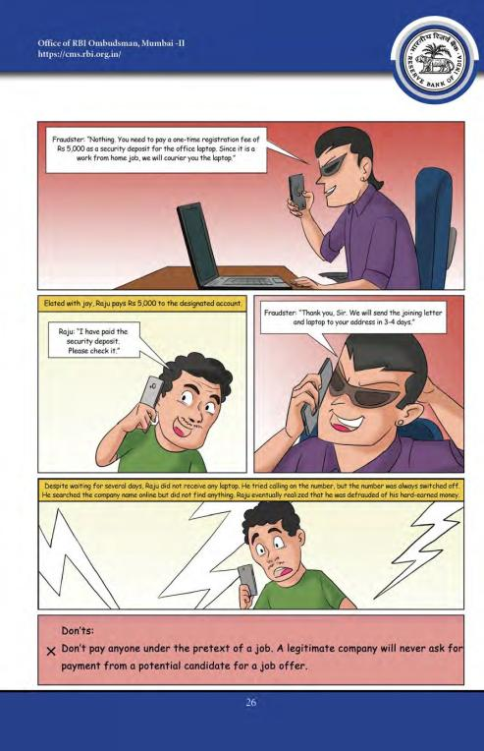

Slide 26
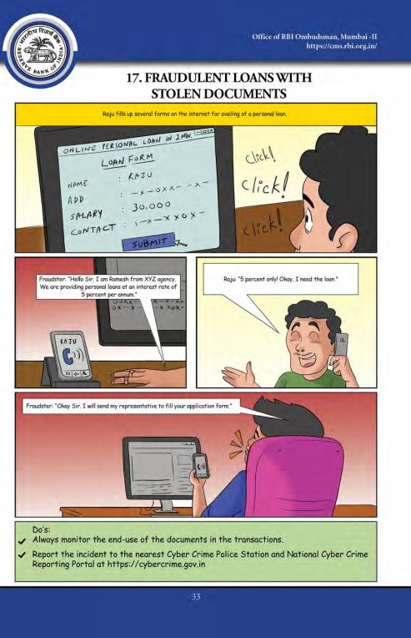

Slide 27
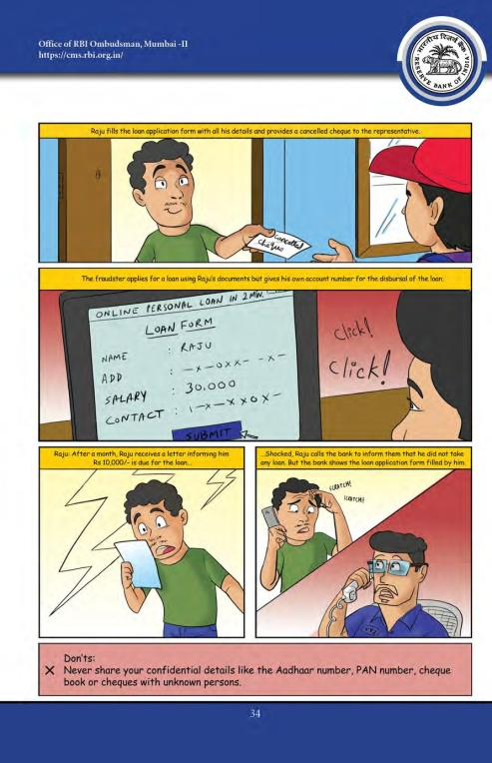

Slide 28
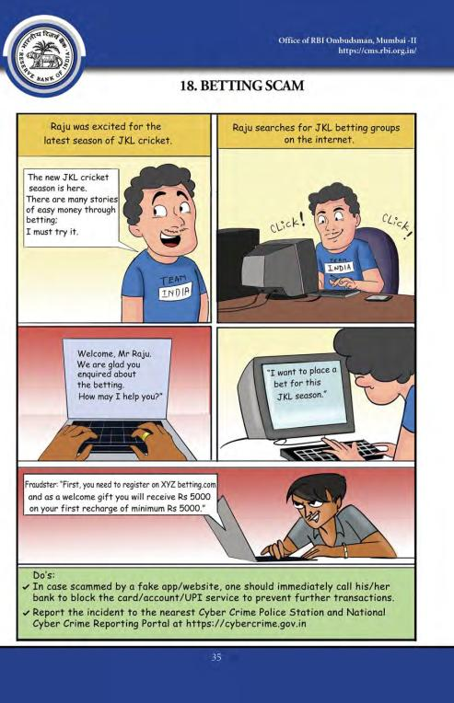

Slide 29
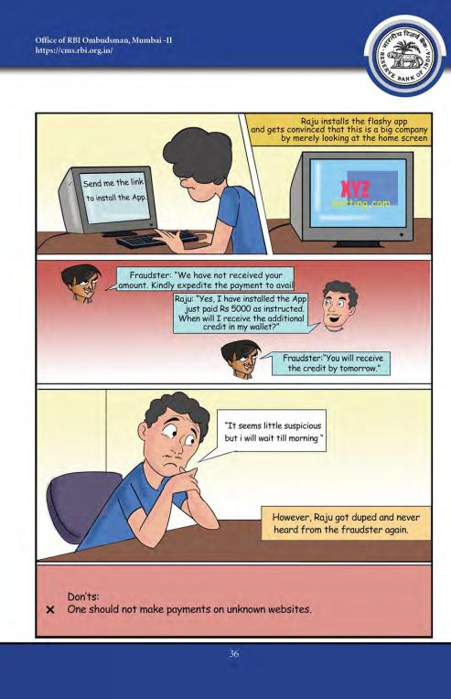

Slide 30
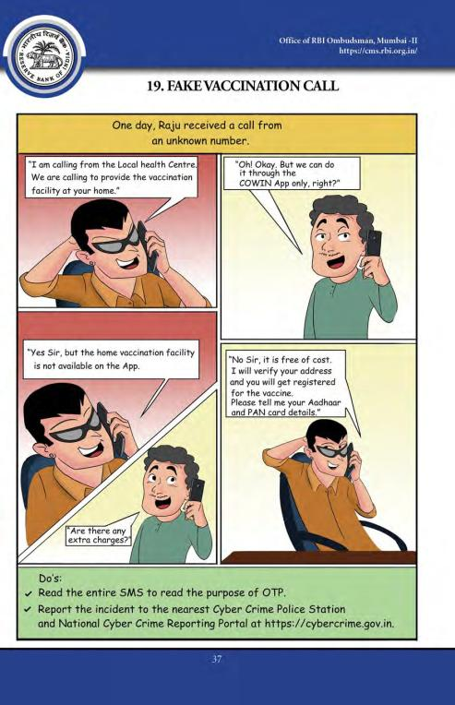

Slide 31
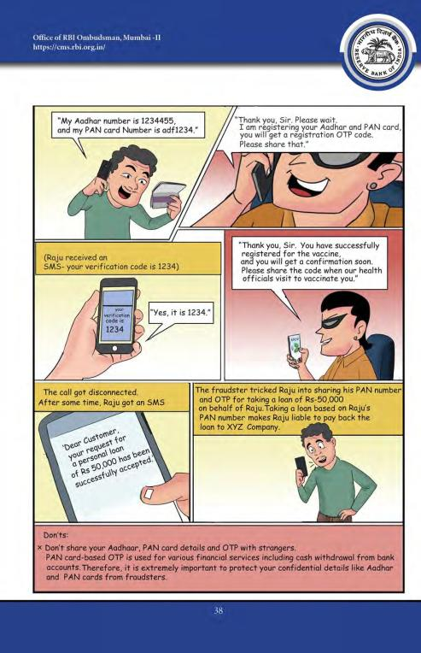

Slide 32
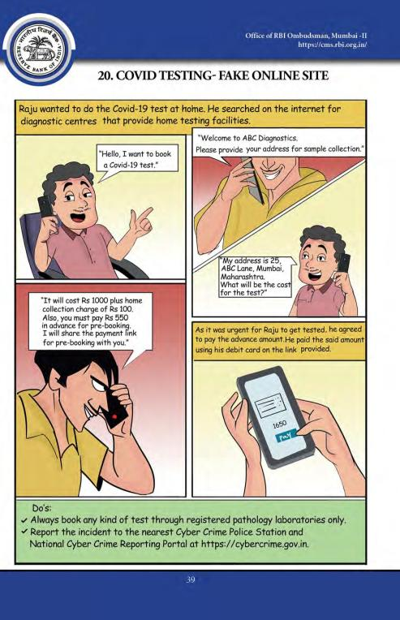

Slide 33
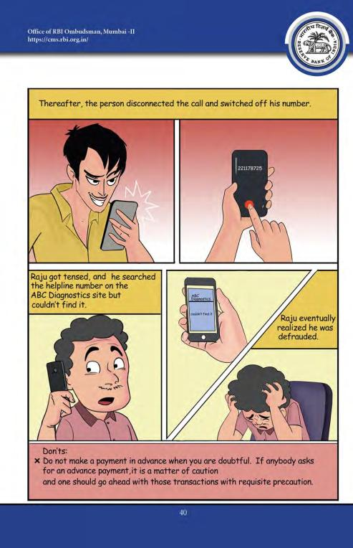

Slide 34
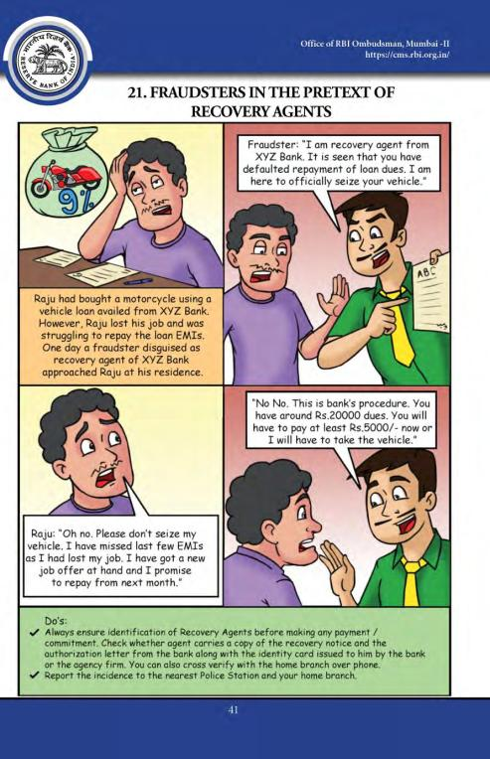

Slide 35
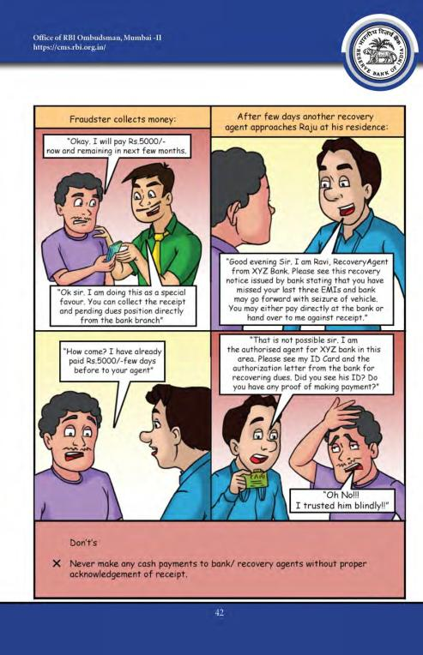

Slide 36
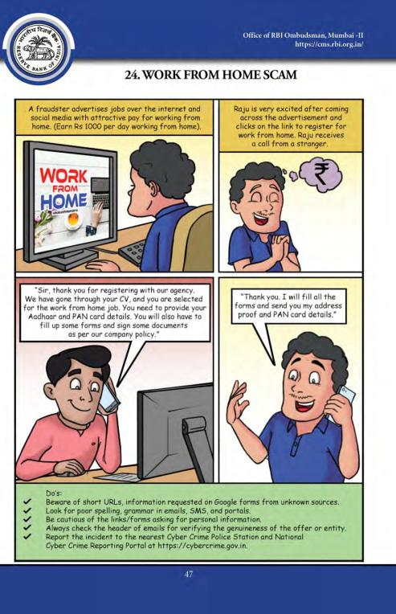

Slide 37
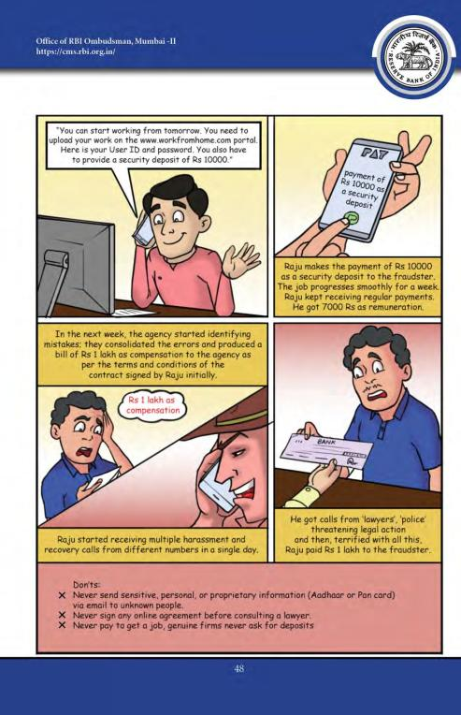

Slide 38
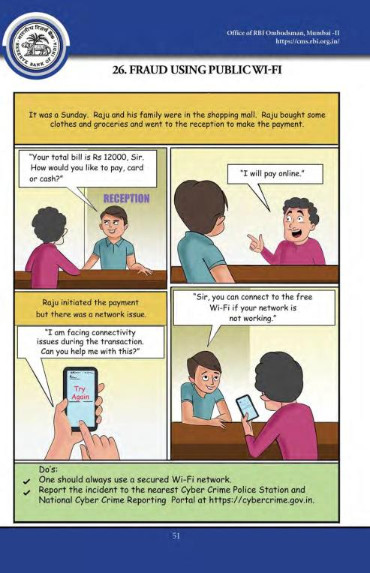

Slide 39
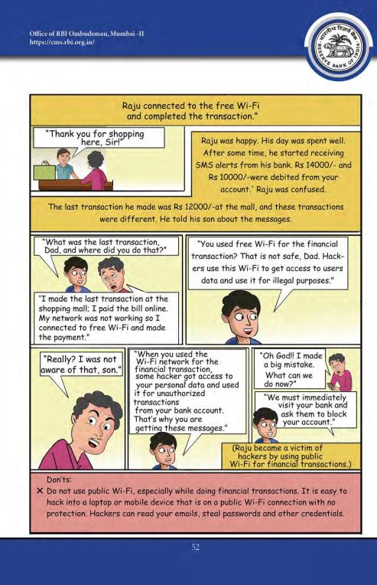

Slide 40
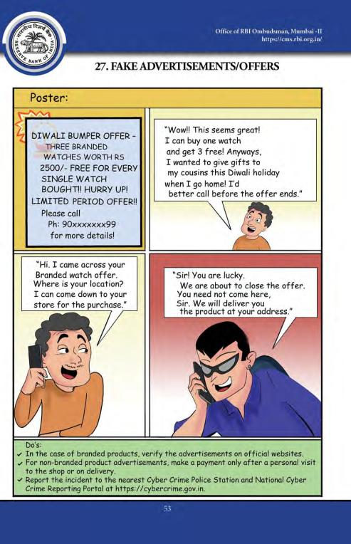

Slide 41
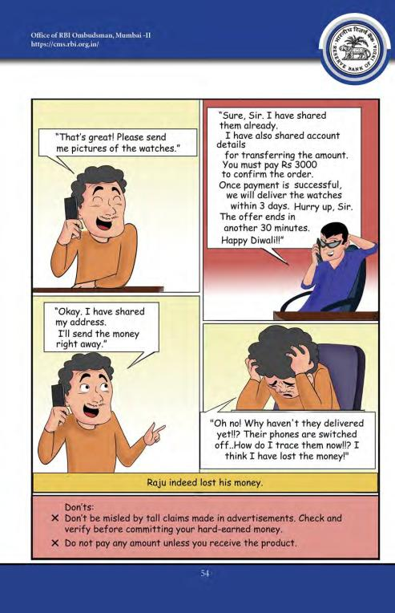

Slide 42
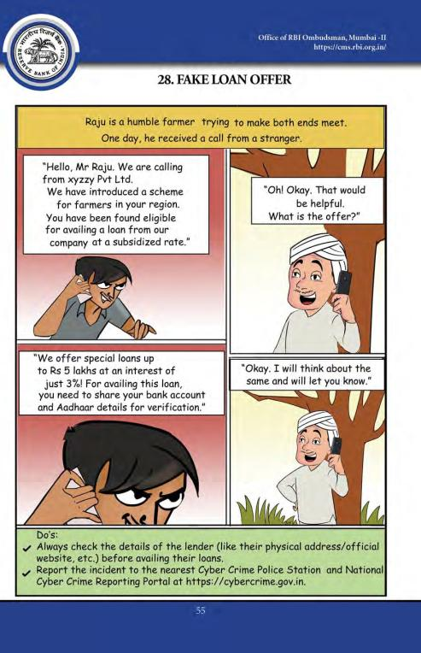

Slide 43
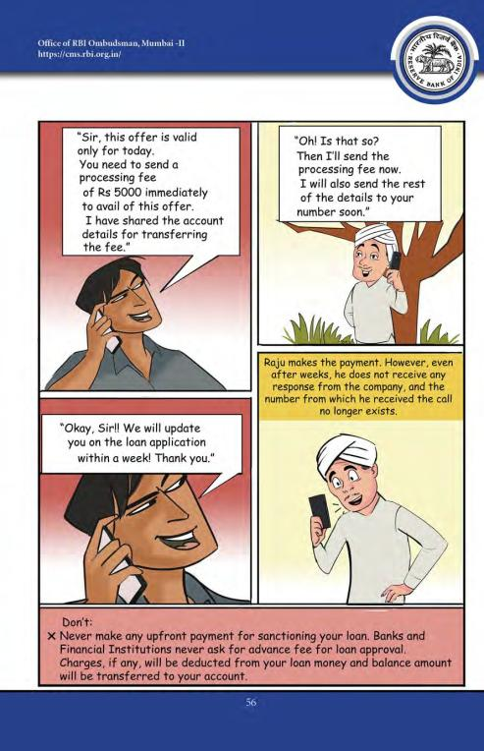

Slide 44
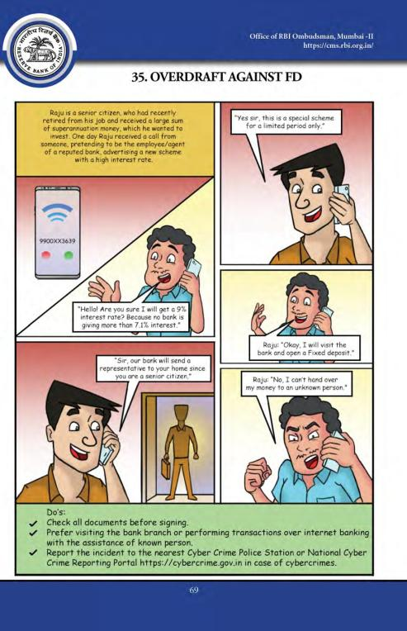

Slide 45
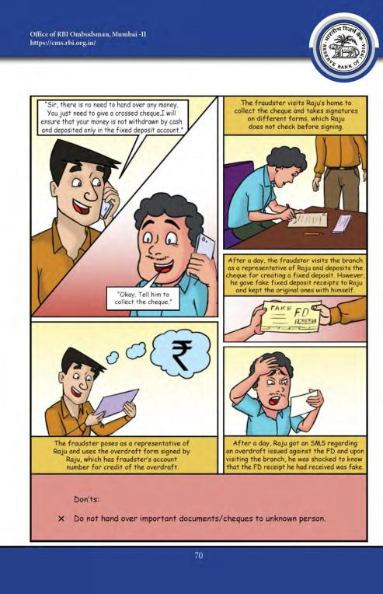

Slide 46
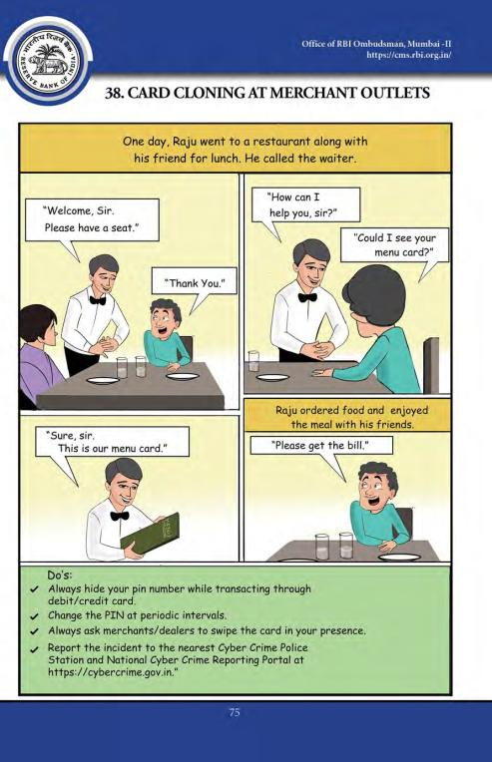

Slide 47
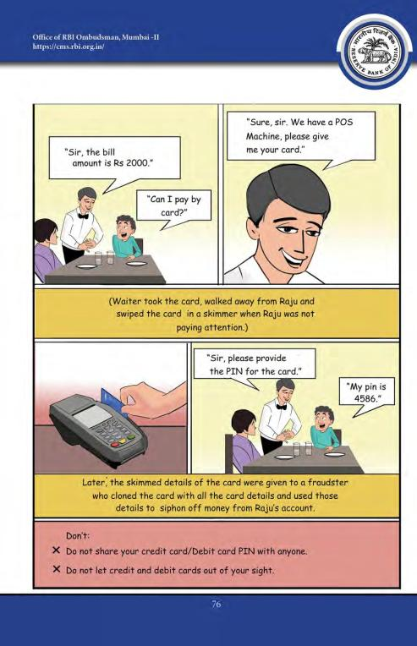

Slide 48
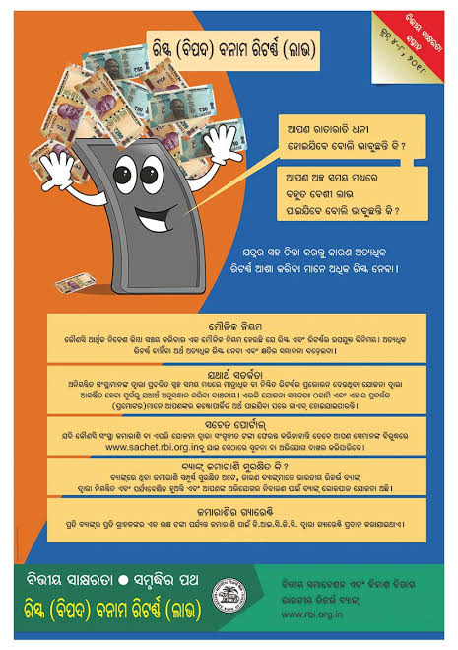

Slide 49


Slide 50
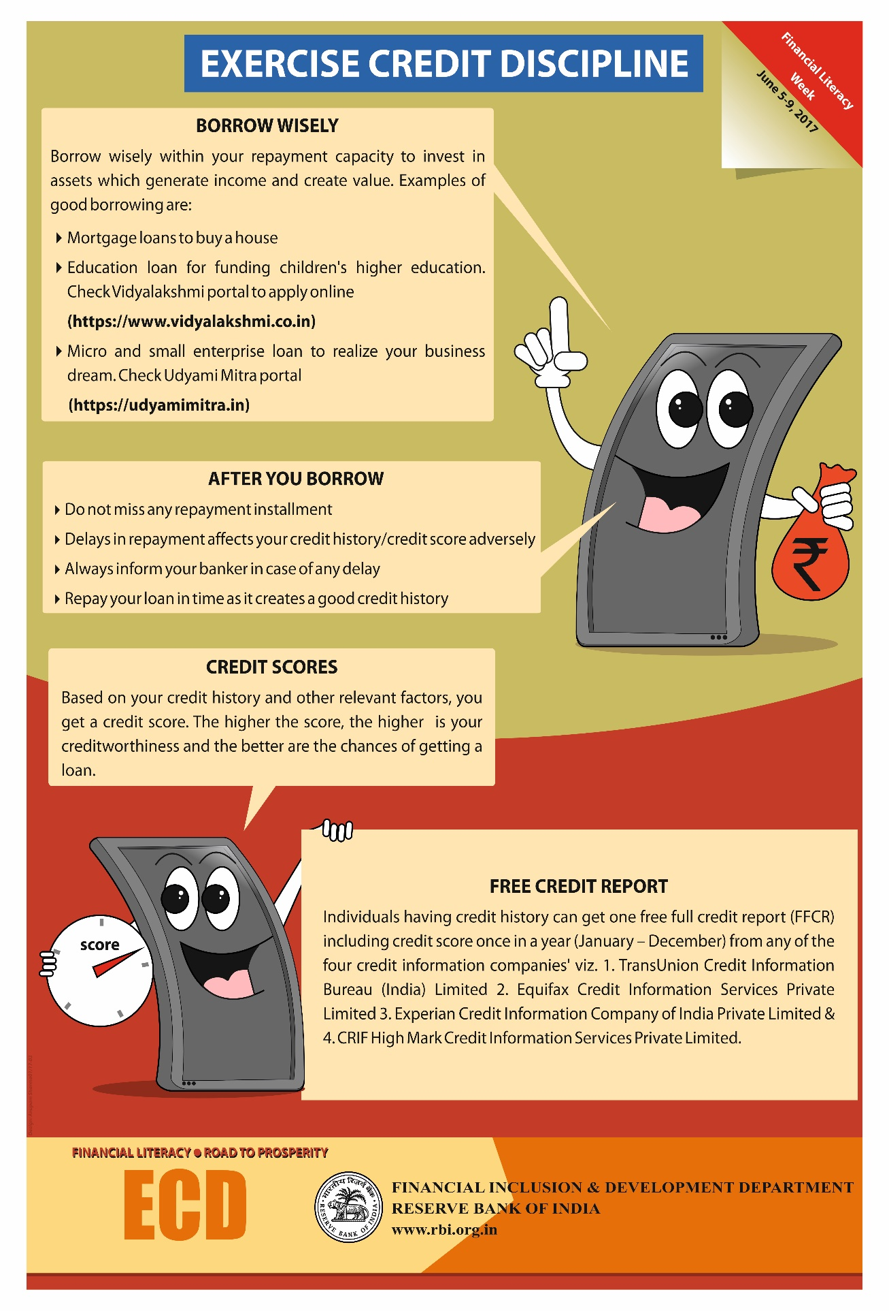

Slide 51
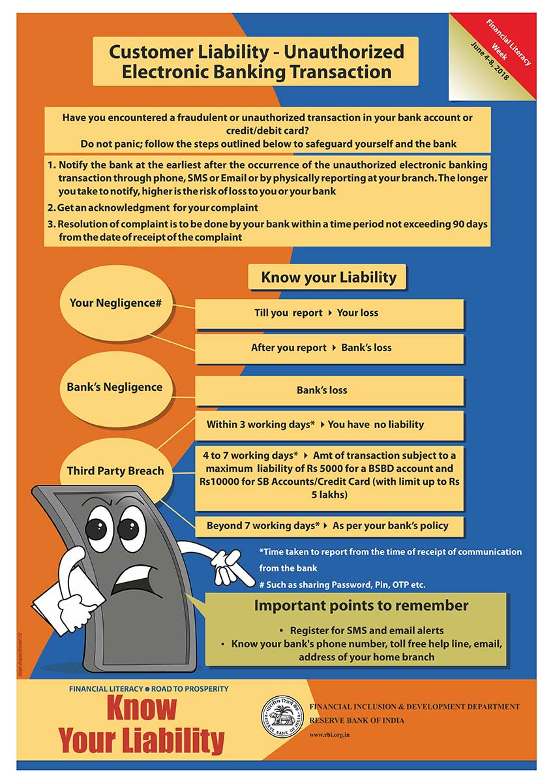

Slide 52
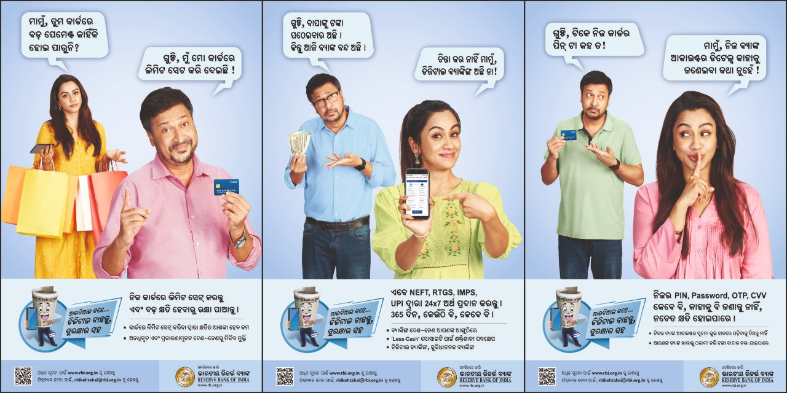

Slide 53

ଧନ୍ୟବାଦ

