Slide 1

Responsibility of DDO: Special Emphasis on Role in IFMS

Slide 2


Integrated Financial management System (IFMS)
It is an electronic platform for carrying out all financial transactions of the state government
It helps in the accounting reconciliation and reporting of all financial transactions of the state

Slide 3
Who is a DDO:
Entrusted with the responsibility of drawing and disbursing funds of the Government
Supplied with funds by Government in shape of Allotment for expenditures
  Responsible for the fund and ensures that payments made to rightful claimant
  In case of any doubt about identity of Govt. Servant, he has to confirm from Govt.
  Draw from Govt. account only when it is required and not to park fund outside Govt. Account

Slide 4
DDO Code:
Pre-requisite for drawal through Treasury
Online Application by using DDO Mgt. Module of IFMS
  Allotment of DDO Code by AG(O)
  Facility in IFMS for any updation in DDO Details
  Submission of claims in Treasury- e-Bill & e-Sanction Order
  Use of DSC/e-Sign

Slide 5
Bill Preparation:
Pay Bills:
Correct Bill Type
Booking under proper HoA
DDO Code mentioned on top of Bill
Deduction schedules: 1) AG Bt 2) Treasury Bt
Signature of DDO
Pay Fixation statement, Option Exercise form, 3rd Schedule, undertaking towards recovery etc.

Slide 6
Bill Preparation:
GPF Bills:
Proper HoA
Account Slip (AG/Controller of Accounts)
Sanction Order by competent authority
Authorisation Slip (OTC-82)
Voucher Slip (OGFR)

Slide 7
Bill Preparation:
Abstract Contingent Bill:
Booking under Proper HoA
Approval by F.D. for drawal through AC Bill
Drawal limit fixed by CO
One bill under one unit in a day
Submission of D.C bill

Slide 8
Bill Preparation:
GIS Bill:
Upon entry into service
Before drawal of first salary
Sanction Order by Head of Office
GIS Passbook / GIS form by F.D. to be pasted in Service Book
Recovery through 10 equal installments

Slide 9
Bill Preparation:
RCM Bill:
For admissible Medicines only
Essentiality Certificate by Physician
Cash Memo
Signature of DDO
Cancellation of Cash Memo by DDO

Slide 10
IFMS – Key Differentiator
40+
22+
Modules
Administrative Department Integrated
17+
Public/ Private Sctor Banks Integrated
>90%
Government Receipt
Through eReceipt
100%
Government Disbursement
through eDisbursement
8000+
Internal Users
25000+
Transactions Per Day

Slide 11
Current IT Scenario of IFMS
IFMS is hoisted at State Data Centre (SDC)
BCP of IFMS is available in National Data Center (NDC) Delhi
State Data
Centre (SDC)
Business
Continuity
Plan (BCP)
Data Backup is available in DTI
Dedicated NDR is planned in IT Centre of State Secretariat
Near Disaster
Recovery (NDR)
Connectivity
Dedicated Leased line from SDC to DTI
Secured Private Network for all treasuries
OSWAN as back-up connectivity

Slide 12
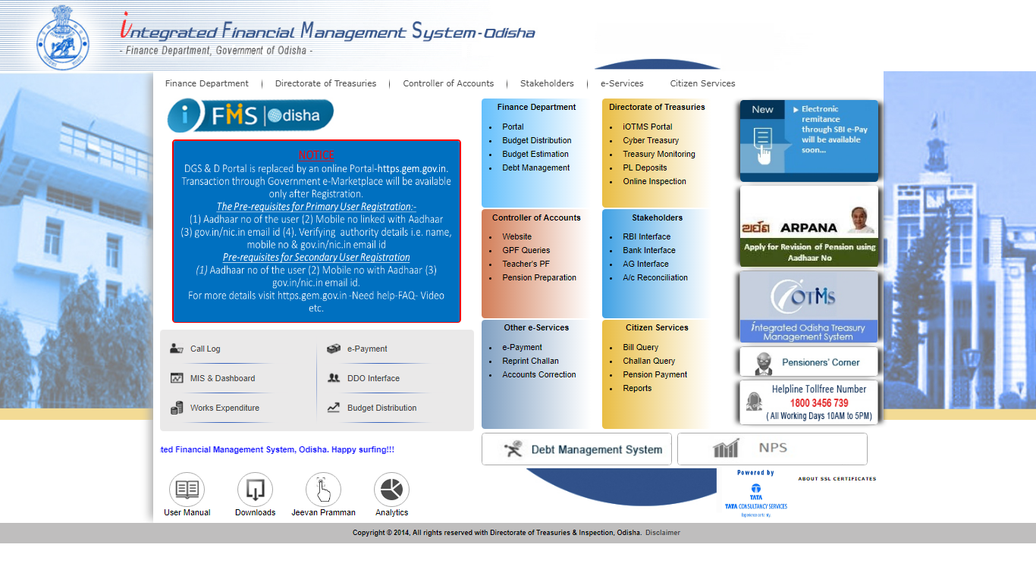
Integrated Financial Management System (IFMS), Odisha

Slide 13
Organizations: Roles & Functions
Finance Department
Prepare, Publish State Budget
State Policy formulation
Development of modules, training, implementation & maintenance of IFMS.
Finance Department
Preparation of First level accounts
Directorate of Treasuries and Inspection
Processing of Govt. claims for
payment and receipts
Centralized Electronic Processing Cell
CEPC
NPS Cell
DTI, FD
Integration with other systems.
Treasuries
Claim Processing
Treasury
District Treasury-30
Sub Treasury 128
Special Treasury-8
Cyber Treasury-1
State Pension Treasury-1
Spl Treasury NDLS
Accounts Preparation
Disbursement of pension

Slide 14
Enhancements of iOTMS to a desired level providing the state government with a complete state of art solution for financial management
Decentralized Treasury Application System
Integrated Financial Management System
(IFMS).
Odisha Treasury Management System (OTMS)
2001
2006
2009
2013
2018
Treasury Computerization Started across 21 District Treasuries.
Integrated Treasury Management System (iOTMS).
Integrated Financial Management System
(IFMS) 2.0.
Primarily used for Accounts Preparation
Introduction of Mobile Apps, Paper less system, Commitment Management etc.
Centralized Architecture
Works Expenditure System
Cyber Treasury and Online Challan
e-Accounts to AG
HRMS Integration

Slide 15
Functionalities of IFMS 1.0
Budget Estimation
Budget Distribution
Electronic Disbursement
Pension Payment / NPS
Electronic Receipt
Works and Forest Provisioning
Account Correction and CO Reconciliation
UC Management
Online Bill
Electronic Sanction Order
IFMS Odisha
Notes:
Blank slide or a freeform slide you may use this to insert or show screenshots etc
If content is added in this slide you will need to use bulleted text

Slide 16
Reach of IFMS
More than forty (40) Modules
Twenty two (22) Administrative Departments integrated
More than seventeen (17) Public/ Private Sctor Banks and two (2) Payment Gateways Integrated
More than Ninety (90) percent Government Receipt through eReceipt
Cent (100) percent Government Disbursement through eDisbursement
More than Eight thousand (8000) internal Users
Approximately Twenty Five Thousand (25000) transactions/ day

Slide 17

Integrations of IFMS 1.0
Departments
HRMS
RBI
PFMS
&
NSDL
IFMS
WAMIS
Bank
AG
BETA

Slide 18
Stakeholders of IFMS
Disbursement Officers (DDOs)
1
2
Controlling Officers (COs)
3
Administrative Department.
    Stakeholders
4
Treasuries
5
Accountant General (AG)
6
Public Works Division
7
Pensioners
8
RBI and Banks

Slide 19
Automation Impact- Odisha Treasury

Slide 20
IFMS 2.0

Slide 21
End to end Digital Transaction-(e-Voucher)
Stakeholders
All DDOs
All Treasuries
AG (A&E), Odisha
Use of DSC by DDOs and Treasuries for processing the claim.
Storage, retrieval and access of electronic document to all stakeholders.
Phased implementation plan
DDOs of Administrative Departments, Heads of the Department, Collectors by December, 2020.
All other DDOs by March, 2021
Procurement of DSC
Procurement of Digital Signatures (DSC) for users of Deptts., HoDs, Collectors are complete.
Process for procurement of DSC and e-Signature has started, expected to complete by February, 2021
Business Process Re-engineering
Notification containing process re-engineering for use of DSC has been issued by the Finance Department.
Design for change, development of new bill formats and sanction orders is in the process

Slide 22
Bulk Disbursement
Stakeholders
All Administrative Departments
Features
To help all Agencies to transfer payment data of approved beneficiary using server to serve integration for drawal from Treasury and DBT.
Status:
Integrations completed with HRMS, ALPHA
Business Process Re-engineering
Draft Notification containing the roles of approving, drawing authorities including DDO and Treasury has been submitted to the Finance Department.
Scheme Implementing Agencies
HRMS
Common Utility Portal for Electricity dues
Presently payments are made through NEFT. RBI has been requested to offer the Aadhaar payment platform.
Integration in process with MAMATA, Common Scholarship Portal, Common Utility Portal
For Department which don’t have backend application, an utility will be developed and provided to upload bulk beneficiary list to IFMS

Slide 23
Mobile Application-
Stakeholders
Features
User specific reports and information will be provided through the Mobile app
Status
Citizen
Pensioners
IFMS/ MIS Users
Development is complete & Live in production environment for Android Version
Steps are being taken to make it available in Apple Platform

Slide 24
Revamping of e-Receipt
Major new Features
Integration with different departments and Banks to be more secure
Additional Payment modes to be available
UPI
Encryption/Decryption Algorithm for Department Integration
Facility like automated double verification of any transaction
Wallet
Payment Gateways
PoS
NEFT/ RTGS
User profile for tax payers- to keep track of all the transactions done
Department console for HoA addition/ modification and Transaction Monitoring & Downloading
Web Service/ SFTP for Department for Downloading Scroll
Web Service for Department to pull payment status from IFMS
Pre-generated Challan reference number for department which has it’s own bank integration

Slide 25
Commitment Management and Identity & Access Management (IDAM)
Commitment Management Scope
To record intra or interior commitments.
Commitment Management Status:
Integration with GeM for blocking of allotments and release of fund directly to the GeM supplier from IFMS is at the final stage of development.
Integration with Government e-Marketplace (GeM)
Integration with WAMIS
Integration with BETA
With the IMF SAARTAC team, the conceptual requirement for developing commitment recording and management system is underway.
Workshop will be conducted in February/March, 2021
Identity and Access Management (IDAM)
Single sign-on
Activation and De-Activation of user- what-if analysis to be done for the pending works associated with that User-id
Multi factor authentication (OTP, DSC, e-Sign, biometric etc.) facility will be available
Audit trail- Time-stamped records of every access change request, approval/denial, justification and change to a managed resource
Clear segregation of duties between user groups
Integration with HRMS

Slide 26
Other Important Activities
Services Achieved
Rollout of Single Page salary
Services to be available
Revised Electronic Receipt system
Smart Pension Payment Order (PPO)
Online Pension Application system
Electronic authority for GPF
Online PRAN generation system for NPS holders
Scheme Based Bank Management System (SBMS)
Commitment Management
Centralized Payment of Final GPF through State Pension Treasury
Facility of DBT for Scheme-based payment to a large no. of Beneficiaries (Revamped Bulk Disbursement Module)

Slide 27
Major Foot prints of IFMS
  Winner of CSI-Nihilent eGovernance Awards 2010-11 "Award of Appreciation”
  Winner of Gold at "National Awards for e-Governance 2011-2012" under the Category - "Best Government Portal“
  Project details published in book from ICFAI University
  Selected as Site of the Week (02/Jan to 08/Jan/2012) by Government of India Web Directory
  A documentary on iOTMS “Khusiyon ki Manzil” by DARPG, Government of India.
  Winner of CSI-Nihilent “Sustenance Award” 2015-16.
  Best State in the category of “Subscriber Record Maintenance” in NPS by PFRDA for the year 2016.
  Our e-Disbursement system & e-Receipt system have been acknowledged as a replication by many states and Govt. of India.
  Winner of National SKOCH order of merit award, 2016
  Winner of SKOCH Smart governance for 2016

Slide 28


We have saved more than 85 thousands reams of papers and 348 Lakh man hours by 2016-17.

Slide 29

Different Services to be available through Mobile App
Citizen Services in Mobile App
  Know your payment status
  Know your bill status
  Challan Correction request
  Know your PRAN application Status
  Know your NPS deduction status
BACK

Slide 30
Different Services to be available through Mobile App
Pensioner’s Services
Know your Pension Payment Status
  Pension payment Statement
BACK

Slide 31
Different Services to be available through Mobile App
IFMS/ MIS Users
Bill Query
Pending Bill status report
DDO Wise Expenditure & Allotment
CO Reconciliation Report
Various Reports for Higher Management
BACK

Slide 32
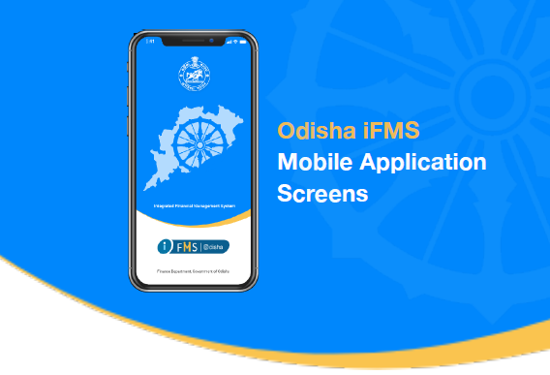
Mobile App
BACK

Slide 33
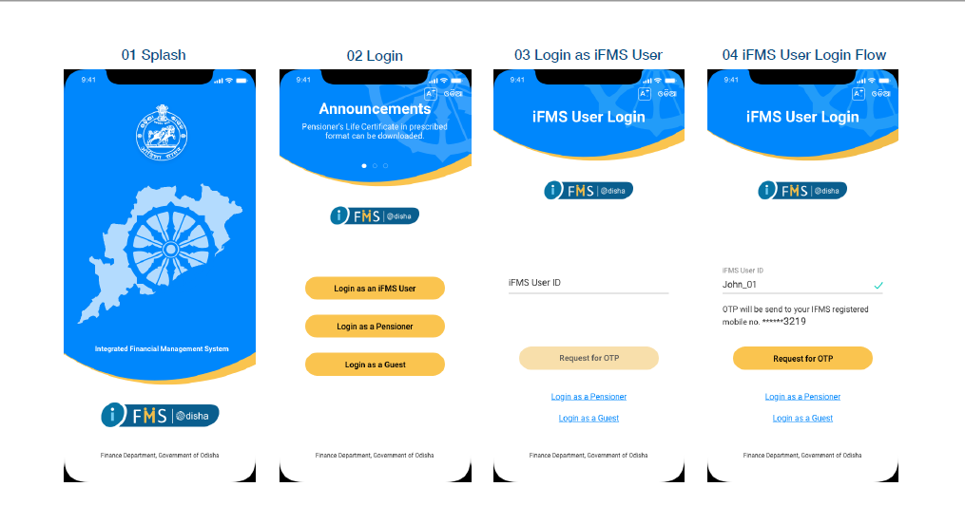
Mobile App
BACK

Slide 34
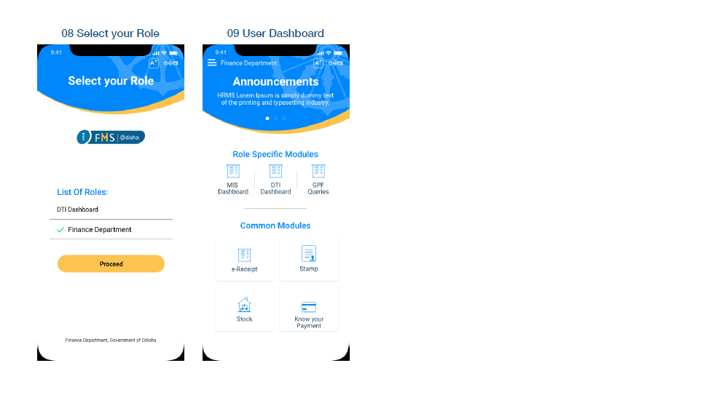
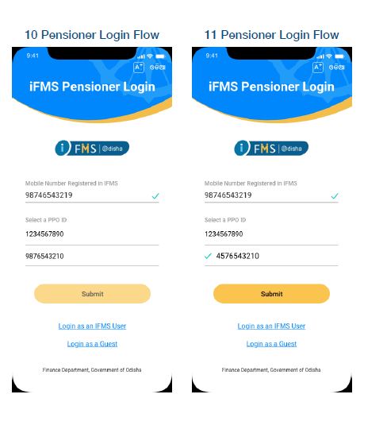
Mobile App
BACK

