Slide 1
Session on Financial Inclusion for Small Savings and Financial Inclusion Officers
Date – July 26, 2022
Venue – Madhusudan Das Regional Academy of Financial Management, Chandrasekharpur, Bhubaneswar

Slide 2

Basic concepts – Income, Expense, Budgeting and Saving
Are you sometimes short of cash at the end of the month? Don't seem to be able to save for the things you really want?? Learn to balance your income with your expenses
Need: A necessity, something that is required, something that is essential for life
Want: A desire, something that is wished for, something that is non-essential
Setting priorities: Needs and Wants
It is very important to know the difference between your needs and your wants. This will help you in setting your priorities so that you know where to spend your money.
“A roof over my head" is a Need. So are clothing, food and medications. "Watching movies in theatre" is a Want, and so are buying an expensive saree, jewellery, etc.

Slide 3
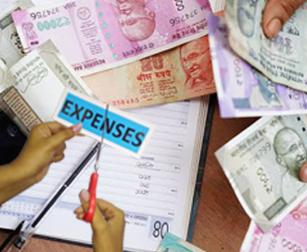
Income and Expenses
Keep every receipt
Record every expenses daily
Total your expense at the end of the month
Do this for three months
Income :
Active Income through job, business, farming, pension, etc.
Passive income through interest income from their investments, pension etc.. You need to know how to keep track of it and manage it to cover your expenses and save for future.
Expense : It costs money to live. You need to pay for food, clothing, housing, transportation, communication, and a dozen other necessary expenses. Then there are things like vacations, entertainment, gifts for relatives and so on.
Know what your expenses are
Reduce unnecessary spending

Slide 4

Budgeting
Set SMART financial Goals
It is simply a comparison of income and expenses.
The difference between your total income and expense :
If it is positive, you have a surplus. Congratulations! With the extra money you must pay off any debt or loan if you have. Otherwise you can increase your monthly savings amount or invest for future.
If it is negative, you have a deficit. You need to increase your income to balance your budget. Reduce your expenses by focusing on what are your needs rather than wants.
SHORT TERM
MEDIUM TERM
LONG TERM
Plan for buying a TV
Paying for a wedding
Plan for Retirement

Slide 5



Emergencies
Unexpected Expenses like
Illness, accident, death
Why Savings are needed?
Future Needs
Large Expenses
With savings, in the future
you can buy what you can
not buy today
To meet larger expenses
like purchasing a house, marriage,
education

Slide 6
SAVING
Saving is a key step to make sure your future is financially secure. Start early to give your savings as much time as possible to grow !!
Why Save?
Help you to meet your goals and provide for your own future.
Without savings, when you want to purchase something, you have to borrow money.
Borrowing is expensive, because not only you have to pay it back, you also have to pay interest, often at a high monthly rate.
How to save?
Now that you've decided you want to save, how do you go about it?
For an example, “saving for a motorbike” is a vague
“saving 50000 rupees for a 100 CC motorbike within 10 months” is SMART.
Its specific – you know exactly what you are saving for. Its measurable – you know how much you will need. Its achievable and realistic – you can break the total amount needed into smaller steps (saving 5000 rupees a month) that will be easier to do. And its time bound you’ve set a deadline of 10 months
Notes:
This template was inserted from Power-user, the productivity add-in for PowerPoint, Excel and Word.
Install Power-user to access thousands of templates, icons, maps, diagrams and charts with Power-user.
Visit https://www.powerusersoftwares.com/
©Power-user SAS, terms of license: https://www.powerusersoftwares.com/terms

Slide 7

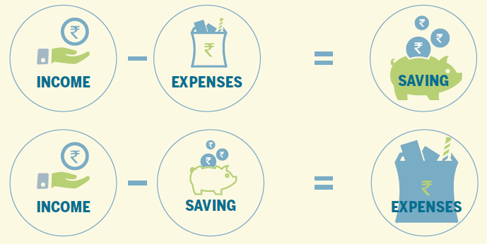


Which equation to be followed??

Slide 8
Inflation & Its impact on savings
* Inflation @ 6% p.a.
What we see on our passbook is called nominal rate of interest. An investor must look at real rate of interest (nominal-inflation).

Slide 9


Drawbacks of Keeping Cash at Home
Unsafe
Loss of Growth
Opportunity
No Credit Eligibility
Money can be stolen or lost
due to natural calamities
Deposits in Bank
creates Credit Eligibility
Loss of Interest Income

Slide 10
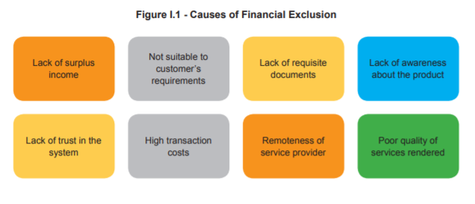

Slide 11
National Strategy for Financial Inclusion (2019-2024) An approach paper to accelerate financial inclusion to promote economic wellbeing, prosperity and sustainable development
The National Strategy for Financial Inclusion 2019-2024 sets forth the vision and key objectives of the financial inclusion policies in India to help expand and sustain the financial inclusion process at the national level through a broad convergence of action involving all the stakeholders in the financial sector.
The strategy aims to provide access to formal financial services in an affordable manner, broadening & deepening financial inclusion and promoting financial literacy & consumer protection.
Notes:
Globally, the adoption of National Financial Inclusion Strategy (NFIS) has accelerated significantly in the past decade. As of mid-2018, more than 35 countries, including Brazil, China, Indonesia, Peru and Nigeria have launched an NFIS and another 25 countries are in the process of developing a strategy. Further, several countries have also updated their original NFIS
The NSFI document has been prepared keeping in mind the significant advancements that have been made in India over the last few years, especially after the commencement of the PMJDY. With substantial gains achieved under the PMJDY, the document intends to take forward the momentum generated so far. The document has been prepared under the aegis of Financial Inclusion Advisory Committee, chaired by, Deputy Governor In-Charge of FIDD, RBI. Further, a focused Inter-Regulatory Working Group comprising officials from DFS, SEBI, PFRDA, IRDAI, RBI, NPCI, NABARD had been set up to prepare the draft NSFI. During the course of preparation of the draft, extensive research on the strategies of a few other countries and views of other stakeholders have been taken on board. The document is being placed for approval and a list of key recommendations along with action plans and milestones is presented in the following slides.

Slide 12
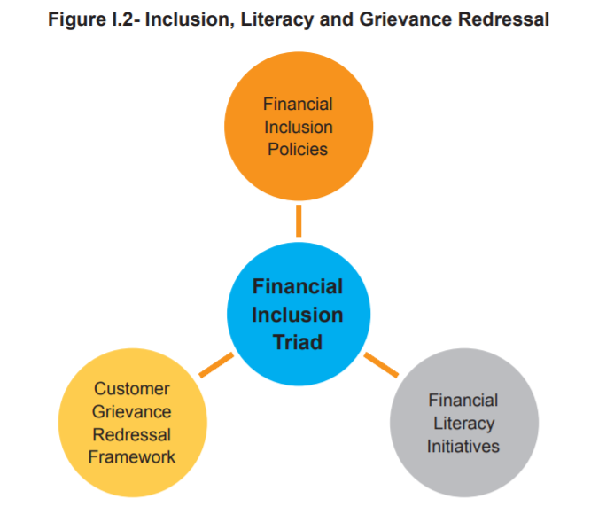

Slide 13
Widening Financial Inclusion
RBI has issued differentiated banking license viz., Small Finance Banks (SFBs) and Payments Banks in 2015.
The objective of setting up of SFBs was to further financial inclusion by provision of a savings vehicle and supply of credit to small business units, small and marginal farmers, micro and small industries and other unorganized sector entities, through high technology-low cost operations.
Payments Banks have been set up to provide small savings accounts and payments/remittance services to migrant labour workforce, low income households, small businesses and other unorganised sector entities / other users.

Slide 14
Providing Basic Bouquet of Financial Services Every adult who is willing and eligible needs to be provided with a basic bouquet of financial services that include a Basic Savings Bank Deposit Account, credit, a micro life and non-life insurance product, a pension product and a suitable investment product.
Action Plan and Milestones:
Every willing and eligible adult who has been enrolled under the PMJDY (including the young adults who have recently taken up employment) to be enrolled under an insurance scheme (PMJJBY, PMSBY, etc.), Pension scheme (NPS, APY, etc.) by March 2020.
Capacity building of all BCs either directly by the parent entity or through accredited institutions by March 2020.
Make the Public Credit Registry (PCR) fully operational by March 2022 so that authorised financial entities can leverage on the same for assessing credit proposals from all citizens.

Slide 15
Universal Access to Financial Services Every village to have access to a formal financial service provider within a reasonable distance of 5 KM radius. The customers may be on boarded through an easy and hassle-free digital process and processes should be geared towards a less-paper ecosystem.
Action Plan and Milestones
Increasing outreach of banking outlets of Scheduled Commercial Banks /Payments Banks/ Small Finance Banks, to provide banking access to every village within a 5 KM radius/ hamlet of 500 households in hilly areas by March 2020.
Strengthen eco-system for various modes of digital financial services in all the Tier-II to Tier VI centres to create the necessary infrastructure to move towards a less cash society by March 2022.

Slide 16
Banking Outlet
A fixed point service delivery unit, manned by either bank’s staff or its Business Correspondent where services of acceptance of deposits, encashment of cheques/ cash withdrawal or lending of money are provided for a minimum of four hours per day for at least five days a week. It carries uniform signage with name of the bank and authorisation from it, contact details of the controlling authorities and complaint escalation mechanism.
The working hours/days need to be displayed prominently.

Slide 17
Business Correspondents
Business Correspondents are retail agents engaged by banks for providing banking services at locations other than a bank branch/ATM.
BCs are permitted to perform a variety of activities which include:
Account Opening
Various Deposits
Remittances
Loan repayments
Facilitating sale of micro insurance/ mutual fund products/ pension products.

Slide 18
Financial Literacy by FLCs (Financial Literacy Centres)
Financial Literacy Centres are the building blocks or the basic units that initiate the financial literacy activities at the ground level.
FLCs are part of the Lead Bank Office.
Target group specific camps for the following segments:
Farmers
SHGs
Micro and Small Entrepreneurs
Senior citizens
School children
Others (may be identified by the FLCs)

Slide 19
Centre for Financial Literacy (CFL) project
An innovative way to impart financial education through community approach
Conceptualised by the Reserve Bank in 2017 as an innovative and participatory approach to financial literacy at the Block level involving select banks and non-governmental organisation (NGOs).
Initially set up in 100 blocks on a pilot basis, the project is now being scaled up across the country to every block in a phased manner by March 2024.
52 CFLs operationalised in Odisha as on November 30, 2021.

Slide 20
Know Your Customer
Which docs can be submitted as KYC?
Officially Valid Documents (OVD) : Passport, Driving license, proof of possession of Aadhaar number, Voter's Identity Card issued by the Election Commission of India, job card issued by NREGA duly signed by an officer of the State Government and letter issued by the National Population Register containing details of name and address, utility bill as per guidelines, property or Municipal tax receipt etc.,
What is KYC?
KYC Stands for ‘Know Your Customer’, it is the process for identifying and verifying the identity of customers
Why to do KYC?
As per the guidelines of RBI, all customers of a bank who wish to avail a higher balance or ability to ability to transfer money need to complete KYC, this compliance is a mandatory exercise under the Prevention of Money Laundering Act, 2002
Notes:
This template was inserted from Power-user, the productivity add-in for PowerPoint, Excel and Word.
Install Power-user to access thousands of templates, icons, maps, diagrams and charts with Power-user.
Visit https://www.powerusersoftwares.com/
©Power-user SAS, terms of license: https://www.powerusersoftwares.com/terms

Slide 21
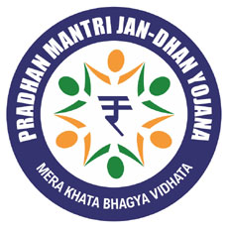
Pradhan Mantri Jan Dhan Yojana (PMJDY)
PMJDY is National Mission for Financial Inclusion to ensure access to financial services, namely, a basic savings & deposit accounts, remittance, credit, insurance, pension in an affordable manner. Under the scheme, a basic savings bank deposit (BSBD) account can be opened in any bank branch or Business Correspondent (Bank Mitra) outlet, by persons not having any other account.
Benefits under PMJDY
One basic savings bank account is opened for unbanked person.
There is no requirement to maintain any minimum balance in PMJDY accounts.
Interest is earned on the deposit in PMJDY accounts.
Rupay Debit card is provided to PMJDY account holder.
Accident Insurance Cover of Rs.1 lakh (enhanced to Rs. 2 lakh to new PMJDY accounts opened after 28.8.2018) is available with RuPay card issued to the PMJDY account holders.
An overdraft (OD) facility up to Rs. 10,000 to eligible account holders is available.
PMJDY accounts are eligible for Direct Benefit Transfer (DBT), Pradhan Mantri Jeevan Jyoti Bima Yojana (PMJJBY), Pradhan Mantri Suraksha Bima Yojana (PMSBY), Atal Pension Yojana (APY), Micro Units Development & Refinance Agency Bank (MUDRA) scheme.

Slide 22
Deposit Insurance
The Deposit Insurance and Credit Guarantee Corporation (DICGC) insures all deposits such as savings, fixed, current, recurring, etc. Each depositor in a bank is insured upto a maximum of Rs. 5,00,000 for both principal and interest amount held by the depositor.
Notes:
This template was inserted from Power-user, the productivity add-in for PowerPoint, Excel and Word.
Install Power-user to access thousands of templates, icons, maps, diagrams and charts with Power-user.
Visit https://www.powerusersoftwares.com/
©Power-user SAS, terms of license: https://www.powerusersoftwares.com/terms

Slide 23
Rights of Transgender Persons – Changes in bank forms/ applications etc.
Banks are directed to include ‘third gender’ in all forms/applications etc. prescribed by the Reserve Bank or the banks themselves, wherein any gender classification is envisaged.

Slide 24
Issuance of Passbooks to Savings Bank Account holders (Individuals)
Banks are advised to invariably offer pass book facility to all its savings bank account holders (individuals) and in case the bank offers the facility of sending statement of account and the customer chooses to get statement of account, the banks must issue monthly statement of accounts. The cost of providing such Pass Book or Statements should not be charged to the customer.

Slide 25
Opening of Bank Accounts in the Names of Minors
With a view to promote the objective of financial inclusion and to bring uniformity among banks in opening and operating minors’ accounts, banks are advised as under:
A savings /fixed / recurring bank deposit account can be opened by a minor of any age through his/her natural or legally appointed guardian.
Minors above the age of 10 years may be allowed to open and operate savings bank accounts independently, if they so desire. Banks may, however, keeping in view their risk management systems, fix limits in terms of age and amount up to which minors may be allowed to operate the deposit accounts independently. They can also decide, in their own discretion, as to what minimum documents are required for opening of accounts by minors.
On attaining majority, the erstwhile minor should confirm the balance in his/her account and if the account is operated by the natural guardian / legal guardian, fresh operating instructions and specimen signature of erstwhile minor should be obtained and kept on record for all operational purposes.
Banks are free to offer additional banking facilities like internet banking, ATM/ debit card, cheque book facility etc., subject to the safeguards that minor accounts are not allowed to be overdrawn and that these always remain in credit.

Slide 26
Providing banking facilities to Visually Impaired Persons
In order to facilitate access to banking facilities by visually challenged persons, banks are advised to offer banking facilities including cheque book facility / operation of ATM / locker, etc., to the visually challenged as they are legally competent to contract.
Banks should therefore ensure that all the banking facilities such as cheque book facility including third party cheques, ATM facility, Net banking facility, locker facility, retail loans, credit cards etc., are invariably offered to the visually challenged without any discrimination.

Slide 27
Nomination Facility
Nomination shall be made only in favour of individuals. As such, a nominee cannot be an Association, Trust, Society or any other Organisation or any office-bearer thereof in his official capacity.
Any nomination other than in favour of an individual will not be valid.
There cannot be more than one nominee in respect of a joint deposit account.
Witness in Nomination Forms: Only Thumb-impression(s) shall be attested by two witnesses. Signatures of the account holders need not be attested by witnesses.

Slide 28
Unclaimed Deposits / Inoperative Accounts in banks
A savings as well as current account should be treated as inoperative / dormant if there are no transactions in the account for over a period of two years.
For the purpose of classifying an account as ‘inoperative’ both the type of transactions i.e., debit as well as credit transactions induced at the instance of customers as well as third party should be considered. However, the service charges levied by the bank or interest credited by the bank should not be considered.

Slide 29
SHG-Bank Linkage Programme
SHGs are affinity-based homogenous groups of 10-20 members (usually women). They follow five cardinal principles or Panchsutra (regular meetings, regular savings, internal lending, regular repayment and bookkeeping)
Opening of Savings Bank A/C
The SHGs, registered or unregistered, which are engaged in promoting savings habits among their members are eligible to open savings bank accounts with banks.
CDD of all the members of SHG as mentioned in the above Direction shall not be required while opening the savings bank account of the SHG. CDD of all the office bearers shall suffice.
SHGs may be sanctioned savings linked loans by banks (varying from a saving to loan ratio of 1:1 to 1:4). However, in case of matured SHGs, loans may be given beyond the limit of four times the savings as per the discretion of the bank.
No loan related and ad hoc service charges/inspection charges should be levied on priority sector loans up to ₹ 25,000. In the case of loans to SHGs/JLGs, this limit will be applicable per member and not to the group as a whole.

Slide 30
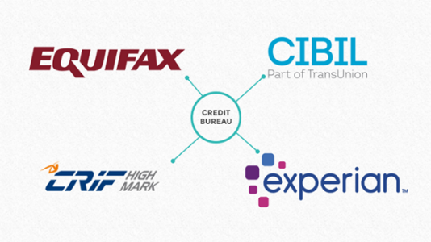
Credit Score
A credit score is a 3-digit number that represents the creditworthiness of an individual. It typically ranges between 300 and 900, 900 being the highest score possible. Banks and various regulated lending institutions check your credit score when you apply for a loan.
This score is prepared by the four credit bureaus functioning in India (CIBIL, Experian, CRIF High Mark and Equifax).
How to build a good credit score?
There are many ways by which one can build a good credit score. They are:
Pay EMIs on time
Do not apply for multiple loans at a time
Try to avail multiple sequential loans
Review your credit scores periodically

Slide 31
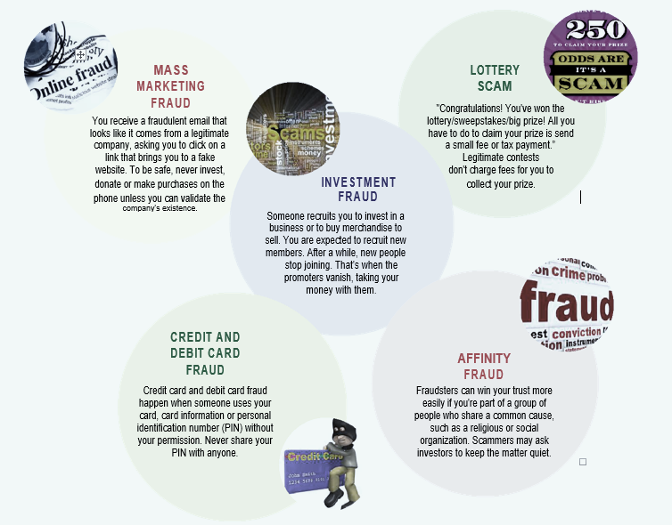
Types of Fraud or Scam

Slide 32
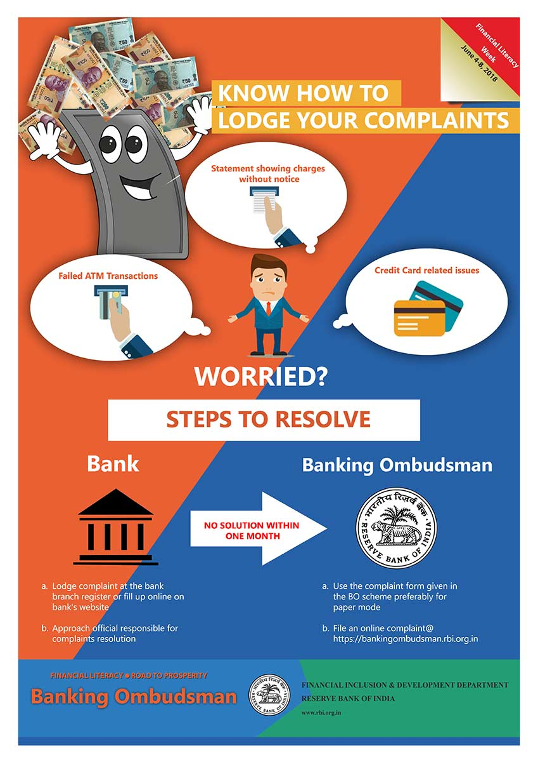
Grievance Redressal

Slide 33
Social Security Schemes
Life insurance coverage of Rs 2 lacs at a premium of Rs 330 /- per annum/ member (Age 18-50)
Assured pension of Rs 1000/- to Rs 5000/- (Age 18-40)
Accidental insurance coverage of Rs 2 lacs at a premium of Rs 12/- per annum/ member (Age 18 – 70)

Slide 34

DIGITAL PAYMENTS
Digital payments are those payments in which the payer and the payee both use electronic modes to send and receive money.
Advantages of Digital Payments
Fast, Easy and Convenient.
Economical and less transaction fee.
Provides a digital record of transactions that customers can track.
Gives a one stop solution for any type of payments.
Helps in keeping a control on black money.
Do’s | Don’ts
Use password for your Mobile and Computer so that no one else can access your systems. | Never save your mobile banking login and password on the phone. Either memorize it or write it down somewhere else.
Always visit your bank’s secured internet Banking site regularly | Never Leave your handset unattended and logged into a mobile banking app.
Log out of your internet banking immediately after you have completed your transaction | Never leave your phone un-attended while carrying out financial transactions through mobile
If you suspect unauthorized transactions in your account, report it to your bank immediately | Never download apps from untrustworthy and dubious sources
Digital Payment Methods
Banking cards
Bank prepaid cards
Internet banking, mobile banking
Point of sale, Micro ATMs
Unstructured Supplementary Service Data (USSD)
Aadhaar Enabled Payment System (AEPS
Mobile wallets
Unified Payment Interface (UPI)

Slide 35
Electronic Mode of Payments
National Electronic Fund Transfer (NEFT)
Transfer of funds from one Bank account to a different account of another Bank using Beneficiary’s account number and IFSC (Indian Financial System Code). (24 x 7)
Real Time Gross Settlement (RTGS)
Transfer of funds from one Bank account to a different account of another Bank on a real time basis facilitating high value transactions using Beneficiary’s account number and IFSC code. (24 x 7)
Immediate Payment Service (IMPS)
Transfer of funds from one Bank account to another facilitating instant Fund Transfer.
Minimum Limit: No limit Maximum Limit: No limit
Minimum Limit: 2 Lakh Maximum Limit: No limit
For fund transfer through Mobile, Mobile Money Identifier (MMID) issued by the bank is required. Transaction can also be done using Beneficiary’s account number and IFSC code.

Slide 36
Mobile Banking :Mobile banking is a service provided by a bank or other financial institution that allows its customers to conduct different types of financial transactions remotely using a mobile device such as a mobile phone or tablet.
Mobile Wallet: A mobile wallet is a way to carry cash in digital format. An individual's account is required to be linked to the digital wallet to load money in it. Most banks have their e-wallets and some private companies. e.g. Paytm, Freecharge, Mobikwik, Oxigen, Airtel Money, etc.
Point of Sale: A point of sale (PoS) is the place where sales are made. On a macro level, a PoS may be a mall, a market or a city. On a micro level, retailers consider a PoS to be the area where a customer completes a transaction, such as a checkout counter. It is also known as a point of purchase.
Micro ATMs :Micro ATM meant to be a device that is used by a million Business Correspondents (BC) to deliver basic banking services. The platform will enable Business Correspondents (who could be a local kirana shop owner and will act as ‘micro ATM’) to conduct instant transactions.
Unstructured supplementary service data (USSD): The innovative payment service *99# works on Unstructured Supplementary Service Data (USSD) channel. This service allows mobile banking transactions using basic feature mobile phone, there is no need to have mobile internet data facility for using USSD based mobile banking. It is envisioned to provide financial deepening and inclusion of underbanked society in the mainstream banking services.

Slide 37
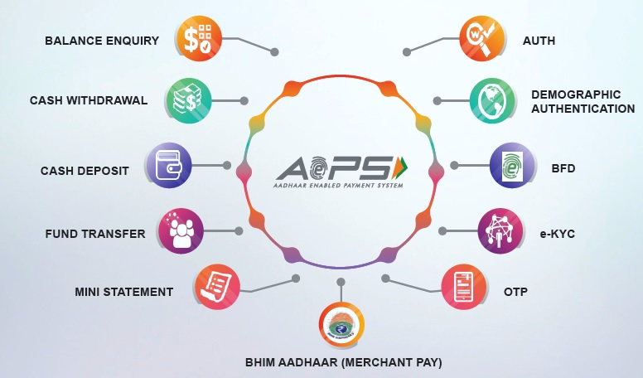
Aadhaar enabled payment system (AEPS)
AEPS is a bank led model which allows online interoperable financial transaction at PoS (Point of Sale / Micro ATM)
Unified Payments Interface (UPI)
A system that powers multiple bank accounts into a single mobile application (of any participating bank), merging several banking features, seamless fund routing & merchant payments into one place.
UPI Benefits To End User :
Privacy- Share only Virtual Payment Address and no other sensitive information
Multiple Utility – Cash on delivery/ bill split sharing/ merchant payments/ remittances
One click 2 FA – Authorise transaction by entering only the PIN
Work across various interfaces – Payment request generated on web interface, Authorised on mobile interface(App)
Availability 24 x 7 and customer does the transaction on his personal device.
For Further Information, See the Link: https://www.npci.org.in/product-overview/upi-product-overview

Slide 38

INSURANCE
No one can plan for an accident or become seriously ill.
Insurance is a means of protection from financial loss and is used to shield against the risk of a contingent or uncertain loss.
Life Insurance
Term Insurance
Whole Life Insurance
Endowment Policy
Money back plans
Children Policies
Annuity (Pension) Plans
Unit Linked Insurance Policy
Life insurance
Provides a financial payment to your nominee upon your death.
Recommended to Purchase an insurance with coverage worth 7 to 10 times your annual income.

Slide 39



General Insurance
Non-health insurance : Auto or vehicle insurance is mandatory if you own a vehicle. Depending on your policy, it covers losses that your vehicle causes to other people (third party insurance policy) and of your own medical expenses if you have met with an accident.
Policies which are not directly related to the life of individuals, insure the policy holder against the risk of wealth and health.
Health Insurance : Cost of treatment has increased many folds.
If your treatment requires you to stay in the hospital for few days, you will end up with a huge medical bill that can severely impact your savings. Every insurance company offers a medical insurance plan that covers basic medical care, including doctor visits and costs of hospitalization.
Notes:
This template was inserted from Power-user, the productivity add-in for PowerPoint, Excel and Word.
Install Power-user to access thousands of templates, icons, maps, diagrams and charts with Power-user.
Visit https://www.powerusersoftwares.com/
©Power-user SAS, terms of license: https://www.powerusersoftwares.com/terms

Slide 40
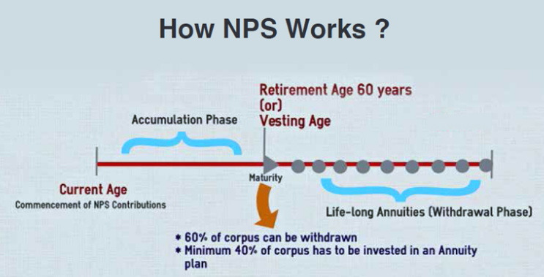
National Pension System
It is open to all citizens of the country between the ages of 18 and 70 on a voluntary basis.
A minimum saving of 500 rupees per year is required to subscribe to the scheme.
When you retire, normally at age 60, you will get a part of your money and the remaining can be withdrawn on monthly basis. For more information visit https://www.pfrda.org.in

Slide 41
Investment in Securities Market
Securities can be broadly classified into two types: Equities and Debts. Securities are sold in the securities market
Primary market: Company directly issues Securities for the first time e.g. IPO (Initial Public Offer)
Secondary Market: Trading of securities in Stock Exchanges e.g. BSE, NSE, etc.
Equity
Equity is a part of a company, also known as stock or share. When you buy shares of a company, you basically own a part of that company and can expect a share of profit when the company makes profits.
Debt Securities
Debt Securities are those instruments such as bond, debenture, promissory note etc. with a fixed amount, a maturity date and usually with a specific rate of interest. These are often less risky than equities.
Mutual Funds
A mutual fund pools money from many investors and invests in stocks, bonds, short-term money-market instruments, other securities or assets, or some combination of these investments.

Slide 42
Thank you !!!

