Slide 1
Account Reconciliation : A Need Based Analysis
Directorate of Treasuries & Inspection (O), BBSR.

Slide 2
What is Accounts: -
Systematic booking of transactions.
Record of various activities and functions expressed in financial terms
Maintained by activity centers.
Accounting period: -
Transactions for the period from 1st April to 31st March.
In compliance with the budgetary structure of the country.
The Govt. Accounts kept open to allow inter government adjustments/correction of mis- classification/clearance of transitory/suspense heads and other relevant adjustment.

Slide 3
Form of Accounts : -
Provisions under Article 150 of the Constitution.
Prescribes broad form of Accounts.
Pronounces the basis for selecting appropriate heads under which
the transactions are to be classified.
Currency in which Accounts are kept : -
The Accounts of Government are maintained in Indian Rupees(INR).

Slide 4
Relevance of Accounting:-
Aim and objectives of Budget taken care of.
Visualizes State’s Financial position.
Points out gap between provisions and utilization.
Provides valuable inputs for future Financial Provisions.
Supports effective implementation of FRBM Act.
Helps in preparation of Annual Accounts of the State.

Slide 5
Role of DDOs in Accounting :-
First level of accounts preparing unit.
Plays a vital role in correct booking of transactions.
Booking of transactions under appropriate HoA.
Avoid Mis-classification.
Timely scrutiny of Voucher Details available in iFMS Treasury Application.
Detects errors in Voucher , may be in HoA, Bill Type, Amount, By Transfer.
Online requests to Treasury for modification.
Timely submission of accounts to respective COs.
Accounts for vis-à-vis Budgetary provisions.

Slide 6
Role of COs in Accounting :-
Final level of accounts preparing unit.
Plays a vital role in checking transactions booked by the DDOs
Monitor booking of transactions under appropriate HoA.
Rectify Mis-classification.
Cross checking Voucher Details available in iFMS with AG(O) figures.
Detects errors in Voucher , may be in HoA, Bill Type, Amount, By Transfer.
Online requests to AG(O) for modification.
Timely submission of request proposal to AG(O).
Maintenance of correct Accounting System .

Slide 7
SIX TIER ARRANGEMENTS : -
The Major head, sub-major head, minor head, sub-head, detail head and sub-detail head constitute a six-tier classification basing on which State Budget is prepared.
Sector / Sub-sector (Broad Group of Classification)
Major Head (1st Tier)
Sub Major Head ( 2nd Tier)
Minor Head (3rd Tier)
Sub-Head (Schemes) (4th Tier)
Detailed Head (sub-schemes) (5th Tier)
Object Head (unit of appropriation (6th Tier)

Slide 8
FORMS, POLICIES AND PROCEDURES : -
The Govt. accounting policies and procedures have bee prescribed, inter-alia, by way of following publications.
Government Accounting Rule 1990
Account code for Accountants General
List of Major and Minor Heads of Account
General Financial Rules
Receipt and Payment Rules
Central Public Works Department Codes
Manual of Standing Orders (A&E), Vol. I & II
Treasury Rules
Financial Hand Book
Budget Manuals etc.

Slide 9
Account Correction : -
The Accountant-General will report to the Controlling Officer concerned the total expenditure for each unit in the third week of the month.
The returns of different disbursing officers should be consolidated in the office of the Controlling Officer.
The Controlling Officer should verify the figures.
In case of no discrepancy found, the CO accepts AG(O)’s figure.
In case of any material discrepancy, the CO will take steps to reconcile the discrepancy in the manner indicated in Appendix VII.
(Source –Rule-133, Odisha Budget Manual)

Slide 10
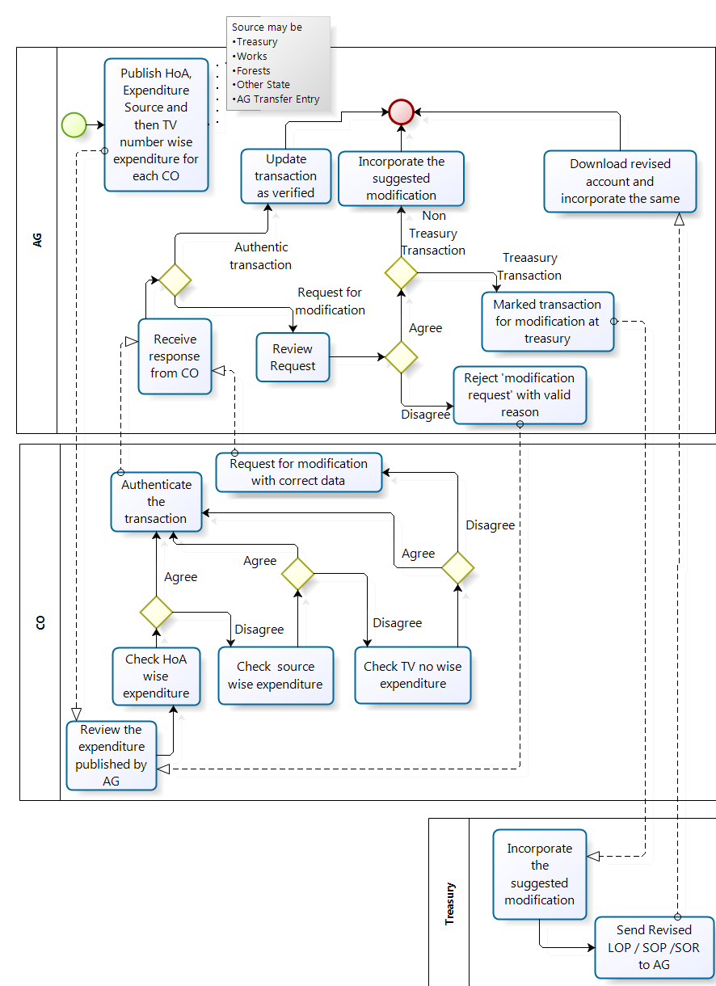

Slide 11
Account Correction Module : A Tool To Minimise Accounting Error
Accounts Correction module shall be used in two ways.
1. Before Accounts closing at Treasury end, there will be two ways of Accounts correction
a. DDO request to Treasury for modification against a voucher.
b. Treasury himself can modify data.
2. After Accounts closing at Treasury end, there will be two ways of Accounts correction.
a. Treasury requests AG for consent and acts accordingly.
b. Account correction through CO Reconciliation.

Slide 12
Process before the Closure of Treasury Account : -
The DDOs to examine correctness of booking of transactions available through their iFMS interface at the Treasury end on daily basis.
In case any mistake/discrepancy in the HoA/BT entry
The para-7 of the F.D.Letter No.28812/F,Dt.10/10/2014: DDOs to send such proposal in iFMS for correction of accounts to the Treasury Officer/STO positively before the third day of the subsequent month.
The DDOs have to furnish an acceptance certificate to the Treasury Officer before raising any claim after third day of the month, certifying that he/she has verified the expenditure and receipt report and no discrepancy has been noticed.

Slide 13
Process after Closure of Treasury Accounts : -
After submission of Treasury Account, no online change request facility
Can submits such requests manually latest by 15th of the subsequent month.
The Treasury Officer can submit online request to AG(O) latest by 20th
The A.G(A&E),Odisha shall allow the Treasury Officer for making necessary correction at their end.
After approval by AG(O), Treasury to update the Accounts online
Conditions for available of budget/claims already drawn etc should be met
The TO is required to submit the physical copy of the revised accounts to the A.G(A&E),Odisha.

Slide 14
Account Correction Module in Treasury Application :
A Process Flow
Type www.odishatreasury.gov.in in the address bar of Internet browser to open iFMS-Odisha Home page.
Click on account correction link.
Enter login ID & password along with choosing the desired F.Y.
Click on DDO inbox-DDO request generate.
Click on voucher date-voucher no.
Click on options namely HoA / BT
Enter proposed HoA / BT and amount against original HoA / BT
Click on save & submit. Get reference ID for future reference.

Slide 15
CO Reconciliation Module:-
AG Odisha
Close the Monthly Accounts for a particular month under consideration at VLC System
Generates electronic file (.txt) containing CO-Reconciliation related data.
Login into iFMS application .
Uploads e-file using AG interface of iFMS.

Slide 16
Controlling Officer
Login into iFMS application
Verifies HoA wise expenditure/Receipt data in iFMS.
CO can view the Expenditure Source( like treasury, works, forest, other state, transfer entry etc) wise data on clicking the HoA link .
CO will verify the Voucher-wise data on clicking the Source link .
In case of discrepancy, CO shall click on disagree button. Alternatively, CO clicks on agree button .
CO sends online correction request to AG with suggested data using iFMS.

Slide 17
AG Odisha
Examines the online correction request received from CO.
Valid requests will be accepted by AG and becomes available to treasury for rectification.
Treasury
Treasury activates the request. The correction will be reflected in the accounts.
AG Odisha
AG will download the revised account containing the changed data.
Controlling Officer
CO can track status of the correction request.

Slide 18
QUERY ? ? ?

Slide 19
Thank You

