Slide 1

Human Resources Management System
of
Government of Odisha
General Administration &
Public Grievance Department

Slide 2
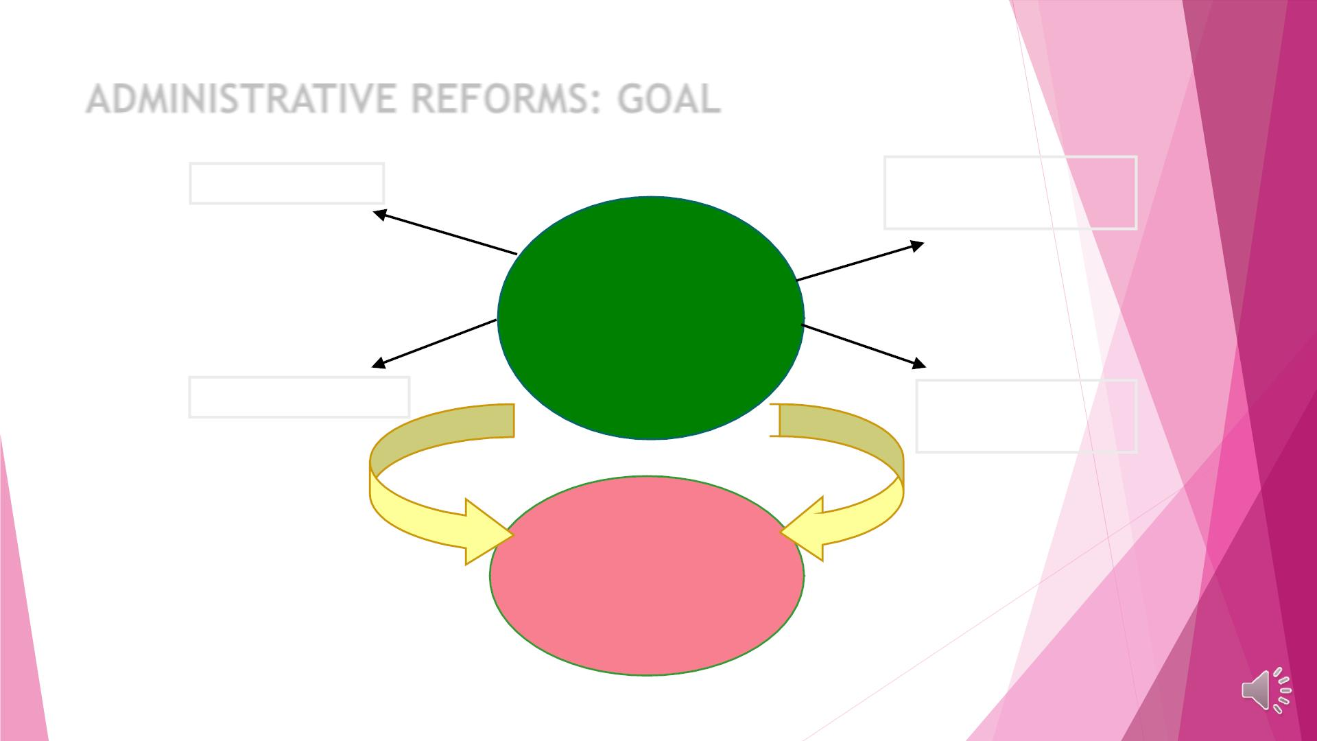
ADMINISTRATIVE REFORMS: GOAL
EMPLOYEES
GOVERNMENT
PROCESSES
4 Pronged
Approach
to
Modernization
TECHNOLOGY
POLICY
FRAMEWORK
FOR
BETTER DELIVERY OF
PUBLIC SERVICES

Slide 3
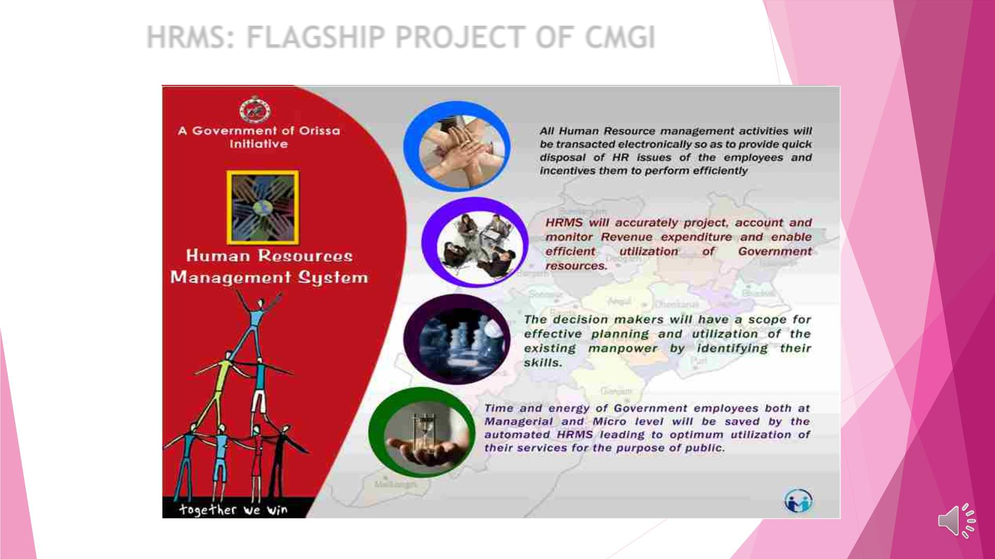
HRMS: FLAGSHIP PROJECT OF CMGI

Slide 4

HRMS: KEY ISSUES
◆ Wide Range of Stakeholder base
◆ 41 Administrative Departments along with their 102 Heads of Department
◆ Total7014 DDO Offices across 30 Districts
◆ 60,000Bills
◆ 4,50,000 Regular Employees approx.
◆ 2,50,000 Contractual Employees approx.
◆ Complexity of Business Logic in Adherence to
◆ All India Service Rules
◆ Odisha Service Code
◆ Odisha Treasury Code
◆ Odisha General Finance Rules
◆ Odisha (GPF) Rules
◆ New Pension Scheme
◆ Odisha Leave Rules
◆ Odisha Government Servants Conduct Rules

Slide 5

HRMS: MASTER PLAN
TeamꢀBuilding
•IndigenouslyꢀDeveloped
Develop-
mentꢀofꢀ •S
QAC
Software
Capturingꢀ
Legacyꢀ
Data
•ꢀ3,75,000ꢀServiceꢀBook
1200ꢀDataꢀ
EntryꢀOperator
Validators
Monitoringꢀ&ꢀ
Support
ꢀCoreꢀ
Mainte-
nance
•
Group
•KnowledgeꢀTransfer
•Handover
HRMS
Procurementꢀofꢀ
Conferences
Changeꢀ
Manage-
ment
Buildingꢀ
ICTꢀInfra-
structure
Newsꢀ
•A
S
ationꢀ
fꢀ
Letters
•Display-board
•P
Computersꢀ&ꢀInternetꢀ
dꢀOffices
ꢀManuals
Impartingꢀ
Training
•ClassꢀRoomꢀ
Training
Manuals

Slide 6

SOFTWARE DEVELOPMENT DELIVERABLES
◆ HRMS-1
◆ Development of HRMS Data Model
◆ Development of HR Legacy System
◆ HRMS-2
◆ e-Service Book
◆ Payroll Automation
◆ Integration with Odisha Treasury Management System (Presently
known as IFMS)
◆ Online PAR submission for all Group A and Group B employees
◆ Online submission of Property Statement
◆ Integration with Employee Database Management System (EDMS)
◆ Integration with Pension Management System (PMS)
◆ Online Training Management

Slide 7
SOFTWARE DEVELOPMENT DELIVERABLES
◆ HRMS-3
◆ Generation of Annual Establishment Report
◆ Single Page Paybill
◆ Online Leave, Online Loan/ Advance Application
◆ Increment Proposal module for increment sanction
◆ Pay Revision option selection
◆ Online Review of Performance Appraisal Report (PAR) and Departmental Promotion Committee(
DPC)
◆ Online PAR for Group C
◆ Auto generation of Last Pay Certificate(LPC)
◆ Online application for Leave Travel Concession(LTC)
◆ Online Transmission of messages to occupants of GOVT. quarters
◆ Mobile Application for HRMS
◆ GPF Nomination
◆ English Query for Data Retrieval (QA)
◆ Bulletin Board Services (BBS)
◆ Decision Support System (DSS)
◆ Dash Board & Analytics

Slide 8
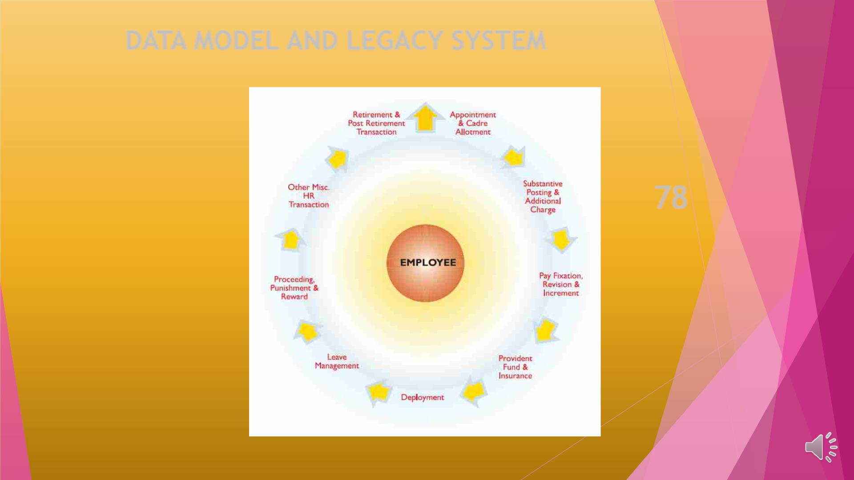
DATA MODELAND LEGACY SYSTEM
78HR
T
EMPLOYEE-LIFE-
CYCLE
FUNCTIONAL
M
I

Slide 9
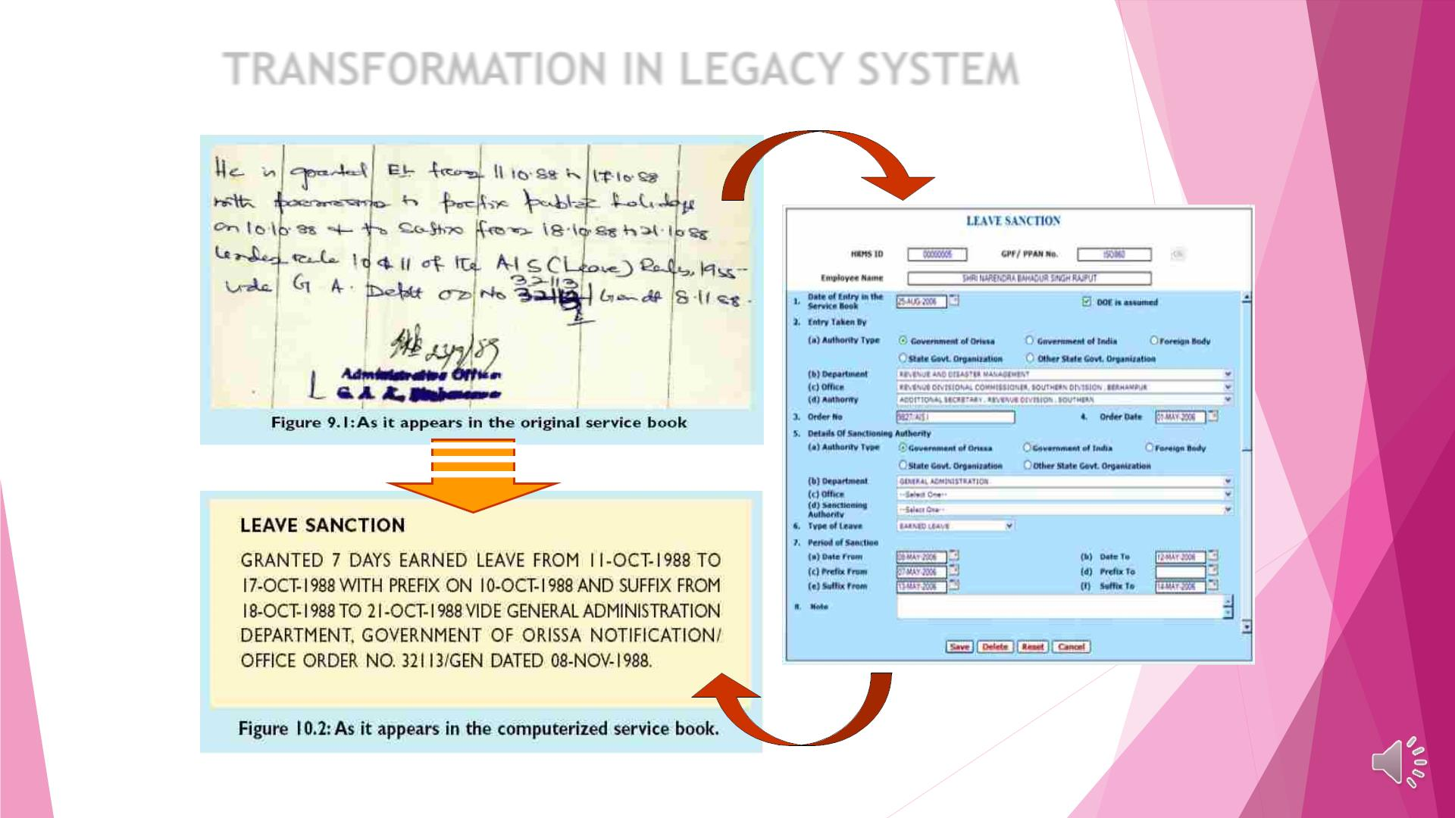
TRANSFORMATION IN LEGACY SYSTEM

Slide 10
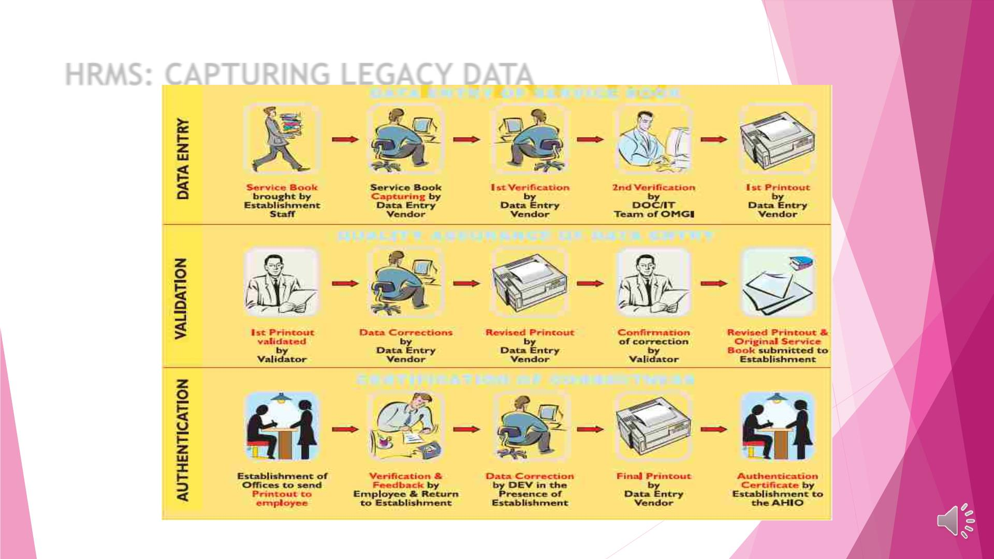
HRMS: CAPTURING LEGACY DATA

Slide 11

Facilities for employees
ServiceꢀBookꢀ
Leaveꢀ
Insuranceꢀ
Passbookꢀ
LongꢀTermꢀAdvances
Account
Accounts of
GPF-TPF-
NPS
Pay Slip
Loan/ Advance Motor Car/ Motor
Ledgers
Cycle/Moped/Personal
Computer
HR Account
Accounts on Submission of GPF(Non-Refundable/
Voluntary
Deductions
Income Tax
Planner
Property
Refundable)
Statement
Submission of
Performance
Appraisal Report
(PAR)
Task List Panel House Building Advance
for disposal of
requests

Slide 12

Facilities for the Heads of Office,
DDOs, HoDs & Admin Departments
SanctionedꢀPost-ꢀ VacancyꢀPositionsꢀ
wiseꢀListꢀofꢀ
Accessꢀtoꢀ
EmployeeꢀRecords
Employees
Automaticꢀ
Onlineꢀsubmissionꢀofꢀ
QuickꢀAttendanceꢀ
Recordꢀ
GenerationꢀofꢀPayꢀ billsꢀtoꢀtreasury
Billsꢀ
Updatingꢀprofileꢀ
andꢀserviceꢀdataꢀofꢀ remindingꢀincrement,ꢀ
employees. retirement,ꢀGISꢀ
BulletinꢀBoardꢀServiceꢀ QuarterꢀAllotmentꢀ
Report

Slide 13

Facilities for Treasury
Fullyꢀautomatedꢀ
Electronicꢀtransferꢀ Uploadingꢀ
accountingꢀofꢀsalariesꢀ ofꢀMonthlyꢀSalaryꢀ statusꢀofꢀ
andꢀdataꢀforꢀ
BillsꢀofꢀRegularꢀ&ꢀ submittedꢀbillsꢀ
preparationꢀofꢀbudgetꢀ Contractualꢀ
employees
duringꢀ
vouchingꢀ
process
Electronicꢀ Transferꢀ ofꢀ otherꢀ Billsꢀ likeꢀ Loan/ꢀ Advanceꢀ Billꢀ
(Festivalꢀ Advance,ꢀ GPFꢀ Advance,ꢀ Motorꢀ Cycle/ꢀ Motorꢀ Car/ꢀ
Mopedꢀ Advance,ꢀ Otherꢀ Loansꢀ andꢀ Advanceꢀ Bills)ꢀ toꢀ theꢀ
officeꢀofꢀAccountantꢀGeneral

Slide 14

Facilities for citizens
CCTNS:ꢀDataꢀ
e-ꢀQuarters:ꢀSharingꢀofꢀ
Sharingꢀ ofꢀ dataꢀ withꢀ FSꢀ &ꢀ CWꢀ
Departmentꢀ forꢀ implementationꢀ ofꢀ
NFSAꢀ forꢀ employeesꢀ havingꢀ grossꢀ
salaryꢀmoreꢀthanꢀRs.10,000/-.
sharingꢀofꢀ
monthlyꢀQuarterꢀRentꢀ
employeeꢀprofileꢀ data
andꢀserviceꢀdataꢀ
ofꢀꢀStateꢀPolice
Sharingꢀ ofꢀ dataꢀ withꢀ Electionꢀ
CommissionꢀOdishaꢀforꢀdeploymentꢀofꢀ
manpowerꢀinꢀelectoralꢀbooths.
Sharingꢀofꢀdataꢀ
Sharingꢀofꢀdataꢀrelatingꢀ SharingꢀofꢀLICꢀDataꢀandꢀmobileꢀnos.ꢀ
withꢀAGꢀforꢀauditꢀꢀ toꢀsanctionedꢀpost,ꢀmenꢀ withꢀLIC,ꢀOdishaꢀforꢀsendingꢀLICꢀ
purposes
ꢀ
inꢀpositionꢀandꢀvacancyꢀ maturityꢀstatusꢀthroughꢀSMSꢀtoꢀ
detailsꢀwithꢀDirectorateꢀ employee.
ofꢀTreasuriesꢀ&ꢀ
InspectionꢀforꢀAnnualꢀ
EstablishmentꢀReviewꢀ
(AER).

Slide 15

Present Status:
Ø All DDO offices at the district as well as at the
State level are now preparing pay bill using HRMS
and are submitting pay bills online to treasury
.
Ø All offices are now maintaining computerized
Service Books.
Ø All Group A and B officers are submitting their
Performance Appraisal Reports online and
Reporting, Reviewing and Accepting Authorities are
submitting their remarks online since 2014-15.
Ø All employees of State Government are submitting
their Property Statement online from the year 2016-
17.
Ø All employees can apply all types of leave and loan
online. The module will be implemented shortly
after concurrence of Finance Department.

Slide 16
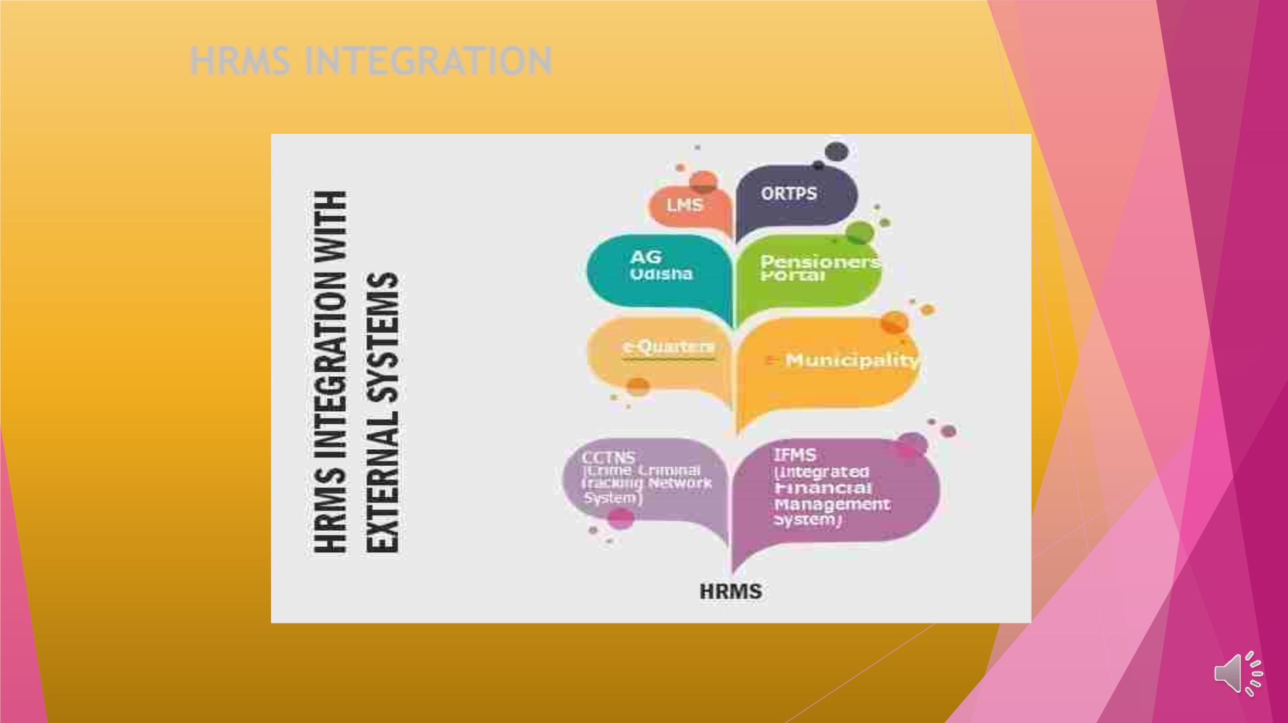
HRMS INTEGRATION

Slide 17
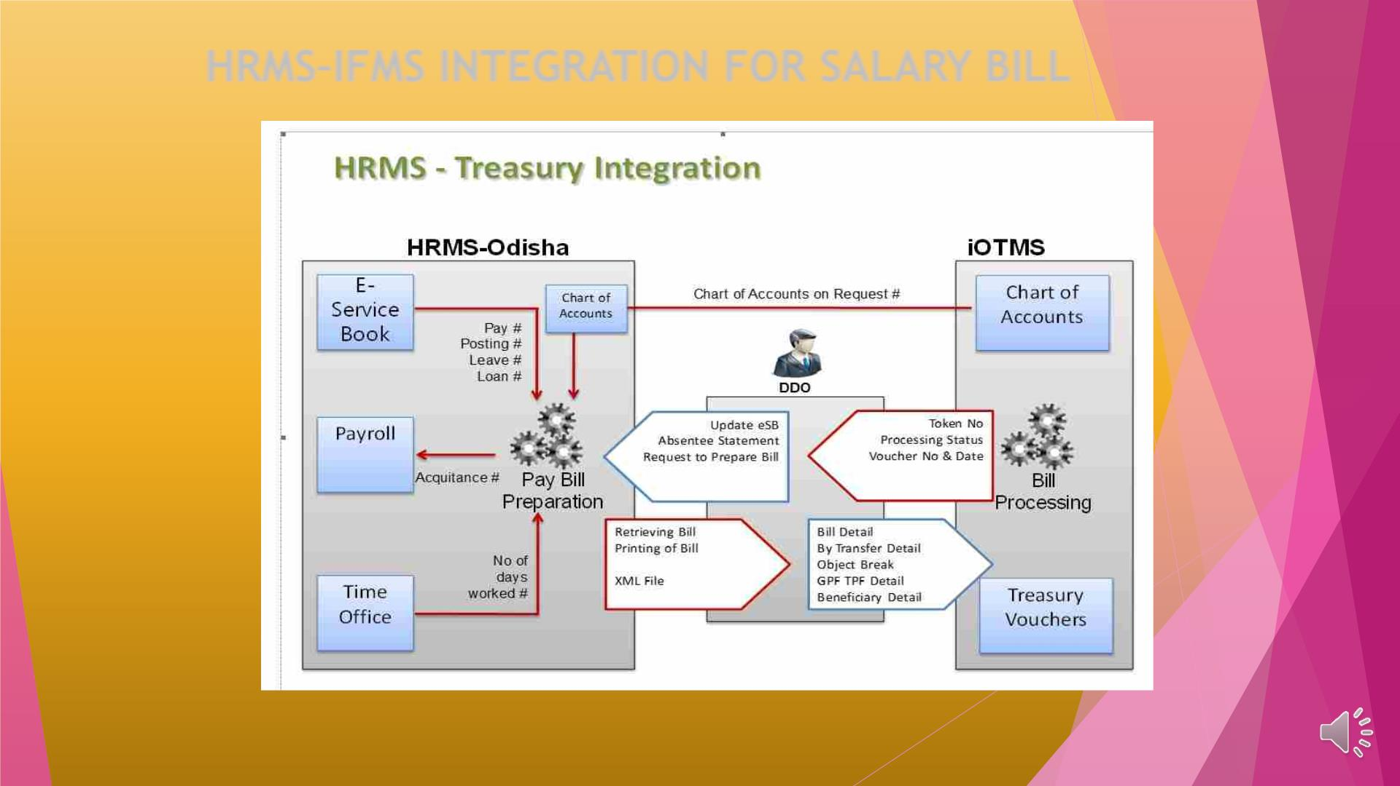
HRMS–IFMS INTEGRATION FOR SALARY BILL

Slide 18
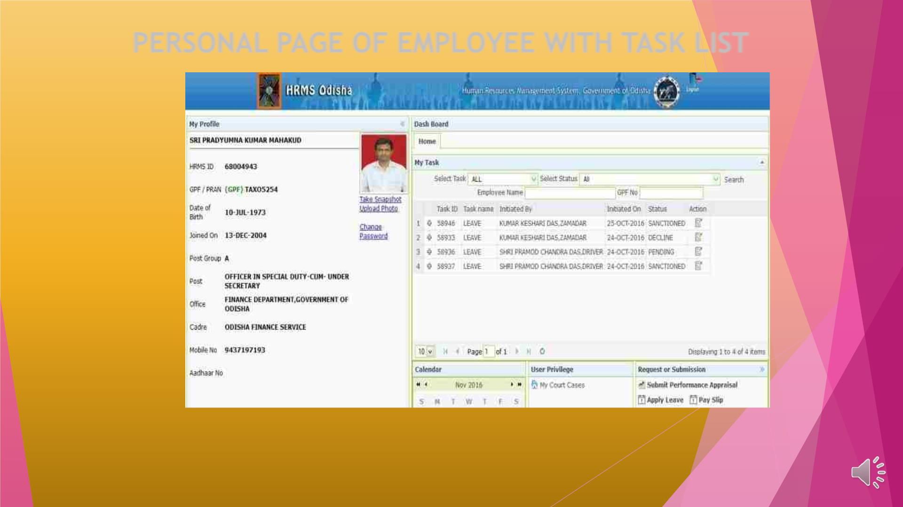
PERSONAL PAGE OF EMPLOYEE WITH TASK LIST

Slide 19
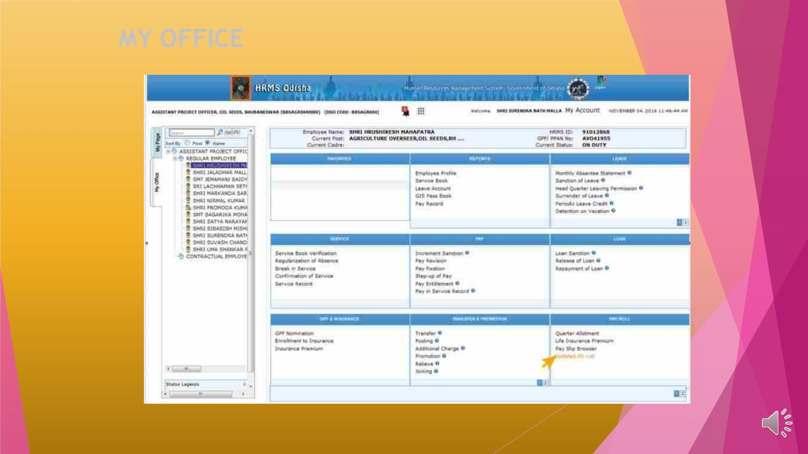
MY OFFICE

Slide 20
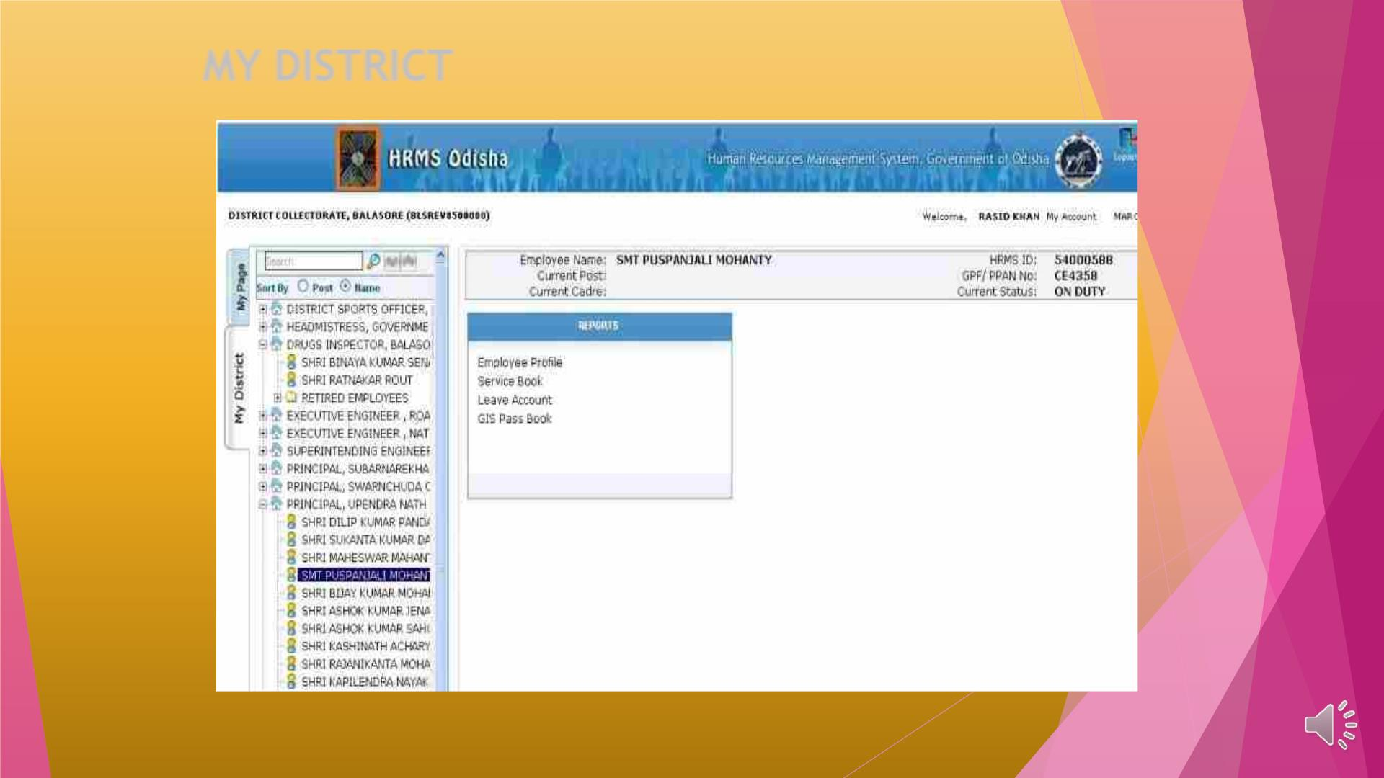
MY DISTRICT

Slide 21
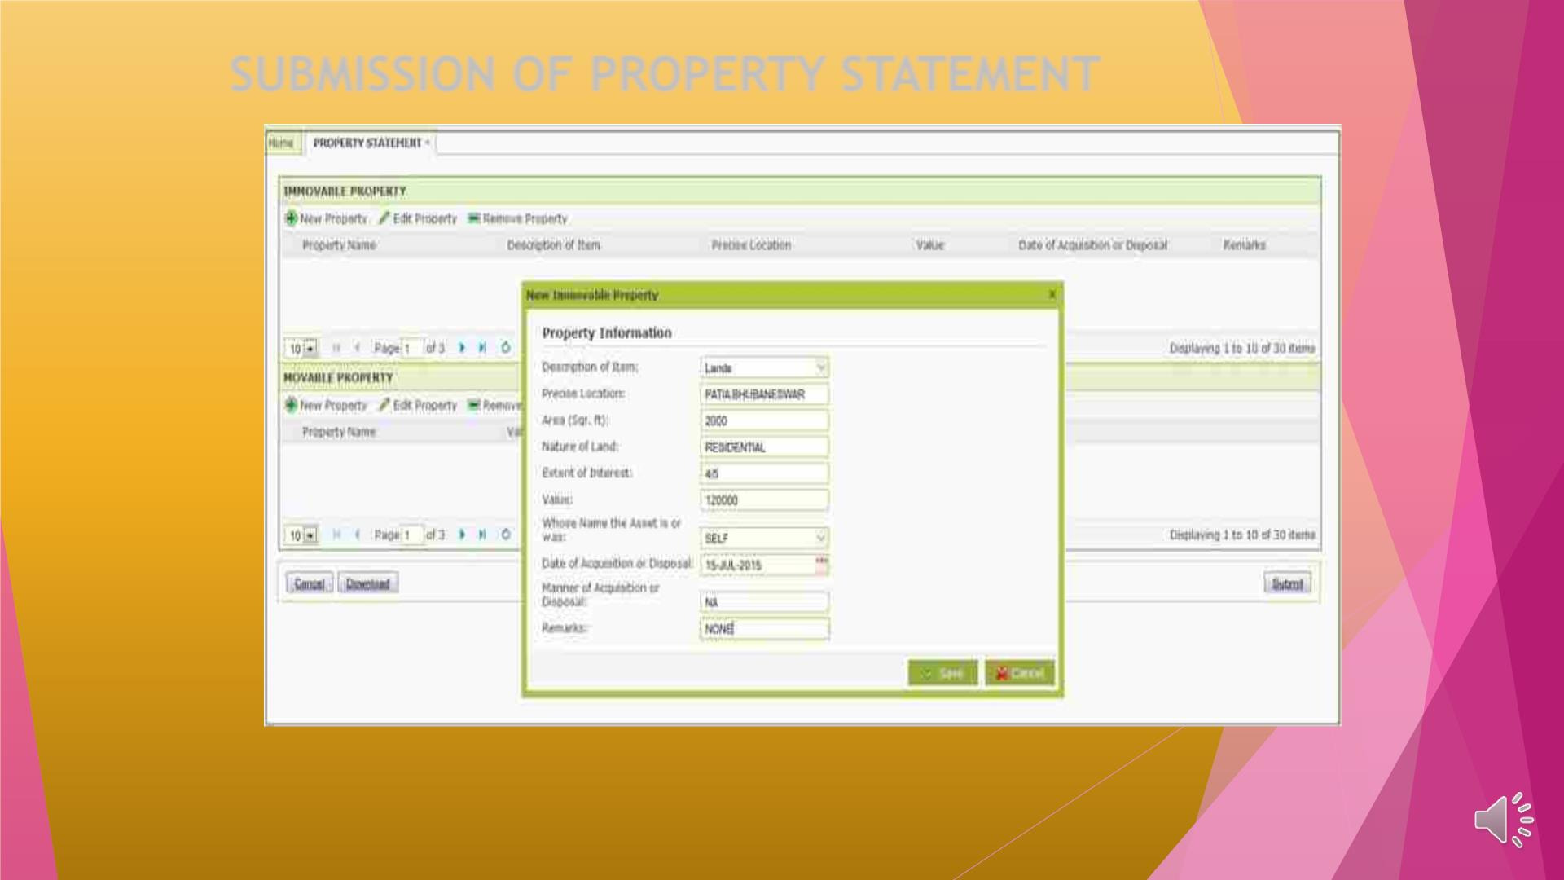
SUBMISSION OF PROPERTY STATEMENT

Slide 22
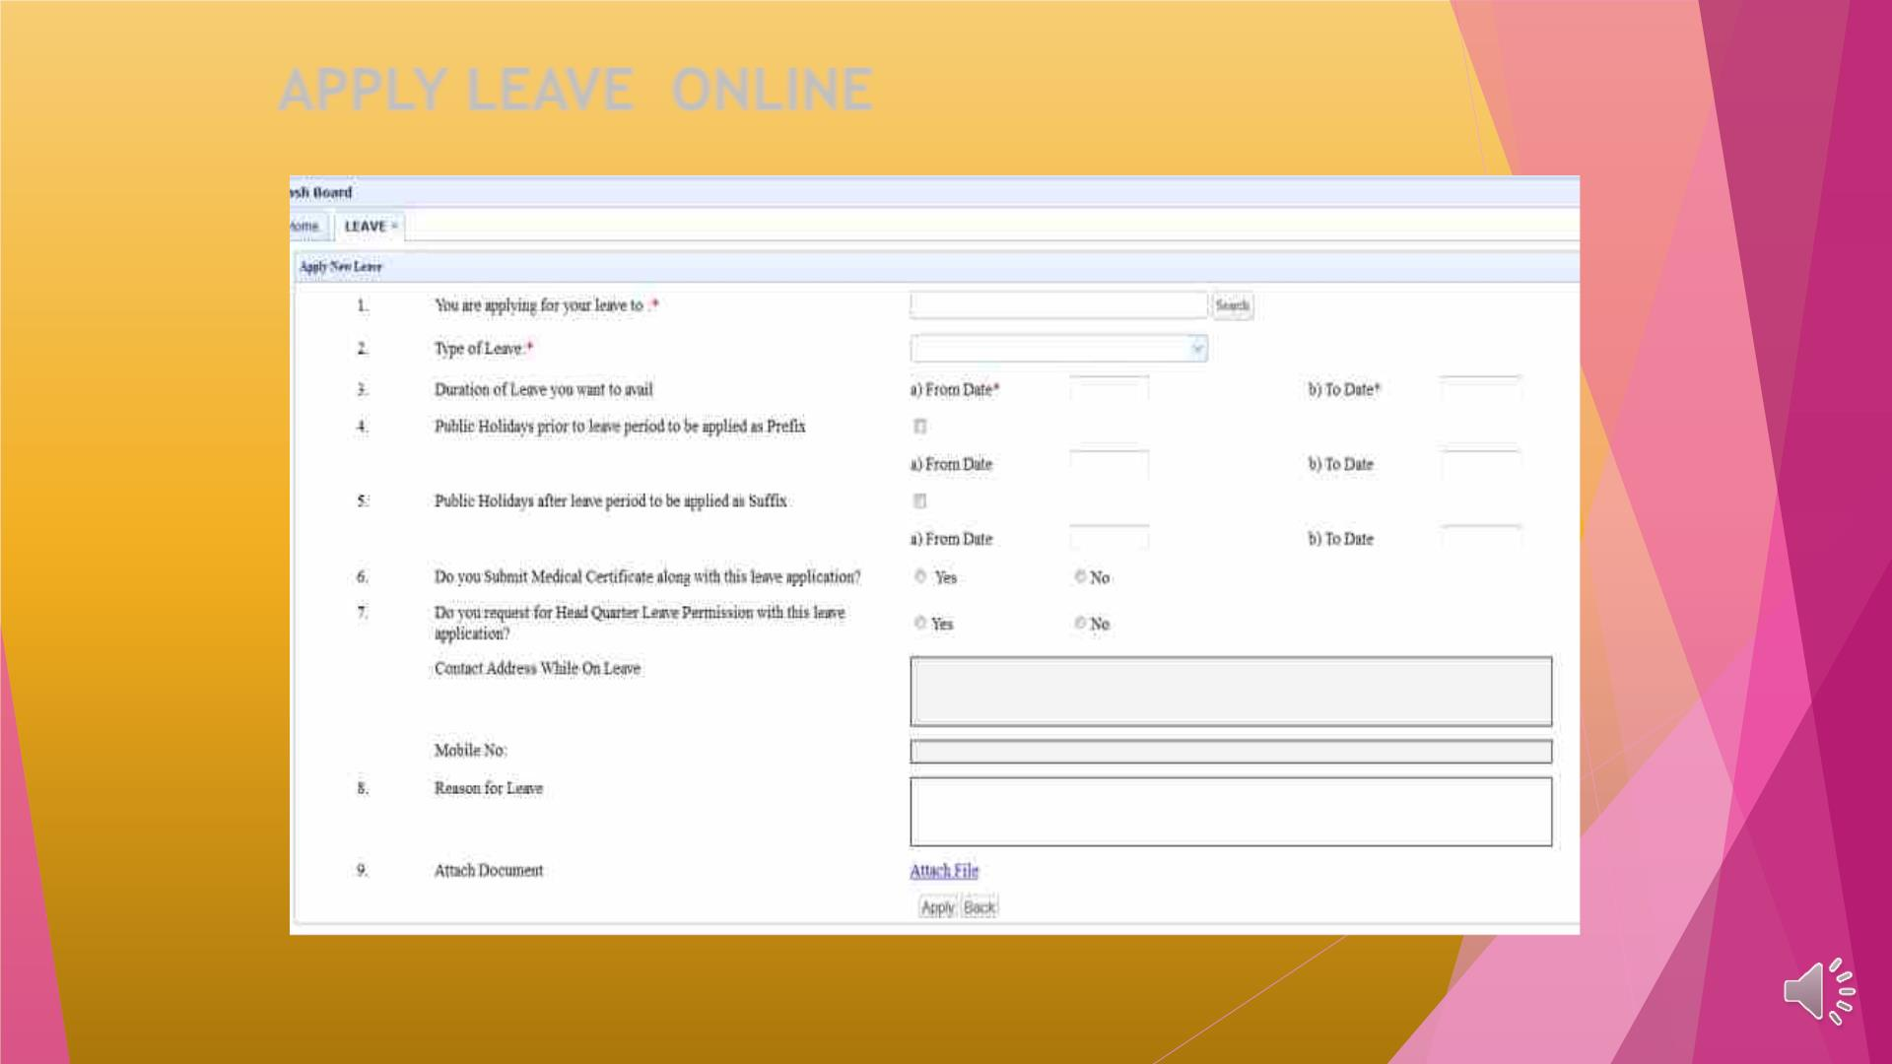
APPLY LEAVE ONLINE

Slide 23

THANK YOU

