Slide 1
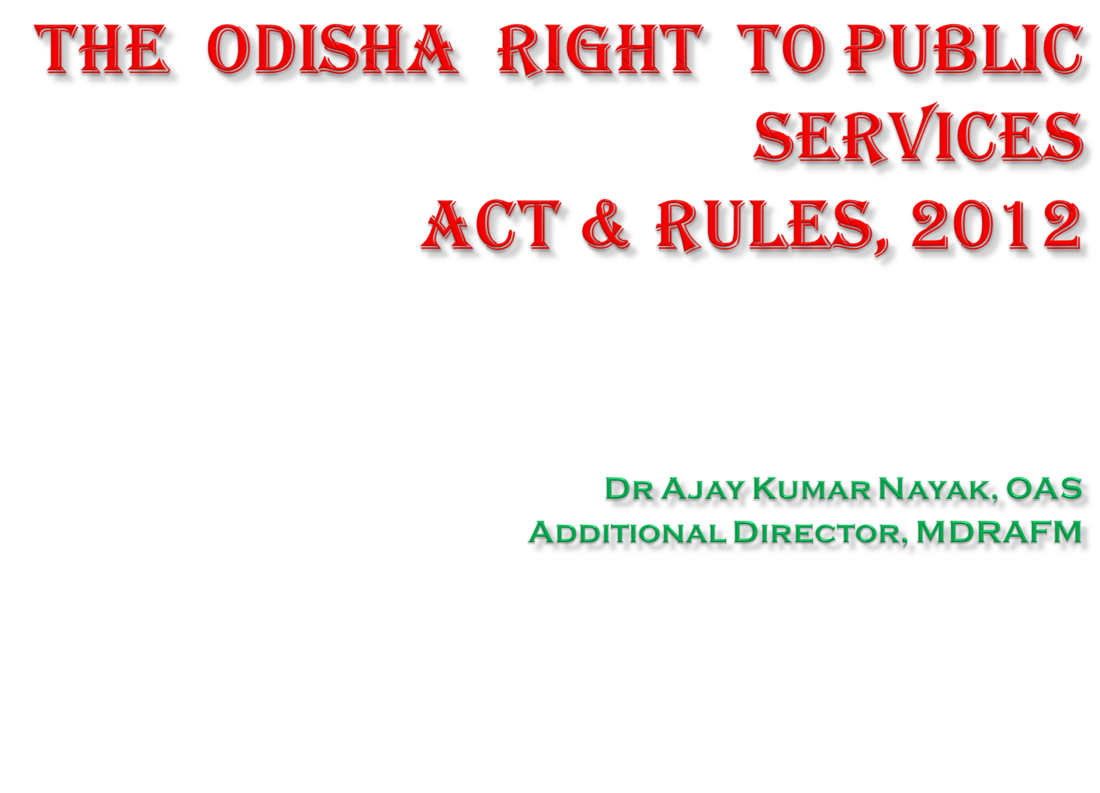
94Vijay Arora, IAS
S94pecial9437051000994hhf Secret (AR) Department

Slide 2
Directive Principles of State Policy , Part-IV of Indian Constitution
India is a Welfare State.
State plays a central role in the protection and promotion of the economic and social welfare of its citizens.
Constitutional goals as envisaged in the DPSP state that everyone should receive the benefits provided by the Govt in real time and there should not be any delay in delivering the same.

Slide 3
Implementation of DPSP
Considering the experience of first 50 years of the Constitution, the thinkers and members of Civil Society felt that all is not well in delivery of Government services to the citizens.
Public Service Delivery System in India is synonymous with inefficiency and slothfullness.
It is felt necessary to remove inadequacies in public service Delivery

Slide 4
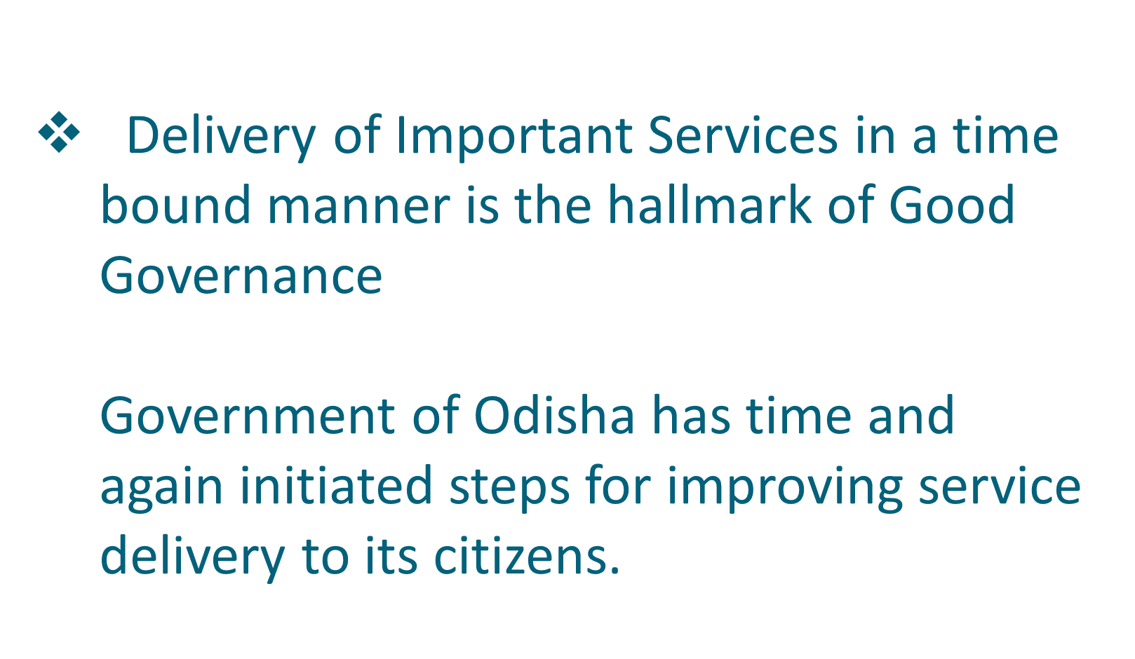

Slide 5

Why there is need of a separate ACT ?
As per the ranking on Human Development Index by UNDP in 2007-08, India ranked at 132 out of 179 countries .
Reason is Government being the largest service provider of Health, Education and Sanitation provides the public service delivery of poor quality in the country.
Important reason is the lack of accountability in public service delivery in India.

Slide 6
Report of Administrative Reform Commission, 2008
The Administrative Reform Commission in its 12th Report entitled ‘ Citizen Centric administration: the heart of Governance’ stated as follows:-
“ The basic principle of Governance redressal system is that if promised level of service delivered is not achieved or if a right of a citizen is not honoured then the citizen should be able to take recourse to a mechanism to have the grievance redressed. The mechanism should well be popularised, easy to use, prompt and above all, citizens must have faith that they will get justice from it.”

Slide 7
Civil Society have taken a series of initiatives to enhance accountability through some direct mechanism of engagement between citizens and the state.
As per the World Development Report, There are not enough mechanisms in place to ensure that the poor could directly interact with the public service providers and provide continuous feedback on the quality of service being provided.

Slide 8

Right to Public Services
Continuous feedback on the implementation of large government programmes provides Government with an opportunity to take corrective action and thus improves the level of service delivery.
As a Governance Reforms Programme, Government tried to enact the obligation of public functionaries upon the citizens to deliver public services in a time bound manner by making the proposed law Right to Public Services Act.

Slide 9
Principles of Service Delivery
Empowering the citizen
Changing the perception of Govt functioning
Tackle the charges of employees being insensitive /corrupt
Bring transparency
Accountability
Removing the feeling of impunity

Slide 10

History of RTPS in other States
No. | State | Title of the Act | Date of Implementation
1. | Madhya Pradesh | The Madhya Pradesh Lok Sewaon Ke Pradan Ki Guarantee Adhiniyam | 18.08.2010
2. | Uttar Pradesh | The Uttar Pradesh Janhit Guarantee Adhyadesh | 13.01.2011
3. | Delhi | The Delhi (Right of Citizen to Time Bound Delivery of Services) Act, 2011 | 28.04.2011
4. | Jammu & Kashmir | The Jammu and Kashmir Public Services Guarantee Act, 2011 | 13.04.2011
5. | Bihar | Bihar Right to Public Services Act, 2011 | 15.08.2011
6. | Rajasthan | The Rajasthan Guaranteed Delivery of Public Services Act, 2011 | 21.09.2011
7. | Uttarakhand | The Uttarakhand Right to Service Act, 2011 | 04.10.2011
8. | Himachal Pradesh | Himachal Pradesh Public Services Guarantee Act, 2011 | 17.10.2011
9. | Punjab | The Punjab Right to Service Act, 2011 | 20.10.2011
10. | Jharkhand | The Jharkhand Right to Service Act, 2011 | 15.11.2011
11. | Chhattisgarh | The Lok Seva Guarantee Act | 12.12.2011
12. | Assam | Assam Right to Public Services Act, 2012 | 19.09.2012
13. | Kerala | Kerala State Right to Service Act, 2012 | 27.10.2012

Slide 11
ODISHA BECAME THE 14TH STATE TO BRING
THE ODISHA RIGHT TO PUBLIC SERVICES ACT , 2012

Slide 12

Transparency
Accountability
Timeliness

Slide 13
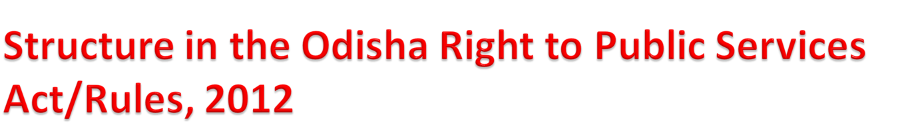


STATE GOVERNMENT
REVISIONAL AUTHORITY
APPELLATE AUTHORITY
DESIGNATED OFFICER

Slide 14
About the ACT & RULES
Odisha Right to Public Services Act, 2012 was given accent to by Governor on 19.10.2012 and it has been notified in the Official Gazette on 1st November, 2012.
Odisha Right to Public Services Rules, 2012 has also been notified in the Official Gazette on 7th December, 2012.

Slide 15
AN ACT TO PROVIDE FOR THE DELIVERY OF PUBLIC SERVICES TO THE CITIZENS WITHIN THE GIVEN TIME LIMITS
Section 1 : Short Title, extent and Commencement
Section 2 : Definitions
Right to Public services means right to obtain the service notified by the State Government under this Act within the given time limit (Sec 2(g)
Service means any service in relation to public notified under section 3 (Sec 2(h)

Slide 16

Notification of Public Services to be covered under this Act (Section 3(1)
Notification of Designated Officer, Appellate Authority, Revisional Authority along with Offices where public services to be delivered by each Department (Section 3(2)
An eligible person can file an application to the Designated Officer for obtaining any service under this Act (Section 4(1)

Slide 17

The Designated Officer shall provide the service to the eligible person within the given time limit from the date of receipt of application (Section 4(2)
Rejection of application should be made with record of reasons in writing and communication of the same to the applicant (Section 4(2)
Every Designated Officer shall maintain detail records of services applied for in the prescribed format (Section 4(3)

Slide 18
The eligible applicant may file an appeal before the Appellate Authority within 30 days from the date of rejection or the expiry of the given time limit (Section 5(1)
The Appellate Authority shall dispose of the appeal within a period of 30 days of its receipt and direct the Designated Officer to provide the service within the time limit mentioned in the order (Section 5(2)

Slide 19

An eligible person aggrieved by the order of the Appellate Authority may file revision to the Revisional Authority within 30 days from the date of that order or the expiry of the time specified by the Appellate Authority
(Section 6)

Slide 20

The Appellate Authority and Revisional Authority shall have the powers as are vested in the Civil Court while trying a suit under Code of Civil Procedure, 1908 (Section 7)
summoning and enforcing the attendance of Designated Officer and appellant and compel them to give oral or documentary evidence
B. requiring the production and inspection of documents
C. any other matter which may be prescribed

Slide 21

The Revisional Authority can impose a penalty of not more than Rs.5000/- on the Designated Officer and/or any other official involved in the process of providing such service who have failed to provide service without sufficient and reasonable cause (Section 8(1)(a)).
The Revisional Authority can impose a penalty of not more than Rs.250/- per each day of delay on the Designated Officer and/or any other official involved in the delay in the process of providing such service (Section 8(1)(b)).

Slide 22

The Revisional Authority can impose a penalty of not more than Rs.5000/- on the Appellate Authority if the AA has failed in the processing and disposal of appeal without any sufficient and reasonable cause (Section 8(2)
The penalty shall be charged from the Designated Officer, Appellate Authority and/or any other official concerned, in proportion to be decided by the Revisional Authority (Section 8(3)

Slide 23

Before imposing penalty, The Revisional Authority will give reasonable opportunity of being heard to the Designated Officer, Appellate Authority and concerned sub ordinate staff (Section 8)(3)
The Revisional Authority can recommend disciplinary action against the defaulting Designated Officer and/or any other official involved in the process of providing such services has/have failed to discharge the duties assigned under this Act (Section 9).

Slide 24

No Court shall entertain any suit, application or other proceeding in respect of any order made under this Act and no such order shall be called in question otherwise than by way of an appeal or revision under this Act (Section 10)

Slide 25

The State Government may, on receipt of an application alleging non-compliance of the provisions, send the same directly to the Appellate Authority for taking further actions as per the provisions of the Act (Section 11)
The Appellate Authority shall dispose of the applications in the same manner as the applications received under Section 11 are disposed of (Section 5(3)

Slide 26

No suit, prosecution or other legal proceeding shall lie against any person for anything which is done in good faith or intended to be done under this Act or any rule made there under. (Section 12)

Slide 27

The services and the given time limit shall be displayed locally and on the website by the Secretary of the Department concerned for information of the public in odia language.(Section 13)

Slide 28

The State Government shall by notification in the Official Gazette, make rules to carry out the provisions of this Act within a period of six months from commencement of this Act (Section 14).
Accordingly, State Government in GA(AR) Department have prepared the Odisha Right to Public Services Rules, 2012 and published in the Official Gazette on 7th December, 2012.

Slide 29
If any difficulty arises in giving effect to the provisions of this Act, the State Government may, by order, make such provisions, not inconsistent with the provisions of this Act (Section 15).
This should be published in the Official Gazette.
No such order shall be made after the expiry of a period of two years from the date of commencement of this Act.
Every order under this Section should be laid before the OLA.

Slide 30
Sl No. | Department Name | No. of Services
1 | Agriculture | 6
2 | Commerce & Transport | 32
3 | Co-operation | 28
4 | Employment and Technical Education & Training | 11
5 | Excise | 2
6 | Finance | 8
7 | Fisheries & Animal Resources Dev | 17
8 | Forest & Environment | 11
9 | General Administration & Public Grie vance | 3
10 | Health & Family Welfare | 2
11 | Higher Education | 36
12 | Home | 31
13 | Housing & Urban Development | 30
14 | Industries | 6
15 | Labour & Employees' State Insurance | 20
16 | Panchayati Raj | 2
17 | Revenue & Disaster Management | 34
18 | ST & SC Development, Minorities & Backward Classes Welfare | 3
19 | School & Mass Education | 7
20 | Works | 1
21 | Micro, Small & Medium Enterprise | 29
22 | Social Security and Empowerment of Person with Disabilities | 1

Slide 31
.No. | Services | Time Limit | Designated Officer | Appellate Authority | Revisional Authority
1 | Disposal of application for registration under VAT/CST Act | 30 Days | Commercial Tax Officers/ Asst. Commissioner of Commercial Taxes/ Deputy Commissioner of Commercial Taxes in charge of Circles & Assessment Units | Joint Commissioner of Commercial Taxes in charge of Ranges | Additional Commissioner of Commercial Taxes (Zonal)
2 | Disposal of application for amendment of registration certificates | 15 days | Commercial Tax Officers/ Asst. Commissioner of Commercial Taxes/ Deputy Commissioner of Commercial Taxes in charge of Circles & Assessment Units | Joint Commissioner of Commercial Taxes in charge of Ranges | Additional Commissioner of Commercial Taxes (Zonal)
3 | Disposal of application for 'C' forms, 'F' forms, 'H' forms & Waybills | 7 days | Commercial Tax Officers/ Asst. Commissioner of Commercial Taxes/ Deputy Commissioner of Commercial Taxes in charge of Circles & Assessment Units | Joint Commissioner of Commercial Taxes in charge of Ranges | Additional Commissioner of Commercial Taxes (Zonal)
4 | Disposal of application for registration for registration under Odisha Entry Tax Act, 1999 | 30 days | Commercial Tax officers/ Asst. Commissioner of Commercial Taxes/ Deputy Commissioner of Commercial taxes in charge of Circle & Assessment Units | Joint Commissioner of Commercial taxes in charge of Ranges | Additional Commissioner of Commercial Taxes (Zonal)

Slide 32
THE ODISHA RIGHT TO PUBLIC SERVICES RULES, 2012

Slide 33
NOTIFICATION OF DO AA & RA
State Government shall notify Designated Officer for every Public Service of the concerned Department to whom an eligible person shall make an application for obtaining the services under the provisions of this Act.
State Government shall notify the Appellate Authority and Revisional Authority for the purposes of this Act.

Slide 34
PUBLIC SERVICES & AUTHORISATION
The State Government may from time to time notify the given time limit for the public services listed out by the Departments.
The Designated Officer may authorize any of his/ her subordinate officer/ staff to receive the applications and give acknowledgement.(Rule-3)

Slide 35
ACKNOWLEDGEMENT & TIME LIMIT
Rule-4
The authorized officer shall give acknowledgement to the applicant in the prescribed format.
The date of given time limit will not be mentioned in the acknowledgement in case any necessary document(s) have not been enclosed with the application. The shall be clearly mentioned in the Application.
If all the necessary documents are enclosed with the Applicaation, then the given time limit shall be mentioned.

Slide 36
Communication in the event of denial/delay of service(Rule-5)
The Designated Officer shall communicate to the applicant
A. The Reasons for such denial or delay
B. The Period within which an appeal against such denial or delay be preferred
C. The Particulars including all available contact information of the Appellate Authority under the provisions of the Act

Slide 37
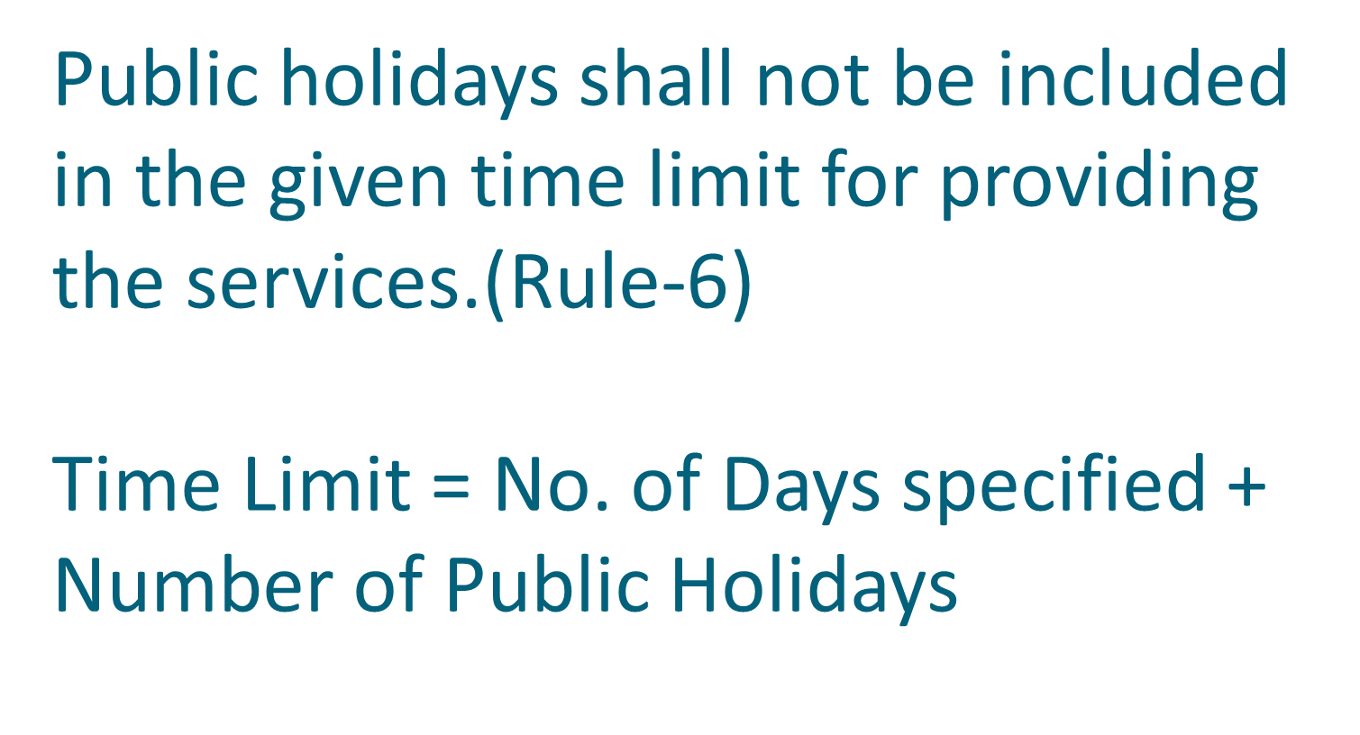

Slide 38
Display of information on notice board(Rule-7)
Designation Officer shall for the convenience of common public shall cause to display all relevant information related to the services on the notice board in Odia language that has been put up in the office for easy view.
All the required documents that are required to be enclosed along with the application are also to be notified.
Details of how an Appeal or Revision can be made and necessary documents there for should also to be given in the notice board.

Slide 39
Penalty(Rule-8 &16)
Penalty imposed on the Designated Officer or Appellate Authority or Subordinate Staff shall be recovered from their salary / honorarium/ remuneration.
And to be deposited in the Head of Account
“ 0070-Other Administrative Services-60-other services-800- Other receipts-0097-Misc Receipts-02214- Fines under Right to Public Services Act”
And send a copy of the Challan to Revisional Authority

Slide 40
Relaxation of Appeal/Revision fees
(Rule-9)
No fees shall be levied for Appeal and Revisions

Slide 41
APPEALS(Rule-10)
An eligible person whose application for obtaining service is rejected or services not provided within the time limit may file an appeal to the Appellate Authority within thirty days from the date of rejection of the application or the expiry of the given time limit, as the case may be.
On hearing of appeal, the Appellate Authority may order the Designated Officer to provide the service within a specified period or may reject the appeal.

Slide 42
REVISION(Rule-10)
The Designated Officer or the appellant aggrieved by any order of the Appellate Authority may file a revision before the Revisional Authority within 30 days from the date of that order of the Appellate Authority or the expiry of the time as the case may be.
While hearing the revision, the Revisional Authority may impose a penalty upon the Designated Officer and the Appellate Authority on failing to provide the service without any sufficient and reasonable cause.
He may impose penalty for delay in providing public services.

Slide 43
Procedure for filing Appeal & Revision
Name & Address of the applicant
Name & Address of the DO, AA/ RA
Gist of the order against which the Appeal or Revision lies
Date of application along with name & address of DO if the appeal is made against non-receipt of acknowledgement of the applications
Basis for Appeal or Revision
Relief Asked for
Any other related information that may be necessary for determining the Appeal or Revision

Slide 44
Documents to be enclosed with Appeal & Revision(Rule-11)
1. Table of Contents of documents
2. Self attested copy of the order against which the Appeal or Revision is being made
3. Copies of the documents mentioned in the application for Appeal or Revision
No fee shall be charged for appeals and revisions.

Slide 45
Process for taking decision in Appeal & Revision(Rule-12)
1. Concerned documents/public records or their copies shall be reviewed.
In exceptional circumstances, any officer may be authorised for required investigation.
The designated Officer or Appellate Authority or subordinate staff may be summoned at the time of review for a hearing.

Slide 46
Process of communicating information on hearing(Rule-13)
Information of hearing of appeal or revision shall be communicated
1. by the Party himself/herself
2. by Hand delivery through Special Messenger
3. by Registered post with acknowledgement

Slide 47
Presence during Hearing(Rule-14)
The hearing date shall be communicated to the applicant/DO/AA/subordinate staff.
The applicant/DO/AA/subordinate staff shall make himself present during hearing.
Before taking final decision, one more chance may be given to all.
If any party remains absent even after due information of hearing duly executed to him/her, the application for Appeal or Revision shall be decided in absentia.

Slide 48
Orders in Appeal or Revision(Rule-15)
Appeal or Revision order shall be read during the hearing and shall also be in writing.
Copy of the appeal/revision order shall be given to all concerned.
In case of imposition of penalty, Revisional Authority shall mark the copy to concerned authority for deduction from the salary/honorarium/remuneration.
In case of departmental enquiry, the concerned Appointing Authority will be intimated.
In case of any amendment in the order of the Appellate Authority, the Revisional authority shall send a copy of the order to the Appellate Authority and all concerned.

Slide 49
NON COMPLIANCE OF ORDER
Non compliance of the orders of Revisional Authority shall amount to misconduct and accordingly Revisional Authority may recommend for disciplinary action.

Slide 50
POWER OF CIVIL COURT
No Civil Court shall entertain any suit, application or other proceeding in respect of any order made under this Act and no such order shall be called in question otherwise than by way of an appeal as specified under this Act.

Slide 51
Maintenance of Records (Rule-17)
The Designated Officer, Appellate Authority and Revisional Authority shall maintain records of all cases in the prescribed format.

Slide 52
Dissemination and Training(Rule-18)
State Govt shall organize campaign/programmes to advance the understanding of the public
Promote timely and effective dissemination of accurate information by public authorities
Train concerned staff, DO, AA and RA
Compile guideline in an easily comprehensible form

Slide 53
DISPLAY OF INFORMATION(Rule-19)
The Secretary of the Department shall display the information on the public service and the given time limit shall be displayed locally on the notice board in Odia language and on the website of the concerned department for the convenience of the common public.

Slide 54
MONITORING OF IMPLEMENTATION & EVALUATION
(Rule-20)
The State Government will introduce a system for centralized monitoring of the timely delivery of notified public services.
Tracking of status of application by the citizen
Tracking of status of appeal and revision
Performance Evaluation of the Public Authority in delivering services

Slide 55
AWARDS(Rule-21)
The State Government may give a reward to the officer against whom no default is reported in one year so as to encourage and enhance the efficiency of the government servants.
The award shall be cash incentive not exceeding Rupees Five Thousand in aggregate along with a certificate of appreciation.

Slide 56
STATUS OF DELIVERY OF PUBLIC SERVICES in 2017
Department | Applications Received | Applications Disposed | Applications Pending
Commerce & Transport | 985,068 | 969,030 | 16,038
Revenue & Disaster Management | 4,301,838 | 3,696,375 | 605,463
Health & Family Welfare | 516,658 | 453,202 | 63,456
Women & Child Development | 137,913 | 135,594 | 2,319
Home | 41,195 | 29,103 | 12,092
Finance | 295,438 | 290,172 | 5,266
Rural Development | 21,164 | 16,473 | 4,691
ST & SC Development, Minorities & Backward Classes Welfare | 521,089 | 518,834 | 2,255
Housing & Urban Development | 3,390 | 2,076 | 1,314
School & Mass Education | 1,487 | 1,485 | 2
Grand Total | 6,825,240 | 6,112,344 | 712,896

Slide 57
STATUS OF DELIVERY OF PUBLIC SERVICES
District | Applications Received | Applications Disposed | Applications Pending
Cuttack | 349,133 | 330,115 | 19,018
Jajpur | 405,803 | 325,310 | 80,493
Jagatsinghpur | 145,940 | 112,357 | 33,583
Kendrapara | 22,031 | 22,009 | 22
Balasore | 484,434 | 477,458 | 6,976
Bhadra | 284,458 | 273,070 | 11,388
Puri | 155,996 | 139,448 | 16,548
Khurda | 359,361 | 311,862 | 47,499
Nayagarh | 210,959 | 154,295 | 56,664
Mayurbhanj | 459,562 | 421,263 | 38,299

Slide 58
STATUS OF DELIVERY OF PUBLIC SERVICES
District | Applications Received | Applications Disposed | Applications Pending
Dhenkanal | 261,445 | 256,395 | 5,050
Angul | 368,561 | 347,176 | 21,385
Bolangir | 186,905 | 186,278 | 627
Subarnapur | 90,893 | 85,921 | 4,972
Sambalpur | 343,774 | 319,024 | 24,750
Bargarh | 260,145 | 228,386 | 31,759
Keonjhar | 340,582 | 309,350 | 31,232
Sundargarh | 680,794 | 636,089 | 44,705
Jharsuguda | 14,115 | 14,115 | 0
Deogarh | 16,853 | 14,573 | 2,280

Slide 59
STATUS OF DELIVERY OF PUBLIC SERVICES
District | Applications Received | Applications Disposed | Applications Pending
Kalahandi | 87,718 | 78,773 | 8,945
Nuapada | 43,617 | 42,579 | 1,038
Ganjam | 722,986 | 583,551 | 139,435
Gajapati | 53,621 | 30,421 | 23,200
Koraput | 50,435 | 40,263 | 10,172
Malkanagiri | 52,440 | 47,658 | 4,782
Rayagada | 111,679 | 83,807 | 27,872
Nawrangpur | 118,971 | 100,902 | 18,069
Kandhamal | 136,138 | 135,395 | 743
Boudh | 5,891 | 4,501 | 1,390
Grand Total | 6,825,240 | 6,112,344 | 712,896

Slide 60
Thank You

