Slide 1
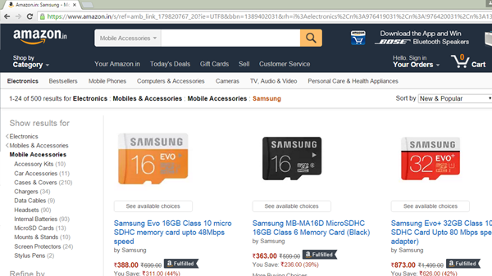
Web Based Applications
The term web application refers to a software system that provides a user interface through a web browser. Examples of web applications include blogs, online shopping, search engines, etc.
Web applications can be simple consisting of only static web pages, or they can be dynamic and interactive.
Static web pages are stored in the file system of web server usually displays the same information to all visitors. Whereas dynamic pages are constructed by a program that produce the HTML. This type of web application provide individual information to the user and let them personalize the content according to their preferences.

Slide 2
Client-Server Architecture
DNS
.com IP
Server (IP Address)
Collection of resources are stored centrally on internet
SMTP, HTTP, FTP
(Tomcat, Jboss, Express, SAP NW Gateway)
Java, .NET, NodeJS,ABAP
Client
User’s workstation
Desktop
Tablet
Mobile
(Browser)
Client
User’s workstation
Desktop
Tablet
Mobile
(Browser)
Client
User’s workstation
Desktop
Tablet
Mobile
(Browser)
Client
User’s workstation
Desktop
Tablet
Mobile
(Browser)
Client
User’s workstation
Desktop
Tablet
Mobile
(Browser)
Request (Header + Body (optional))
Port
Response (Header + Body)
Types of HTTP Request
GET – Request which is used to Read data
POST – Request which are used to create data on server
PUT – Change some data server
DELETE – remove some data from server
DB

Slide 3
HTML stands for HyperText Markup Language which means what you write is what you get. HTML is tag based, and every tag is pre-defined. HTML is used to create static web-component/page/document.
There are multiple tags available for creating different user interface elements like input, Button, text, label, list, etc.
W3C – World Wide Web Consortium, is responsible to release the tags which the world must use to create and HTML page. All the browsers are the member of this consortium. They all must comply to the definition of tags provided by W3C.
HTML is not a programing language
Browser Directly understand HTML.
Version | Year
HTML | 1991
HTML 2.0 | 1995
HTML 3.2 | 1997
HTML 4 | 1999
XHTML | 2000
HTML 5 | 2014

Slide 4
What is the difference between HTML and HTML5?
HTML5 is only latest version of HTML
Older versions of html the doc type declaration was little complex <!DOCTYPE HTML PUBLIC “-//W3C//DND XHTML 1.0”>, this was simplified as <!DOCTYPE html>
HTML5 is also more liberal in nature, older version any wrong tag can cause whole page not being loaded.
There are some tags which doesn’t need the ending tag anymore like img and input.
There were new type properties available for input elements.
It does automatic data validation for basic input types.
In old days when we want to support audio and video files, there were extra plugins which a client would need to playback, but with HTML5 direct support for audio and video has been provided.
Morden website elements like header, toolbar, section, article etc.
HTML is a tree data structure, The runtime representation of this tree is called DOM (Document Object Model), press F12 key on browser to see the DOM in elements section. This F12, internet developer tool/toolbar.

Slide 5
HTML page/document consist of 2 parts head and body
These are also tags
Most of the tags has ending tags
We do nesting of tags also
Every html page has file extension as .html
Documentation of html is here https://www.w3schools.com/html/default.asp
Syntax
<tagName property=“value” pro2=“val”>Content</tagName>
<!DOCTYPE html>
<html>
</html>
<head>
<body>

Slide 6
CSS – CSS stands for Cascading Style Sheets, it is used to beautify the HTML Content. Beautification means applying the formatting, styling, changing the colors, background etc. Before CSS was introduced, we used to use HTML tags for the same
<p>I <color value=“red”><b>Love</b></color> <font value=“calibri”><em>India</em></font></p>
Laborious and error prone
CSS is the way to simplify the styling of HTML content
How can we apply CSS
Inline CSS (similar to old approach) – style code is written at tag level
<tagName style=“prop:val;prop:val”>Content</tagName>
Internal CSS – When we apply style at page level, for this we use <style></style> tag, write the code inside.
External CSS – Where we write the code in a external file with css extension and just create a reference (INCLUDE in ABAP)
Syntax:
selector {
propname: value ;
propname2: value
}
selector – on what elements the style will be applied
#id – targeted therapy to single element on entire of page
.className – class name based style
tagName – tagname based style

Slide 7
CSS Box Model – it decides the positioning, relative position and actual width of an element on the UI.
margin
border
border
Padding
Padding
Actual HTML Element
Actual HTML Element

