Slide 1




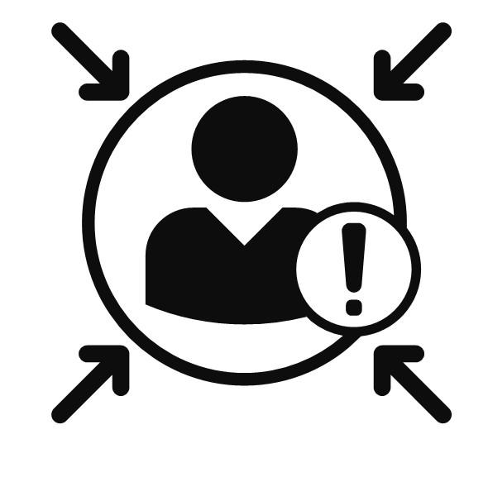


LSE/LSEG
Enhance Cross-Browser Testing with BrowserStack and Achieve 100% Faster Execution.
PROBLEM STATEMENT
BROWSERSTACK BENEFITS
CHALLENGES/RISKS
Challenges Associated with Manual Execution::
Testing on Real Browsers across various versions
Infrastructure Dependencies
Environmental Issues
Browser Stack job latency.
Browser Stack delays.
WebDriver Manager Integration
High time consumption
Cross-Browser/Mobile Devices Compatibility testing
Execution on a Single Browser:
Email notification to stake-holders
Resource-intensive
Multiple jobs with DX1pipeline.
Scheduled on all browsers, including Edge, Chrome, and Firefox.
BROWSER STACK ISSUE METRICS & MILESTONES(LSEG)
15- Jan-2025
Automation Status - 100%
20- Jan-2025
Automation Status - 50%
1- Dec-2024
Failure Analysis

Slide 2





LSEG/LSE Enhancements
Analysis and Solutions for Browser Stack Failures
Integrating report portal with the existing framework
LSEG.COM Automating Manual Processes to Save Time
Migrating LSE framework to Selenium/Cucumber
Utilizing Parallel Execution to Optimize Time Efficiency

Slide 3

LSEG REGRESSION AUTOMATION
LSEG.com Automation enhances efficiency, precision, and scalability but also reducing execution time by 85% compared to manual testing.
PROBLEM STATEMENT
AUTOMATION BENEFITS
CHALLENGES/RISKS
Manual Execution Faces the Following Challenges :
Scalability
Highly Dynamic Nature of web pages.
DX1 pipelines have a 2-hour execution time limit.
Application exhibits latency issues when evaluated in Browser Stack.
Configuration of third-party email services for authentication purposes.
Consistency and Accuracy
High time consumption
Early Bug Detection
Susceptible to human error
Reduced Execution Time with Parallel Execution
Resource-intensive
EXECUTION ANALYSIS
AUTOMATION METRICS & MILESTONES
31- Jan-2025
Automation Status - 100%
Total Regression Cases | : 441
Total Automated Cases | : 424
Automated Scripts Count | : 218
New Defects | : 2
Production Defects | : 6
10- Jan-2025
22- Jan-2025
Automation Status - 50%
Automation Status - 75%
Automation Commenced
13 - Dec-2024
28- Dec-2024
4- Dec-2024
Automation Status - 25%
Test Case Analysis

