Slide 1
AUTOMATED INVOICE PROCESSING
Group 2 :
1. Ankita Pawar
2. Nita Rajge
3. Nilesh Suryavanshi
4. Shoaib Mohammed
5. Pooja Rathod
6. Smruti Pote
Mentor : Dhiraj Sir

Slide 2
BUSINESS PROBLEM
Manual processing of invoices and receipts presents several challenges:
The handling of invoices and receipts is a labor-intensive and error-prone process.
Accounts payable departments often manually process these documents, which involves extracting key information (such as vendor details, amounts, dates) and inputting it into financial systems.
This manual effort can lead to inefficiencies, delayed payments, and errors in financial records.

Slide 3
PROBLEM STATEMENT
To develop an automated system using Natural Language Processing (NLP) techniques to streamline the extraction, validation, and integration of invoice and receipt data into financial systems . This system aims to reduce labor costs, increase accuracy, and improve processing speed, ultimately enhancing overall operational efficiency.

Slide 4
OBJECTIVE
Scope/Objective (what will change using this project?)
Automate the extraction of key information from invoices and receipts .
Increased efficiency and accuracy in accounts payable processes. Reduced manual effort, processing time and errors in financial records.
Enhanced ability to meet payment deadlines, avoiding late fees . Allow staff to focus on higher-value tasks.

Slide 5
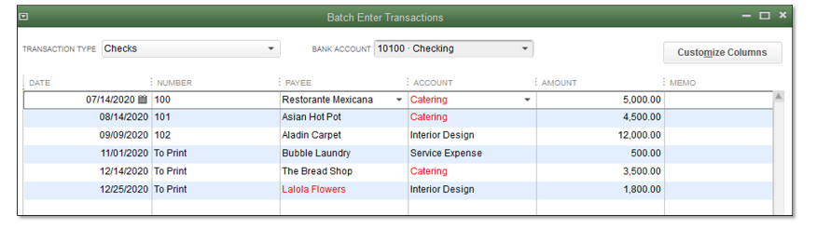
DATA GATHERING AND REQUIREMENTS
(how you got it?)
Access of s3 bucket AWS cloud was provided using IAM user role by the client
Final Data requirement format: Invoice entry in QuickBooks

Slide 6
APPROACHES
Rule Based : Based on regular expressions (Regex). This, however, was not scalable as it required a lot of different rules as per different format.
Template matching : CV2 template matching technique where a predefined template is slide over a large image to get a sub image which matches the template.
OCR + Rule Based: Extraction of data from OCR engines and applying Regex pattern to match
OCR + Named Entity Recognition (NER): Classify and categorize extracted text into relevant fields like invoice number, date, and amount.
(Finalized Approach)

Slide 7
EDA AND DATA PREPROCESSING
Assumptions: Consistent entity formats (e.g., dates, amounts).
Features used: Organization, Address, Order /Invoice ID, Date, Final Amount.
Data Preprocessing
Converted PDFs to images
Preprocessing of images using cv2 :CLAHE (Contrast Limited Adaptive Threshold, Histogram Equalization) for image contrast enhancement. enhanced image to grayscale, Converts the grayscale image to a binary image using adaptive thresholding, deionize (Removes noise from the binary image while preserving edges),filter2D sharpening.

Slide 8
MODEL BUILDING STEPS
Step 1: Data Collection
Step 2: Converting data in different formats into images
Step 3 : Splitting the data(Train, Validation, test)
Step 4: Customizing YOLOv5 on label trained data and initialization.
Step 5:Prediction of bounding boxes and applying pytesseract for text extraction from bounding boxes.
Step 6: Using Spacy NER for entity recognition from the extracted text
Step 7: saving extracted entities in csv format

Slide 9
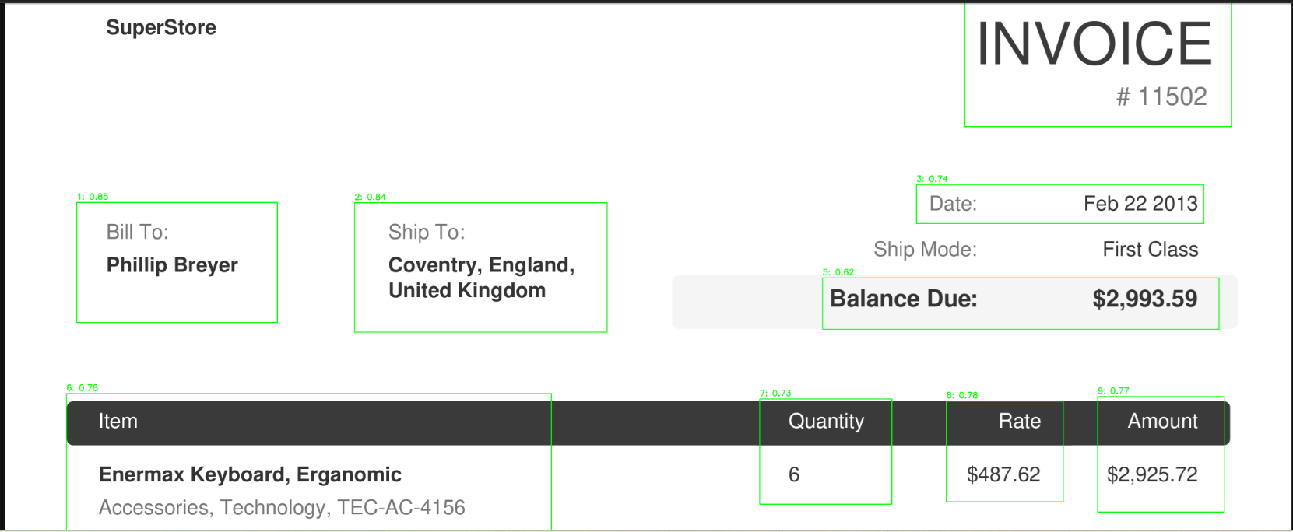

Slide 10
MODEL SELECTION AND EVALUATION
Used YOLOv5 for object detection to find text regions.
Text extraction from these text regions using Pytesseract.
Used spaCy’s pre-trained NER model for entity extraction . However, entities like OrderID were not in its standard format, contained alpha numeric values, so used customized NER
Enhanced with custom patterns for OrderID recognition.
Fine-tuning involved adjusting Regex patterns.
Results showed high accuracy in extracting key entities as the extracted entities/labels were crosschecked with the trained labels
Deployment : The Final model was saved and API for the same was created.

Slide 11
OUTCOME AND CONCLUSION
Achieved significant optimization in invoice processing . Reduced manual effort and increased processing speed . Improved accuracy in financial records. Potential for revenue generation through early payment discounts and avoidance of late fees.
NLP-based automation offers a scalable solution to manual invoice processing . Significant improvements in efficiency and accuracy.

