Slide 1
PERSONALIZED INVESTMENT RECOMMENDATION SYSTEM FOR ENHANCED CUSTOMER FINANCIAL WELL-BEING
GROUP 2
MENTOR: DHIRAJ SIR

Slide 2
INTRODUCTION
Project goal: Enhance customer satisfaction with personalized investment recommendations
Importance of personalized services in the banking industry

Slide 3
DATA COLLECTION AND PREPROCESSING
Features included in the dataset:
Age, Marital Status, Education Level, Occupation, Income Level, Location, Monthly Average Balance, Number Of Transactions Per Month, Existing Bank Products, Investment Horizon

Slide 4
Data cleaning steps:
- Drop duplicates
- Treat outliers
- Impute missing values
- Encode categorical features

Slide 5
EXPLORATORY DATA ANALYSIS (EDA)
• The dataset was nearly balanced across various categories.
• Visualization techniques used is box plots for outliers.

Slide 6
CLUSTERING METHODOLOGY
KMeans and DBScan algorithms are used to make clusters.
Better clusters formed using KMeans as it is more effective for large dataset.
Iterated over a range of values to determine the optimal number of clusters (K).

Slide 7
FEATURE IMPORTANCE ANALYSIS
Utilized the SHAP (Shapley Additive explanations) method to identify the most influential features.
Top features identified:
- Occupation
- Income Level
- Monthly Average Balance
- Number Of Transactions Per Month

Slide 8
CLUSTERING EVALUATION METRICS
Clustering evaluation metrics used
WCSS,
Davies-Bouldin Index,
Calinski-Harabasz Index,
Silhouette Score.

Slide 9
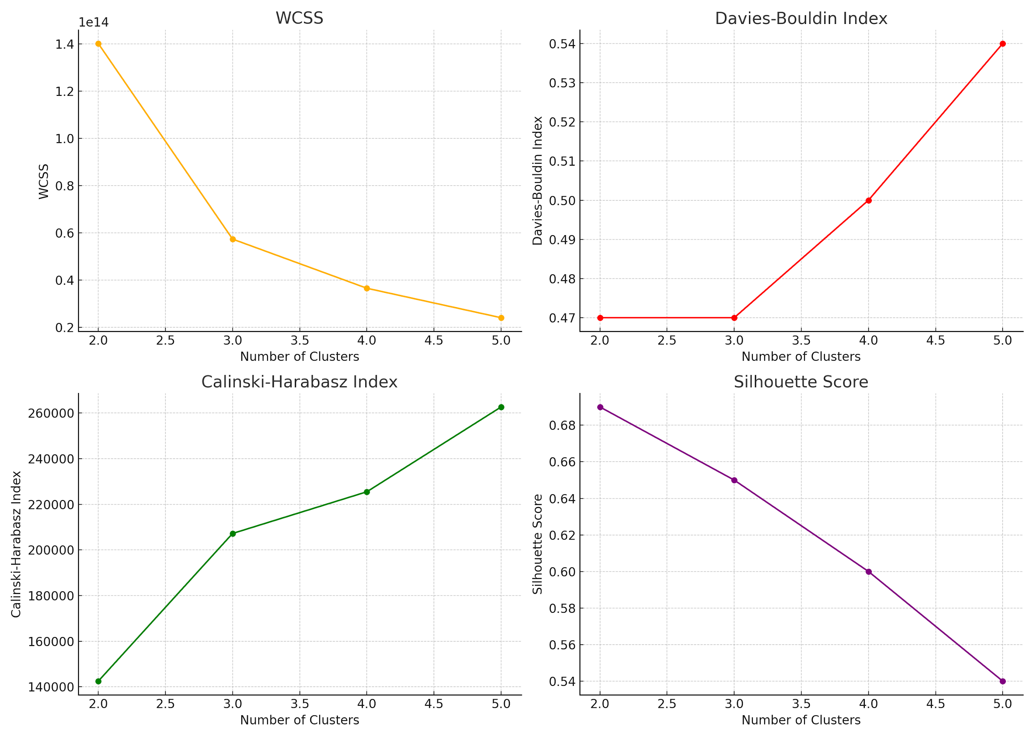

Slide 10
CONCLUSION
Project Outcome: Developed personalized investment recommendations using KMeans and SHAP.
Impact: The system identified key customer attributes that influence investment decisions, enabling the bank to offer tailored investment products

