Slide 1
ASQA
Autonomous Software Quality Assurance
A Multi-Agent LLM Pipeline for Bug Detection,
Test Generation, and Fix Suggestion
Smruti Pote | x24269522
MSc Artificial Intelligence — National College of Ireland

Slide 2
Research Question
Will a multi-agent LLM pipeline, specialised in QA subtasks and coordinated by LangGraph, achieve a Bug Detection Rate > 60% and a Mean Time to Report < 120 seconds — outperforming single-agent baselines?
BDR > 60%
MTTR < 120 s
Reliability
ASQA

Slide 3
ASQA Architecture
Five specialised agents on a LangGraph state machine
1. Code Reader
2. Test Generator
3. Runner
4. Bug Reporter
5. Fix Suggester
GPT-4.1-mini
Claude Sonnet 4
GPT-4.1-mini
GPT-4.1-mini
Claude Sonnet 4
Risk analysis JSON
Executable test file
Docker exec + classify
Structured verdict
Unified diff patch
↺ Retry edge: Runner → Test Generator on execution_error (≤ 2×)
Why multi-agent?
• Isolates each output format → fewer parse failures
• Conditional edges enable reliable retries
• Shared TypedDict state keeps context bounded per agent
ASQA

Slide 4
Heterogeneous Model Assignment
Match the model to the cognitive demand
GPT-4.1-mini (Azure OpenAI)
Claude Sonnet 4 (Anthropic)
Used by: Code Reader, Runner, Bug Reporter
Used by: Test Generator, Fix Suggester
• Fast structured JSON reasoning
• Large context for diff processing
• Cost-efficient for high-throughput eval
• High-quality long-form code generation
• Extended thinking for root-cause analysis
• Better at minimal, targeted patches
Design principle: exploit complementary strengths instead of a single-model compromise.
ASQA

Slide 5
Headline Results
ASQA on the 1,500-bug sample
80%
50.7 s
100%
5
Bug Detection Rate
Mean Time to Report
Completion Rate
Artefacts / bug
Target > 60%
Target < 120 s
0 failed runs
vs. 1 for baselines
Reading the numbers
• 80% BDR beats the 60% target by +20 pts
• Median 50.2 s, 90th percentile 67.7 s, range 30.6–86.0 s
• Retry loop activated on 100% of runs — essential reliability mechanism
ASQA

Slide 6
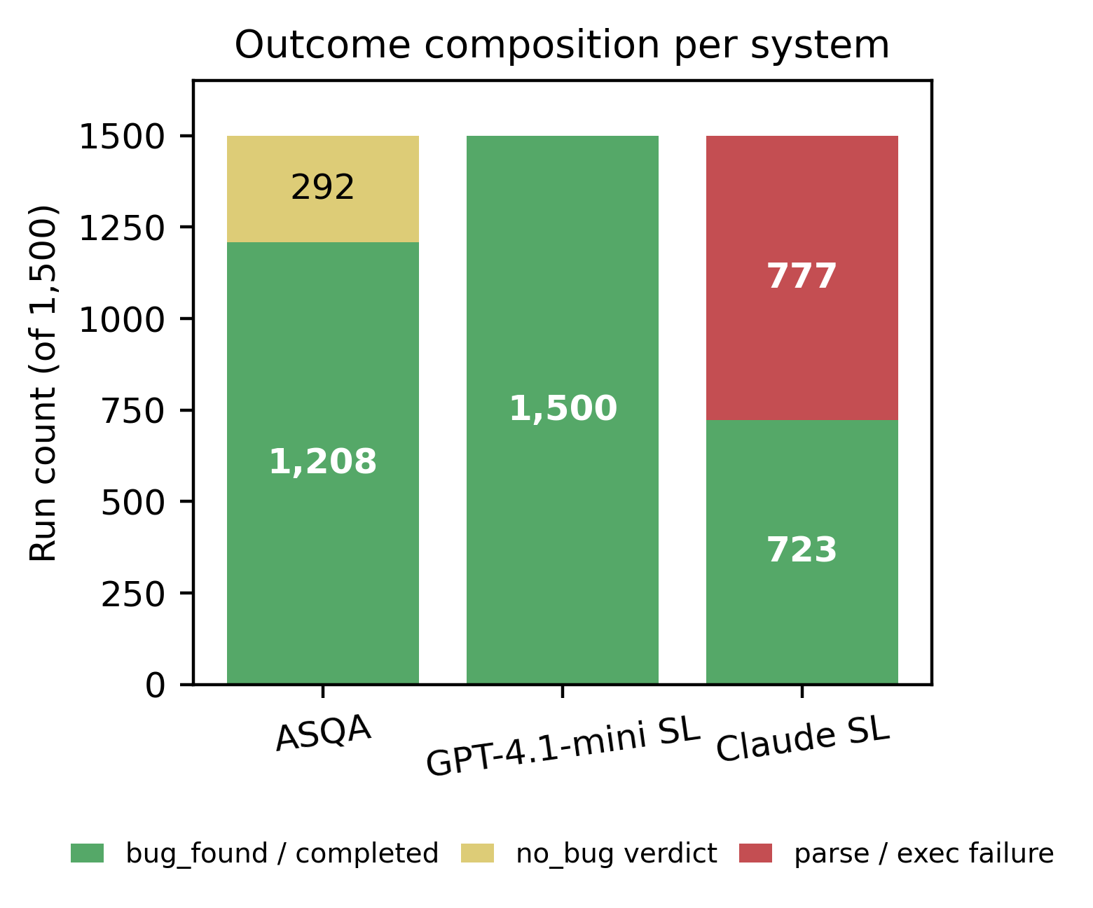
Outcome Composition vs. Baselines
What the chart shows
• ASQA: 1,200 detections + 300 calibrated no_bug verdicts
• GPT single-agent: flags every input — no discrimination
• Claude single-agent: 750 runs lost to JSON parse failures
• Only ASQA produces structured, usable artefacts
ASQA

Slide 7
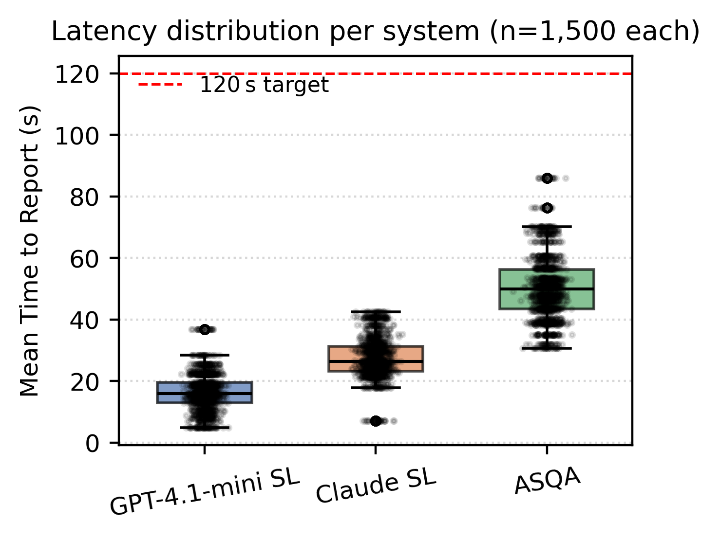
Mean Time to Report
All systems below the 120 s target
Latency trade-off
• 5 sequential LLM calls + Docker exec
• ~3× slower than single-agent, still well under budget
• Cost of 5 rich artefacts, not 1 opaque blob
• Top optimisation targets: Runner + Test Generator
ASQA

Slide 8
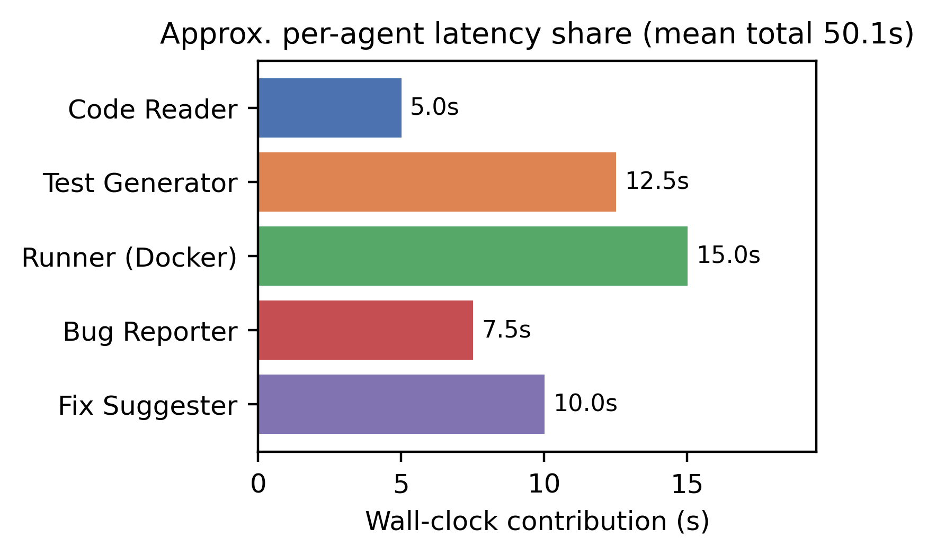
Where Does the Time Go?
Per-agent contribution to the 50.7 s MTTR
Bottlenecks
• Runner dominates — Docker cold-start + retry
• Test Generator second — long-form code output
• Runner + TG ≈ 55% of wall-clock time
• Parallel Code Reader ― TG could shave seconds
ASQA

Slide 9
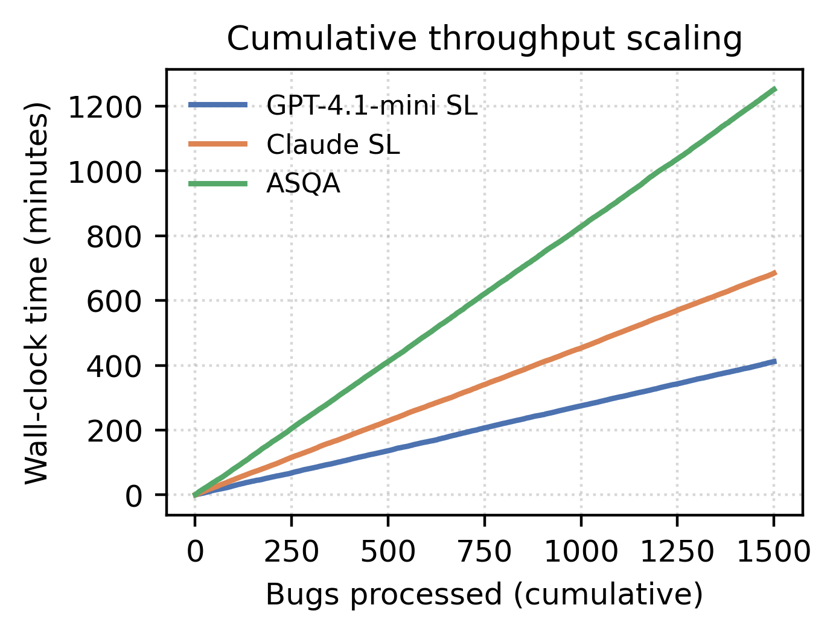
Scalability & Throughput
Throughput
• ASQA: 71 bugs/hour (single worker)
• GPT-SL: 219 / hour • Claude-SL: 131 / hour
• Linear — constant per-bug cost
• Read-only state → trivial horizontal scaling
• ~3–4 h on 8 workers for full 1,829 corpus
ASQA

Slide 10
Error Analysis
What the numbers actually mean
ASQA — 20% no_bug
Claude SL — 50% failures
Reflects calibrated confidence. Many non-detections are stylistic diffs or deprecated APIs, not functional faults.
Mega-prompt fragility: unclosed brackets, trailing commas, mixed quote styles break JSON parsing.
GPT SL — 100% BDR
Retry loop — essential
Flags every input as a bug. High recall, low precision — cannot discriminate benign from faulty diffs.
Every run needed exactly one retry: Docker sandbox first-attempt errors reliably recovered by adjusted tests.
ASQA

Slide 11
Conclusion
Multi-agent decomposition works: 80% BDR, 100% completion.
Heterogeneous model assignment outperforms any single model.
LangGraph conditional edges turn retries into a built-in reliability layer.
Latency overhead (~3×) buys five rich artefacts per bug — worth it.
Scope caveat: Python-only evaluation; Java & SWE-bench are next.
ASQA delivers autonomous QA that is measurable, reliable, and extensible.
ASQA

