Slide 1

Group 2
Jyoti Maske : 8985452 | Smruti Shah : 8895968
Urvi Surti : 8993413 | Diksha Sangmitra : 8875278

Slide 2
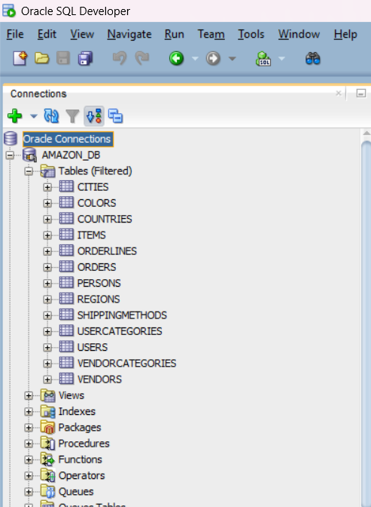
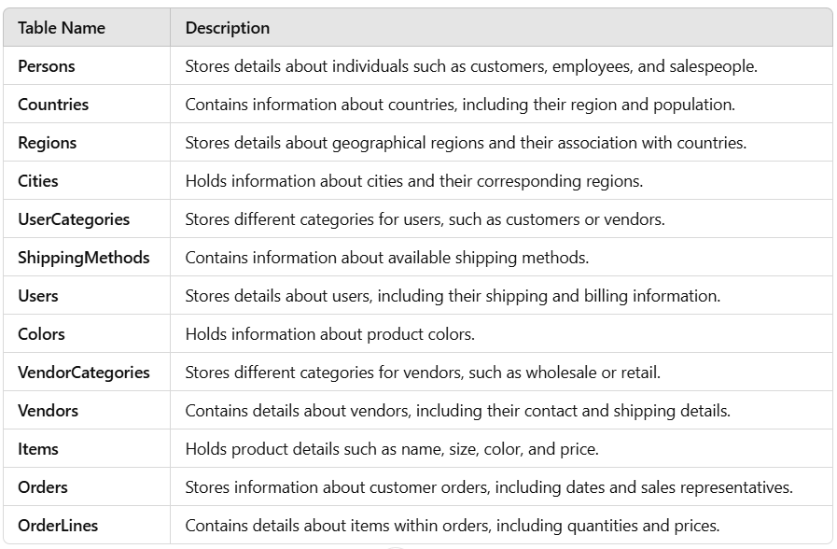
Source Relational Tables

Slide 3

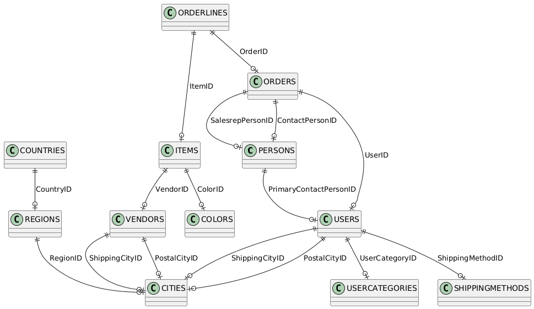
ERD Diagram

Slide 4
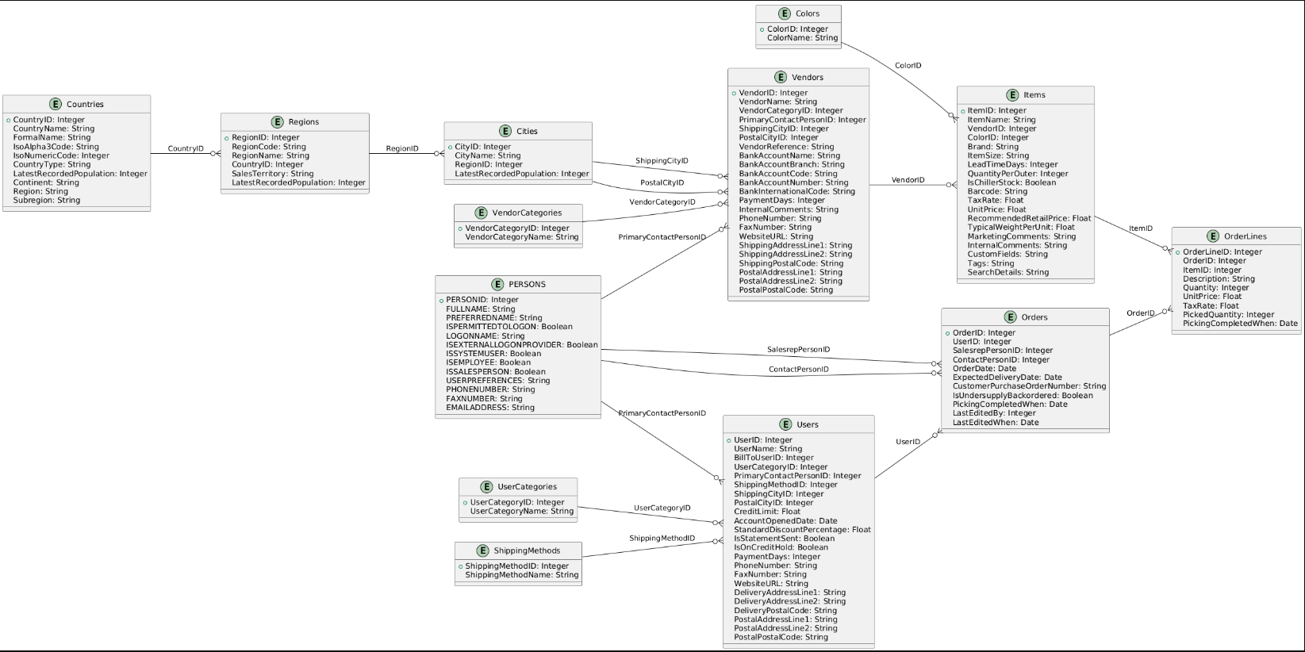
ERD Diagram With Attributes

Slide 5
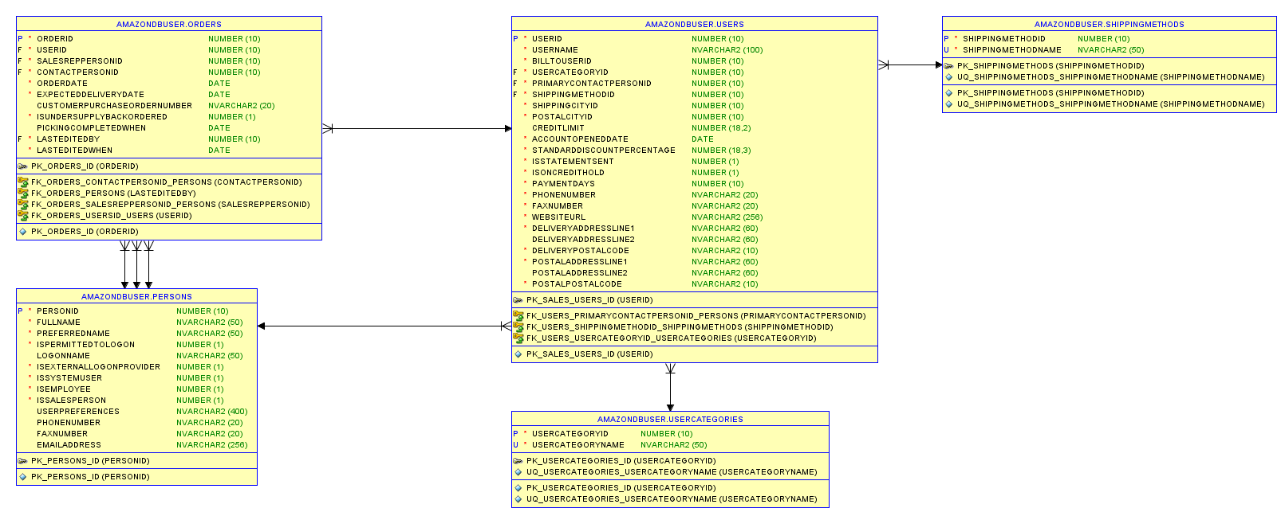
ERD Data Model

Slide 6
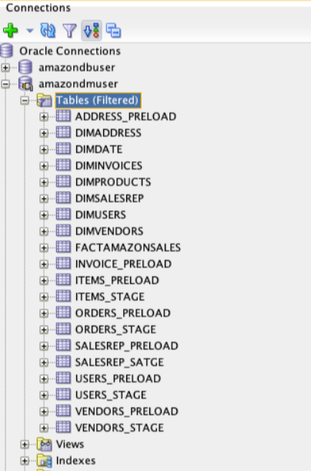
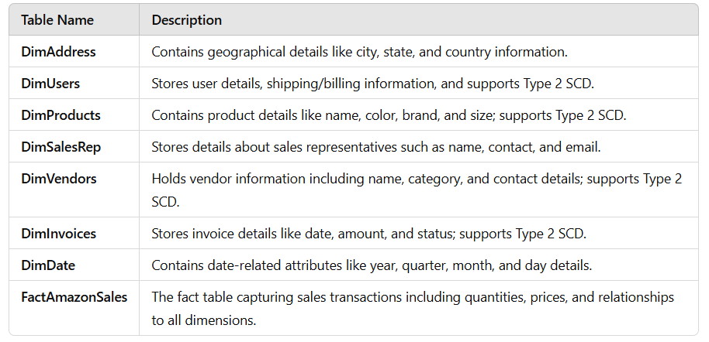
Star Schema

Slide 7
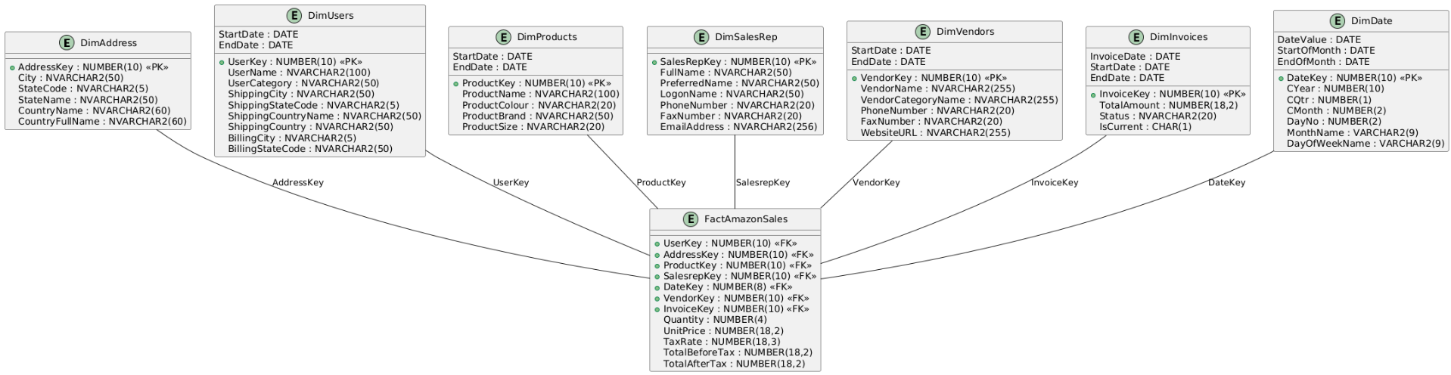
Star Schema Diagram

Slide 8
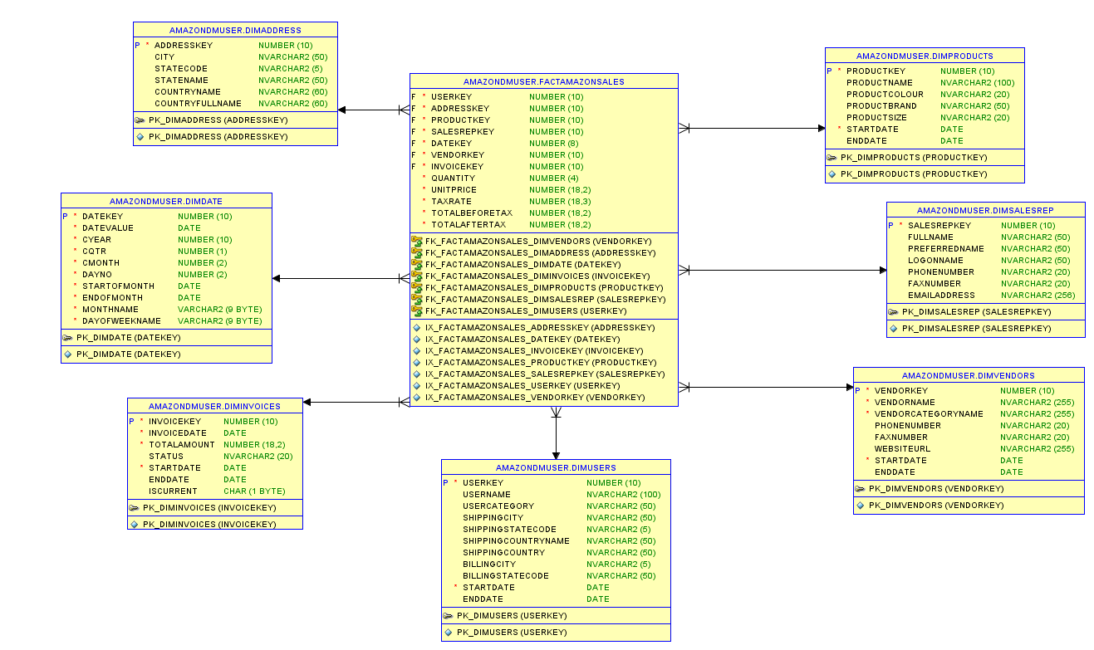
Star Schema Data Model

Slide 9
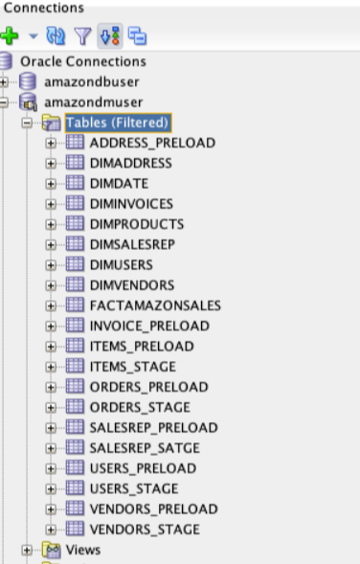
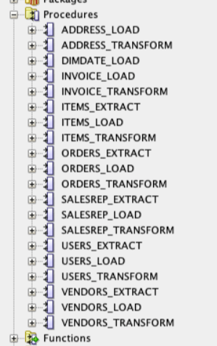
Extract – Transform - Load
The ETL Process stands for Extract, Transform, Load, which is a process used to move data from one or multiple source systems into a centralized data warehouse or database for analysis and reporting:
Extract: Data is collected (extracted) from various sources like databases, APIs, or files.
Transform: The raw data is cleaned, formatted, and transformed into a suitable structure for analysis (e.g., removing duplicates, applying business rules, or converting data types).
Load: The transformed data is loaded into the target system, such as a data warehouse or star schema.

Slide 10
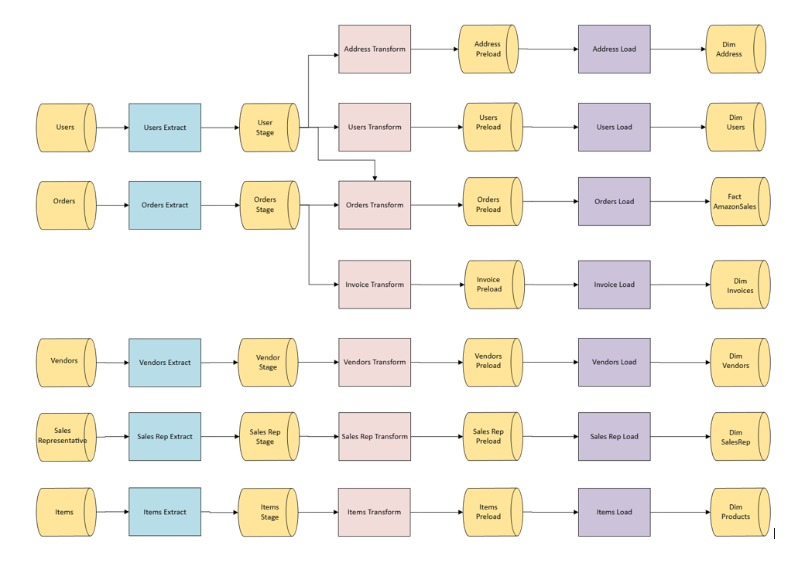
ETL Process Diagram

Slide 11
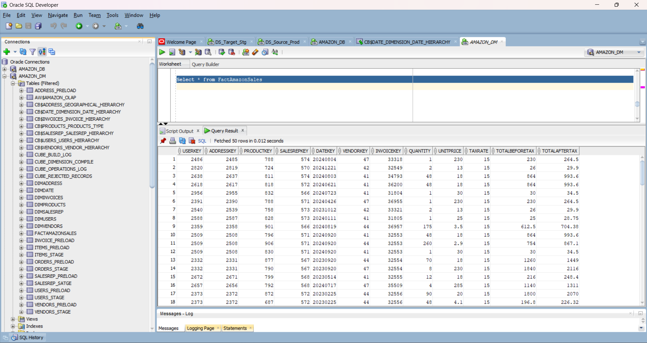
Fact-AmazonSales Table Data

Slide 12
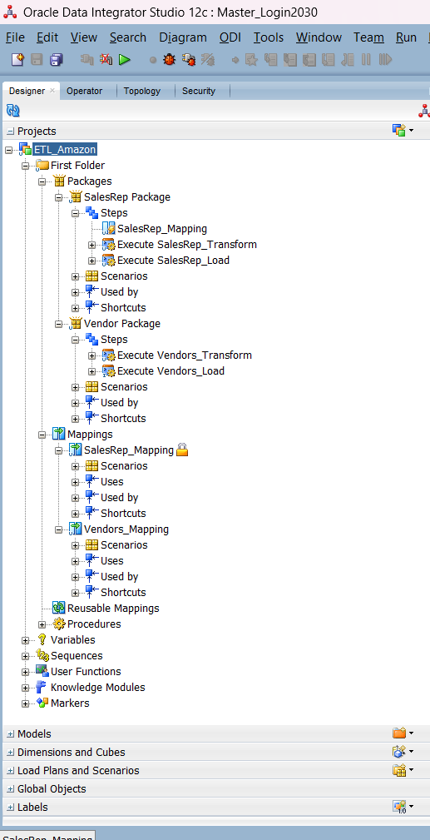
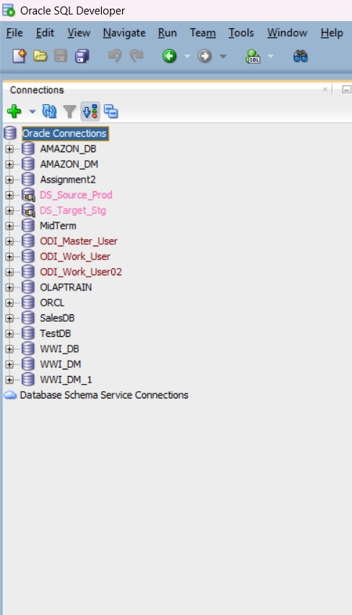
Oracle Data Integration (ODI)

Slide 13
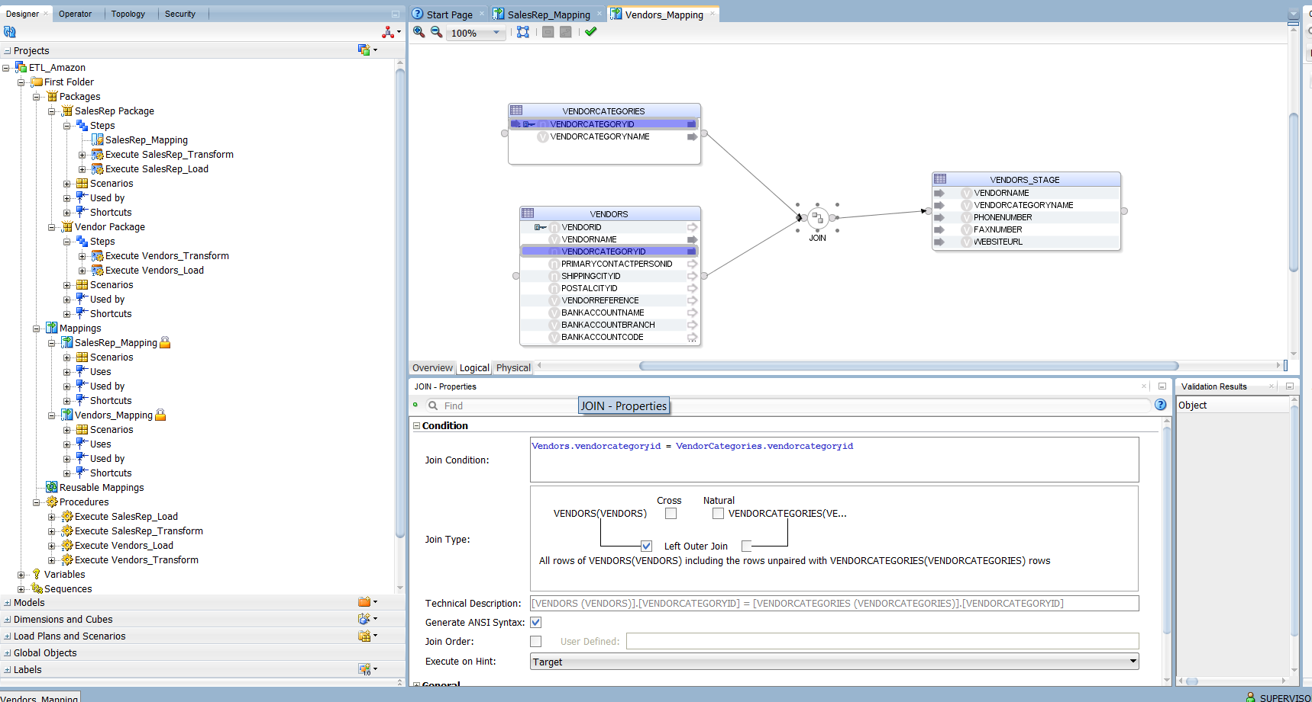
Vendors Table Logical Mapping
Vendors + Vendor Categories → Vendors_Stage

Slide 14
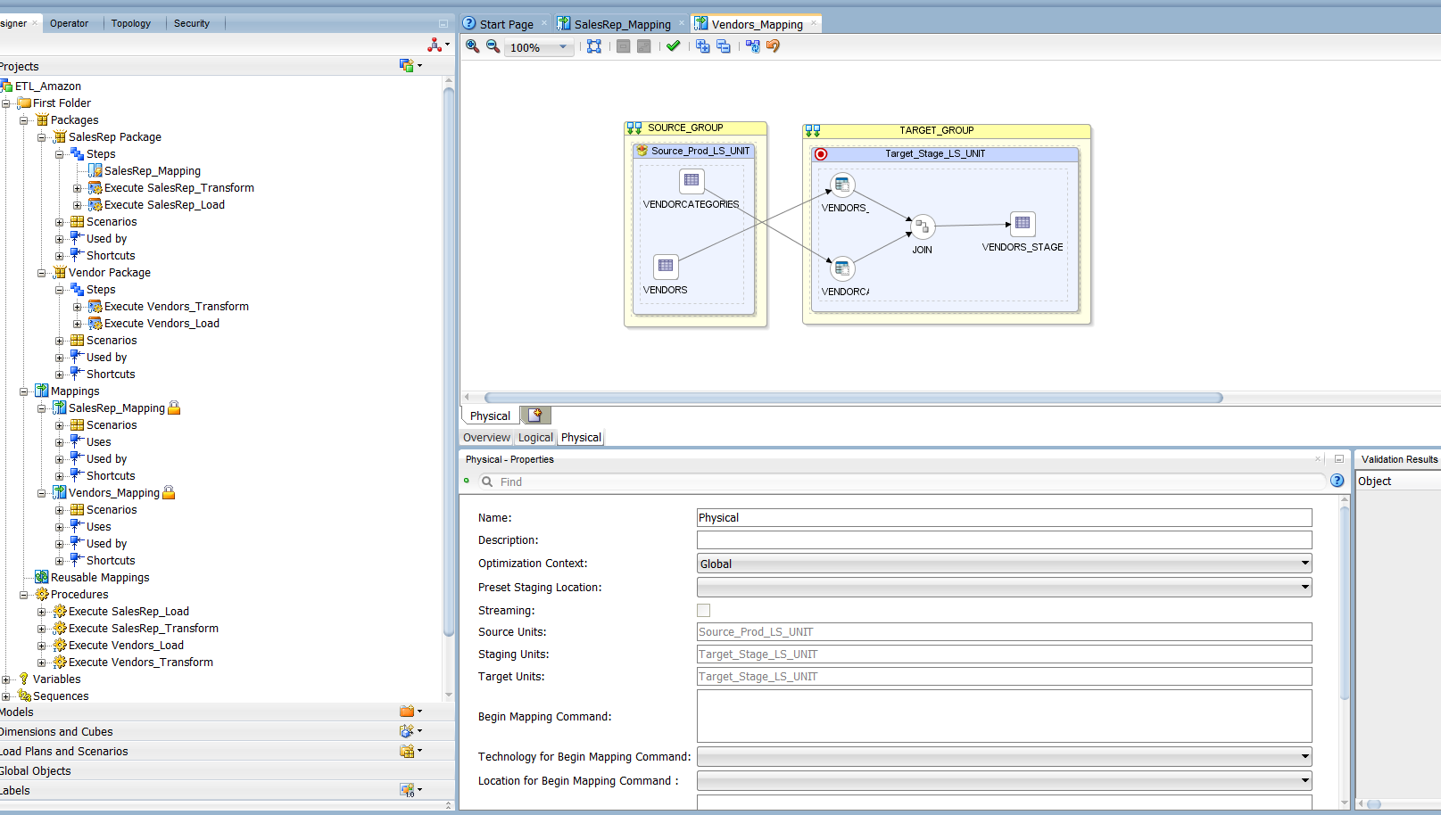
Vendors Table Physical Mapping

Slide 15
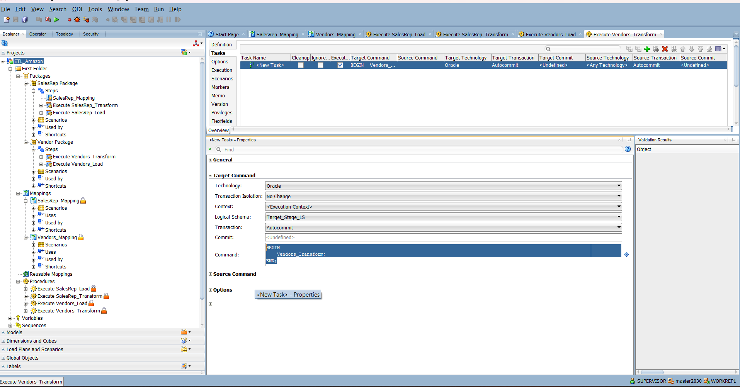
Vendors Transform Procedure
Vendors_Stage → Vendors_Preload

Slide 16
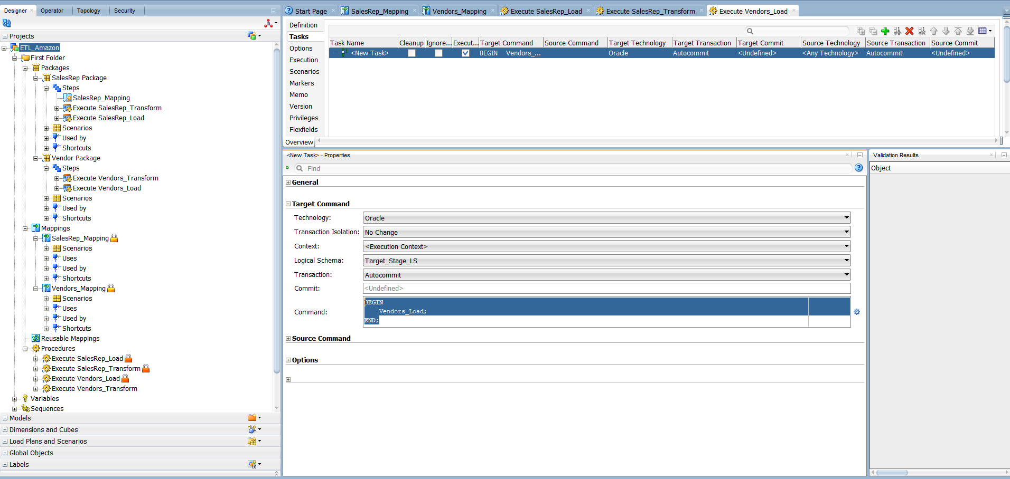
Vendors Load Procedure
Vendors_Preload → DimVendors

Slide 17
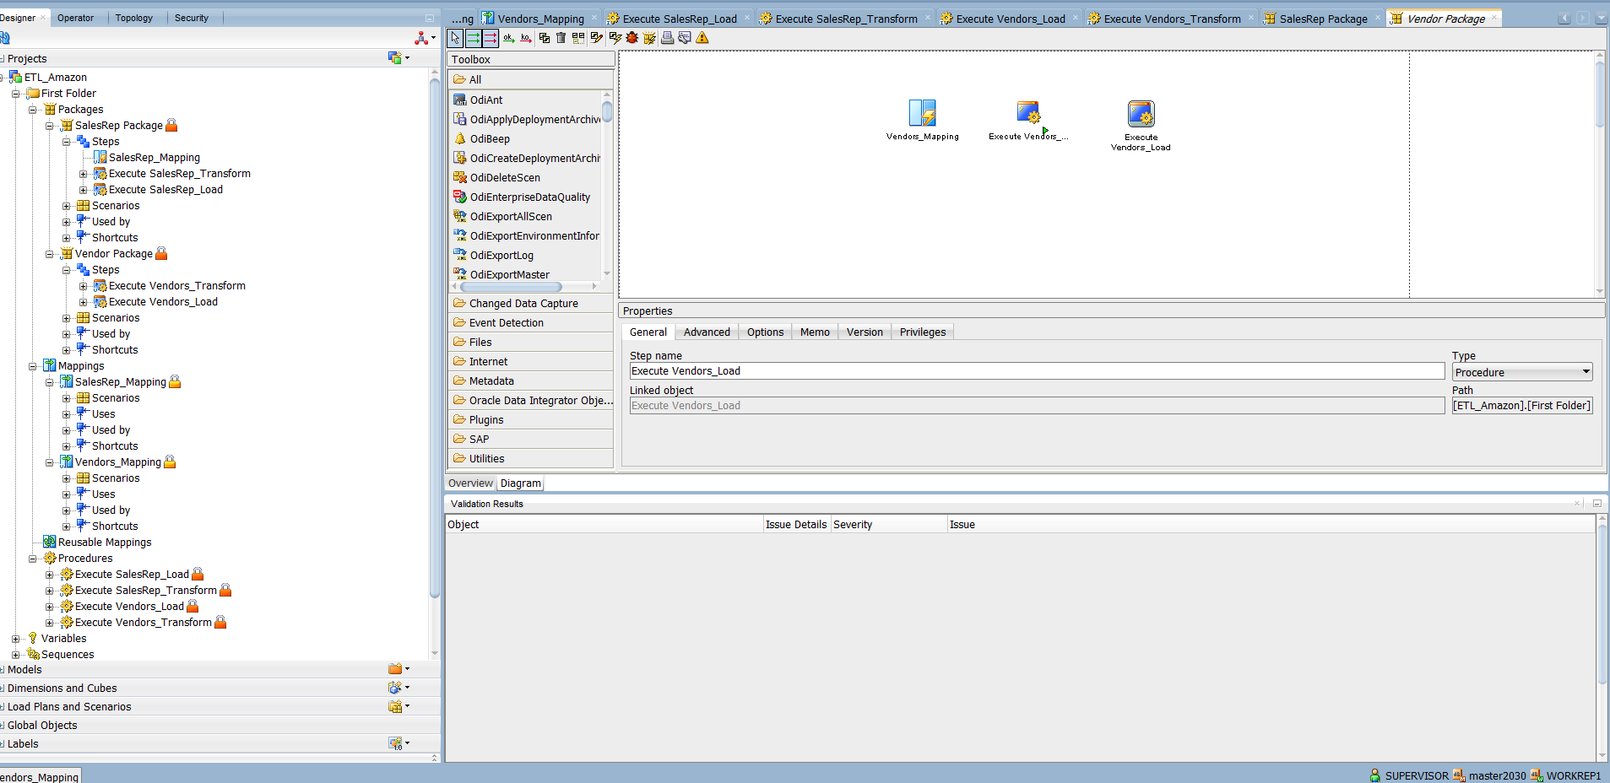
Vendors Package(Mapping + Transform & Load Procedure)

Slide 18
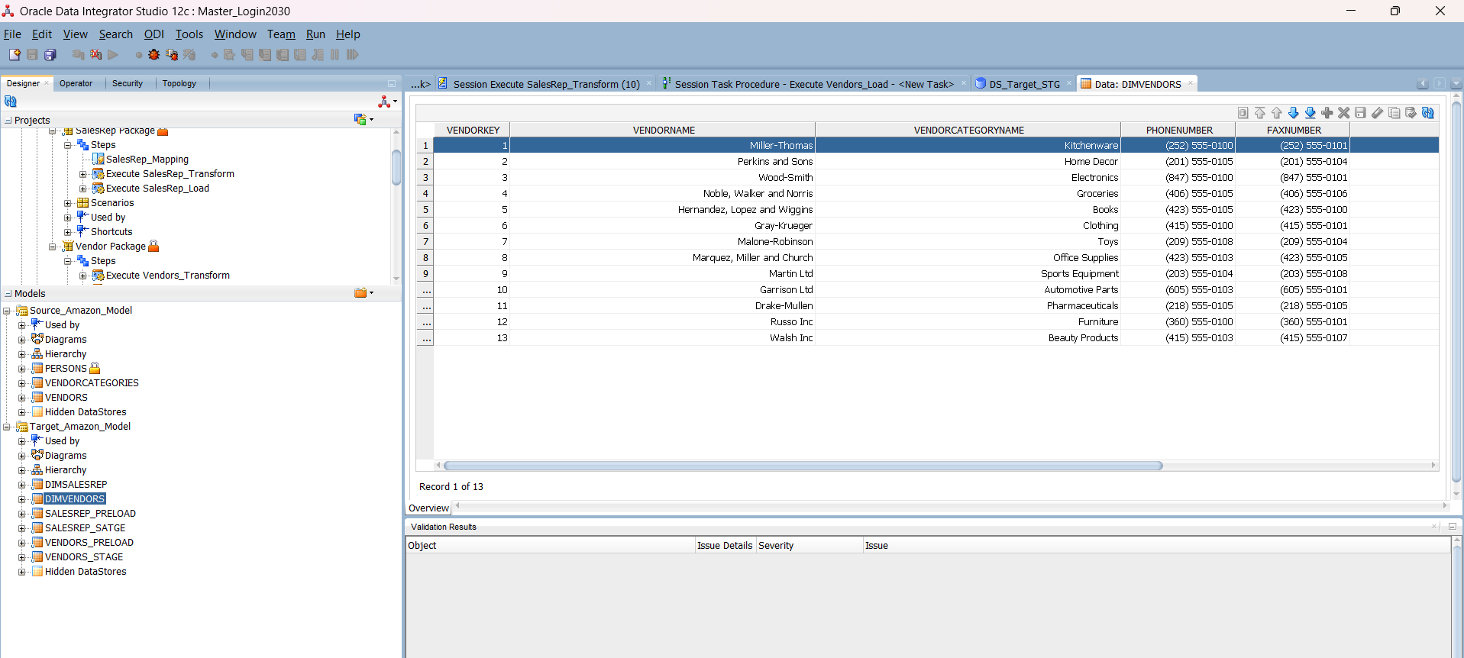
Dim Vendors Data

Slide 19
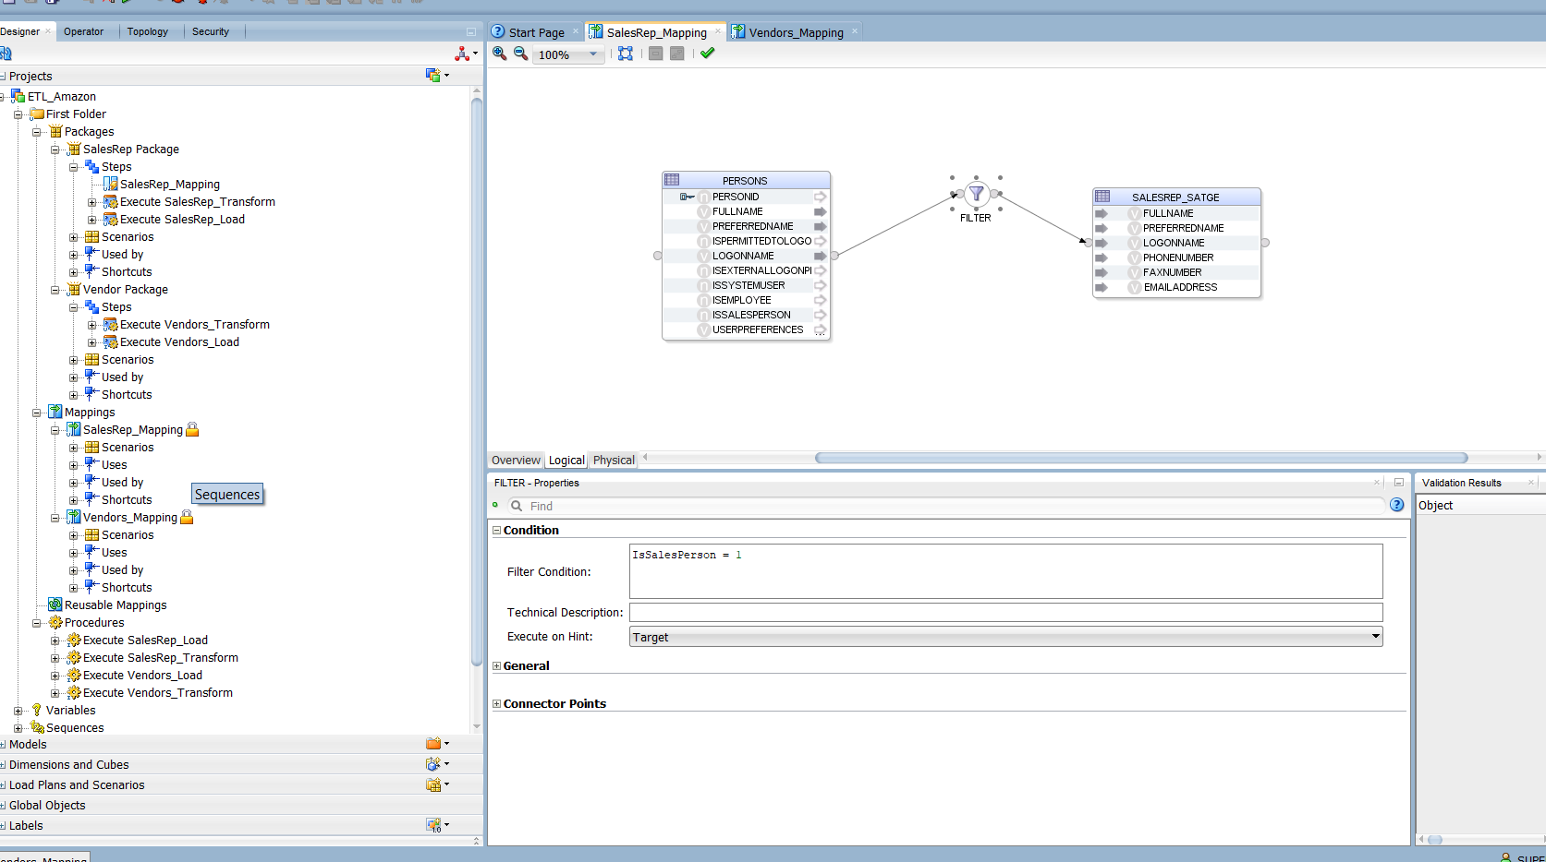
SalesRep Table Logical Mapping
Persons → SalesRep_Stage

Slide 20
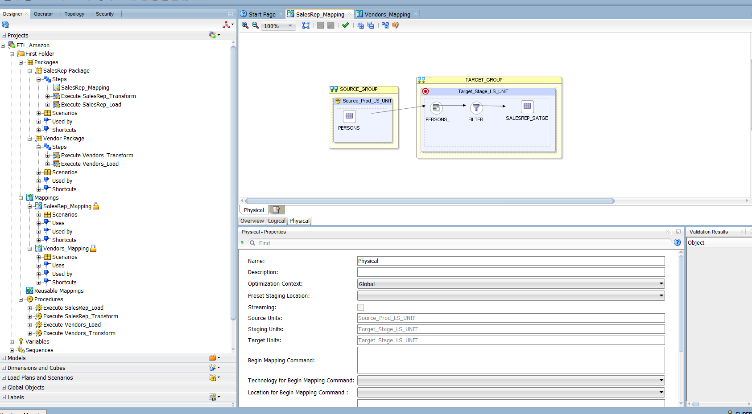
SalesRep Table Physical Mapping

Slide 21
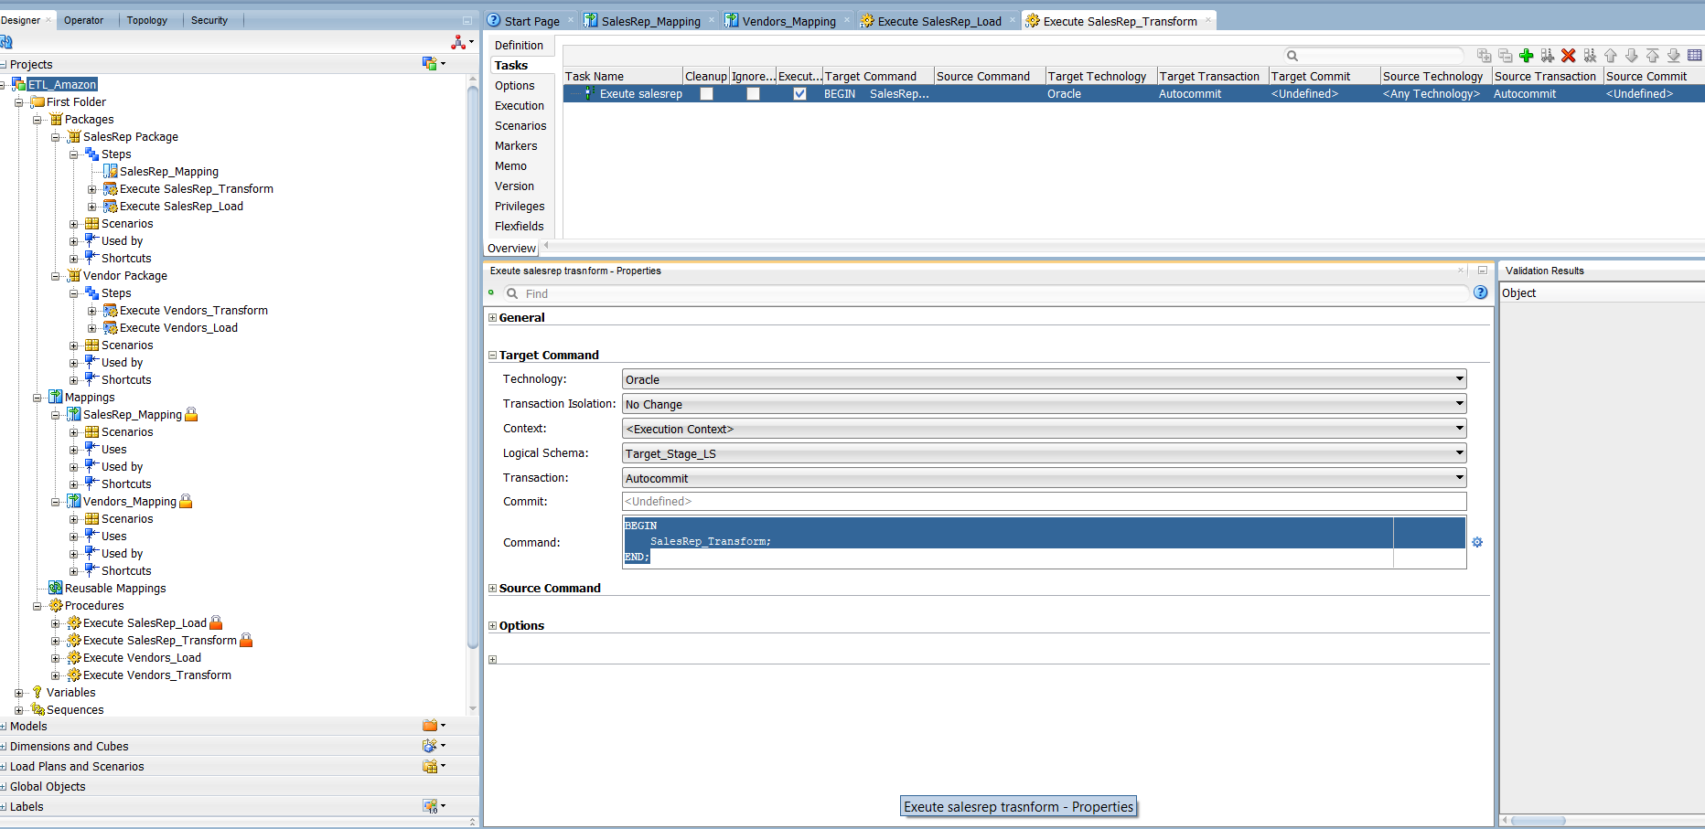
SalesRep Transform Procedure
SalesRep_Stage → SalesRep_Preload

Slide 22
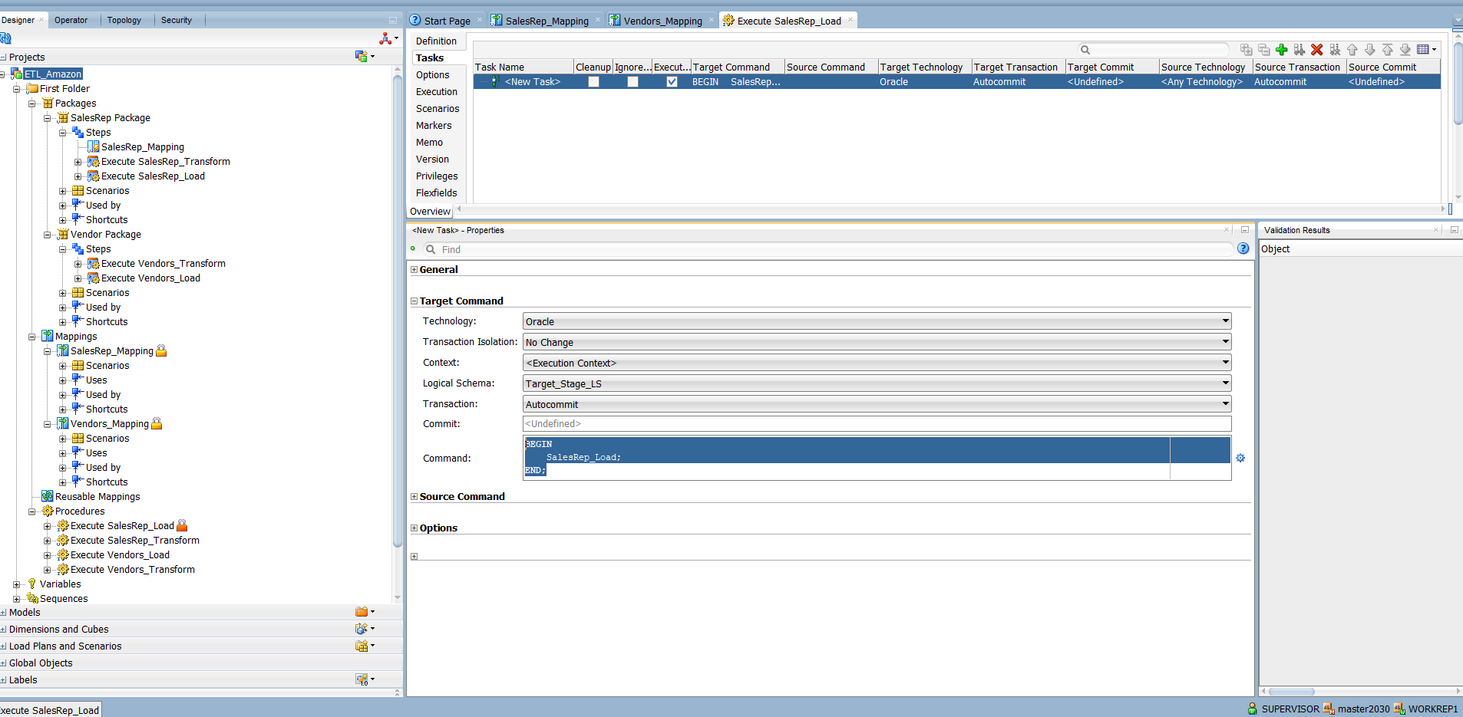
SalesRep Load Procedure
SalesRep_Preload → DimSalesRep

Slide 23
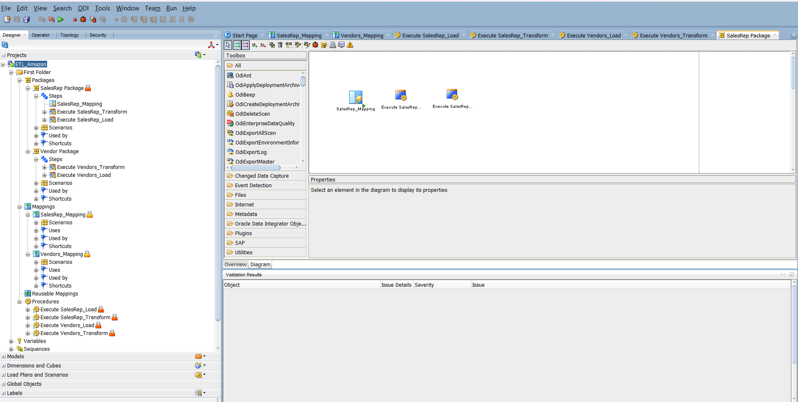
SalesRep Package(Mapping + Transform & Load Procedure)

Slide 24
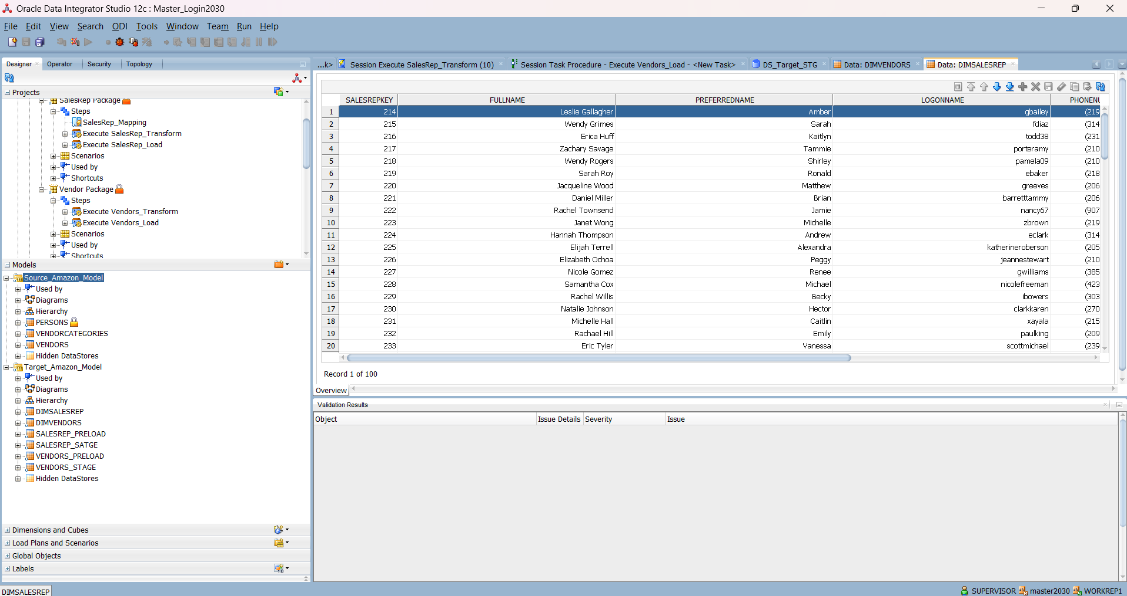
DimSalesRep Table Data

Slide 25
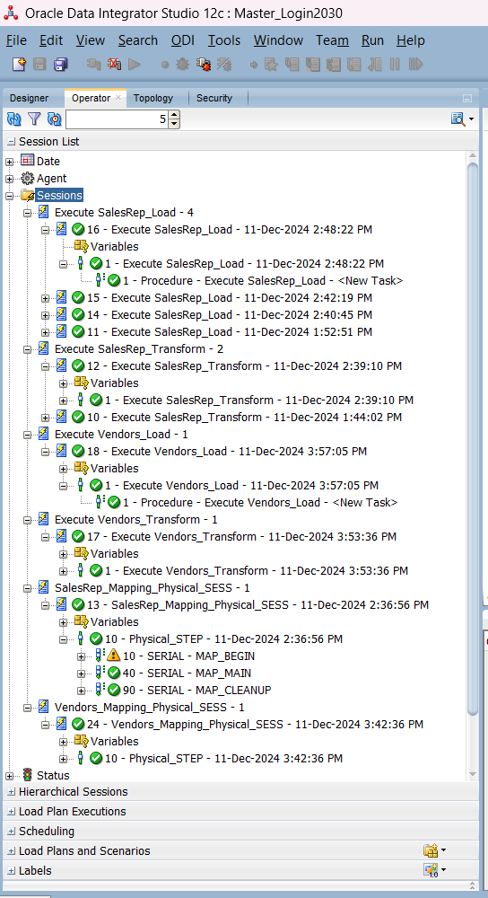
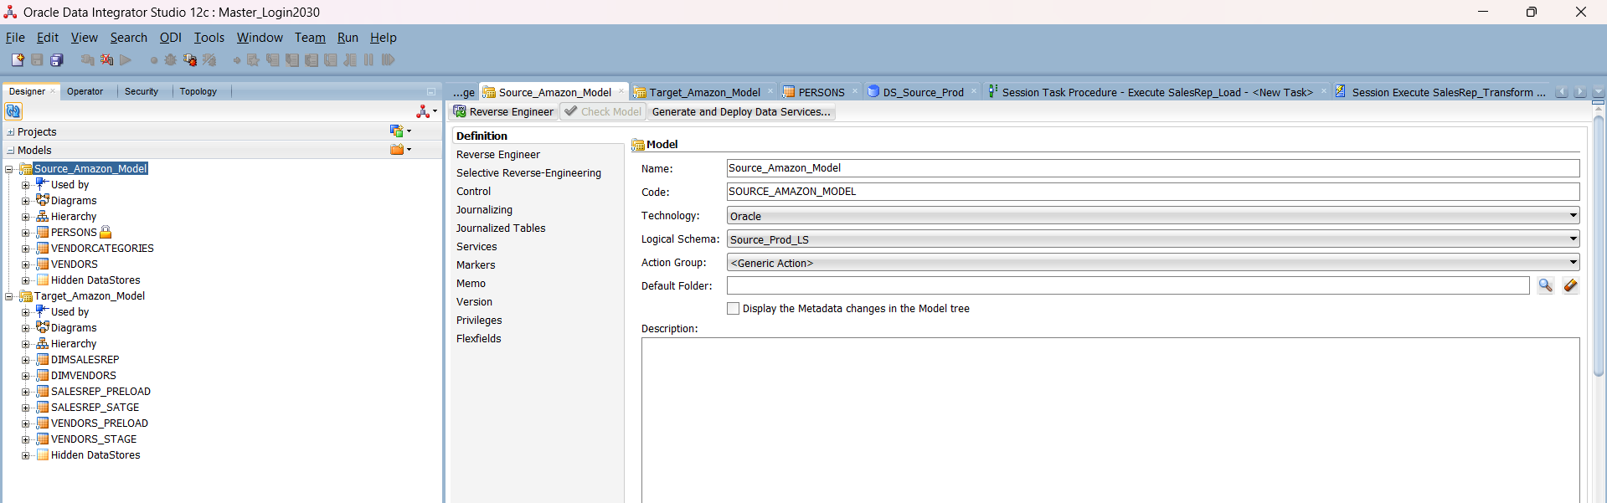
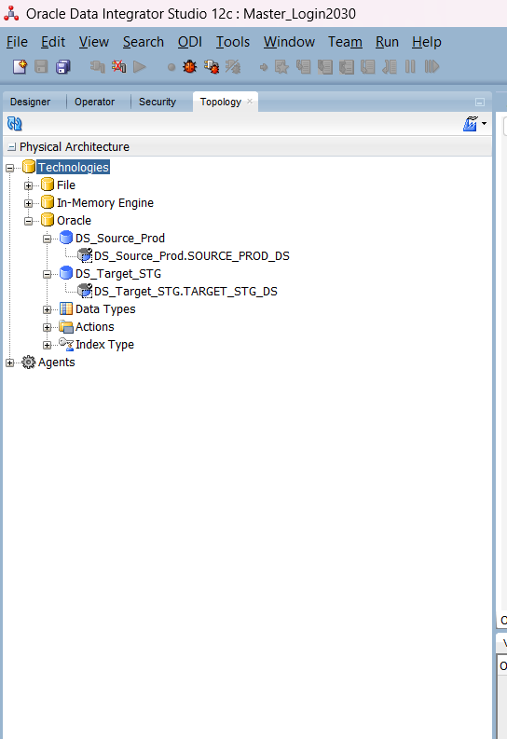
All Layer Setup

Slide 26
Products
All Products
Products
Invoices
All Invoices
Invoice Date
Invoices
Address
All Address
Country
State
City
Address
All Address
Country
State
City
Online Analytical Processing (OLAP)
SalesRep
All SalesRep
SalesRep
Date
All Dates
Years
Quarter
Month
Day
Hierarchies (Highest to Lowest)
Users
All Users
User Category
Users
Vendors
All Vendors
Vendor Category
Vendors

Slide 27
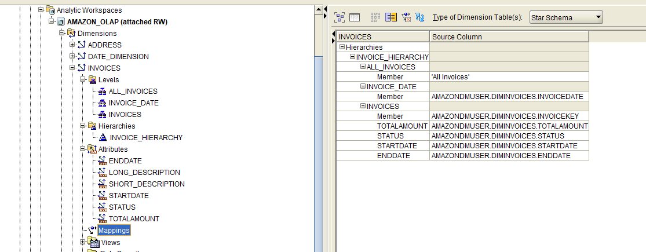
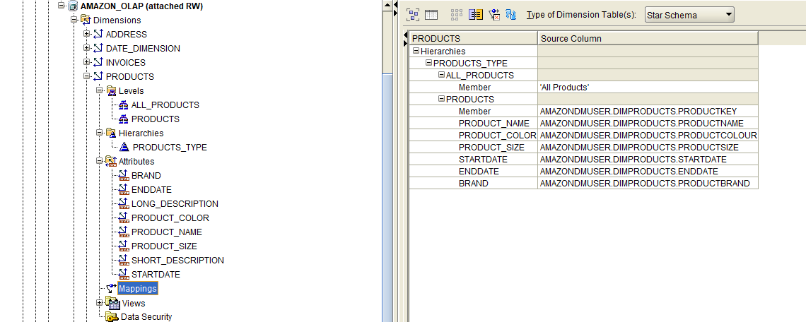
DIM_Invoices
Setup
DIM_Products
Setup

Slide 28
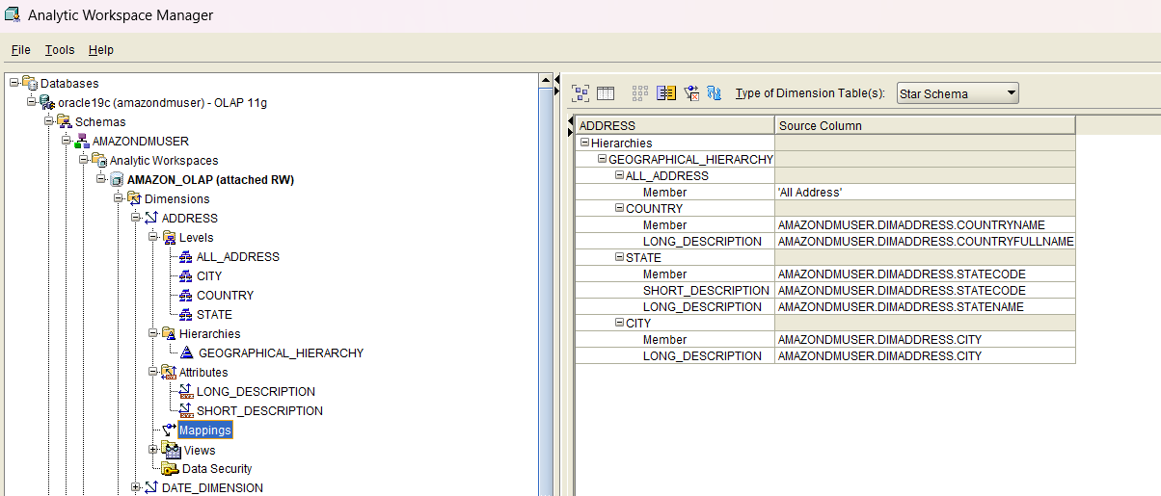
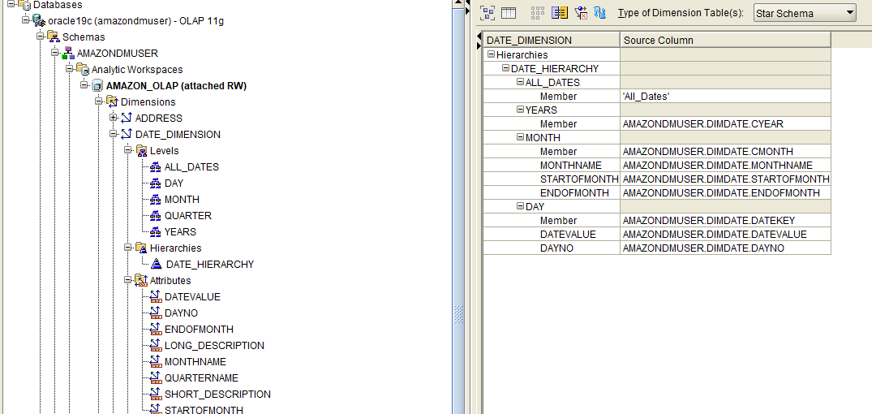
DIM_Address
Setup
DIM_Date
Setup

Slide 29
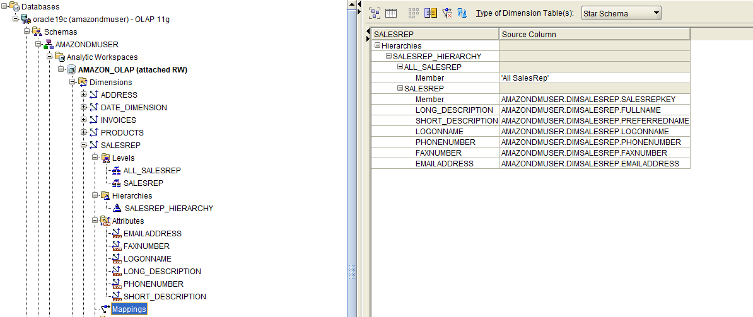
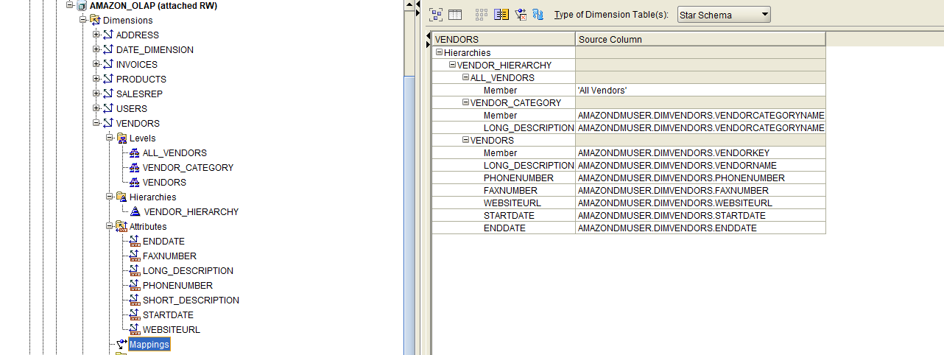
DIM_SalesRep
Setup
DIM_Vendors
Setup

Slide 30
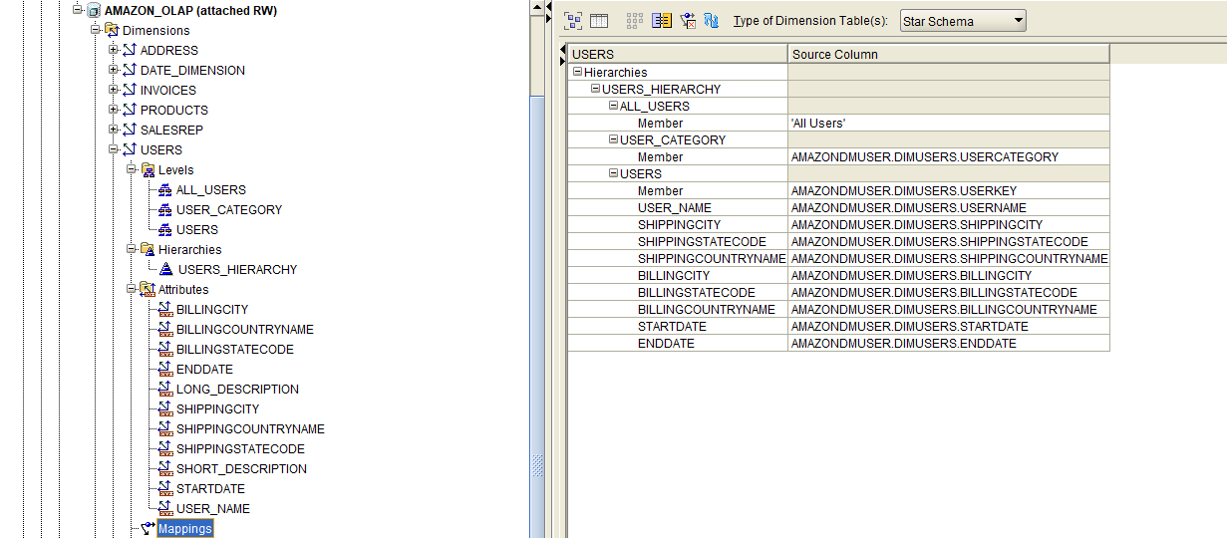
DIM_Users
Setup

Slide 31
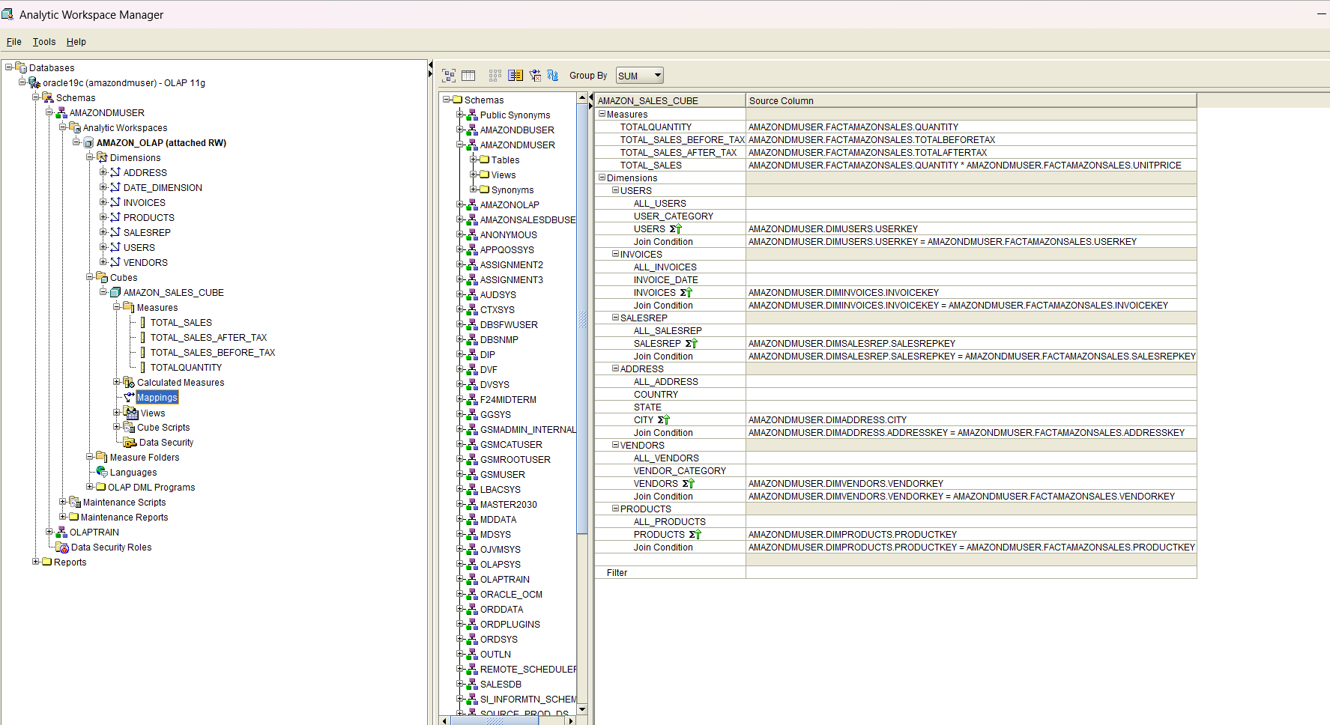
OLAP AMAZON_SALES CUBE MAPPING

Slide 32
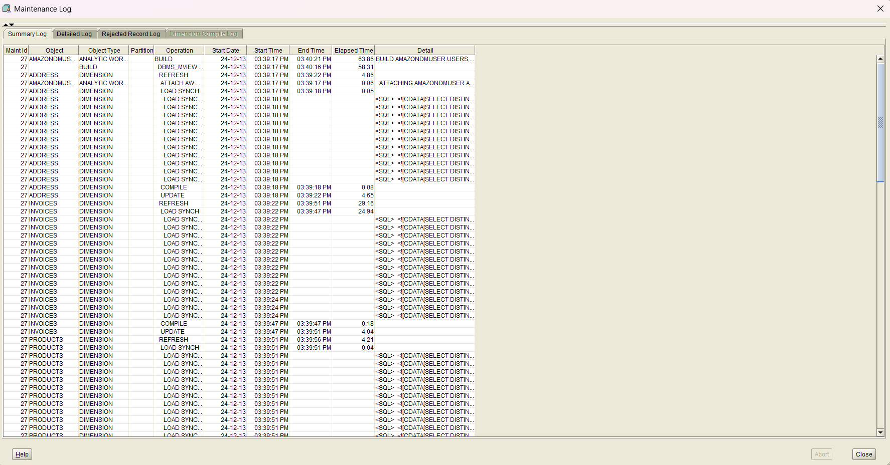
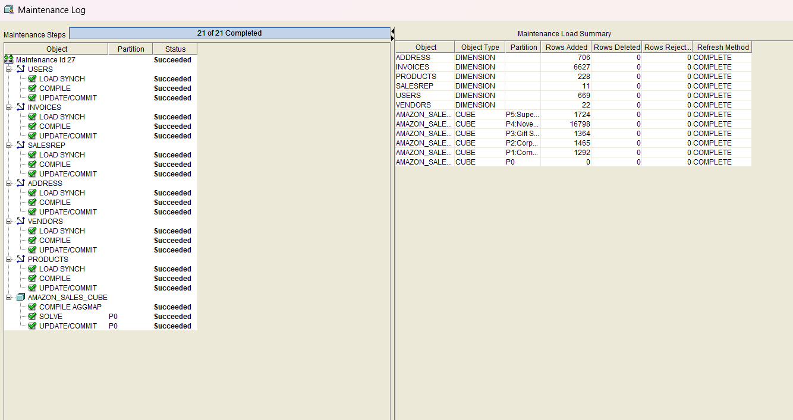
Maintenance Log

Slide 33
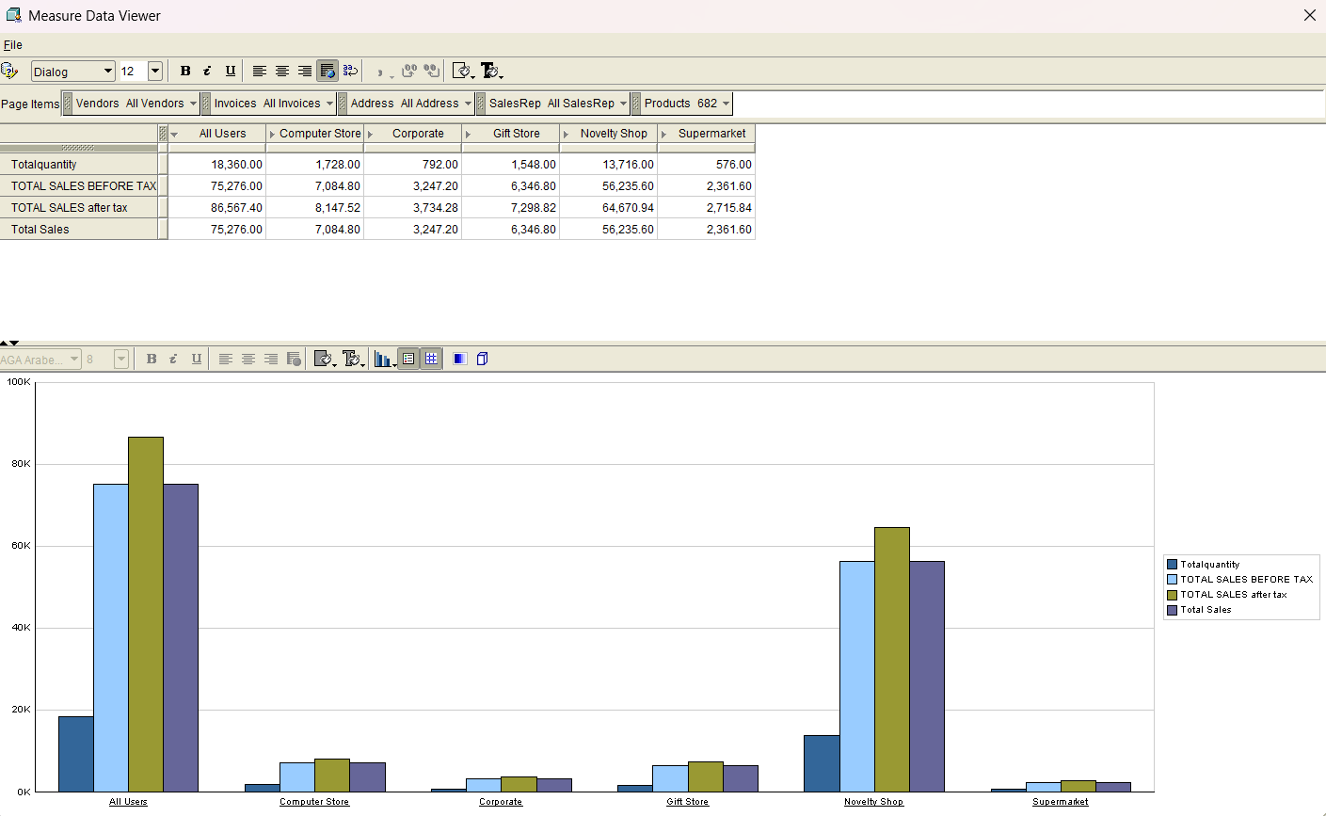
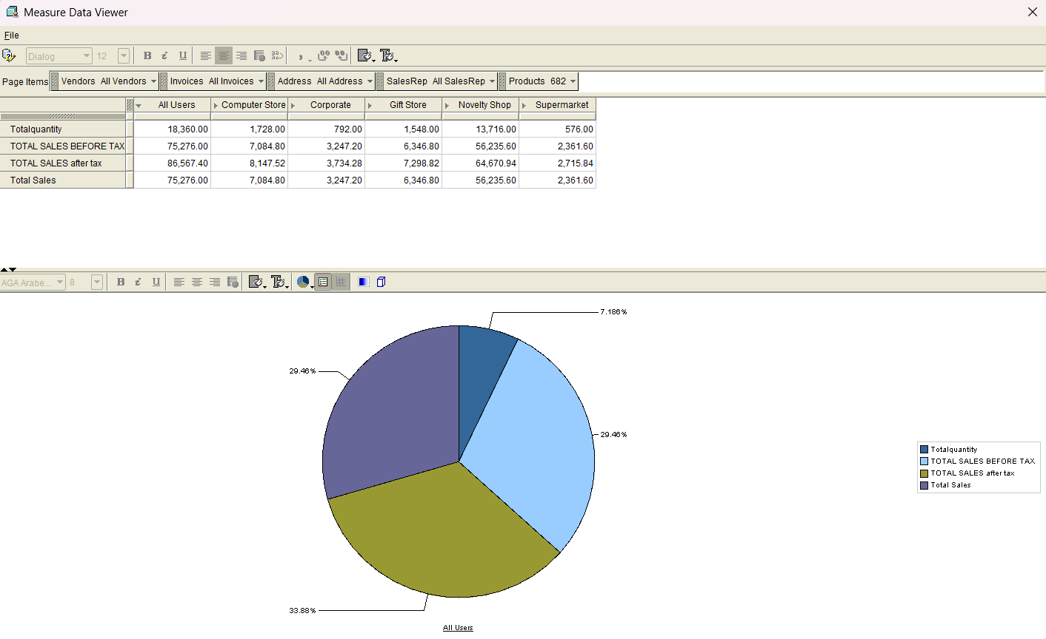
Charts

Slide 34
Thank You

