Slide 1

Predictive analysis of REAL OR FAKE JOBS
Data Mining – ISM6136 – Final Project
Date: 10 November 2022

Slide 2


Team Introduction
Manish Boyina
(U59955856)
Suryamouli Rajendra Varma Kathari
(U69901705)
Amit gaur
(U87764295)
Monisha Lanka
(U83830101)
Prasanna Reddy
(U24108900)

Slide 3

Business problem
Introduction:
Employment fraud is becoming more prevalent.
Due to a rare incidence, many people are becoming victims of scammers who feed on their despair.
As a student, I have encountered several of these fraudulent emails. Users are offered highly well-paid job opportunities.
Scope:
The goal of this project is to develop a classifier that can distinguish between fake and real jobs.
The final result will be evaluated based on different models.
The final model will include all relevant data from job postings and generate a decision on whether the job is real or not.

Slide 4
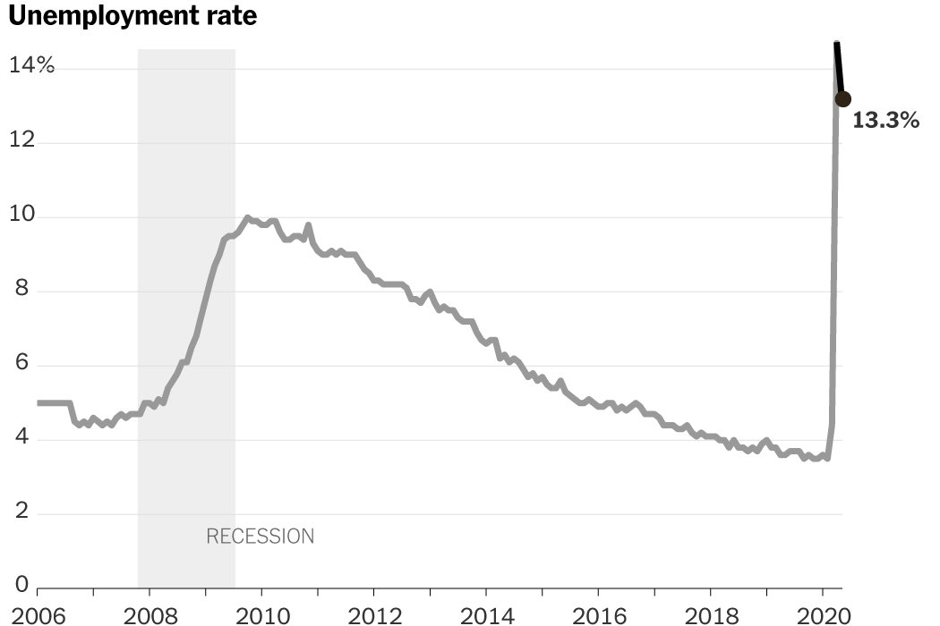
One of the main issues with occupations in the modern world is this. Tendencies in predicting jobs are more alarming whether it is real or fake.
Why job posting data?
Unemployment rate:
The unemployment rate has gradually reduced from 10% to 3.8% and raised again to 13.3% due to the crises of covid.
Click for source

Slide 5
Business issues and the necessity for forecasting real or fake jobs.
Today's environment has a higher prevalence of employment fraud. According to statistics cited by CNN, there were twice as many employment frauds in 2018 as there were in 2017.
This results in a larger unemployment rate and fewer employment opportunities, which has become a severe problem in the modern world.
Machine learning approaches can be used to address this risky situation.
The primary goal of this project is to create a classifier that can tell legitimate jobs from phony jobs.

Slide 6

existing solution and scope for improvement
Previously, many competitors in Kaggle worked on this data and performed the analysis of the data, achieving good results using models like logistic regression, random forest, navies Bayes, and xgboost.
But very few used the sampling technique on the data. Now let’s try to understand the data and perform our analysis.

Slide 7

Data Analysis

Slide 8

Data source
The data collected and research done by the University of the Aegean. This research was done in 2020 after the covid pandemic. The data is collected from different sources and preprocessed by the researchers. It is chosen from Kaggle which is an open-source data.
It is a binary classification problem consisting of two classes i.e., 0 and 1 which indicates a real or fake job.

Slide 9
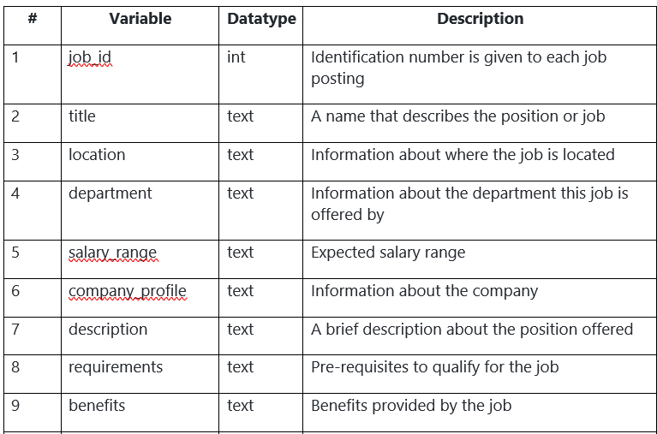
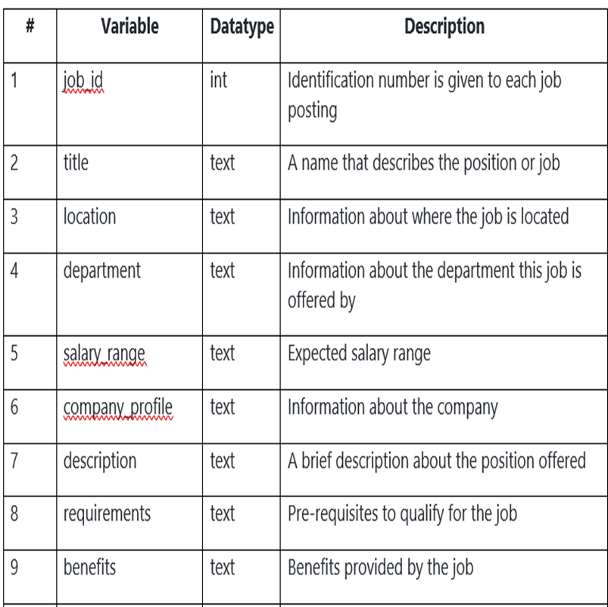
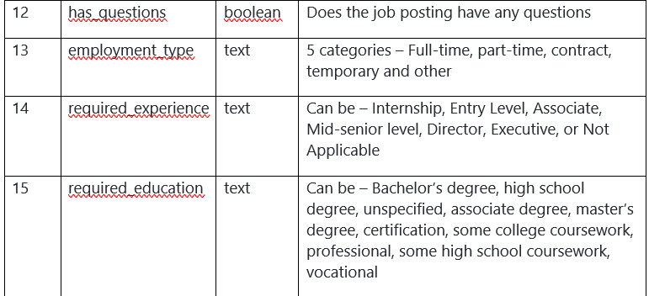
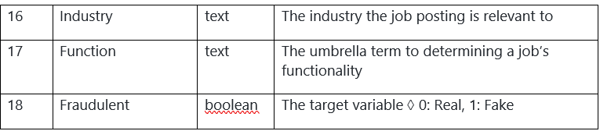
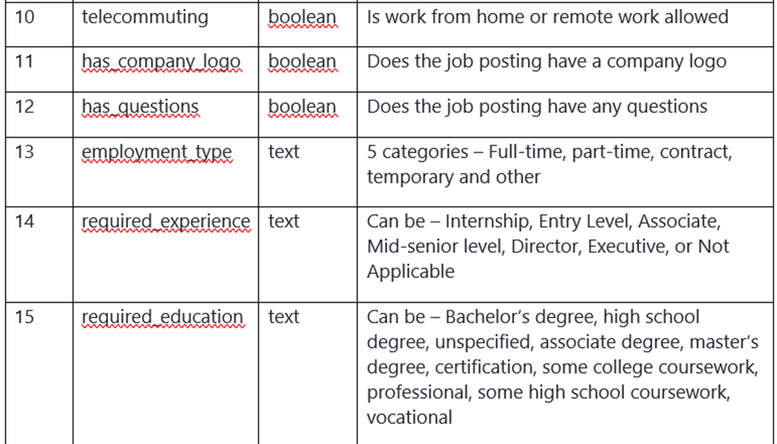
Attributes in data

Slide 10
Data imbalance
Total records
17,880
Real cases
17,014
Fake cases
866

Slide 11
Modeling techniques and performance tuning
Classifier models used:
Logistic regression
Decision trees
K nearest neighbours
Hyper parameter tuning
Ensemble techniques used:
Random forest
XGBoost
Hyper parameter tuning

Slide 12
Metric for evaluation
False positives:
The model predicts that the posting is fake but actually it is a real job posting.
In this case, the applicant might lose the opportunity.
False negatives:
The model predicts that the posting is real but actually it is a fake job posting.
In this case, the applicant might get into scam and lose money.

Slide 13

Model selection
Best model:
Random forest classifier is the best model acquired for our dataset.
Best F1-score:
F1-score = 0.925

Slide 14
Applications and Future scope
The model can be deployed into job portal website servers for real-time testing to remove the fake postings.
Incoming observational data will be fed to the model and improvised the model.
This can also be developed as a product and given to companies after the model is well refined.
By predicting fake postings can help the applicant preventing from scam.

Slide 15
Thank You
University of South Florida
Business analytics and Information systems
Fall 2022

